Slide 1
Neuro modalities of imaging 2022-2023
DR. HANA QUDSIEH MD

Slide 2
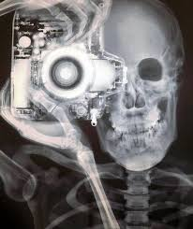

Slide 3
CT SCAN (CAT SCAN)

Slide 4
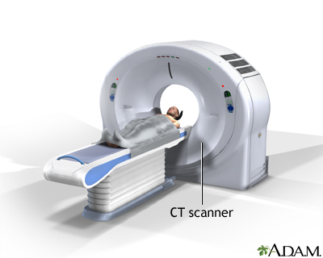

Slide 5
CAT SCAN (PATIENT SPEECH)
WATCH THIS VIDEO
https://youtu.be/XDZR6QPOMiE

Slide 6
YOU HAVE TO NOTICE AFTER THE FORMER VIDEO
1.SHAPE OF CAT MACHINE
2-DURATION OF SCAN
3-WHAT DID HER FATHER WEAR IN CAT ROOM?? WHY???
4-WHERE DID THE TECHNICIAN SIT FOR MONITORING??? AND WHY??

Slide 7
CAT SCAN TECHNIQUE
WHAT IS THE BASIC MECHNISM ???
https://youtu.be/tqGmqRrxajQ

Slide 8
CT (CAT )SCAN
IT IS MULTIPLE X-RAYS BEAM THAT PENETRATE THE SCANNED AREA AND RECEIVED BY DETECTORS AND THEN ANALYSED BY COMPUTER
INDICATION OF BRAIN CT:
1-HEAD INJURY.
2-HEAD INFECTION (IN A COMBINATION WITH CONTRAST MEDIA)
3-BRAIN HEMORRHAGE (SENSITIVE)
4-STROKE WE MAY NEED CTA (STUDY OF VESSEL WITH CONTRAST MEDIA).
5-INCREASE INTRACRANIAL PRESSURE (HYDROCEPHALUS)
6-OTHERS; DEMENTIA TUMOR SEIZURE.

Slide 10
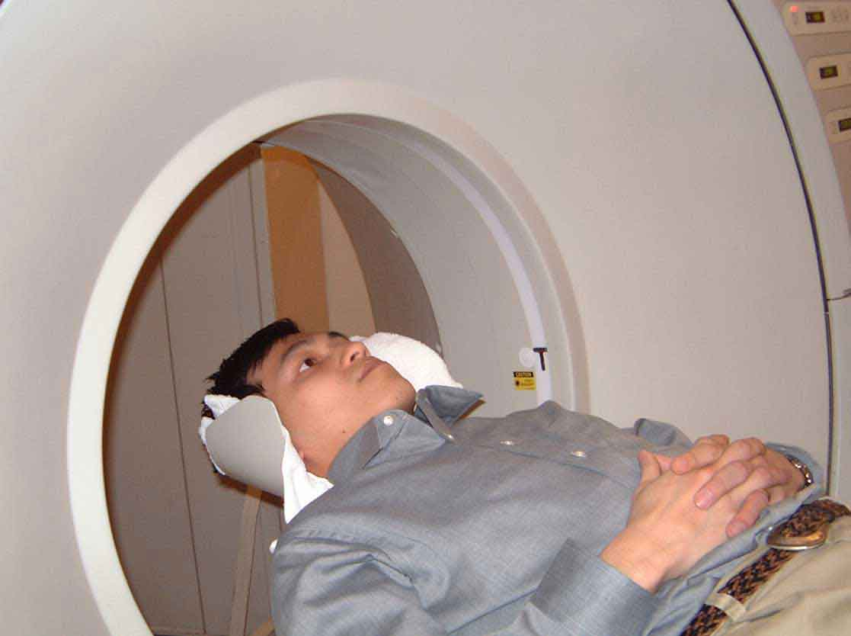
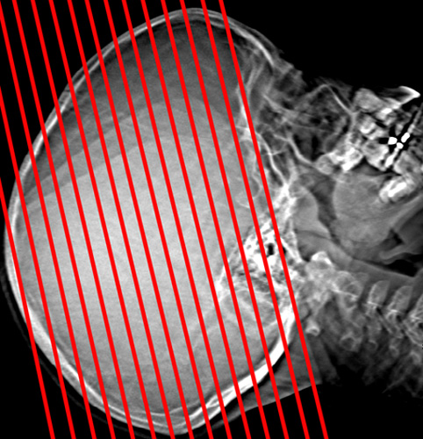
BRAIN CT ANGULATION SEEN IN SCOUT

Slide 12
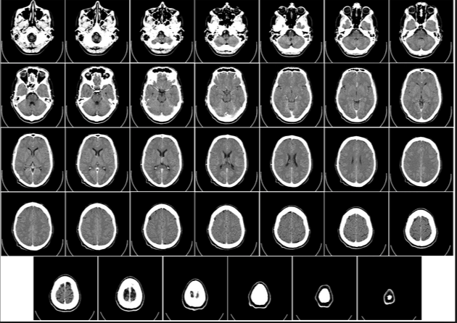

Slide 13
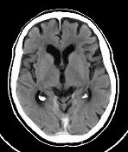
Densities description
FLUID
DENSITY
(HYPODENSE)
OR CSF DENSITY
HYPERDENSE
BONE

Slide 14
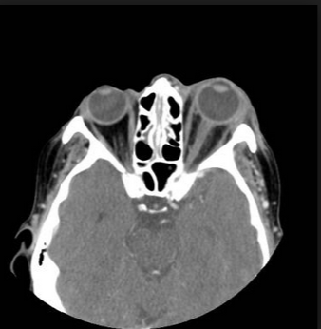
HYPODENSE
FAT
HYPODENSE
GAS

Slide 15
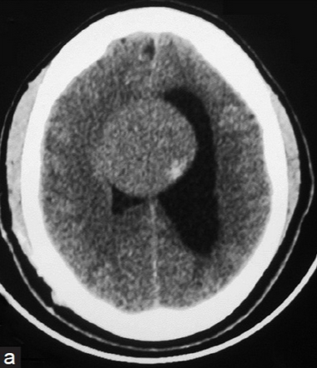
ISODENSE
LESION
HYPODENSE
SUBCAUTANOUS
FAT

Slide 16
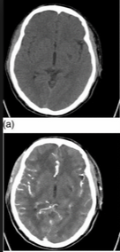
CONTRAST MEDIA
WITHOUT
CONTRAST
WITH CONTRAST with CM (enhanced ) the subarachnoid spaces are hyperdense are hyperdense
Without CM (non enhanced) plain

Slide 17
I.V. CONTRAST MEDIA NICM:NON IODINATED CONTRAST MEDIA
INDICATION OF CONTRAST
1-TUMOUR: DIFFERENT TUMOURS HAVE DIFFERENT PATTERN OF ENHANCEMENT.
2-INFECTION. LIKE ABCESS
3-VASCULAR ASSESSMENT

Slide 18
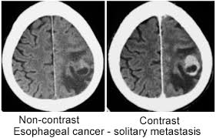
METS
ENHANCEMENT :UPTAKE OF CONTRAST MEDIA
ENHANCEMENT

Slide 19
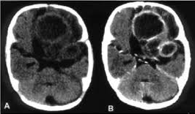
ABCESS:RING ENHANCEMENT
FEVE

Slide 20
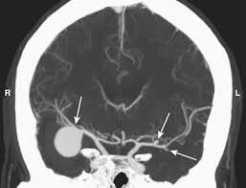
Mca ANEURYSM IN cta

Slide 21
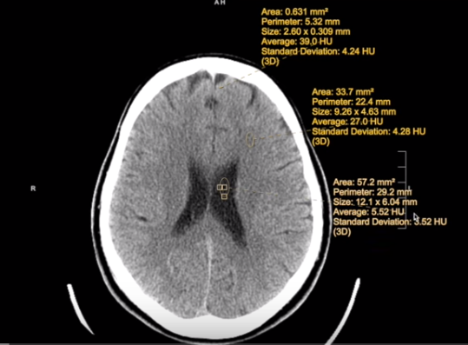

Slide 24
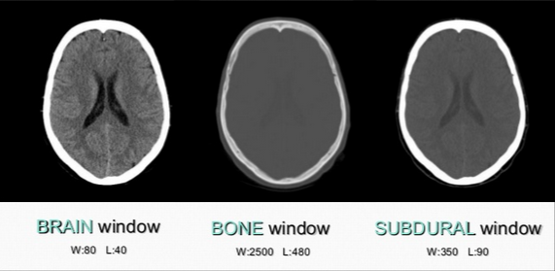
WINDOWS

Slide 25
MRI

Slide 26
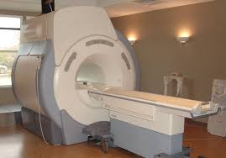

Slide 27
MRI VIDEO
HAVE YOU EVER SEEN MRI MACHINE ???????
WOULD YOU LIKE TO GO WITH TOMAS TO SEE HIM SCANNED WITH MRI????
LETS GOOOOOOOOOOOO
https://youtu.be/bxt-DXsMKDc
BUT…..

Slide 28
YOU HAVE TO NOTICE
1-SHAPE OF MACHINE
2-SAFTEY MEASURES
2-DURATION OF SCAN

Slide 29
T1WI’S

Slide 30
T2WI’S
RECOGNITION:
1-WHITE MATTER IS DARKER
2-FLUID IS BRIGHT
3-SIGNAL VOIDE BLOOD FLOW
USEFUL IN MOST LESIONS BUT CANNOT
DISTINGUISH EDEMA FROM CSF

Slide 31
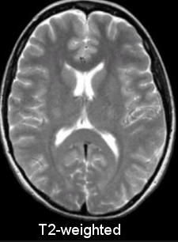
T1 VS T2

Slide 32
FLAIR
RECOVERY

Slide 33
T2 VS FLAIR

Slide 34
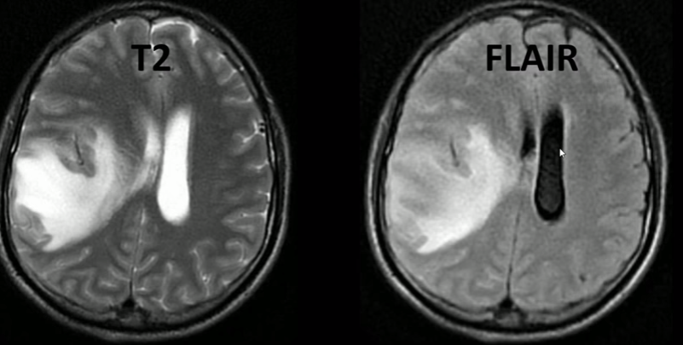
CSF OR EDEMA

Slide 35
GRADIENT ECHO

Slide 36
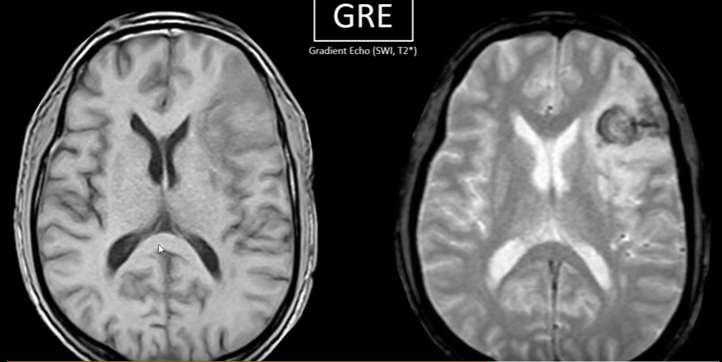
T1 VS GE

Slide 37
DIFFUSION DWI

Slide 38
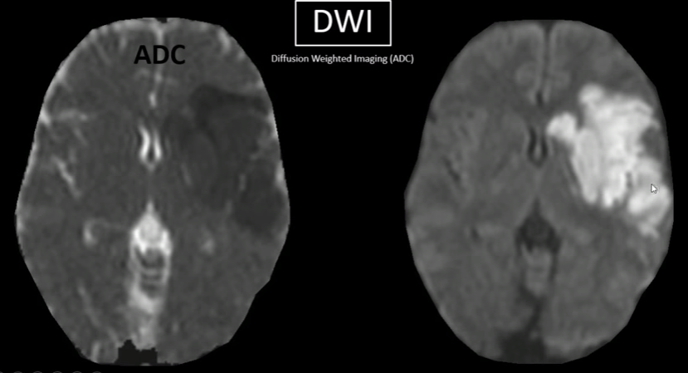

Slide 39
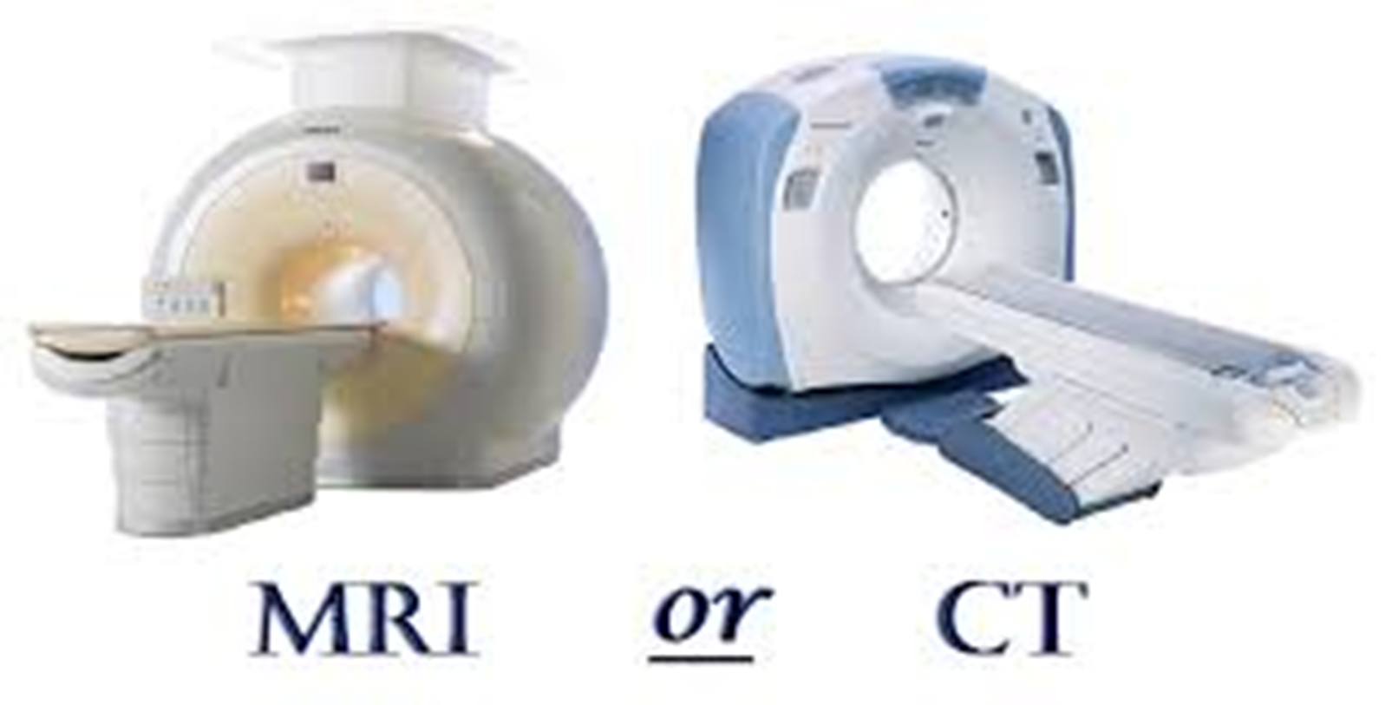

Slide 40
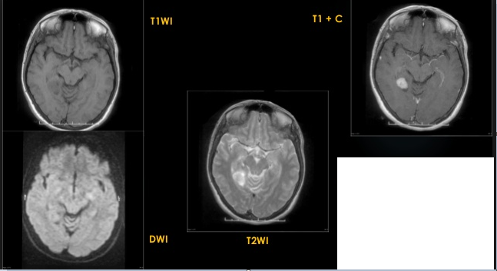
DESCRIPTION
THE LESION IS :
1-HYPOINTENSE ON T1
2-HYPERINTWNSE ON T2
3-ENHANCED POST Gd
4-NO FLUID RESTRECTION IN DWI’S

Slide 41
MRI ACCIDENTS

Slide 47
WORST MRI ACCIDENTS
https://www.google.com/url?sa=i&url=https%3A%2F%2Fm.facebook.com%2FTheInfographicsShow%2Fvideos%2Ffreak-mri-accident-worst-ways-to-die%2F688955358391007%2F&psig=AOvVaw3a_1EqDAf-y3o5hn3E8mjv&ust=1632852802350000&source=images&cd=vfe&ved=2ahUKEwi4m6fr4J_zAhUFexoKHb4KACcQr4kDegUIARCQAg

Slide 48
Other Modalities of neurovasculature imaging will be discussed later
Modalities of imaging to study neurovasculature:
MRA
CTA
DSA
Doppler ULTRASOUND(Transcranial /NECk )
MRV
CTV

Slide 49
IMAGE ORIENTATION

Slide 50
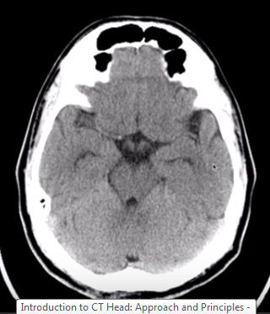
Axial CT
Anterior
Rt
Lt
Posterior

Slide 51
Image Orientation Axial MRI
Anterior
Rt
Lt
Posterior

Slide 52
Superior and inferior levels in axial scanning obtained by changing the slides ups and down

Slide 53
Image Orientation Sagittal MRI
Upper(superior)
anterior
Posterior
Lower (inferior)

Slide 54
RT and left images obtained by moving scanned slides to the Rt and Lt .

Slide 55
Image Orientation Coronal MRI
Superior
Rt
Lt
Inferior

Slide 56
Anterior and posterior images obtained by changing the the scanned images from anterior to posterior

Slide 57
