Slide 1
Pediatric gastrointestinal bleeding
Nada Hamadneh
Ayah Naimat
Waed Ismael
Ayah Al-Qaisi
Maha Qudah
Lana Mhadeen
Rana Hisham
Dr. Baker Rawashdeh

Slide 2
Introduction
Gastrointestinal (GI) bleeding in infants and children occurs frequently. Fortunately, the majority of cases do not result in serious health consequences.
The initial approach to patients with significant GI bleeding should be to ensure patient stability, to establish adequate oxygen delivery, to place intravenous access, to initiate fluid and blood resuscitation, and to correct any underlying coagulopathies.

Slide 3
SYMPTOMS OF UPPER GI BLEED
Hematemesis vomiting of blood which can be:
bright red blood: high volume bleeding, may need emergent endoscopy
Coffee ground-like material: slow low volume bleeding, or stopped bleeding
Melena passing black, tar-like stool
Notes:
"Coffee ground emesis" refers to the vomiting of small dark brown or black clots of blood mixed with gastric secretions. When blood is exposed to gastric acid, it turns a dark color and coagulates into small clots. These small dark clots can resemble the appearance of coffee grounds. Coffee ground emesis is usually seen with slow, low-volume bleeding that doesn't require emergent intervention. In contrast, lesions with high volume bleeding (such as an ulcer that has eroded into a vessel) often present with emesis of bright red blood or very large amounts of blood.

Slide 4
SYMPTOMS OF LOWER GI BLEED
Defined as bleeding distal to the ligament of Treitz, manifested as: Hematochezia passing pure blood, blood clots mixed with or in between stool.
The color of the blood can range from bright red to maroon, depending on the site of bleeding
Notes:
Lower GI bleeding, which is defined as bleeding distal to the ligament of Treitz, usually manifests as frank blood per rectum. The color of the blood can range from bright red to maroon, depending on the site of bleeding. The color of the blood in the stool can give you a clue as to where the bleeding originated. The further from the anus that the blood originates, the darker it will appear upon passage in the stool.

Slide 5
Clinical clues for lower GI bleeding
Firm stool or very large stool, painful, bright blood on the surface: Anal fissure
Normal formed stool with blood on surface: bleeding in the distal sigmoid or rectum
Normal formed stool with blood mixed throughout: source of bleeding is proximal to the rectum
Bloody diarrhea: colitis, either infection, allergy, or inflammatory bowel disease
Notes:
firm stool or very large stool usually indicates that the bleeding is a result of trauma from passing stool and stooling may be described as painful; this suggests anal fissure or possibly hemorrhoids in older pediatric patients
normal formed stool with blood on the surface indicates a source of bleeding in the distal sigmoid or rectum because the stool was formed before blood was present; this may suggest a rectal or sigmoid polyp but could also be caused by anal fissure
normal formed stool with blood mixed throughout indicates that the source of bleeding is proximal to the rectum since the blood had to be present before the stool became formed; this could suggest a more proximal polyp
bloody diarrhea indicates colitis; this suggests either infection, allergy, or inflammatory bowel disease

Slide 6
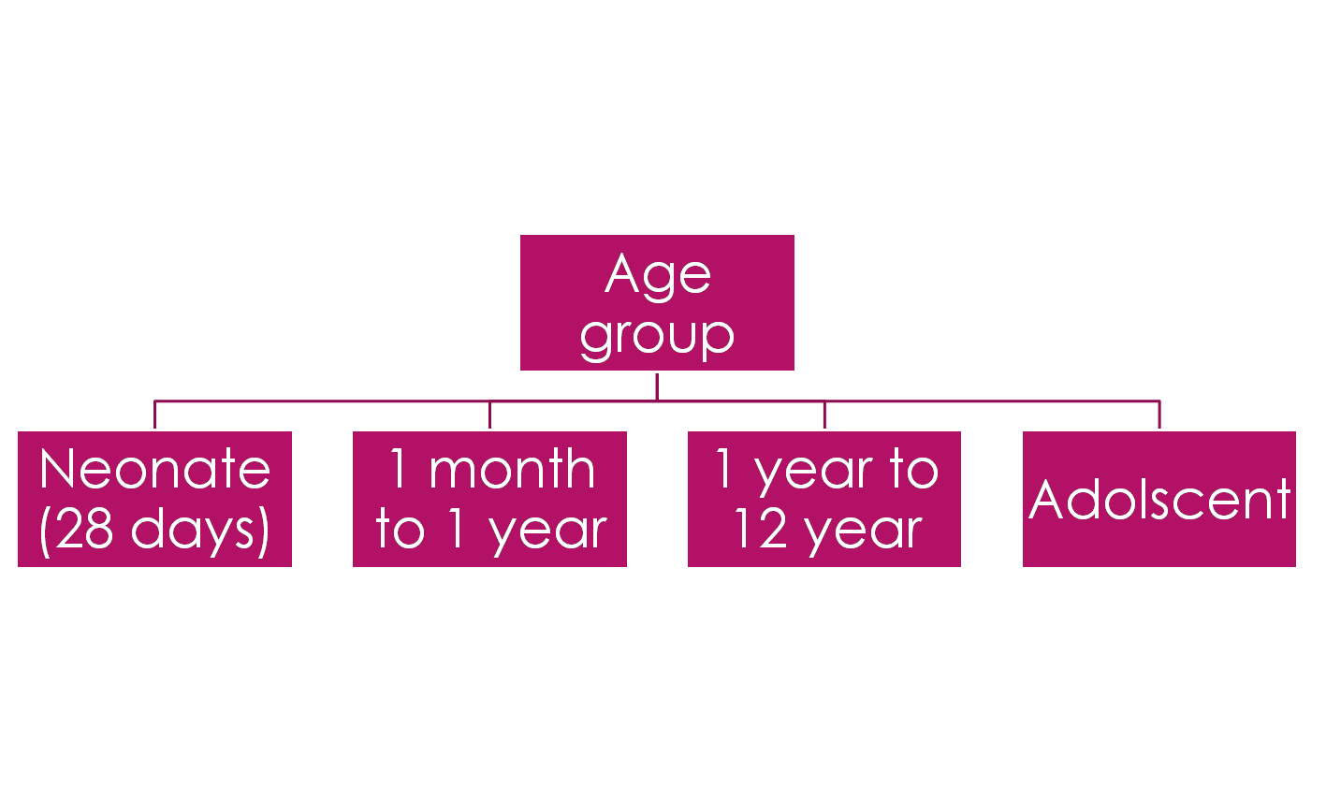
Etiology
Age-specific etiologies for GI bleeding :
1 - 2 year
Older children

Slide 7
GI bleeding in neonate
Lower Gastrointestinal Bleeding | Upper Gastrointestinal Bleeding
Anal fissure Necrotizing enterocolitis Malrotation with volvulus CMPA | Swallowed maternal blood Hemorrhagic disease of the newborn Stress gastritis
Notes:
Stress gastritis = shocked or nicu baby
The most common sites of hemorrhage or bleeding are the umbilicus, mucous membrane, the gastrointestinal (GI) tract, circumcision site, and venipuncture sites. Hematomas frequently occur at the sites of trauma (ie, large cephalohematomas, scalp
bruising related to instrumentation used at delivery and, rarely, intracranial hemorrhage).
Maternal drug

Slide 8
Neonate ( lower bleeding )
1- Anal fissures
They are the most common cause of GI bleeding in pediatric age group.
Bright red blood streaks on stool associated with firm stool or very large caliber stool.
In the infant , the history often suggests painful defecation with straining , grunting and back arching while passing a bowel movement .
They are diagnosed easily by spreading the perineal skin to evert the anal canal showing a tear dorsally in the midline
Chronic fissure ( more than 6 weeks ) may be accompanied by skin tag ( sentinel pile ) and hypertrophied anal papillae .
Anal fissure usually respond to stool softener and lubricants such as Vaseline
Notes:
Firm stool or very large stool, painf, Anal fissure = most common 1st yr of lower gi
Anal fissure, which is a superficial tear in the squamous epithelium of the anal canal, is the most common cause of hematochezia in pediatric patients. It can occur at any age, from the newborn period through adolescence and into adulthood. It is usually the result of passage of hard or large stools, and the history is usually quite characteristic of this. Because anal fissures can be painful, children will often withhold stool to avoid painful defecation. This then results in more hard, large stools which perpetuates the cycle. The treatment of choice of anal fissures is softening of the stools and promoting a regular bowel habit.
ul, bright blood on the surface

Slide 10
Neonate ( lower bleeding )
2- Necrotizing enterocolitis (NEC)
1 – 5 % of neonates in NICU
It usually develops in 2-3 weeks after birth, more in prematures and LBW
10% in term babies
The terminal ilium is usually involved
The triad of: intestinal ischemia, enteral nutrition and bacterial translocation has been linked to NEC
After initiation with enteral feeding, less with human milk
Notes:
usually develops within 10 to 16 days after birth most commonly in premature infants and low birth weight ( less than 1.5 kg ) , though can present in 13% of term infants.
- It may involve single or multiple segment of the intestine , most comonly the terminal ileum .
- Although the pathophysiology is currently unclear. the underlying mechanism is believed to involve a combination of poor blood flow and infection of the intestines.

Slide 11
Neonate ( lower bleeding )
2- Necrotizing enterocolitis (NEC)
Symptoms: abdominal distension, poor feeding, vomiting, diarrhea, apnea and temperature instability, frank or occult bloody stools, and systemic manifestation as hypotension
Examination : abdominal distension, tenderness, and possible RLQ mass and erythema and edema of anterior abdominal wall
Radiological Findings: Pnuematosis intestinalis, portal vein gas is a sign of severe disease, and pneumoperitonium if bowel perforated
Treatment: NPO, NG tube, broad spectrum antibiotic, correction of electrolytes and metabolic acidosis, and possible surgical intervention

Slide 12
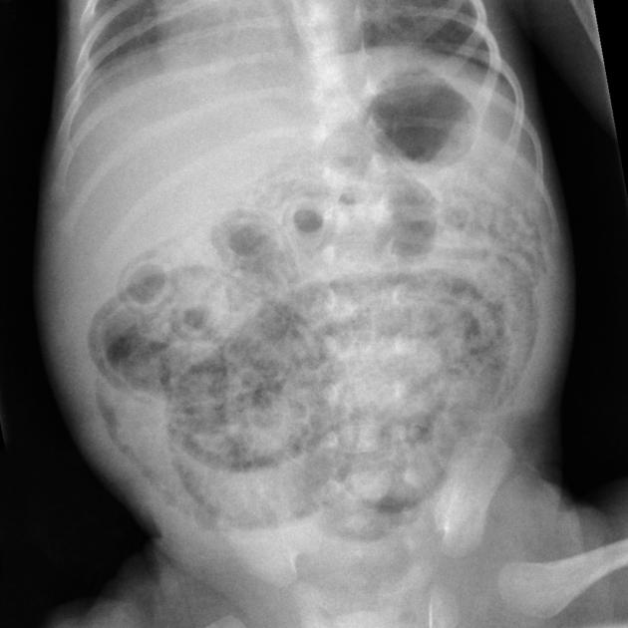
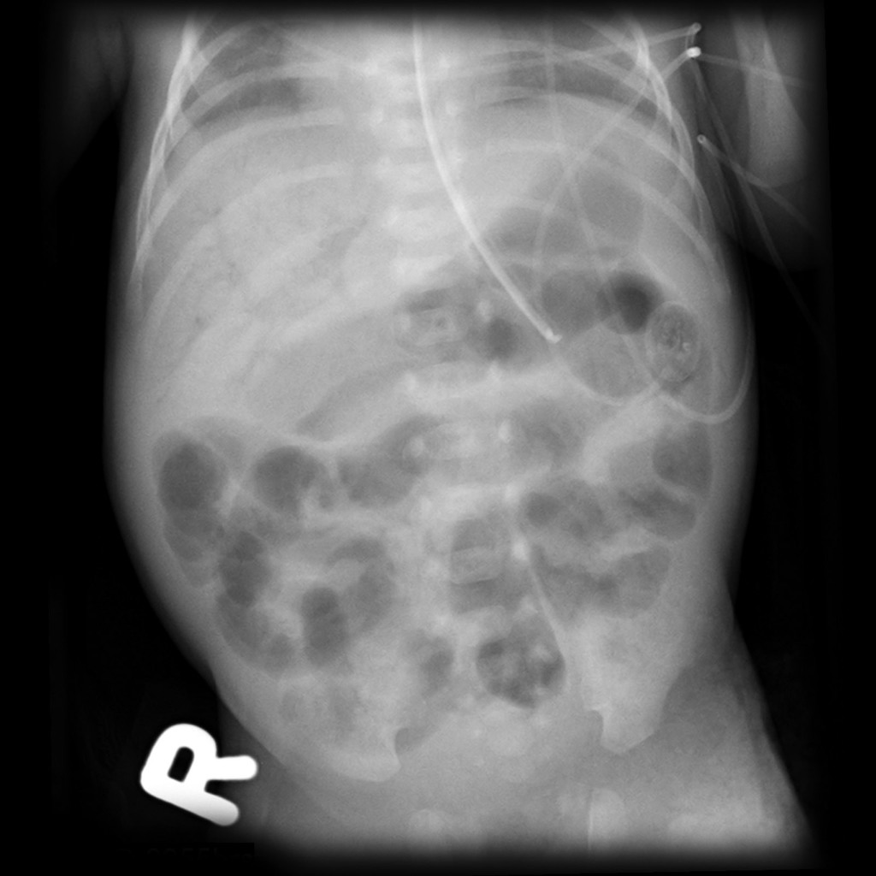
Notes:
Pnuematosis intestinalis (left), portal vein gas (right)

Slide 13
3- Malrotation with midgut volvulus
Neonate ( lower bleeding )
By 12th week of gestation , the midgut has returned to the fetal abdomen from the extraembryonic coelom and has begun rotating counterclockwise around the superior mesenteric artery axis . In malrotation this process fails and predispose to midgut volvulus:
duodenojejunal flexure lies to the right of the midline
Ceacum is central
Narrow base for the small bowel mesentery

Slide 14
Clues
Presentation:
Bile stained vomiting, abdominal pain, abdominal distension, and rectal bleeding
40% in the first wk, 50% in the 1st month, 75% in 1st Yr
Diagnosis: Barium study
Management: Immediate laparotomy reveals the anomaly and allows derotation of the bowel, assessment of intestinal viability, possible bowel resection, and performance of a Ladd procedure.
Notes:
- It is diagnosed with the sudden onset of melena in combination with bilious emesis and abdominal distention in a previously healthy neonate. Immediate upper GI contrast study should be performed to confirm diagnosis of malrotation with midgut volvulus. Immediate laparotomy reveals the anomaly and allows derotation of the bowel, assessment of intestinal viability, possible bowel resection, and performance of a Ladd procedure.

Slide 15
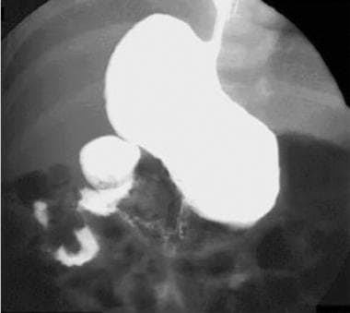
Corkscrew sign

Slide 16
Neonate ( upper bleeding )
1- Maternal blood ingestion
Hematemesis in the first day of life in a healthy baby most likely materanl
Often after traumatic delivery or abrauptio placenta
May also have bleeding per rectum
In breast fed infants, if cracked nipples
Notes:
Hematemesis in the first day of life in a healthy baby most likely materanl
Often after traumatic delivery or abrauptio placenta
May also have bleeding per rectum
In breast fed infants, if cracked nipples

Slide 17
Maternal
Fetal
Notes:
Apt test differentiate maternal from fetal blood

Slide 18
Neonate ( upper bleeding )
2- Stress gastritis
It is found mainly in neonates who are in the NICU unit
Risk factors: prematurity, neonatal distress, and mechanical ventilation.
Diagnosis: by upper endoscopy

Slide 19
3- Hemorrhagic disease of the newborn
In the absence of prophylactic vitamin K, the incidence of VKDB ranges from 0.25% to 1.7%.
Prophylaxis by vitamin K administration at birth for all newborns
Resulting from a deficiency in vitamin K–dependent coagulation factors (II, VII, IX, and X).
The most common sites of hemorrhage or bleeding are the umbilicus, mucous membrane, the gastrointestinal (GI) tract, circumcision site, and venipuncture site and occurs on 2-7 days of life
In contrast, early VKDB develops within the first 24 h of life and is more severe with intracranial, intraabdominal, or intrathoracic hemorrhage.
Early VKDB is linked to maternal use of medications that interfere with vitamin K stores or function such as warfarin or certain anticonvulsants.
Treatmet: Vit K, FFP
Notes:
The most common sites of hemorrhage or bleeding are the umbilicus, mucous membrane, the gastrointestinal (GI) tract, circumcision site, and venipuncture sites. Hematomas frequently occur at the sites of trauma (ie, large cephalohematomas, scalp
bruising related to instrumentation used at delivery and, rarely, intracranial hemorrhage).
Classically, idiopathic vitamin K-deficiency bleeding occurs on days 2–7 of life in solely breast-fed term neonates who did not receive vitamin K prophylaxis at birth and likely results from poor placental transfer of vitamin K, marginal vitamin K content in breast milk (only 15 μg l⁻ ¹ of vitamin KI), and a sterile gut. Bleeding seen is often mucosal, cutaneous, or from venipuncture or circumcision sites. In contrast, early VKDB develops within the first 24 h of life and is more severe with intracranial, intraabdominal, or intrathoracic hemorrhage. Early VKDB is linked to maternal use of medications that interfere with vitamin K stores or function such as warfarin or certain anticonvulsants.

Slide 20
Clinical scenario
14-day old term male baby , presented to the ER for evaluation of spitting up bright red blood , the baby is feeding well and behaving normally , the physical exam is completely unremarkable , the baby looks great!
There were no problems with pregnancy or labor!

Slide 21
Clinical scenario
14-day old female born at 30 weeks gestational age via vaginal delivery , BW was 1400 g , presented with poor feeding , abdominal distension, bilious vomiting with bloody stool .
Her urine output is decreased, she is lethargic and slightly toxic .
Exam : T 36 , RR 60 , BP 60/40 , HR 185 .
Her abdomen is distended with redness , tenderness , and hypoactive bowel sound .
Cardiac exam demonstrate tachycardia
Her early hospital course was remarkable for RDS
Investigation reveals leukocytosis , thrombocytopenia , increase in BUN and plasma creatinine with metabolic acidosis on ABG

Slide 22
Causes of GI bleeding in infants (1month -1 year)

Slide 23
1 M – 1 yr
Lower Gastrointestinal Bleeding | Upper Gastrointestinal Bleeding
Anal fissure Intussusception Milk protein allergy Gangrene | Esophagitis Gastritis Swallowed maternal blood Varices Mallory-Weiss tear

Slide 24
Upper GI bleeding 1 month – 1 year
1- Esophagitis (Peptic esophagitis)
It is the most common cause of upper GI bleeding in children aged 1 month to 1 year.
This condition is caused by gastroesophageal reflux disease (GERD) or less likely eosinophilic esophagitis
The infants presents with regurgitation following feeding, failure to thrive.
Associated with wheezy chest, stridor, recurrent aspiration

Slide 26
Upper GI bleeding 1 month – 1 year
2. Gastritis
Either:
Primary (peptic ulcer, duodenal): correlated to H. pylori, but 20% are idiopathic
Secondery: (more common, gastric): sepsis, shock, cushing ulcer (increased ICP), curling ulcer (burn), NSAID, and zollinger Ellison syndrom
Symptoms: epigastric abdominal pain, recurrent vomiting, upper GI bleeding
Diagnosis of peptic ulcer disease is based on Endoscopic findings
Positive antibody test may indicate past exposure, not active ongoing infection
Treatment of H. pylori: Triple therapy (PPI + clarithromycin + amoxicillin or metronidazole)
C-urea breath tests used to check response to treatment
Notes:
can be distinguished as primary or secondary in etiology:
1. primary causes:
correlated with Helicobacter pylori infection and is the most common cause of gastritis in children.
symptom :
. an ache or burning pain in the abdomen
. nausea
. loss of appetite
. unintentional weight loss

Slide 27
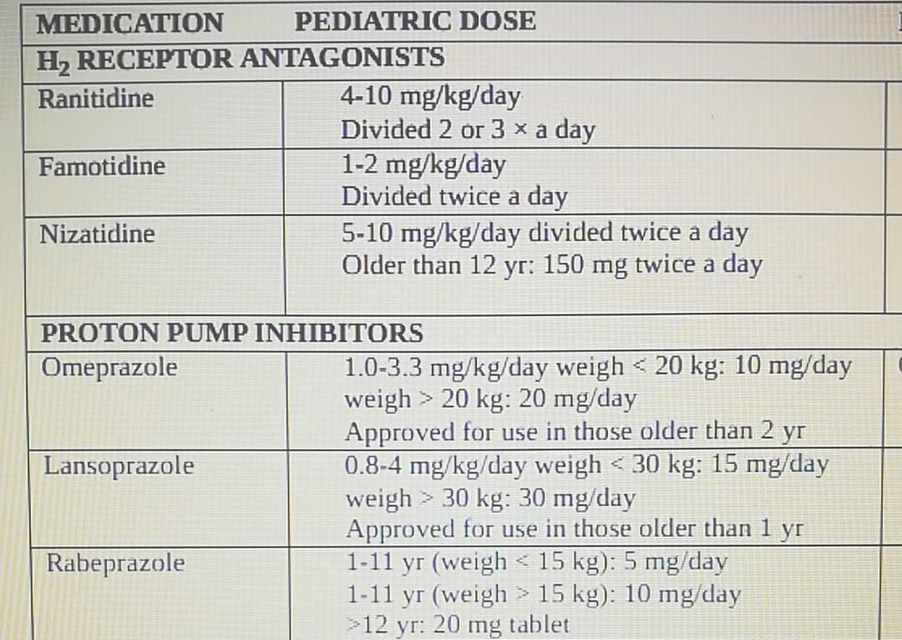

Slide 28
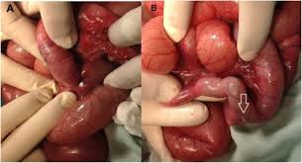
Lower GI bleeding 1 month – 1 year
1. intussusception
its occur when one segment of bowel is pulled into itself or neighboring loop of the bowel by peristalsis
It is the most common cause of lower GI bleeding in infants ranging from 6-18 months of age.
In this group its usually idiopathic and occur in ileocecal region
Secondary: usually in older children, associated with meckels diverticulum, duplication cysts, intestinal lymphoma, etc

Slide 29
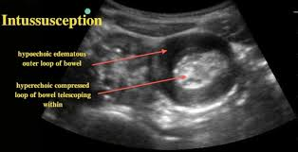
intussusception
Symptoms: a triad of paroxysmal abdominal pain, vomiting and current jelly stool
Flexion of the knees and hips
Vomiting is food content then become bile stained
Signs: Sausage like abdominal mass in 30% of patients
ultrasonography is the method of choice to detect intussusption : target sign
Air or barium contrast enema are diagnostic and therapeutic
Laparotomy if peritonitis, failed enema reduction

Slide 30
2. Gangrenous bowel
Lower GI bleeding 1 month – 1 year
It is the second most common cause of lower GI bleeding in this age group.
Causes include:
1- Malrotation with volvulus
2- Omphalomesenteric remnant with volvulus
3- Internal hernia with strangulation
4- Segmental small-bowel volvulus, and on rarely, sigmoid volvulus.

Slide 31
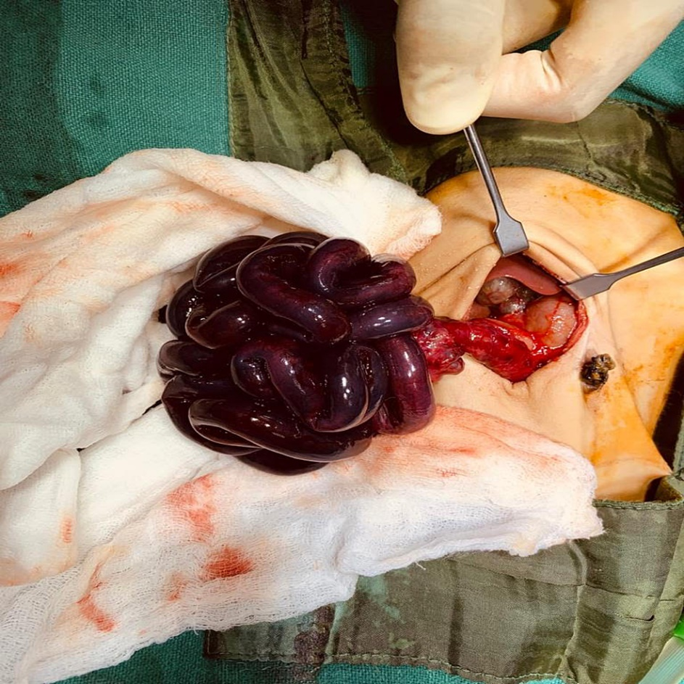
Gangrenous bowel
Signs and symptoms of acute intestinal ischemia typically include:
Sudden abdominal pain that may be mild, moderate or severe
An urgent need to have a bowel movement
Frequent, forceful bowel movements
Abdominal tenderness or distention
Blood in your stool
Mental confusion in older adult.
Mal-rotated bowel with volvulus and
black gangrenous bowel

Slide 32
Lower GI bleeding 1 month – 1 year
3. Milk protein allergy
Or cow’s milk protein allergy, can cause gastrointestinal bleeding in infants due to the inflammatory response triggered by the immune system’s adverse reaction to milk proteins, as well as the damage induced upon the GI lining.
MPA causes a colitis that may be correlated with occult or gross lower GI bleeding. Additional symptoms include diarrhea, weight loss, vomiting, and irritability.
It can occur in infants who are formula fed, or less commonly in breastfed infant due to consumption of cow’s milk in mother’s diet.

Slide 33
Treatment:
The main principle in management is to avoid allergens while maintaining a balanced, nutritious diet for infants and mothers:
This includes avoiding breast milk from a mother who consumes dairy and switching to a hypoallergenic infant formula.
Hypoallergenic formulas are specially designed to be free of cow's milk protein. These formulas can be extensively hydrolyzed (broken down into smaller protein fragments) or based on amino acids (completely protein-free).

Slide 34
Clinical scenario:
A 7-week-old baby presented with an 8 h history of lethargy, vomiting and refusal to feed. Symptoms started the same day soon after a feed at 11:30 h. She had been well until then. She became very sleepy and had a high pitched cry. She had three vomits prior to presentation and one of the vomitus was reported to have had a greenish tinge to it. She had another vomit while on admission which was nonbilious. There was no history of fever, constipation or diarrhea.
On examination, she was lethargic, pale and quiet. Her temperature was 36.4°C and capillary refill time was less than 2 s. Her heart rate was 134/min and blood pressure 85/42 mm Hg. Her abdomen was scaphoid and soft with normal bowel sounds. There were no masses palpable. She weighed 4.14 kg (9th–25th centile). Her length was 57 cm and head circumference 37.5 cm.
Nine hours after admission, she passed a small amount of blood per rectum. On re-examination of the abdomen, she had a palpable mass in the epigastrium.
Notes:
Adiotomre P, Asumang E, Godbole P. Intussusception in a 7-week-old baby. BMJ Case Rep. 2013 May 15;2013:bcr2012008518. doi: 10.1136/bcr-2012-008518. PMID: 23682081; PMCID: PMC3669823.

Slide 35
Upper and lower GI-Bleeding Children 1-2 YEARS
Lower Gastrointestinal Bleeding | Upper Gastrointestinal Bleeding
Polyps Meckel diverticulum | Peptic ulcer disease Gastritis

Slide 36
Juvenile polyps
Most common cause of lower GI bleeding in toddlers
Juvenile polyps are single, sporadic, benign hamartomas which typically occur between the ages of 2-10 years.
Patients usually present with painless rectal bleeding, with our without mucus, and they may experience abdominal pain.
Colonoscopy is the best way to diagnose polyps and permits their painless removal
In cases of patients with three to five or more juvenile polyps, and a family history of polyps, they may have familial juvenile polyposis or juvenile polyposis syndrome. These patients should undergo colonoscopy and biopsy every 2-3 years as surveillance for colorectal neoplasia.
Notes:
Juvenile polyps are the most common cause of significant lower GI bleeding in toddlers and school-aged children. Bleeding from a juvenile polyp can occur because the surface of the polyp is very friable or if the polyp outgrows its blood supply, it can become ischemic and auto-amputate. Bleeding is usually bright red, painless, and small in amount (rarely do patients become anemic or require blood transfusions). The patient is otherwise asymptomatic with normal stools, except for the blood and/or mucus usually present on the surface of the stool. Most juvenile polyps are solitary and carry little, if any, malignant potential. They can occur in any portion of the colon, but most are found in the rectosigmoid area or left colon (thus the bleeding is usually bright red).
Colonoscopy is indicated in this patient with hematochezia and suspected juvenile polyp. Colonoscopy can be both diagnostic and therapeutic, as the treatment of choice for juvenile polyps is endoscopic removal. This is accomplished by snaring the polyp at the base of the stalk (juvenile polyps are pedunculated) and applying electrocautery.

Slide 37
Meckel diverticulum
Abnormal sac or pouch develops at a weak point in the intestines (usually in the ileum) , the only true congenital diverticulum (involves all layers of the bowel wall)
the most common congenital small-intestine anomaly that results from incomplete obliteration of the fetal vitelline (omphalomesenteric) duct that connects the midgut lumen and yolk sac cavity early in fetal life.
Most (~85%) diverticula contain heterotopic gastric tissue and less commonly contain pancreatic tissue.
The etiology of GI bleeding due to Meckel diverticulum is ileal ulceration caused by acid secretion from the ectopic gastric mucosa. Erosion into small arterioles leads to painless, brisk rectal bleeding

Slide 38
the rule of 2 in meckel's diverticulum
Peak at 2yrs
Male: Female 2:1
2% symptomatic
Length 2 inches
Diameter 2 cm
Located 2 feets proximal to iliocecal valve
Two types of tissues

Slide 39
Congenital anomalies associated with meckel's diverticulum
•Cardiac anomalies
•Congenital diaphragmatic hernia
•Duodenal atresia
•Esophageal atresia
•Imperforate anus
•Gastroschisis /Omphalocele
•Malrotation
•Hirschsprung's disease
•Down's syndrome

Slide 40
Clinical presentation
The presentation of meckel's diverticulum depends on the age.
•all age groups : abdominal pain, nausea, vomiting, anorectal bleeding(massive bleeding , causes severe anemia or hemorrhagic shock) and abdominal distention.
•Newborns: symptoms of intestinal obstruction due to an under lying volvulus or intussusceptions.
•In infants and young children : painless lower GI bleeding.
•In older children meckel's diverticulum may undergo inflammation and mimics appendicitis

Slide 41
Complication
Perforation if the out pouching becomes impacted with food, leading to distention and necrosis
bands of tissue extend from the Meckel’s diverticulum to the anterior abdominal wall, and these may represent starting points around which volvulus may develop.
intussusceptions.

Slide 42
Diagnostic Tests/Treatment
The best diagnostic test is a technetium-99m pertechnetate scan (Meckel's scan). Accumulation of pertechnetate in the right lower abdominal quadrant is diagnostic of a Meckel diverticulum that contains ectopic gastric mucosa.
The patient receives a tiny amount of intravenous technetium-99m, and a gamma camera highlights gastric mucosa and ectopic gastric tissue.
Because not all diverticula are seen, ultrasound , barium enteroclysis, or video capsule endoscopy may be useful. When the level of suspicion is high, surgical or laparoscopic investigation is warranted.
The treatment is surgical excision. to prevent further bleeding or other complications

Slide 43
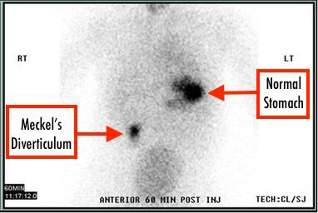

Slide 44
Common causes of GI bleeding in children (2 years and above)
Lower Gastrointestinal Bleeding | Upper Gastrointestinal Bleeding
Polyps Inflammatory bowel disease Infectious diarrhea Vascular lesions | Esophageal varices Peptic Ulcer Mallory-Weiss tear

Slide 45
Esophageal varices
Esophageal varices are abnormally enlarged veins in the lower part of this tube.
Esophageal varices are often a complication of serious liver diseases(portal vein thrombosis,biliary atrasia)

Slide 46
Symptoms of esophageal varices are:
-Vomiting blood
-Black, tarry or bloody stools
- Signs of chronic liver disease

Slide 47
INVESTIGATION:
1-Upper endoscopy is the preferred diagnostic test for esophageal varices, as it provides definitive diagnosis.
2-Also we can use US, Barium contrast studies,CT !!
The management of acute variceal bleeding must include :
1-hemodynamic stability through blood transfusion.
2-vasoactive drugs.
3- short-term antibiotic use, and
4- endoscopy to perform or sclerotherapy, as needed

Slide 48
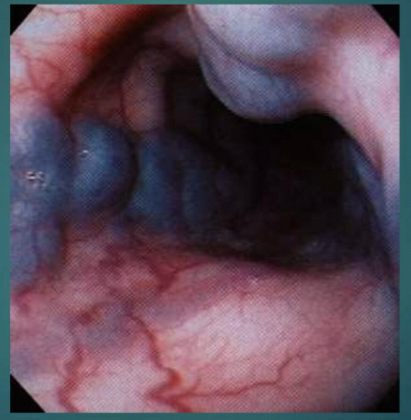
Esophageal varices

Slide 49
Vascular lesions
consist of a variety of malformations that include hemangiomas , arteriovenous malformations, and vasculitis.
Lesions located in the colon can be diagnosed with colonoscopy. However, bleeding can cause this to be challenging making localizing the bleeding practically impossible.

Slide 50
Treatment of acute GI bleeding :
For children with large-volume bleeds, the ABCs of resuscitation (airway, breathing, circulation) should be addressed first.
Oxygen should be administered and the airway protected with an endotracheal tube if massive hematemesis is present
Place intravenous line: CBC, PT/ INR, BUN, LFT, IVF boluses and possible blood transfusion, platelets, or FFP
Cardiopulmonary and urine output monitoring.
NG tube insertion for both upper and lower GI bleeding
PPI/ H2 blocker for upper GI bleeding
Notes:
Fluid boluses and transfusion with packed red blood cells as required should be administered through two large-bore IVs.
Frequent reassessment should continue to ensure maintenance of physiological stability
Blood transfusion is appropriate for unstable patients and those with hemoglobin ≤8 g/dL.⁸ The amount of blood transfused should be determined according to age and weight. Children with active bleeding and coagulopathy should be considered for transfusion with fresh frozen plasma; those with thrombocytopenia should also be considered for platelet replacement, particularly when platelet count is <30,000

Slide 51
Specific care :
In all children, the presence of blood can be confirmed by the use of peroxide-based tests, such as the Hemoccult or Hematest for lower GI bleeding and Gastroccult for upper GI bleeding.
Endoscopic treatments include the application of clips, coagulation, banding, injection, sclerotherapy, and the use of tissue adhesives
The site of upper GI bleeding can be identified in 90% of cases when endoscopy is performed within 24 hours.
For lower GI bleeds, colonoscopy can reveal the source of bleeding more effectively than barium enema can, and it has 80% sensitivity.
Angiography is used to localize lesions when endoscopy has failed or when the patient cannot cooperate.

Slide 52
Surgical options
If all medical measures fail
- Laprotomy
- Laproscopy
- Vagotomy
- Pyloroplasty
- Fissurotomy, fistulectomy
- Diverticulectomy

Slide 53
THANK YOU

