Slide 1
Oxygen therapy

Slide 2
Out line
Definition of the oxygen therapy
Types of oxygen therapy
purposes of using the oxygen therapy
Administration of oxygen therapy
Complication of oxygen therapy

Slide 3
Learning objectives:
Define the oxygen therapy
Discuss the type of c oxygen therapy
List the purpose of using the oxygen therapy
Explain the procedure
Demonstrate the procedure
List Complication of oxygen therapy

Slide 4
Oxygen therapy
Definition:
Oxygen is a colorless, odorless, tasteless gas that is essential for the body to function properly and to survive.

Slide 5
What is meaning of O2 therapy
Oxygen therapy is the administration of oxygen at a concentration of pressure greater than that found in the environmental atmosphere
The air that we breathe contain approximately 21% oxygen
the heart relies on oxygen to pump blood.

Slide 6
Purpose
Oxygen therapy is a key treatment in respiratory care.
The purpose is to increase oxygen saturation in tissues where the saturation levels are too low due to illness or injury.

Slide 7
oxygen therapy is used to treat
Example in case :-
Documented hypoxemia
Severe respiratory distress (acute asthma or pneumonia)
Severe trauma
Chronic obstructive pulmonary disease (COPD, including chronic bronchitis, emphysema, and chronic asthma)

Slide 8
oxygen therapy is used to treat
Pulmonary hypertension
Acute myocardial infarction (heart attack)
Short-term therapy, such as post-anesthesia recovery
Oxygen may also be used to treat chronic lung disease patients during exercise .

Slide 9
Preparation
A physician's order is required for oxygen therapy, except in emergency use.
Clinical observations.
indicated in Artial Blood Gas measurements,(ABGs ) .
Pulse Oximetry.

Slide 10
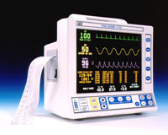
Pulse oximetry

Slide 11
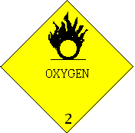
Cautions For Oxygen Therapy
Oxygen toxicity – can occur with FIO2 > 50% longer than 48 hrs
Danger of fire
Infection

Slide 12
Methods
of oxygen
administration:

Slide 13
Classification of Oxygen Delivery Systems
Low flow systems
contribute partially to inspired gas client breathes
Ex: nasal cannula, simple mask , non-re breather mask , Partial rebreather mask
High flow systems
deliver specific and constant percent of oxygen independent of client’s breathing
Ex: Venturi mask,, trach collar, T-piece

Slide 14
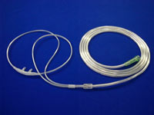
Methods of oxygen administration:
1- Nasal cannula

Slide 15
Nasal cannula
It is a disposable.
plastic devise with two protruding prongs for insertion into the nostrils, connected to an oxygen source.
Used for low-medium concentrations of Oxygen (24-44%).

Slide 16
Disadvantages | Advantages | Priority Nursing Interventions | Amount Delivered F1o2 (Fraction Inspired Oxygen) | Method
may cause irritation to the nasal and pharyngeal mucosa if oxygen flow rates are above 6 liters/minute Variable FIO2 | Client able to talk and eat with oxygen in place Easily used in home setting | Check frequently that both prongs are in clients nares Never deliver more than 2-3 L\min to client with chronic lung disease | Low flow 24-44 % 1 L\min=24% 2 L\min=28% 3 L\min=32% 4 L\min=36% 5 L\min=40% 6 L\min=44% | Nasal Cannula

Slide 17
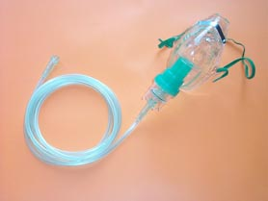
Face mask
The simple Oxygen mask
The partial rebreather mask:
The non rebreather mask:
The venturi mask:

Slide 18
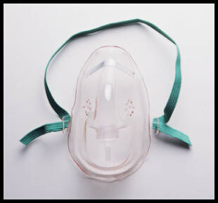
The simple Oxygen mask
Simple mask is made of clear, flexible , plastic or rubber that can be molded to fit the face.

Slide 19
The simple Oxygen mask
It delivers 35% to 60% oxygen .
A flow rate of 6 to 10 liters per minute.
Often it is used when an increased delivery of oxygen is needed for short periods
(i.e., less than 12 hours).

Slide 20
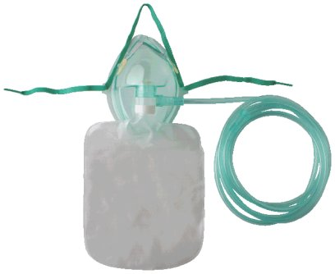
The partial rebreather mask:
The mask is have with a reservoir bag must romaine inflated during both inspiration & expiration
It collection of the first parts of the patients' exhaled air.
It is used to deliver oxygen concentrations up to 80%.

Slide 21
The partial rebreather mask
The oxygen flow rate must be maintained at a minimum of 6 L/min to ensure that the patient does not rebreathe large amounts of exhaled air.
The remaining exhaled air exits through vents.

Slide 22
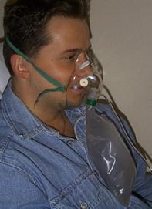
The non rebreather mask
This mask provides the highest concentration of
oxygen (95-100%) at a flow rate6-15 L/min.
It is similar to the partial rebreather mask
except two one-way valves prevent conservation of exhaled air.
_{The bag is an oxygen reservoir}

Slide 23
Venturi mask
It is high flow concentration of oxygen.
Oxygen from 40 - 50%
At liters flow of 4 to 15 L/min.

Slide 24
T-piece
Used on end of ET tube when weaning from ventilator
Provides accurate FIO2
Provides good humidity

Slide 25
Side effect & complication of oxygen therapy
Oxygen toxicity
Retrolental fibroplasia
Absorption atelectasis

Slide 26
oxygen toxicity
It is a condition in which ventilator failure
occurs due to inspiration of a high
concentration of oxygen for aprolonged
period of time.
Oxygen concentration greater than 50% over 24 to 48 hours can cause pathological changes in the lungs.

Slide 27
Signs and symptoms of oxygen toxicity:
• Non-productive cough.
• Nausea and vomiting.
• Substernal chest pain.
• Fatigue.
• Nasal stuffiness.
• Headache.
• Sore throat.
• Hypoventilation.
. Nasal congestion.
. Dyspnea.
. Inspiration pain.

Slide 28
Evaluation:
Breathing pattern regular and at normal rate.
pink color in nail beds, lips, conjunctiva of eyes.
No confusion, disorientation, difficulty with cognition.
Arterial oxygen concentration or hemoglobin
Oxygen saturation within normal limits.

Slide 29
Documentation:
Date and time oxygen started.
Method of delivery.
Oxygen concentration and flow rate.
Patient observation.
Add oronasal care to the nursing care plan

Slide 30
O2 DELIVERY DEVICES
EQUIPMENT FLOW FIO2 SPECIAL NOTES
NASAL CANNULA 1/2 - 6 L/M .24 – 44 6 L/M MAX.
SIMPLE O2 MASK 6 - 10 L/M .35 – 55 USE 5 L/M
(WITHOUT BAG) MINIMUM
RESERVOIR MASK 10-15 L/M .60 -80 PAGE RT IF USED
(MASK WITH BAG) (BAG TO NOT
COLLAPSE)
VENTI MASK 3 L/M .24, 26, 31, READ ENCLOSED
6 L/M .35, .40, .50 INSTRUCTIONS
NEBULIZER 8 L/M OR > .28, .30, .35 MIST MUST BE
.40, .50, 70 VISIBLE
*** SHOWS THAT FIO2 VARIES WITH DIFFERENT
F, VT, INSPIRATORY FLOW RATES.

Slide 31
Thank you

