Slide 1
وسهلا
أهلا
الأستاذ الدكتور/ يوسف حسين
أستاذ التشريح وعلم الأجنة
كلية الطب – جامعة الزقازيق- مصر
رئيس قسم التشريح والأنسجة وعلم الأجنة - كلية الطب - جامعة مؤتة
دكتوراة من جامعة كولونيا المانيا
جروب الفيس
د. يوسف حسين (استاذ التشريح)

Slide 2
The first week

Slide 3
Fertilization

Slide 4
Sperm & Corona radiata
Cumulus ovaricus
Zona pellucida
Head
Cell membrane
Neck
Middle piece
Secondary oocyte
Tail

Slide 5
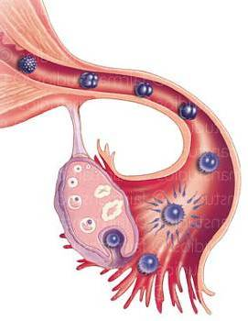
Fertilization is the process by which male & female gametes fuse to form the zygote.
Time of fertilization: during the ovulation that occurs roughly at the 14th days

Slide 6
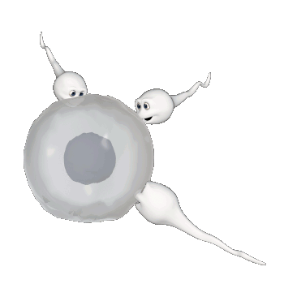
Site: It occurs at ampulla of uterine tube (lateral 1/3 of uterine tube)
The lifespan of the ovum is 24 hour

Slide 7
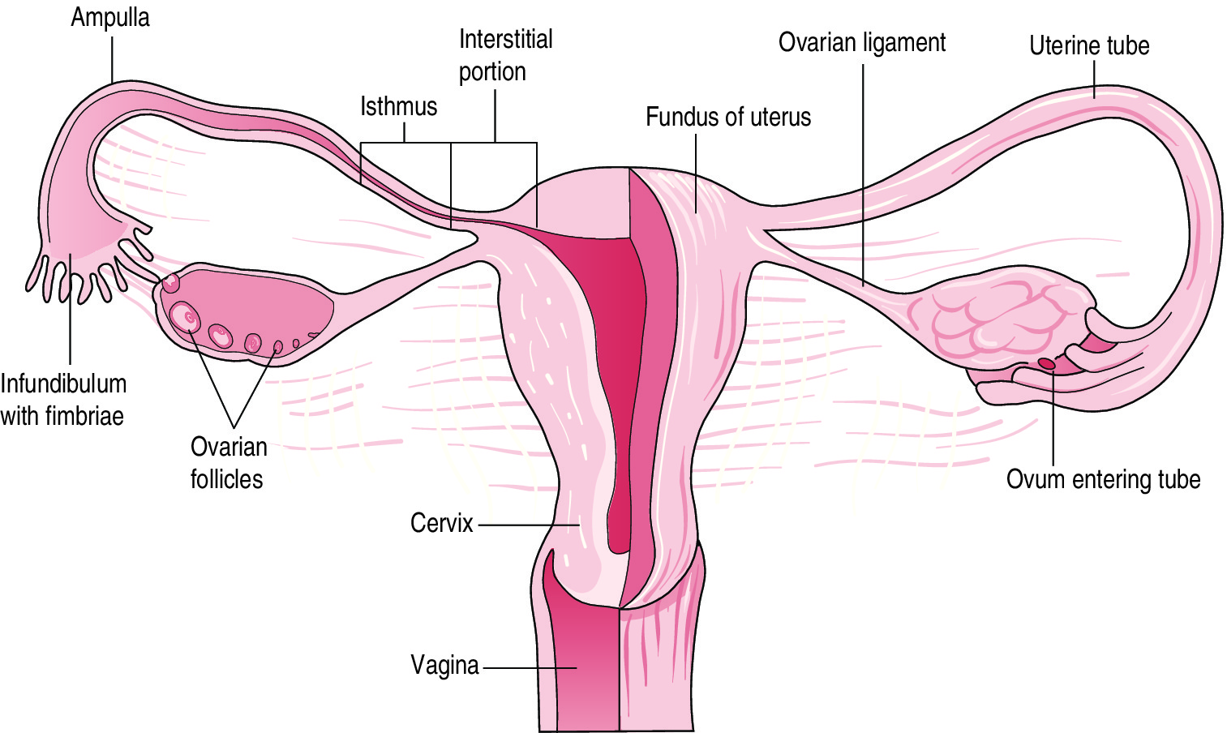
** The sperms reach lateral 1/3 of the fallopian tube by;
1- Movement of tails of the sperms.
2- Contraction of the uterus and fallopian tubes.
3- Movement of the cilia of the uterine tube.

Slide 8
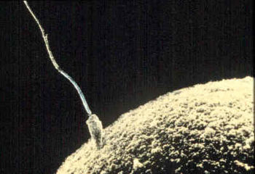
Only 200–300 sperms survive to reach the site of fertilization in the uterine tube
Most of sperms able to fertilization within 48 hours.
Only one can penetrate the secondary oocyte

Slide 9
Steps of Fertilization
Preparatory step
Actual step
1- Penetration of corona radiata barrier (cumulus ovaricus)
2- Penetration of the Zona Pellucida
3- Fusion of plasma membranes of the gametes
1- Sperm Capacitation
2- Acrosomal reaction

Slide 10
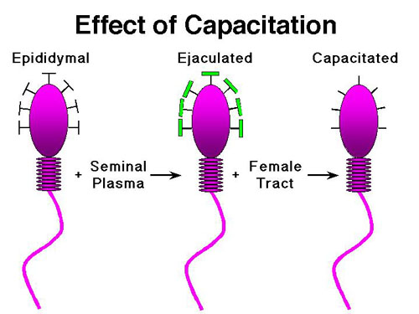
Capacitation, loss of the glycoprotein coat from the acrosomal cap of the sperm head
it lasts about 7 hours in female genital tract
Notes:
This ability is achieved by two processes: (a) capacitation and (b) acrosome reaction.
Capacitation, during which time a glycoprotein coat and seminal plasma proteins are removed from the spermatozoon head

Slide 11
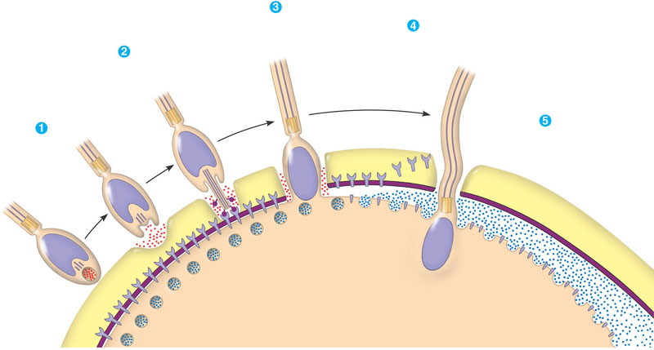
Acrosomal reaction; release of the proteolytic enzymes from the acrosomal cap to help penetration of the sperm to the ovum.
- They include hyaluronidase enzyme, trypsin like enzyme and zona lysine enzyme.
Notes:
The Acrosomal Reaction-
The acrosome reaction, during which acrosin- and trypsin-like substances are released to penetrate the zona pellucida
hydrolytic enzymes dissolve a hole in the jelly coat
actin fibres begin elongate and form the acrosomal process
the acrosomal process elongates further and binds with the sperm binding receptors this binding causes the vitelline membrane to begin to break down

Slide 12
Penetration of the corona radiata cells
Penetration of corona radiate cells by :
Hyaluronidase enzyme of the sperms.
Mucous secretion of fallopian tube.
Only capacitated sperm can pass through the corona radiata barrier

Slide 13
Penetration of the Zona Pellucida
Penetration of the zona pellucida by the zona lysine enzyme and trypsin like enzyme of the sperms.
Zona reaction: After penetration of the sperm, the zona pellucida changes its chemical composition to prevent entry of other sperms.

Slide 14
Fusion of gametes cell membranes
Cortical reaction: after penetration of the sperm, the cell membrane of the 2ry oocyte alters its chemical composition to prevent entry of other sperm.
The 2ry oocyte completes the 2nd meiotic division giving rise to definitive ovum and 2nd polar body. The nucleus of the ovum enlarged to form female pronucleus.

Slide 15
Fusion of gametes cell membranes
The head of the sperm swells and forms the male pronucleus

Slide 16
Fusion of gametes cell membranes
Both male and female pronuclei become in contact with each other and fuse together to form the zygote (46 chromosomes).

Slide 17
Results of Fertilization
Formation of zygote.
Restoration of diploid number (46 chromosomes).
Cleavage (segmentation) starts.
Determination of sex.
Determination of general features by the autosomes chromosomes.
Inhibition of further ovulation and menstrual cycles

Slide 18
Mitosis (cell division) in the new zygote uses centrioles derived from the sperm but the oocyte has no centrioles.
The sperm’s mitochondria degenerate with the formation of the male pronucleus.
This is why all mitochondria in humans are of maternal origin.

Slide 19
Cleavage (Segmentation)

Slide 20
START OF CLEAVAGE
1- Zygote
2- Cell Stage
4- Cell Stage
Morula
16- Cell Stage
8- Cell Stage

Slide 21
blastomere
Morula
Formation of morula التوتية
The zygote divides repeatedly by mitotic divisions leading to an increasing number of cells then formation of 16 cells surrounded by zona pellucida ( Morula).
The morula reaches the uterine cavity at the 3rd - 4th days after fertilization.
Zygote

Slide 22
Formation of Blastocyst

Slide 23
Inner cell mass (Embryoblast)
blastocyst
Outer cell mass (Trophoblast)
Blastocele
Blastocyst
5th day
Notes:
About the time the morula enters the uterine cavity, fluid begins to penetrate through the zona pellucida into the intercellular spaces of the inner cell mass

Slide 24
Formation of blastocyst
- The cells of the morula rapidly proliferate and forming a large number of cells.
- Fluid collects between the cells and form a single cavity called blastocele
- The morula becomes changed into a cystic structure called blastocyst at the 5th days after fertilization.
- The blastocele divides the cells into 2 groups;
a- Outer layer of flat cells called trophoblast that forms the placenta.
b- Inner cell mass (embryoblast). This mass will form the embryo.

Slide 25
Implantation
** Definition: It is the entrance of the blastocyst into the thick endometrium of the uterus (decidua) .
** Sites of implantation: into the middle of the upper part of the posterior wall of the uterus.

Slide 26
Implantation
Implanted blastocyst
Timing: Starts at 6th-8th day and completed at 11th day.

Slide 27
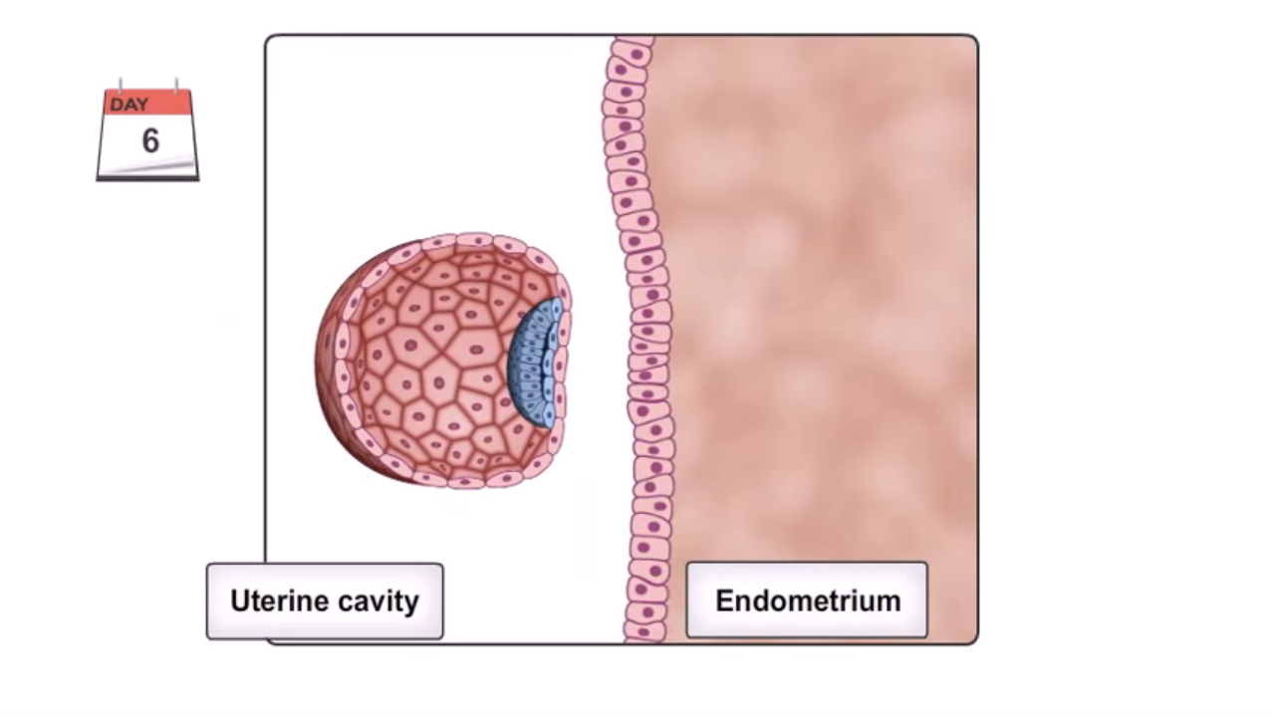
Steps of implantation
5
1- Rupture of the zona pellucida around blastocyst due to increase amount of fluid in the blastocele

Slide 28
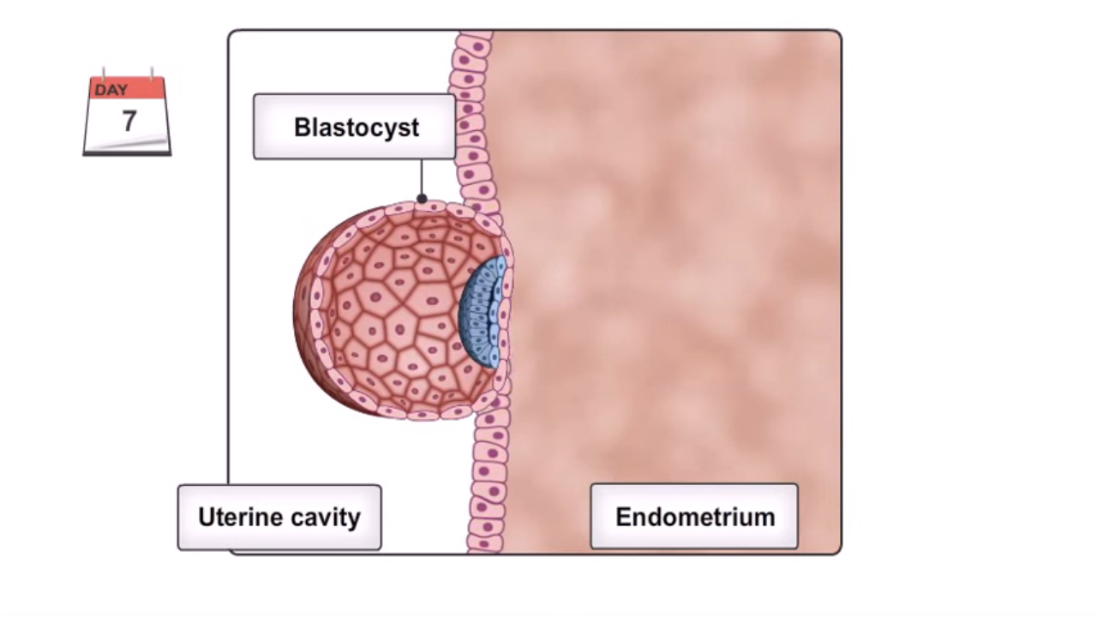
Steps of implantation
Inner cell mass embryoblast
6
2- The trophoblast covering the inner cell mass adherent to the endometrium.

Slide 29
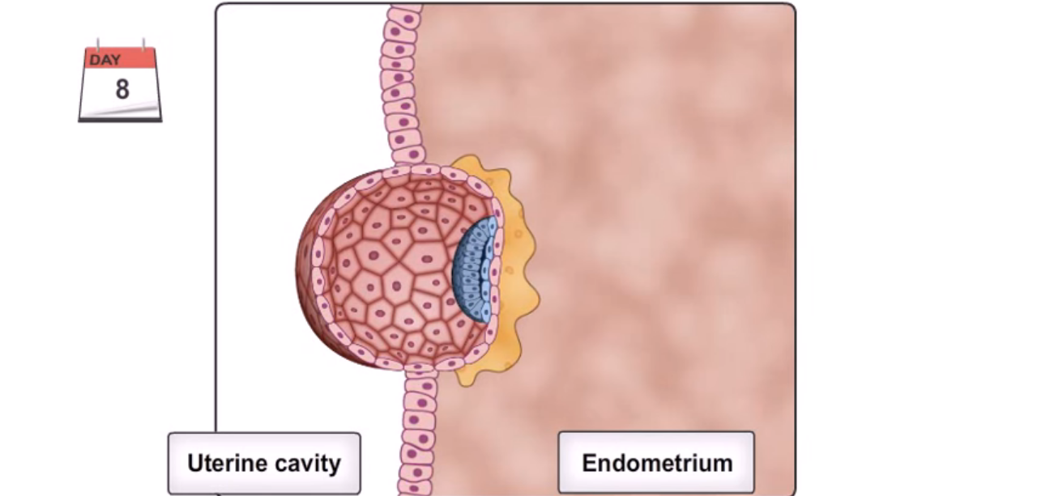
Steps of implantation
cytotrophoblast
trophoblast
syncytiotrophoblast
3- The trophoblast covering the inner cell mass adherent to the endometrium, and differentiates into 2 layers: 1) An inner layer called cytotrophoblast.
2) An outer layer called syncytiotrophoblast.
The syncytiotrophoblasts have a phagocytic function.
They erode the endometrium and gradually sink into it.

Slide 30
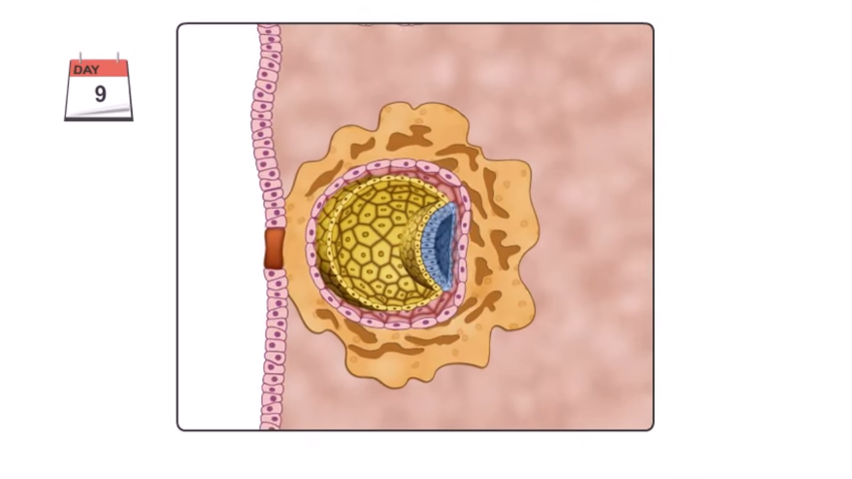
Steps of implantation
fibrin clot
syncytiotrophoblast
4- The blastocyst becomes completely embedded into the endometrium.
- The site of implantation is closed by a fibrin clot.

Slide 31
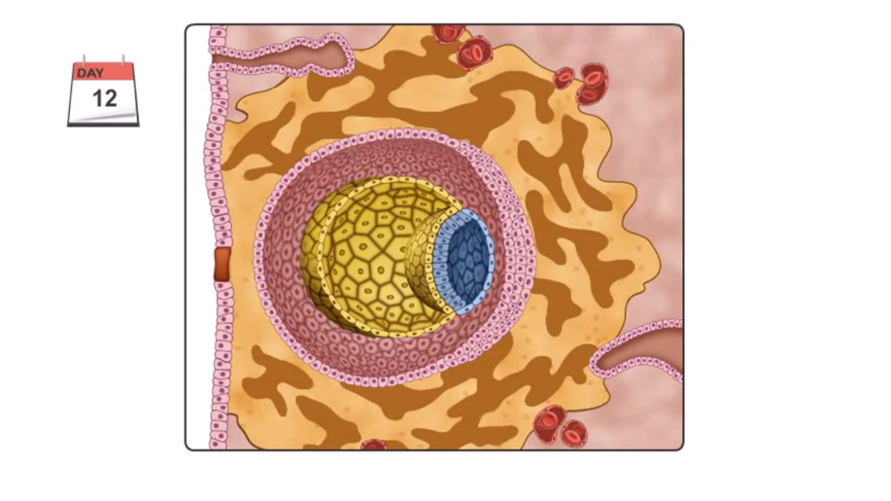
Steps of implantation
surface epithelium covers the original defect
5- By the 11th to the 12th day of development, the blastocyst is completely embedded in the endometrium (decidua) and the surface epithelium covers the original defect in the uterine wall

Slide 32
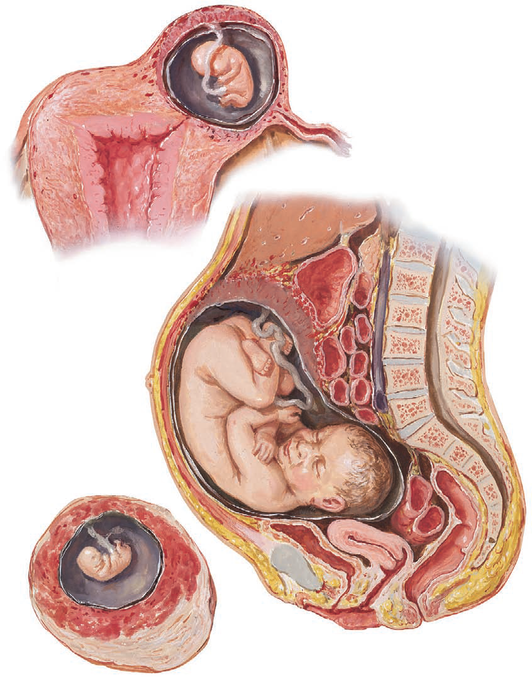
Ectopic Pregnancy
Extra uterine abnormal implantation (ectopic pregnancy)
1- Tubal pregnancy (uterine tube).
2- Ovarian pregnancy (in the ovary).
3- Peritoneal cavity.
Abnormal implantation

Slide 33
Placenta previa
Intrauterine abnormal implantation:
- Implantation at any site rather than the normal site
- In this case, the placenta is called placenta previa.
Abnormal implantation

Slide 34
Thank You

