Slide 1
CNS II Traumatic vascular disease of the nervous system
Dr. Sura Al Rawabdeh MD
28-12-2022

Slide 2
CENTRAL NERVOUS SYSTEM TRAUMA:
Result & morphology depend on:
Penetrating or Blunt trauma→ Open or Closed
Mobile or immobile head at time of trauma
Lesions at bony prominences e.g
Frontal, orbital, temporal & occipital poles
Spinal cord
Edema may occur & worsen the condition
? skull fracture

Slide 3
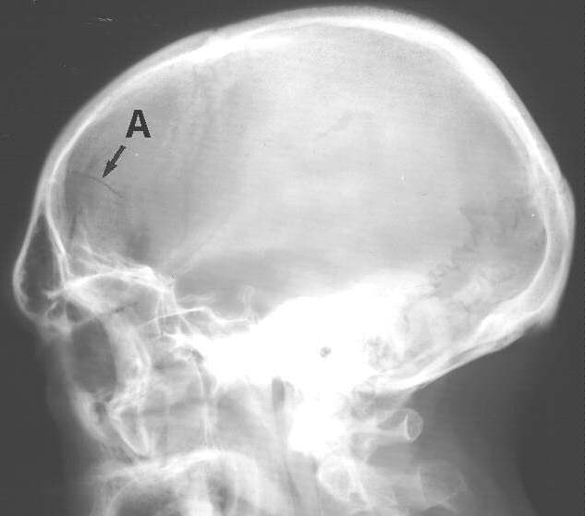
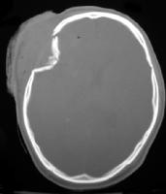
“HAIRLINE”
“DEPRESSED”or “DISPLACED”
Notes:
3
Skull fracture types

Slide 4
A- Parenchymal injury:
1- Concussion:
Immediate and temporary disturbance of brain function with reversible altered consciousness.
No demonstrable lesion
Signs: confusion, headache, visual disturbances, nausea, vomiting, dizziness…. Then recovery with Amnesia for the event

Slide 5
I. Concussion
Is a clinical syndrome of altered consiousness secondary to head injury.
Brought by a change in the momentum of the head when a moving head suddenly arrested by impact on a rigid surface.

Slide 6
The characteristic neurologic picture includes onset of transient neurologic dysfunction including:
Loss of consciousness,
Temporary respiratory arrest
Loss of reflexes.

Slide 7
Although neurologic recovery is complete , amnesia for the event persists.
Pathogenesis is unknown but may result from temporary deregulation of the reticular activating system in the brainstem.

Slide 8
Complications
Post concussive neuropsychiatric syndromes typically associate with repetitive trauma are well recognized
Significant cognitive impairment with distinct pathologic findings called chronic traumatic encephalopathy

Slide 9
Direct parenchymal injuries
1. Contusions
- Caused by blunt trauma to the brain
The pia- arachnoid is not breached
Mechanism
A blow to the surface of the brain transmitted through the skull leads to rapid tissue displacement , disruption of vessels , hemorrhage and tissue injury.
Tissue injury, more on crests of gyri ± The crest of gyri are most susceptible than the depth of sulci
Intraparenchymal, subarachnoid hemorrhage
Coup Contusion & Contrecoup contusion

Slide 10
2- Contusions & lacerations of cortex:
Coup lesions:
*Contusions immediately beneath and associated with direct trauma *Stationary head, no fracture, enough energy to damage brain
Contrecoup lesions:
* Contusions at a distance from & frequently opposite to the point of trauma
* Often represent rotational & deceleration injury, related to irregularities of the skullopposite point of impact

Slide 11
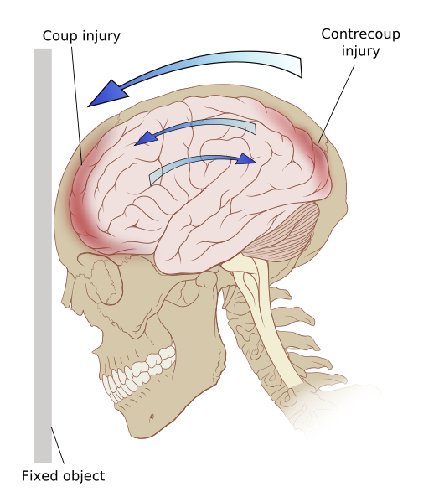

Slide 12
Contusions are common in regions of the brain overlying rough and irregular inner skull surfaces, such as:
The orbital surfaces of the frontal lobes
And the temporal lobe tips
Note
- Contusions are less frequent over the occipital lobes, brainstem and cerebellum until these sites are adjacent to a skull fracture.

Slide 13
Both types of contusions have similar gross and microscopic appearances.
The distinction is made on identification of the point impact.
a. If the head is immobile at the time of trauma, only a coup injury is found.
- Is caused by contact between the surface of the brain and skull at the site of impact
b. If the head is mobile at the time of the trauma, both coup and contrecoup contusions may be found.
- Is thought to arise when the brain strikes the opposite inner surface of the skull after sudden deceleration

Slide 14
MORPHOLOGY :
Contusions are wedge-shaped with the broad base lying along the surface at the point of the impact
Microscopic examination
a. In the earliest stage:
Edema and hemorrhage.

Slide 15
b. During next few hours:
- Extravasation of blood extend throughout the cortex to white matter then to the subarachnoid space.
c. Old traumatic lesions:
- Are depressed retracted yellow brown patches (called plaque jaune).

Slide 16
Early contusions at orbital gyri of frontal lobes

Slide 17
Old contusions

Slide 18
Cerebral trauma. (A) Acute contusions are present in both
temporal lobes, with areas of hemorrhage and tissue disruption. (B) Remote
contusions, seen as discolored yellow areas, are present on the inferior
frontal surface of this brain

Slide 19
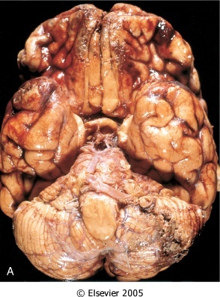
Multiple contusions involving the inferior surfaces of frontal lobes, anterior temporal lobes, and cerebellum.

Slide 20
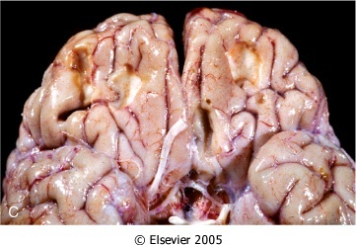
Remote contusions are present on the inferior frontal surface of this brain, with a yellow color

Slide 21
3- Intracerebral hemorrhage:
Cutting of brain vessels, high impact
4- Cerebral Edema: Occurs with and without an obvious structural lesion
Note: Can occur without evidence of hemorrhage
5- Diffuse Axonal Injury:
Stretching force & cutting of axons

Slide 22
Diffuse Axonal Injury:
Acceleration / Deceleration injury
50% of patients with post-traumatic coma
Affect white matter (corpus callosum, paraventricles, hippocampus…etc ) & at junction of grey & white matter
Characteristic asymmetric axonal swelling (Retraction Balls), micro – hemorrhages, ↑microglia, later gliosis
Post-traumatic dementia & vegetative state.

Slide 23
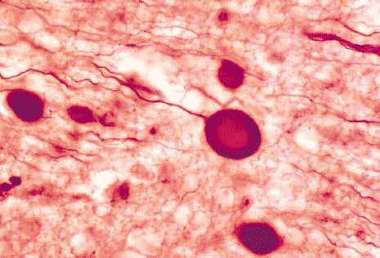
Axonal retraction balls
Axonal retraction balls

Slide 24
B-Traumatic vascular injuries
1- Epidural Hematoma:
Normally the dura is fused with the periosteum on the internal surface of the brain.
- Dural arteries, most importantly, the middle meningeal artery are vulnerable to injury especially with skull fracture in which the fracture cross the course of the vessel.
Usually acute & accompanied by skull fracture
Seen in 3% of significant trauma
Rupture of middle meningeal artery
Rapid collection of blood (30 – 50ml → symptoms)

Slide 25
1- Epidural Hematoma:
Mass effect  Dura & Brain compression
Rapid increase in ICP
Clinically: Patient has LUCID interval for hours followed by rapid loss of consciousness
Fatal within 24 – 48 hrs. if untreated

Slide 26
Note
- In children in whom the skull is deformable, a temporary displacement of skull bones leading to lacerations of a vessel can occur in the absence of skull fracture

Slide 27
Comparison of epidural to subdural hematomas

Slide 28
When blood accumulates slowly, patients can be lucid for several hours between the moment of trauma and the development of neurologic signs..
An epidural hematoma may expand rapidly and constitutes a neurosurgical emergency necessitating prompt drainage and repair to prevent death

Slide 29
Epidural hematoma

Slide 30
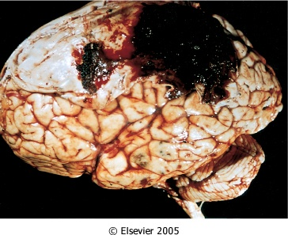
Epidural hematoma covering a portion of the dura.
Multiple small contusions are seen in the temporal lobe.

Slide 31
2- Subdural hematoma:
The dura is composed of two layer, The external collagenous layer and inner border cell layer with scant fibroblasts and abundant extracellular space devoid of collagen
When bleeding occurs, these two layers separate and create the subdural space in which the blood accumulates
Bridging veins travel from convexities of the cerebral hemispheres through the subarachnoid space and the subdural space to empty into superior sagittal sinus

Slide 32
2- Subdural hematoma:
These vessels are prone to tearing along their course through the dural layers
The venous sinuses are fixed relative to the dura, so the displacement of the brain that occurs in trauma can tear the veins at the point where they penetrate the dura

Slide 33
2- Subdural hematoma:
Most occur with changed head velocity e.g. boxers, battered baby & old age
More common than epidural
Disruption of Bridging Veins from brain to dural sinuses, more over convexities
About 50% of acute are accompanied by fracture.

Slide 34
Susceptible people:
1. Old people with brain atrophy
- Patients with brain atrophy, the bridging veins are stretched out, and the brain has additional space within which to move, accounting for the higher rate of subdural hematomas in elderly persons.
2. Infants also are susceptible to subdural hematomas because their bridging veins are thin-walled.

Slide 35
May be categorized based on the interval between the hematoma and the traumatic event
– Acute: within 3 days of trauma
– Subacute: between 3 days and 3 weeks after trauma
– Chronic: develops after 3 weeks

Slide 37
Morphology
Grossly,
- Acute subdural hematomas appear as a collection of freshly clotted blood along the brain surface, without extension into the depths of sulci
- Flattened underlying brain and subarachnoid space is often clear.

Slide 38
- Typically, venous bleeding is self-limited; breakdown and organization of the hematoma take place over time
Lysis of the blood within one week
Growth of granulation tissue from the dural surface into the hematoma (2 weeks)

Slide 39
Typically, the organized hematoma is firmly attached to the inner surface of the dura and is free of the underlying arachnoid, which does not contribute to healing.
The lesion can eventually retract as the granulation tissue matures until only a thin layer of reactive connective tissue remains
(“subdural membranes”).

Slide 40
- In other cases, however, multiple recurrent episodes of bleeding occur (chronic subdural hematomas), presumably from the thin-walled vessels of the granulation tissue.
- The risk of repeat bleeding is greatest in the first few months after the initial hemorrhage

Slide 41
Clinically
Neurologic signs are attributable to the pressure exerted on the adjacent brain.
Symptoms may be localizing but more often are nonlocalizing, taking the form of headache confusion, and slowly progressive neurologic deterioration.

Slide 42
- Subdural hematomas typically become manifest within the first 48 hours after injury.
- They are most common over the lateral aspects of the cerebral hemispheres and may be bilateral. - Symptomatic subdural hematomas are treated by surgical removal of the blood and associated reactive tissue

Slide 43
Acute:
- Clear history of trauma
- Frontoparietal is common
- Slow collection of clotted blood with
surrounding edema→↑ ICP
- Nonfatal cases → Chronic

Slide 44
Chronic:
Trauma often not recorded
More in elderly with brain atrophy or
‘ Battered Baby Syndrome’
Hematoma → Fluid filled cyst enclosed by membrane may be resorbed, or calcified
Risk of rebleeding in first few months
Clinically: confusion, dementia….etc

Slide 45
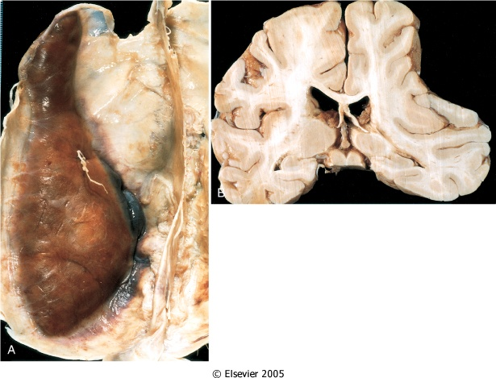
A. Large organizing subdural hematoma attached to the dura.
B. Coronal section of the brain showing compression of the hemisphere underlying the hematoma.

Slide 47
Spinal cord trauma:
Level of injury determines outcome
Lesions include contusions, fiber transection, hemorrhagic necrosis → cystic foci in spinal cord
Late effects: Ascending & descending degeneration in nerve tracts & systemic effects.

Slide 48
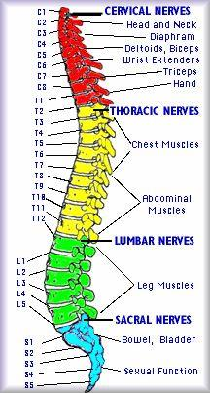
Notes:
48

Slide 49
Effects depend on level:
Cauda equina  pain, weakness of lower limbs...
Thoracolumbar → Paraplegia
Cervical → dysfunction loss of bladder & anal control, bed sores …. Quadriplegia
Above C4 → Paralysis of diaphragm
Result: Infections, genitourinary

Slide 50
Perinatal Brain Injury
May be intrauterine or during birth
Causes include:
Hypoxic/Ischemic injury
Germinal matrix hemorrhage
Infections & Toxins
Birth trauma
May not be noticed at birth
Important cause of Cerebral Palsy  Neurological motor deficits, e.g. spasticity, dystonia, ataxia….

Slide 51
Secondary Complications of Trauma:
1- Diffuse brain edema, secondary hemorrhage & herniations
2- Hypoxic brain damage
3- Infection
4- Fat embolism
5- Post-traumatic dementia
6- Persistent vegetative state
7- Epilepsy.

Slide 52
The End
Good Luck

