Slide 1
Anemia 1
Dr Rami AL-Majali

Slide 2
Reduction in hemoglobin, hematocrit, or number of red blood cells of two standard deviations below the mean for age, sex and race for the normal population.

Slide 4
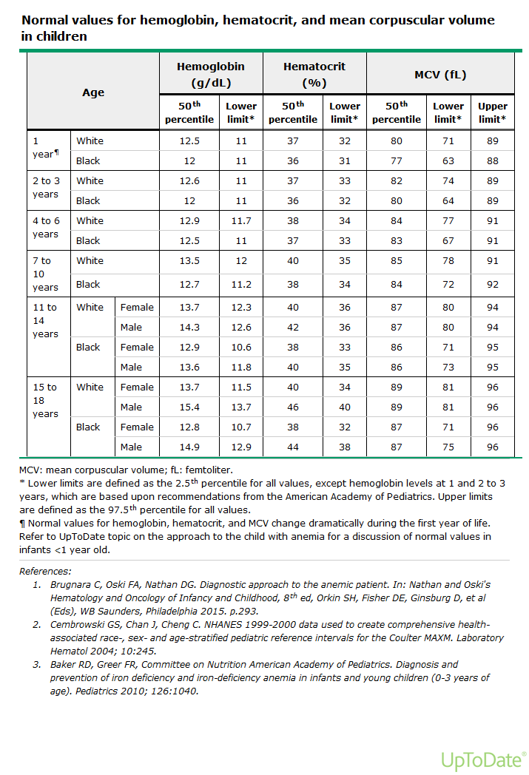

Slide 6
Erythropoiesis
Fetal erythropoiesis is regulated by growth factors produced by the fetus, not by the mother, Erythropoietin (EPO)
EPO does not cross the human placenta.
EPO is produced by monocytes and macrophages in the fetal liver during the first and second trimesters.
After birth, the anatomic site of EPO production shifts to the kidney.

Slide 7
Red Cell Life Span in the Fetus and Neonate
The average erythrocyte life span in normal adults is approximately 120 days.
The life span of fetal/neonatal erythrocytes was once estimated to be considerably less, with an average of 60- 90 days.

Slide 8
Hemoglobins in the Fetus and Neonate
Hemoglobin is a tetramer of 4 globin chains ( 2 alpha (α) and 2 beta (β) polypeptide chains ) with an iron-containing porphyrin ring called heme bound to each chain.
A dynamic interaction between heme and globin gives hemoglobin its unique properties in the reversible transport of oxygen.
The α-globin and β-globin gene clusters are located on chromosome 16 and 11, respectively.
There are 4 α-globin genes and 2 β-globin genes.
Within erythrocytes of an early embryo, fetus, child, and adult, 6 different hemoglobins may normally be detected.
The embryonic hemoglobins (Gower-1, Gower-2, and Portland), fetal hemoglobin (HbF), and the adult hemoglobins (HbA and HbA2 ).

Slide 11
Embryonic Hemoglobins
Gower-1 and Gower-2, and Hb Portland, which has HbF-like mobility.
In embryos up to 6 wk gestation, the Gower hemoglobins predominate but are no longer detectable by 3 mo of gestation.

Slide 12
Fetal Hemoglobin
By 6-8 wk gestation, HbF (α2 γ2 ) is the predominant hemoglobin; at 24 wk gestation it constitutes 90% of the total hemoglobin.
HbF declines modestly in the third trimester, such that the HbF comprises 70–80% of the total hemoglobin at term.
HbF production decreases rapidly postnatally and by 6-12 mo of age reaches adult levels of <2%.
Hb F has a higher affinity for oxygen than adult hemoglobin

Slide 13
Adult Hemoglobins
HbA constitutes 5–10% of total hemoglobin at 24 wk gestation, at term, HbA averages 30% of total hemoglobin.
By 6-12 mo of age, reach adult levels of HbA.
The minor adult hemoglobin component, HbA2, at birth, <1.0% of
HbA2 is detected, but by 12 mo of age the normal level is 2.0–3.4%.
Throughout life, the normal ratio of HbA to HbA2 is about 30 : 1.

Slide 14
Physiologic adjustments to anemia:
Increased cardiac output.
Augmented oxygen extraction (increased arteriovenous oxygen difference).
Shunting of blood flow toward vital organs and tissues.
The concentration of 2,3-diphosphoglycerate increases within the RBC
( “shift to the right” of the oxygen dissociation curve reduces the affinity of
hemoglobin for oxygen ).
Higher levels of erythropoietin.

Slide 15
Approach to the child with anemia. Evaluation of anemic patient.
History.
Physical examination.
Laboratory tests

Slide 16
Terminology
Hematocrit (HCT): Is the fractional volume of a whole blood sample occupied by RBCs, expressed as a percentage.
Hemoglobin (HGB): This is a measure of the concentration of the RBC pigment HGB in whole blood, expressed as grams per 100 mL (dL) of whole blood.
Mean corpuscular volume (MCV): Represents the mean value (in femtoliters [fL]) of the volume of individual RBCs in the blood sample.
Red cell distribution width (RDW): The RDW is a quantitative measure of the variability of RBC sizes in the sample (anisocytosis).
Mean corpuscular hemoglobin concentration (MCHC): is a calculated index (MCHC = HGB/HCT) yielding a value of grams of HGB per 100 mL of RBC.

Slide 17
Microcytic anemia: Is defined as anemia with a low MCV value (ie, ≤2.5th percentile for age, race, and sex).
Normocytic anemia: Is defined as anemia with a normal MCV value.
Macrocytic anemia: Is defined as anemia with a high MCV value.
Hypochromic anemia: Is defined as anemia with low MCHC (≤32 g/dL).
Normochromic anemia: Is defined as anemia with MCHC values in the normal range (33 to 34 g/dL).
Hyperchromic anemia: Is defined as anemia with high MCHC (≥35 g/dL).
Because reticulocytes have a greater MCV than do mature cells, patients with significant degrees of reticulocytosis may have elevated MCV values in the face of otherwise normocytic RBCs.

Slide 18
Reticulocyte count
Reticulocytes are the youngest red cells in the circulation and are identified by the presence of residual RNA.
The reticulocyte is reported as a percentage of the RBC population.
After the first few months of life, the normal reticulocyte percentage is the same as that of the adult: approximately 1.5 percent.
In patients with anemia, the reticulocyte percentage must be interpreted in relation to the reduced number of RBCs.
The simplest approach is to calculate the absolute reticulocyte count (ARC) as follows:
ARC = Percent reticulocytes × RBC count/L.
ARC is expected to increase in the presence of anemia, ARC values within the normal range (<100 × 10⁹/L) generally indicate an inappropriately low erythropoietic response.
The ARC is an indication of bone marrow erythropoietic activity and is used to classify the bone marrow response to anemia:
Anemia with a high ARC reflects an increased erythropoietic response to hemolysis or blood
loss
Anemia with a low or normal ARC reflects deficient production of RBCs (ie, a reduced marrow
response to the anemia)

Slide 19
History and Physical Examination
As with any medical condition, a detailed history and thorough physical exam are essential when evaluating an anemic child.
Important historical facts should include age, sex, race and ethnicity, diet, medications, chronic diseases, infections, travel, and exposures.
A family history of anemia and associated difficulties (e.g. splenomegaly, jaundice, early-age onset of gallstones) is also important.
Clinical findings generally do not become apparent until the hemoglobin level falls to <7-8 g/dL.

Slide 20
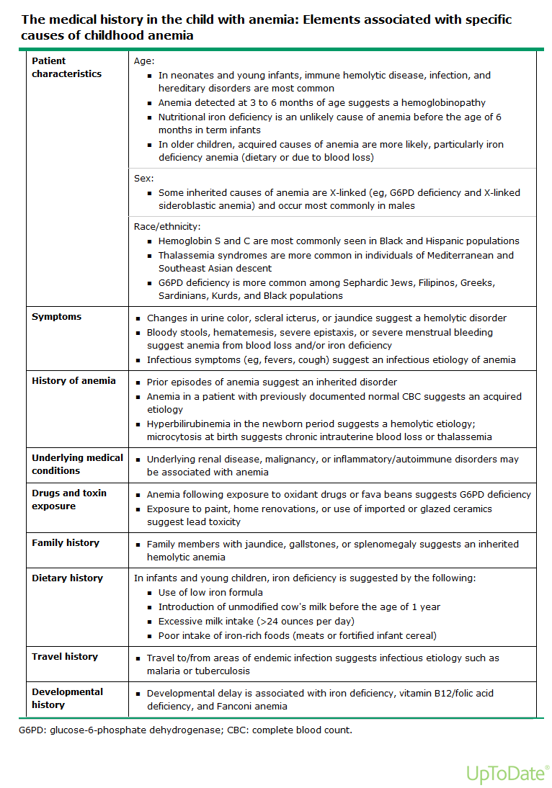

Slide 21
Clinical features can include pallor, sleepiness, irritability, and decreased exercise tolerance.
Pallor can involve the tongue, nail beds, conjunctiva, palms, or palmar creases.
A flow murmur is often present. Ultimately, weakness, tachypnea, shortness of breath on exertion, tachycardia, cardiac dilation, and high-output heart failure will result from increasingly severe anemia, regardless of its cause.

Slide 24
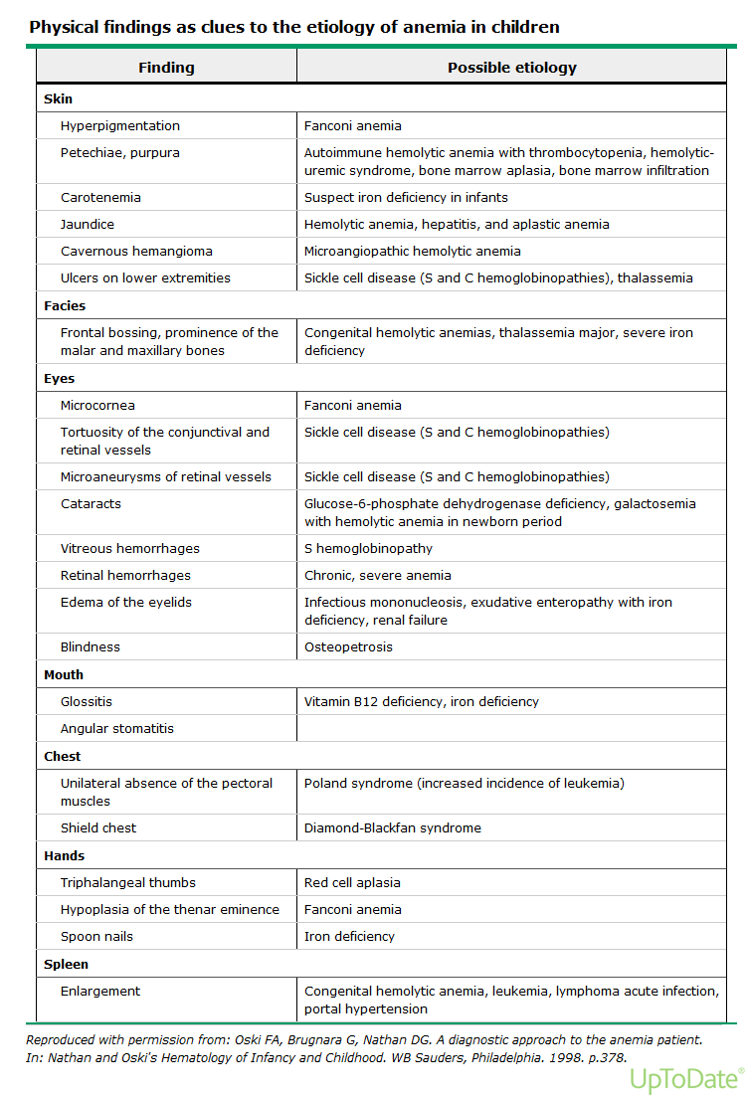

Slide 25
Laboratory Studies
Initial laboratory testing should include hemoglobin, hematocrit, and RBC indices as well as a white blood cell (WBC) count and differential, platelet count, reticulocyte count, and examination of the peripheral blood smear.
The need for additional laboratory studies is dictated by the history, physical exam,and results of this initial testing.

Slide 26
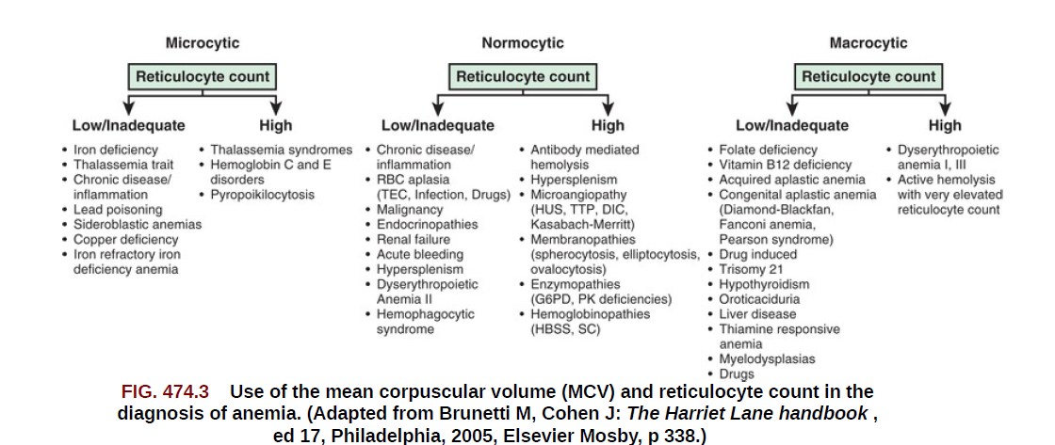
Differential Diagnosis
Anemias may be classified on the basis of their morphology and physiology

Slide 27
Anemias may be classified on the basis of their morphology and physiology
The 2 major categories are decreased production and increased destruction (or loss ).
Decreased RBC production may be a consequence of ineffective erythropoiesis or a complete or relative failure of erythropoiesis.
Increased destruction or loss may be secondary to hemolysis, sequestration, or bleeding.
The peripheral blood reticulocyte percentage or absolute number helps to distinguish between the 2 physiologic categories.

Slide 28
Classifications of Anemias
Physiologic :
Disorders of effective red cell production
rapid erythrocytes destruction or loss
Red cell size; MCV:
macrocytic anemias
microcytic anemias
normocytic anemias

Slide 29
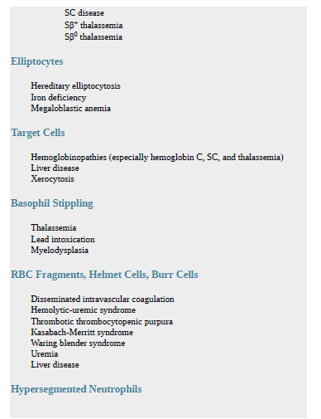
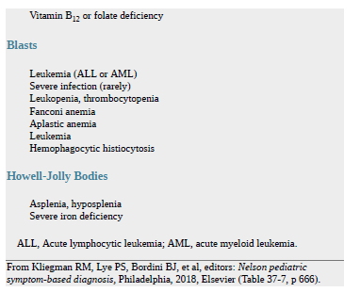

Slide 30
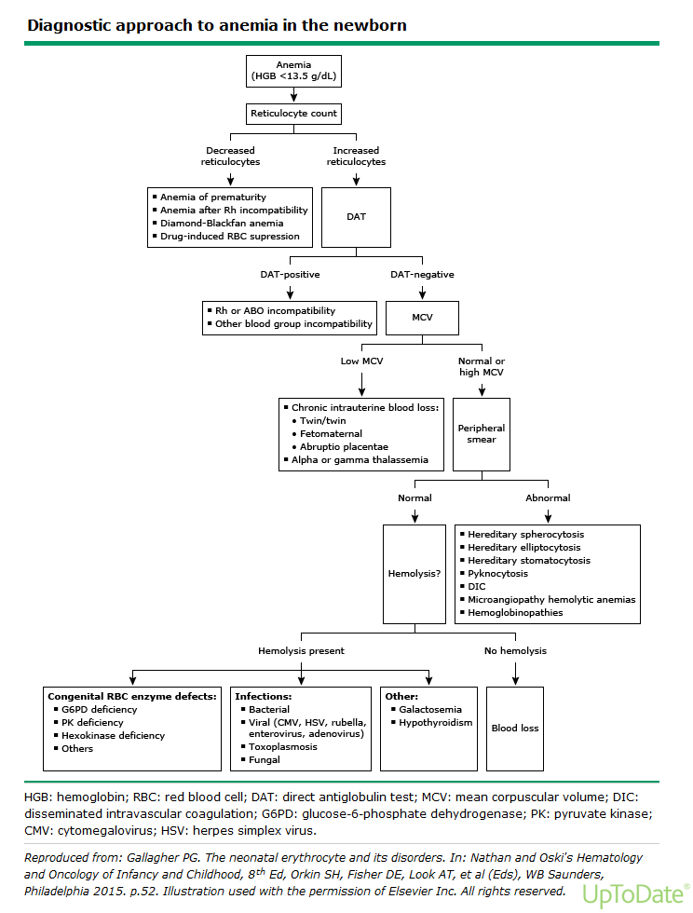

Slide 31
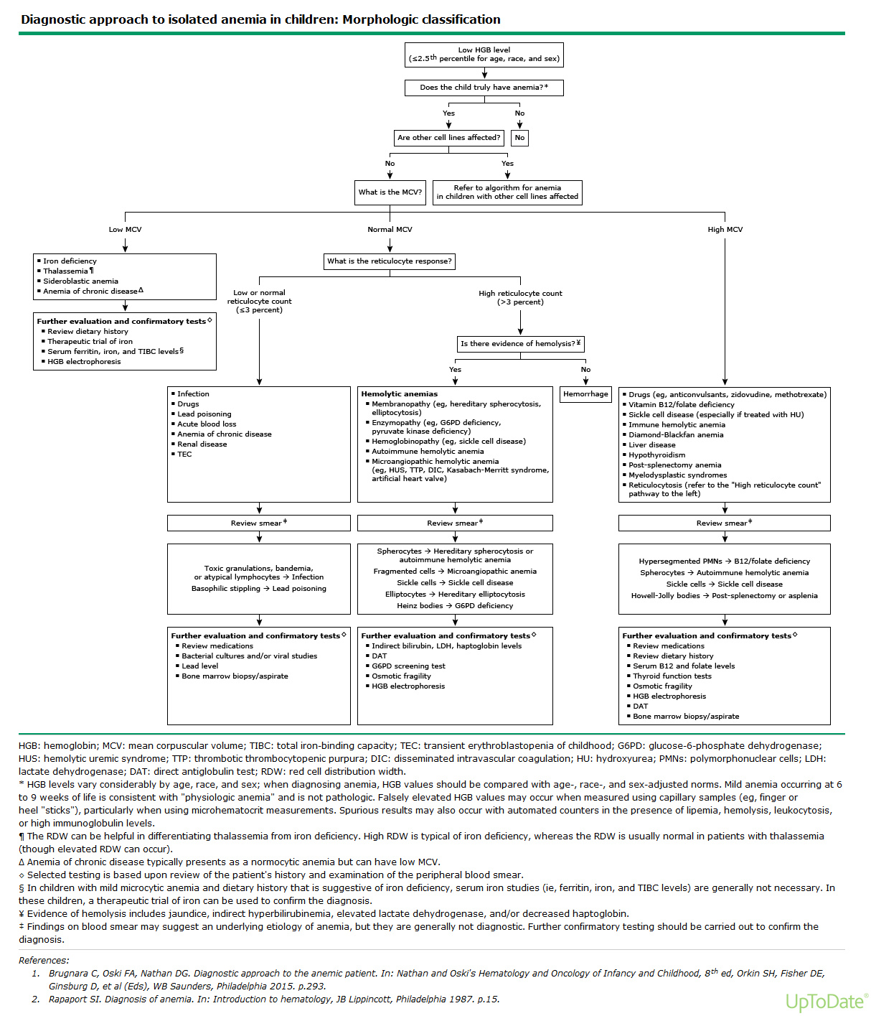

Slide 32
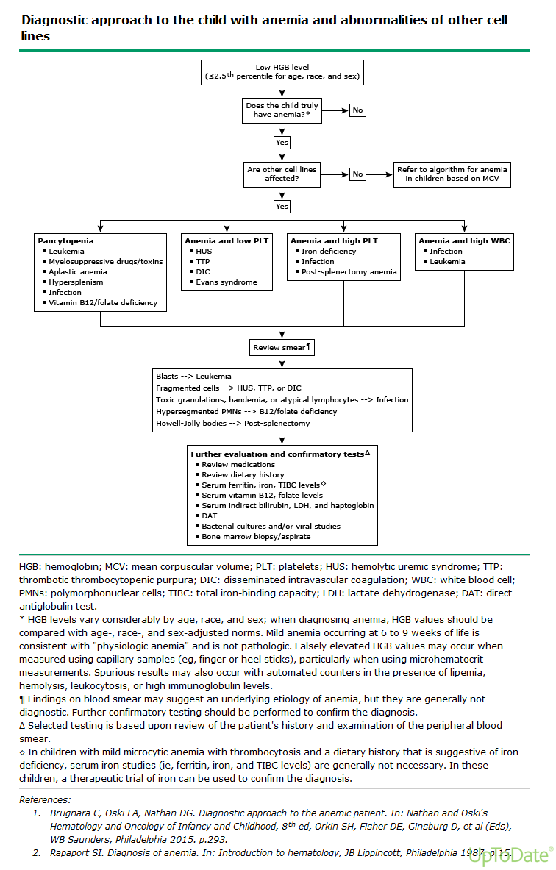

Slide 33
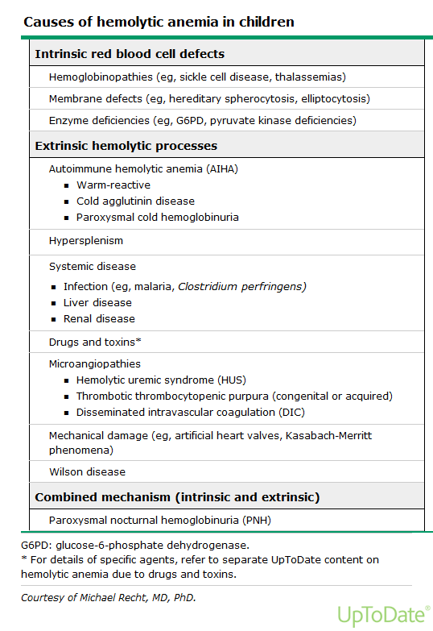

Slide 34
Blood Film.
Sickle cells, as seen in sickle cell disease.
Spherocytes , as seen in hereditary spherocytosis and acute hemolysis.
Elliptocytes, as seen in congenital elliptocytosis.
Target cells, as seen in the various hemoglobinopathies, including thalassemia, as well as in liver disease and post-splenectomy
Bite cells and Heinz bodies, as seen in hemolytic anemia due to oxidant sensitivity, such as G6PD deficiency.
Howell-Jolly bodies are associated with absence or hypofunction of the spleen.
Basophilic stippling is classically seen in lead poisoning and may also be present in thalassemia, sickle cell anemia, and sideroblastic anemia.
Hypersegmented neutrophils suggest vitamin B12 or folate deficiency
The presence of early WBC forms (eg, blasts) along with anemia should raise the suspicion of leukemia.

Slide 35
Anemia detected at three to six months of age suggests a hemoglobinopathy.
Nutritional iron deficiency is an unlikely cause of anemia before the age of six months in term infants.
Toddlers, older children, and adolescents, acquired causes of anemia are more likely, particularly iron deficiency anemia.
Screening for iron deficiency anemia is recommended in all children at 9 to 12 months of age and should be considered in children with additional risk factors (eg, excessive cow's milk intake in toddlers 12 to 36 months of age, onset of menarche in adolescent females).

Slide 36
PHYSIOLOGICAL ANEMIA
PHYSIOLOGIC ANEMIA OF INFANCY occurs at 8-12wk in full term babies and 6-8wk in premature babies.
hemoglobin concentration is as low as 9–11g/dl in term and, in premature Minimal hemoglobin levels of 7–9 g/dL.
Erythropoiesis decreases dramatically after birth as a result of increased tissue oxygenation and a reduced production of erythropoietin.
Notes:
No underlying pathology
No need for treatment
No complications
Asymptomatic
Pre- term babies have rapid growth period during this period(6-8wks) which is a dilution factor, there will be discrepancy between their needs and growth requirements

Slide 37
Pathologic anemia in newborns and young infants is distinguished from physiologic anemia by any of the following :
Anemia (HGB <13.5 g/dL) within the first month of life
Anemia with lower HGB level than is typically seen with
physiologic anemia (ie, <9 g/dL)
Signs of hemolysis (eg, jaundice, scleral icterus, or dark urine)
or symptoms of anemia (eg, irritability or poor feeding)

Slide 38
physiologic anemia of prematurity.
Premature infants also develop a physiologic anemia, known as physiologic anemia of prematurity.
The Hb decline is both more extreme and more rapid.
Hb levels of 7-9 g/dL usually are reached by 3-6 wk of age, and levels may be even lower in very small premature infants.
Nonetheless, plasma EPO levels are lower than would be expected for the degree of anemia, resulting in a suboptimal erythropoietic response.

Slide 39
Treatment
In the full-term infant, physiologic anemia requires no therapy beyond ensuring that the infant's diet contains essential nutrients for normal hematopoiesis.
When transfusions are necessary, an RBC volume of 10-15 mL/kg is recommended.
It is good practice to split units derived from a single donor so that sequential transfusions can be given as required and donor exposure minimized.
In early preterm infants (weighing <1,250 g), the half-life of transfused RBCs is about 30 days.
Delayed cord clamping or umbilical cord milking at birth results in fewer transfusions and a reduction in both intraventricular hemorrhage and necrotizing enterocolitis in preterm infants.

Slide 42
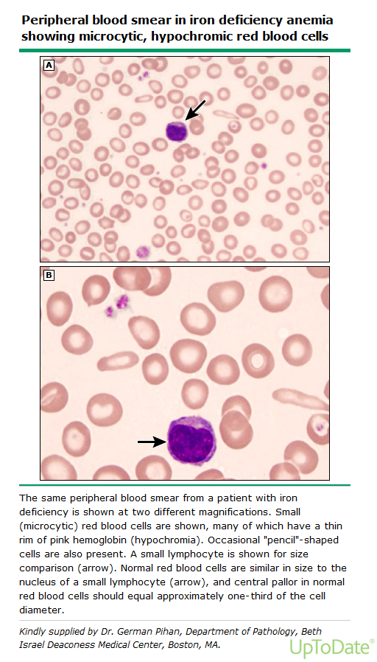

Slide 50
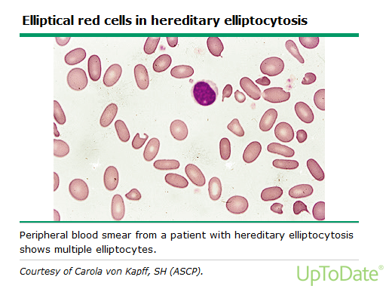

Slide 51
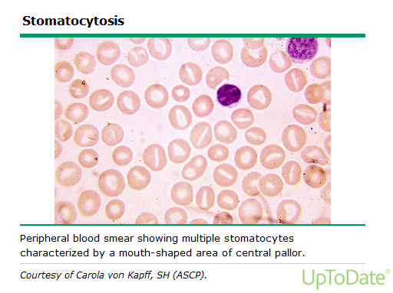

Slide 54
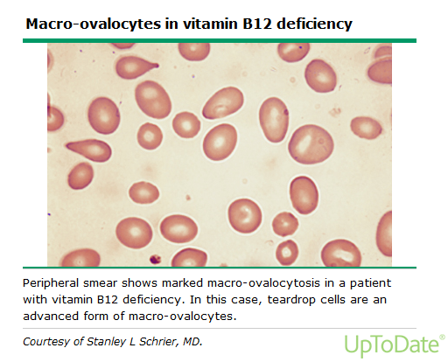

Slide 55
Thank you

