Slide 1
Vitamins

Slide 2
Classification
Vitamins are classified into two major groups:
Fat-soluble (4 fat soluble) Vitamin A, D, E, K.
Water-soluble (9 water soluble)
B₁ (thiamine)
B₂ (riboflavin)
B₃ or Vitamin P or Vitamin PP (niacin)
B₅ (panthotenic acid)
B₆ (pyridoxine and pyridoxamine)
B₇ or Vitamin H (biotin)
B₉ or Vitamin M (folic acid)
B₁₂ (cobalamin)
Vitamin C

Slide 3
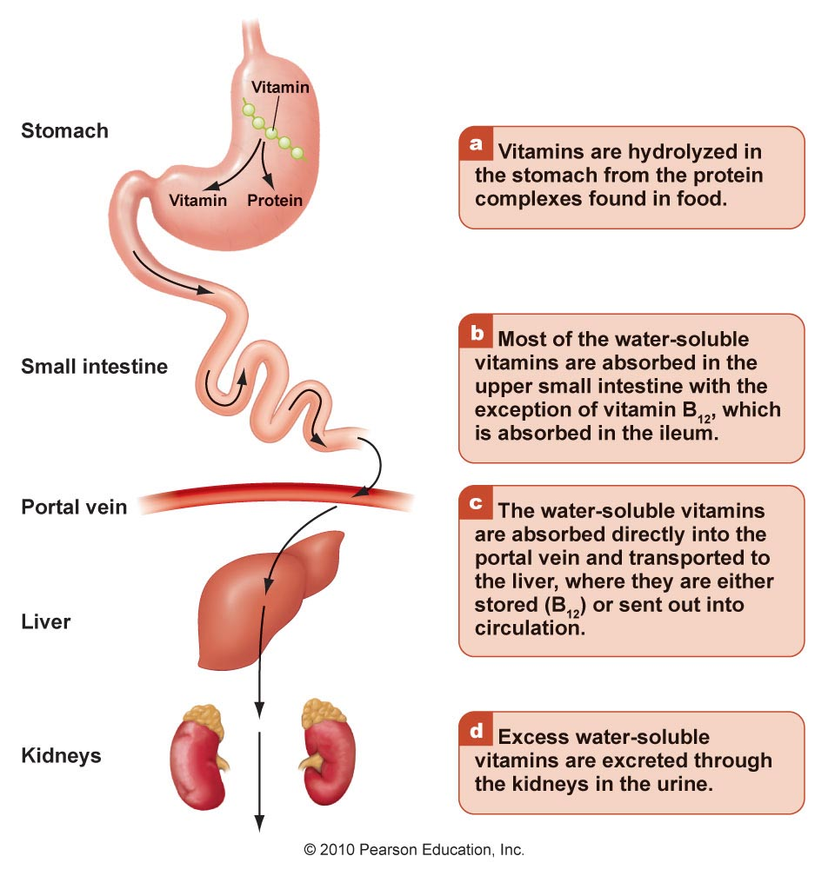
Digesting and absorbing water-soluble vitamins

Slide 4
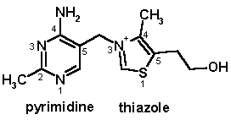
Thiamin (B 1)
Chemistry:
A substituted pyrimidine joined by a methylene bridge to a substituted thiazole.
Requirements: 1-1.5 mg/day for adults. (Higher needs in pregnancy, high CHO diet)
Sources:
Plant sources: whole grains (unrefined cereal grains), beans, peas, nuts and bran.
Animal sources: liver, heart, kidney and milk.
Yeast
Activation (Co-enzyme):
Conversion of thiamin to its active form thiamin pyrophosphate (TPP)

Slide 5
Absorption
- Thiamine is released by the action of pyrophosphatase
- At low concentrations, the process is carrier-mediated.
- At higher concentrations, absorption also occurs via passive diffusion.
- It can be inhibited by alcohol consumption.
- On serosal side of the intestine, its transport is Na⁺-dependent ATPase.
- The majority of thiamine in serum is bound to proteins,
mainly albumin.
- Approximately 90% of total thiamine in blood is in RBCs.
Cellular uptake
- Thiamine uptake and secretion appears to be mediated by a soluble
thiamine transporter that is dependent on Na⁺ [Thiamin transporter-
1 & 2 (human THTR-1 & 2)].
Storage: of thiamine occurs in muscle, heart, brain, liver, and kidneys.
Excretion: Thiamine and its metabolites are excreted in urine.

Slide 6
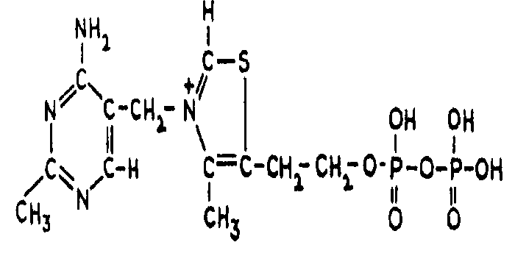
Thiamin: activation
Thiamin TPP
ATP-dependent thiamin
diphosphotransferase
Brain, liver
Thiamine + ATP → TPP + AMP (EC 2.7.6.2).
ATP
Oxidative decarboxylation of pyruvate
ETC
CO2
NAD⁺ NADH + H⁺
pyruvate
acetyl CoA
Pyruvate Dehydrogenase complex
PDH
Vitamins (thiamin, lipoic, riboflavin, Niacin, pantothenic acid)
Co enzymes (TPP, Lipoamide, FAD, NAD+, CoASH)

Slide 7
Functions
TPP serves as a coenzyme transferring an activated aldehyde unit in the following enzymatic reactions:
Oxidative decarboxylation of α-keto acids.
Transketolase reaction (pentose phosphate pathway; PPP). It is used for the biosynthesis of pentose sugars deoxyribose and ribose.
Acetylcholine synthesis which is one of neurotransmitters and for myelin synthesis.
Important in:
Producing energy from carbohydrates
Nerve function
Muscle function
Appetite
Growth
Therapy: It can be used for treatment of Heart failure & Alzheimer disease.

Slide 8
Deficiency
Causes:
Low intake, malabsorption , and/ or defective phosphorylation to TPP.
Antithiamine factors : These are enzymes present in the viscera of shell fish and many microorganisms . They cause cleavage of thiamin producing pyrimidine and thiazole rings so they are called thiaminases. These antithiamine factors cause an isolated thiamine deficiency. Plant thiamine antagonists are heat-stable; for examples caffeic acid, and tannic acid. These compounds interact with the thiamine to oxidize the thiazole ring, thus rendering it unable to be absorbed.
Alcoholism : Chronic alcoholism gives the manifestation of moderate thiamine deficiency. This is called Wernike korsacoff , syndrome. Alcohol interferes with absorption
Excessive loss (diuretics).

Slide 9
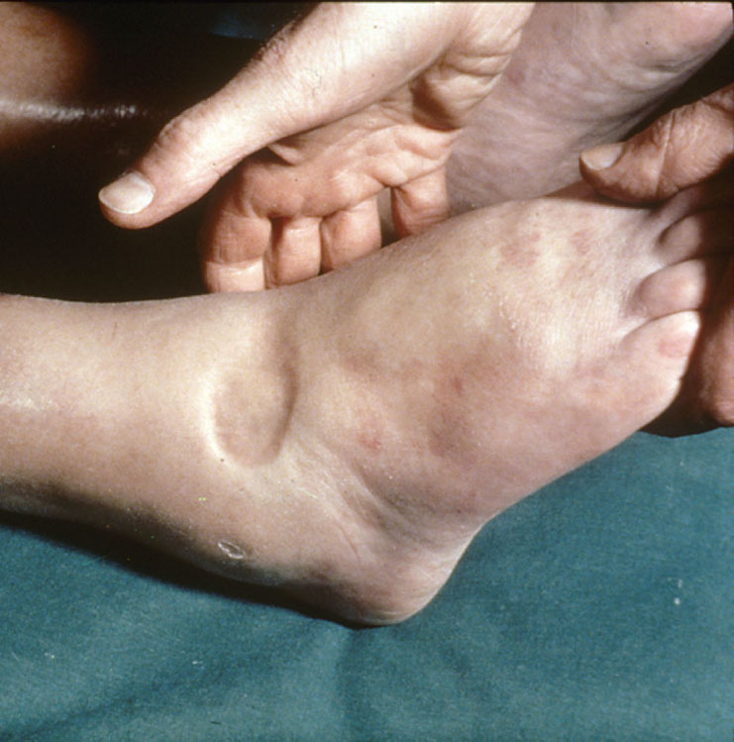
Manifestations of thiamine deficiency
Mild deficiency: leads to
Gastrointestinal complaints
Weakness.
2. Moderate deficiency:
Wernike korsacoff , syndrome
Peripheral neuropathy.
Mental abnormalities.
3. Severe thiamin deficiency
A. Beriberi
Dry beriberi is characterized by advanced neuromuscular symptoms:
Atrophy and weakness of the muscles
Peripheral neuropathy
Memory loss.
Wet beriberi: the previous symptoms (dry beriberi) are coupled with oedema.
B. Wernike korsacoff , syndrome

Slide 10
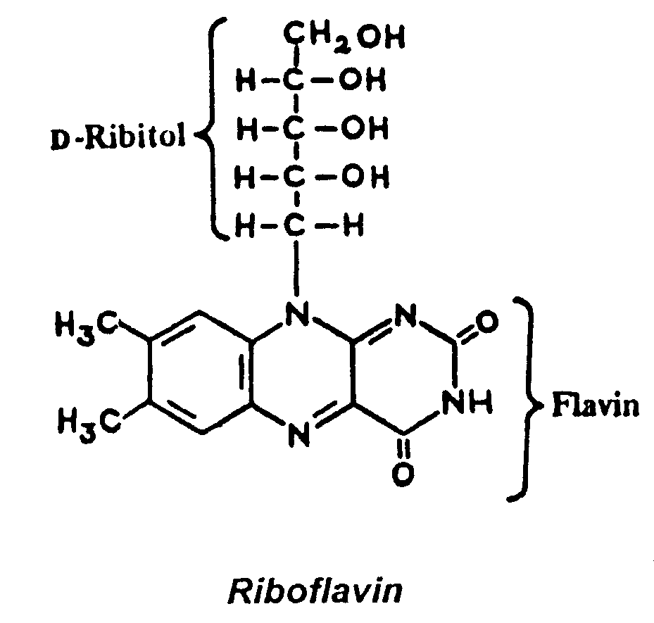
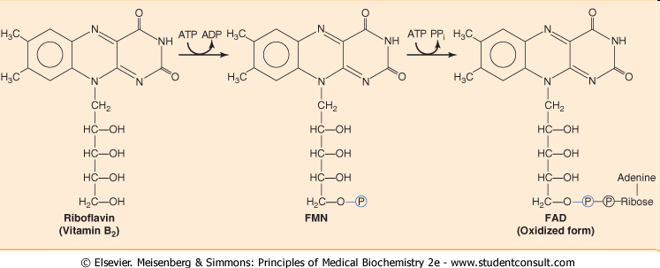
Riboflavin (B 2)
Chemistry: It consists of a flavin ring attached to the sugar alcohol D- ribitol.
Co enzyme forms
Flavin mononucleotide (FMN) is formed by ATP-dependent phosphorylation of riboflavin.
Flavin adenine dinucleotide (FAD) is synthesized by a further reaction with ATP in which the AMP moiety of ATP is transferred to FMN. Biosynthesis of FMN and FAD occurs in most tissues.

Slide 11
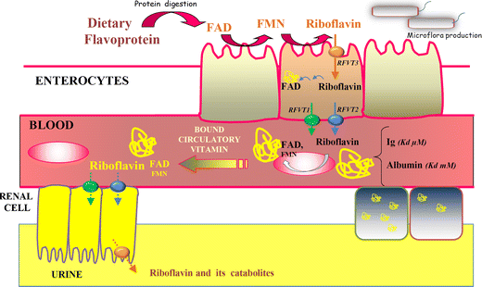
Absorption
In diet, riboflavin (RF) exists in the free and FMN and FAD forms. They are hydrolyzed to free Rf by intestinal phosphatases.
RF absorption in the intestines involve a speciﬁc carrier-mediated mechanism for Rf uptake located at the apical membrane & across the BLM.
Both RFT-1 (RF transporter1) and RFT-2 are expressed in intestine.
RFT-3 is more brain- speciﬁc.
Riboflavin in blood associates with albumin or globulins.

Slide 12
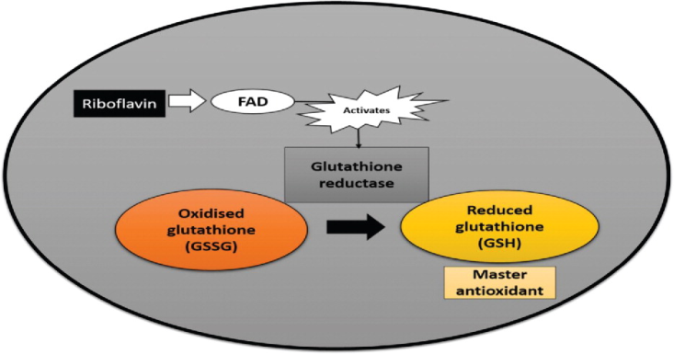
Sources
Animal origin: liver and beef, milk, dairy products, fish, eggs, nuts
Yeast
Plant origin: Green leafy vegetables, nuts, of smaller quantities in cereals.
Function:
Involved in energy metabolism (ATP production): Participate in
Oxidative decarboxylation
Citric acid cycle
Beta-oxidation of fatty acids
Electron transport
Associated with antioxidant glutathione reductase (utilizes an FAD prosthetic group and NADPH to reduce GSSG to two GSH.)
GS–SG + NADPH + H⁺ → 2 GSH + NADP⁺

Slide 13
1. Chemical structure of vitamin B2 is ……..
[flavin + ribitol ], fluorescent, light sensitive, heat stable.
2. Active form (Co-enzyme) of vitamin B2 is ……..
[FMN & FAD]
3. Its function is to act as ………
[prosthetic groups of oxidoreductases]
4. Reactions requiring FAD are:
a- [oxidative decarboxylation of a keto acids as PDH Energy (ATP)
b- [C.A.C.] Energy (ATP)
c- [ β -oxidation of F.A.] Energy (ATP)
2H
FMN FMNH2
FAD FADH2

Slide 14
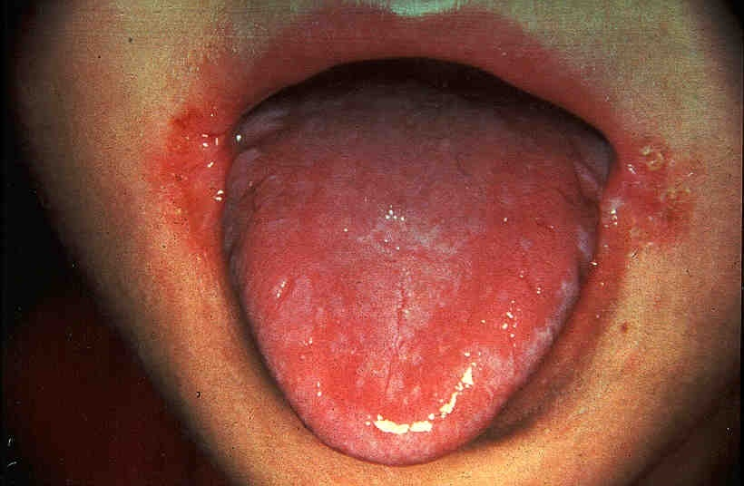
symptoms of deficiency
Related to Energy production (skin & mucous membrane inflammation).
Glossitis & angular stomatitis (Inflammation of the lining of mouth and tongue).
Keratitis , dermatitis (Dry and scaling skin).
Cheilosis (cracked and red lips).
Ocular manifestations (vascularization of cornea)
N.B. :
Deficiency occurs in newborn infants with hyperbilirubinemia who are treated by phototherapy.

Slide 15
Niacin (B 3)
Niacinamid (nicotinamide)
Niacin (nicotinic acid)
Chemistry:
Nicotinic acid is a carboxylic acid derivative of pyridine.
Synthesis: PLP (vit. B6)
Tryptophan →→ → →→→→ Niacin (vit. B3) (insufficient)
most people require dietary sources of both tryptophan and niacin.
Sources:
Food stuffs containing nicotinic acid: as B₁
Tryptophan containing proteins
Functions: niacin required for the synthesis of NAD⁺ (nicotinamide adenine dinucleotide) and NADP⁺ (nicotinamide adenine di-nucleotide phosphate)
NAD⁺ and NADP⁺ are coenzymes of many oxidoreductase enzymes.
Generally, NAD⁺-linked dehydrogenases catalyze oxidoreduction reactions in oxidative pathways, e.g. the citric acid cycle.
Whereas NADP⁺-linked dehydrogenases are often found in pathways concerned with reductive synthesis e.g. the pentose phosphate pathway.
NAD⁺+ AH₂ ⎯⎯⎯⎯→ NADH + H⁺ + A

Slide 16
Structure of NAD+
NAD⁺ NADH+H⁺
NADP⁺ NADPH+H⁺
Nicotinamide Adenine
Ribose—P-------—---P----Ribose
AMP
Nicotinamide Adenine
Ribose—P-------—---P----Ribose-P
AMP + P

Slide 17
reduction of NAD+
+
2H = H + e + H+
NAD+
R
H
CONH2
e
NADH + H+
N
R

Slide 18
Reactions requiring NAD+ are:
a- [oxidative decarboxylation of a keto acids as PDH] Energy (ATP)
b- [C.A.C.] Energy (ATP)
c- [β oxidation of F.A.] Energy (ATP)
Reactions requiring co-enzyme NADP+ as:
Glucose-6-phosphate dehydrogenase (NADP+)
Folate reductase (NADPH+H+)
intestinal niacin absorption process: intracellular protein-tyrosine-kinase-mediated pathway regulates vitamin uptake.

Slide 19
Deficiency
Causes of deficiency:
- in elderly on very restricted diet.
- malabsorption.
- in maize-dependant population.
- in vit. B6 def.
- Hartnup disease (decreased tryptophan absorption)
- Malignant carcinoid syndrome (increased tryptophan metabolism to serotonin)
- INH (anti-TB) (decreased B6)
Clinical use: Treatment of hyperlipidemia

Slide 20
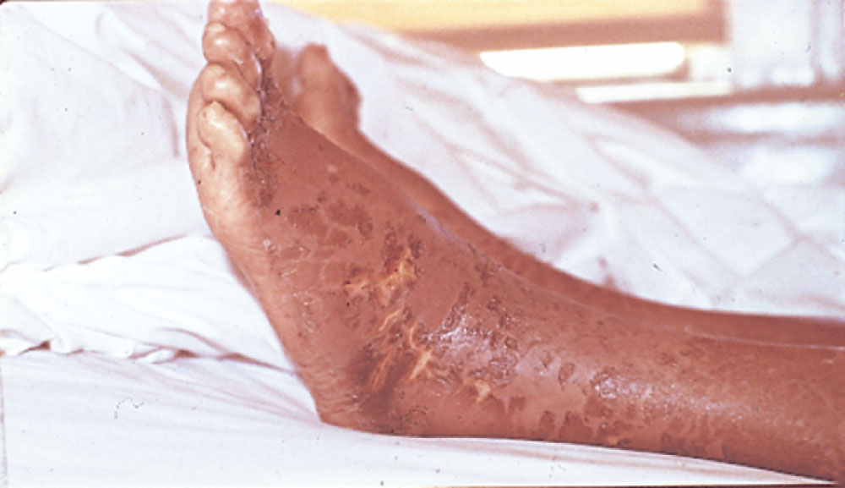
Deficiencies found in southeast if subsisting on diet of corn ; niacin is bound by protein. Pelagra is very rare now
Deficiency:
Milder deficiencies of niacin cause:
Poor appetite, fatigue.
Dermatitis, Diarrhea.
Severe deficiencies lead to pellagra which is characterized by “the four D_{S}”: dermatitis, diarrhea, dementia (lack of concentration) and death.
Dermatitis is usually seen in skin areas exposed to sun light and is symmetric.
The neurologic symptoms start by nervous disorders and mental disturbances.

Slide 21
Pantothenic acid (B 5)
Absorption
- For the intestinal cells to absorb pantothenic vitamin, it must be
converted into free pantothenic acid.
- Free Pantothenic acid and Biotin are absorbed into intestinal cells
via a saturable, sodium-dependent active transport system. [Sodium-
dependent multivitamin transporter (SMVT)]
- At high levels of intake, when this mechanism is saturated, some
pantothenic acid may also be absorbed via passive diffusion. As intake
increases 10-fold, however, absorption rate decreases to 10%.

Slide 22
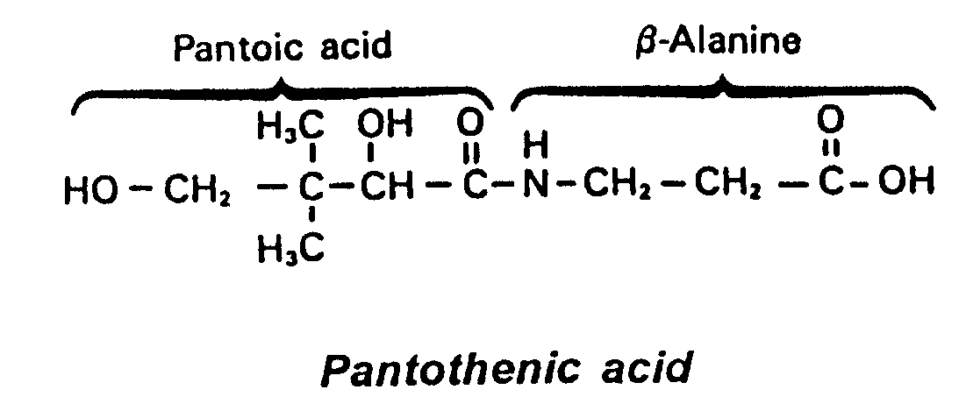
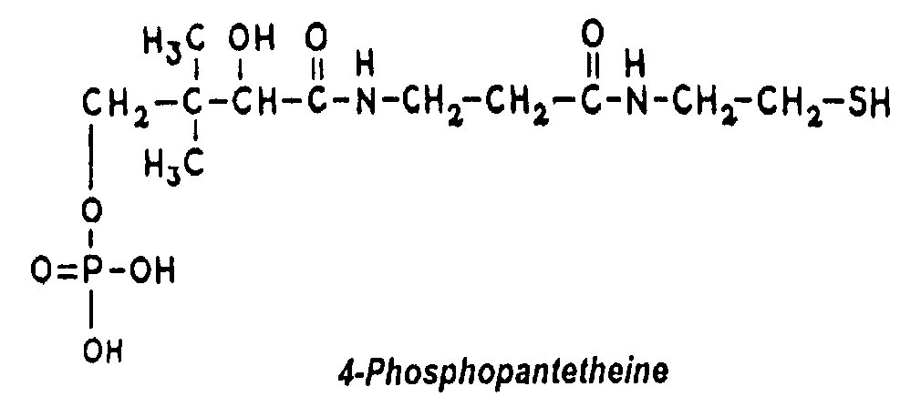
1. Chemical structure is …….. [Pantoic & β- Alanine ]
2. Active pantothenic acid is ……….. [ 4-phosphopantotheine ]
3. Active form enters in the structure of ……
CoASH = 4-phosphopantotheine + AMP
ACP; acyl carrier protein
4. Its active group is: ……. [ Thiol group ]
5. Its function as is: [ Carrier of acyl radicals ]. coenzyme A used in energy metabolism

Slide 23
Adenine Thioethanolamine
¦ ¦
Ribose — P — P — Pantothenic acid
AMP
6- Sources are: [as B1 ]
7- Reactions requiring CoASH:
a- oxidative decarboxylation of a keto acids Energy.
b- oxidation of Fatty acid
e- acetylating reactions as acetyl choline.
8- Reaction requiring ACP is : [ Fatty acids synthesis ]
Destruction: Easily destroyed by food processing.
Functions: Part of coenzyme A used in energy metabolism.
Deficiency: rare because it is very widespread in natural food.
Nausea, vomiting. -Easy fatigability. -Dermatitis.
Depression, neurological symptoms (disorders of the synthesis of acetylcholine). Numbness, muscle cramps, inability to walk.
Burning foot syndrome (severe burning and excessive sweating).
Structure of Co-ASH

Slide 24
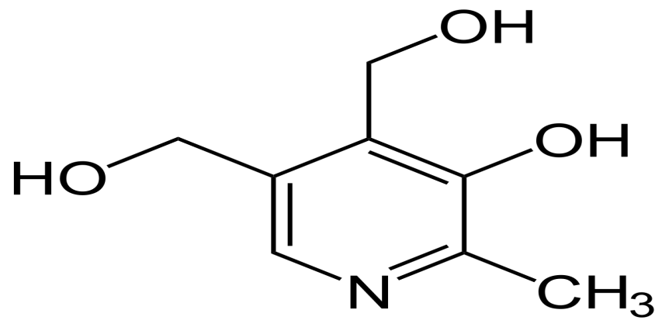
Pyridoxine (B 6)
Chemistry:
- It is a water soluble vitamin
- A pyridoxine derivative
Consists of 3 closely related compounds equally effective as precursors
of its coenzyme PLP (pyridoxal phosphate)
- Pyridoxine (alcohol)
- Pyridoxal (aldehyde)
- Pyridoxamine (amine)
- Pyridoxamine is mostly present in plants
- Pyridoxal & pyridoxine is present in animal foods
- Pyridoxine can be converted into pyridoxal & pyridoxamine
- Pyridoxal phosphate (PLP) is the active form of Pyridoxine
- PLP is synthesized by pyridoxal kinase, utilizing ATP

Slide 25
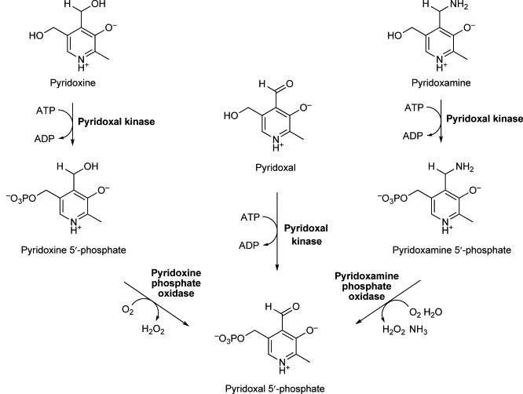

Slide 26
Metabolism
Absorption: It occurs in proximal jejunum by passive diffusion
- In the mucosal cells, all forms of pyridoxine is converted into pyridoxal
- Transport: It transported in the circulation bound to albumin
- Storage: It is stored in the tissues as its coenzyme form, PLP
- Mainly stored in liver, brain, kidney & muscle
Excretion: 4 – pyridoxic acid excreted in urine
Biochemical functions
- PLP is the coenzyme of B6 is found attached to ε –amino group of
lysine in the enzyme
- PLP is associated with Amino acid metabolism
- PLP is involved in:
1- Transamination 2- Decarboxylation 3- Deamination
4- Transsulfuration 5- Condensation

Slide 27
Transamination
PLP is involved in transamination reaction converting amino acids to
keto acids
- Keto acids enter the TCA cycle and get oxidized to generate energy
During transamination, PLP interacts with amino acids to form Schiff
base
The amino group is handed over to PLP to form Pyridoxamine
phosphate and ketoacid is liberated.

Slide 28
Decarboxylation
- α - Amino acids undergo decarboxylation to form respective amines
- The reaction is carried out by decarboxylases which require PLP
1- Serotonin produced from tryptophan is important in nerve impulse
transmission. It regulates sleep, behavior, blood pressure.
Decarboxylase PLP
Tryptophan 5-HydroxyTryptophan 5-Hydroxytryptamine
CO2
2- Histamine is vasodilator lowering blood pressure
- It stimulates gastric HCl secretion and is involved in inflammation and
allergic reactions
3- Glutamate on decarboxylation gives GABA which inhibits
transmission of nerve impulses
Decarboxylase, PLP
Histamine Histidine
CO2
Decarboxylase, PLP
Glutamate GABA
CO2

Slide 29
- PLP Plays an important role in metabolism of sulfur containing A.A.s
Transsulfuration from homocysteine to serine occurs in the synthesis of
cysteine
- PLP dependent enzyme cystathionine synthase
- Deamination of hydroxyl group containing A.A.s requires PLP
PLP, dehydratase
Serine Pyruvate + NH3
- Synthesis of serine from glycine require PLP.
Glycogen phosphorylase contains PLP for converting glycogen to
glucose 1-phosphate
- PLP is needed for the absorption of amino acids from intestine
- B6 is useful to prevent urinary stone formation

Slide 30
RDA (Recommended Dietary allowance) of vitamin B 6
- Adult men – 2 - 2.2 mg/day
- Adult women - 2.0 mg/day
- Pregnancy and lactation - 2.5 mg/day
Dietary sources:
- Animal sources: egg yolk, fish, milk, meat
Vegetable sources: wheat, corn, cabbage, roots & tubers
Deficiency
- Decreased dietary intake
- Alcoholism
- Impaired absorption
- Antivitamins: chronic administration of drugs such as isoniazid and
penicillamine
Clinical features
- Neurological manifestations due to B6 deficiency, serotonin,
epinephrine, norepinephrine and GABA are not produced properly

Slide 31
- The synthesis of niacin from tryptophan is impaired
Xanthurenic acid, produced in high quantities is excreted in urine and
can be used as reliable index of B6 deficiency
- Decreased Hb levels, associated with hypochromic microytic anemia
seen in B6 deficiency
Toxicity of B6
- Excess use of B6 (2.5 g/day) may lead to sensory neuropathy
- It is manifested by imbalance, numbness, muscle weakness and nerve
damage

Slide 32
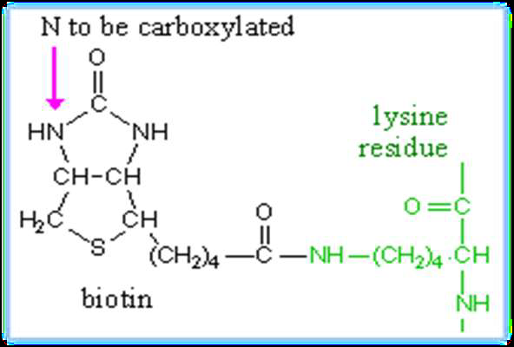
Biotin (B 7)
- It is formerly known as anti-egg white injury factor or vitamin H
- It is water soluble sulfur containing B-complex vitamin
- Biotin mainly participates in the carboxylation reactions
Chemistry
- It is a heterocyclic sulfur containing monocarboxylic acid
- Biotin is imidazole derivative formed by fusion of imidazole and
thiophene rings with a valeric acid side chain
- Biotin covalently bound to ε – amino group of lysine to form biocytin
Coenzyme form
- Biocytin is the coenzyme form of Biotin
- Biotin is a prosthetic group of carboxylase

Slide 33
Biochemical functions
- Biotin is required for carboxylation reactions
- Biotin is required for the enzymes
- Pyruvate carboxylase
- Acetyl CoA carboxylase
- Propionyl carboxylase
- β - Methyl crotonyl CoA carboxylase
- Pyruvate carboxylase catalyzes conversion of pyruvate to oxaloacetate
CO2, ATP, pyruvate carboxylase
Pyruvate Oxaloacetate
ADP+Pi Biotin, Mg++/Mn
- Acetyl CoA carboxylase catalyzes the formation of malonyl CoA from
acetyl CoA, the reaction provides acetate molecule for fatty acid
synthesis
CO2, ATP, Acetyl CoA carboxylase
Acetyl CoA Malonyl CoA
ADP+Pi Biotin, Mg++/Mn

Slide 34
- Propionyl CoA carboxylase catalyzes the formation of D – Methyl
malonyl CoA from propionyl CoA(from odd chain FA & methionine)
- It required for entry of Propionyl CoA to TCA cycle via succinyl CoA
CO2, ATP, propionyl CoA carboxylase
Propionyl CoA D – Methyl malonyl CoA
ADP+Pi Biotin, Mg++/Mn
- β - Methyl crotonyl CoA carboxylase catalyzes the formation of β –
Methylglutaconyl CoA from β - Methyl crotonyl CoA
- It is essential for leucine catabolism
CO2, ATP, β - Methyl crotonyl CoA carboxylase
β - Methyl crotonyl CoA β – Methylglutaconyl CoA
ADP+Pi Biotin, Mg++/Mn
- Not all carboxylation reactions in the biological system are biotin
dependent, few carboxylation reactions which do not require biotin
- Formation of carbamoyl phosphate in urea cycle
- Incorporation of CO2 in purine synthesis

Slide 35
Dietary sources
- Rich sources are eggs, liver, kidney, & yeast, pulses, nuts, vegetables
- Poor sources are cereals & dairy products
RDA
- Adults - 200 – 300 mg/day
Deficiency
- Biotin deficiency is generally not seen in man because of
1- Its wide distribution in foods
2- Synthesis of vitamin by the bacterial flora in the gut
Clinical features
- Severe dermatitis, weakness, & nausea
- In animals muscle weakness, dermatitis & loss of hair around the eye

Slide 36
- Avidin-biotin system is commonly utilized for detection of
pathogenesis in ELISA test
- DNA is generally labelled by radioactive nucleotides
- Recently, biotin labelling of DNA is becoming more popular
- Biotin is added to nucleotides, which will be incorporated into the
newly synthesized DNA
- The fixed biotin can be identified by reaction with Avidin
- Intake of 20 raw eggs/day will produce Biotin deficiency in humans
- Prolonged use of antibacterial drugs such as sulfonamides

Slide 37
Biotin antagonists
- Avidin ( Raw egg white injury factor)
- Raw egg white injury factor is a heat labile protein known as avidin
and is present in raw egg white
- Avidin binds to biotin & makes its unavailable for absorption
- Avidin is inactivated by boiling the eggs & biotin is readily absorbed
when boiled eggs are used in the diet
- One molecule of avidin can combine with four molecules of biotin
- Egg white contains Avidin & egg yolk contains biotin
- The affinity of Avidin to biotin is greater than most of the usual
antigen-antibody reactions

