Slide 1
Diet, nutrition and Cardio Vascular Diseases
Faculty of Medicine
Mutah University
2021

Slide 2
Contents
Diet and cardiovascular disease
Fatty acids and dietary cholesterol
Dietary fibre
Sodium and potassium
Food items and food groups
Dietetic measures aimed at reducing the risk of CVD

Slide 3
Introduction
The second half of the 20th century has witnessed major shifts in the pattern of disease, in addition to marked improvements in life expectancy.
This period is characterized by profound changes in diet and lifestyles that contributed to an epidemic of non-communicable diseases NCDs.
This epidemic is now emerging, and accelerating, in most developing countries, while infections and nutritional deficiencies are decreasing as leading contributors to death and disability.

Slide 4
Introduction
Cardiovascular disease (CVD) remains the leading cause of morbidity and mortality worldwide, accounting for approximately one third of all deaths .
Poor diet is one of the major risk factors for CVD, with approximately 72% of CVD deaths attributable to this risk factor.
Healthy dietary patterns and lifestyles are effective for the prevention of CVD.

Slide 5
Classes of Nutrients
• Macronutrients :
Carbohydrates
Proteins
Fats
• Micronutrients
Vitamins
Minerals
Water

Slide 6
Carbohydrates
The types and quantity of carbohydrate consumed are important determinants of CHD health effects.
- Simple (e.g., glucose, fructose, galactose, sucrose, lactose, lactulose)
- Complex (e.g., starch, cellulose, hemicellulose, glycogen).
Specific factors that determine the health effects of high-carbohydrate foods include:
- dietary fiber content, glycemic index (GI) and glycemic load (GL), and the extent of processing (i.e., refined grains versus whole grains).
A glycemic load of 20 or more is high, 11-19 is medium, and <=10 is low.
For good health, choose foods that have a low or medium glycemic load, and limit foods that have a high glycemic load

Slide 7
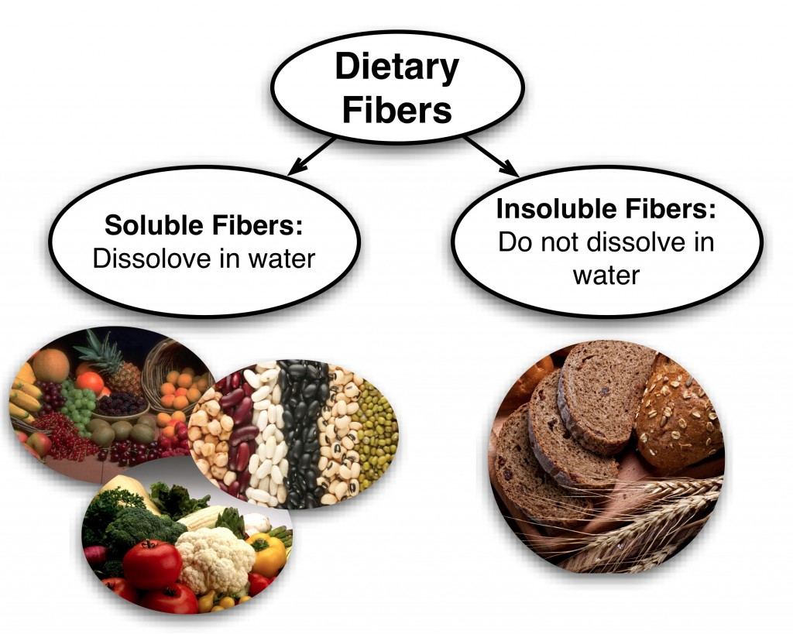
Dietary fiber
Dietary fibers is a heterogeneous mixture of polysaccharides and lignin that cannot be degraded by the endogenous enzymes of vertebrate animals.
Water-soluble fibers include pectin's, gums, and some hemicelluloses.
Insoluble fibers include cellulose and other hemicelluloses.

Slide 8
Dietary fiber
Several large cohort studies carried out in different countries have reported that a high fiber diet + a diet high in whole grain cereals lowers the risk of coronary heart disease.
Most fibers reduce plasma total and LDL cholesterol, as reported by several trials.

Slide 9
Fats
TYPES OF FAT:
Classifications of fats is defined by:
1. The degree of unsaturation:
(e.g., saturated, monounsaturated (MUFAs), polyunsaturated (PUFAs)
2. The type of double bond
(e.g., omega[n]-3 or omega[n]-6)

Slide 10
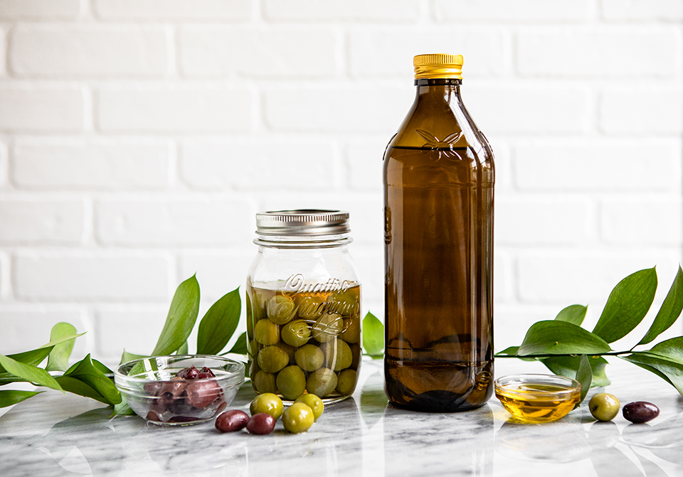
Fatty acids and dietary cholesterol
The only nutritionally important mono-unsaturated fatty acids is oleic acid, → olive and canola oils and also in nuts.
The most important poly-unsaturated fatty acid is linoleic acid →in soybean and sunflower oils.

Slide 11
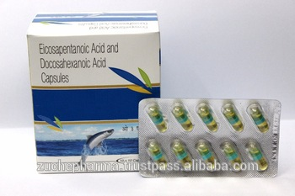
Fatty acids and dietary cholesterol
The most important n-3 PUFAs are :
two acids (eicosapentaenoic acid and docosahexaenoic acid) found in fatty fish ,
œ-linolenic acid found in plant foods (walnut, soybeans).

Slide 12
Fatty acids and dietary cholesterol
Partial hydrogenation, the process used to increase shelf-life of polyunsaturated fatty acids (PUFAs):
creates trans fatty acids (geometrical isomers that adapt a saturated fatty acid-like configuration.)
removes the critical double bonds in essential fatty acids necessary for the action.

Slide 13
Fatty acids and dietary cholesterol
The most effective replacement for saturated fatty acids in terms of coronary heart disease outcome are polyunsaturated fatty acids, especially linoleic acid.
Replacement of saturated and trans fatty acids by polyunsaturated vegetable oils lowered coronary heart disease risk

Slide 14
Fatty acids and dietary cholesterol
Trans fatty acids makes the plasma lipid profile more atherogenic than saturated fatty acids, by :
Elevating LDL cholesterol to similar levels
Decreasing high density lipoprotein (HDL) cholesterol.
Intake of trans fatty acids increases the risk of coronary heart disease .

Slide 15
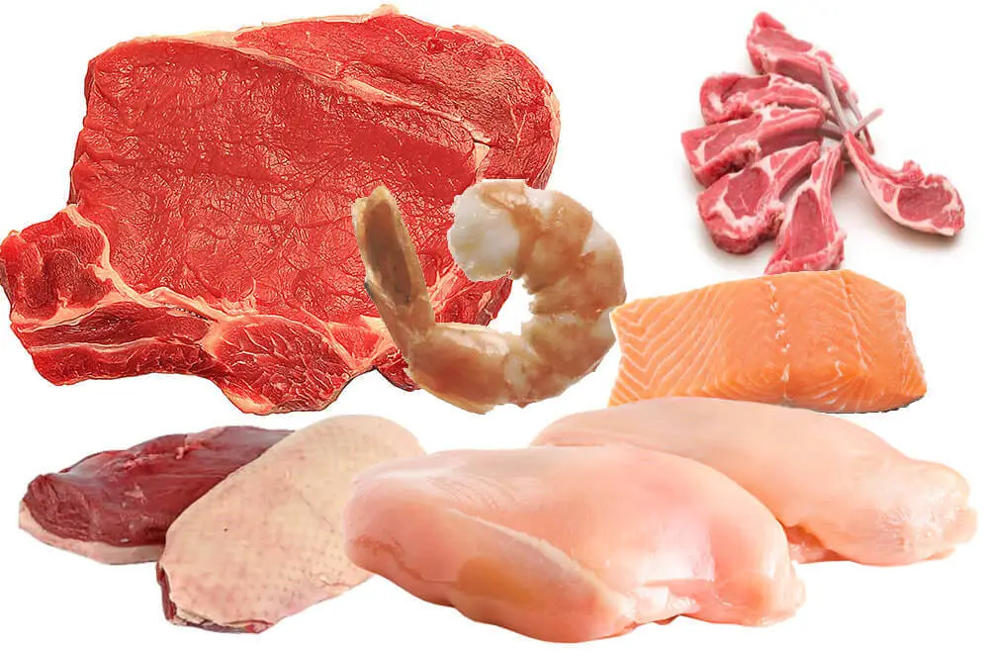
Fatty acids and dietary cholesterol
Cholesterol in the blood and tissues is derived from two sources: diet and endogenous synthesis.
Dairy fat and meat are major dietary sources of Cholestrol.
Egg yolk is particularly rich in cholesterol but unlike dairy products and meat does not provide saturated fatty acids.

Slide 16
Sodium and potassium
High blood pressure is a major risk factor for coronary heart disease and both forms of stroke (ischemic and hemorrhagic).
Of the many risk factors associated with high blood pressure, the dietary exposure that has been most investigated is daily sodium intake.

Slide 17
Fruits and vegetables
Numerous studies have reported a significant protective association for coronary heart disease and stroke with consumption of fruits and vegetables.

Slide 18
Fish consumption:
Fish consumption is associated with a reduced risk of coronary heart disease.

Slide 19
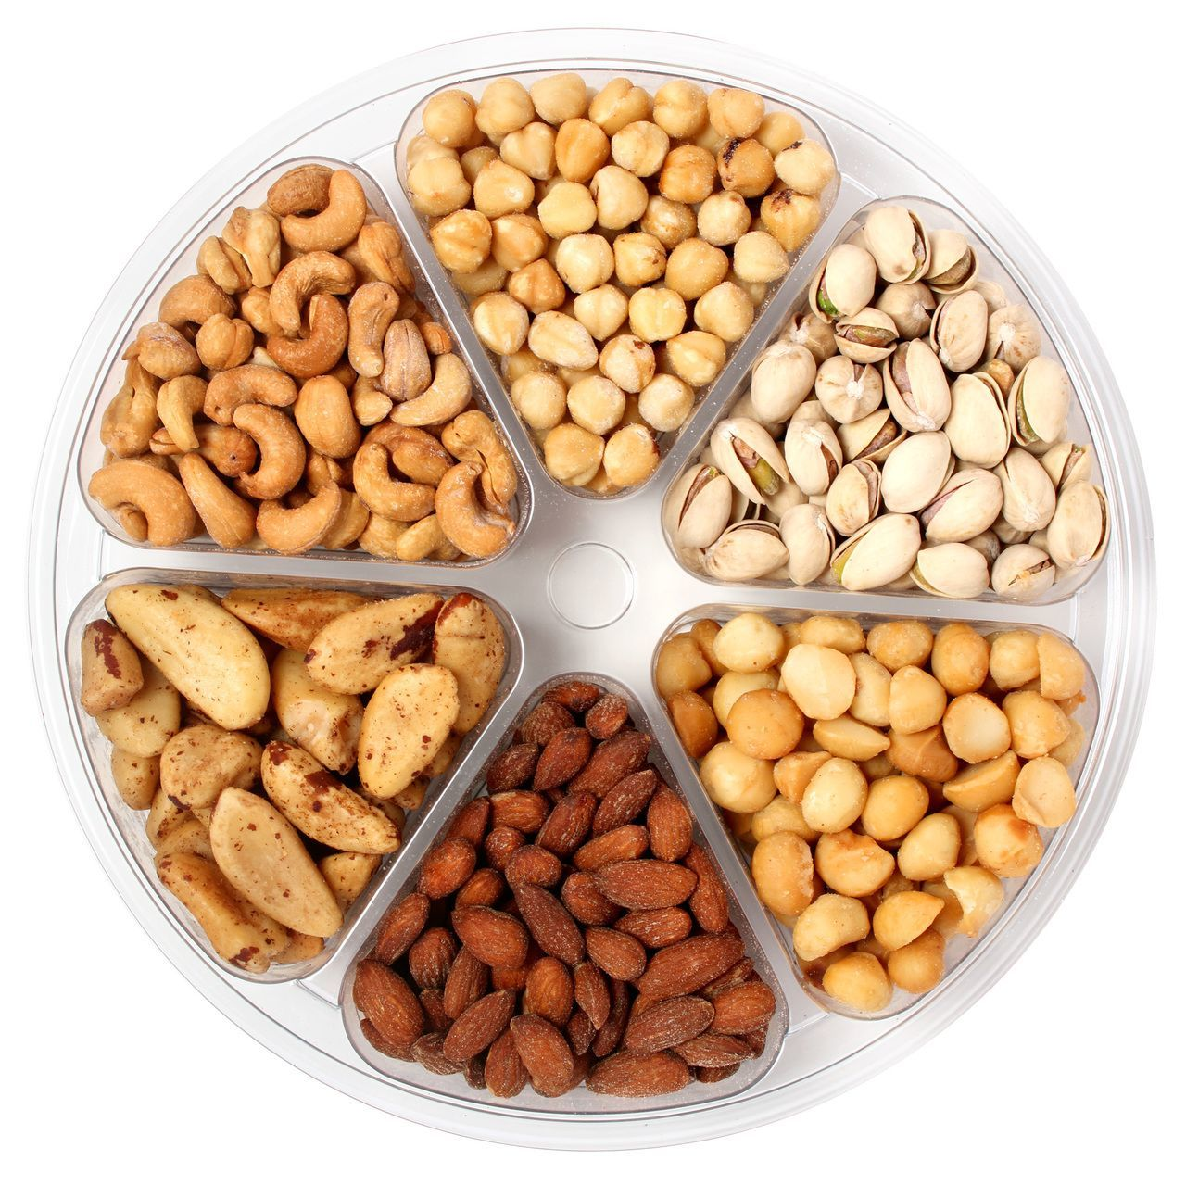
Nuts
Several studies have demonstrated that frequent consumption of nuts was associated with decreased risk of coronary heart disease.
Nuts are high in unsaturated fatty acids and low in saturated fats, and contribute to cholesterol lowering by altering the fatty acid profile of the diet as a whole.
However, because of the high energy content of nuts, advice to include them in the diet must be adjusted in accordance with the desired energy balance.

Slide 20
Boiled, unfiltered coffee:
It raises total and LDL cholesterol because coffee beans contain a terpenoid lipid called cafestol.
The amount of cafestol in the cup depends on the brewing method: it is zero for paper-filtered drip coffee, and high in the unfiltered coffee (still widely drunk).

Slide 21
Coffee
In Greece, the Middle East and Turkey. Intake of large amounts of unfiltered coffee markedly raises serum cholesterol and has been associated with coronary heart disease.
A shift from unfiltered, boiled coffee to filtered coffee has contributed significantly to the decline in serum cholesterol in Finland

Slide 22
Patterns of diets:
DASH Diet: (Dietary Approaches to Stop Hypertension)
High in vegetables, fruits, low-fat fermented dairy products,
whole grains, poultry, fish, and nuts;
Low in sweets, sugar-sweetened beverages, and red meats;
Low in saturated fat, total fat, and cholesterol;
Rich in potassium, magnesium, and calcium;
Rich in protein and fiber.
Significant reductions in total/LDL cholesterol and estimated CHD risk
Mediterranean Diet:
Plenty of plant foods
Minimal red and processed foods
Substituted lower-fat or fat-free dairy products for higher-fat dairy foods;
Olive oil as main lipid source,
Low-moderate consumption of wine with meals
Evidence :Lower serum triglycerides, cholesterol, and systolic/diastolic blood pressure

Slide 23
Recommendations

Slide 24
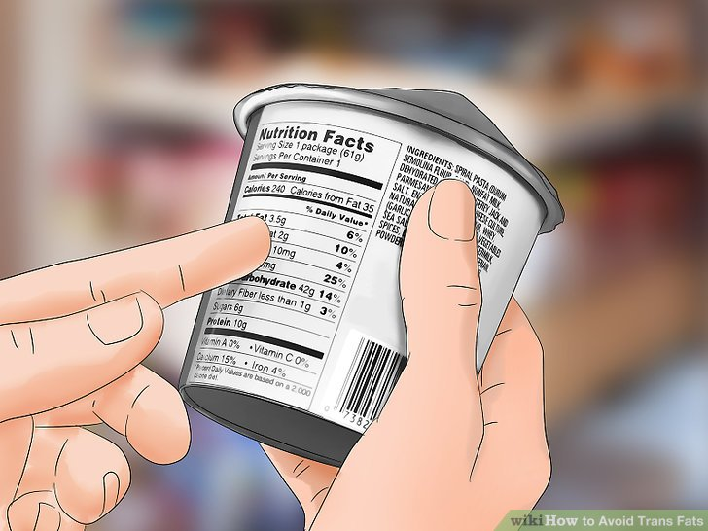
Measures aimed at reducing the risk of CVD :
The traditional target is to restrict the intake of saturated fatty acids to less than 10%, of daily energy intake and less than 7% for high-risk groups.

Slide 25
Measures aimed at reducing the risk of CVD:
Diets should provide a very low intake of trans fatty acids (hydrogenated oils and fats) or better avoiding their use in cooking.
Limiting the intake of fat from dairy and meat sources.

Slide 26
Measures aimed at reducing the risk of CVD:
Using appropriate edible vegetable oils in small amounts,
Ensuring a regular intake of fish (one to two times per week) or plant sources of a-linolenic acid.
Preference should be given to food preparation that use non-frying methods.

Slide 27
Measures aimed at reducing the risk of CVD:
Daily intake of fresh fruit and vegetables in an adequate quantity (400--500 g per day), is recommended to reduce the risk of coronary heart disease, stroke and high blood pressure.
80g of fresh→ 1 portion
30g of dried fruit→ 1 portion

Slide 28
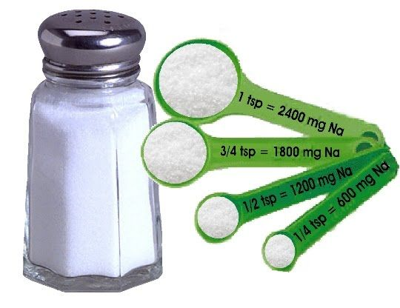
Measures aimed at reducing the risk of CVD:
Sodium
Should be limited
Intake of no more than 70 mmol or 1.7 g of sodium per day is beneficial in reducing blood pressure.

Slide 29
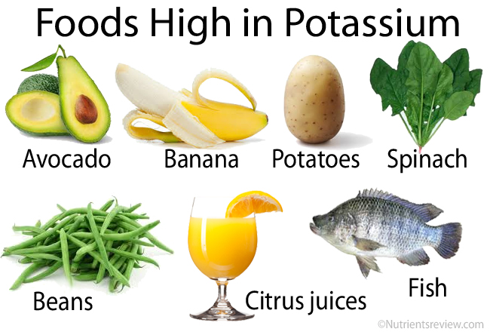
Potassium
Potassium intake should be at a level which will keep the sodium to potassium ratio close to 1.0, i.e. a daily potassium intake level of 70--80 mmol per day.

Slide 30
Dietary fiber
Fibre is protective against coronary heart disease and has also been used in diets to lower blood pressure.
Adequate intake may be achieved through fruits, vegetables and whole grain cereals.
30-45 g/day

Slide 31
Fish
Regular fish consumption (1-2 servings per week) is protective against coronary heart disease and ischaemic stroke and is recommended.
People who are vegetarians are recommended to ensure adequate intake of plant sources of œ-linolenic acid.

Slide 32
Unhealthy dietary practices include:
The high consumption of saturated fats, salt and refined carbohydrates,
Low consumption of fruits and vegetables.
These tend to cluster together.

Slide 33
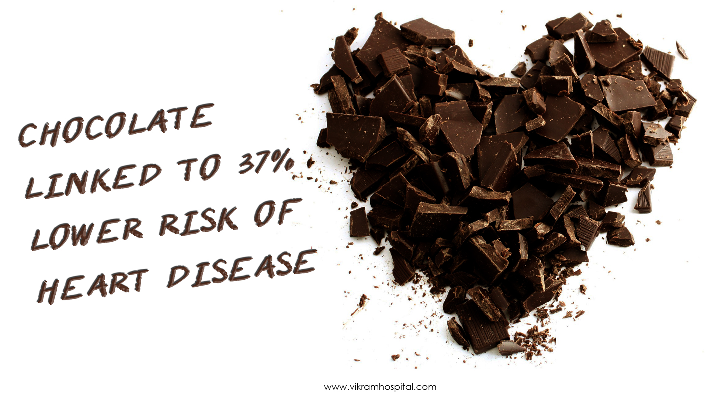
For updates: https://link.springer.com/article/ https https://link.springer.com/article/10.1007%2Fs11883-018-0704-3 10.1007%2Fs11883-018-0704-3
THANK YOU

