Slide 1
Metabolic Acidosis and RTA
Supervised by : Dr. Salma Ajarmeh
By : Islam Al Banawi
Meera Abualsoud
Asala Qudah
Rahaf Nawaiseh

Slide 2
Acid-Base Balance
Islam Al Banawi

Slide 3
Normal serum electrolyte and arterial blood gas values (ABG values) :
.pH 7.35-7.45
.HCO₃⁻ 22-26mmol/L (Av. 24 mmol/L)
.pO₂ 80-100mmHg
.pCO₂ 35-45 mmHg (Av.40 mmHg)
.Cl⁻ 96-106 mmol/L
.K⁺ 3.5-5 mmol/L
.Na⁺ 135-145 mmol/L

Slide 4
Mechanisms of regulation of pH :
-First line of defence: Buffers (instantaneous)
-Second line of defence: Respiratory regulation (6-24hr)
-Third line of defence: Renal regulation (24h-5days)
Renal regulation is supplemented by: Liver

Slide 5
Role of Lungs in acid base balance :
-The lungs prevent an increase in the Pco2 in the blood by excreting the CO2 that the body produces the rapid pulmonary response (usually within 6 to 24 hours) to changes in the CO2 concentration occurs via central sensing of the Pco2 and a subsequent increase or decrease in ventilation to maintain a normal Pco2 (35-45 mm Hg).
-An increase in ventilation decreases the Pco2, and a decrease in ventilation increases the Pco2.

Slide 6
Role of kidney in acid base balance :
-Kidney regulates acid base homeostasis by 3 mechanisms:
Proton secretion
Bicarbonate reabsorption
Bicarbonate generation
Acidosis → H⁺ secreted → acidic urine
Alkalosis → HCO₃⁻ excreted → alkaline urine

Slide 7
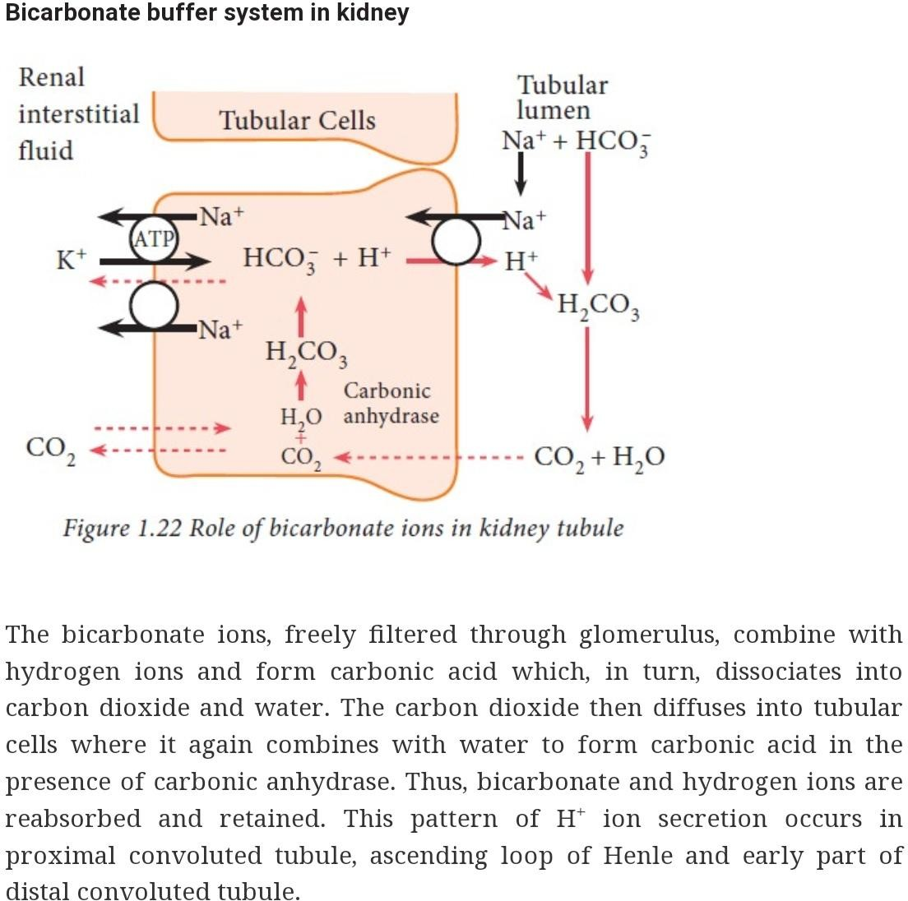

Slide 8
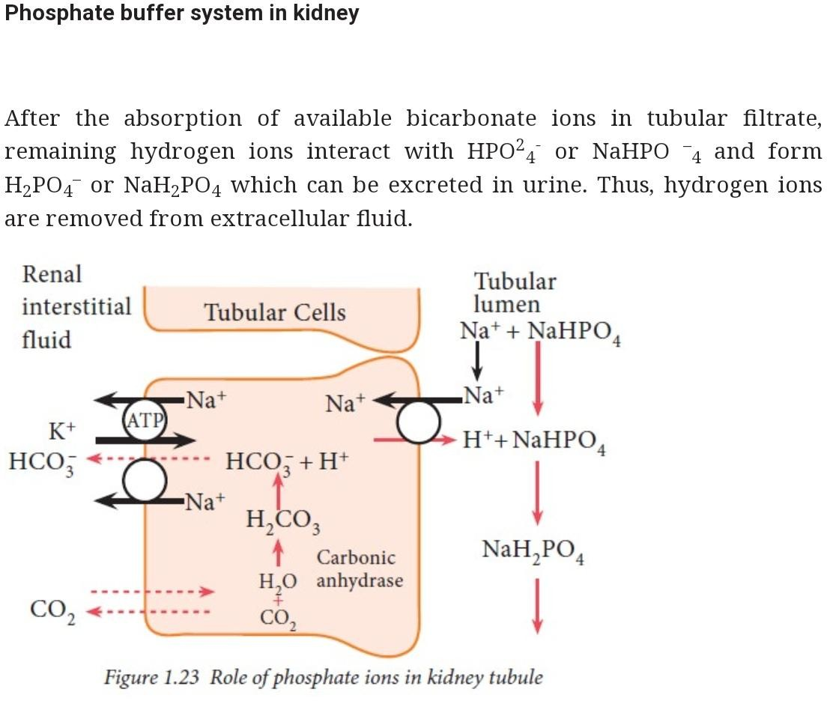

Slide 9
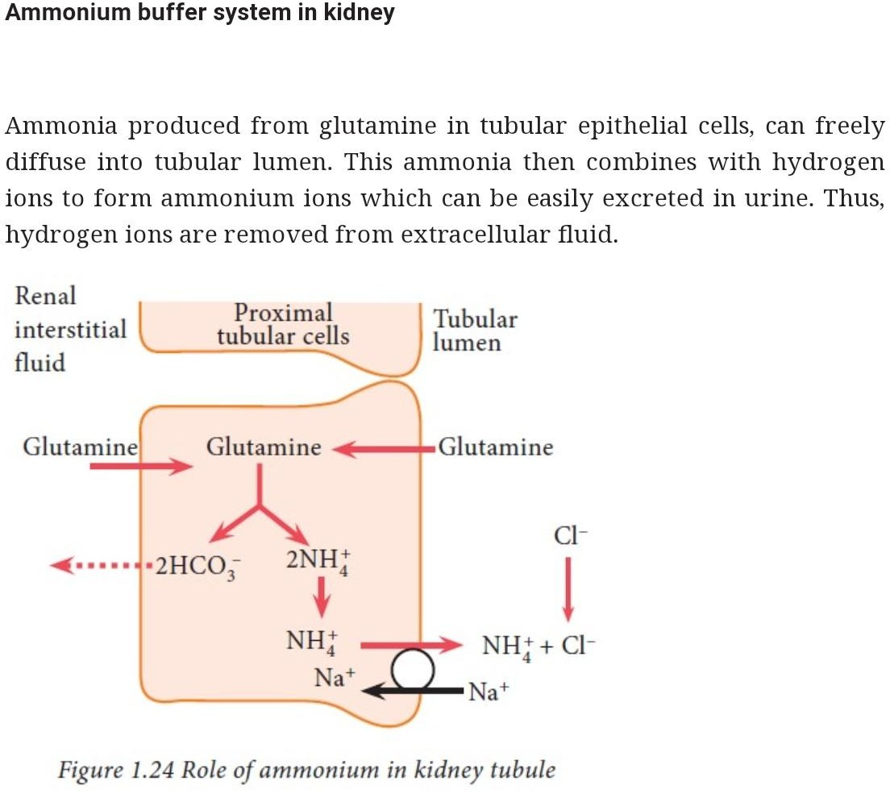

Slide 10
Clinical assessment of acid-base disorder
-Acidemia is a pH below normal (<7.35), and alkalemia is a
pH above normal (>7.45).
-Acidosis is a pathologic process that causes an increase in the hydrogen ion concentration, and alkalosis is a pathologic process that causes a decrease in the hydro- gen ion concentration.
-A simple acid-base disorder is a single primary disturbance.

Slide 11
Anion gap
-Normally, [cations] =[anions] for electrical neutrality
-Plasma cations measured in lab are Na and K (contribute to 95%of total cations)
-Plasma anion measured in the lab are HCO3- and CL (contributes to 80% of total anion)
-Anion gap= difference between the concentration of measured cations and measured anion.
Represents the unmeasured anions in plasma.

Slide 12
- Unmeasured anions include protein, phosphate, sulfate, urate and organic acids
(Na+ + K+) – (Cl- + HCO3-) = Anion Gap.
-Normal anion gap is 8-12 mEq/L.

Slide 13
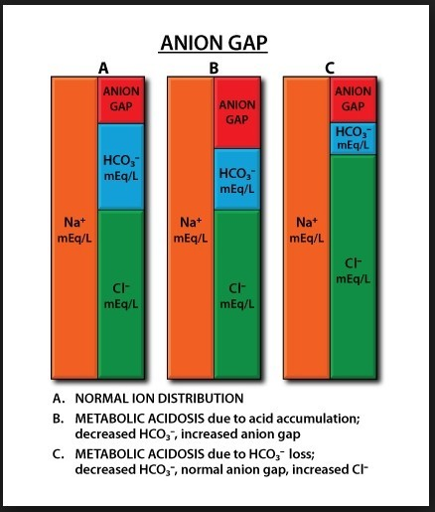

Slide 14
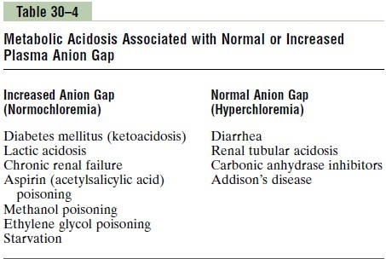

Slide 15
pH and plasma potassium :
-During acidemia, there may be exchange of H+ in blood
with K+ in ICF to maintain pH of blood.
-Therefore, acute acidosis >> hyperkalemia
acute alkalosis >>hypokalemia
When you try to correct acidosis, K+ may suddenly go
back to cells>> hypokalemia.
Hence, it is important to maintain potassium balance during correction of acidosis.

Slide 16
-Hypoalbuminemia can mask an increased concentration of gap ions andlowering the values of AG.
-Adjusted AG= AG +2.5*(normal albumin-actual albumin)
-A decrease in the albumin concentration of 1g/dl decrease the anion gap by roughly 4mEq/L.

Slide 17
Metabolic Acidosis Meera Abu Soud

Slide 18
Etiology :
increase acid concentration
Excess HCO٣ loss 3.Dilution of serum HCO3
concentrations by nonbicarbonate/ acetate/lactate-containing solutions
4.Mixed mechanisms
Metabolic acidosis is a biochemical abnormality defined by an :
increase in blood hydrogen ion (H+) concentration or a reduction in serum bicarbonate (HCO3) concentration.

Slide 19
Clinical Manifestations
The Clinical manifestations are related to the degree of acidemia .
Children with acute metabolic acidosis typically present with
symptoms related to the underlying
condition and may also have signs/symptoms of compensatory respiratory alkalosis.
Tachypnea and hyperpnea : most common manifestation of acute metabolic acidosis, due to respiratory
compensation mechanism.
Older children can exhibit an increase in respiratory rate and depth of respiration (eg,
(tachypnea)
Kussmaul respirations).
In young children and infants,
tachypnea
may be the only response to metabolic acidosis.

Slide 20
Neurologic findings – Mental confusion and lethargy have been observed in patients with severe acute metabolic acidosis, despite minor changes in cerebrospinal and brain pH
Chronic metabolic acidosis causes
failure to thrive
PH lower than 7.2 cause impaired cardiac contractility, increase risk of arrhythmias, especially if underlying heart disease or other electrolytes disorders
Acidemia cause
vasconstriction
of
pulmonary vasculature
, and there will be a decrease in the
cardiovascular response to
catecholamine
, that potentially exacerbate
hypotension
in children
with volume depletion or shock
Newborns and infants are
more vulnerable to developing metabolic acidosis
than are older
children and adults as they have a
lower kidney capacity for net acid excretion

Slide 21
Anion Gap
calculation of the anion gap us used to help know narrow differential diagnosis
AG=NA - (Cl+HCO٣)
Normal AG = 12 +/-2
And is made from phosphate, sulfates, organic acids, and negatively charged proteins

Slide 22
Classification of metabolic acidosis by AG
High anion gap metabolic acidosis
Non AG metabolic acidosis (hyperchlormic metabolic acidosis)
Metabolic acidosis with decrease AG

Slide 23
Metabolic Acidosis with high AG
The causes is remembred by the menmonic MUDPILES
M :Methanol U:Uremia
D:DKA, or alcoholic ketoacidosis، Drugs P:Paraldehyde
I:Ischemia, imIsonizide , Iron L:Lactic acidosis
E:Ethylene glycol (antifreeze) S:Starvation
Do evaluation of :
Serum ketons
Serum lactate
Toxicology screening
Salicylate level
Drugs as metformin and nucleoside reverse trancriptase inhibitor

Slide 24
Delta gap in patients with a high anion gap metabolic acidosis
The delta anion gap/delta
HCO3 ratio
usually between 1 and 1.6.
Higher than 1.6:
usually reflects a mixed acid-base disorder
Less 1:
ketoacidosis
D-lactic acidosis
early-stage chronic kidney disease
severe diarrhea
Another way to calculate delta-delta
Delta AG-delta HCO٣ =0+/- 5 range

Slide 25
Metabolic acidosis with normal AG
The menmonic for the most common causes is
HARDASS
H:Hyperalimentation A:Addisson disease R:Renal Tubular Acidosis
In this group, the increased anion is chloride with decreased HCO٣, so that the anion gap dose not change
Therefire, is somtimes reffered to as hyperchlormic acidosis
D:Diarrhea
A:Acetazolamide
S:Spironolactone S:Saline infusion
DURHAM menmonic U for ureteral diversion
M for miscellaneous (amphotericin B, toluene)

Slide 26
Urine Anion Gap
Determination of the urine AG may be useful if the etiology of the normal AG remains unclear. The urine AG is calculated from the following formula:
Urine AG = (Urine Na + Urine K) – Urine Cl
positive urine AG value indicates impaired ammonium excretion, such as is seen in distal (type 1) and hypoaldosteronism (type 4) renal tubular acidosis (RTA).
Conversely, a negative urine AG is consistent with intact urinary ammonium excretion as seen in children with metabolic acidosis due to proximal (type 2) RTA (with a very low serum total CO2 concentration) and gastrointestinal losses

Slide 27
Metabolic acidosis with decrease AG
Less common
Causes
Hypoalbuminemua
Multiple myloma
Ingestion of bromid and lithium

Slide 28
Respiratory Compensation
The body compensates by to createnen
hyperventilation
respiratory alkalosis
To know What if the respiratory compensation is adequate or not, we used
Winters formula
(just in primary metabolic acidosis)
Expected PCO٢=(1. 5 *HCO٣ +8) +/-2
If the actual CO٢ is within the range… respiratory compensation If not, there is another disorder
Actual less than expected…. Respiratory alkalosis Actual more than expected…. Respiratory acidosis

Slide 29
Laboratory Investigation & Findings
Metabolic acidosis is typically detected by a
low serum total carbon dioxide (CO2) in an electrolyte panel
bicarbonate (HCO3) concentration in a blood gas sample.
low
decrease
in
Partial pressure of carbon dioxide (PCO2) – The respiratory alkalotic compensation results in a the PCO2 concentrations
Hyperkalemia:For every decrease in the blood pH by 0.1, the serum potassium increases by 0.6 mEq/L.
Ionized calcium and magnesium – Ionized calcium and magnesium increased with increasing acidemia
Basic laboratory tests are : BUN, Creatinine, gloucose, urine analysis, serum electrolytes and ketones

Slide 30
Metabolic acidosis + hyperglycemia + ketonuria = DKA
Metabolic acidosis +ketosis = inborn errors of metabolism
Metabolic acidosis +hypoglycemia = liver failure or adrenal inssufficiency
Metabolic acidosis + normoglycemia +glycosuria =type 2//fanconi syndrome
Metabolic acidosis +Hyperkalemia +hyponatremia =sever aldosterone deficienciy or resistance

Slide 31
Treatment
Treat the underlying cause
Acute metabolic acidosis
IV sodium HCO3 for patients with impaired kidney acid excretion
Kidney replacement therapy — Dialysis and/or continuous kidney replacement therapy may be needed for treatment of severe, life-threatening metabolic acidosis unresponsive to medical therapy, especially if it is associated with other electrolyte abnormalities including hyperkalemia.
Chronic metabolic acidosis
— Children with chronic acidosis typically require consistent administration
exogenous oral alkali preparations to correct the acidosis, thereby preventing the clinical manifestations of chronic acidosis

Slide 32
RTA Asala Qudah

Slide 33
Renal tubular acidosis (RTA)
In RTA, there is a normal anion gap metabolic acidosis in patients with normal or almost normal renal function.
is caused by defects in the tubular transport of HCO₃⁻ and/or H⁺
May be inherited and persistent from birth or acquired, as is seen more commonly in clinical practice.

Slide 34
RTA Types:
Proximal RTA ( type 2 )
Classical distal RTA ( type 1 )
Hyperkalaemic distal RTA ( type 4 )
what about type 3 RTA (Mixed type) ?
Term inconsistently applied to a rare congintal deficiency of carboic anhydrase II, which result in features of both type 1 and type 2 RTA

Slide 35
Proximal renal tubular acidosis (type 2)
Type 2 renal tubular acidosis is characterized by a
dysfunctional proximal convoluted tubule (PCT) that is unable to reabsorb HCO3-.

Slide 36
 | Isolated proximal RTA | Fanconi syndrome
• • Pathophysiology • | The proximal convoluted tubule cells are unable to reabsorb HCO ₃⁻ leading to increased HCO₃⁻ excretion in the urine. H⁺ secretion from α-intercalated cells in the collecting duct can acidify the urine, but cannot compensate for the excessive HCO₃⁻ excretion in the urine, thus resulting in distal tubular acidosis.
 | • Only HCO₃⁻ reabsorption is impaired. | Impaired reabsorption of HCO₃⁻ and other compounds (e.g., potassium, glucose, phosphate, and amino acid reabsorption) in the PCT
• • Etiology ^{[3]} • | • Sporadic type 2 RTA (idiopathic) Familial type 2 RTA (inherited genetic defects) • Autosomal recessive disease (more common) • Autosomal dominant disease • Drugs: acetazolamide • • • • | Inherited disorders Cystinosis Tyrosinemia Galactosemia Type 1 glycogen storage disease Wilson disease Light chain nephropathy (e.g., multiple myeloma) Ischemia (acute tubular necrosis) Amyloidosis Vitamin D deficiency Paroxysmal nocturnal hemoglobinuria Drugs: ifosfamide, tenofovir, expired tetracyclines, aminoglycosides, cisplatin Heavy metal poisoning (e.g., lead, cadmium, mercury)

Slide 37
Clinical features
Vitamin D-resistant hypophosphatemic rickets/
osteomalacia (caused by phosphaturia and hypophosphatemia; individuals with Fanconi syndrome typically have more severe symptoms)
Short stature
Polyuria → polydipsia, dehydration
In some cases, features of hypokalemia (e.g., muscle weakness, hyporeflexia, paralysis, U waves and flattened T waves on ECG)

Slide 38
Diagnostics Serum
Hyperchloremic metabolic acidosis (i.e., normal anion gap)
Hypokalemia that worsens with alkali therapy
Fanconi syndrome
Hypouricemia
Hypophosphatemia
Urine
Urine pH
If serum HCO₃⁻ is higher than its reabsorption threshold: pH ≥ 5.5
If serum HCO₃⁻ is depleted: pH < 5.5
Bicarbonate infusion test: Urine pH rises to a level higher than 7.5 and the fractional excretion of bicarbonate is > 15% following administration of IV sodium bicarbonate .
Negative urine anion gap
Fanconi syndrome
Aminoaciduria
Glucosuria despite normal or low serum glucose
Phosphaturia

Slide 39
Treatment
Alkali therapy with orally administered potassium citrate
**Potassium citrate is required to correct the hypokalemia that occurs with the initiation of alkali therapy.
Thiazide diuretics if alkali therapy is not tolerated or effective
**Thiazide diuretics cause volume depletion and enhanced bicarbonate reabsorption.

Slide 40
Cystinosis:
Deﬁnition: inherited genetic disorder characterized by impaired cystine storage
Inheritance: autosomal recessive
Pathophysiology
Defective transport of cystine out of lysosomes → Accumulation of cystine within lysosomes
Formation of cystine crystals and cellular dysfunction (particularly, renal proximal tubular cells)
Fanconi syndrome: a tubular disorder with increased excretion of sodium, potassium, phosphate, bicarbonate, glucose, amino acids, uric acid, and water
*Three clinical forms in order of severity: infantile > juvenile > ocular (adult) cystinosis

Slide 41
Cystinosis is classified into three forms based upon the age of presentation and severity of symptoms:
▪
Infantile or “ Nephropathic " cystinosis: 95%
1st 2 years of life
the most common and severe form
if no t/t then ESRD till first decade
▪
Late-onset (juvenile) : 4-5%
Mild
slower progression to ESRD
▪
Ocular or non-nephropathic cystinosis: 1%
A benign adult form with no renal involvement

Slide 42
Clinical features
Growth faltering
Vomiting, weakness, dehydration
Polyuria, polydipsia
Progressive renal failure
Photophobia (due to corneal crystal formation)
Additional organ involvement (e.g., hepatomegaly)

Slide 43
Diagnosis:
Observation of cystine crystals in the cornea during slit-lamp examination
Progressive decrease of GFR
Hypokalemia, hyponatremia, metabolic acidosis
Confirmed by elevated cystine content in leukocytes
Treatment
Correction of metabolic abnormalities associated with Fanconi syndrome or renal failure
Specific therapy: cysteamine
Renal transplantation

Slide 44
RTA type 1 & 4 Rahaf Nawaiseh

Slide 45
Distal renal tubular acidosis (type 1)

Slide 46
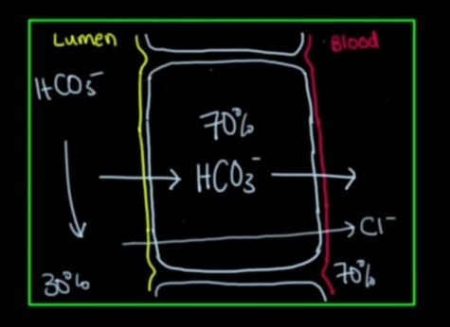
NAGMA
Hypokalemia
No acid in urine ---- less acidic urine PH>5,3
-
-
Kidney stones
Less acidic urine also facilitates the precipitation of kidey stone
Citrate

Slide 47
PATHOGENESIS
The distal nephron is responsible for secreting the acid generated from metabolism.
In distal RTA , this function is defective ( defective proton secretion ).

Slide 48
ETIOLOGY
Distal RTA can be sporadic or inherited. It can also occur as a complication of inherited or acquired diseases of the distal tubules.
Primary or secondary causes of distal RTA can result in damaged or impaired functioning of one or more transporters or proteins involved in the acidification process, including the H+/ATPase the HCO3−/Cl− anion exchangers, or the components of the aldosterone pathway.
Distal RTA can be secondary to collagen vascular diseases such as Sjögren syndrome or drugs such as amphotericin B .

Slide 49
Notes:
Amphotericin-B-induced distal RTA (backleak RTA)
• Characterised by hyperchloraemic metabolic acidosis with normal serum anion gap and hypokalaemia
in patients receiving treatment with amphotericin-B.
• The collecting duct proton pump function is normal, but the collecting duct epithelium is unable to
maintain a pH gradient because protons leak through amphotericin pores inserted into the apical cell
membrane.
• Urine pH exceeds 5.5 in acidaemia, but the urine PCO2 rises normally during bicarbonate infusion
he drug amphotericin-B acts as a proton-potassium ionophore that allows backleak of secreted protons from the urine into the cells and leakage of potassium from the cells to the urine. [47] [48] [49] Normally the fluid in the late distal nephron can have a pH as low as 4.5 and the cell interior pH is near 7; the backleak permitted by amphotericin-B keeps the lumen pH at a level equal to the cell (7.0).

Slide 50
Clinical features
Because of impaired hydrogen ion excretion, urine pH cannot be reduced to <5.5, despite the presence of severe metabolic acidosis.
Loss of sodium bicarbonate distally, due to lack of H+ to bind to in the tubular lumen , results in increased chloride absorption and hyperchloremia .. So Hyperchloremic metabolic acidosis .
Inability to secrete H+ is compensated by increased K+ secretion distally, leading to hypokalemia.
The hypokalemia can be severe enough to cause muscle weakness

Slide 51
Clinical features
The chronic metabolic acidosis results in bone demineralization and hypercalciuria.
Bone demineralization in distal RTA probably relates to dissolution of bone because the calcium carbonate in bone serves as a buffer against the metabolic acidosis due to the hydrogen ions retained by patients with RTA so Bone disease is common.
Citrate is an important factor increasing the solubility of urinary calcium.
The increased calcium excretion along with hypocitraturia, the result of increased citrate absorption by the proximal tubule due to acidosis and hypokalemia, leads to nephrocalcinosis.
It has long been known that acidosis decreases renal citrate excretion, whereas alkalosis increases it .

Slide 52
Clinical manifestations
Distal RTA shares features with those of pRTA, including non–anion gap metabolic acidosis and growth failure; distinguishing features of distal RTA include nephrocalcinosis and hypercalciuria.
The phosphate and massive bicarbonate wasting characteristic of pRTA is generally absent.
H /ATPase deficincey autosomal recessive form is associated with sensorineural deafness.
Notes:
Metabolic acidosis and

Slide 53
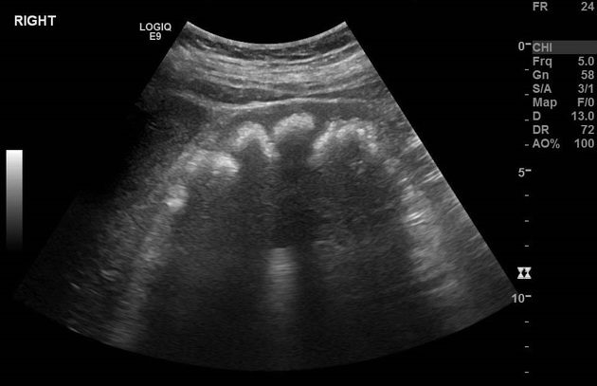

Slide 54
Diagnostics and treatment
Serum
Hyperchloremic metabolic acidosis (normal anion gap)
Hypokalemia that improves with alkaline therapy
Urine
Urine pH ≥ 5.5
Positive urine anion gap Hypercalciuria
Decreased NH₄⁺ excretion Decreased citrate excretion
Treatment
Alkalinization therapy with orally administered sodium bicarbonate
Potassium citrate may be used if hypokalemia persists despite alkalinization therapy
6

Slide 55
Hyperkalemic renal tubular acidosis (type 4)

Slide 56
NAGMA MILD
Hyperkalemia
Urine PH <5.3
Notes:
Factors involved in hyperkalemic acidosis. (A) Proper function of the ENaC at the apical surface of principal cells is necessary for K⁺ secretion by ROMK in these same cells and H⁺ secretion by adjacent intercalated cells. Inherited or acquired loss of ENaC function or its regulation by aldosterone via the mineralocorticoid receptor (MR) gives rise to hyperkalemic acidosis. (B) Hyperkalemia raises intracellular pH by exchange with protons, impairing enzymes involved in ammoniagenesis. (C) Ammoniagenesis in the proximal tubule is chiefly by deamidation of filtered or secreted glutamine (Gln). Ammonia (NH₃) diffusing into the nascent urine assists in buffering H⁺; both NH₃ and NH₄⁺ undergo further reabsorption in the medullary loop followed by distal nephron movement into the final urine. Glu, glutamate; aKG, α-ketoglutarate.
Hyperkalemia results in
lower ammonia production by the proximal tubule, which exacerbates the
metabolic acidosis by limiting urinary buffer excretion.

Slide 57
Hyperkalemic (Type IV) Renal Tubular Acidosis PATHOGENESIS
1-occurs as the result of impaired aldosterone production (hypoaldosteronism) or
2- impaired renal responsiveness to aldosterone (pseudohypoaldosteronism).
- Acidosis results because aldosterone has a direct effect on the H+/ATPase responsible for hydrogen secretion.
- In addition, aldosterone is a potent stimulant for potassium secretion in the collecting tubule; consequently, lack of aldosterone results in hyperkalemia. This further affects acid–base status by inhibiting ammoniagenesis and, thus, H+ excretion.
Notes:
This is the most common form of RTA in adults and results from aldosterone deficiency or resistance. The collecting duct is a major site of aldosterone action; there it stimulates Na⁺ reabsorption and K⁺ secretion in the principal cells and stimulates H⁺ secretion in the A-type intercalated cells. Hypoaldosteronism, therefore, is associated with decreased collecting duct Na⁺ reabsorption, hyperkalemia, and metabolic acidosis.
Hyperkalemia also reduces proximal tubular NH₄⁺ production and decreases NH₄⁺absorption by the thick ascending limb, leading to a reduction in medullary interstitial NH₃ concentration. This diminishes the ability of the kidneys to excrete an acid load and worsens the acidosis.
Because the function of H⁺ –ATPase is normal, the urine is appropriately acidic in this form of RTA. Correction of hyperkalemia leads to correction of metabolic acidosis in many patients, pointing to the central role of hyperkalemia in the pathogenesis of this acidosis.

Slide 58
Causes of type 4 RTA
Aldosterone deficiency typically occurs as a result of adrenal gland disorders such as Addison disease or some forms of congenital adrenal hyperplasia.
In children, aldosterone unresponsiveness is a more common cause of type IV RTA.
This can occur transiently, during an episode of acute pyelonephritis or acute urinary obstruction,
or chronically, particularly in infants and children with a history of obstructive uropathy.
Angiotensin-converting enzyme inhibitors and chronic heparin administration can result in hypoaldosteronism.

Slide 59
Notes:
The following are causes of type 4 RTA:
Hypoaldosteronism (low renin) - Hyporeninemic hypoaldosteronism (diabetes mellitus/mild renal impairment, chronic interstitial nephritis, nonsteroidal anti-inflammatory drugs, beta-blockers)
Hypoaldosteronism (high renin) - Primary adrenal defect (isolated: congenital hypoaldosteronism; generalized: Addison disease, adrenalectomy, AIDS), inhibition of aldosterone secretion (heparin, ACE inhibitors, AT1 receptor blockers)
Aldosterone resistance (drugs) - Diuretics (amiloride, triamterene, spironolactone), calcineurin inhibitors (cyclosporine, tacrolimus), antibiotics (trimethoprim, pentamidine)
Aldosterone resistance (genetic) - Pseudohypoaldosteronism (PHA) types I and II
****Type 4 RTA affects the Na+JK+-H+ exchange mechanism
in the distal tubule. It has an effect similar to
spironolactone or hypoaldosteronism: hyperkalemic,
hyperchloremic (i.e., normal anion gap) acidosis.
Causes ofType 4 RTA:
• Obstructive uropathy
• Interstitial renal disease
• Multicystic dysplastic kidneys
• Type I pseudohypoaldosteronism
• Diabetic nephropathy
• 2 1-hydroxylase deficiency
• Renal transplant

Slide 60
CLINICAL MANIFESTATIONS
Patients with type IV RTA can present with growth failure in the first few years of life. Polyuria and dehydration (from salt wasting) are common.
Rarely, patients (especially those with pseudohypoaldosteronism type 1) present with life-threatening hyperkalemia.
Patients with obstructive uropathies can present acutely with signs and symptoms of pyelonephritis, such as fever, vomiting, and foul-smelling urine.
Laboratory tests reveal a hyperkalemic non–anion gap metabolic acidosis , Urine may be alkaline or acidic .
Elevated urinary sodium levels with inappropriately low urinary potassium levels reflect the absence of aldosterone effect.
Notes:
The following findings are typical of type 4 RTA:
Mild-to-moderate chronic kidney disease (stages 2-3) in most patients, with a creatinine clearance of 30-60 mL/min
Hyperkalemia
Hypoaldosteronism
Diabetes mellitus (in approximately 50% of patients)

Slide 61
Diagnosis and treatment
Diagnostics
Serum
Hyperchloremic metabolic acidosis (i.e., normal anion gap)
Hyperkalemia
Urine
Urine pH < 5.5
Positive urine anion gap (persistent sodium excretion) Decreased NH₄⁺ excretion
Normal or decreased calcium excretion
Treatment
Furosemide
Mineralocorticoid replacement (ﬂudrocortisone) Low-potassium diet
10

Slide 62
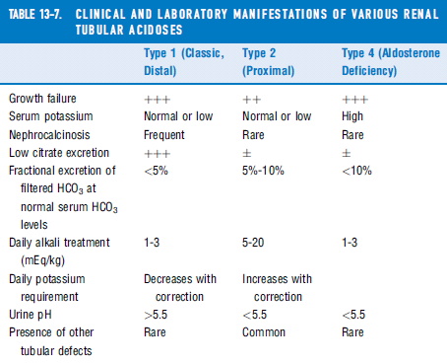
62

Slide 63
Thank you

