Slide 1
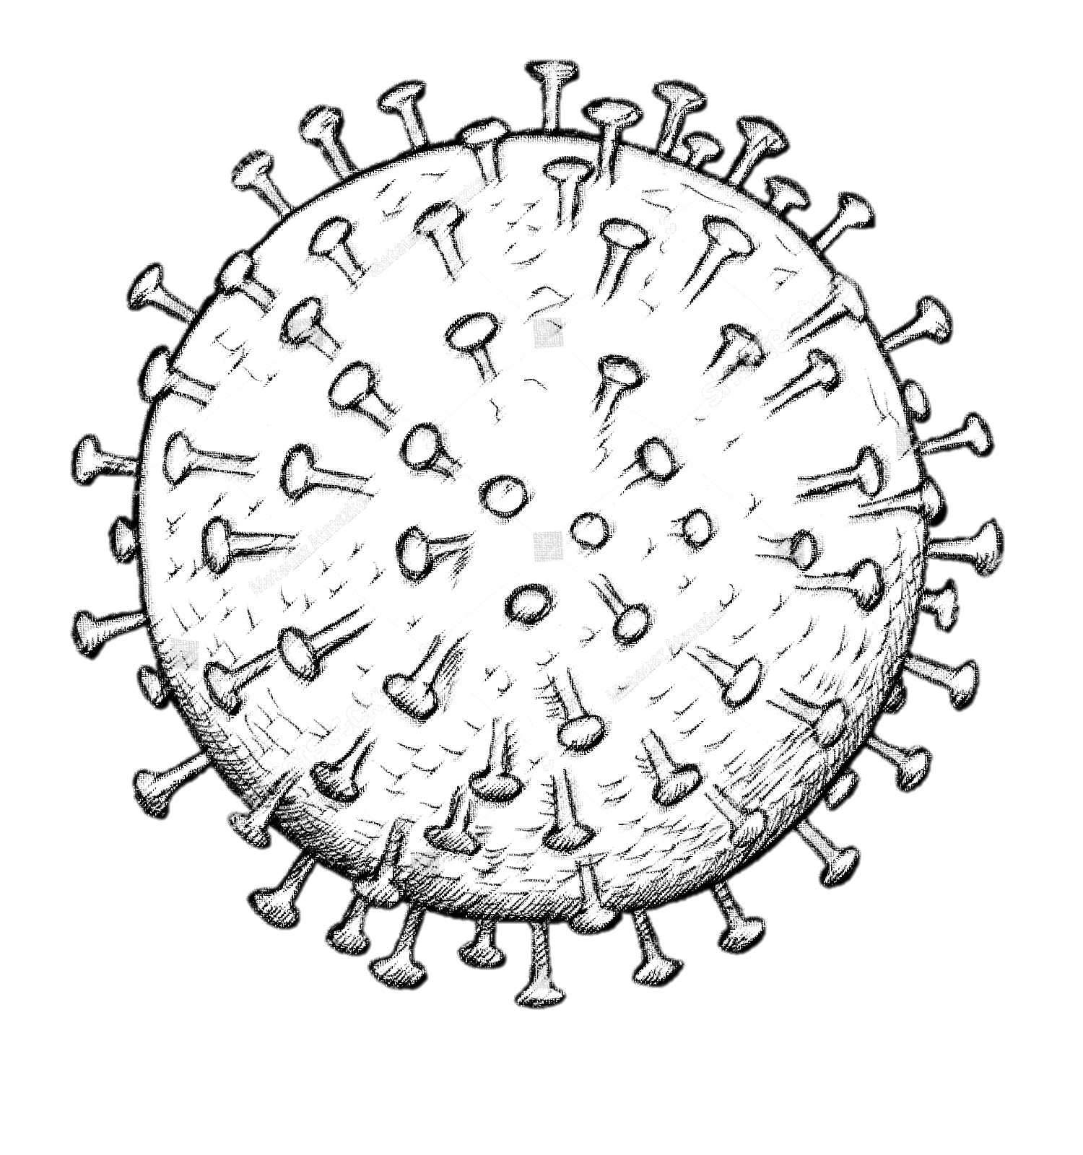
COVID-19 IN PREGNANCY
Presented by :
Nadine Othman
Mohamad hmooz
Ena’am domi
Supervised by :
Dr. Ahlam Al-Kharabsheh
Assistant Professor, OBS & GYN department
Mu’tah University

Slide 2
Coronaviruses are enveloped positive-stranded RNA viruses. SARS-CoV-2 are betacoronavirus in the same subgenus of the SARS virus, and the closest RNA sequence similarity is to two bat coronaviruses, which indicates that bats are likely the primary source; whether COVID-19 virus is transmitted directly from bats or through some other mechanism (eg, through an intermediate host) is unknown.
The host receptor for SARS-CoV-2 cell entry is the same as for SARS-CoV, the angiotensin-converting enzyme 2 (ACE2), SARS-CoV-2 binds to ACE2 through the receptor-binding gene region of its spike protein.

Slide 3
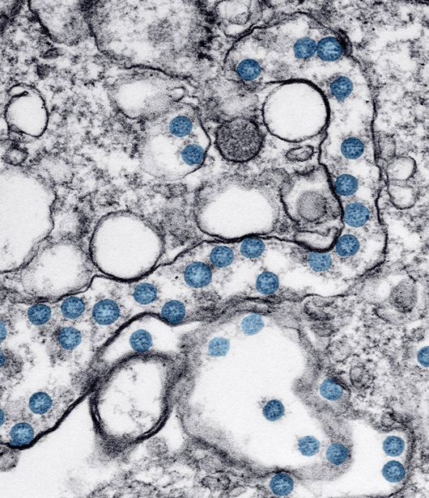
At the end of 2019, a novel coronavirus was identified as the cause of a cluster of pneumonia cases in Wuhan, China.
In February 2020, the World Health Organization designated the disease COVID-19, which stands for coronavirus disease 2019, and the virus that causes it is designated severe acute respiratory syndrome coronavirus 2 (SARS-CoV-2).

Slide 4
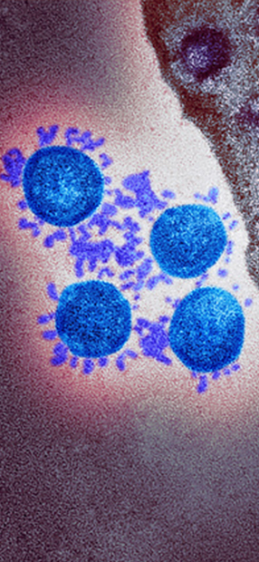
Notable variants
Alpha (B.1.1.7) lineage, was first identified in the United Kingdom in late 2020 and was temporally associated with an increase in regional infections. early estimates were that the variant was 50 to 75 percent more transmissible.
Delta (B.1.617.2 lineage) was first identified in India in December 2020 and has become the most prevalent variant there and in several other countries, including the United States and United Kingdom, The Delta variant is highly transmissible, more so than Alpha (B.1.1.7), which was more transmissible than previously circulating SARS-CoV-2 lineages.
Beta (B.1.351 lineage) was identified in South Africa in late 2020. It is phylogenetically distinct from B.1.1.7 but shares several spike protein mutations.
Gamma (P.1 lineage) was first identified in Japan but has since declined in prevalence globally. It has several mutations, it has the potential for increased transmissibility and an impact on immunity
Omicron (B.1.1.529) was first identified in Botswana and Africa, and reported as a new variant by WHO on November 24,2021

Slide 5
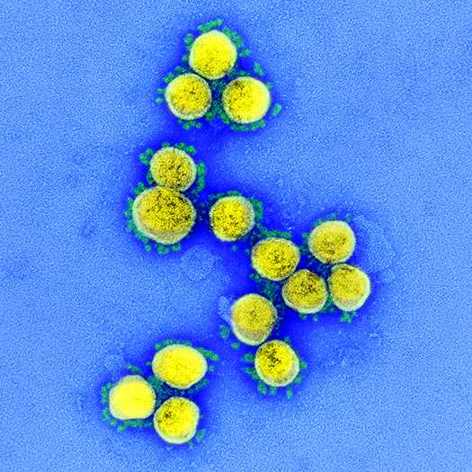
Epidemiology
Globally, over 276 million confirmed cases and over 5 million deaths of COVID-19 have been reported.
The reported case counts underestimate the overall burden of COVID-19, as only a fraction of acute infections are diagnosed and reported. Seroprevalence surveys in the United States and Europe have suggested that after accounting for potential false positives or negatives, the rate of prior exposure to SARS-CoV-2, as reflected by seropositivity, exceeds the incidence of reported cases by approximately 10-fold or more.
Notes:
1.94 mortality rate ☺

Slide 6
Transmission
Direct person-to-person respiratory transmission is the primary means of transmission of SARS-CoV-2. Mainly through close-range contact (ie, within approximately six feet or two meters) via respiratory particles; when a person with infection coughs, sneezes, or talks can infect another person if it is inhaled or makes direct contact with the mucous membranes.
SARS-CoV-2 can also be transmitted longer distances through the airborne route (through inhalation of particles that remain in the air over time and distance), but the extent to which this mode of transmission has contributed to the pandemic is controversial.
The risk of transmission from an individual with SARS-CoV-2 infection varies by the type and duration of exposure, use of preventive measures, and likely individual factors (eg, the amount of virus in respiratory secretions)
Notes:
As examples, studies using specialized imaging to visualize respiratory exhalations have suggested that respiratory droplets may get aerosolized or carried in a gas cloud and have horizontal trajectories beyond six feet (two meters) with speaking, coughing, or sneezing [49-51]. Other studies have identified viral RNA in ventilation systems and in air samples of hospital rooms of patients with COVID-19, including patients with mild infection [52-56]; attempts to find viable virus in air and surface specimens in health care settings have only rarely been successful [55-59]. Nevertheless, the overall transmission and secondary attack rates of SARS-CoV-2 suggest that long-range airborne transmission is not a primary mode [44,45].
Furthermore, in a few reports of health care workers exposed to patients with undiagnosed infection while using only contact and droplet precautions, no secondary infections were identified despite the absence of airborne precautions

Slide 7
Viral shedding and period of infectiousness — The precise interval during which an individual with SARS-CoV-2 infection can transmit infection to others is uncertain. The potential to transmit SARS-CoV-2 begins prior to the development of symptoms and is highest early in the course of illness; the risk of transmission decreases thereafter. Transmission after 7 to 10 days of illness is unlikely, particularly for otherwise immunocompetent patients with nonsevere infection.
Detectable viral RNA, however, does not necessarily indicate the presence of infectious virus, and there appears to be a threshold of viral RNA level below which infectiousness is unlikely.
The risk of transmission from an individual who is asymptomatic appears less than that from one who is symptomatic.
Virus present on contaminated surfaces may be another source of infection if susceptible individuals touch these surfaces and then transfer infectious virus to mucous membranes in the mouth, eyes, or nose.
There is no evidence suggesting animals (including domesticated animals) are a major source of infection in humans.

Slide 8
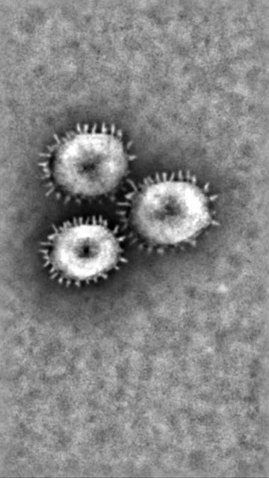
Immunity following infection
Humoral immunity – the magnitude of antibody response may be associated with severity of disease, and patients with mild infection may not mount detectable neutralizing antibodies. Most studies suggest that neutralizing activity is maintained for up to six to eight months
Risk of reinfection — Overall, the short-term risk of reinfection (eg, within the first few months after initial infection) appears low. Nevertheless, sporadic cases of reinfection have been documented.

Slide 9
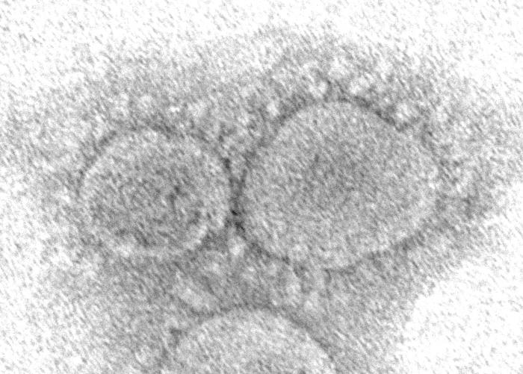
Prevention
Personal preventive measures: - Diligent hand washing, particularly after touching surfaces in public. Use of hand sanitizer that contains at least 60% alcohol is a reasonable alternative if the hands are not visibly dirty. - Respiratory hygiene (eg, covering the cough or sneeze). - Avoiding touching the face (in particular eyes, nose, and mouth). - Cleaning and disinfecting objects and surfaces that are frequently touched. - Ensure adequate ventilation of indoor spaces. - Physical distancing (2 meters).

Slide 10
Post-exposure management
postexposure prophylaxis — Clinical trials are also being conducted in the United States and elsewhere to evaluate the safety and efficacy of pre- and postexposure drug prophylaxis against COVID-19. In the United States, the FDA has issued an emergency use authorization (EUA) to use the monoclonal antibody casirivimab-imdevimab to prevent SARS-CoV-2 infection in select individuals over age 12 who have had close contact with an individual with infection or who are at high risk of exposure to individuals with infection in an institutional setting. Pregnant people who meet these exposure criteria would be candidates since they are at high risk for progression to severe COVID-19
Notes:
https://www.uptodate.com/contents/image?imageKey=PC%2F131725&topicKey=OBGYN%2F127535&search=covid%2019%20pregnancy&rank=1~150&source=see_link

Slide 11
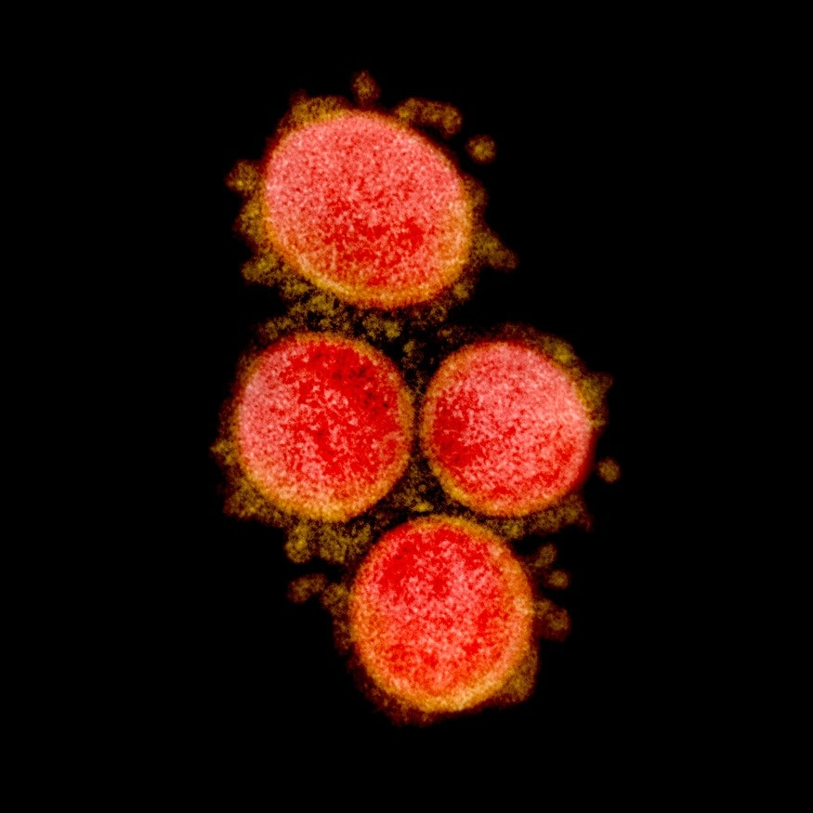
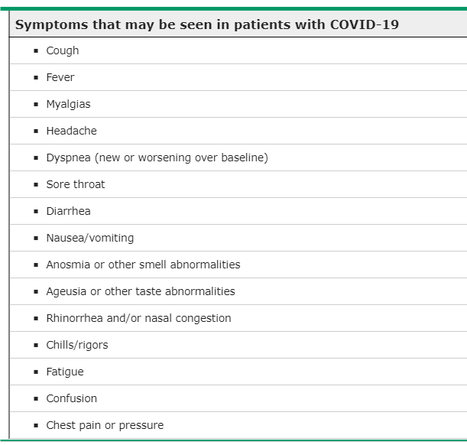
Clinical features
The majority of pregnant women who are infected with SARS-CoV-2 are asymptomatic
Most symptomatic women experience only mild or moderate cold/flu-like symptoms.
• The main symptoms of COVID-19 are cough, fever, sore throat, dyspnoea, myalgia, loss of sense of taste and diarrhoea.

Slide 12
Pregnant VS non-pregnant …… symptoms
Symptoms frequency in pregnancy
Cough – Pregnant 50.3 percent (nonpregnant 51.3 percent)
Headache – Pregnant 42.7 percent (nonpregnant 54.9 percent)
Muscle aches – Pregnant 36.7 percent (nonpregnant 45.2 percent)
Fever – Pregnant 32.0 percent (nonpregnant 39.3 percent)
Sore throat – Pregnant 28.4 percent (nonpregnant 34.6 percent)
Shortness of breath – Pregnant 25.9 percent (nonpregnant 24.8 percent)
New loss of taste or smell – Pregnant 21.5 percent (nonpregnant 24.8 percent)

Slide 13
Classification of disease severity
Asymptomatic or pre-symptomatic infection: Positive test for SARS-CoV-2 but no symptoms.
Mild illness: Any signs and symptoms (eg, fever, cough, sore throat, malaise, headache, muscle pain) without shortness of breath, dyspnea, or abnormal chest imaging.
Moderate illness: Evidence of lower respiratory disease by clinical assessment or imaging and a saturation of oxygen (SaO2) ≥94 percent on room air at sea level.
Severe illness: Respiratory frequency >30 breaths per minute, SaO2 <94 percent on room air at sea level, ratio of arterial partial pressure of oxygen to fraction of inspired oxygen (PaO2/FiO2) <300, or lung infiltrates >50 percent.
Critical illness: Respiratory failure, septic shock, and/or multiple organ dysfunction.

Slide 14
Severe COVID-19 illness in pregnant women
More than two-thirds of pregnant women with COVID-19 are asymptomatic.
Compared to non-pregnant with COVID-19, pregnant women with COVID-19:
have higher rates of intensive care unit (ICU) admission; this may reflect a lower threshold for admission to ICU, rather than more severe disease.
have higher needs for ventilation and extracorporeal membrane oxygenation (ECMO).
who require hospitalization have overall worse maternal outcomes, including an increased risk of death, although the risk of death remains very low.
Pregnant women may be at increased risk of complications in the third trimester when compared to earlier in pregnancy
Notes:
increased complement activity during pregnancy
Eosinophil and basophil counts were not affected by pregnancy.
Increased eosinophil degranulation during the second and third trimester and reduced mast cell degranulation during the last trimester,
Increase in neutrophil counts from the first trimester onwards.

Slide 15
Risk factors for hospital admission with COVID-19 infection in pregnancy:
Black, Asian or other minority ethnic background.
having a BMI of 30 kg/m2 or more.
pre-pregnancy co-morbidity, such as pre-existing diabetes and chronic hypertension.
maternal age 35 years or older.
living in areas or households of increased socioeconomic deprivation (data not specific to pregnancy)

Slide 16
Effect of COVID-19 on pregnancy
Symptomatic maternal COVID-19 is associated with an increased likelihood of iatrogenic preterm birth.
COVID-19 may be associated with an increased incidence of small-for-gestational-age babies.
It seems likely that neonatal morbidity for babies born to mothers with COVID-19 infection is linked to preterm birth rather than the COVID-19 infections itself.
While stillbirth remains a rare outcome, maternal COVID-19 infection is associated with an increased risk of stillbirth.

Slide 17
Laboratory findings
In a systematic review of pregnant and recently pregnant persons with suspected or confirmed COVID-19, laboratory findings included: ●Lymphopenia (35%) ●Leukocytosis (27%) ●Elevated procalcitonin level (21%) ●Abnormal liver chemistries (11%) ●Thrombocytopenia (8%)
Leukocytosis can be normal in pregnancy, and some of the other laboratory findings overlap with those caused by pregnancy-related disorders (eg, thrombocytopenia and elevated liver chemistries in preeclampsia with severe features).

Slide 18
Diagnosis
The diagnosis of COVID-19 is made primarily by direct detection of severe acute respiratory syndrome coronavirus 2 (SARS-CoV-2) RNA by nucleic acid amplification tests (NAATs), most commonly reverse-transcription polymerase chain reaction (RT-PCR) from the upper respiratory tract.

Slide 19
Whom to test
All symptomatic patients
Following close contact with an individual with COVID-19 (this includes neonates born to mothers with COVID-19).
Screening hospitalized patients at locations where prevalence is high (eg, ≥10 percent PCR positivity in the community).
Prior to time-sensitive surgical procedures or aerosol-generating procedures.
Prior to receiving immunosuppressive therapy (including prior to transplantation).
In areas where the infection is prevalent, we believe testing all patients upon presentation to labor and delivery with a rapid test for SARS-CoV-2 is reasonable, if testing is available. Patients with scheduled inductions and cesarean deliveries can be tested within 72 hours of the scheduled admission.
Negative NAAT test If initial testing is negative but the suspicion for COVID-19 remains (eg, suggestive symptoms without evident alternative cause) and confirming the presence of infection is important for management or infection control, we suggest repeating the test. The optimal timing for repeat testing is not known; it is generally performed 24 to 48 hours after the initial test. Repeat testing within 24 hours is not recommended.

Slide 20
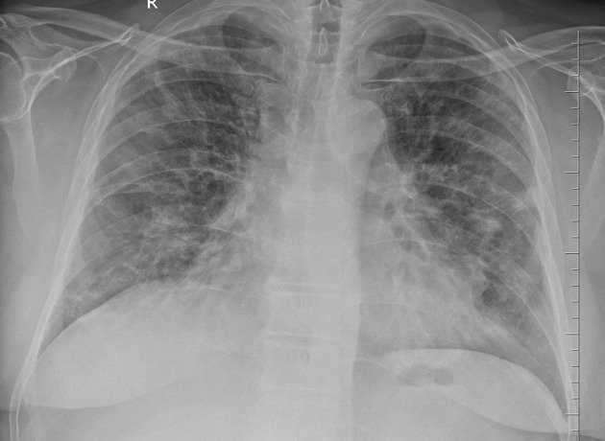
Imaging
Chest radiographs may be normal in early or mild disease. In a systematic review of 427 pregnant patients diagnosed with COVID-19, the most frequently encountered pulmonary findings on chest computed tomography were ground-glass opacities (77 percent), posterior lung involvement (73 percent), multilobar involvement (72 percent), bilateral lung involvement (69 percent), peripheral distribution (68 percent), and consolidation (41 percent).
A portable chest radiograph is sufficient for initial evaluation of pulmonary complications and extent of lung involvement in hospitalized patients with COVID-19. A single chest radiograph carries a very low fetal radiation dose of 0.0005 to 0.01 mGy.
Computed tomography (CT) should be performed, if indicated, as the fetal radiation dose for a routine chest CT is also low and not associated with an increased risk of fetal anomalies or pregnancy loss.
Some authorities have advocated lung ultrasound, possibly at the same time as the obstetric scan, for quick diagnosis of pneumonia in symptomatic pregnant women.
A14.pdf (discoveryjournals.org)
Notes:
If the abdomen or pelvis is not being imaged, such as in chest or head CT, there is no risk to the baby from radiation. The amount of radiation used in normal CT imaging has never been shown to cause harm to an unborn child.

Slide 21
COVID-19 IN PREGNANCY
Presented by :Mohamad-Alhmouz
Supervised by : Dr. Ahlam Al-Kharabsheh
Assistant Professor, OBS & GYN department
Mu’tah University

Slide 22
Complications and outcomes
Differential diagnosis
Prenatal care
Timing of delivery

Slide 23
Complications :
Respiratory disorders – Pneumonia, respiratory failure, acute respiratory distress syndrome (ARDS)
Cardiac disorders (arrhythmias, acute cardiac injury)
Thromboembolic complications
Secondary infections
Acute kidney failure
Neurologic disorders – Headache, dizziness, myalgia, alteration of consciousness, disorders of smell and taste, weakness, strokes, seizures
Cutaneous disorders – Morbilliform rash; urticaria; pernio-like, acral lesions; livedo-like, vascular lesions; and vesicular, varicella-like eruption
Gastrointestinal and liver disorders
Psychiatric illness (eg, anxiety disorders, depressive disorders, insomnia disorder, posttraumatic stress disorder)

Slide 24
Frequancy of Congenital infection
Criteria for diagnosis :
In a mother with SARS‐CoV‐2 infection, we would make a definitive diagnosis of congenital infection in a live born neonate if SARS-CoV-2 is detected by polymerase chain reaction in :
umbilical cord blood
neonatal blood collected within the first 12 hours of birth
amniotic fluid collected prior to rupture of membranes

Slide 25
Hematogenous : Viremia rates in patients with COVID-19 appear to be low (1% in one study but higher in severe disease and transient)
Ascending: Data on positive vaginal swabs and positive swabs and amniotic fluid suggesting the ascending route of infection and intrapartum transmission from contact with vaginal secretions are rare
Intrapartum : viral shedding in maternal feces is common, so fecal contamination of the perineum could theoretically be a source of intrapartum transmission
Postpartum: could occur through ingestion of breast milk or from an infected mother (or other caregiver) to her infant through respiratory or other infectious secretions

Slide 26
SARS-CoV-2 cell entry is thought to depend on the angiotensin-converting enzyme 2 receptor and serine protease TMPRSS2, which are minimally coexpressed in the placenta .
This may account for the infrequent occurrence of placental SARS-CoV-2 infection and fetal transmission. However, SARS-CoV-2 could reach the fetus as a result of ischemic injury to the placenta, without requiring placental cell infection .

Slide 27
Frequency of congenital infection
The extent of vertical transmission (in utero, intrapartum, early postnatal period) remains unclear. Only a few well-documented cases of probable vertical transmission have been published . Many other possible cases of congenital infection have been reported in the setting of third-trimester maternal infection within 14 days of delivery, suggesting congenital infection is uncommon (approximately 2 % of maternal infections

Slide 28
In a systematic review of infants born to 936 COVID-19-infected mothers, neonatal viral RNA testing was positive in:
- 27/936 (2.9 percent) nasopharyngeal samples taken immediately after birth or within 48 hours of birth,
- 1/34 cord blood samples,
- 2/26 placental samples;
- in addition, 3/82 neonatal serologies were immunoglobulin M (IgM) positive for SARS-CoV-2
In the CDC COVID-19 Response Pregnancy and Infant Linked Outcomes Team report of over 5000 pregnant persons with laboratory-confirmed SARS-CoV-2 infection, 2.6 % of the 610 infants with available SARS-CoV-2 test results had a positive test, primarily those born to women with infection at delivery

Slide 29
Pregnancy and newborn outcome
Risk of miscarriage : The frequency of miscarriage does not appear to be increased, but data on first- and second-trimester infections are limited
Preterm and CS :
Preterm birth and cesarean delivery rates have been increased in many studies but not all
The increased risk appears to be limited to patients with severe or critical disease
Fever and hypoxemia may increase the risks for preterm labor, prelabor rupture of membranes, and abnormal fetal heart rate patterns, but preterm deliveries also occur in patients without severe respiratory disease

Slide 30
In two large cohort studies of pregnant patients with COVID-19 in the United States
 | With covid19 | Without covid19
Overall preterm delivery rate | 7.2% | 5.8%
 | 12.9% | 10.2%
The overall rates of cesarean delivery | 28.9% | 27.5
 | 34.0% | 31.9

Slide 31
3. Preeclampsia : A meta-analysis of observational studies of SARS-CoV-2 infection during pregnancy found a 62 percent higher odds of developing preeclampsia among infected patients . Preeclampsia with severe features, eclampsia, and HELLP syndrome were all increased. In contrast to preterm birth, both asymptomatic and symptomatic patients experienced an increased risk, with a higher risk among symptomatic patients (OR 2.11 versus OR 1.59).
In addition to the usual limitations of observational studies, an additional limitation of these data are that some COVID-19-related laboratory abnormalities (elevated liver enzyme levels, thrombocytopenia) are identical to those that occur in preeclampsia with severe features and HELLP syndrome

Slide 32
Outcome by gestational age at time of infection
In an international retrospective cohort study that compared obstetric and neonatal outcomes of 393 SARS-CoV-2-positive patients according to gestational age at the time of infection, maternal infection after 20 weeks of gestation increased the risk for a composite of adverse obstetric outcomes, and maternal infection after 26 weeks increased the risk for a composite of adverse neonatal outcomes, whereas earlier infection did not increase these risks . These data support vaccination as soon as possible to reduce the risk of acquiring SARS-CoV-2 infection.

Slide 33
Fetal outcome :
It has been found that there is a significant increase in the rate of sillbirth among pregnant patients with covid19 about 3% compared to a percentage of 0.4-0.5% in patients without covid19
**There is limited information on the reasons for the increase in stillbirth in patients hospitalized because of COVID-19.
Severe and critical maternal illness likely accounted for some stillbirths.
It is possible that some stillbirths have been related to disruptions in prenatal care and to a higher frequency of home birth

Slide 34
Differential diagnosis
Other infections :
Early symptoms of COVID-19 can be similar to those of multiple other viral and bacterial respiratory infections
It is reasonable to also test for influenza when testing for SARS-CoV-2 as this could have management implications
Coinfection with tuberculosis has also been reported and should be considered in patients with impaired immunity or at increased risk for exposure to Mycobacterium tuberculosis
Preeclampsia, HELLP syndrome
In pregnant women, some COVID-19-related laboratory abnormalities (elevated liver enzyme levels, thrombocytopenia) are identical to those that occur in preeclampsia with severe features and HELLP syndrome
The diagnosis of preeclampsia with severe features or HELLP syndrome should be considered in the differential diagnosis of persons under investigation for COVID-19, as well as in patients with confirmed COVID-19 as these pregnancy-related disorders may coexist with the infection
The presence of acute hypertension can be helpful as it is a common finding in patients with preeclampsia or HELLP syndrome and not a feature of COVID-19
Notes:
In pregnant women, some COVID-19-related laboratory abnormalities (elevated liver enzyme levels, thrombocytopenia) are identical to those that occur in preeclampsia with severe features and HELLP syndrome. Autoimmune hemolysis; prolonged prothrombin time; elevated D-dimer, procalcitonin, and C-reactive protein (CRP) levels; positive lupus anticoagulant screen; and low fibrinogen levels may also be observed in complicated COVID-19 cases (note the normal reference ranges for D-dimer, CRP, and fibrinogen levels are higher in pregnant women) [16,70]. Symptoms also overlap: Headache, acute cerebrovascular disease, and seizures can be neurologic manifestations of COVID-19, as well as findings in preeclampsia with severe features/eclampsia.

Slide 35
Prenatal care
Uninfected pregnant persons
Asymptomatic pregnant persons with potential exposure
Asymptomatic patients
Symptomatic patients
Maternal and fetal follow up after recovery
Timing of delivery

Slide 36
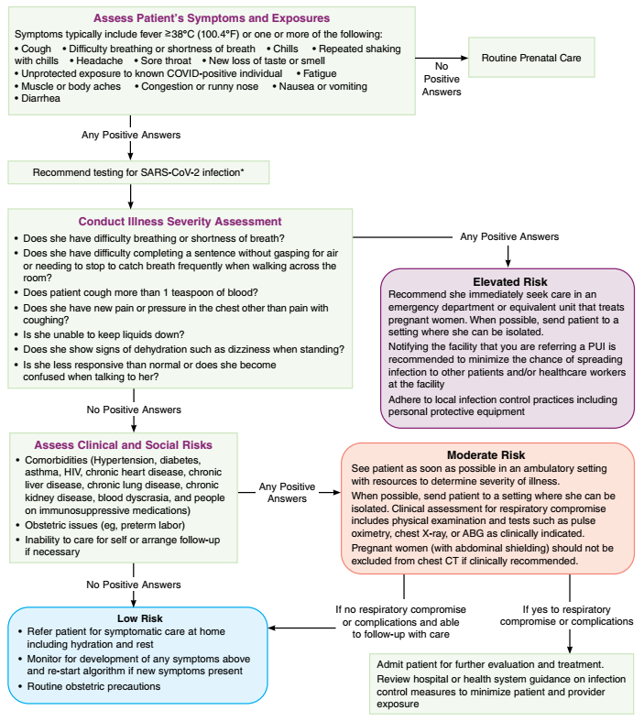

Slide 37
Uninfected pregnant persons
The American College of Obstetricians and Gynecologists ,the Society for Maternal-Fetal Medicine, and others have issued guidance regarding prenatal care during the COVID-19 pandemic. It includes general guidance for testing and preventing spread of COVID-19, and suggestions for modifying traditional protocols for prenatal visits.
These modifications, which should be tailored for low- versus high-risk patients (eg, multiple gestation, hypertension, diabetes).

Slide 38
telehealth
reducing the number of in-person visits
timing of visits
limiting the number of persons in waiting rooms and physical distancing,
grouping tests for the same visit/day (eg, aneuploidy, diabetes, infection screening) to minimize maternal contact with others
timing of indicated obstetric ultrasound examinations (eg, gestational age, fetal anomaly, fetal growth, placental attachment),
timing and frequency of use of nonstress tests and biophysical profiles

Slide 39
There are many ways to reduce the time patients, including patients with high-risk pregnancies, are in the office.
For example:
The clinician can order a 75 gram two-hour oral glucose tolerance test (GTT) instead of a glucose challenge test and 100 gram three-hour GTT (in patients with positive results)
cell-free DNA screening can be used (at >10 weeks) for Down syndrome screening rather than the combined test (ie, nuchal translucency on ultrasound and serum analytes)

Slide 40
In addition, The psychological impact of COVID-19 should also be recognized and support offered . The COVID-19 pandemic may be associated with new onset or exacerbation of subsyndromal psychiatric symptoms as well as full-blown psychiatric disorders, including anxiety disorders, depressive disorders, posttraumatic stress disorder, or substance use disorders.

Slide 41
Asymptomatic pregnant persons with potential exposure
Daily monitoring for fever, cough, or dyspnea for 14 days. Individuals who develop such signs or symptoms should stay home and maintain distance from other individuals, including those in their household, if they are not doing so already
Self-quarantine at home, with maintenance of at least six feet (two meters) from others at all times. In particular, they should avoid contact with individuals at high risk for severe illness
The preferred quarantine period is 14 days following the date of the last exposure
The CDC acknowledges that shorter durations of quarantine may ameliorate the associated community burdens and adherence challenges in exchange for a slightly increased risk of post-quarantine transmission
A 7day quarantine period, provided that the individual remained asymptomatic throughout and has a negative NAAT or antigen SARS-CoV-2 test within 48 hours of the planned end of quarantine
A 10-day quarantine period, provided that the individual remained asymptomatic throughout
Testing (ideally five to seven days following exposure) is also recommended following close contact to promptly identify new infections . However, a negative test performed earlier after exposure should not be used to reduce the quarantine period to shorter than seven days

Slide 42
*Care of asymptomatic patients with confirmed or probable SARS-CoV-2 infection involves :
assessing their risk for developing severe disease,
close monitoring for respiratory decompensation (which may occur rapidly), infection control and self-isolation for the anticipated duration of illness,
Appropriate timing of discontinuation of precautions

Slide 43
Comorbidities the CDC classifies as established or possible risk factors for severe COVID-19^{[1,2]}
Established risk factors
Cancer
Chronic kidney disease
Chronic obstructive pulmonary disease
Down syndrome
Immunocompromised state from solid organ transplant
Obesity (body mass index ≥30 kg/m²)
Pregnancy
Serious cardiovascular disease
Heart failure
Coronary artery disease
Cardiomyopathies
Sickle cell disease
Smoking
Type 2 diabetes mellitus
Possible risk factors
Asthma (moderate to severe)
Cerebrovascular disease
Cystic fibrosis
Hypertension or high blood pressure
Immunocompromised state from hematopoietic cell transplant, HIV, use of corticosteroids or other immunosuppressing agents, other immunodeficiencies
Liver disease
Neurologic conditions, such as dementia
Overweight (body mass index ≥25 but <30 kg/m²)
Pulmonary fibrosis (having damaged or scarred lung tissue)
Thalassemia (a type of blood disorder)
Type 1 diabetes mellitus

Slide 44
Symptomatic patients
The clinical care of symptomatic patients depends on:
illness severity,
underlying medical comorbidities,
coexistent pregnancy complications,
social situation

Slide 45
Home care
When to call the provider :
If they experience worsening dyspnea,
Unremitting fever >39°C despite appropriate use of acetaminophen,
Inability to tolerate oral hydration and medications,
Persistent pleuritic chest pain,
Confusion,
Obstetric complications (eg, preterm contractions, vaginal bleeding, rupture of membranes) . Those in the third trimester should perform fetal kick counts and report decreased fetal movement
Notes:
Most (at least 86 percent [66]) pregnant patients with known or suspected COVID-19 have mild disease (no shortness of breath) that does not warrant hospital-level care in the absence of obstetric problems (eg, preterm labor), concern for rapid deterioration, inability to promptly return to the hospital, or, possibly, inability to self-isolate.
These patients should be followed closely for progression to severe or critical disease and given instructions for infection control, symptom management, warning symptoms, and obstetric follow-up (at least once within two weeks of COVID-19 diagnosis [82]).

Slide 46
Supportive care and medications
Generally
Hydration, adequate rest, and frequent ambulation with more advanced activity as soon as tolerated are advised.
Medications
We suggest heated humidified air for congestion
acetaminophen for sore throat/headache/fever
ipratropium bromide and cromolyn nasal spray for symptomatic relief of rhinorrhea
Monoclonal
antibodies
Bamlanivimab -etesevimab is a combination neutralizing monoclonal antibody available as an option for the treatment of nonhospitalized patients with mild to moderate COVID-19 who are at high risk for progressing to severe disease and/or hospitalization
The combination casirivimab-imdevimab is another monoclonal antibody option for nonhospitalized COVID-19 patients.
Notes:
The drug combination should not be withheld from pregnant patients who are deemed to be at high risk for progression to severe disease if they would otherwise qualify for its use, after a discussion of the potential benefits and theoretic risks [130]. Placental transfer may be expected since human immunoglobulin G1 (IgG1) antibodies are known to cross the placental barrier. Nonclinical reproductive toxicity studies have not been performed, and there is no information regarding whether the potential transfer of these drugs provides any treatment benefit or risk to the developing fetus.

Slide 47
Hospital care
Candidates for inpatient care :
●A comorbid condition warranting admission (eg, poorly controlled hypertension or diabetes, preeclampsia, prelabor rupture of membranes, uterine bleeding).
●Fever >39°C despite use of acetaminophen (which raises concern for cytokine storm syndrome).
●Moderate or severe signs and symptoms (eg, oxygen saturation <95 percent [when pulse oximetry is available] on room air and while walking, respiratory frequency >30 breaths per minute, rapidly escalating supplemental oxygen requirement).
●Critical disease – Respiratory failure, hypotension despite appropriate hydration, and/or new end-organ dysfunction (eg, mental status changes, hepatic or renal insufficiency, cardiac dysfunction).

Slide 48
Maternal respiratory support
Patients with severe disease often need oxygenation support. High-flow oxygen and noninvasive positive-pressure ventilation have been used, but the safety of these measures is uncertain, and they should be considered aerosol-generating procedures that warrant specific isolation precautions.
Some patients may develop acute respiratory distress syndrome (ARDS) and warrant intubation with mechanical ventilation
In the ICU prone position for severely ill patients is encouraged. Padding above and below the gravid uterus >24 weeks is desirable to offload the uterus and avoid aortocaval compression

Slide 49
maternal peripheral oxygen saturation (SpO2) should be maintained at ≥95 percent
If SpO2<95 obtain ABG for PaO2, PaO2>70mmHg is desirable
The World Health Organization (WHO) suggests maintaining maternal SpO₂ ≥92 to 95 percent once the patient is stable
Permissive hypercapnia (PCO₂ <60 mmHg) and extracorporeal membrane oxygenation (ECMO), if indicated for management of ARDS, do not appear to be harmful to the fetus, but data are limited
High positive end-expiratory pressure strategies (>10 mmHg), if considered, require close ongoing maternal and fetal monitoring because they decrease preload and cardiac output
Notes:
During pregnancy, maternal peripheral oxygen saturation (SpO₂) should be maintained at ≥95 percent, which is in excess of the oxygen delivery needs of the mother. If SpO₂ falls below 95 percent, an arterial blood gas may be obtained to measure the partial pressure of oxygen (PaO₂): Maternal PaO₂ greater than 70 mmHg is desirable to maintain a favorable oxygen diffusion gradient from the maternal to the fetal side of the placenta. The World Health Organization (WHO) suggests maintaining maternal SpO₂ ≥92 to 95 percent once the patient is stabl

Slide 50
Venous thromboembolism prophylaxis
Risk factors of VTE in covid19 patients:
pregnancy
Reduced mobility
Dehydration
-VTE occurs primarily in hospitalized patients with severe or critical illness
in one series of 1219 pregnant patients with COVID-19, the incidence of VTE was :
In severe to critical disease | 6%
In mild to moderate disease | 0.2%
In asymptomatic patients | 0%

Slide 51
Women who are self-isolating at home should stay hydrated and mobile
Thromboprophylaxis initiated for pregnant women who are self-isolating should be continued until they have recovered from the acute illness (between 7 and 14 days).
All pregnant women who have been hospitalised and have had confirmed COVID-19 should be offered thromboprophylaxis for 10 days following hospital discharge.
Unfractionated heparin is usually preferred ,5000 units in the first trimester, 7500 to 10,000 units in the second trimester, and 10,000 units in the third trimester, administered subcutaneously every 12 hours (reduce if the activated partial thromboplastin time is elevated
Intermittent pneumatic compression is suggested when pharmacologic prophylaxis is contraindicated.
For pregnant patients who are unlikely to be delivered within a few days, prophylactic- or intermediate-dose LMWH is reasonable (eg, enoxaparin 40 mg subcutaneously daily or 1 mg/kg [commonly rounded to the nearest 10 mg] subcutaneously every 24 hours).
Notes:
Pregnancy is a hypercoagulable state.73 The existing RCOG Green-top Guidelines No. 37a76 and 37b77 on VTE prevention and management should continue to support decision making during the COVID-19 pandemic. VTE risk assessment in the context of the COVID-19 pandemic should consider both the hypercoagulable state associated with the infection, as well as the increased risk that may come from self-isolation

Slide 52
Dexamethasone use
Dexamethasone 6 mg daily for 10 days or until discharge is recommended for severely ill nonpregnant patients who are on supplemental oxygen or ventilatory support. Glucocorticoids may also have a role in the management of refractory shock in critically ill patients with COVID-19
In pregnant patients who meet criteria for use of glucocorticoids for maternal treatment of COVID-19 and also meet criteria for use of antenatal corticosteroids to induce fetal maturity, we suggest administering the usual doses of dexamethasone (four doses of 6 mg intravenously 12 hours apart) and continue maternal treatment to complete the course of dexamethasone (6 mg orally or intravenously daily for 10 days or until discharge, whichever is shorter)
Others have suggested using glucocorticoids such as methylprednisolone or hydrocortisone to complete the course of maternal treatment because they result in less fetal steroid exposure

Slide 53
NSAIDs
The lowest effective dose is used, ideally for less than 48 hours and guided by gestational age-related potential fetal toxicity
we use acetaminophen as the preferred antipyretic and analgesic agent, if possible
Antiviral
remdesivir is being used to treat pregnant patients with severe COVID-19
Ribavarin is teratogenic and should be avoided
Baricitinib , risk-benefit ratio ?
Convalescent plasma
Is one approach that may be combined with other aspects of disease-specific and supportive care

Slide 54
Maternal follow up after recovery
Patients with COVID-19 generally warrant outpatient follow-up through telehealth or an in-person visit within a few days following discharge to home
Reinforce the importance of infection control and provide counseling on the warning symptoms which should prompt reevaluation.
Patients with documented VTE or those at high risk should be discharged on anticoagulation
Notes:
After discharge from the inpatient hospital setting or the emergency department (ED), clinician follow-up is warranted, either in outpatient clinic or via telehealth visit [107]. At each encounter after hospital or ED discharge, we reinforce the importance of infection control and provide counseling on the warning symptoms which should prompt reevaluation. (See 'Infection control' above and 'Counseling
Some patients discharged from the hospital, including those with documented venous thromboembolism (VTE) as well as those who are at high risk for VTE, will be discharged on anticoagulation.

Slide 55
Fetal follow up after recovery
authorities have suggested that pregnant persons with confirmed infection should have at least one ultrasound assessment of fetal amniotic fluid volume, beginning in the third trimester and at least 14 days after symptom resolution>
For those with first- or early second-trimester infection, a detailed fetal morphology scan at 18 to 23 weeks of gestation is also indicated and is a standard part of routine prenatal care.
Antenatal testing (nonstress test, biophysical profile) can be reserved for routine obstetric indications
Notes:
Development of fetal growth restriction is a theoretic concern and has been described with other SARS infections [105,106]. Very limited COVID-19-specific data on fetal growth after maternal infection are available [107]. Although significant placental histopathologic changes are not universally present [108,109], suboptimal fetal growth due to placental insufficiency is plausible because maternal COVID-19 has been associated with fetal and/or maternal vascular malperfusion, including acute and chronic intervillous inflammation, focal avascular villi, and thrombi in larger fetal vessels in the chorionic plate and stem villi [110-112]. These lesions could be caused by COVID-19-related coagulopathy, placental hypoxia during the acute maternal illness, placental viral infection, or a combination of these factors.

Slide 56
Timing of delivery
Non-sever \ Asymptomatic | Sever\ critical – Not intubated | Sever\Critical – Intubated
at ≥39 weeks of gestation, delivery can be considered | delivery in pregnancies >32 to 34 weeks in the setting of worsening status may be considered | After 32 to 34 weeks, the decision of delivery is controversial
<39 with nonsevere illness delivery is considered according to he usual obstetric indications | Most authorities do not advocate delivery prior to 32 weeks, even though the maternal situation may worsen in the second week, given the known morbidity and mortality of very preterm infants | Between viability and <30 to 32 weeks, continuing maternal support eith fetal monitoring is suggested

Slide 57
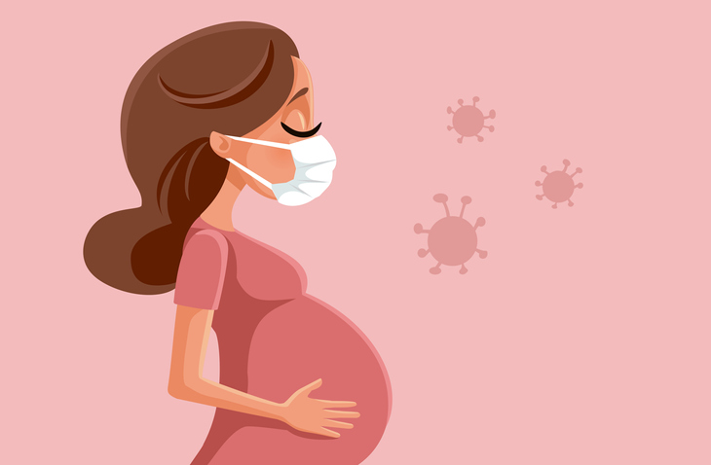
Covid-19 in Pregnancy
Intrapartum & postpartum care
Presented by Nadine Othman

Slide 58
General Guidance
• Women admitted to hospital, including maternity units, should be offered testing for SARS CoV-2 on admission. This includes women admitted for intrapartum care
COVID-19 infection should not dictate timing of delivery except the cases where the potential for rapid deterioration in maternal respiratory status or maternal life is at risk.

Slide 59
Should home birth be encouraged in areas of active transmission?
The American College of Obstetricians and Gynecologists:
hospitals are a safer location for birth than the home.
Availability of physicians.
Blood transfusions, antibiotics, anesthesia.
Other resources for intensive/emergency maternal and newborn care, if needed
The Society of Obstetricians and Gynecologists of Canada:
Describes a planned home birth with a registered midwife or appropriately trained physician in their integrated system as a reasonable choice; for persons
With a low degree of risk where the birth is anticipated to be uncomplicated .
Neither the mother nor the neonate will require resources beyond the local capacity.
Notes:
This is so the maternity team looking after you can monitor you and your baby closely and respond quickly if necessary.

Slide 60
What infection control precautions should be taken on the labor and delivery unit?
Screen patients for clinical manifestations of COVID-19 (eg, cough, headache, sore throat, myalgia, fever, shortness of breath, loss of taste/smell) and close contact with a confirmed case or persons under investigation prior to and upon entry into the health care facility
Make appropriate infection control preparations when a screen-positive patient is identified (eg, identify the most appropriate room for labor and delivery, ensure that appropriate personal protective equipment [PPE] is available, discuss risk to the patient's close contacts).
Ensure that all patients and any visitors are given surgical masks to wear upon entry into the health care setting for universal source control. When there is ongoing community transmission of SARS-CoV-2, it is reasonable to use certain enhanced infection control precautions when caring for patients who are not suspected of having COVID-19, even those who had a negative test for SARS-CoV-2 upon entry into the health care setting.
Prioritize testing of pregnant persons admitted with suspected COVID-19 or those who develop symptoms consistent with COVID-19 during hospitalization ..

Slide 61
What infection control precautions should be taken on the labor and delivery unit?
It has been recommended that women (and their support partners in NHS England) should be offered testing for SARS-CoV-2 when they are admitted to maternity units to give birth.
Ensure that all patients and any exempted visitors are given surgical masks to wear upon entry into the health care setting for universal source control
Minimize the number of people involved in any procedure.
The appropriate use of PPE is to protect healthcare workers, women and their families by functioning as a physical barrier to the transmission of infectious particles present in bodily fluids

Slide 62
When caring for patients with confirmed or suspected COVID-19, health care workers should use contact and droplet precautions (ie, gown, gloves, mask, face shield or goggles).
In particular, during episodes of patient deep respiratory efforts and during the second stage of labor, health care workers should also use airborne precautions (ie, N95 mask or powered air purifying respirator, where available), in addition to contact and droplet precautions.
Person-to-person contact and time in the labor unit and hospital should be limited, as is safely feasible.

Slide 63
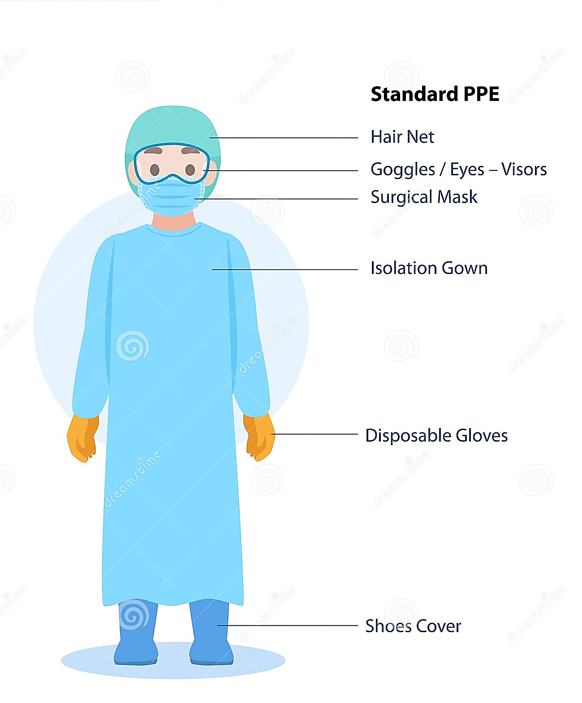
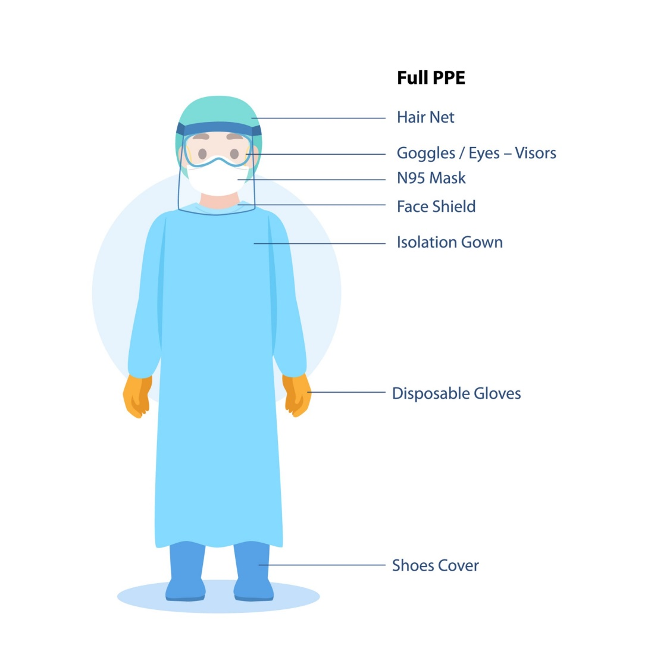
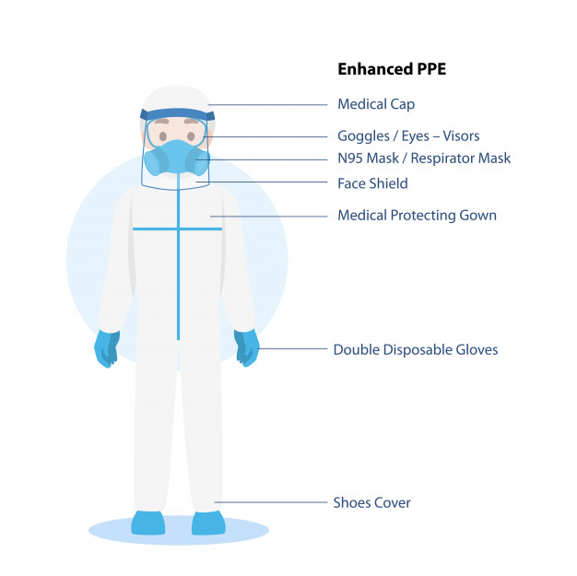

Slide 64
Labor and birth during the COVID-19 pandemic
COVID-19 infection should not dictate timing of delivery except the cases where the potential for rapid deterioration in maternal respiratory status or maternal life is at risk.
For women with suspected or confirmed COVID-19 early in pregnancy who recover, no alteration to the usual timing of delivery.
For women with suspected or confirmed COVID-19 in the third trimester, it is reasonable to attempt to postpone delivery till they recover ,provided no other medical indications arise
Notes:
For women with suspected or confirmed COVID-19 early in pregnancy who recover, no alteration to the usual timing of delivery

Slide 65
Labor and birth during the COVID-19 pandemic
For asymptomatic women who test or have tested positive for Covid-19 on admission
-continuous electronic fetal monitoring (CEFM) during labour using cardiotocography (CTG) is not recommended solely because of a positive test. Fetal monitoring options should be discussed with the woman, acknowledging the current uncertainties in women who are asymptomatic with a positive test for SARS-CoV-2
Notes:
There is no evidence83,84 that the practice of delayed cord clamping and skin-to-skin contact between mother and baby increases the transmission of SARS-CoV-2 to the neonate. The well documented benefits of these practices should be discussed with the woman to make an informed choice and implemented in line with pre-pandemic practice. In the absence of other evidence, NICE CG190 should be followed.82 5.2 How should a woman with suspected or confirmed COVID-19 be cared for in labour if they are symptomatic

Slide 66
Labor and birth during the COVID-19 pandemic
How should a woman with suspected or confirmed COVID-19 be cared for in labour if they are symptomatic?
Women with symptomatic suspected or confirmed COVID-19 should be advised to labour and give birth in an obstetric unit.
On admission a full maternal and fetal assessment should be undertaken, including:
Assessment of the severity of COVID-19 symptoms by the most senior available clinician.
Maternal observations including temperature, respiratory rate and oxygen saturation.
Confirmation of the onset of labour, as per standard care.
CEFM should be offered to women with symptomatic suspected or confirmed COVID-19 during labour and vaginal birth
Notes:
While further data is required in women with symptomatic confirmed or suspected COVID-19, it appears prudent to use CEFM, as would usually be recommended for maternal systemic infection.

Slide 67
-The following members of the MDT should be informed of the woman’s admission: consultant obstetrician, consultant anesthetist, midwife-in-charge, consultant neonatologist, neonatal nurse-in-charge and the infection control team.
Other members of the team may include an obstetric physician or respiratory physician. •
-Standard hourly maternal observations and assessment should be performed. With the addition of hourly oxygen saturation monitoring

Slide 68
Maternal infection with SARS-CoV-2 is in itself not a contraindication to performing a fetal blood sample or using fetal scalp electrodes.
The number of staff members entering the room should be minimized, and units should develop a local policy specifying essential personnel for emergency scenarios.
Women with symptomatic suspected or confirmed COVID-19 should be offered delayed cord clamping and skin-to-skin contact with their baby, if the condition of the woman and infant allows.
Notes:
There is no evidence83,84 that the practice of delayed cord clamping and skin-to-skin contact between woman and baby increases the transmission of SARS-CoV-2 to the neonate

Slide 69
Considerations for labour and birth for women who have recovered from COVID-19?
1- For women who have recovered from antenatal COVID-19 without requiring admission to hospital, and who have completed self-isolation in line with public health guidance, there should be no change to planned care during labour and birth.
2- For women who have recovered following a hospital admission for serious or critical COVID-19 illness needing supportive therapy; healthcare professionals should discuss and plan place of birth with the woman

Slide 70
Should support persons be permitted on the labor and delivery unit?
Women should be supported and encouraged to have a birth partner present with them during active labour and birth if they wish to do so.
NHS England recommends efforts should be made to utilize the available testing capacity to test both the woman and her birth partner to mitigate infection risk where resources allow.
Notes:
Having a trusted birth partner present throughout labour is known to make a significant difference to the safety and wellbeing of women in childbirth.91–93 The pandemic has affected the levels of perinatal stress experienced by pregnant women, as well as feelings of fear and loneliness in relation to their birth experience.94,95 A supportive birth partner is a recognized protective factor for the emotional wellbeing and birth experiences of women.

Slide 71
Having a trusted birth partner present throughout labour is known to make a significant difference to the safety and wellbeing of women in childbirth. The pandemic has affected the levels of perinatal stress experienced by pregnant women, as well as feelings of fear and loneliness in relation to their birth experience. A supportive birth partner is a recognized protective factor for the emotional wellbeing and birth experiences of women.
Birth partners who are symptomatic, or in a period of self-isolation for confirmed SARS-CoV-2 infection, should remain in self-isolation at home and not attend the hospital

Slide 72
On attendance at the maternity unit, all birth partners should be asked whether they have experienced any symptoms suggestive of COVID-19 in the preceding 10 days, e.g. fever, acute persistent cough, changes in or loss of sense of smell (anosmia) or taste.
If they have had a fever within the last 48 hours, birth partners should leave the maternity unit immediately and self-isolate at home, regardless of their test result
Birth partners should wear a face covering, remain by the woman’s bedside, be advised not to walk around the ward/hospital and should wash their hands frequently.

Slide 73
What are the considerations for water birth?
Water birth is not contraindicated for women who are asymptomatic of COVID-19 and presumed or confirmed SARS-CoV-2 swab negative, providing adequate PPE can be worn by those providing care.
Women with symptomatic COVID-19 who have a cough, fever or feel unwell, should not labour and birth in water

Slide 74
Intrapartum Monitoring
• Besides strict monitoring maternal and fetal well being with partogram, also
– Periodic evaluation of respiratory status
– Symptoms of difficulty or shortness of breath
– Oxygen saturation using pulse oximeter
- hourly oxygen saturation needs to be examined and should be >94%
• Prolonged labour should be avoided-
early decision for c section should be taken in case of prolonged labor and indications for intervention should follow standard obstetric practice

Slide 75
Indications for ICU Admission
❖ Respiratory rate > 30 breaths/min
❖ Oxygen saturation < 93% at rest
❖ Arterial partial pressure of oxygen (PaO2)/oxygen concentration (FiO2) < 300 mm Hg
❖ Patients with > 50% lesions progression within 24 to 48 hours in lung imaging

Slide 76
Maternal and fetal monitoring and procedures
In laboring women with COVID-19 who are not severely ill, maternal and fetal monitoring and procedures are generally routine, with the following exceptions:
●Continuous electronic fetal monitoring is recommended since an increased frequency of nonreassuring tracings has been reported among pregnant patients with suspected or confirmed COVID-19, but these case series typically had a high proportion of women with pneumonia.
●SARS-CoV-2 has rarely been detected in vaginal secretions or amniotic fluid, so rupture of fetal membranes and internal fetal heart rate monitoring may be performed for usual indications, but data are limited . It should be noted that labor, and particularly pushing, often causes loss of feces, which can contain the virus .

Slide 77
Maternal and fetal monitoring and procedures
As intrapartum oxygen has no proven fetal benefit, the practice of maternal oxygen therapy for fetal resuscitation should be abandoned; the nasal cannula and face mask used are in contact with the maternal respiratory tract and secretions, so handling of such equipment increases contamination/exposure between patient and provider.
We suggest not delaying pushing in the second stage, although others have suggested minimizing the duration of active pushing because deep breathing and maternal expulsive efforts may increase exposure to the patient's respiratory secretions.

Slide 78
Mode of delivery for COVID-19 suspected or confirmed case:
Mode of birth should not be influenced by the presence of COVID19, unless the woman’s respiratory condition demands urgent delivery
There is no evidence to favor one mode of birth over another in women with COVID-19
C- Section Indication?
COVID 19 is NOT an indication for c –section
Decision based on obstetric (fetal or maternal) indications and not COVID-19 status alone.
Scheduled inductions of labor or cesarean deliveries: Inductions of labor and cesarean deliveries should continue to be performed as indicated.
Notes:
Clinicians should discuss mode of birth during the COVID-19 pandemic with the woman and her family. Consideration should be given to her preferences and any obstetric or fetal indications for intervention

Slide 79
Patients with asymptomatic
COVID-19 is not an indication to alter the planned route of delivery in these patients .
Cesarean delivery does not appear to reduce the already low risk for neonatal infection .
Patients with severe or critical disease
cesarean delivery is performed for
standard obstetric indications. which may include concerns of acute decompensation of intubated and critically ill mothers.
Intubated patients
Induction of labor can be performed safely in intubated patients.
cesarean birth was associated with an increased risk for clinical deterioration
Regardless of the type or site of delivery (eg, labor and delivery unit, main operating room, intensive care unit), a multidisciplinary care team should be present!!!
Notes:
cesarean birth was associated with an increased risk for clinical deterioration

Slide 80
considerations for labour analgesia or anesthesia
There is no evidence that epidural or spinal analgesia or anesthesia is contraindicated in the presence of coronaviruses.
The option of epidural analgesia should be discussed with women with suspected or confirmed COVID-19 when they are in early labour so they can make informed decisions regarding use or type of labour analgesia. Women should be informed that the use of epidural analgesia may avoid the need for GA in some cases.

Slide 81
Advantages:
has several advantages in laboring patients.
It provides good analgesia and thus reduces cardiopulmonary stress from pain and anxiety and, in turn, the chance of viral dissemination.
Available in case an emergency cesarean is required, thus obviating the need for general anesthesia

Slide 82
Postpartum care

Slide 83
Infection control
In general, mothers with suspected or confirmed SARS-CoV-2 infection should be isolated from other healthy mothers and cared for according to standard infection control guidelines.
Women who test positive for SARS-CoV-2 during their maternity admission, but who are not unwell with COVID-19 need only self isolate for 7 days.
Women with suspected or confirmed COVID-19 and do not otherwise require maternal critical care and her newborn does not require additional medical care at this time; should remain with their baby and be supported to practice skin-to-skin care

Slide 84
How should neonatal care for the baby be provided?
Women and their healthy babies should remain together in the immediate postpartum period and be supported to practise skin-to-skin/kangaroo care ,if they do not otherwise require maternal critical care or additional neonatal care.

Slide 85
Mother-newborn contact in the hospital
We recommend not separating the mother and newborn after birth in situations in which the mother has suspected or confirmed SARS-CoV-2 infection. The newborn's risk for acquiring SARS-CoV-2 from its mother is low, and data suggest no difference in risk of neonatal SARS-CoV-2 infection whether the neonate is cared for in a separate room or remains in the mother's room.
However, mothers should wear a mask and practice hand hygiene during contact with their infants, and at other times, reasonable physical distancing between the mother and neonate or placing the neonate in an incubator is desirable, when feasible

Slide 86
Criteria for discontinuing mother-newborn infection precautions
Symptomatic mothers : Previously symptomatic mothers with suspected or confirmed COVID-19 are not considered a potential risk of virus transmission to their neonates if they have met all of the criteria for discontinuing isolation and precautions :
At least 10 days have passed since symptoms first appeared (up to 20 days if they have more severe to critical illness or are severely immunocompromised).
At least 24 hours have passed since their last fever without the use of antipyretics.
Symptoms have improved.
Asymptomatic mothers : For asymptomatic mothers identified because of routine SARS-CoV-2 screening upon hospital admission, at least 10 days should have passed since the positive test before discontinuing mother-newborn infection precautions.
Notes:
These are symptom- and time-based strategies for discontinuing transmission precautions. Test-based strategies also exist and are discussed in detail separately. They are not recommended for most patients because a positive SARS-CoV-2 RT-PCR result can persist for weeks and reflects presence of viral RNA but does not necessarily mean that viable virus is present and can be transmitted [30]. Data regarding postinfection risk of transmission and personal immunity are limited

Slide 87
Maternal monitoring
For patients with known or suspected COVID-19 who are asymptomatic, postpartum maternal monitoring is routine.
For patients with mild illness ,we check vital signs and monitor intake and output every 4 hours for 24 hours after vaginal delivery and 48 hours after cesarean delivery.
For patients with moderate illness, we perform continuous pulse oximetry monitoring for the first 24 hours or until improvement in signs and symptoms, whichever takes longer. The type and frequency of follow-up laboratory studies and chest imaging (initial or repeat) are guided by the patient's course.
For patients with severe or critical illness, very close maternal monitoring and care on the labor and delivery unit or intensive care unit are indicated.

Slide 88
V
T
E
Venous thromboembolism prophylaxis
Prophylactic-dose anticoagulation is recommended for postpartum patients with severe/critical COVID-19, if there are no contraindications to its use, and generally discontinued when the patient is discharged to home.
Postpartum patients with COVID-19 who are asymptomatic or mildly symptomatic and hospitalized for reasons other than COVID-19 (eg, labor and delivery) do not require postpartum anticoagulation unless they have other thrombotic risk factors, such as prior venous thromboembolism (VTE) or, in some cases, cesarean delivery. Either low molecular weight heparin or unfractionated heparin is acceptable, and both are compatible with breastfeeding.
In patients who develop dyspnea and hypoxemia postpartum, the differential diagnosis includes severe COVID-19, sepsis, influenza, cardiomyopathy, and pulmonary embolism.

Slide 89
Postpartum fever
The differential diagnosis of postpartum fever:
COVID-19 infection it self.
postpartum endometritis
breast inflammation
UTI , pyelonephritis
surgical site infection

Slide 90
What should women and families be advised regarding infant feeding :
• Breastfeeding should be recommended to all women in line with usual guidance.
Women and their families should be informed that infection with COVID-19 is not a contraindication to breastfeeding
When a woman is not well enough to care for her own infant or where direct breastfeeding is not possible, the woman should be supported to express her breast milk by hand or using a breast pump, and/or offer access to donor breast milk.
Notes:
In the setting of maternal COVID-19 infection, the infant may receive passive antibody protection from the virus since breast milk is a source of antibodies and other anti-infective factors.
The long term well-established benefits of breastfeeding are highly likely to outweigh any potential risks of transmission of the virus through breast milk.

Slide 91
precautions should be taken to limit viral spread to the baby;
Wash hands before touching the baby, breast pump or bottles.
Avoid coughing or sneezing on the baby while feeding.
Consider wearing a face covering or fluid-resistant facemask while feeding or caring for the baby
Babies should not wear masks or other face coverings as they may risk suffocation

Slide 92
Feeding pumped breast milk
If mother and baby separation has been implemented, ideally, the infant is fed expressed breast milk by another healthy caregiver until the mother has recovered or has been proven uninfected, provided that the other caregiver is healthy and follows hygiene precautions . Expressing breast milk is important to support establishment of the maternal milk supply.
Before pumping, ideally with a dedicated breast pump, mothers should wear a mask and thoroughly clean their hands and breasts with soap and water and clean pump parts, bottles, and artificial nipples . If possible, the pumping equipment should be thoroughly cleaned by a healthy person.
If feeding by a healthy caregiver is not possible, mothers with confirmed COVID-19 or symptomatic mothers with suspected COVID-19 should take precautions to prevent transmission to the infant during breastfeeding (wear a mask, hand and breast hygiene, disinfect shared surfaces that the symptomatic mother has contacted). However, it should be noted that the value of precautions, such as cleansing the breast prior to breastfeeding/milk expression or disinfecting external surfaces of milk collection devices (eg, bottles, milk bags) for reducing potential transmission of SARS-CoV-2, has not been formally studied .

Slide 93
What are the considerations for postnatal care for women and babies following admission with COVID-19?
When a woman with COVID-19 has given birth, all members of her household are recommended to self-isolate at home for 10 days.
Women and their families should be advised about safe sleeping and a smoke-free environment and careful hand hygiene and infection control measures when caring for and feeding the baby.

Slide 94
How will I know if my baby has coronavirus?
Many babies with the virus will not show signs of illness and will recover fully. Some can develop an unstable temperature and/or a cough. Babies with infections do not always develop a fever
If your baby has a cough, fever or feels unusually hot or cold.
If your baby is jaundiced or feeding poorly .
If your baby shows any signs which concern you in relation to their breathing, color or movement.

Slide 95
Discharge from hospital
Patients without COVID-19
In stable patients, we suggest early discharge postpartum, such as one day after vaginal delivery and two days after cesarean delivery, to limit their personal risk of acquiring infection in the hospital environment . However, this should be considered in the context of the clinical scenario since early discharge may place additional burdens on families to access recommended newborn care and pediatric offices to provide this care .Vaccination for prevention of COVID-19 is recommended, if a vaccine is available. Breastfeeding is not a contraindication to vaccination.
Patients with known or suspected COVID-19
The decision to discharge a patient with COVID-19 is generally the same as that for other conditions and depends on the need for hospital-level care and monitoring.
We counsel all patients on the warning symptoms that should prompt reevaluation by telehealth visit and in-person visit, including emergency department evaluations. These include new onset of dyspnea, worsening dyspnea, dizziness, and mental status changes, such as confusion. Patients are also counseled about what to expect after recovery

Slide 96
Postpartum office visit
Modifying or reducing in-person postpartum outpatient care in the midst of the pandemic is appropriate to reduce the risk of inadvertent exposure. For example, it may be possible to perform early postpartum assessments, including wound and blood pressure checks, with telehealth. A comprehensive postpartum visit may still be important by 12 weeks, especially in patients with comorbidities and in patients who lose insurance coverage at that time.
All postpartum patients should still be screened for postpartum depression four to eight weeks after delivery.

Slide 97
Vaccines
Vaccines to prevent SARS-CoV-2 infection are considered the most promising approach for curbing the pandemic and are being vigorously pursued. By the end of 2020, several vaccines had become available for use in different parts of the world
The primary antigenic target for COVID-19 vaccines is the large surface spike protein, which binds to the angiotensin-converting enzyme 2 (ACE2) receptor on host cells and induces membrane fusion.
Currently available vaccines for prevention of COVID-19 are not thought to affect fertility, pregnancy testing is not a requirement prior to receiving any approved COVID-19 vaccine, and it is not necessary to delay pregnancy after vaccination

Slide 98
Vaccines
The Pfizer-BioNTech and Moderna vaccines are messenger RNA (mRNA) .
The Oxford-AstraZeneca and Janssen vaccines are viral-vector vaccines.
Sinopharm, Sinovac-CoronaVac inactivated vaccine with an adjuvant that is commonly used in many other vaccines with a well-documented safety profile.

Slide 99
The adverse effect profiles of the four available vaccines were similar in their phase 3 trials. Most participants in the trials had a minor local reaction (pain, redness or swelling at the injection site). Mild systemic adverse effects like fatigue, headache or myalgia were also common; these were typically short-lived (less than a few days). About 10–20% of participants had a fever after vaccination. In general, adverse events are more common after the first dose than the second dose for the Oxford-AstraZeneca vaccine and more common after the second dose than the first dose for the Pfizer-BioNTech and Moderna vaccine.
most of the safety data regarding vaccination in pregnancy comes from the USA where pregnant women were usually offered the Pfizer-BioNTech or Moderna vaccines

Slide 100
Maternal effects
Minor and short-lived adverse effects such as soreness at the injection site, headache and fatigue are common in the general population after a COVID-19 vaccine. A report200 on the first 35 000 pregnant women to receive a COVID-19 vaccine in the USA showed similar patterns of reporting for common minor adverse effects. Systemic features such as fever appeared more commonly in non-pregnant women, but pregnant women did report nausea and vomiting more frequently after the second dose of the Pfizer-BioNTech and Moderna vaccines
Vaccine-induced thrombosis and thrombocytopenia (VITT)
-The rare syndrome of vaccine-induced thrombosis and thrombocytopenia (VITT) has been reported after the Oxford-AstraZeneca vaccine; it has also been reported after the Janssen vaccine.203 VITT is an unpredictable idiosyncratic vaccine reaction (not dissimilar to heparin induced thrombocytopenia and thrombosis associated with heparin therapy) and it is not associated with any of the usual venous thromboembolism (VTE) risk factors. It has been described as presenting 5–28 days after the first dose, particularly in adults younger than 50 years old. Although pregnancy increases the risk of coagulopathy there is no evidence that pregnant or postpartum women are at higher risk of VITT than non-pregnant women.
There is no known risk of VITT with the PfizerBioNTech and Moderna vaccines.
pregnant and postpartum patients and those planning pregnancy might reasonably choose an mRNA vaccine, but if not available or convenient for administration, they would advise patients to select these other vaccines rather than avoid/defer vaccination
If an individual becomes pregnant after receiving the first dose of a two-dose COVID-19 vaccine series, the second dose should be administered at the same time specified by the manufacturer for nonpregnant persons.

Slide 101
Fetal effects
Pregnancy outcomes following mRNA vaccination (Pfizer-BioNTech and Moderna) appear similar to comparator groups prior to the onset of COVID-19
Antibody transfer:
- SARS-CoV-2 antibodies in neonatal cord blood and in breast milk have been found following COVID-19 infection in pregnancy, and it may therefore be that passive immunity is conferred.
Vaccine-elicited antibodies have also been found in infant cord blood and breast milk following the administration of the COVID-19 vaccine. The degree of protection these antibodies confer to the neonate, however, is not known
The available data on the Sinovac-CoronaVac \ Sinopharm vaccines in pregnant women are insufficient to assess either vaccine efficacy or possible vaccine-associated risks in pregnancy.
In the interim, WHO recommends the use of the Sinovac-CoronaVac \ Sinopharm vaccine in pregnant women when the benefits of vaccination to the pregnant woman outweigh the potential risks

Slide 102
Recommended vaccine timing
Timing of vaccination in pregnancy
- COVID-19 vaccines can be given at any time in pregnancy
Pregnant women are more likely to become seriously unwell when compared to non-pregnant women and have a higher risk of their baby being born prematurely if they develop COVID-19 in their third trimester (after 28 weeks of gestation). As far as possible, women should be offered both doses before giving birth, or before entering the third trimester, bearing in mind that it takes time for immunity to develop and protection is higher after the second dose of the vaccine. Women who had a first dose of vaccine before becoming pregnant should complete the course with the same vaccine.
Timing in the postpartum period: Women in the immediate postpartum period should be offered vaccination in line with the general (non-pregnant) population
Timing with breastfeeding: there is no need to stop breastfeeding to have the vaccine

Slide 103
Sources:
Coronavirus (COVID-19) Infection in Pregnancy: RCOG
COVID-19: Epidemiology, virology, and prevention
COVID-19: Pregnancy issues and antenatal care
COVID-19: Vaccines to prevent SARS-CoV-2 infection

Slide 104
Thank you ^^

