Slide 1
Think positive

Slide 2
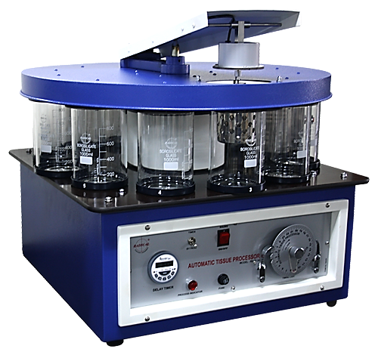
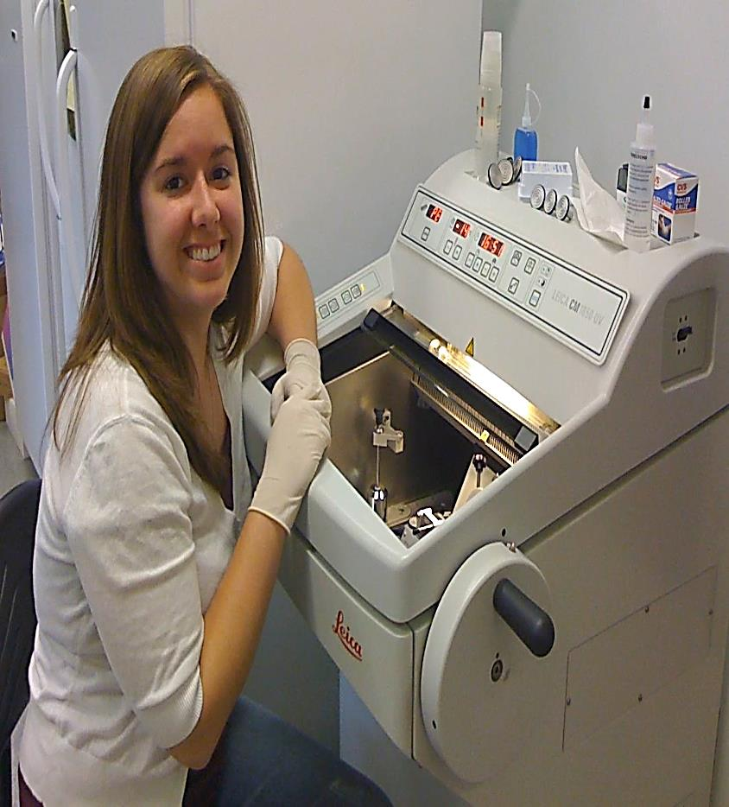
Cell Bio-2 Microtechniques

Slide 3
Micro techniques
For
Light microscopy
I
Paraffin
II Freezing
To preserve the structure and chemical composition of the specimen

Slide 4
I: Paraffin technique
Technique used to prepare the tissues for light microscopy
it includes the following steps:
1. Fixation : in appropriate solution (formol saline)
2. Dehydration and clearing : in alcohol then xylol
3. impregnation & Embedding : in paraffin wax (Soft & hard)
4. Sectioning : by microtome
5. Mounting : on glass slides
6. Staining of the sections

Slide 5
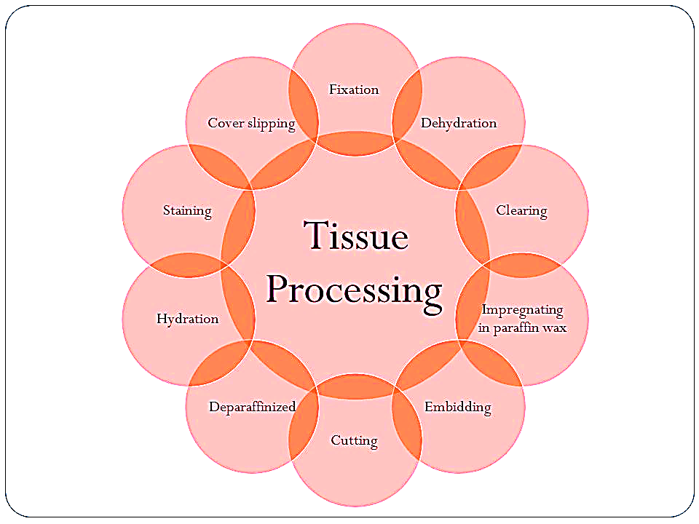

Slide 6
Fixation
To maintain the structure of the tissue as in the life state
Immediately the sample for analysis is placed in a fixative solution upon removal from the body
Fixation is done as soon as possible to prevent autolysis and to preserve the morphology.
For LM:
Formol saline
For EM: a mixture of
Glutaraldehyde
Osmium tetroxide

Slide 7
Advantage of fixation :
Hardens the tissue by coagulating its protein → Facilitate the process of cutting & staining & examination
Prevent putrefaction & stop autolytic changes by killing bacteria
Preserves the molecular & morphological structure of the tissue

Slide 8
Dehydration & Clearing
Dehydration : Is done by treating the specimen with ascending concentration of alcohol ( 50% → 70%→ 100%) ….. Gradual removal of water from the specimen (H2o represent 70% of the body)
Clearing : with this process the tissue become translucent (to allow the light to penetrate the specimen)
the tissue is treated with xylol or benzol …to remove the alcohol

Slide 9
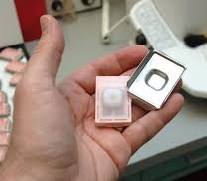
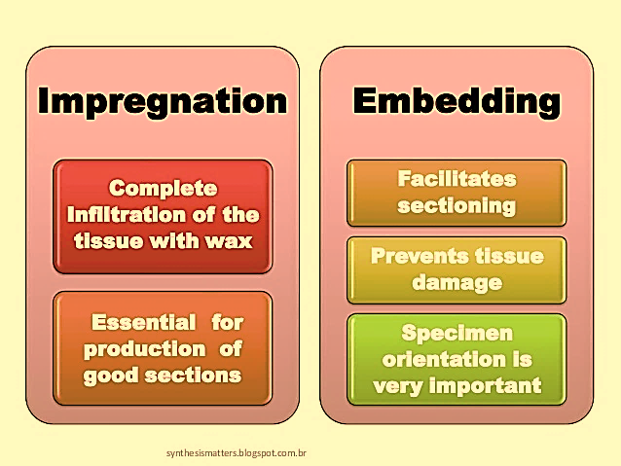
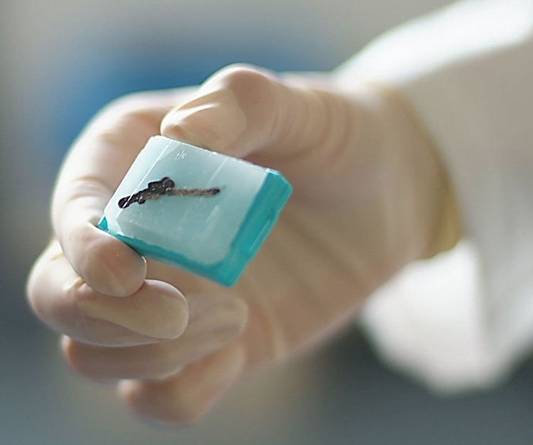
Impregnation & Embedding
Impregnation :
Tissues are placed in molten soft paraffin wax
The wax infiltrates the tissue & occupies all
the spaces that were originally occupied with water
Embedding:
Tissue are placed in molten hard paraffin wax
The tissue is placed in the
center of the paraffin,
which hardens as it cools
→ paraffin block

Slide 10
Automatic tissue processor
The steps required to take animal or human tissue from fixation to the state where it is completely infiltrated with soft paraffin wax then to be embedded in hard wax for section cutting on the microtome.

Slide 11
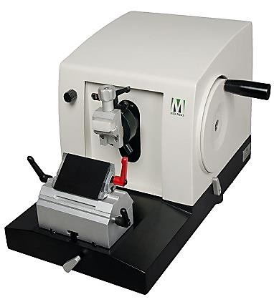
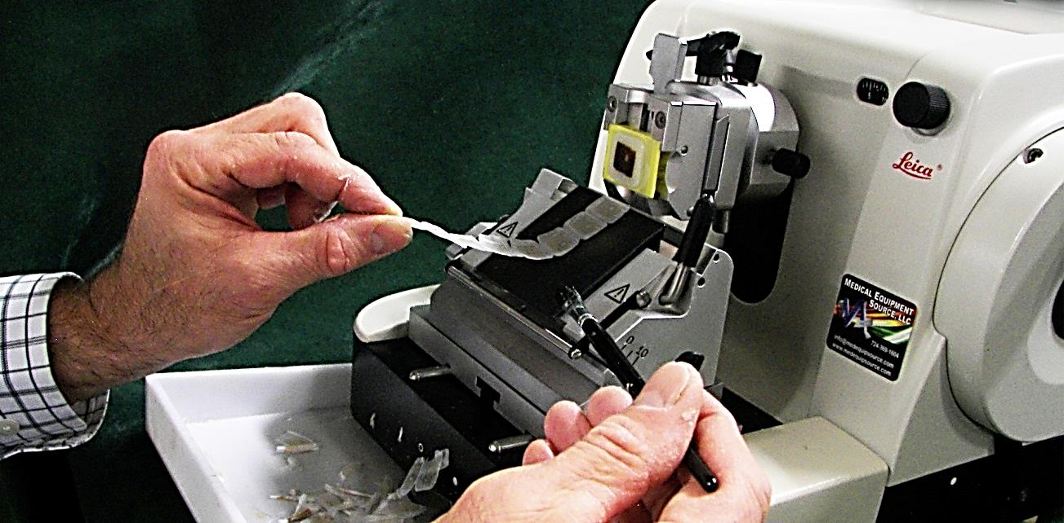
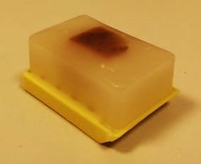
Sectioning by Microtome
A microtome is a mechanical device used to cut extremely thin slices of a fixed tissue block
known as sections.
It holds the block of hard paraffin with the tissue in its center against a sharp metal knife that used to cut the block into thin sections (3-10 microns) as it moves up and down.

Slide 12
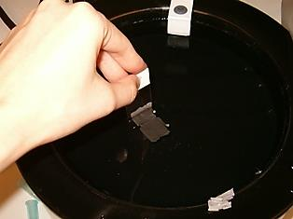
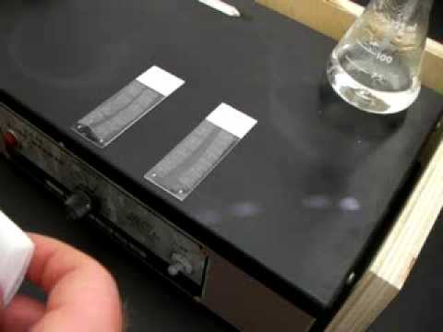
mounting
Tissue sections are placed on glass slides smeared with egg albumin , then warmed on a hot plate to dry.
The sections are now ready to be stained

Slide 13
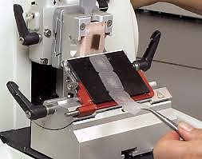
II. Freezing technique
Fresh frozen tissues are cut using freezing
microtome (cryostat). The sections placed
in cold fluid called Isopentane/liquid nitrogen
(-50 C) then rapidly stained.
Advantages:
Rapid technique for diagnosis of tumors.
No fixation , No dehydration & No chemicals are used, so useful for histochemical (enzyme staining) studies.
Disadvantages:
Non serial & Fragmented sections .
Cannot be preserved for a long time.

Slide 14
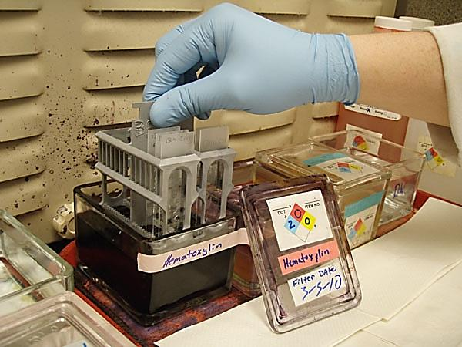
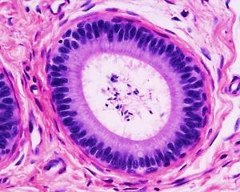
Staining
The tissue sections that will be studied using the light microscope must be stained first since most tissues are colorless
Dyes (stains) used are either basic or acidic

Slide 15
Staining
Used to visualize & distinguish the different parts of cells & tissues
Routine stains
H&E
Special stains
e.g. Ag & orcein,
trichrome….etc

Slide 16
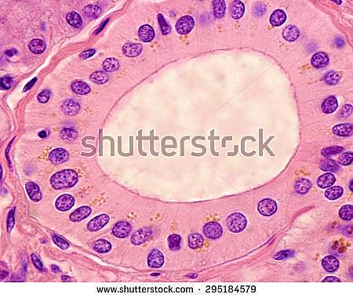
Common (Routine) histological stains H&E
Hematoxylin (H) :
blue basic dye ( +ve charged)
Stains acidic (anionic –ve) components of the cell with a blue color e.g. nucleus, ribosomes (r-RNA)
Basophilic structure=blue
Eosin (E):
red acidic dye (- ve charged)
Stains basic (cationic +ve) components of the cell with a red color e.g. cytoplasm, mitochondria, muscles !!
(it has +ve charged proteins)
Acidophilic structure=red

Slide 17
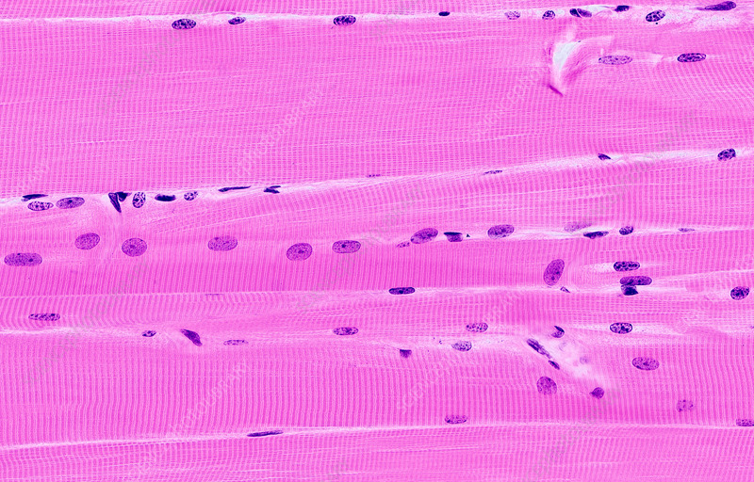
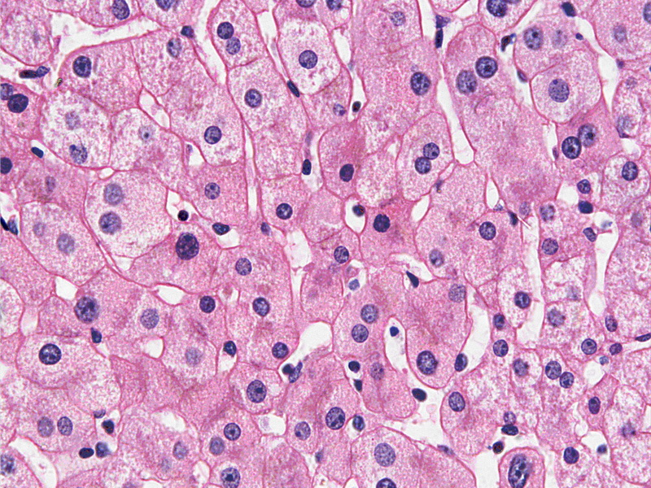
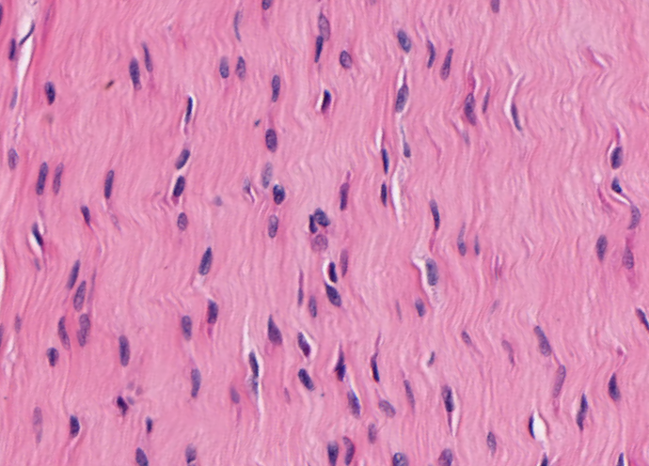
L.S skeletal ms. fiber ( contains actin & myosin) stained with H &E
Liver cells contains plenty of mitochondria stained with H &E
Collagen fibers stained with H & E

Slide 18
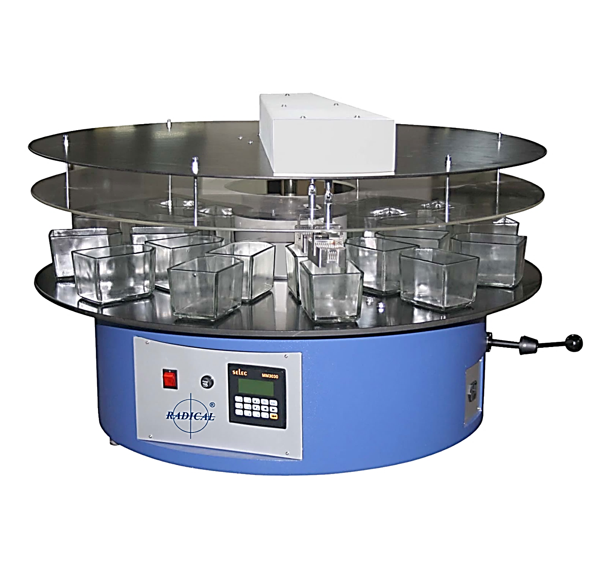
Automatic slides staining machine

Slide 19
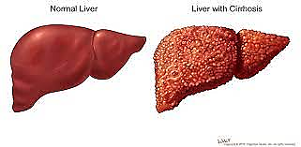
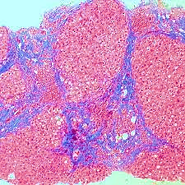
The clinical values of special stains
Special stains answer specific questions like what type of cells and tissues
Used in the diagnosis of medical diseases like Tichrome stain in case of Liver Cirrhosis

Slide 20
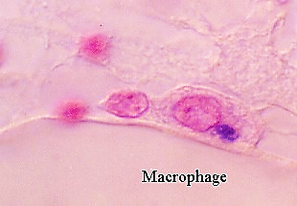
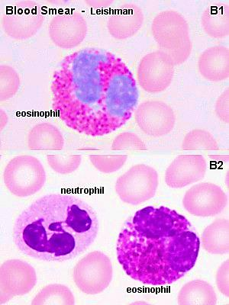
Vital stain:
Stain the living cells inside the living animal. Done by injecting the dye into living animal prior to examine the tissue .e.g. staining phagocytic cells (macrophages) with Trypan blue & Indian ink
Leishman stain:
mixture of acidic & basis stains to stain
nuclei & cytoplasm
(methylene blue & Eosin)It used to stain
blood films to demonstrate white blood
cells, malaria parasite

Slide 21
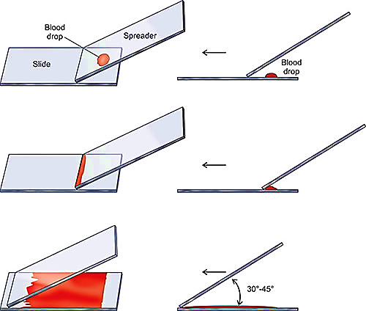
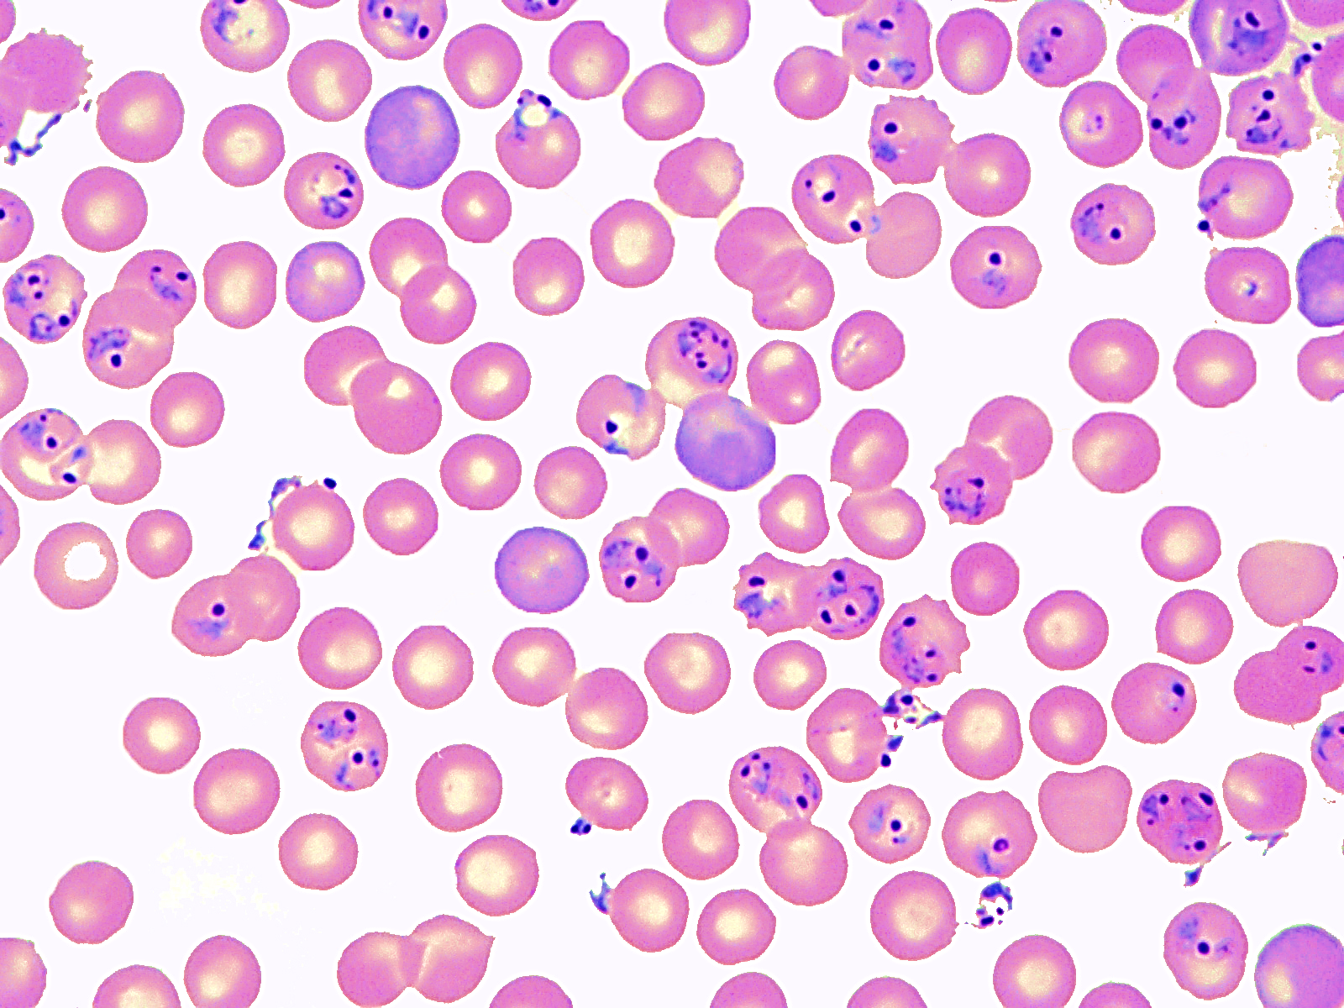
Red blood cells infected with malaria parasite
Technique of blood film

Slide 22
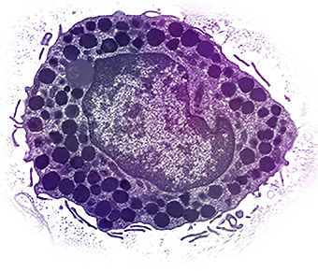
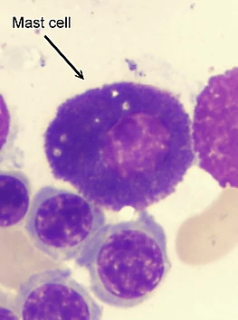
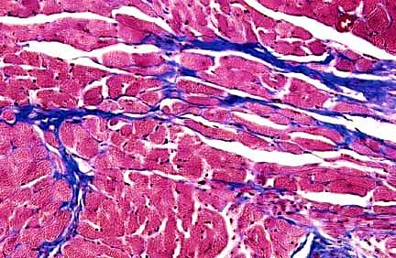
Metachromatic stain:
Stain gives the tissue new color different from that of the original stain e.g. Toluidine blue when stains Mast cells gives purple color (different from the blue color of the stain). Phenomenon called metachromasia.
Trichrome stains: (connective tissue)
3 stains used in combination to stain different tissues Components e.g. collagen fibers stained blue
Mast cell

Slide 23
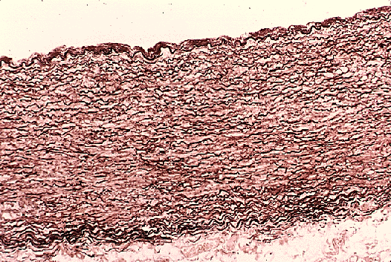
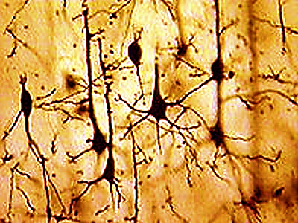
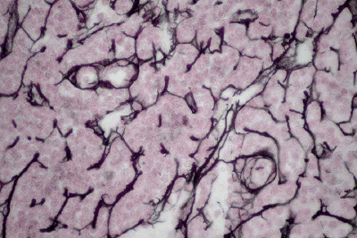
Orcein stain : stains elastic fibers brown ( wall of aorta)
Silver (Ag) stain: nerve cell brown & reticular fibers black

Slide 24
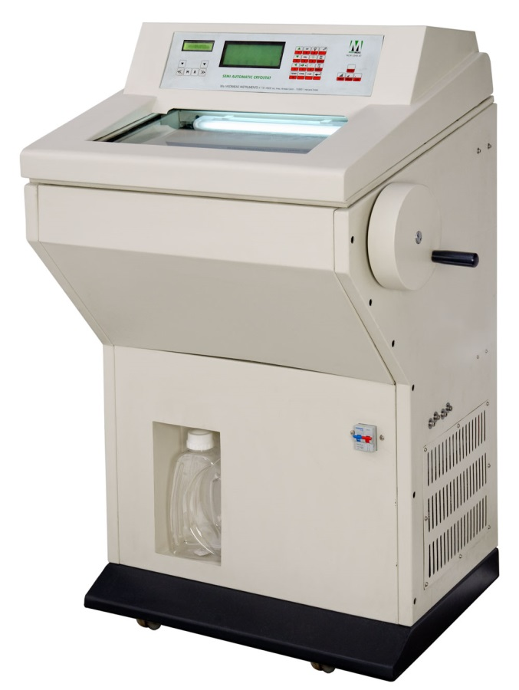
Histochemical stains: (Relate structure to function)
technique used selectively identify & demonstrate the distribution of chemical compounds or enzymes within and between the cells e.g. mucine or alkaline phosphatase enzyme
Concept: enzyme of interest in a cell or tissue converts its substrate to a colored or florescent product that can be visualized at the site of the activity
Immuno-histochemical (IHC) stains:
Laboratory method that selectively identify antigens
using specific antibodies to check for these
antigens in a sample of tissue. The antibodies are usually linked to an enzyme or a florescence dye (markers) ( Labeled antibodies).
cryostat

Slide 25
After the antibodies are linked to the antigen in the tissue sample the enzyme or dye is activated. The localization of the antigen can be seen under the microscope
IHC staining can be detected through 2 methods of detection either chromogenic and florescent
(labeling we use : Fluorescein , Rhodamine)
Indirect vs direct IHC : high sensitivity , signal amplification, ability to detect several targets in the same sample
This is method use for:
Diagnosis of cancers ( markers) and can tell the difference
between different types of cancer . Tumor specific

Slide 26
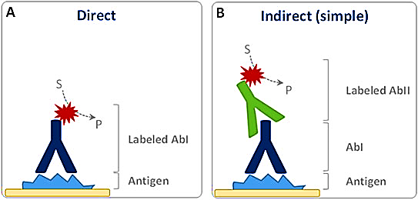
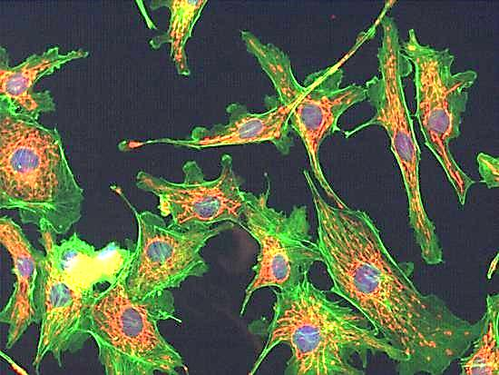
Histochemistry
(Alkaline phosphatase enzyme)
(this enzyme removes phosphate group from protein)
immunohistochemistry

Slide 27
Molecular analysis
It means biochemical analysis of certain components of the cell. It is usually quantitative in nature.
Examples are:
Protein-electrophoresis
DNA – electrophoresis
Fluorescent In situ hybridization ( FISH technique)
Detection of certain ions in the cell e.g. Ca, Fe….etc.

Slide 28
Protein electrophoresis: (BL serum protein electrophoresis) Proteins carry a positive or a negative electrical charge, and they move in fluid when placed in an electrical field. Proteins will be separated according to their charge & molecular weight
( e.g. blood cancers:↑ increased gamma globulin protein (M protein) = multiple myloma)
DNA electrophoresis: is technique used to identify & quantify DNA fragments ( DNA fragments are -ve charged).
(in this case separation is based on length of the base pair)
Samples are loaded into wells of an agarose or acrylamide gel and subjected to an electric field, causing the negatively charged nucleic acids to move toward the positive electrode.
Small fragments will move faster than the large ones
( DNA fingerprint , gene isolation, disputed paternity )

Slide 29
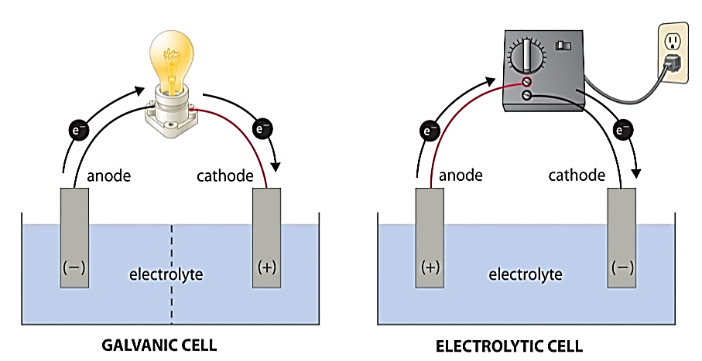
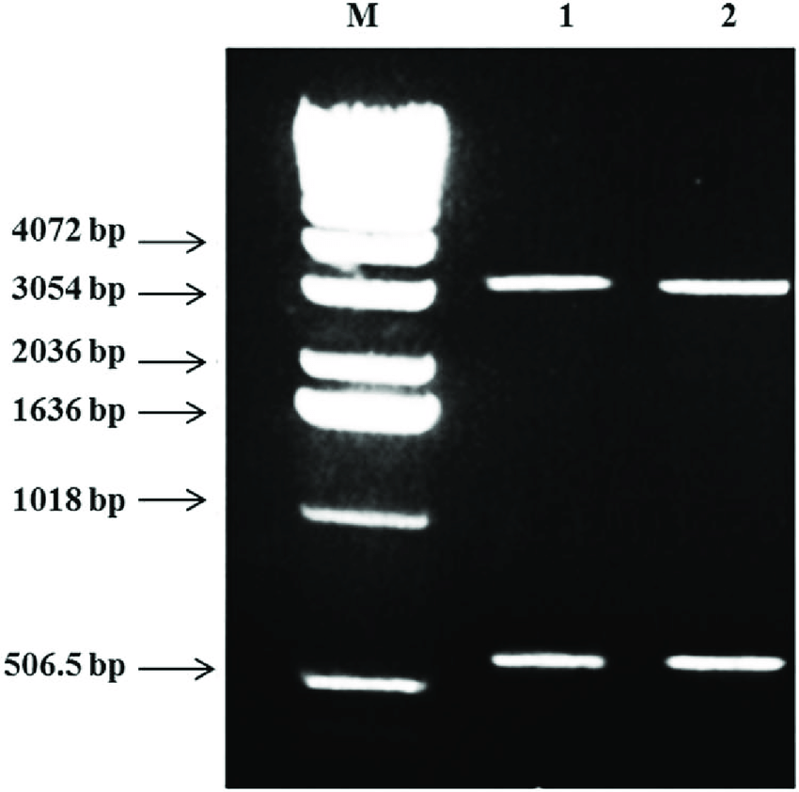
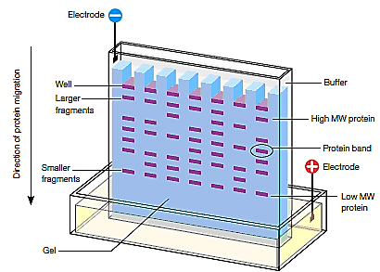
DNA Ladder: DNA fragments of known lengths
used to estimate the size of unknown DNA molecule
Fragment size usually referred
to as base pair (bp). The shorter fragments travel faster
Protein electrophoresis

Slide 30
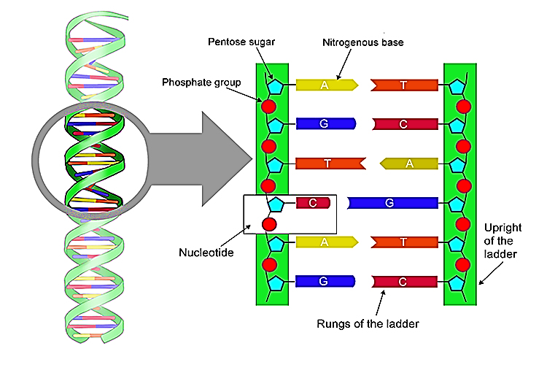
A base pair: is a unit consisting of two nucleobases bound to each other by hydrogen bonds.
They form the building blocks of the DNA double helix.
Sequence of bases on DNA determine genetic code for a trait
The human genome contains approximately 3 billion of these base pairs, which reside in the 23 pairs of chromosomes within the nucleus of all our cells

Slide 31
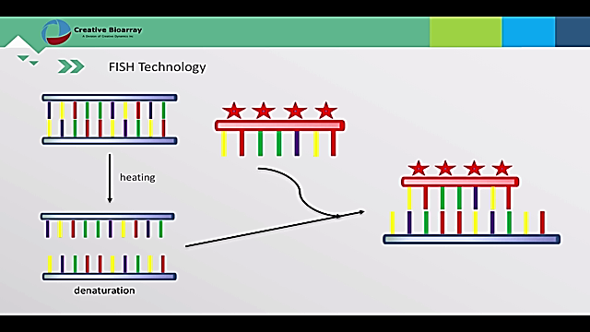
Fluorescent In situ hybridization ( FISH technique):
Molecular technique used to visualize and map the genetic material. Use to localize the site of the genes on chromosomes using a fluorescent probe
fluorescent probe:
fragment of DNA or RNA of variable length which can be radioactively labeled (probe)
It can be used in DNA or RNA
samples to detect the presence
or absence of nucleotide
sequence that are complementary
to the sequence on the probe .
Useful in detect chromosomal abnormalities

Slide 32
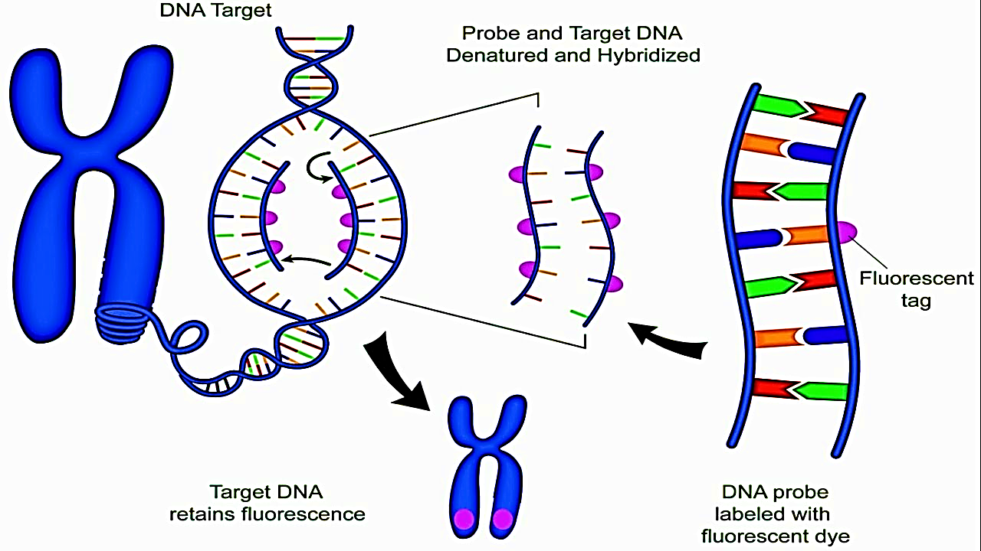

Slide 33
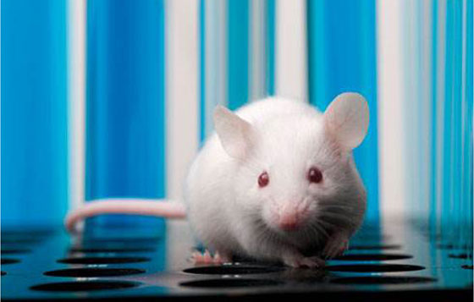
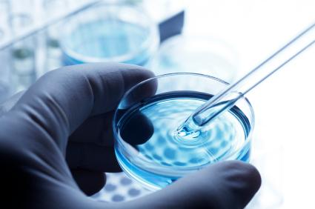
Methods for study tissues
1-In vivo studies: within the living body . Study of tissues after doing any experiment inside the living body ( animal model based testing)
2-In vitro studies: outside the body Study of tissues outside their normal biological
context ( cell based testing )

Slide 34
Cell and Tissue Culture
In vitro cultivation of tissues & cells at defined temperature(37C) using an incubator & supplemented with a medium containing cell nutrients & growth factors(like animal serum) is collectively known as tissue culture.
Different types of cells can grow in cultures as:
white blood cells, fibroblasts, skeletal and cardiac
muscle, epithelial tissue (liver, breast, skin, kidney)
and many different types of tumor cells.

Slide 35
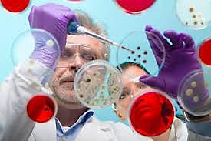
Medical uses of tissue culture:
1- used in studying chromosomal patterns of individuals …. Karyotyping, gene therapy
2- Used in researches of cancer
3- Used in cultivation of bacteria, viruses, in order to prepare different vaccination
4- Study the effects of new drugs

Slide 36
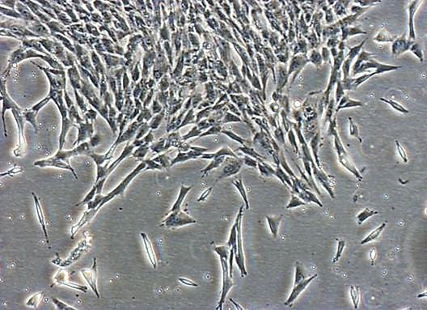
Cell culture
Cells can be isolated from the body for in vitro cultures. Cells can be released from tissues by enzymatic digestion Using enzymes such as collagenase and trypsin which break down the extracellular matrix.
Primary cultures:
Refer to the cells that are cultured directly
from a tissue (parent cells).
Secondary cultures:
Once the parent cells reach confluence they have to be sub-cultured (i.e. passaged) by transferring them to a new vessel with fresh growth medium to provide more room for continued growth
Confluence:
stage in which the cells (1ry or 2ry) become adherent to & covering most of the culture surface forming monolayer( e.g. 25%, 50%, 100%)

Slide 37
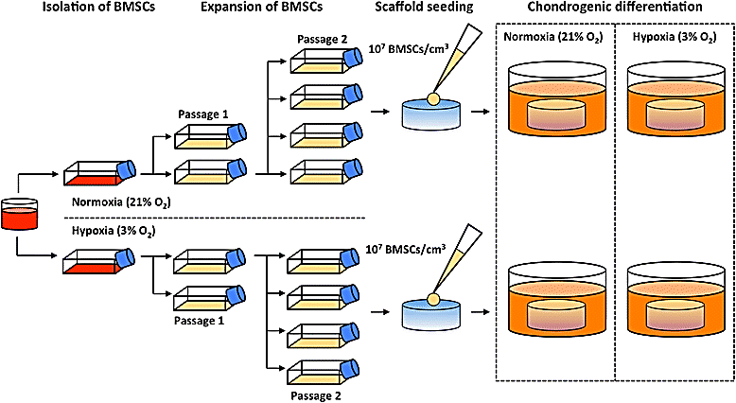
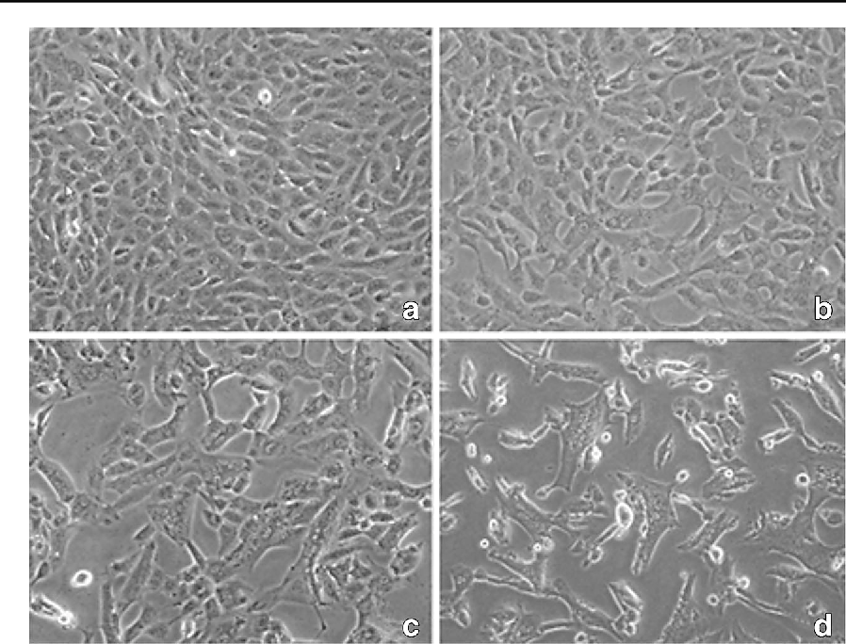
Cell passage = subculture
Different degrees of confluency

Slide 38
cell line:
a population of cells (clone)developed from a single cell therefore consisting of cells with a uniform genetic make-up (phenotype & function)
Cell lines have a limited life span, and as they are passaged
immortalized cell line
Has acquired the ability to proliferate indefinitely.
It is obtained from subcultures of the primary culture
Normal immortalized cell line: stem cells
Abnormal immortalized cell lines : cancer cells

Slide 39
Cell fractionation
It means isolation of the cell components (nucleus & organelles) while preserving its individual function to study the features of each.
This is done by the use of centrifugation at different speeds and periods of time. The factor that determine whether a specific cell component ends up in the supernatant or the pellet is size and weight of component
Nuclei are the first to be separated followed by different cell organelles

Slide 40
The sediment at the bottom of the tube is called pellet, the less dense component at the top is called supernatant

Slide 41
Thank you

