Slide 1
Legal and Ethical Issues in Healthcare
Dr. Israa Al-Rawashdeh MD, MPH, PhD
Faculty of Medicine
Mutah University
2022

Slide 2
Importance for the healthcare professional to understand legal and ethical issues
1. Knowledge of legal responsibilities
2. Limitations of practice
3. Implications of their actions

Slide 3
Importance for the healthcare professional to understand legal and ethical issues
Protection of
Healthcare professionals
Patients
Co-workers
Facility

Slide 4
Importance for the healthcare professional to understand legal and ethical issues
Ethical behavior ensures
Quality patient care
Positive work relationships
Well-managed workplace

Slide 5
Examples of current legal and ethical dilemmas
Abortion
Euthanasia (mercy killing)
Organ donation
Research and Experimental Treatment (right to try experimental drugs)
Sex Determination & genetic counselling
Patient Confidentiality
Artificial Intelligence

Slide 6
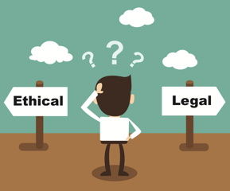
Medical Law and Ethics
Law
Ethics
A law is a rule of conduct or action.
Ethics is a standard of behavior.
Moral values serve as the basis for ethical conduct.
Governments enact laws to maintain order and public safety.
Criminal and civil laws apply to health care practitioners.
Family, culture, and society help form individual’s moral values.

Slide 7
Ethical concepts
Ethics: Standards of behavior developed as a result of your moral values
The ability to distinguish right from wrong Involves a commitment to do what is right, good, and proper
Role of HA: Making decision of the right behaviour! Difficult in some cases!

Slide 8
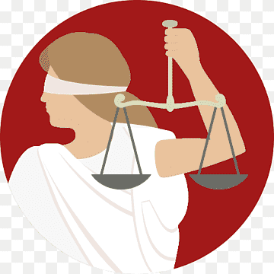
Theoretical base of ethical decisions
Deontological decisions (Deon = duty):
Based on a duty or moral obligation motivated by oath or other circumstance.
Considers that it is the professional’s duty to do everything possible for the patient, regardless of the possible outcomes.
Actions determined by rightness or wrongness (virtue ethics)

Slide 9
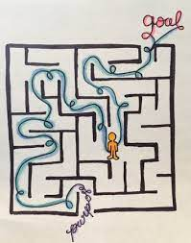
Theoretical base of ethical decisions
2. Teleological decisions (Telos = goal/end):
Based on the considerations for the outcome of the action
“The end justifies the means.”
Actions will vary depending on the situation (situational ethics)
The principle of utility, which states that an act must result in the greatest amount of good for the greatest number of people involved in a situation.
Views the consequences of the action as valuable as the ability to perform the procedure.

Slide 10
Theoretical base of ethical decisions
Deontology
Values are not universally shared
Do not consequences matter?
Teleology
Greatest good for the greatest number does not protect minority rights
Not always possible to predict consequences accurately
Your values may conflict with the action needed

Slide 11
Ethical Principles
1. Autonomy: The state of being self-governing or essentially respecting an individual’s right to make decisions for themselves. It is more than a patient’s constitutional right to refuse treatment.
Includes respect for the patients’ privacy and confidentiality.
It includes each staff member’s right to decide what is the right thing for him or her to do.
Needs to provide enough information for them to make informed choices.
Truth telling.
Protection of persons with diminished or impaired autonomy.

Slide 12
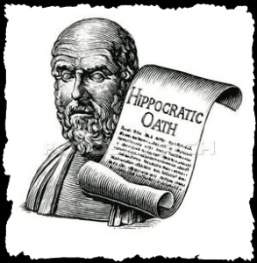
Ethical Principles
2. Non-maleficence: The absence of harm or as it is attributed to the physician’s oath to “do no harm.” Maleficence is an action that is considered harmful or evil.

Slide 13
Ethical principles
3. Beneficence: Beneficence refers to the state of producing good acts.
Acting always in the patients’ best interest to maximise benefits and minimise harm.
This is affected by one’s personal definition of what is “good.”
However, there are general aspects of this principle that are common to most cultures and religions.

Slide 14
Ethical principles
4. Justice: Society as a whole believes the principle of justice means that all people are treated fairly and equally.
It also means:
duty to help others in serious need
the right to health care is a basic component of a just society (social justice).

Slide 15
Ethical principles
5. Veracity, the obligation to tell the truth.
6. Fidelity, the duty to do what one has promised.

Slide 16
Organizational ethics
Organizational ethics is an emerging area in health care management.
Health care organizations have focussed on the ethical issues faced by clinicians in the direct delivery of clinical care (i.e. clinical ethics) or by researchers in the conduct of clinical research (i.e. research ethics).
Organizational ethics is more concerned with the ethical issues faced by managers and board members and the ethical conswquences of organizational decisions and practices on patients, staff, and the community.

Slide 17
What organizational ethics issues are health care administrators facing?
Resource allocation
Business development
Disagreement over treatment decisions
Access to care for the uninsured
Workplace ethics

Slide 18
Unethical practices (Ajlouni et al 2015)
Examples of unethical practices reported by studies done in Jordan. Clinicians and Administrators highlighted the following concerns:
1. Hiring of unqualified workers to care for patients with complex problems.
2. The request for commission and “split-fees”
3. Unethical practice by families.
4. providing unnecessary services
5. Health professionals in private hospitals are obligated to their patients, they compromise their professional standards to please the owners.
6. Private hospitals consider the cost of medical care and make decisions on behalf of patients; avoid taking care of financially-uncapable patients; admit the financially capable patients; and welcome short-term illnesses for profit.
Ajlouni, M. T., Dawani, H. and Diab, S. M. (2015) ‘Home Health Care (HHC) Managers Perceptions About Challenges and Obstacles that Hinder HHC Services in Jordan’, Global Journal of Health Science, 7(4), pp. 121–129. doi: 10.5539/gjhs.v7n4p121.
Oun, S. S. Al and Smadi, Z. (2011) ‘Healthcare commercialisation in Jordan’s private hospitals: ethics versus profit’, International Journal of Behavioural and Healthcare Research, 2(4), p. 362. doi: 10.1504/ijbhr.2011.043417.

Slide 19
Legal concepts
Law means body of rules to guide human action.
Law is a system of rights & obligations which the state enforces.
Law is the body of principles recognised by the state & the administration of justice.

Slide 20
Laws
1. Public (Criminal) Law: Protect the public as a whole from the harmful acts of others. Wrongs against a person, property or society.
Felonies جنائي – carry a punishment of death or imprisonment in a state or federal prison. Examples: murder, rape, robbery, tax evasion, practicing medicine w/o license, misuse of narcotics, theft.
Misdemeanors جنحة– less serious offenses that carry a punishment of fines or imprisonment in jail for up to a year.
2. Civil (Private) Laws: Concerns relationships between individuals and the protection of a person’s rights. Generally carry a financial damage. Healthcare employees are most frequently involved in cases of civil law.

Slide 21
Laws
Includes a general category of laws known as torts الاضرار
Torts are either:
Intentional (willful)
Unintentional (accidental)

Slide 22
Intentional Torts
Health care workers (Administrators) are required to report any signs or symptoms of intentional torts.
Assault
To cause another person to feel threatened.
Battery
An action that causes bodily harm to another. Even touching without permission (consent).
Invasion of privacy
The intrusion into the personal life of another. Public disclosure of private information. Inappropriate exposure. Violating confidentiality.
Fraud
intentional misrepresentation that may cause harm, loss, or collection of monies not legitimately due.
Defamation of Character
False Imprisonment
Damaging a person’s reputation
by making a public statement. تشهير
Intentional, unlawful restraint or confinement of a person.

Slide 23
Unintentional Torts
Acts that are committed with no intent to cause harm
but are done with a disregard for the consequences.
The term negligence is used to describe such actions when health care practitioners fail to exercise ordinary care resulting in patient injury.
Malpractice is the negligent delivery of professional services.

Slide 24
Claims
Malpractice claims are lawsuits by a patient against a physician for errors in diagnosis or treatment.
Negligence cases are those in which a person believes a medical professional’s actions, or lack thereof, caused harm to the patient.

Slide 25
Examples of Negligence:
Abandonment
Delayed treatment
Legal Terms used to classify Negligence
Malfeasance (unlawful act or misconduct)
Misfeasance (lawful act done incorrectly)
Nonfeasance (failure to perform an act that is one’s required duty or that is required by law)

Slide 26
The 4 Ds of Negligence
D
amages
Patients must prove that they suffered injury.
erelict
Patients must show that the physician failed to comply with the standards of the profession.
uty
Patients must show that a physician-patient relationship existed.
irect Cause
Patients must show that any damages were a direct cause of a physician’s breach of duty.
Patients must be able to prove all 4 Ds in order to move forward with a malpractice suit.

Slide 27
Contracts
A contract is a voluntary agreement between two parties in which specific promises are made for a consideration.
4 Elements of a Contract
Agreement
Consideration
Contractual Capacity (competency)
Legal Subject Matter

Slide 28
Contracts
Types of Contracts
Expressed Contracts
Clearly stated in written or spoken words
A payment contract is an example
Implied Contracts
Actions or conduct of the parties, rather than words, create the contract
Examples: A patient rolling up his/her sleeve to receive an injection, A patient filling in a questionnaire.

Slide 29
Other legal health documents
A legal document stating types of treatment the patient does and does not want in an event of terminal illness, unconsciousness, or comatose state.
Living
Wills
(Advance
Directives)
Patients with living wills are asked to name someone that will make decisions on their behalf (durable power of attorney) if they are unable to do so.
Uniform
Donor
Card
A legal document that states a person’s wish to donate one or more organs as a donation. Even total body anatomical donations are made.

Slide 30
A case from Jordan
September 2017.
A new born with malformations needed operation
The operation required the father’s consent.
The father refused to give consent because of issues with the mother.
Operations could not be done (administrators decision)
The newborn passed away.

Slide 32
RIGHTS
A patient has the right to:
1. Considerate and respectful care
2. Obtain complete, current information concerning diagnosis, treatment, and prognosis
3. Receive information necessary to give informed consent prior to the start of any procedure or treatment
4. Refuse treatment to the extent permitted under law
5. Privacy concerning a medical-care program
6. Confidential treatment of all communications and records
7. Reasonable response to a request for services
8. Obtain information regarding any relationship of the hospital to other health care and educational institutions
9. Be advised of and have the right to refuse to participate in any research project
10. Expect reasonable continuity of care
11. Examine bills and receive and explanation of all charges
12. Be informed of any hospital rules or regulations

Slide 33
Responsibilities
Patient Responsibilities The collaborative nature of health care requires that patients and/or their families participate in their care.
Provide information about past medical history.
Participate in decision-making.
Ask for information and/or clarification if they do not fully understand.
Follow the physician’s order for treatment
Inform providers if they anticipate problems in following prescribed treatment.

Slide 34
THANK YOU

