Slide 1
Locomotor System

Slide 2
System that gives humans the ability to move while providing support, stability.

Slide 3
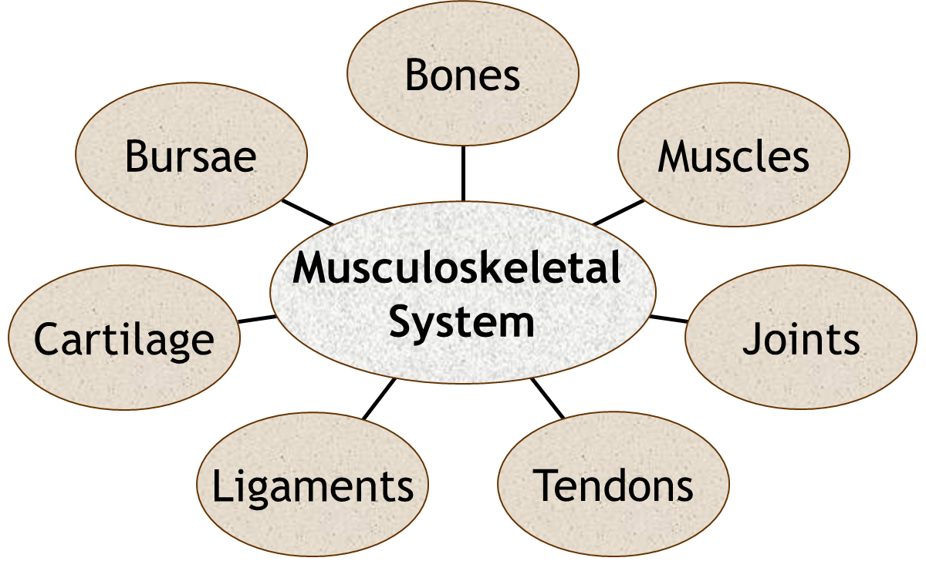

Slide 4
Symptoms
Pain
Stiffness
Swelling
Redness
Deformity
Weakness
Instability
Loss of function

Slide 5
Pain
Onset
Duration
Character
Course
Timming
Severity
Aggravating and relieving factors
Location
Radition
Associated symptoms

Slide 6
Stiffness
Limited Range of motion
Generalized or localized
Timing and duration
Locking

Slide 7
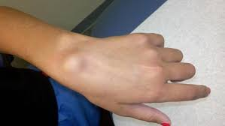
Swelling

Slide 8
Redness

Slide 9
Deformity

Slide 10
When taking a history for an acute problem always inquire about the mechanism of injury, loss of function, onset of swelling (< 24 hours), and initial treatment
When taking a history for a chronic problem always inquire about past injuries, past treatments, effect on function, and current symptoms.

Slide 11
Review of system
Fever
Weight loss
Pain other joint
Related positive , other organ as part of rheumatological disease.

Slide 12
Past History
Past medical history
Past surgical history
Prior injuries or operations

Slide 13
Medication and Allergies
NSAIDs
steroids
narcotics

Slide 14
Family history
Rhematological disorder
Pain joints ( OA )

Slide 15
Social History
Occupation
Working / Retired
Manual labor / Desk job
Living situation
Alone / Spouse / Other supports
Ambulatory status
How far can they walk
Do they use a walker / cane
Smoking/ Alcohol/ Drug Use

Slide 16
Examination

Slide 17
Examination
The patient should be gowned and exposed as required for the examination
Some portions of the examination may not be appropriate depending on the clinical situation (performing range of motion on a fractured leg for example)

Slide 18
The musculoskeletal exam is all about anatomy
Think of the underlying anatomy as you obtain the history and examine the patient

Slide 19
Always begin with inspection, palpation and range of motion, regardless of the region you are examining (LOOK,FEEL, MOVE)
Specialized tests are often omitted unless a specific abnormality is suspected
A complete evaluation will include a focused neurological exam of the effected area

Slide 20
Inspection
Look for scars, rashes, or other lesions like abrasions/open wounds
Look for asymmetry, deformity, or atrophy
Always compare with the other side
Look for swelling
Look for erythema (redness)
Posture/position of the joint or limb

Slide 21
Percussion
Typically, we don’t percuss things in orthopedics however the one exception is nerves
If tapping over a nerve causes pain or electric shock sensations, this is called Tinel’s sign
Present when nerves are compressed or irritated
Also used to monitor nerve recovery after injury (in the form of an “advancing Tinel’s sign”)

Slide 22
Palpation
Examine each major joint and muscle group in turn
Identify any areas of tenderness
Joint line
Tendinous insertions
Palpate for any crepitus
Identify any areas of deformity
Always compare with the other side

Slide 23
Palpation
Warm or cold including pulses
Fluctuation/fluid collection
Compartments – soft or firm and painful
Sensation

Slide 24
Move
Active and passive
Ask the patient to move each joint through a full range of motion
Note the degree and type of any limitations (pain, weakness, etc.)
Note any increased range of motion or instability
Always compare with the other side
Proceed to passive range of motion if abnormalities are found

Slide 25
Passive ROM
Ask the patient to relax and allow you to support the extremity to be examined
Gently move each joint through its full range of motion
Note the degree and type (pain or mechanical) of any limitation
If increased range of motion is detected, perform special tests for instability as appropriate
Always compare with the other side

Slide 26
Muscle strength

Slide 27
Vascular
Pulses
Upper extremity
Check the radial pulses on both sides
If the radial pulse is absent or weak, check the brachial pulses
Lower extremity
Check the posterior tibial and dorsalis pedis pulses on both sides - if these pulses are absent or weak, check the popliteal and femoral pulses

Slide 28
Vascular
Capillary Refill
Press down firmly on the patient's finger or toe nail so it blanches
Release the pressure and observe how long it takes the nail bed to "pink" up
Capillary refill times greater than 2 to 3 seconds suggest peripheral vascular disease, arterial blockage, heart failure, or shock

Slide 29
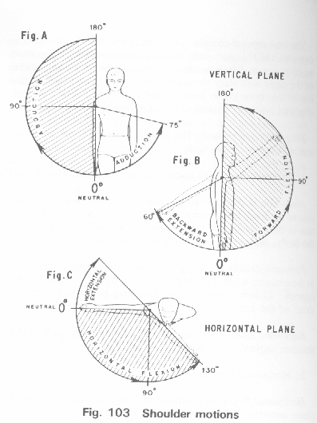
Special Joint and Special Test
Shoulder

Slide 30
Shoulder

Slide 31
Muscle strength
Internal rotation — subscapularis
External rotation — infraspinatus, teres minor
Abduction — supraspinatus and deltoid
Abduction with thumbs down and 30° horizontal adduction (“empty can test”) — isolates supraspinatus

Slide 32
Biceps
Palms up with elbows bent to 15° flexion and resisted upward motion (Speed’s test) — biceps
Simultaneous resisted supination and elbow flexion (Yergason’s test) — biceps

Slide 33
Impingement Signs/Impingement Test
Neer’s sign — extreme forward flexion with the forearm pronated
Hawkin’s sign — 90° forward flexion of the shoulder with the elbow flexed to 90° then internal and external rotation movements of the shoulder

Slide 34
Instability Tests
Anterior apprehension — performed with shoulder and elbow at 90°; apply an anterior force to the posterior shoulder pushing the humeral head anteriorly

Slide 35
Elbow

Slide 36
Elbow

Slide 37
Elbow
Varus test: Tests for ligamentous stability of the lateral collateral ligament
Valgus test: Tests the medial collateral ligament
Cozen’s test: (Lateral Epicondylitis / Tennis elbow test) Patient makes fist and pronates the forearm radially deviates and extends the wrist against resistance. Positive if pain in the lateral epicondyle area.
Golfer’s elbow test: While palpating the medial epicondyle, the forearm is supinated and the elbow and wrist are extended. Positive if pain over the medial epicondyle.
Tinel’s of the elbow: Percussion of the ulnar nerve in the grove. Positive if radiating sensation down arm into hand.

Slide 38
Hand and wrist

Slide 39
Hand and wrist

Slide 40
Hand and wrist

Slide 41
Phalen’s test

Slide 42
Tinel test

Slide 43
Spine

Slide 44
Spine

Slide 45
Hip

Slide 46
Hip

Slide 47
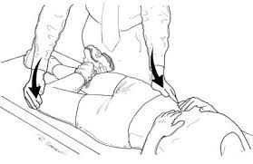
Patrick test

Slide 48
Knee

Slide 49
Knee

Slide 50
Knee

Slide 51
Anterior drawer test

Slide 52
Lachman

Slide 53
Posterior drawer test

Slide 54
Varus/ Valgus stress test

Slide 55
Mcmurray test

Slide 56
Ankle and foot

Slide 57
Ankle and foot

Slide 58
Anterior drawer test

