Slide 1
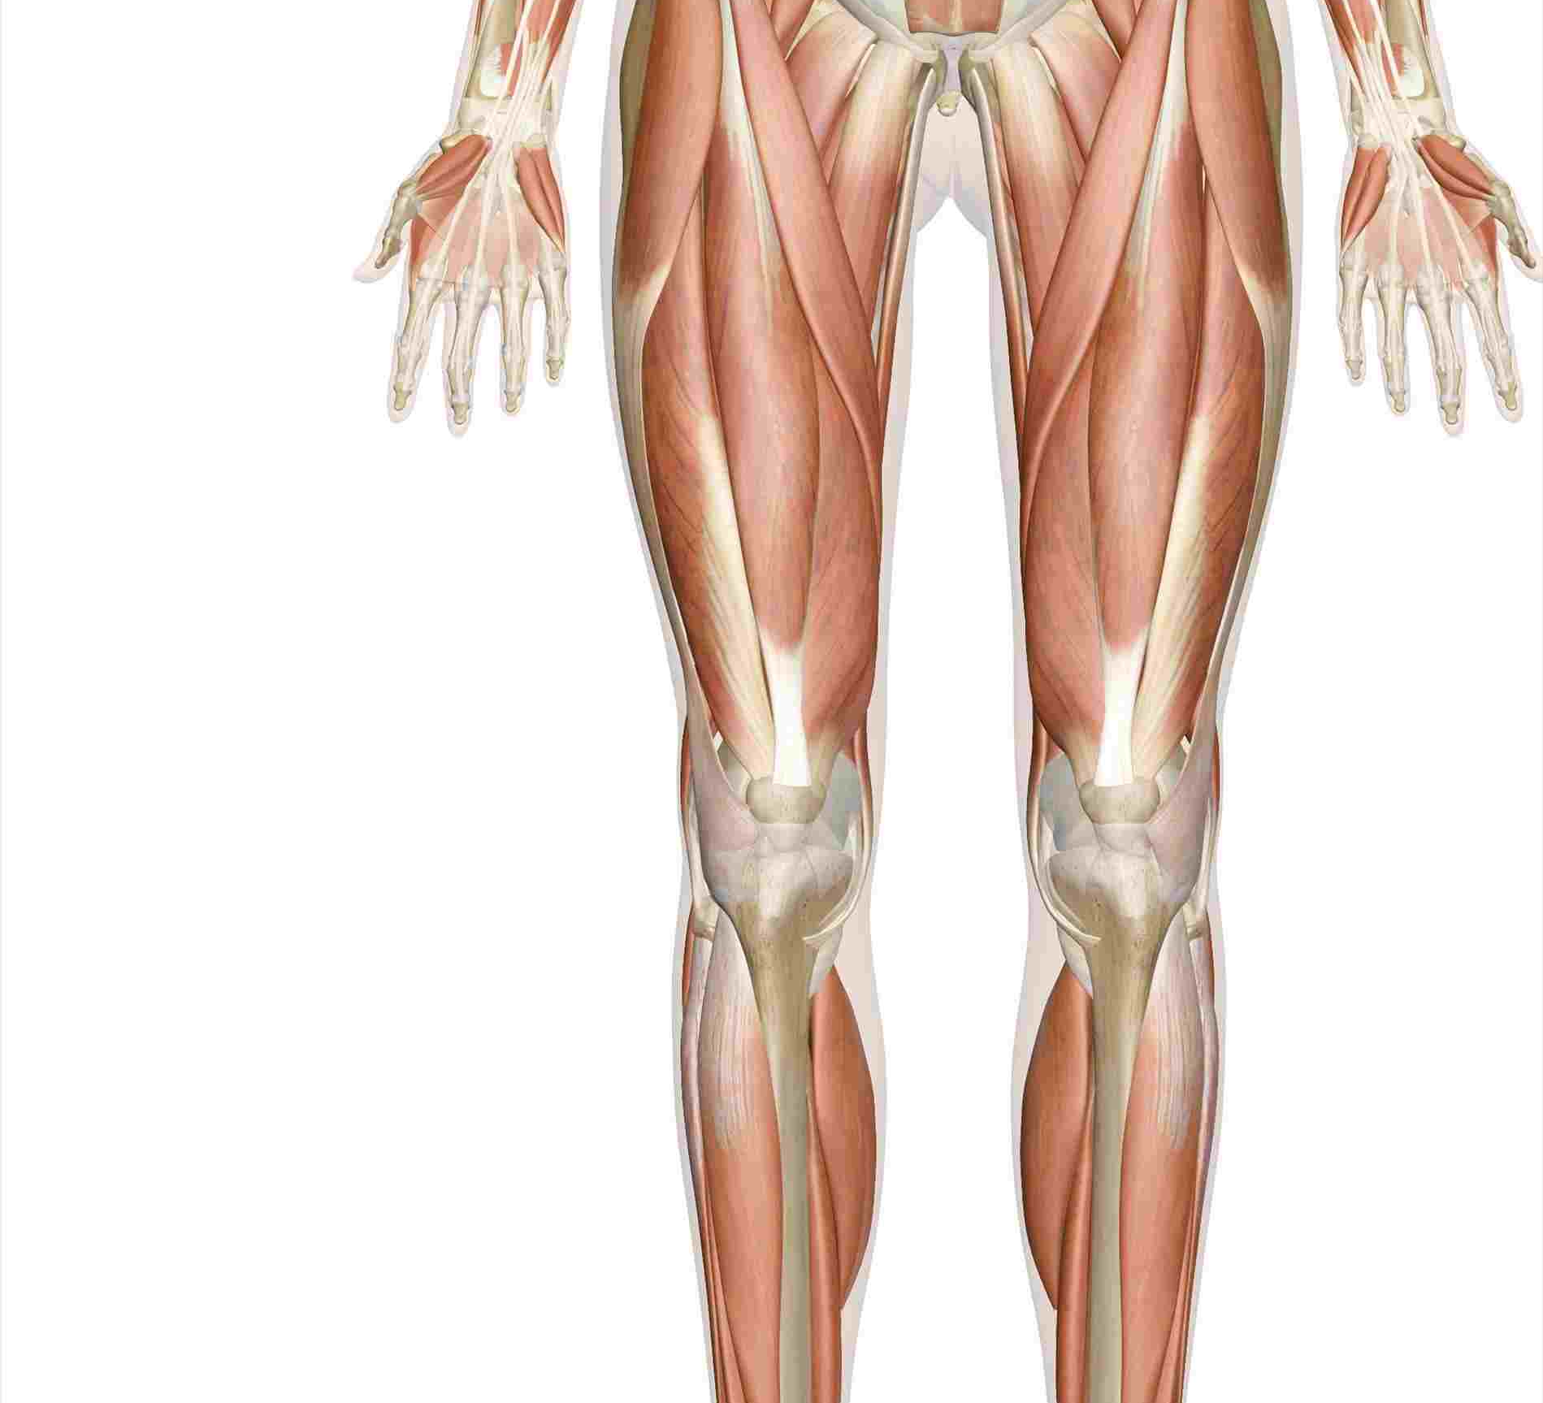
Lower Limb Muscules/ Part II
Dr Amal Albtoosh
Al-Rawashdeh

Slide 2
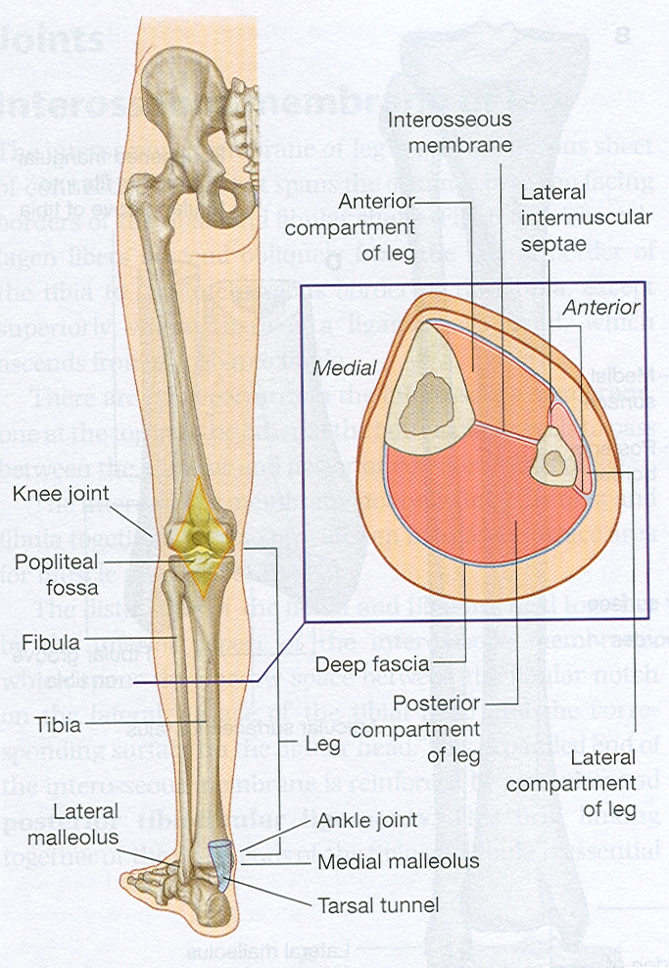
Leg compartments

Slide 3
The posterior compartment of the leg
The posterior compartment of the leg contains SEVEN MUSCLES
They organised into two layers – SUPERFICIAL and DEEP. The two layers are separated by a band of fascia.
The posterior leg is the largest of the three compartments.
Collectively, the muscles in this area PLANTARFLEX and INVERT the foot.
They are innervated by the TIBIAL NERVE, a terminal branch of the sciatic nerve.

Slide 4
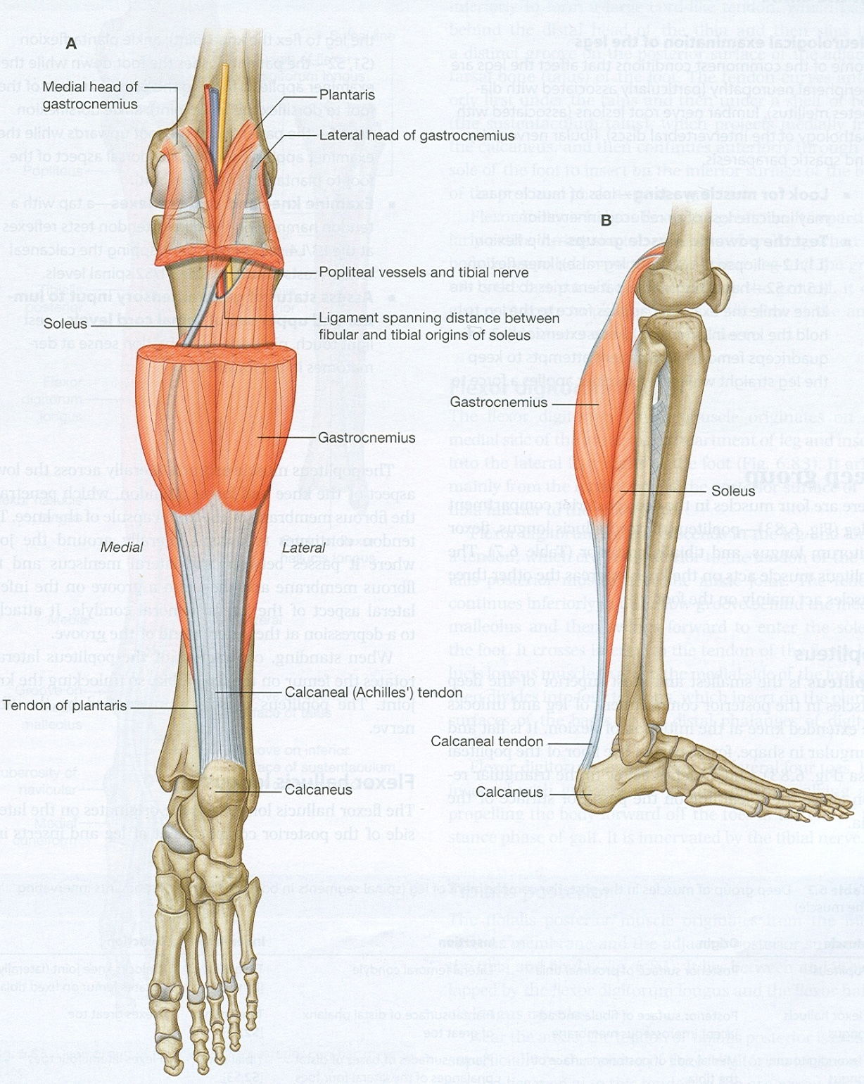
Superficial Posterior Muscles
The superficial muscles form the characteristic ‘calf’ shape of the posterior leg.
They all insert into the calcaneus of the foot (the heel bone), via the calcaneal tendon.
To minimise friction during movement, there are two bursae (fluid filled sacs) associated with the calcaneal tendon:
Subcutaneous calcaneal bursa – lies between the skin and the calcaneal tendon.
Deep bursa of the calcaneal tendon – lies between the tendon and the calcaneus

Slide 5
Superficial Posterior Muscles of the leg
GASTROCNEMIUS: is the most superficial of all the muscles in the posterior leg. It has two heads – medial and lateral, which converge to form a single muscle belly
PLANTARIS: is a small muscle with a long tendon, which can be mistaken for a nerve as it descends down the leg. It is absent in 10% of people.
SOLEUS is located deep to the gastrocnemius. It is large and flat, named soleus due to its resemblance of a sole – a flat fish.

Slide 6
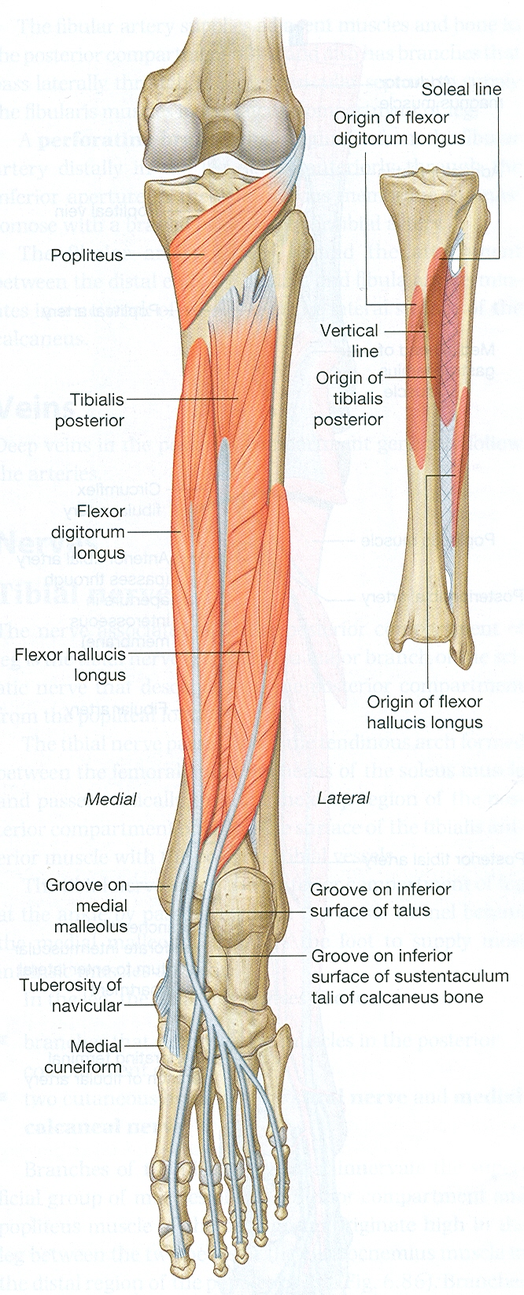
Deep posterior Muscles of the leg
There are FOUR MUSCLES in the deep compartment of the posterior leg.
One muscle, the popliteus, acts only on the knee joint. The remaining three muscles (tibialis posterior, flexor hallucis longus and flexor digitorum longus) act on the ankle and foot.
POPLITEUS: is located superiorly in the leg. It lies behind the knee joint, forming the base of the popliteal fossa. It Laterally rotates the femur on the tibia – ‘unlocking’ the knee joint so that flexion can occur.
TIBIALIS POSTERIOR: is the deepest out of the four muscles. It lies between the flexor digitorum longus and the flexor hallucis longus.
FLEXOR DIGITORUM LONGUS: FDL is (surprisingly) a smaller muscle than the flexor hallucis longus. It is located medially in the posterior leg.
FLEXOR HALLUCIS LONGUS: is found on the lateral side of leg. This is slightly counter-intuitive, as it is opposite the great toe, which it acts on

Slide 7
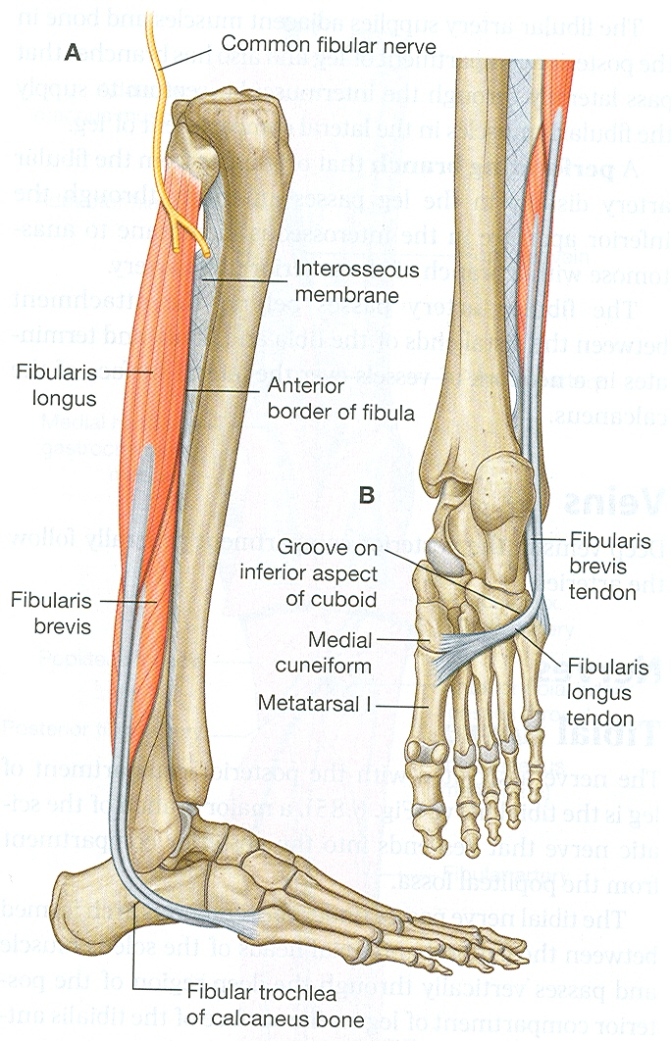
Lateral compartment of the leg
There are two muscles in the lateral compartment of the leg;
the Peroneal (fibularis )longus
Peroneal (fibularis ) brevis .
The common function of the muscles is eversion – turning the sole of the foot outwards.
They are both innervated by the superficial fibular nerve.
From the anatomical position, only a few degrees of eversion are possible. In reality, the job of these muscles is to ‘fix’ the medial margin of the foot during running, and prevent excessive inversion.

Slide 8
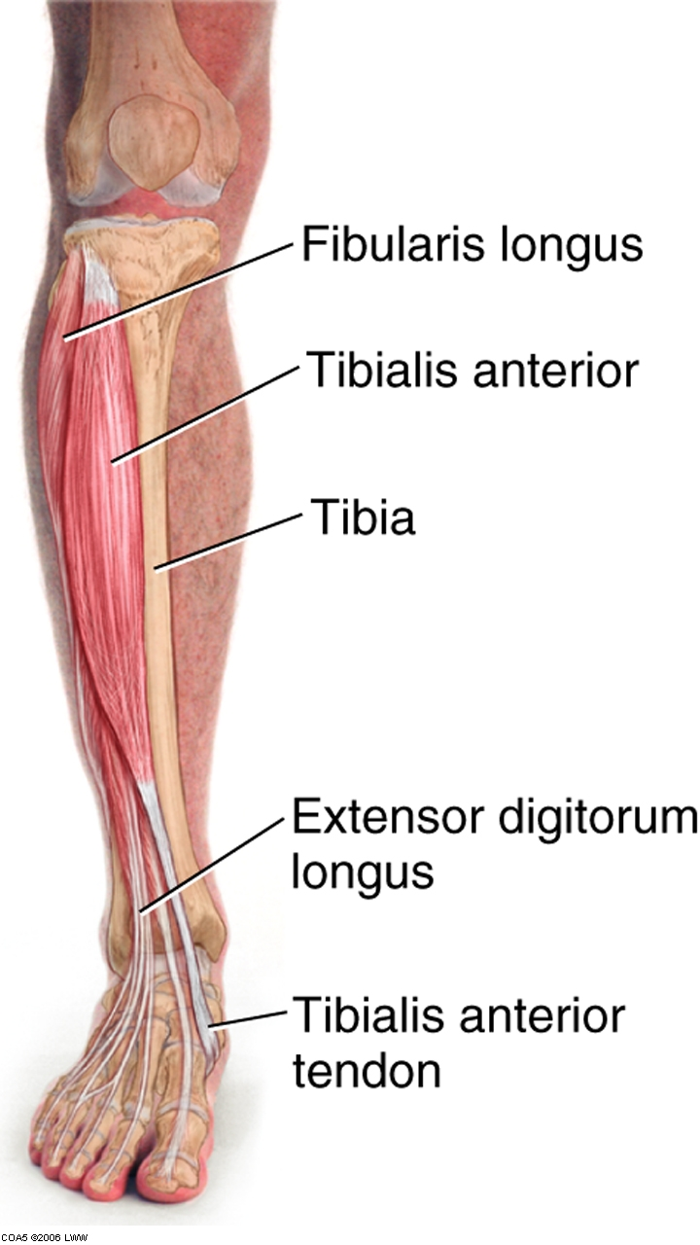
Anterior Compartment Of The Leg
There are four muscles in the anterior compartment of the leg;
Tibialis Anterior,
Extensor Digitorum Longus,
Extensor Hallucis Longus And
Peroneal Fibularis Tertius.
Collectively, they act to: DORSIFLEX and Invert the foot at the ankle joint.
The extensor digitorum longus and extensor hallucis longus also extend the toes.
The muscles in this compartment are innervated by the deep fibular nerve, and blood is supplied via the anterior tibial artery.

Slide 9
Muscles of the foot
The muscles acting on the foot can be divided into two distinct groups; extrinsic and intrinsicmuscles.
The extrinsic muscles arise from the anterior, posterior and lateral compartments of the leg.
They are mainly responsible for actions such as eversion, inversion, plantarflexion and dorsiflexion of the foot.
The intrinsic muscles are located within the foot and are responsible for the fine motor actions of the foot, for example movement of individual digits.
the intrinsic muscles of the foot can be divided into those situated on the dorsum of the foot, and those in the sole of the foot.

Slide 10
Dorsal Aspect/ Foot
Whilst many of the extrinsic muscles attach to the dorsum of the foot, there are only one intrinsic muscles located in this compartment – the EXTENSOR DIGITORUM BREVIS.
mainly responsible for assisting some of the extrinsic muscles in their actions. Both muscles are innervated by the DEEP FIBULAR NERVE

Slide 11
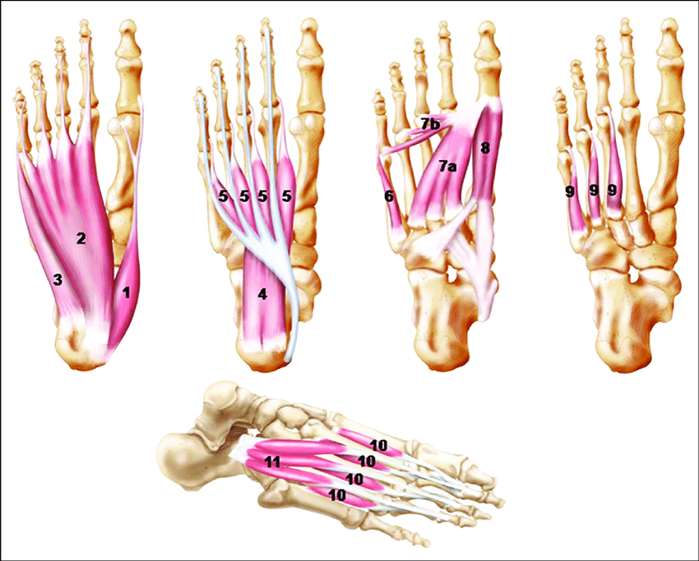
Planter muscles
There are 10 intrinsic muscles located in the sole of the foot.
They act collectively to stabilise the arches of the foot, and individually to control movement of the digits.
All the muscles are innervated either by the medial plantar nerve or the lateral plantar nerve, which are both branches of the tibial nerve.
The muscles of the plantar aspect are described in four layers (superficial to deep).

