Slide 1
Principles of fractures
Dr Mohammad Abu Hilal
Ass. Prof Muta University

Slide 2
Introduction:
Trauma remains the leading cause of death in the first four decades of life
(1-44 years).
Surpassed only by cancer and atherosclerosis as the major cause of death in all age groups in general.

Slide 3
Life then limb then wound then fracture.
No patient ever died of a broken bone as cause

Slide 4
ATLS program.
Primary survey
C then ABC : C-spine stabilization
Detailed history was not essential to begin the evaluation and treatment.
Two large bore canulla and fluids
Primary survey XR
C-spine lateral, CXR AP and pelvis

Slide 5
Secondary survey :
1-After stability of patient
2-Examination from head to toe
3-Done multiple times
4-XR according to findings

Slide 6
Description of fractures
Fracture: discontinuity of bone cortex .
Fractures can be categorized :
-traumatic, pathological or stress
location in bone
mechanism of injury: direct or indirect
status of soft tissue : open or closed

Slide 7
Pathologic fractures.
A bone is broken through an area weakened by pre existing disease, by a degree of stress that would not affect normal bone.
Osteoporosis, metabolic, infection, malignancy…etc.
Insufficiency fracture??

Slide 8
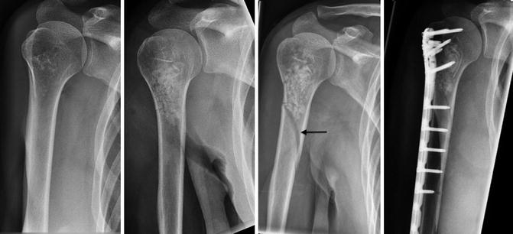
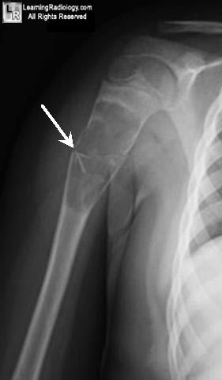

Slide 9
Stress fractures
Bone reacts to repeated minor loading or trauma
One single trauma or load is not strong enough to harm the bone
Military installations, ballet dancers, athletes.
Lower limbs more than upper limbs
XR may be noraml initially …….MRI
Metatarsal bone are most common beside tibia and femur neck

Slide 11
Classification by anatomical location.
Epiphysis: Articular surface+ Capsule
Metaphysis.
Diaphysis.
Growth plate.

Slide 12
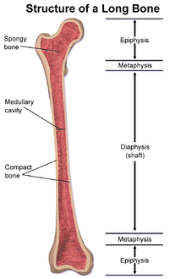

Slide 13
Epiphysial fractures:
1- intraarticular: difficult reduction, joint stiffness and arthritis
2-Intracapsular: haemarthrosis that affects union,, tamponade leads to pain and necrosis, blood supply.
AO principles:
1-Anatomic reduction
2- rigid stability
3-soft tissue preservation and early ROM

Slide 14
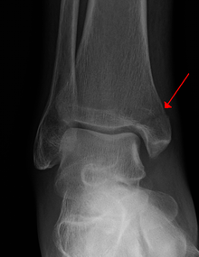
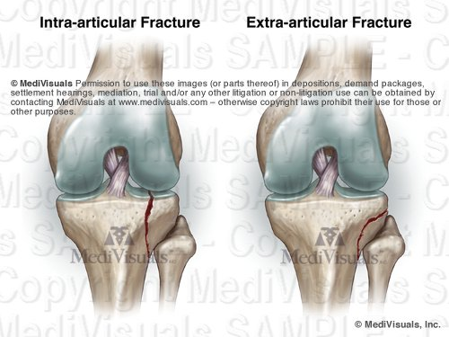

Slide 15
metaphysis
Good blood supply.
Malunion rather than nonunion.
AO principles:
1-Restoration of length ,alignment and rotation
2-relative stability
3-soft tissue preservation and early ROM

Slide 16
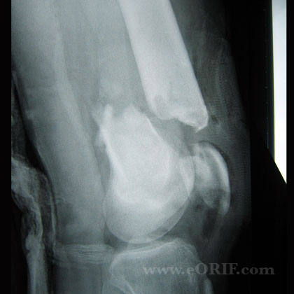
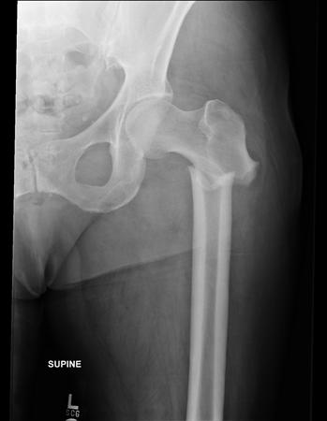

Slide 17
diaphysis
Proximal, middle, distal 1/3.
Extra-articular
Easier to reduce and Better results
AO principles:
1-Restoration of length ,alignment and rotation
2-relative stability
3-soft tissue preservation and early ROM

Slide 19
Growth plate injury
Salter-Harris classification.
A paediatric fractures
Deformity.
Growth disturbance

Slide 20
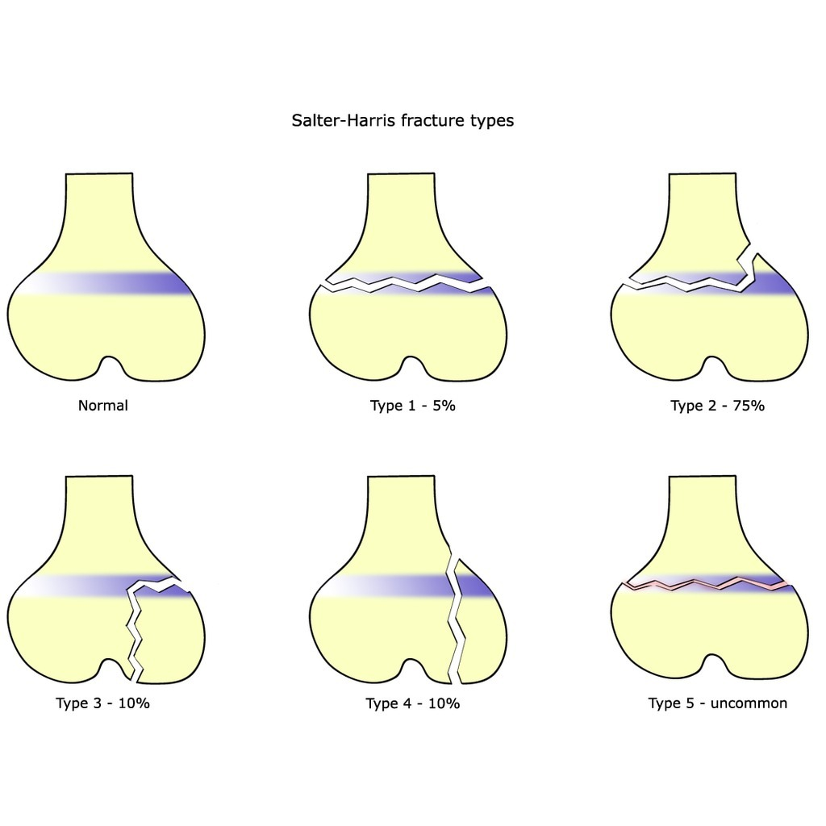

Slide 21
Classification
Simple fractures are fractures that only occur along one line, splitting the bone into two pieces.
multi-fragmentary fractures involve the bone splitting into multiple pieces.
Comminuted Fracture: very small peaces, difficult to reduce and fix

Slide 22
Description
Transverse Fracture- A fracture that is at a right angle to the bone's long axis.
Oblique Fracture- A fracture that is diagonal to a bone's long axis.
Spiral Fracture- A fracture where at least one part of the bone has been twisted. Two plans fracture
Notes:
Linear Fracture- A fracture that is parallel to the bone's long axis.

Slide 23
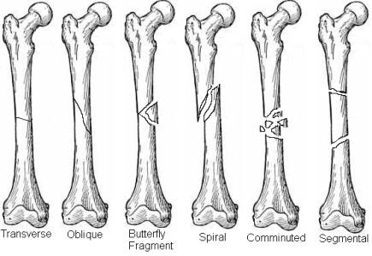

Slide 24
Principles of fractures Description
Complete Fracture- A fracture in which bone fragments separate completely.
Incomplete Fracture- A fracture in which the bone fragments are still partially joined.
Greenstick fractures in children and buckle
Fissure Fracture – This is a light fracture that involves minimal damage. The fracture is mostly stable and displaces no bone.
a compression fracture, an example of a compression fracture is when the front portion of a vertebra in the spine collapses due to osteoporosis.

Slide 25
Mechanism of injury
Direct trauma:
1- Tapping #: target force acting on small area, transverse # of one bon
2-Crush #: large force acting on small area.
extensive soft tissue damage, and comminuted.
3-Penetrating #: large force acting on small area. low velocity, high velocity. velocity more important than mass.

Slide 26
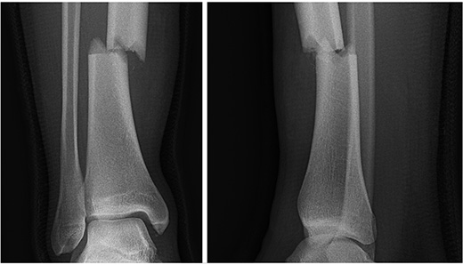
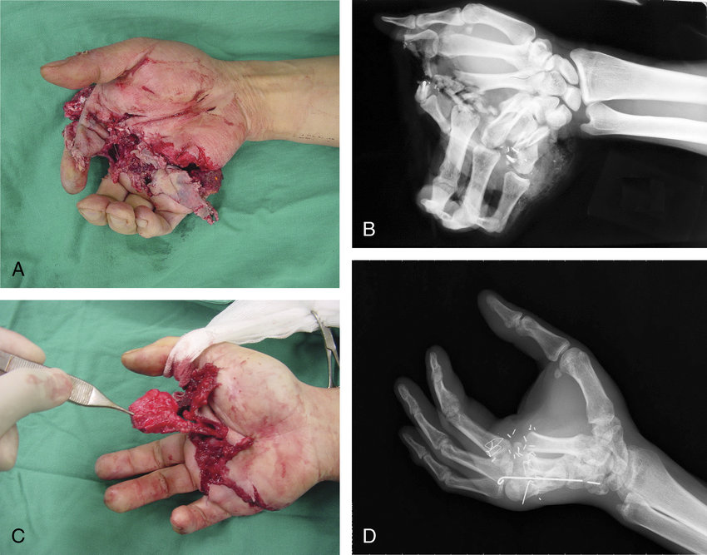
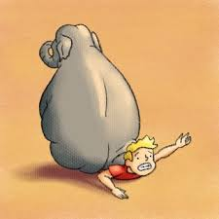

Slide 27
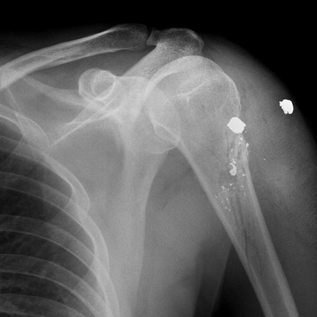

Slide 28
Indirect trauma:
Traction: avulsion fracture, patella, olecranon, and medial malleolus.
Angulation: transverse or with triangular
fragment. convexity under tension, concavity under compression.
Rotational: complete rotation around the circumference joined by vertical line.
Compression fracture: axial loading

Slide 29
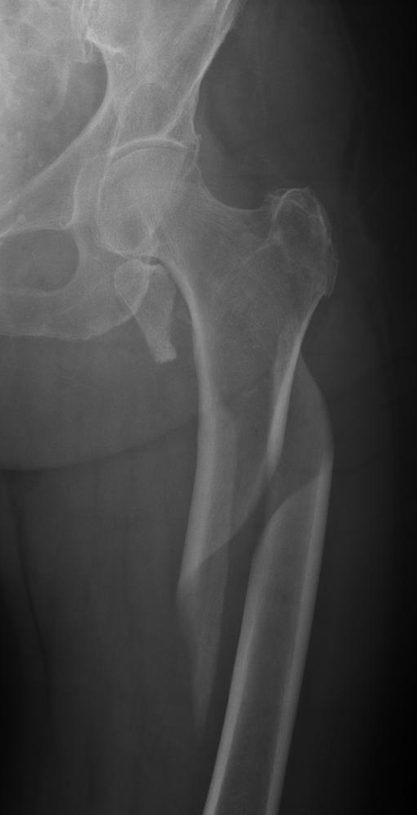
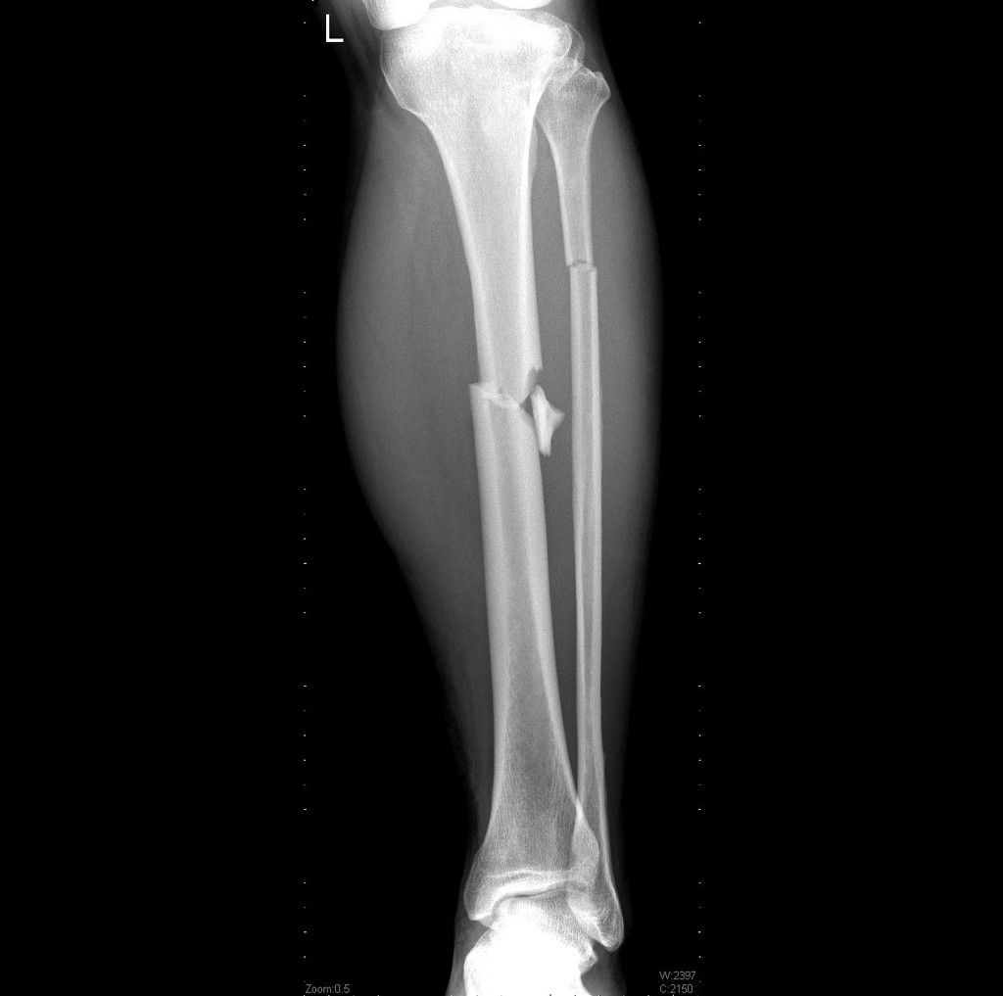
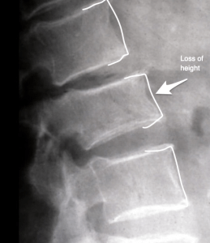

Slide 30
The condition of the surrounding soft tissue
Closed fracture: intact soft tissue
Open fractures by definition communicate bt bone through traumatic wound to outer environment.
4 As:
1-analgesia
2-Anti-tetanus
3-Adequate Irrigation and debridement within 4-8 hrs.
4-Antibiotic prophylaxis: first or second generation cephalosporine + aminoglycoside (high energy) +penicillin (barnyard).
-not all skin injuries mean open fracture

Slide 31
Gustilo and Anderson(1976, 1984):
I : clean wound < 1 cm.
II : 1-10 cm without extensive soft tissue
damage, skin flaps, or avulsion.
IIIA : >10 cm ,extensive soft tissue damage or any high energy trama , but maintains adequate coverage.
No need for plastic or vascular surgeon
IIIB : periosteal stripping and bony exposure. Plastic surgeon for flao
IIIC : vascular injury and vascular surgeon

Slide 32
Description of the deformity on XR:
Distal segment in relation to proximal
3 planes: axial, Sagittal, coronal.
Displacement and angulation and traslation
2 views, 2 joints, 2 limbs, 2 positions,
2 occasions.

Slide 34
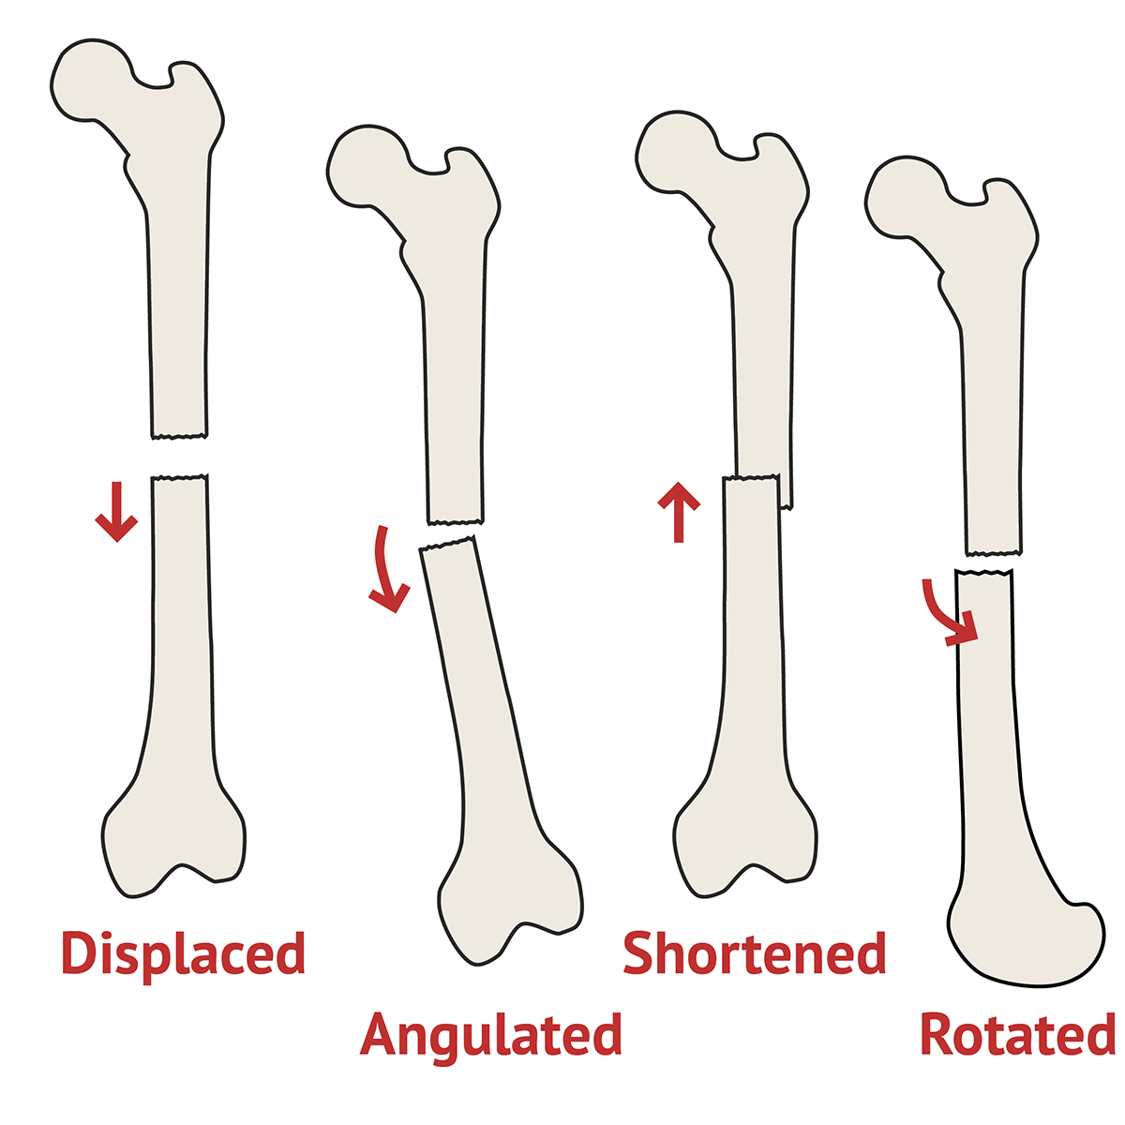

Slide 35
Clinical features of fractures:
Pain and tenderness.
Loss of function.
Deformity.
Attitude( the position taken by the pt).
Abnormal mobility and crepitus.
Neurovascular injury.
X-ray findings.

Slide 36
Emergency management of #
Pain relief by analgesia
Splint the patient :
1-Prevent further soft tissue or NV damage.
2-Decrease the incidence of clinical fat emboli by decreasing manipulation and movement
3-Facilitates patient transport and radiographic studies.

Slide 37
Treatment for any fracture
Reduction :closed or open.
Closed better ? Why?
Immobilization:
traction, cast and splint, external fixation and internal fixation
Rehabilitation and early ROM

Slide 38
Healing calendar.
Upper limb,child: 3 weeks.
lower limb, child: 3X2=6
Upper limb,adult: 3X2=6
lower limb, adult : 3X2X2=12

Slide 39
Complications : early
Soft tissue injuries: arterial, nerve injuries, compartment syndrome.
Pulmonary complications: PE and ARDS.
DVT
Bleeding and shock
Infection.

Slide 40
Complications : late
-Delayed union: more time to heal than expected
-Nonunion: no radiographic evidence of union with clinical motion & pain 6 mo.
-Malunion: bony healing in an unacceptable position in any plane.
-AVN: disruption of blood supply lead to collapse,
- CRPS: chronic regional pain syndrome
-Stiffness
-O.A
-Infection

