Slide 1
Diabetic ketoacidosis (DKA)
Presented by Fuad k jawazneh, Mohammed magableh, Abdalleh abu aladas & Shahd abdallat, Mohammed mohawesh, Ahmed talat
Supervised by Dr. Randa Al-Qaisi

Slide 2
Definition
Metabolic disorders due to acute insulin insufficiency.
A life-threatening medical emergency requiring immediate evaluation and treatment.
It’s defined by the presence of all the following In a patient with diabetes:
Hyperglycemia – Blood glucose of >200 mg/dL (11 mmol/L).
Metabolic acidosis – Venous pH <7.3 or a plasma bicarbonate <15 mEq/L and decrease in Paco2).
Ketosis – Determined by the presence of ketones in the blood (blood ß-hydroxybutyrate≥3 mmol/L) or moderate-large ketonuria urine ketones are typical≥2+ (“moderate or large”).
Fingerstick blood glucose measurements should be considered for all children presenting with rapid breathing or with vomiting and abdominal pain without diarrhea.

Slide 3
Pathophysiology
Insulin deficiency due to absence of adequate insulin secretion >>> increased levels of the counterregulatory hormones: glucagon, catecholamines, cortisol, and growth hormone)and peripheral insulin resistance lead to>>Hyperglycemia,Dehydration,ketosis,electrolyte imbalance.
Hyperglycemia
Inadequate insulin secretion causes an accelerated catabolic state with increased glucose production by the liver and kidney (via glycogenolysis and gluconeogenesis) and impaired peripheral glucose utilization, which results in hyperglycemia that cause osmatic diuresis, that is initially compensated for by increased fluid intake.

Slide 4
Ketosis
Insulin deficiency and high counterregulatory hormone concentrations also increase lipolysis and ketogenesis and decrease lipogenesis,abundant free fatty acids are converted to Ketone bodies (B-hydroxybutrate, acetoacetate and acetone)cause ketonemia and ketonuria and metabolic acidosis, Acetone cause acetone odor of breath.
Ketonemia cause acidosis >>>>> vomiting , increase insensible fluid loss(caused by tachypnea Kussmul breathing) , hyperkalemia ,renal potassium and phosphate loss.

Slide 5
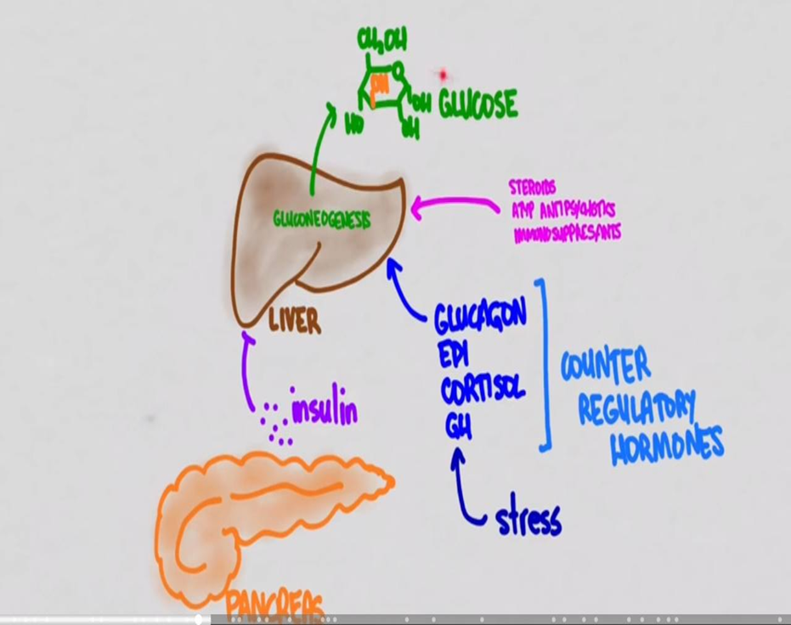
Dehydration
Hyperglycemia exceeding the usual renal threshold of approximately 10 mmol/L (180 mg/dl) together with hyperketonemia causes osmotic diuresis and obligatory loss of electrolytes (sodium, potassium, phosphate, magnesium) leading to dehydration, often aggravated by vomiting associated with severe ketosis.
Most patients are unable to maintain the large fluid intake and thus dehydration occures.
These changes stimulate further stress hormone production, which induces more severe insulin resistance and worsening hyperglycemia and hyperketonemia.
Dehydration along with metabolic acidosis coma

Slide 6
Electrolyte abnormalities
Electrolyte abnormalities occur through a loss of electrolytes in the urine and transmembrane alterations resulting from acidosis.
As hydrogen ions accumulate as a result of ketoacidosis, intracellular potassium is exchanged for hydrogenions. Serum concentrations of potassium increase initially with acidosis then decrease as serum potassium is cleared by the kidney. Depending on the duration of ketoacidosis, serum potassium concentrations at diagnosis may be increased, normal,or decreased, but intracellular potassium concentrations are depleted. A decreased serum potassium concentration is an ominous sign of total body potassium depletion.
Phosphate depletion also can occur as a result of the increased renal phosphate excretion required for elimination of excess hydrogenions.
Sodium depletion is also common in ketoacidosis resulting from renal losses of sodium caused by osmotic diuresisand from gastrointestinal losses from gastrointestinal loss from vomiting.

Slide 7
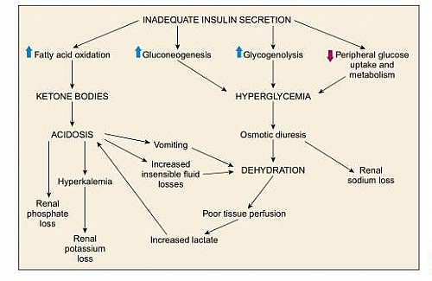
Lipolysis of Triglceride
3 Fatty acide
Glycerol

Slide 8
Risk factors
Newly diagnosis DM
Infants <2 years of age.
History of transient or permanent neonatal diabetes.
low social or economic status.

Slide 9
Risk factors
Known cases of DM
Children who omit insulin.
Children with poor metabolic control.
Previous episodes of DKA.
During an intercurrent illness when greater insulin requirements are needed in the presence of elevated concentrations of the counter-regulatory and stress hormones (glucagon, growth hormone [GH], cortisol, and catecholamines).
Gastroenteritis with persistent vomiting and inability to maintain hydration.
Children with psychiatric disorders, including those with eating disorders.
Children with difficult or unstable family circumstances (eg, parental abuse).
Peripubertal and adolescent girls.
Binge alcohol consumption.
Children with limited access to medical services .

Slide 10
Signs & symptoms
Polyuria (early symptoms); due to glucose induced osmotic diuresis
Polydipsia (early symptom); due to increased urinary water loss.
Fatigue.
Weight loss.
Nocturia, enuresis.
Fruity smell breathing; due to breaking down of acetoacetate will lead to the production of byproducts called “Acetone” which is exhaled by the lung giving the breath a fruity smell.
Polyphagia may be present early in the course of the illness. However, once insulin deficiency becomes more severe and ketoacidosis develops, appetite is suppressed.

Slide 11
Clinical manifestations
Dehydration
Tachypnea; deep, sighing (Kussmaul) respiration
Nausea, vomiting, and abdominal pain that may mimic an acute abdominal condition.
Confusion, drowsiness, altered mental status can occur, ranging from disorientation to coma.

Slide 12
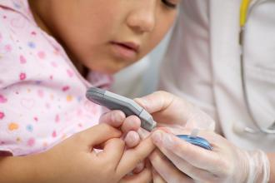
DIAGNOSIS

Slide 13
Clinical Evaluation

Slide 14
History:
Ask about the symptoms : polyuria,polydipsia,Nausea and vomiting,abdominal pain etc..
Past medical : Known case of DM , previous attacks of DKA , history of neonatal diabetes
Nutritional : Compliance to diet
Drug history : compliance to medications
Family history : type 1 or type 2 DM , any autoimmune diseases

Slide 15
Physical Examination :
General look : -Level of consciousness → GCS
- signs of dehydration
- respiratory distress (kussmaul ) .
- fruity odor (acetone odor )
Vital signs : HR , RR , BP , TEMPRATURE ,pulse oximetry
Growth parameter : weight , height , HC .
Examine the site of insulin injection.
Abdominal exam might reveal abdominal tenderness

Slide 16
Laboratory Tests
Glucose level
Electrolytes :
Sodium: Hyponatremia is common in DKA and HHS
Serum sodium concentrations may be elevated, normal, or low, depending on the balance of sodium and free water losses. The measured serum sodium concentration is artificially low, however, because of hyperglycemia.The corrected Na can be calculated using the equation:Corrected Na = measured Na + [1.6(glucose –100)/100]
Potassium
Phosphorus levels may be depleted
Renal function :BUN and creatinine are often elevated.
Blood beta-hydroxybutyrate (BOHB) ≥3 mmol/L
ABG/ Calculate the anion gap
Bicarbonate <15 mEq/L
Urine Ketones/ Serum Ketones
ECG
WBC elevated
Criteria of diagnosis:
Hyperglycemia
Metabolic Acidosis
Ketosis

Slide 17
Urine ketone testing detects acetoacetate and acetone but not BOHB, the main ketone in DKA. Therefore, reliance on urine testing alone may underestimate the severity of ketonemia
Beta-hydroxybutyrate (BOHB) in blood or serum is the most accurate measure of ketosis andshould be used whenever available. Serum BOHB concentrations ≥3 mmol/L are present in most children with DKA . Furthermore, BOHB ≥5.3 mmol/L is a strong indicator of DKA
Other:
Hyperlipidemia
Infection screen: CBC, Blood and urine cultures, CRP, ESR. Chest x-ray

Slide 18
Assessment of severity

Slide 19
Hyperosmolar hyperglycemic Nonketotic syndrome
HHS occurs most commonly in adults with poorly controlled type 2 diabetes but has also been reported in children.
Recognition of HHS is important because it is associated with more severe dehydration and a higher frequency of complications than is typical of DKA.
Characterized by:
Marked hyperglycemia (blood glucose >600 mg/dL
Minimal acidosis
Absent to mild ketosis
Marked elevation in serum osmolality (effective osmolality >320 mOsm/kg)
Polyuria, polydipsia, lethargy, weakness, confusion, seizures .

Slide 20
Newly diagnosed case:
Thyroid , celiac disease antibody screen and anti insulin antibodies :
Islet cell antibodies
GAD antibodies
Thyroid function tests, TSH, T4
Immunoglobulin A

Slide 21
Management

Slide 22
Emergency assessment
Acute management should follow the following: ABC
Obtain vital signs and measure weight - If body surface area is used for fluid therapy calculations, measure height or length to determine surface area.
Insert peripheral intravenous line, obtain blood for laboratory evaluation and start intravenous fluid therapy.
Immediately measure blood glucose and blood BOHB levels ,Measurement of blood BOHB concentration with a point-of-care meter, is very useful to confirm ketoacidosis and to monitor the response to treatment.
Measure venous or arterial pH, pCO2, glucose, electrolytes (including serum bicarbonate), serum urea nitrogen and creatinine.
Perform a detailed history and physical exam with particular attention to mental status and any possible source of infection.

Slide 23
Assess Severity of dehydration:
- prolonged capillary refill time ( >2 seconds) /abnormal skin turgor dry mucus membranes/ sunken eyes/ absent tears/ weak pulses/ cool extremities
- Laboratory measures have been found to be better predictors of dehydration severity than clinical signs. These include: Higher serum urea nitrogen (>20 mg/dL) and Lower pH (<7.1)
Assess level of consciousness GCS
Give oxygen to patients with circulatory impairment or shock.
A continuous cardiac monitor should be used to assess degree of tachycardia, monitor for arrhythmias, and assess T-waves for evidence of hyper or hypokalemia.
Prolonged QTc has also been found to occur frequently in children with DKA and is correlated with DKA severity and anion gap.
Patients with prolonged QTc interval (>460 msec) should have continuous monitoring of heart rhythm during DKA treatment because of possible increased risk for arrhythmias.
Antibiotics may be required for patients with evidence of infection after obtaining appropriate cultures such as blood, urine, spinal fluid, throat or tracheal aspirate as indicated.

Slide 25
Management

Slide 26
Goals of therapy
Correct acidosis and reverse ketosis
Correct dehydration
Restore blood glucose to near normal
Monitor for complications of DKA and its treatment
Identify and treat any precipitating event

Slide 27
Management of DKA is not complete until an attempt has been made to identify and treat the cause. DKA without a preceding illness in a child with known diabetes is almost always the result of failure to appropriately administer insulin injections or interruption of insulin delivery, most often as a result of insulin pump infusion set dysfunction. In new onset diabetes, DKA is frequently the consequence of a delay in diagnosis

Slide 28
The principles described below are based on consensus statements from panels of expert physicians representing the Pediatric Endocrine Society (PES), the European Society for Pediatric Endocrinology (ESPE), and the International Society for Pediatric and Adolescent Diabetes (ISPAD).

Slide 29
Resuscitation fluids
For children who are volume depleted but not in shock, volume expansion (resuscitation) should begin immediately with 0.9% saline, 10 to 20 ml/kg infused over 20–30 min to restore the peripheral circulation. If tissue perfusion is poor the initial fluid bolus volume should be 20 ml/kg.
Repeat as necessary to maintain adequate circulation.
Unless the patient is in shock, do not give more than 40 mL/kg in bolus fluids in the first 4 hours.
Use crystalloid not colloid. There are no data to support the use of colloid in preference to crystalloid in the treatment of DKA.

Slide 30
Replacement fluids
Fluid therapy should begin with deficit replacement plus maintenance fluid requirements (minus initial fluid bolus amount) over 24–48 h.
Deficit replacement should be with a solution that has a tonicity in the range of 0.45%–0.9% saline, with added potassium chloride, potassium phosphate or potassium acetate.
Now how to calculate Deficit?
Fluids = Weight *the percentage of dehydration *10
(remember for any Child: 5% mild, 7% moderate, 10% severe.)

Slide 31
How to calculate Maintenance?
For fluids:
First 10 Kg ….100 ml/Kg
Second 10 Kg…. 50 ml/Kg
The rest Kg…. 20 ml/Kg
For Sodium: 2-3 meq/Kg

Slide 32
Potassium
In spite of total body depletion, serum potassium levels may be normal, increased, or decreased at presentation.
Administration of insulin and the correction of acidosis drives potassium back into the cells, decreasing serum potassium levels during DKA treatment.
Potassium replacement is required regardless of the serum potassium concentration, except if renal failure is present.

Slide 33
Potassium (cont.)
Serum Potassium
<3.5 | Hold insulin. Give a bolus of potassium (not to exceed 0.5 mmol/ Kg/h), along with cardiac monitoring.
3.5-5.5 | Start replacing potassium after initial volume expansion and concurrent with starting insulin therapy.
>5.5 | Begin infusion with non-potassium fluids, remeasure potassium hourly, and begin potassium infusion when serum potassium is below 5.5 mmol/L.
*The starting potassium concentration in the infusion should be 40 mmol/L.
*Subsequent potassium replacement therapy should be based on serum potassium measurements.
*Potassium phosphate may be used together with potassium chloride or acetate.
*The maximum recommended rate of intravenous potassium replacement is usually 0.5 mmol/kg/h.
*As you observed we give potassium in all case scenarios.

Slide 34
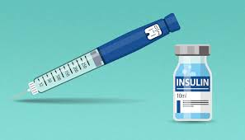
Insulin
Begin with 0.05 to 0.1 U/kg/h of regular insulin at least 1 hour AFTER starting fluid replacement therapy.
The lower dosage (0.05 U/ kg/h) can be considered for children with pH > 7.15.
An IV bolus should not be used at the start of therapy; it is unnecessary, may increase the risk of cerebral edema, can precipitate shock by rapidly decreasing osmotic pressure, and can exacerbate hypokalemia.
Adding dextrose to intravenous fluids: When the serum glucose concentration decreases to 250 to 300 mg/dL, dextrose should be added to the IV fluid infusion

Slide 35
Insulin (cont.)
Route of administration: Intravenous (IV)
If IV cannulation is not possible due to severe dehydration, insulin can be administered IM.
Central venous catheters should not be used for insulin administration because the large dead space may cause erratic insulin delivery
The dose of insulin should usually remain at 0.05-0.1 unit/kg/hour at least until resolution of DKA.

Slide 36
Insulin (cont.)
If biochemical parameters of DKA (venous pH, anion gap, BOHB concentration) do not improve, reassess the patient, review insulin therapy, and consider other possible causes of impaired response to insulin; e.g. infection, errors in insulin preparation or route of administration.
In circumstances where continuous IV administration is not possible and in patients with uncomplicated mild to moderate DKA, hourly or 2-hourly SC rapid acting insulin analog (insulin lispro or insulin aspart) is safe and may be as effective as IV regular insulin infusion

Slide 37
Electrolytes:
Bicarbonate: Bicarbonate therapy generally should not be used in children with DKA unless in special cases like severe acidosis (PH <6.9) and life-threatening hyperkalemia.
Sodium: Calculate corrected sodium.
Corrected NA+= Na + 1.6([plasma glucose – 100]/100)
Phosphate:
phosphate depletion is common in uncontrolled diabetes.
Phosphate should be replaced during DKA treatment (typically by including potassium phosphate in IV fluid.)
Manifestation of severe hypophosphatemia include: metabolic encephalopathy, seizures, impaired myocardial contractility, ventricular arrhythmia, respiratory failure, hemolytic anemia, muscle dysfunction with proximal myopathy, dysphagia, ileus, and rhabdomyolysis.
Severe hypophosphatemia (1 mg/dl) with or without symptoms should be managed.

Slide 38
Complications

Slide 39
1- Cerebral Edema (Most serious).
2- Hypokalemia.
3- Hypoglycemia (Most common).
4- Intracranial thrombosis or infarction.
5- Acute kidney injury with acute renal failure caused by severe dehydration.
6- Pancreatitis.
7- Arrhythmias caused by electrolyte abnormalities.
8- Pulmonary Edema.

Slide 40
CEREBRAL EDEMA
• Cerebral edema is the most serious complication of DKA, occurring in 1-5% of cases of DKA, with a mortality rate of 20-80%.
• Cerebral edema usually develops within first 12 hours after therapy for DKA is begun, often following a period of apparent clinical improvement.
• Pathophysiology: Cerebral edema occurs from rapid lowering of glucose levels and an ensuing rapid drop in plasma osmolality. Brain cells, which trap osmotically active particles, preferentially absorb water (osmotic shifting) and swell during rapid rehydration ,Cerebral edema follows, and given the constraints of the cranium, uncal herniation may be the cause of death in persons with DKA.

Slide 41
Factors That Correlate With Increased Risk For Cerebral Edema:
High blood urea nitrogen at presentation.
Lower initial PCO2( Hypocapnia at presentation).
Failure of the serum sodium concentration to increase as glucose concentration decreases during treatment.
Severe acidosis at presentation.
Treatment with bicarbonate( for acidosis correction).
Age less than 5 years.
New onset DM.
High volumes of fluid given in the first 4 hours.
Administration of insulin in the first hour of fluid treatment.

Slide 42
Signs & Symptoms of Cerebral Edema:
Onset of headache after beginning treatment or progressively worsening or severe headache.
Change in neurological status (irritability, confusion, increased drowsiness, incontinence)
Specific neurological signs (e.g. cranial nerve palsies, papilledema)
Cushing’s triad (rising blood pressure, bradycardia, and respiratory depression) is a late but important sign of increased intracranial pressure.
Decreased O2 saturation.

Slide 43
Management
1- Rapid use of IV mannitol.
2- Endotracheal intubation.
3- Hyperventilation.

Slide 44
Hypokalemia
Low or high serum potassium levels can be a cause of cardiac arrhythmias, which can be fatal.
Potassium must never be given until the serum potassium level is known.
Once the serum potassium is known to be normal or low, and after voiding is observed, generally after the first hour of fluid resuscitation, all IV fluids should include 20-40 mmol/L of potassium.
If the serum potassium is high, it is best to wait to add K+ to the IV until the K+ begins to decrease.
Do not give K+ as a rapid IV bolus or cardiac arrest may result.
Severe hypokalemia may lead to respiratory arrest due to muscle dysfunction.

Slide 45
Hypoglycemia
Hypoglycemia may result from inadequate monitoring of glucose levels during insulin therapy. Insulin sensitivity improves after clearance of ketones (after tx).
Give 2-5 ml/kg D10% bolus, hold insulin for 15- 30 min then repeat Blood Glucose.

Slide 46
Cognitive impairment
DKA may be associated with subtle neurocognitive dysfunction after recovery, even in patients who did not have clinical evidence of cerebral injury during DKA treatment Subtle alterations in memory, attention, and IQ and changes in cerebral microstructure .

Slide 47
Pancreatic enzyme elevations
Mild elevations in serum amylase and lipase are seen in approximately 40% of children with DKA In most cases, this does not reflect acute pancreatitis.

Slide 48
Acute kidney injury
high frequency of acute kidney injury (AKI) in children with DKA (approximately 50%) Many of these children have stage 2 or 3 AKI, suggesting intrinsic tubular injury beyond pre-renal dysfunction. Kidney failure can also occur but is rare. Renal function generally returns to normal after recovery from DKA.

Slide 49
Other Complications
Rare complications of pediatric DKA include:
cardiac arrhythmias resulting from electrolyte derangements.
pulmonary edema.
venous thrombosis.
multiple organ dysfunction syndrome.
intestinal necrosis.
acute pancreatitis .

Slide 50
Thank you <3

