Slide 1
IMMUNIZATION & COVID19 VACCINE
Ibraheem M.alkhawldeh
maysa eyalsalman
salsabeel almanaseer
abdalsalam ibraheem
mohammad almashaqbah
Supervised by: prof . Omar Nafi
Updated 2022

Slide 2
TYPES OF IMMUNITY
INNATE
Non-specific
ACQUIRED
Specific
No antibodies involved
Antibodies involved
Active
Form your own antibodies
Passive
Ready-made antibodies
Physical Barriers
Exposure to antigen
No exposure to antigen
Blood (Phagocytes)
Natural
Natural
Infection
Transplacental
Breast milk
Artificial
Artificial
Vaccination
Antibodies from other sources (IVIG)

Slide 3
Active vs Passive immunity
PASSIVE | ACTIVE
Ready-made immune globulin (antibodies) from human or animal sources are given to the body. | Immunogenic antigen is given then the body forms its own protective antibodies.
Temporary immunity that decreases with time (turnover of the administered immunoglobulin) | Long term protection (Sometimes life long)
Examples: Natural: Mother’s Ig to infant (transplacental/breast milk) effective for about 6 months. Artificial: Adminestration of antibodies (e.g: Hepatitis B IG, Varicella IG) | Examples: Natural: Infection Artificial: Vaccination

Slide 4
Vaccination vs Immunization
Vaccination:
The act of giving a vaccine (antigen)
Immunization:
Induction of an immune response following exposure to an antigen
Vaccination ≠ Immunization
A vaccinated person isn’t necessarily immunized.
Immunity can be acquired without vaccination.

Slide 5
Artificial Active Immunization ( Vaccination)

Slide 6
What is vaccination?
It is the introduction of an immunogen (antigenic material) to artificially induce immunity.
It induces antibody formation without causing an illness
What is the importance of vaccination?
The most effective method in preventing infectious diseases
By eradication: Small pox
By elimination: Polio
Provide “herd immunity”.

Slide 7
What is herd immunity? [AKA community immunity]
A form of immunity that occurs when the vaccination of a significant portion of a population (or herd) provides a measure of protection for individuals who have not developed immunity.
It’s an indirect way of protecting those individuals who haven’t been or can’t be vaccinated, by immunizing a sufficiently large number of people to prevent the spread of infection to the unimmunized.
Notes:
Say, you’ve got ten people. One of them gets infected with checken pox, the other nine will get it too. However if you vaccinate, let’s say, seven out of the ten, then the spread of infection will be restricted. And if one of those three that haven’t been vaccinated has a contraindication like being immunocompromised, they will be protected too, because the others won’t spread the infection to them.

Slide 8
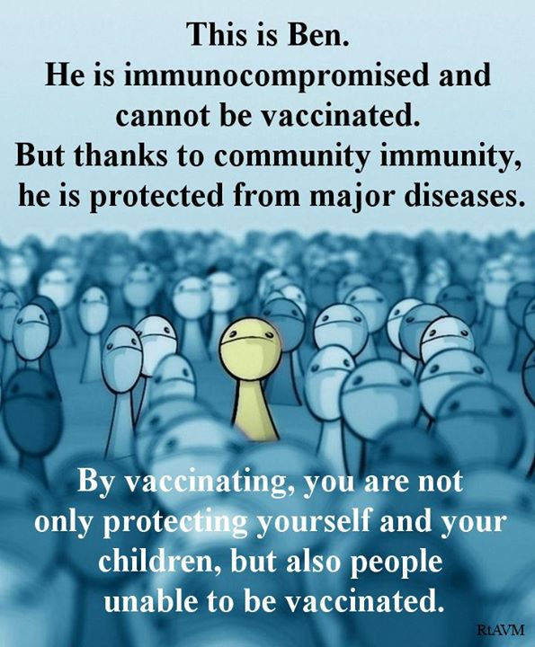

Slide 9
Elimination vs Eradication
Eradication:
Complete and permanent wordwide reduction of incidence to zero cases with no need for further control measures.
Eg. Small pox
Elimination:
Reduction of incidence to zero or a very low defined target in a defined geographical area. It requires further measures to prevent reestablishment of disease.
Eg. Measles & Polio

Slide 10
Extinction | Control | Elimination | Eradication
0 | Acceptable low levels | 0 | 0 | Incidence
Worldwide |  | Definite area | Worldwide | Geographic area
No | Yes | Yes | No | Need for further control
No | Yes | Yes | Yes | Causative agent still exists?
None | Diarrheal disease | Measles Polio | Smallpox | Example

Slide 11
Types Of Vaccines
Fractional
Protein based
Whole Cell
Killed
(inactivated)
Live Attenuated
Polysaccharide based
Pure
Conjugated
Toxoids
Recombinant

Slide 12
Inactivated vaccine | Live attenuated
Killed organisms (by heat/chemicals [formaldehyde]). | Live organisms Lost ability to induce the disease Retain capacity to grow but slowly and locally only
Cannot keep producing antigens: Less potent Need booster doses Shorter immunity | Can produce antigens continuously: More potent 1 Dose is sufficient Longer immunity
Induce humoral immunity only Antibody titers fall with time | Induce humoral & cellular immunity
No risk of infection | Risk of infection Can mutate back to its virulent form
Safe | Not safe for immunocompromised people 1-immunocompromised individuals. 2-People being treated for certain chronic illnesses (steroids used) 3-Pregnant women unless absolutely necessary.
Notes:
Nonliving vaccines administered parenterally fail to induce mucosal immunity because they lack a delivery system that can effectively transport them to local mucosal antigen-processing cells.
It also Typically require multiple doses and periodic boosters for the maintenance of immunity because antibody titer falls with time.

Slide 13
Recombinant Vaccines
They are made by inserting viral genes that code for important antigens into common baker’s yeast. The yeast then produces the antigens, which are collected and purified for use in the vaccine

Slide 15
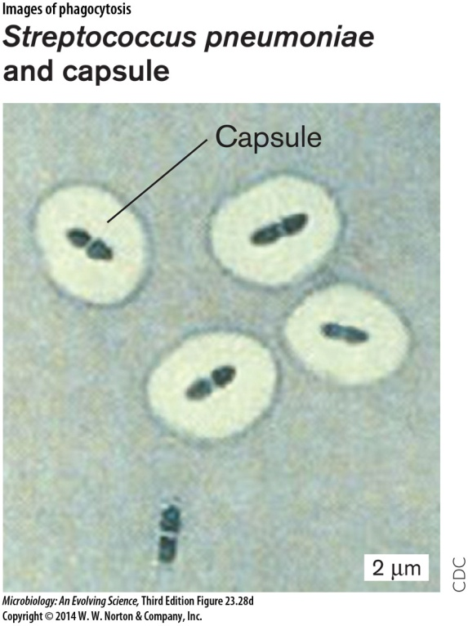
Polysaccharide-based Vaccines
Hemophilus influenzae B
Streptococcus pneumoniae
Nisseria meningitidis
All of the above posses a polysaccharide layer that forms a large capsule outside the bacterial cell wall.
Pure polysaccharide vaccines:
They induce a T-cell INDEPENDENT immune response. This means that they stimulate B cells without the need for T helper cells (humoral immunity only)
This causes them to have weaknesses:
Not immunogenic in children younger than 2 years of age (underdeveloped immune system. B cells must be activated through T cells)
No booster response in adults (antibody titers don’t increase).

Slide 16
How was this problem solved?
By joining the polysaccharide molecule to a protein molecule and making a conjugated polysaccharide vaccines.
This way the polysaccharide vaccine will stimulate a T cell DEPENDENT immune response.
Conjugated vaccines:
Induce an immune response in children younger than 2 years
have a booster response.

Slide 17
Examples For Each Type Of Vaccines
Live attenuated
BCG
Whole cell
Pertussis
Subunit (conjugated)
Hib
MMR
OPV
Rota
Varicella
Yellow fever
Pneumo
Meningo
Subunit (recombinant)
HepB
Toxoids
Tetanus
Diphtheria
IPV
Flu
HepA

Slide 18
Artificial Passive Immunization

Slide 19
What is it?
It is giving ready-made antibodies from another source to provide a temporary immunization.
When is it used?
When instant immunization is needed
Person cannot be vaccinated (eg. due to a contraindication)
Person hasn’t received the vaccine yet
What are the benefits?
Preventing severe complications of the disease.
What are the drawbacks?
The acquired immunity is temporary and of a short duration.

Slide 20
Approaches To Passive Imunization
Standard human serum immunoglobulins
Ig not specific for a disease
Specific human immunoglobulins from an immunized donor
Ig against specific disease
Specific animal immunoglobulins
Eg. Horse Ig against tetanus toxin.

Slide 21
Examples
Tetanus Ig
Rabies Ig
Hepatitis A + B Ig
Varicella Ig

Slide 22
How Can Passive Immunization Interfere With Vaccination?
Antibody from any source (e.g., transplacental, transfusion) can interfere with replication of the vaccine organism and lead to poor response or no response to the vaccine (also known as vaccine failure).
Which type of vaccines is affected by passive immunization?
Live attenuated vaccines.
Which vaccine types are not affected by passive immunization?
Inactivated vaccines
Some types of live attenuated vaccines
BCG
Oral Polio
Intranasal live flu vaccine

Slide 23
Route & Site of Administration for Vaccines

Slide 24
Why are there different routes of administration for each vaccine?
Route of administration affects:
The immune response
Rate of adverse injection site reaction
At the beginning, all vaccines (except BCG vaccine) were given subcutaneously.
However, SC injections of vaccines with adjuvants were associated with:
High rate of injection site adverse reactions
Low immunogenicity
Therefore, another route was proposed for vaccines with adjuvants; the intramuscular route.
Lesser injection site reaction
Higher immunogenicity

Slide 25
The oral route is mostly used for pathogens infecting the intestinal tract to induce a mucosal immunity (IgA):
Polio
Rotavirus
The BCG vaccine is given intradermally only because if it’s given suncutaneously, a local abscess may form that can sometimes ulcerate, and may require treatment with antibiotics immediately. Otherwise, without treatment, it could spread the infection causing severe damage to vital organs.

Slide 26
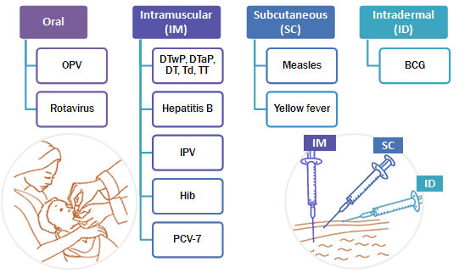

Slide 27
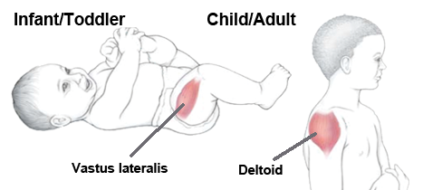
Site of Administration
You must avoid vascular, neural or tissue injury when injecting the vaccine.
The preferred sites for IM administration are:
Anterolateral aspect of the thigh in infants
The deltoid region in children and adults.

Slide 28
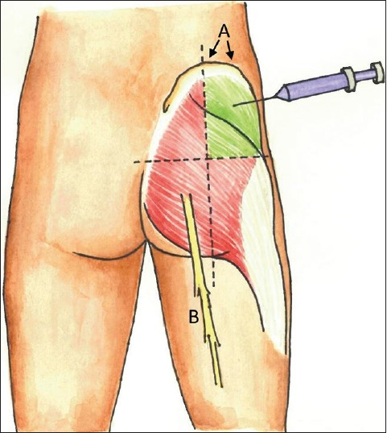
The sciatic nerve may be injured by deep intragluteal injections.

Slide 29
Vaccine Adverse Reactions

Slide 30
Vaccine reactions can be categorised into two types:
Common, usually minor and self-limiting
Rare and more serious
The common reactions are caused by the body’s response to the vaccine antigen(s) and the other vaccine constituents (adjuvants).
In general they occur early within 24-48 hours of vaccination and are self-limiting.
However, reactions following live vaccines (e.g. MMR) may be delayed and resemble a mild version of the disease.

Slide 31
Common minor reactions include:
Local
Pain , swelling, redness at site of injection
Systemic
Fever & non-specific symptoms (malaise,headache)
Allergic (anaphylaxis)
Common with inactivated vaccines
Usually mild and self limited
May be unrelated to vaccine
Within 5-30 min after the vaccination .
Appear within 24-48 h
Appear within 24-48h
Live attenuated vaccines: Symptoms occur after 7-21days (time for viral replication)
severe anxiety/hives (itchy skin rash)/swelling of the lips and face/difficulty breathing/LOC
Rare: in about 1 in every million.
The treatment for anaphylaxis is→immediate injection of adrenaline

Slide 32
Contraindications to Vaccines
What is a contraindication?
A condition in the recipient that greatly increases the chance of a serious life threatening adverse event.
Contraindications can be classified into:
Absolute
Relative
Notes:
Disorders of Humoral Immunity:There is a spectrum of disease within this category ranging from patients with an inability to make any type of antibody response to patients whose only defect is making an IgA antibody response. Patients with severe deficiencies of humoral immunity (X-linked agammaglobulinemia and common variable immunodeficiency) have little or no ability to mount antibody responses to vaccines or microbial pathogens. They are highly susceptible to infections caused by encapsulated bacteria and enteroviruses, including polio and coxsackie viruses. Treatment with prophylactic intravenous infusions of gamma globulin (IVIG) is effective at preventing bacterial sepsis and meningitis, but may be less helpful for preventing sinusitis and bronchitis. Less severe forms of humoral immune deficiency include patients with selective inability to produce antibodies of a specific class (IgA deficiency) or subclass (IgG subclass deficiency). They generally have less severe problems with infection since some elements of humoral immunity are intact. IgA deficient patients typically develop infections along mucosal surfaces (otitis, sinusitis and bronchitis) but rarely develop tissue invasive infections because they have normal ability

Slide 33
General Absolute contraindications
Anaphylaxis or a severe hypersensitivity reaction to a vaccine or a vaccine component should not receive subsequent doses of that vaccine.
influenza and yellow fever vaccines → produced in embryonated chicken eggs (CI in people with anaphylactic-like reaction to eggs)
Notes:
There is immunosuppre
Severe immunosuppression (congenital immunodeficiency /HIV infection/ leukemia / lymphoma / cancer therapy / a prolonged course of high-dose corticosteroids (≥2 mg/kg/day for >2 weeks) )
ssion during pregnancy so that the body doesn’t attack the fetus as a foreign body

Slide 34
Specific absolute contraindications
DTP → History of Encephalopathy (e.g., coma, decreased level of consciousness; prolonged seizures) within 7 days of DTP vaccine
Rotavirus → History of intussusception

Slide 35
General Relative contraindications
Moderate or severe acute illness (such as diarrhea) with or without fever.
Can be vaccinated as soon as they are recovering and no longer acutely ill.

Slide 36
Specific Relative contraindications
For DTP vaccine:
Progressive neurologic disorder (infantile spasms/ uncontrolled epilepsy/ progressive encephalopathy )
vaccine postponed until symptoms are controlled
Temperature of 40.5° C or higher within 48 hours after vaccination with a previous dose of DTP/DTaP
Collapse or shock-like state (i.e., hypotonic hyporesponsive episode) within 48 hours after receiving a previous dose of DTP/DTaP
Seizure within 3 days after receiving a previous dose of DTP/DTaP
Persistent, inconsolable crying lasting 3 or more hours within 48 hours after receiving a previous dose of DTP/DTaP

Slide 37
Invalid contraindications
Convalescent (recovery) phase of acute illness
Recent exposure to infectious diseases
Current antibiotic therapy
Breastfeeding
Stable neurological condition (CP, controlled convulsion)
History of penicillin allergy or other non-vaccine allergy or receiving allergen extract immunotherapy.

Slide 38
What influences the body’s immune response to a vaccine?
1. Age at administration:
Immaturity of immune system in children <2 y
2. Presence of maternal antibodies younger than 6 months:
Maternal antiboides interfere with live attenuated vaccines
3. Host factors: nutrition, immunity:
Immunodeficient people cannot produce enough anitbodies
Nutritionally acquired immunodeficiency (Kwashiorkor)
4. Route of administration:
SC hepatitis B in buttock less immunogenic than IM in deltoid

Slide 39
National Jordanian Vaccination Program

Slide 40
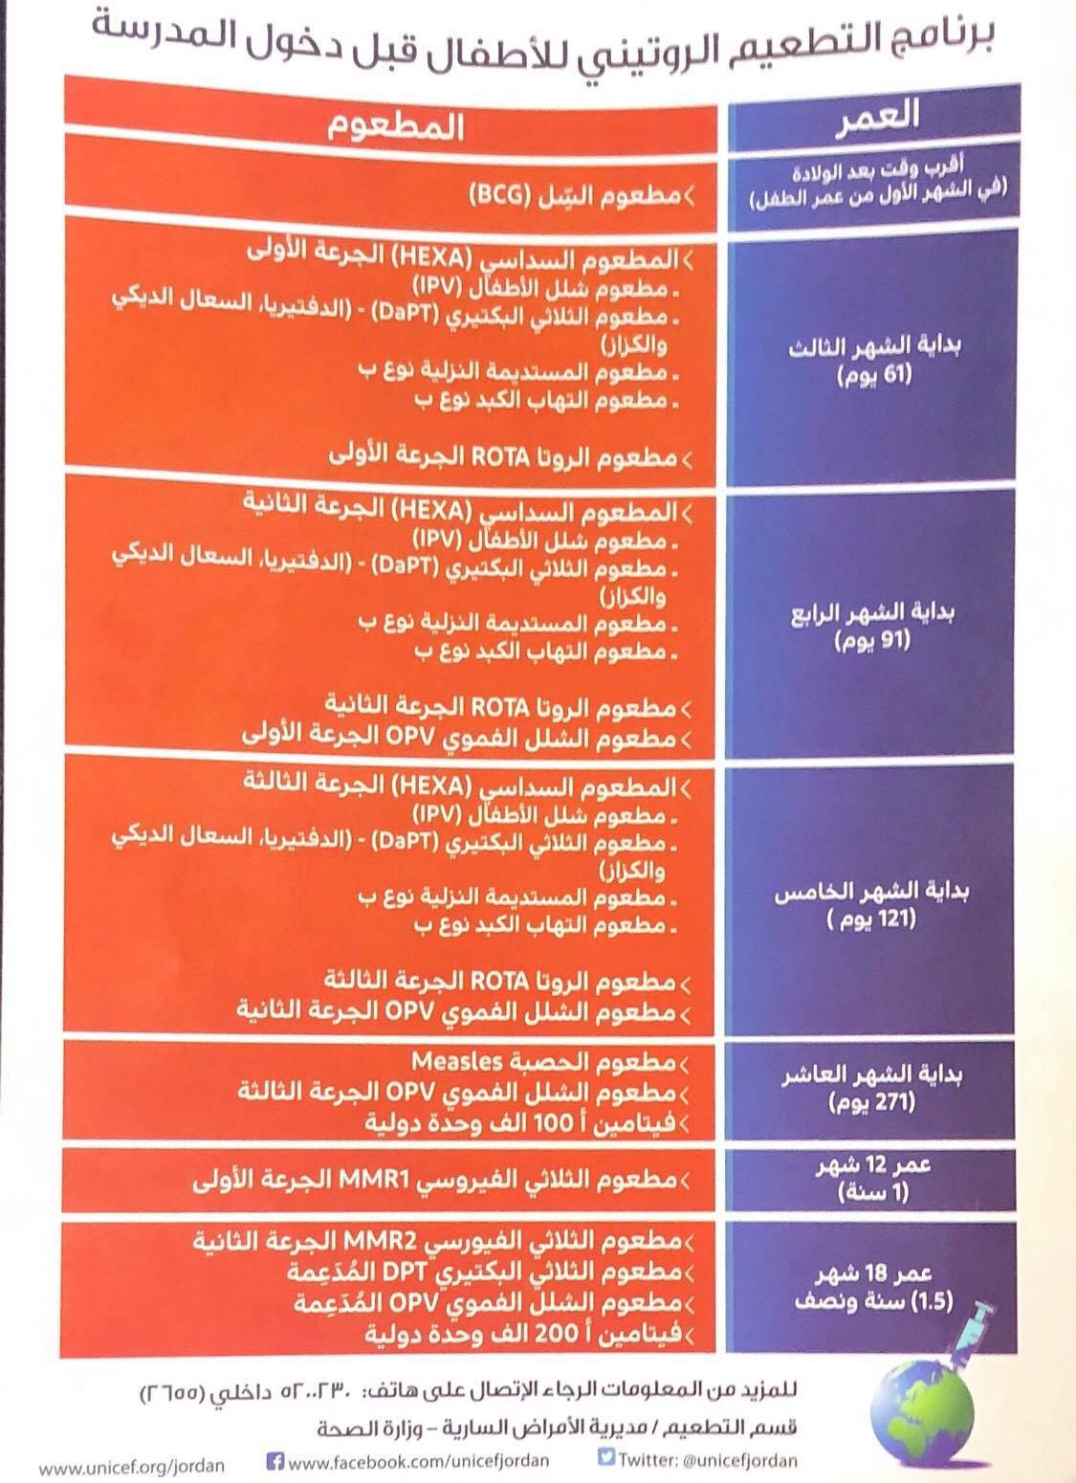
- مطعوم الكبد الوبائي أ
- مطعوم الكبد الوبائي أ

Slide 41
The Jordanian National Immunization Program
Recommended Vaccines |  |  | Age
 |  | BCG | First Month
 | IPV | DaPT-HBV-Hib-Rota | 61 Days
OPV | IPV | DaPT-HBV-Hib-Rota | 91 Days
OPV | IPV | DaPT-HBV-Hib-Rota | 121 Days
 | OPV | Measles | 9 Months
 | Hepatitis A first dose | MMR | Months12
Hepatitis A MMR | OPV (booster) | DaPT (booster) | 18 Months
 | OPV | Td | 6 Years (First Grade)
 |  | Td | 15 Years ( 10th Grade)

Slide 42
العمر والجرعة | المطعوم
أقرب وقت بعد الولادة (أول مراجعة للمركز الصحي ) | التدرن BCG
على عمر شهرين (61يوم) يعطي الطفل الجرعة الأولى من : | شلل الأطفال IPV + المطعوم الثلاثي DaPT +المستديمة النزلية B +التهاب الكبد الوبائي نوع B + الفيروس العجلي Rota
على عمر ثلاثة شهور (91يوم) يعطى الجرعة الثانية من : | شلل الأطفال OPV+ IPV + الثلاثيDaPT +المستديمة النزلية B +التهاب الكبد الوبائي نوع B + الفيروس العجلي Rota
على عمر 4 شهور (121يوم ) يعطى الجرعة الثالثة من : | شلل الأطفال OPV+ IPV + الثلاثي DaPT +المستديمة النزلية B +التهاب الكبد الوبائي نوع B + الفيروس العجلي Rota
على عمر 9 شهور يعطى (بداية الشهر العاشر ) : | الحصبة + مطعوم الشلل OPV
عند بلوغ الطفل عامه الأول يعطى : | الجرعة الأولى من مطعوم الثلاثي الفيروسي MMR مطعوم الحصبة والحصبة الألمانية والنكاف .
على عمر 18 شهر (عام ونصف) يعطى الطفل : | الجرعة المدعمة من مطعوم الشلل OPVومطعوم DaPT الجرعة الثانية من مطعوم الثلاثي الفيروسي MMR
عند بلوغ الطفل عامه السادس يعطى : | مطعوم الشلل OPV ومطعوم Td
عند بلوغه عامه ال 15 يعطى : | مطعوم Td

Slide 43
Notes on the new vaccination program
Started on 1/3/2015 after adding rota vaccine
Hepatitis A vaccine introduced on 1-7-2020
Number of vaccine s : 12( with rota vaccine and hepatitis A )
Remember measles vaccine is giving alone and in combination with triple mmr vaccine
Remember 2 month age mean completion of two months and entering the 3rd month (I.e 61 days )
AT 3 monthS ---------- (91 days)
AT 4 monthS ----------- (121 days )
AT 9 MONTHS----------- (ENTERANCER OF 10TH MONTH )
Vitamin a is giving as a supplement not as a vaccine

Slide 44
IMMUNIZATION
Special notes on some vaccines

Slide 45
BCG (Bacillus Calmette–Guérin ) 1 Month
Type of vaccine?
(Bacterial, live attenuated )(the only bacterial live attenuated )
Why is it given?
Decrease risk of TB meningitis
Decrease risk of miliary TB
When is it given?
At 1 month
Route of administration?
Intradermal
Whom is it given to?
Tuberculin –ve people
What is an absolute contraindication for BCG vaccine?
Immunosuppression
What is anotherr CI for BCG vaccine?
Tuberculin +ve people → risk of severe local inflammation and scarring

Slide 46
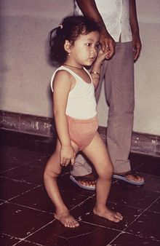
Polio Vaccine OPV (Sabin vaccine) IPV (Salk vaccine)
2nd+3rd+4th m
9th m
1.5y + 4-6y

Slide 47
IPV
OPV
Type of vaccine?
Inactivated/whole cell
Why is it given?
Prevent infantile paralysis
Route of administration?
IM
To whom?
Can be given to immunocompromised people
Can be given to immunocompromised contacts of an infected/recently vaccinated person
Type of vaccine?
Live attenuated
Why is it given?
Prevent infantile paralysis
Route of administration?
Oral
To whom?
Only to immunocompetent people
The vaccine is against strains 1 &3
Poliovirus strain 2 had been eliminated since 2016
The vaccine is against strains 1,2 &3
Notes:
In immune individuals, IgA antibodies against poliovirus are present in the tonsils and gastrointestinal tract, and are able to block virus replication; IgGand IgM antibodies against PV can prevent the spread of the virus to motor neurons of the central nervous system.
Polio vacc provide immunity against polio 1,2,3

Slide 48
IPV
OPV
Advantages?
No vaccine associated paralytic polio
Can be given to immunocompromised patients
Disadvantages?
No mucosal immunity
No contact immunity
Harder to administer
Costly
Advantages?
Mucosal immunity
Contact immunity
Easy to administer
Cheaper
Disadvantages?
Vaccine associated paralytic polio
Notes:
Contact immunity: a person vaccinated with Opv will shed the virus in their feces. Healthy immunocompetent people who come in contact with that person will acquire the viral particles and develop immunity without having to be vaccinated.
This shedding of viral particles in the feces of vaccinated individuals puts their immunocompromised contacts at risk of poliomyelitis .

Slide 49
Hepatitis B vaccination in infants
Infants born to an HBsAg-negative mother
receive their normal doses according to the program at the 2nd, 3rd & 4th month.
Infants born to an HBsAg-positive mother:
HepB Vacc + HBIG → within 12 h
Infants born to a mother whose status is unknown:
HepB vacc → within 12 h
Determine mother’s HBsAg status as soon as possible
HBIG if mother turns out positive → within 1 w

Slide 50
HepB Vaccination in Adults
First injection: At any given time
Second injection: 1 month after 1st dose
Third injection: 6 months after 1st dose
Levels of anti-Hbs antibody are tested:
Levels >100 mIU/ml → good response
Levels 10-100 mIU/ml → Single booster needed
Levels <10 mIU/ml → failure to respond (repeat the course and retest after 1-4 months)
Levels still <10 mIU/ml? → High dose intradermal injection may cause a response
Still <10 mIU/ml? → HBIg will be needed If exposed to infection later in life

Slide 51
Tetanus prophylaxis following wound contamination
Tetanus Ig | Not contamin-ated | Tetanus Ig | Contamin-ated wound | Immunization status
 | Give vaccine | Give Ig | Give vaccine | Unknown or <3 doses
 |  |  |  | >3 doses <5 years
 |  |  | Yes | >3 doses 5-10 years
 | yes |  | Yes | >3 doses >10 years

Slide 52
Side effects of the DTP vaccination
Mild (Common):
Fever, Redness, swelling, Soreness (1 in 4)
Fussiness ,Tiredness or poor appetite and Vomiting (1 in 50).
These problems occur more often after the 4th and 5th doses of the DTP series than after earlier doses.
Moderate Problems (Uncommon):
Seizure (1 in 14,000),
Non-stop crying for 3 hours or more (1 in 1,000)
High fever (1in 16,000)
Severe Problems (Very Rare) :
Serious allergic reaction (1 in a million dose)
Long-term seizures, coma, or lowered consciousness
Permanent brain damage.

Slide 53
Notes on Rotavirus infection
Rotavirus vaccination
Diarrhoeal disease is considered to be the most important cause of infant morbidity in Jordan.
Rotavirus is among the most common causes of diarrhoea in Jordanian children regardless of their social background (39.9% in Al Karak and 33.3% in the north of Jordan)
→ There really is a need for a vaccine against rotavirus
The great majority of cases of rotavirus diarrhoea (96.6%) were in children < 2 years of age
→ Immunization against rotavirus should be early in life
Notes:
Source: http://www.researchgate.net/publication/49743936_Nafi_O._Rotavirus_gastroenteritis_among_children_aged_under_5_years_in_Al_Karak_Jordan

Slide 54
Rotavirus vaccine
Started in Jordan on March/2015.
Type of vaccine?
Live attenuated (Rotateq)
Why is it given?
Prevent morbidity from diarrhea (decrease the severity of symptoms)
Route of administration?
Oral
Contraindication?
Immunodeficiency
Previous history of intussusception
Notes:
Rot-1 (Rotarix™) requires 2 doses (at least 4 weeks apart) and Rot-5 (RotaTeq™) requires 3 doses (4-10 weeks apart).

Slide 55
Latest Rotavirus Vaccines Recommendations
Rotarix (RV1) | RotaTeq (RV5)
2 | 3
6 wks | 6 wks
20 wks | 12 wks
24 wks | 32 wks
Doses
Min age
Max age- 1st dose
Max age- any dose
ACIP Reco 2009
--
6 wks
14 wks 6 days*
8 mon 0 days*

Slide 56
Hepatitis A Vaccine
It is RNA virus
Killed virus
Dose 0.5 ml
Route IM
Efficacy 94%
Protection duration more than 25 years
At age 12 and 18 months
Introduced on 1-7-2020

Slide 57
Vaccines not part of the Jordanian vaccination program

Slide 58
pneumococcal vaccines
There are 2 types of pneumococcal vaccines:
Pneumococcal conjugated vaccine(PCV7):
Given for children <2 years old.
Pneumococcal polysaccharide vaccine (PPV)/ Pneumovax:
Given to older children and adults.
When to administer PCV7 in a child <2 years old?
Cystic fibrosis
Cochlear implants
When to administer PPV in older children/adults?
all persons over 65 years
Immunocompromised patients (increased risk of infection)
Organ transplant / lymphoma / myeloma / HIV
CSF leak (fractured skull) & cochlear implants

Slide 59
Patients with chronic illnesses that increase risk of complicated pneumococcal infection
DM / Alcoholism / Chronic heart, lung or kidney disease
Patients with Splenectomy / Asplenia
Given 2 weeks prior to splenectomy
Individuals at occupational risk
There is a strong association between welding and the development of pneumococcal disease, particularly lobar pneumonia
What is the route of administration?
IM

Slide 60
Flu vaccine
Each injected seasonal influenza vaccine contains three killed influenza viruses:
one influenza type A subtype H3N2 virus strain
one influenza type A subtype H1N1 (swine flu) virus strain
one influenza type B virus strain
Type of vaccine?
Inactivated/Whole cell
Route of administration?
IM→ Killed
Nasal spray→ live attenuated
not recommended for individuals under age 2 or over age 50

Slide 61
Whom is it given to?
To those at high risk of complications:
Elderly >65yrs
Chronic lung diseases (asthma, COPD)
Chronic heart diseases (congenital heart disease, chronic heart failure, ischaemic heart disease)
Chronic liver diseases (including liver cirrhosis)
Immunosuppressed ( HIV , chemotherapy and long-term steroids) and their household contacts
People in an environment where influenza can spread rapidly (prisons or nursing homes)
healthcare workers (to prevent sickness and to prevent spread to patients)
pregnant women

Slide 62
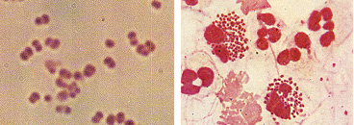
Meningococcal vaccine Nisseria meningitidis
Gram -ve diplococci (encapsulated)
It exists as normal flora in the nasopharynx of up to 40% of adults.
Spread through respiratory secretions
What are the most important strains?
(Strains are based on the chemical composition of their polysaccharide capsule)
The most clinically important are:
A, B {most lethal form}
C, X, Y
W135 {pilgrimage to Mecca}
Notes:
Two outbreaks coinciding with pilgrimage seasons for Hajj/Umra in 2000 and 2001 have been associated with N.meningitidis W135.

Slide 63
Meningococcal vaccine
What are the two types of meningococcal vaccine available in the US?:
Tetravalent polysaccharide vaccine (MPSV4) :
For ages 2 years and up
Tetravalent polysaccharide-protein conjugate vaccine (MCV4).
Less than 2 years
Both protect against serogroups A, C, Y, and W-135,
There is no vaccine currently available against serogroup b, which is actually the most prevalent. Why?
the capsular polysaccharide on the type B bacterium is too similar to human neural antigens to be a useful target.
Notes:
the capsular polysaccharide on the type B bacterium is too similar to human neural antigens to be a useful target.

Slide 64
Why is it important to get vaccinated against N. meningitidis?
The infection can rapidly progress from fever, headache and neck stiffness to coma and death.
Death occurs in approximately 10% of cases.
Whom is the vaccine given to?
Impaired immunity
Nephrotic syndrome (immunoglobulin loss)
Splenectomy
Complement deficiencies
HIV
Laboratory personnel exposed to aerosolized meningococci
Travelers to areas hyperendemic or epidemic with meningococcal infection.
Notes:
Encapsulated bacteria need antibodies and complements and opsonins (produced by the spleen) to be phagocytosed by macrophages in the spleen and elsewhere

Slide 65
Varicella vaccine First dose: 12- 15 months of age Second dose: up to 4 years of age
Type of vaccine?
Live attenuated
Why is it given?
Can prevent chickenpox and if The person gets chickenpox the disease will be mild, with fewer spots, less likely to have a fever, and will recover faster
Whom is it given to?
recommended for children 12 to 18 months of age and for susceptible older children.
Route of administration?
IM

Slide 66
COVID-19 Vaccination UPDATED 2022

Slide 67
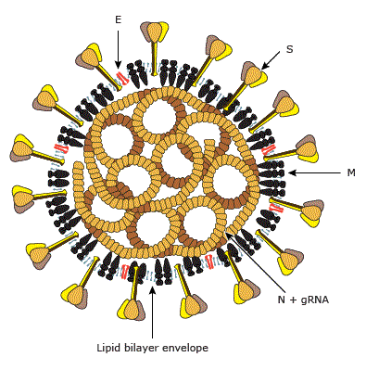
The nature of the virus
A family of enveloped, positive-sense, single-stranded RNA viruses There are four genera, among which α-coronavirus and βcoronavirus have ability to cross animal-human barriers and emerge to become major human pathogens
The spike (S-protein) : receptor binding and fusion with the host cell membrane. (major Ag)
The membrane (M-protein) : role in viral assembly
The nucleocapsid (N-protein)
The hemagglutinin-esterase glycoprotein (HE) : adsorption of the virus to the membrane.
The small envelope (E) Its function is not known.
Notes:
Viral stability refers to the ability of a virus to remain infectious over time and under different conditions. Viral assembly refers to the process by which a virus is assembled from its component parts.
tropism , fusion of envelope , assemply.

Slide 68
History of the virus
 | SARS COV1 | MERS | COVID19
First emergence | November2002 China | In September 2012,KSA | December2019 China
Status | Completely controlled ( Since mid-2004, no cases of SARS-CoV-1 have been reported). | Sporadic, continuous ( The most recent lab-confirmed patients were reported by Riyadh on 28 March 2020) | ONGOING ! no longer a Public Health Emergency of International Concern (PHEIC), but still has the criteria of a pandemic.
N. cases | 8096 | 2553 | 768,560,727
N. Death | 774 deaths | 876 | 6,952,522

Slide 71
Latest updates
Notes:
increase and plateu

Slide 72
Bats are natural hosts for SARS-CoV1 and palm civets were important intermediate hosts (palm civets on farms found to be largely free from SARS-CoV infection while 80% of the civets sold in an animal market were serologically positive indicating they became intermediate hosts by getting infected during trade activities in or before reaching markets.
Bats were probably the source for MERS-CoV with The intermediate reservoir being dromedary camels.
emergence of SARS-CoV-2 was considered to be associated with trade activities in a wet market in Wuhan..

Slide 73
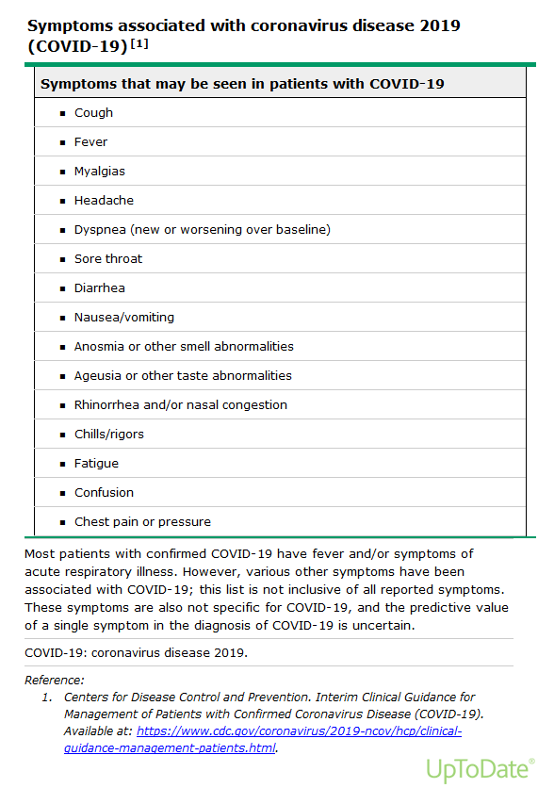

Slide 74
CRS-like syndrome ("cytokine storm")
Acute systemic inflammatory response characterized by fever and multiple organ dysfunction that is most often caused by immunotherapy but also with sever viral infections like influenza and SARS-COV2 !
Much of the mortality has been associated with a cytokine storm syndrome in patients admitted to hospital with COVID-19 pneumonia.1
Activation of manly T cells or lysis of immune cells induces a release of (IFN-γ) or (TNF-α). This leads to the activation of macrophages, dendritic cells, other immune cells and endothelial cells.
These cells further release proinflammatory cytokines. Importantly, macrophages and endothelial cells produce large amounts of (IL-6) which in a positive feedback loop manner activates T cells and other immune cells leading to a cytokine storm.
is an umbrella term encompassing several disorders of immune dysregulation
Cytokine release> endothelial activation,Neutrophil recruitment & degranulation in lung > ↑ Capillary permeability, alveolar fluid accumulation > Formation of hyaline membrane > Acute Respiratory distress syndrome (Hypoxia , Bilateral pulmonary infiltrate)
Notes:
pople have it more severe

Slide 75
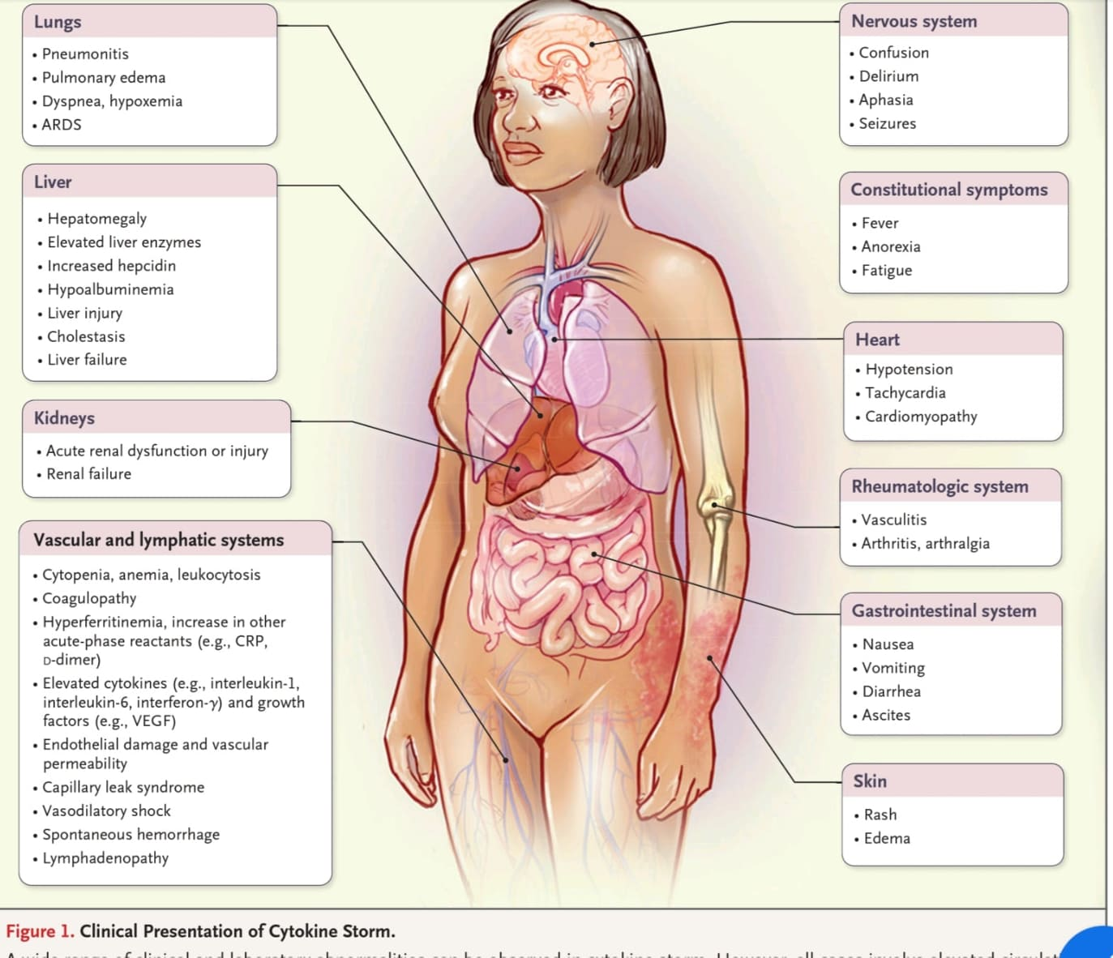
clinical presintation of the cytokine storm
Notes:
multi organ dysfunction

Slide 76
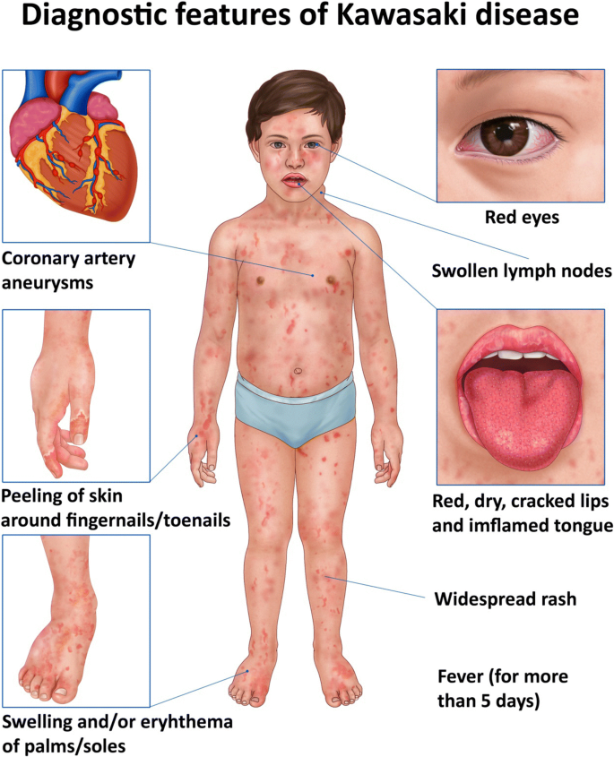
Kawasaki disease
Also known mucocutaneous lymph node syndrome
It’s the most common medium size vessel vasculitis
most common in young children 6 >years old.
Diagnostic criteria:
“fever for 5 days + four of the five clinical manifestation”
May develop coronary artery aneurysms
thrombosis or rupture can cause death
Treatment : IV immunoglobulin and aspirine

Slide 77
Multisystem inflammatory syndrome (MIS-C)
Multisystem inflammatory syndrome in children (MIS-C) is a serious condition that appears to be linked to coronavirus disease 2019 (COVID-19).
An inflammatory syndrome that resemble Kawasaki disease.
Signs and symptoms:
1-Fever that lasts 24 hours or longer 2- Skin rash
3-Diarrhea&Vomiting 4-Pain in the stomach
5-Redness or swelling of the hands or feet 6-Red eyes
7-Redness or swelling of the lips and tongue 8-Enlarged lymph nodes
9-Fast heartbeat 10-Rapid breathing

Slide 78
"Defining Kawasaki disease and pediatric inflammatory multisystem syndrome-temporally associated to SARS-CoV-2 infection" key takeaways:
Children with Kawasaki disease-like multisystemic disease were significantly older at onset and presented more frequently from gastrointestinal and respiratory involvement.
Cardiac involvement was more common in patients with Kawasaki disease-like multisystemic disease, with 60.4% demonstrating myocarditis.
The risk of ICU admission was higher patients with Kawasaki disease-like multisystemic disease.
Coronary artery abnormalities were more common in children with Kawasaki disease.
COVID-19 positivity was prevalent in 75.5% of children in the Kawasaki disease-like multisystemic disease group, compared with 20% among this with Kawasaki disease (P ( .0001 ).

Slide 79
RT-PCR test
Sample collection is done using a “nasopharyngeal swab”... After collection, the swab is sealed in a tube and then sent to a laboratory.
Extraction : isolates genetic material from the sample including genetic material from any virus that may be present.
The PCR step then uses special chemicals (template, polymerase, primers , deoxynucleotide triphosphates (dNTPs) and PCR buffers) and a PCR machine, called a thermal cycler, Uses reverse transcription to create a complementary DNA template that is amplified via standard PCR procedure. that makes millions of copies of a small portion of the SARS-CoV-2 virus’s genetic material. During this process, one of the chemicals produces a fluorescent light if SARS-CoV-2 is present in the sample. This fluorescent light is a “signal” that is detected by the PCR machine and special software is used to interpret the signal as a positive test result.
The rt-PCR can Detects and
quantifies mRNA levels in a sample

Slide 81
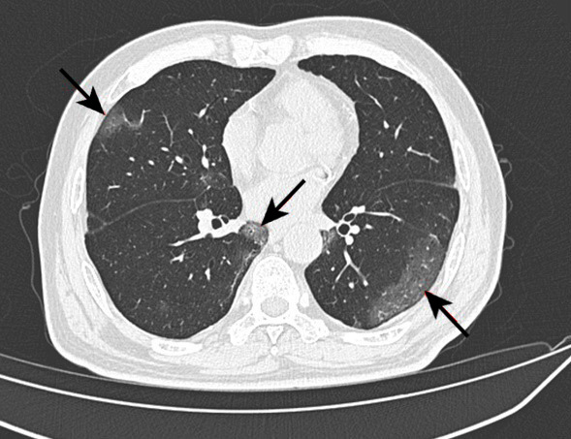
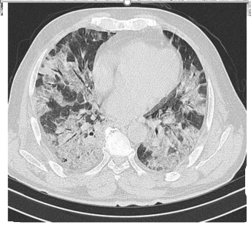
CT scan
The typical appearance of COVID-19 pneumonia is bilateral patchy areas of ground glass infiltration, more in the lower lobes
The appearance of other signs like consolidation, air bronchogram, crazy pavement appearance, and air bubble signs appear during the course of the disease

Slide 82
What are the avilable vaccines ?
Inactivated virus Vaccine
Sinopharm
Bahrat Biotech(not in the seminare)
Virus like Particle Vaccine
Novavax)not mentioned in the seminar)
Viral vector Vaccine
Jonson&Jonson
Oxford/AstraZeneca
Encapsulated mRNA Vaccine
BioNTech/Pfizer
Moderna
Gamaleya(Sputnik V)

Slide 83
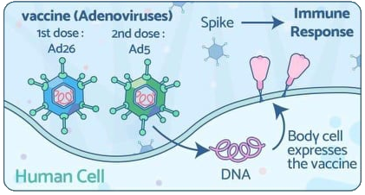
Sputnik V
Type of vaccine:
replication-incompetent
adenovirus 26 and
adenovirus 5 vectors
Number of shots: 2 shots 3 weeks apart
How given: Shot in the muscle of the upper arm
Storage: Liquid form: Freezer (–18°C) for 2 years
Freeze-dried form: Refrigerated (2 to 8°C) for 3 months
Efficacy: 92%
Most common side effects:
Local S\E: Pain, Redness and Swelling
Systemic S\E: Tiredness, Headache, Muscle, pain, Chills, Fever and Nausea.

Slide 84
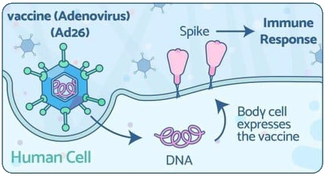
University of Oxford, AstraZeneca
Type of vaccine: replication-incompetent chimpanzee adenovirus vector that expresses the spike protein
Number of shots: 2 shots 8 to 12 weeks apart
How given: Shot in the muscle of the upper arm
Storage: 2-8C for 6months
Efficacy: 70%
Most common side effects:
Local S\E: Pain, Redness and Swelling
Systemic S\E: Tiredness, Headache, Muscle, pain, Chills, Fever and Nausea

Slide 85
JHONSON & JHONSON
Name: Janssen COVID-19 Vaccine
Type of vaccine: Viral vector
(adenovirus 26 vector)
Number of shots: 1 shot
How given: Shot in the muscle of the upper arm
Refrigerated: (2-8 c)
Efficacy: 66.3%
FDA approved
Most common side effects:
Local S\E: Pain, Redness and Swelling
Systemic S\E: Tiredness, Headache, Muscle, pain, Chills, Fever and Nausea

Slide 86
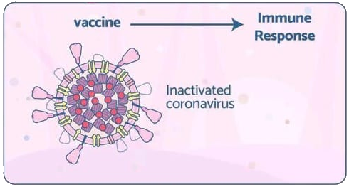
SINOPHARM
Name: Sinopharm \ BBIBP-CorV
Type of vaccine: Inactivated virus
Number of shots: 2 shots
How given: Shot in the muscle of the upper arm
Refrigerated: (2-8 c)
Efficacy: 79-86%
Most common side effects:
Local S\E: flush, swelling, scleroma, rash, and itching
Systemic S\E: fever, fatigue, muscle ache, joint pain, cough, difficulty breathing, nausea, diarrhea, and itchy skin
Used in Jordanian vaccine program

Slide 87
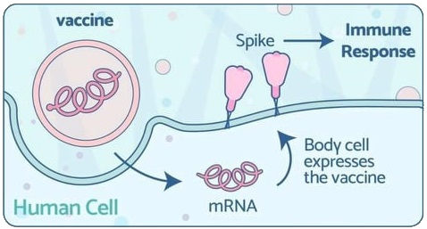
mRNA vaccines
mRNA inside a special coating. That protects the mRNA from enzymes and helps the mRNA to enter the dendritic cells and macrophages in the lymph node near the vaccination site.
the mRNA has the instructions to make Spike protines
Researchers have been studying and working with mRNA vaccines for decades. because they can be developed in a laboratory using readily available materials. This means the process can be standardized and scaled up, making vaccine development faster than traditional methods of making vaccines.
It is important to note that the mRNA strand never enters the cell’s nucleus or affects genetic material. This information helps counter misinformation about how mRNA vaccines alter or modify someone’s genetic makeup
Notes:
talk about the misconception that it changes the dna , and the mechanisms , efficacy , oral intake

Slide 88
BioNTech/Pfizer
Name: BioNTech/Pfizer COVID-19 Vaccine (BNT162b2)
Type of vaccine: Encapsilated mRNA vaccine
Number of shots: 2 shots 21 days apart
How given: Shot in the muscle of the upper arm
Storage: -70c for 6 month / +2-8C for 5days
Efficacy: 95%
FDA approved
Most common side effects:
Local S\E: Pain, Redness and Swelling
Systemic S\E: Tiredness, Headache, Muscle, pain, Chills, Fever and Nausea

Slide 89
Moderna
Name: Moderna COVID-19 Vaccine (mRNA-1273)
Type of vaccine: Encapsilated mRNA vaccine
Number of shots: 2 shots 28 days apart
How given: Shot in the muscle of the upper arm
Storage: -20c for 6 month / +2-8C for 30days
Efficacy: 94%
FDA approved
Most common side effects:
Local S\E: Pain, Redness and Swelling
Systemic S\E: Tiredness, Headache, Muscle, pain, Chills, Fever and Nausea

Slide 90
HIPRA COVID-19 vaccine
Manufacturer: HIPRA, a Spanish biopharmaceutical company
Type: Recombinant protein-based vaccine
Target: Spike protein of SARS-CoV-2
Administration: Two doses, 21 days apart
Storage: 2 to 8 degrees Celsius
Efficacy: 88.3% against symptomatic COVID-19, 71.6% against hospitalization, and 81.3% against severe COVID-19
Safety: The vaccine is generally well-tolerated. The most common side effects are mild and go away on their own within a few days.
Approvals: The vaccine has been approved for use in Spain, the European Union, and the United Kingdom.
Notes:
oral intaek againt omecron , as afourth dose

