Slide 1
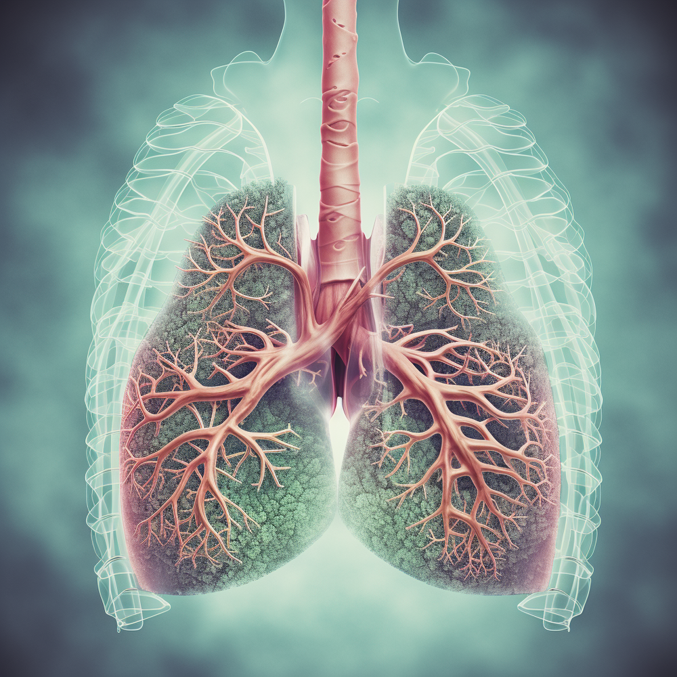
AIRWAY ANATOMY ASSESSMENT
Done and presented by:
Bayan Mahmoud Qattawi
Sadeel Mokhles
Hala Abu Azzeh
Aya Abu Samra
Hamzeh Al-Tamimi
Supervised by:
Dr.Mohammad Amir

Slide 2
AIRWAY ANATOMY SIGNIFICANCE IN ANESTHESIA AND ICU
Accurate knowledge of anatomy and physiology of the respiratory tract is important in anaesthesiology and critical care
for safe and smooth conduction of anaesthesia and ICU management. as General anaesthesia sedation and muscle relaxation are associated with alterations in the respiratory function and carry with them at least a small risk of airway obstruction and apnea.

Slide 3
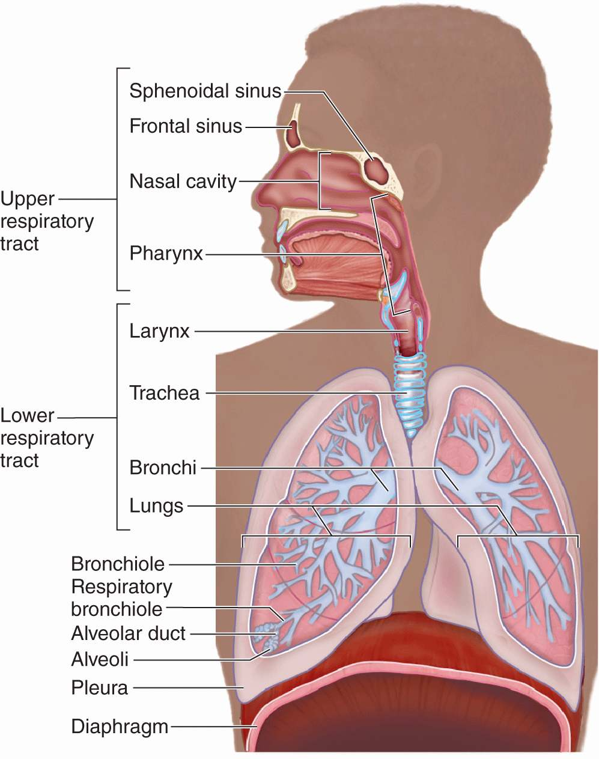
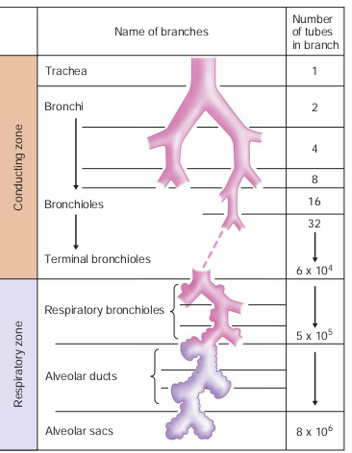
Airway is divided
Anatomically
Functionally

Slide 4
Air way is defined as a passage through which the air/ gas passes during respiration.
Functionally divided into:
*conductive zone – till terminal bronchioles
*respiratory zone – includes respiratory bronchioles,alveolar ducts,alveoli
And anatomically divided into:
*upper airway (oral and nasal cavities,pharynx,larynx)
More vulnerable to obstruction
*lower airway (trachea,bronchi,bronchioles,alveoli)

Slide 5
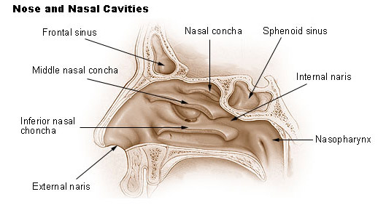
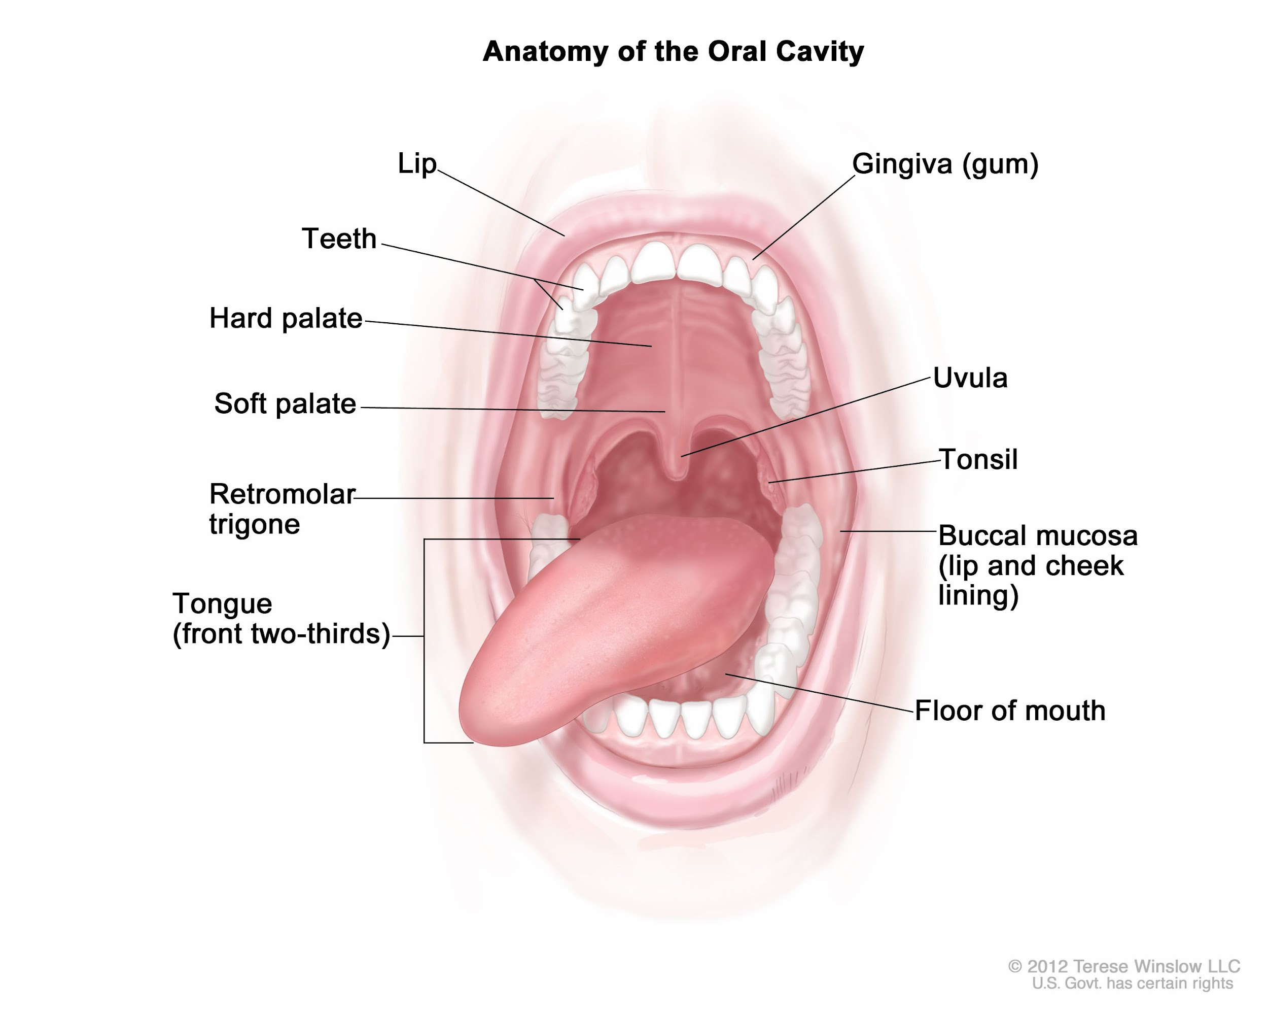
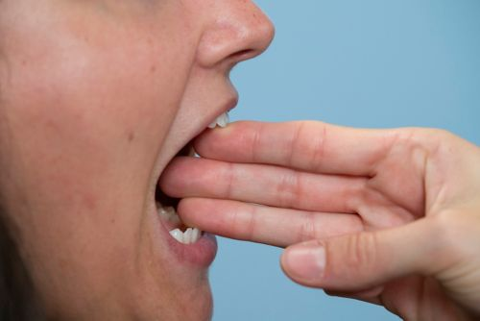
ORAL CAVITY
NASAL CAVITY
Extending from nostrils to posterior nasal aperture.
Divided by nasal septum into 2 halves (right and left)
Aims in humidification, heating and filtering of inspired air.
Extending from lips into oropharyngeal isthmus.
During evaluation for airway assessment, mouth opening must at least 3 fingers width (>6cm)

Slide 6
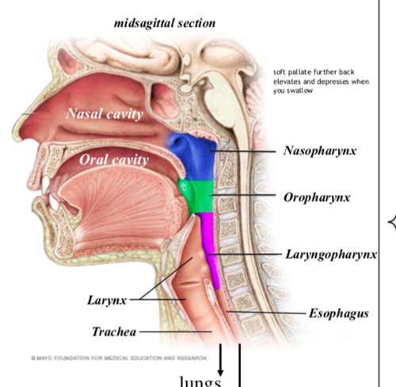
PHARYNX =THROAT
A hollow muscular tube inside the neck that connects the posterior nasal and oral cavities to the larynx and esophagus.
*12-14 cm in length
Nasopharynx | Oropharynx | Laryngopharynx
Behind the nasal cavity and above the soft palate. | Behind the oral cavity, between soft palate and top of hyoid bone. | Behind the larynx and below the epiglottis to the beginning of esophagus.

Slide 7
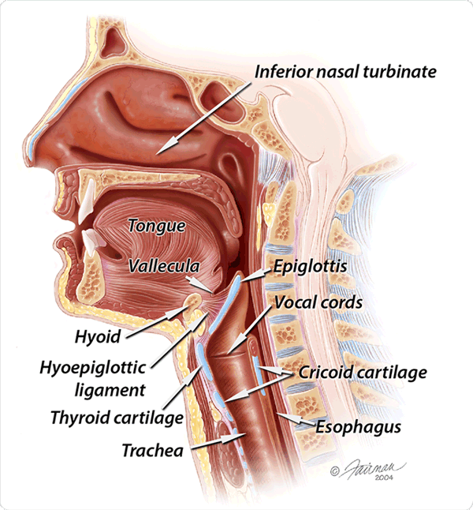
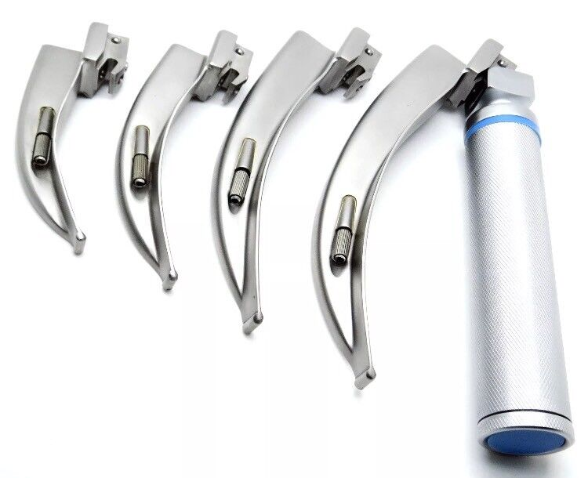
Vallecula
₋ Vallecula: a depression between epiglottis and base of the tongue
*where blade of laryngoscope rests.

Slide 8
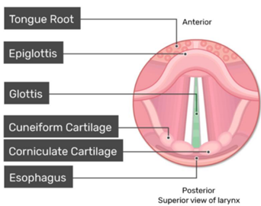
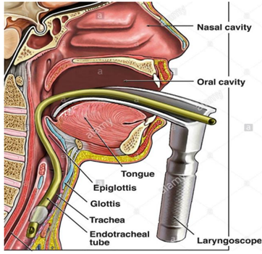
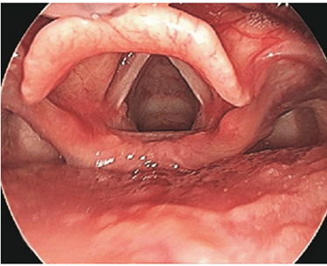
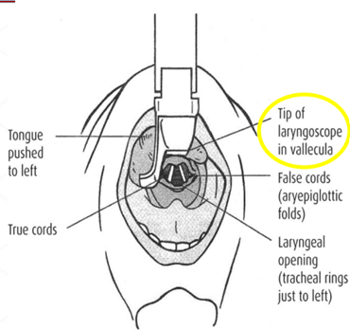
Laryngoscopy
• Laryngoscopy for tracheal intubation:
₋ Endoscopy of the larynx to obtain a
good view for vocal cords and glottis.
₋ Used for placement of the Endotracheal Tube ( ETT) into the trachea

Slide 9
Endotracheal Tube ( ETT)
ETT is a tube constructed of polyvinyl chloride .
placed into the windpipe through the mouth or nose .

Slide 10
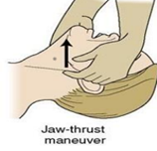
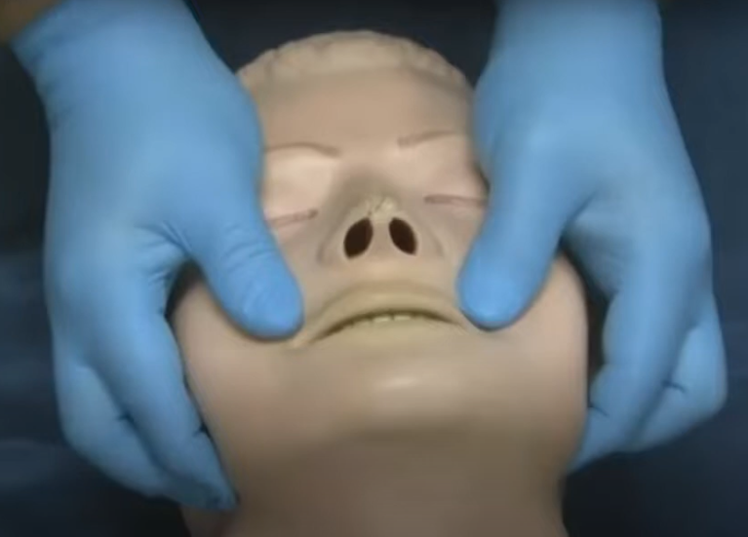
• Jaw thrust maneuver
₋ In cases of decreased consciousness as in General Anesthesia and due to decreased muscle tone,tongue may be posteriorly displaced into oropharynx obstructing the airway.
₋ These maneuvers are used to maintain patient’s airway.
₋ performed by placing the index and middle fingers
to physically push the posterior aspects of the lower jaw upwards and outwards
while their thumbs push down on the chin to open the mouth.
https://youtu.be/PdkgnRCoci4?si=qy21zF7KV7PUjNni

Slide 11
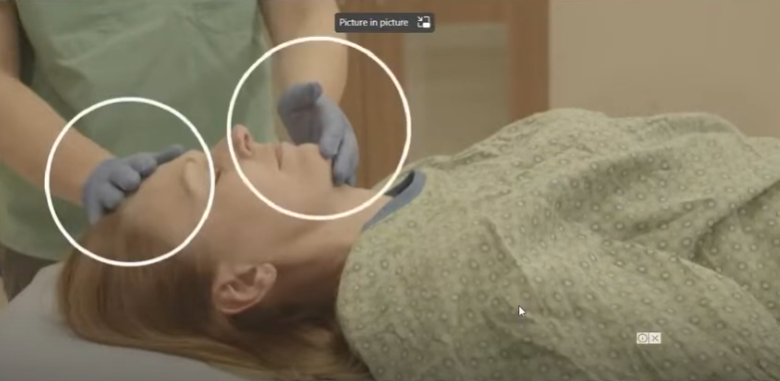
Head Tilt Chin Lift
The head tilt-chin lift maneuver consists of two separate maneuvers. First, one hand is placed on the forehead and is used to rotate the head into a "sniffing" position (i.e., neck fully extended and head tilted backwards). Second, the other hand is used to lift the chin forward and up.

Slide 12
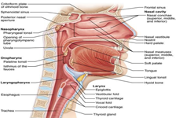
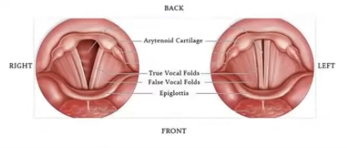
• Larynx (sound box)
₋ The passageway for air between the pharynx above and the trachea below.
₋ Extends from C3-C6 in adults.
₋ It is formed a number of cartilages which articulates by synovial joints
and connected together by ligaments and membranes and moved by number of muscles.
₋ Laryngeal cavity has 2 pairs of mucous membrane folds:
*upper folds = false vocal cords
*lower folds = true vocal cords,
which could be injured during intubation

Slide 13
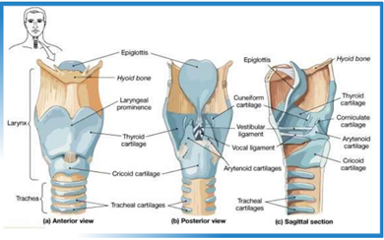
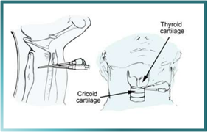
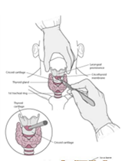
Cricothyrotomy:
Surgical airway made via the cricothyroid membrane in acute emergency
when obstruction at or above the larynx not relieved.

Slide 14
INDICATIONS AND CONTRAINDICATIONS
Cricothyrotomy , also known as Cricothyroidotomy,is an important emergency procedure that is used to obtain an airway when other,more routine methods (eg, laryngeal mask airway [LMA] and endotracheal intubation) are ineffective or contraindicated.
Indications
Cricothyroidotomy is indicated upon failure to obtain an airway with traditional methods in the following situations:
•Trauma causing oral ,pharyngeal, or nasal hemorrhage .
•Facial muscle spasms or laryngospasm.
•Uncontrollable emesis.
•Upper airway stenosis or congenital deformities.
•Clenched teeth.
•Tumor,cancer,or another disease process or trauma causing mass effect. Airway obstruction indications include the following:
•Oropharyngeal edema (eg,anaphylaxis.
Contraindications
The only absolute contraindication to surgical cricothyroidotomy is age,although the exact age at which a surgical cricothyrotomy can be safely performed is controversial and has not been well
defined.Various sources list lower age limits ranging from 5 years[15]to 12 years[16] ,and Pediatric Advanced Life Support (PALS) defines the pediatric airway as age 1-8 years.

Slide 15
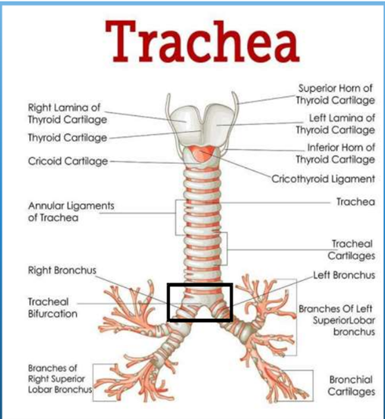
• The Trachea
₋ The trachea is a mobile cartilaginous and membranous tube.
₋ It begins as a continuation of the larynx at the lower border of the cricoid cartilage
at the level of the 6th cervical vertebra
₋ Trachea ends at the carina by dividing into right and left principal (main) bronchi
at the level of the sternal angle
(opposite the disc between the fourth and fifth thoracic vertebrae
₋ The carina is a cartilaginous ridge within the trachea at the site of the tracheal bifurcation
₋ In adults the trachea is about 4½ in. (11.25 cm) long and 1 in. (2.5 cm) in diameter

Slide 16
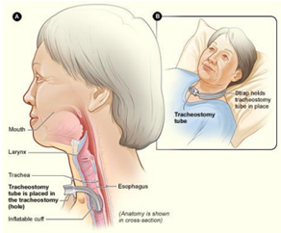
• Tracheostomy
₋ tracheostomy is an opening (made by an incision) through the neck into the trachea (windpipe).
A tracheostomy opens the airway and aids breathing.
₋ A tracheostomy may be done in an emergency, at the patient's bedside or in an operating room.
₋ Anesthesia (pain relief medication) may be used before the procedure
o Levels of tracheostomy :
1. High level at first tracheal ring
2. Mid-level at second tracheal ring
3. Low level at third tracheal ring

Slide 17
INDICATIONS OF TRACHEOSTOMY
Respiratory obstruction:
Retained secretion :
Respiratory insufficiency :
-Inability to cough -Respiratory muscles spasm -Respiratory muscles paralysis -Coma of any cause : head injury -Painful cough
-Chest injuries , multiple rib fractures, pneumonia -Aspiration of secretion
-Infection -Trauma -Laryngeal oedema
-Neoplasm -Foreign body -Bilateral abductor paralysis
-Chronic lung conditions as :
*Emphysema *Chronic bronchitis
*Bronchiectasis
*Atelectasis

Slide 18
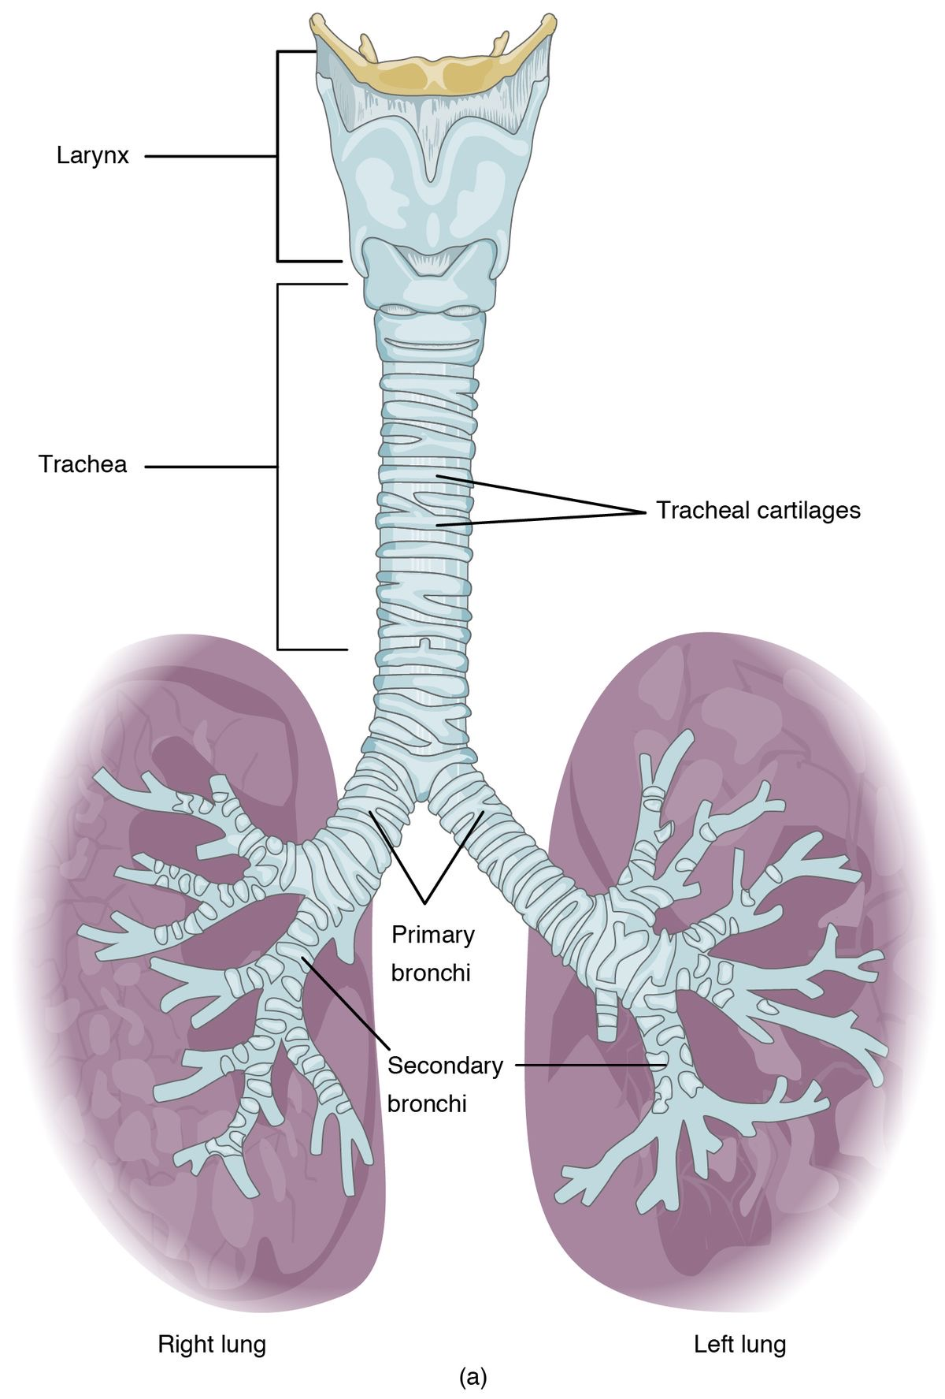
BRONCHI
Right bronchus is shorter and wider and is more vertical than the left bronchus.
Foreign bodies usually enter the right bronchus .

Slide 19
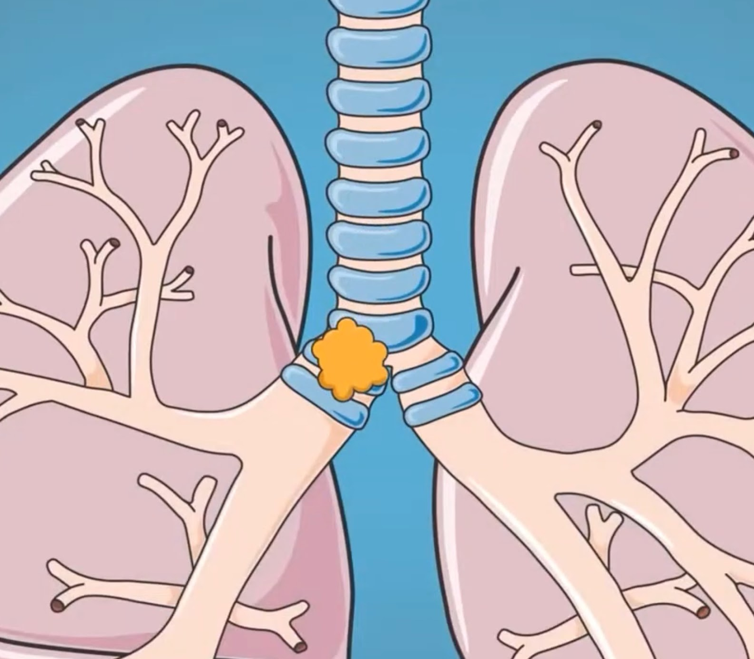
Carina clinical significance
Foreign bodies that fall down the trachea are more likely to enter the right bronchus.
The mucous membrane of the carina is the most sensitive area of the trachea and larynx for triggering a cough reflex.

Slide 20
Airway assessment
• History
• Local examination
•Specific tests
• Radiological presentation

Slide 21
Airway assessment is the first step in successful airway management. Several anatomical and functional manoeuvres can be performed to estimate :
1 - difficulty of endotracheal intubation; account 17% of respiratory related injury and result in significant morbidity and mortality
2- Oesophageal intubation
3- Inadequate ventilation
*28%of anaesthesia related death are secondary to the inability to mask ventilate or intubation

Slide 22
Predictor of difficulty encountering ventilation mask :
Bearded man
mask sealing difficult due to receding mandible syndromes with facial abnormality burn stricture and treacher Collins syndrome .etc
Obesity, upper airway obstruction
Advanced age
no teeth
Snorer

Slide 23
WHY IT IS NECESSARY ?
TO DIAGNOSE THE POTENTIAL FOR DIFFICULT AIRWAY FOR :
1- Optimal patient preparation
2- Proper selection of equipment and technique
3- Participation of personnel experienced in difficult airway management

Slide 24
LEMON
LOOK
Evaluation
Mallampati scores
Obstructive
Neck mobility

Slide 25
Look
Examination of the airway look for:
• Short immobile muscular neck
• Receding mandible
• Protruding maxillary incisors
• Long high-arched palate
• Loose or capped Missing teeth
• Enlarged tonsils &tongue
• tumor that could obstruct air flow
• Limited temporomandibular joint mobility

Slide 26
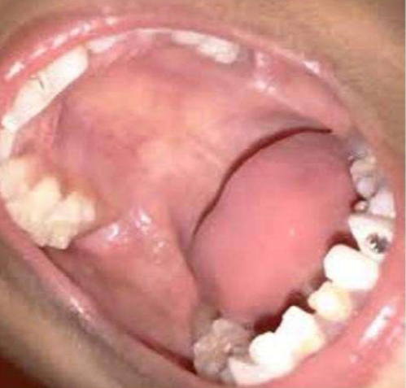
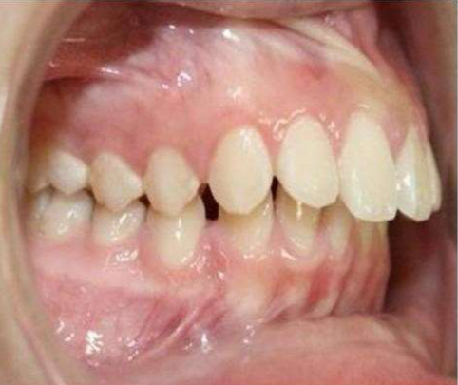
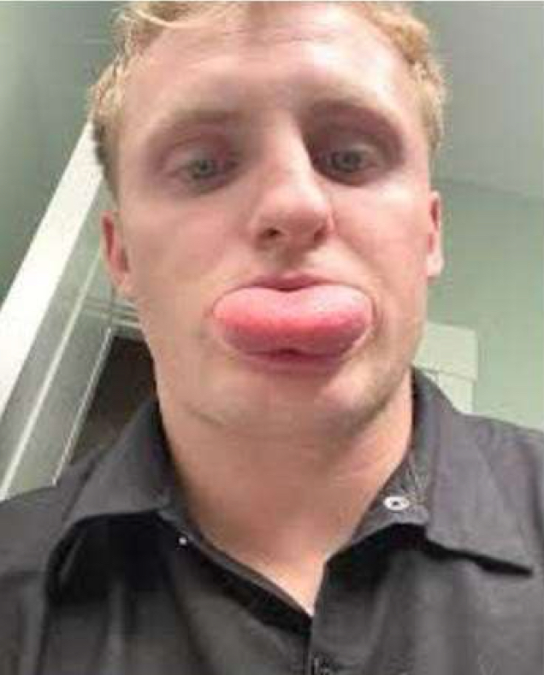
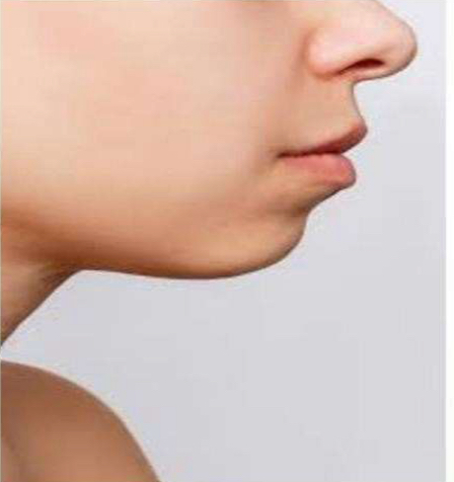
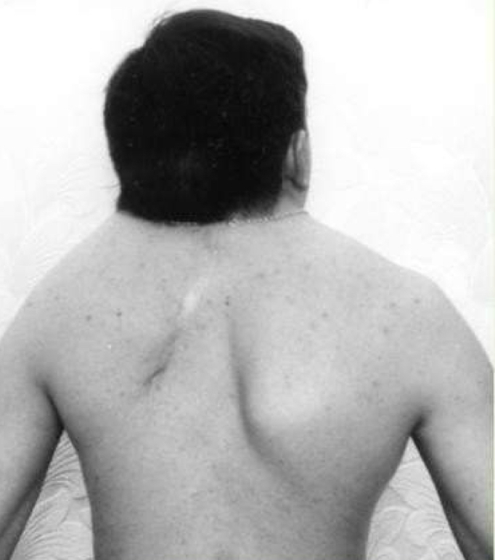
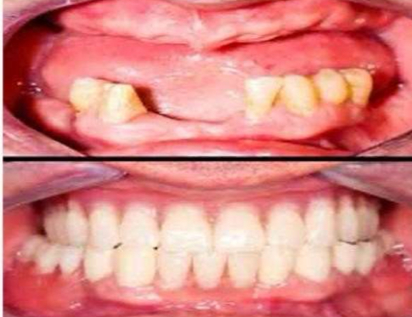

Slide 27
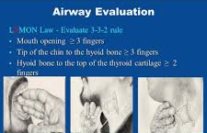
Evaluation
EVALUATE 3 32
Mouth Opens at least three finger widths (>6cm)
Thyromental distance Three finger widths(> 6cm)
hyomental distance Two finger widths

Slide 28
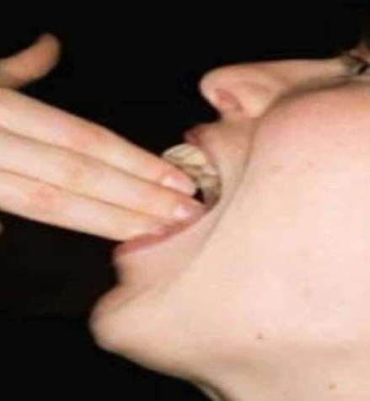
- Inter-incisor distance with maximal mouth opening
- Minimum acceptable value: > 5 cm
- Significance:
< 3 cm: Difficult laryngoscopy
< 2 cm: Difficult LMA insertion

Slide 29
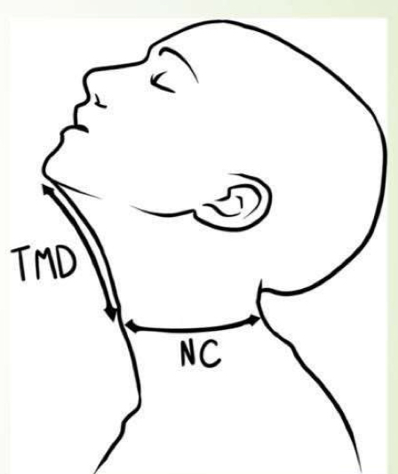
Thyromental Distance (Pail’s Test):
• Distance from the tip of the thyroid cartilage to inside of the mentum
•Neck fully extended / mouth closed
• >6.5 cm: No problem with laryngoscopy and intubation
• 6-6.5 cm: Difficult laryngoscopy but possible
• <6 cm: Laryngoscopy is impossible

Slide 30
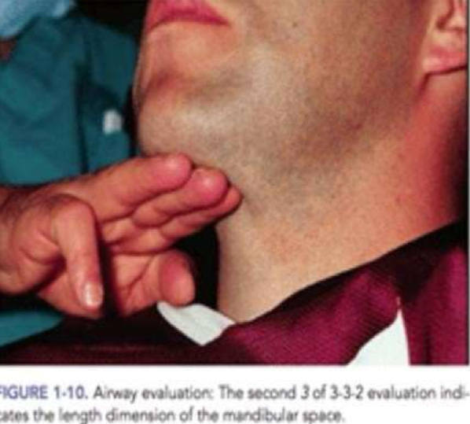
Hyomental distance
- Measured from the mentum to the top of the hyoid bone >2 fingers
- The position of the hyoid bone marks the entrance to the larynx.
- <2 fingers: less space to displace tongue tends to be more difficult to intubate.

Slide 31
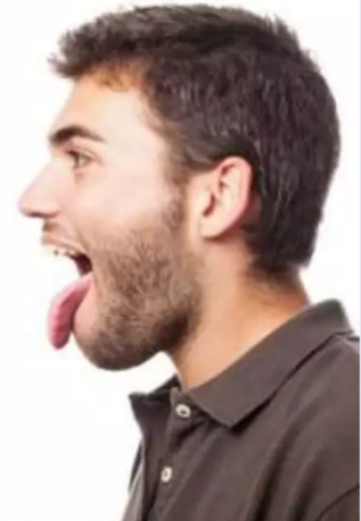
LEMON:
3-Mallampati score :
- The assessment of the size of the tongue relative to the size of the pharyngeal opening to predict intubation difficulty.
- Performed with the patient in
a sitting position,
head neutral,
mouth open wide,
and tongue protruding to the maximum.

Slide 32
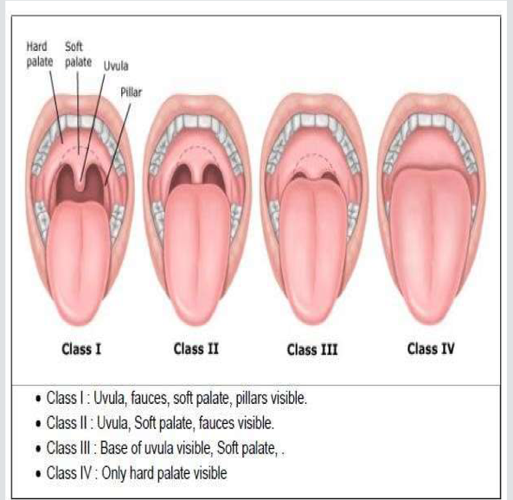
- Mallampati score :
( Back of the pharynx)
Class I: 46% prevalence
(No Difficult intubation)
Class II:40% prevalence
(No Difficult intubation)
Class III:<13% prevalence (Moderate Difficult intubation)
Class IV:<1% prevalence
(Severe Difficult intubation)

Slide 33
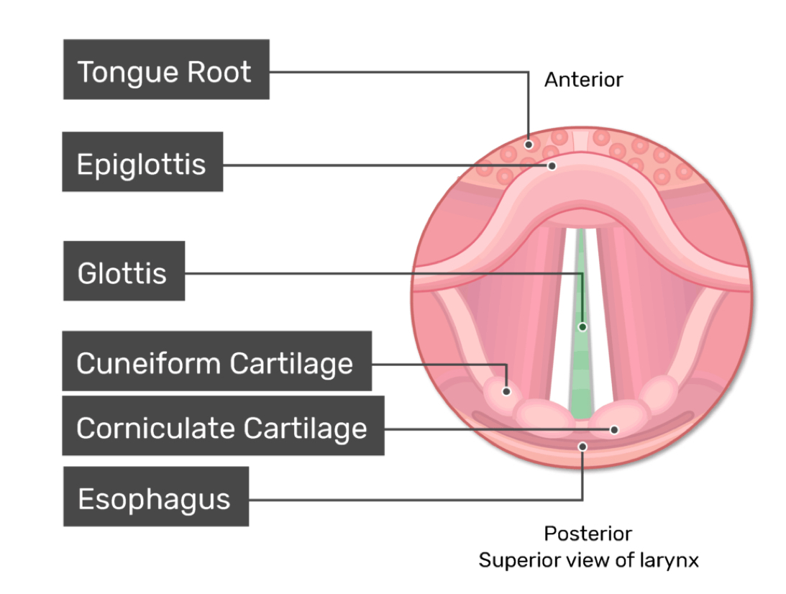
•Cormack-Lehane Grading (Laryngoscopic view Grades)
Grade 1: Full view of the glottis.
Grade 2: Only the posterior extremity of the glottis
seen or only arytenoid cartilages.
Grade 3: Only the epiglottis seen.
Grade 4: Neither glottis nor epiglottis seen (very rare).

Slide 34
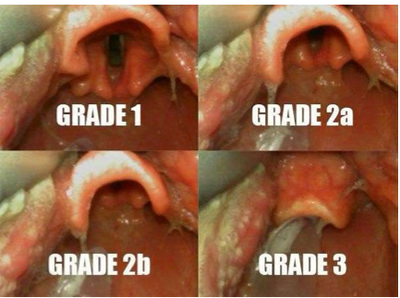

Slide 35
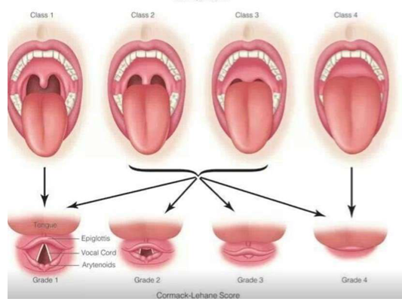

Slide 36
LEMON:
4-Airway obstruction
Partial or complete blockage in any part of the airway resulting in a
decreasing the ability to ventilate.
Airway obstruction can be either acute or chronic. EX:
Tongue.
foreign body.
trauma (burn, bleeding).
Infections (epiglottitis).
allergic reactions.
tumors.
abscess(Peritonsillar abscess, Retropharyngeal abscess).

Slide 37
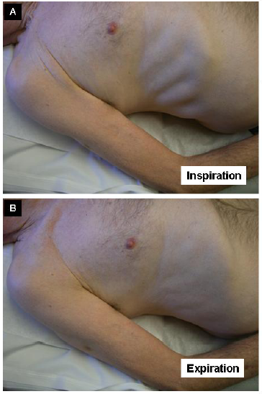
Partial and Complete Airway Obstruction Symptoms:
Partial:
•Noisy breathing (stridor, snoring).
•Coughing.
•Retraction of the sternum.
•Hypoxemia.
•Hypercarbia.
Complete:
• Lack of any air movement
• Lack of breath sounds with a stethoscope
• Choking sign (hands clenched throat).
• Cyanosis.
• Retraction of the sternum and rib cage
• Hypoxemia
• Hypercarbia

Slide 38
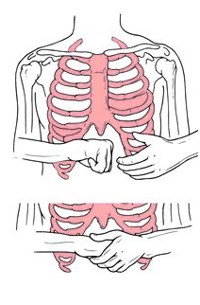
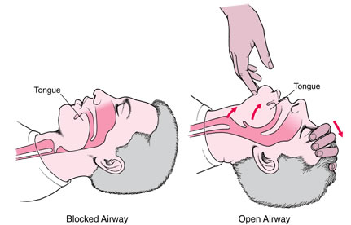
Airway Obstruction Management
Heimlich maneuver
- Quick history and clinical examination can help in determining the site of obstruction.
- Heimlich maneuver: Subdiaphragmatic abdominal thrust creates an artificial cough and expels a foreign body from the airway.
- Head-tilt/chin-lift: Contraindicated in suspected cervical injury.
- Jaw thrust maneuver
- Surgical intervention
- Investigation: X-ray, CT, and bronchoscopy
Jaw thrust

Slide 39
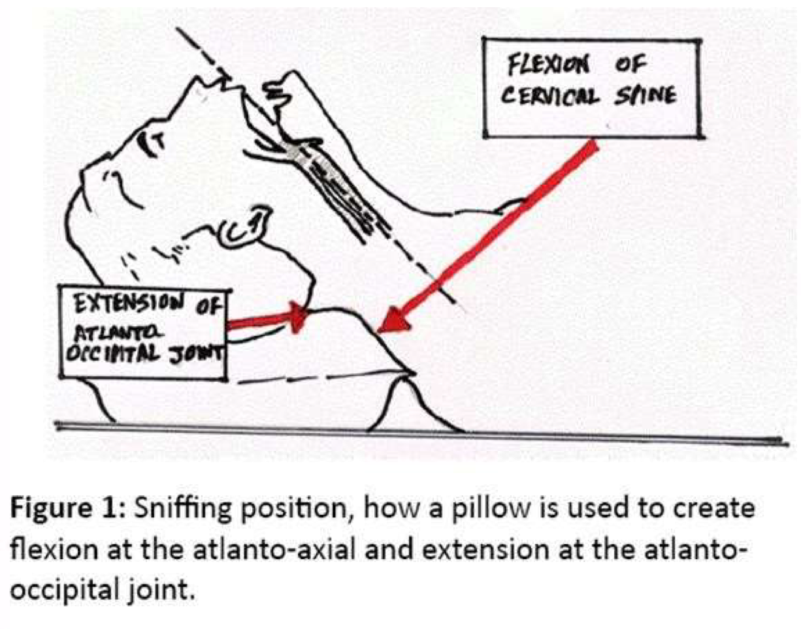
LEMON :
5-Neck mobility
- Ideally, the neck should be able
to extend back approximately 35°.
- The best position for intubation
is the sniffing position.
- Atlanto-occipital movement assesses neck mobility.

Slide 40
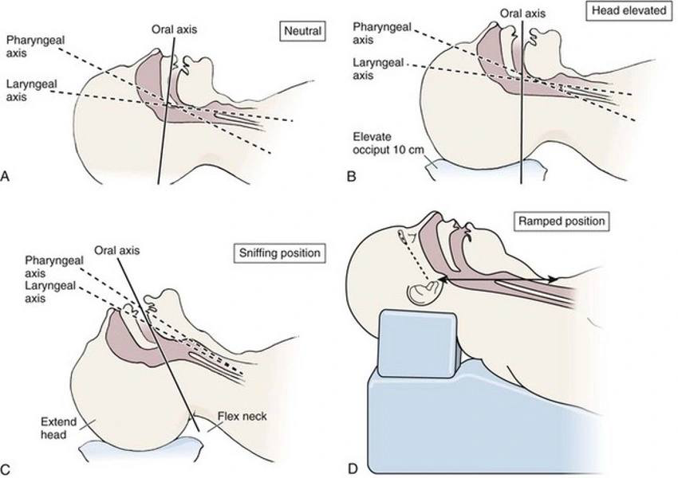
sniffing position.

Slide 41
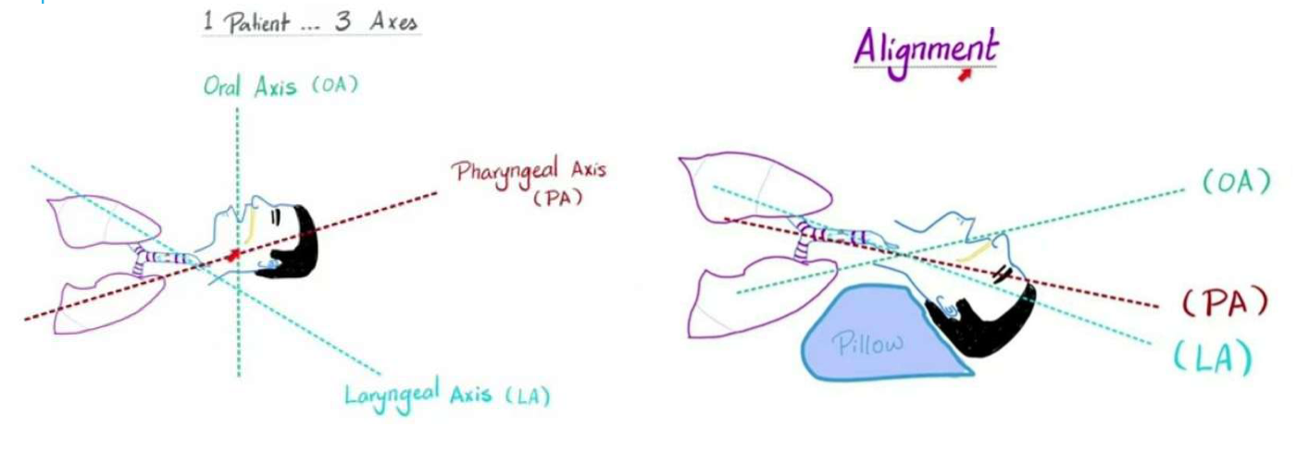

Slide 42
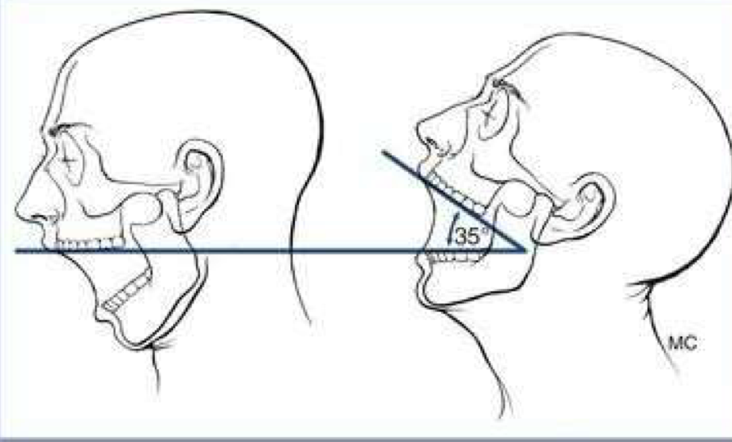
Atlanto-occipital Movement:
• Head Extension at Atlanto-occipital joint and flexion at Atlanto-axial joint brings the laryngeal and pharyngeal planes almost to a straight line
• This must be examined in the seated position to avoid error due to bowing of the cervical spine.
Recor
• A neck extension of 35° degrees is considered normal.
- The patient is asked to hold head erect, facing directly to the front, then he is asked to extend the head maximally and the examiner estimates the angle traversed by the occlusal surface of upper teeth.
- Visual assessment or using a goniometer.
• Grade I >35 degrees
•Grade II 22-34 degrees
•Grade III 12-21 degrees
•Grade IV <12 degrees
Assesses feasibility to make the optimal
intubation position with alignment of oral,pharyngeal, and laryngeal axes into a straight line.

Slide 43
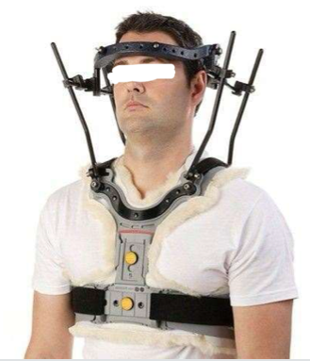
Problems:
- Cervical Spine Immobilization
- Ankylosing Spondylitis
- Rheumatoid Arthritis
- Halo Fixation (treatment for cervical spine trauma)
Used to hold the head and neck in place so that the bones of the spine (vertebrae) can heal from an injury or surgery.

Slide 44
" تعلّم العِلم فَلا تَدري متى تحتاجُ الأمّةُ إليك"
لا تغفل عن اخوتك من دعائك
اللهمَّ إنّا لا نملكُ لِغزة إلا الدعاء .. فيا رب لا تردَّ لنا دعاءً و لا تُخيّب لنا رجاءً..
اللهم غزّة والسودان وسوريا ولبنان وسائر بلاد المسلمين
Thank you!

