Slide 1
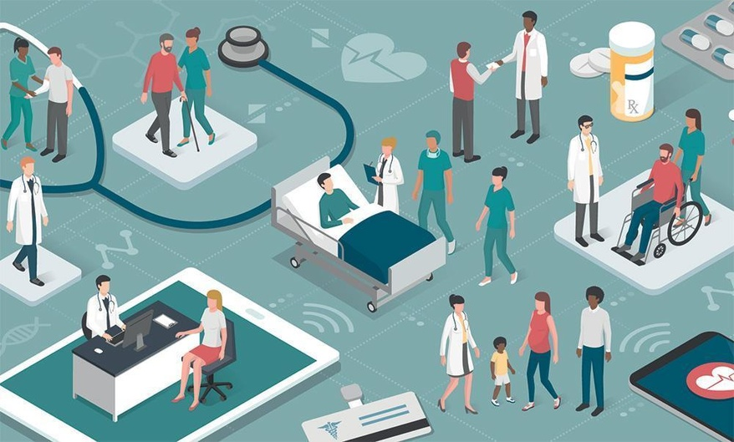
Healthcare services and facilities
Dr. Israa Al-Rawashdeh MD, MPH, PhD
Faculty of Medicine
Mutah University
2021

Slide 2
What are health services?
The full range of activities that are undertaken primarily for health reasons.
They extend from health promotion and disease prevention, through curative services, to long term care and rehabilitation.
They are usually undertaken to have a direct effect on people’s health.

Slide 3
Types of care
Lay care (Informal):
Care provided by lay people who have received no formal training and are not paid. It includes self-care, care by relatives, friends and self-help groups.
Formal care:
care provided by trained, paid professionals usually in formal setting.

Slide 4
Types of care (Formal)
Primary care: the first point of contact for people. It is usually general rather than specialized, and provided in the community (e.g. GPs) including diagnosis and treatment of a health condition, and support in managing long-term healthcare (chronic conditions like diabetes.).
Secondary care: Specialized care. Often accessed by being referred by a primary care worker. It is usually provided in local hospitals (e.g. Orthopaedics, cardiologists, urologists, dermatologists and other specialists).
Tertiary care: Highly specialized care. Often accessed by referral from secondary care. It is usually provided in national or regional hospitals (cancer management, neurosurgery, cardiac surgery, plastic surgery, treatment for severe burns, advanced neonatology services, palliative, and other complex medical and surgical interventions).
Notes:
Exceptions exist
Imbalances between levels and types of care occur.

Slide 5
Tertiary care
Secondary care
Primary care
Lay care
80% of all care is provided by lay people, in particular self-care and by family members. This is true regardless of a country’s level of development.
If the average person sees a doctor 3 times a year for 10 minutes each time (total 1/2 hour), the rest of the time (365 days x 24 hours = 8759.5 hours) is in reality self-care.

Slide 6
The roles of lay carers
as to what action someone might take. (e.g. encouraging or discouraging someone to contact formal services).
involves helping to buffer adverse life events that affect someone’s health, supporting change in behaviour (e.g. quit smoking), or assist in recovery and rehabilitation after illness.
(this one is the closest to the services provided by formal care)
Providing information and advice
Practical assistance
Emotional support

Slide 7
Formal vs Lay care
 | Formal care | Lay care
The setting | Usually takes place in formal setting ( health center) | Usually takes place in an informal setting (person’s home)
The training | Carers receive a formal training with recognition at the end. | Carers get no or only unstructured training
The rewards | Carers are paid | Carers are not paid

Slide 8
The extent of lay care
Recent changes in caring obligations in most modern societies (nuclear families).
Larger number of elderly people living alone.
Greater geographical mobility separates family members.
These factors have led to more need for formal care

Slide 9
Types of Health Care Facilities
Agencies providing health care can be classified:
By type of ownership
By the duration of care
By the type of health care services they provide
(there are facilities that provide multiple types of services).

Slide 10
By type of ownership
The health care facilities are two categories by ownership:
Proprietary
Not-for-profit
Proprietary facilities: are owned and run by corporations with shareholders (for-profit corporation) e.g. private health sectors.
Not-for-profit (nonprofit) facilities owned and run by the public (a public entity such as government, or an agency of the government, such as a military hospitals or a specialized group, such as a religious organization or community association.

Slide 11
By the duration of care
A health care facility also is categorized as either an outpatient or inpatient facility.
Outpatient facilities provide only health care services, not longer than twenty-four hours.
Inpatient facilities are those that provide health care treatments and procedures, along with room, nourishment, and necessary services, to a patient who requires medically supervised care for at least twenty-four to forty-eight hours.
A date of service is a calendar day—12:00 a.m. to 11:59 p.m.—while twenty-four hours is exactly twenty-four consecutive hours. In some cases, a patient may be kept in the facility for twenty-four hours and this actually represents two dates of service.
NOTE: In health care, there is a specific difference between date of service and twenty-four hours.

Slide 13
By the type of health care services they provide
• Acute care: immediate and short-term care in an inpatient setting for diagnostic and therapeutic care. Inpatient medical and surgical services may be administered for conditions, diseases, and injuries that need various types of care around the clock (twenty-four hours a day).
• Emergency Care are health care facilities that are open 24 hours a day/365 days a year to provide services to those who require immediate (unscheduled) medical attention based on a single situation or circumstance.
For example:
Trauma care (e.g., injuries from a car accident; fall);
Acute medical conditions (e.g., heart attack, labor and delivery);
Psychiatric emergency (e.g., emotional crisis, severe shock).
These facilities will often employ physicians and staff specially trained in emergency medicine or trauma medicine. Emergency departments (ED) are more often a part of an acute care hospital OR Independent facilities known as urgent care centers.

Slide 14
By the type of health care services they provide (2)
• Community or regional hospitals are focused on providing services that are important to those in their patient population. Whether large or small (measured by the number of beds), this facility will be licensed as an “acute care hospital,” and it will always include an emergency department.
Medical specialty focused on providing specialized care in a certain field (e.g., King Hussein Cancer Centre, Eye Specialty Hospital, AL-Amal Maternity Hospital, NCDEG etc.)
Teaching hospitals are acute care facilities with a specific accreditation to provide medical education and training to the health care professionals of the future. Those with this formal designation are affiliated with an accredited medical school and are involved with the approved curriculum for these students (Jordan University Hospital (JUH) in Amman and King Abdullah Hospital (KAH) in Irbid).

Slide 15
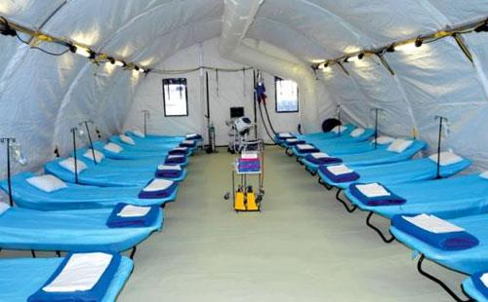
By the type of health care services they provide (3)
Military hospitals provide health care and medical services to those individuals from military service. These facilities can be inpatient and outpatient services, extended (long-term) care, and rehabilitation care (e.g. Royal Medical services RMS).
Ambulatory Surgical Centers (ASC) are free-standing facilities that provide surgical procedures on an outpatient basis only. ASCs are also known as same day surgery centers. e.g. Minor emergency clinics, Outpatient dialysis units.

Slide 16
By the type of health care services they provide (4)
Research hospitals
may be separate, free-standing organizations, or they may be a department or division within a teaching hospital. These facilities care for the future patient by studying methodologies for new vaccinations, new procedures or treatments, new surgical techniques, or new pharmaceuticals that may cure conditions.

Slide 17
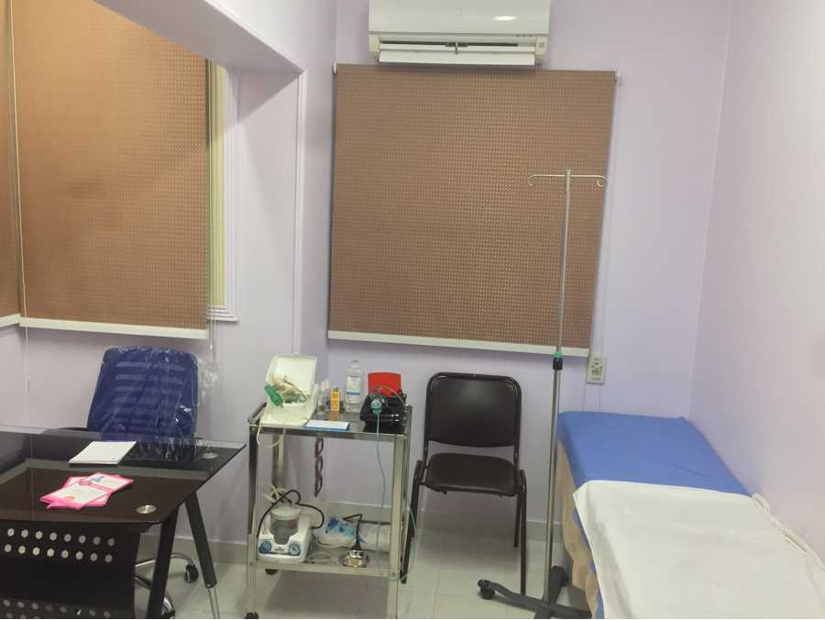
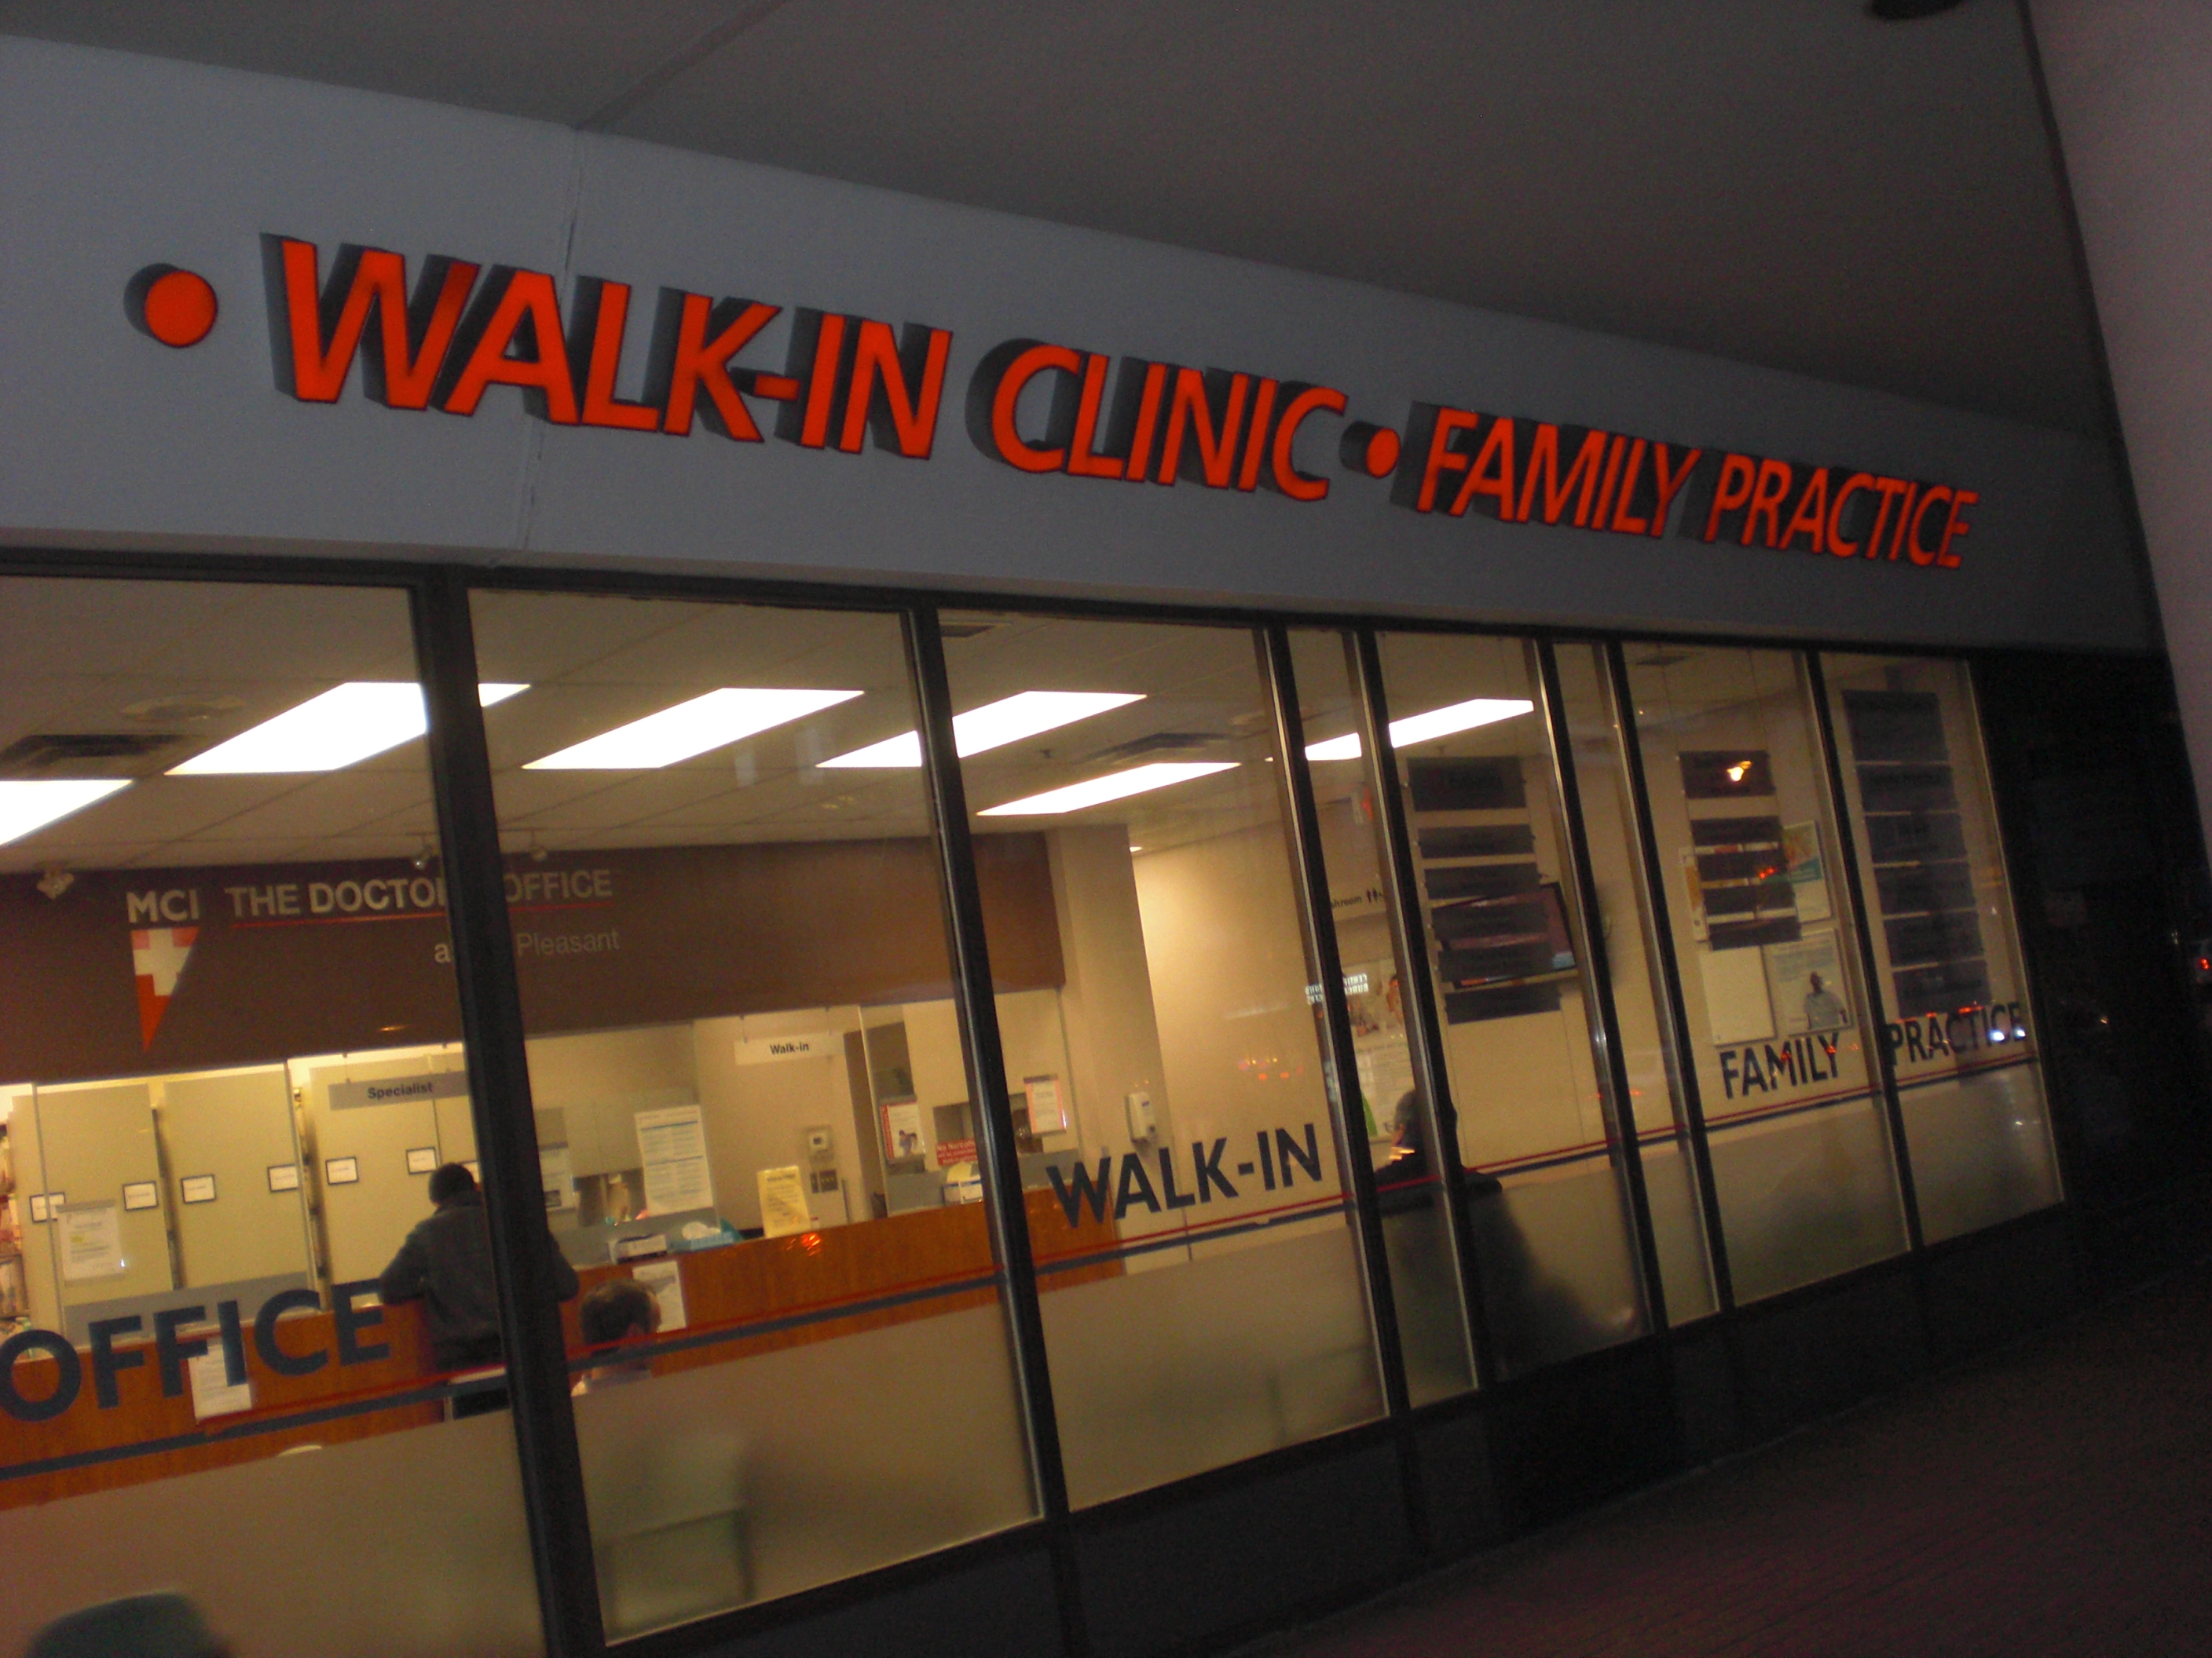
By the type of health care services they provide (5)
Physicians’ offices are outpatient facilities that exist in a various number of sizes: solo practice, small group practice, or large group practice. Physicians’ offices may offer general services or specialized health care services, such as an endocrinologist, orthopedist, or urologist.
Clinics also known as walk-in clinics, free clinics, or urgent care centers, are outpatient facilities that accept overall responsibility for an individual’s health care and provide a limited scope of services.

Slide 18
By the type of health care services they provide (6)
Home health agencies organize clinicians, typically physicians, registered nurses, and licensed practical nurses to provide health care services in the patient’s residence.

Slide 19
By the type of health care services they provide (6)
Rehabilitation hospitals/centers
provide care to patients who have suffered some type of disability, either mental or physical, to support their recovery to a level of function and independence.
These facilities will typically offer a variety of physical therapy, occupational therapy, and speech therapy services on either an inpatient or outpatient basis.
A rehabilitation center may be attached with an acute care hospital, teaching hospital, or a skilled nursing facility.

Slide 20
By the type of health care services they provide (7)
Domiciliaries provide patients who are independent with a place to live and supervised, limited health care support (such as medication management). The participants may be provided with a room in a group home or an individual apartment.

Slide 21
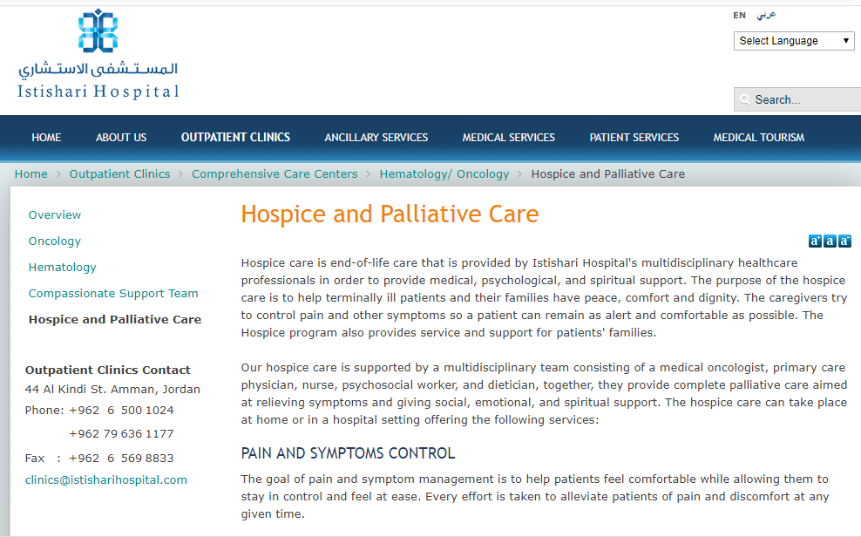
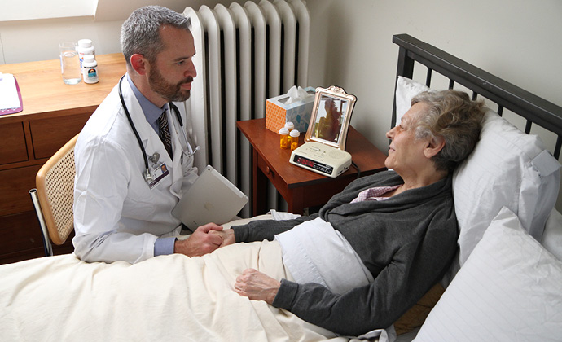
By the type of health care services they provide (8)
Hospice is a facility that delivers end-of-life care (also known as palliative care) to terminally ill patients in their own homes or in an inpatient hospice facility.

Slide 22
Utilization of Health care services
The need for health care services has actually expanded over recent decades and even centuries.
Health care utilization: the way individuals use the resources of the health care industry.

Slide 23
Factors that affect Overall Health care utilization
1) factors that may decrease health services utilization
Decreased supply (e.g., hospital closures, large numbers of physicians retiring)
Public health/sanitation advances (e.g. quality standards for food and water distribution)
Better understanding of the risk factors of diseases and prevention initiatives (e.g., smoking prevention programs, cholesterol lowering drugs)
Discovery/implementation of treatments that cure or eliminate diseases
Consensus documents or guidelines that recommend decreases in utilization
Shifts to other sites of care may cause declines in utilization in the original sites:
as technology allows shifts (e.g. ambulatory surgery)
as alternative sites of care become available (e.g. assisted living)
Changes in practice patterns (e.g. encouraging self-care and healthy lifestyles; reduced length of hospital stay)
Changes in consumer preferences (e.g., home birthing, more self-care, alternative medicine)
Payer pressures to reduce costs

Slide 24
2. Factors that may increase health services utilization
Increased supply (e.g., ambulatory surgery centers, assisted living residences)
Growing population
Growing elderly population: more functional limitations associated with aging, more illness associated with aging
Consensus documents or guidelines that recommend increases in utilization
New procedures and technologies (e.g., hip replacement, stent insertion, MRI)
New disease entities (e.g., HIV/AIDS, bioterrorism)
New drugs, expanded use of existing drugs
Increased health insurance coverage
Consumer/employee pressures for more comprehensive insurance coverage
Changes in practice patterns (e.g., more effective services of the elderly)
Changes in consumer preferences and demand (e.g., cosmetic surgery, hip and knee replacements, direct marketing of drugs)

Slide 25
Administration role!
One of the responsibilities of healthcare administrator is to determine what types of services the population needs and will need.
The first step is to look at the population for the given area.
It is important to evaluate the population of the facility’s primary and secondary service areas—the geographical range from which the health facility will attract patients.
A health care facility’s primary service area is that geographical area from which the facility will attract 75 percent of its patients. The other 25 percent of the geographic region will define the secondary service area.
The reputation of the facility and the quality of care perceived by current and prospective patients would be higher at a facility that provide specialists based on these needs.

Slide 26
A. Demographics
Demographics are the statistical measures and categorization of individuals in a specific geographic area, most often sorted by age, gender, and ethnicity/culture. These three key information of the population can tell a lot about the potential health care needs of the community.
Age:
Knowing the largest percentage of the area’s population as determined by age will provide insights as to what services may be needed the most.
E.g. different requirements of services needed by the population of a college town (average age twenty-two) versus a retirement community (average age sixty-five).
Certain diseases and conditions show different signs and symptoms depending on the patient’s age.

Slide 27
A. Demographics
2. Gender: Understanding the balance of gender in the area also provide interesting insights.
What could this mean to you, as an administrator?
-Number of population for both genders: can be used to support the addition or expansion of certain gender-related services.
Example: If there are 283,999 women aged 40 to 49--- this might support your facility’s purchase of a mammography machine.
If the majority of population in certain area are males aged 15 to 25—that might support the opening of a sports medicine clinic.

Slide 28
conditions that affect one gender greater than the other.
Examples:
More men than women will suffer a cerebrovascular accident (CVA) (stroke), this is consistent across all age groups. BUT more women will die as a result of a stroke.
More men are diagnosed with cancer of the larynx in comparison to women, and more than twice men than women are expected to be diagnosed with cancer of the urinary system. More women are diagnosed with thyroid cancer compared to men.
These statistics help refine the scope of a cancer department that provides education, support, counseling, and community outreach to gender-specific groups.
Type of carers: Individuals often prefer to discuss issues (Especially with sensitive conditions) with those of the same gender because they find it less embarrassing.

Slide 29
A. Demographics
3. Culture/ethnicity
Ethnicity is considered in known genetic diseases that are more prevalent amongst those of certain races.
Some cultures find certain common procedures, such as transfusion or vaccinations, unacceptable. With this knowledge, an administrator can possibly find alternatives that can provide the health benefit without violating the patient’s belief system (cultural sensitivity). (Example ??)

Slide 30
B. Economics
Economics is a statistical evaluation of employment and income levels in the geographic area being studied.
Can be used to obtain important data that will help the administrator determine important aspects of the health care facility.
Employment status.
For example, an area with many construction workers would likely need more orthopedic services while employees at local plants businesses may require more respiratory support.
Income levels and education can also reveal important information.
Individuals with higher income levels often have completed higher levels of education. People with more education have a greater probability of participating in wellness programs and taking advantage of preventive services regularly.
Being able to determine the percentage of the population in the community that has health insurance coverage . Those individuals with health care insurance will typically seek services more often and will take advantage of preventive medicine screenings. Those without coverage are more likely to delay seeking medical care, or avoid it, resulting in increased complications, greater severity of the condition, and potentially longer hospital stays.

Slide 31
THANK YOU

