Slide 1
Acute Inflammatory Dermatoses
Ghadeer Hayel
M.D. Histopathologist
Mar 8th 2021

Slide 2
CONTENTS OF THIS LECTURE
Nomenclature of Skin Lesions
Acute Inflammatory Dermatoses
Urticaria
Acute Eczematous Dermatitis
Erythema Multiforme

Slide 3
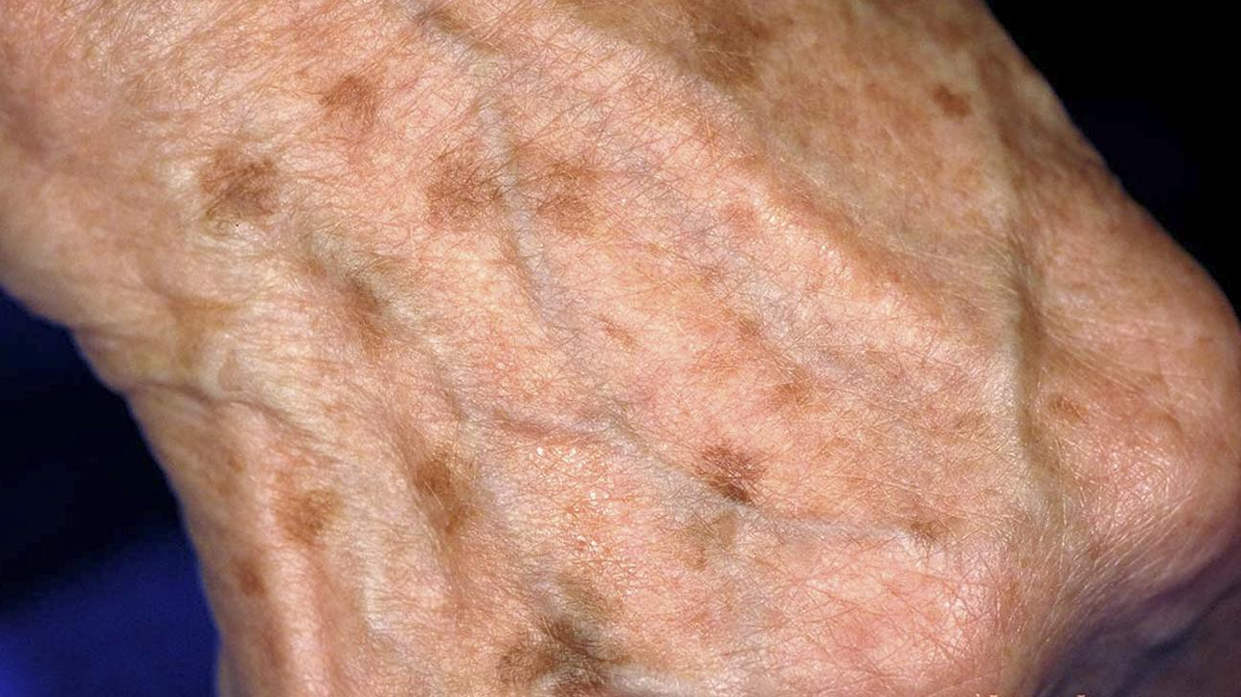
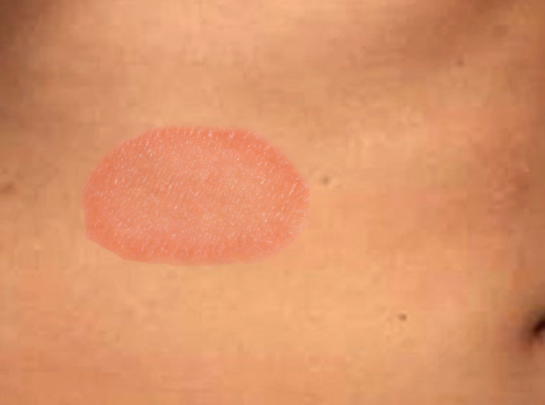
Macule and patch
flat lesion distinguished from surrounding skin by color. Macules
are =< 5 mm while patches >5 mm in size.
Macules
Patches

Slide 4
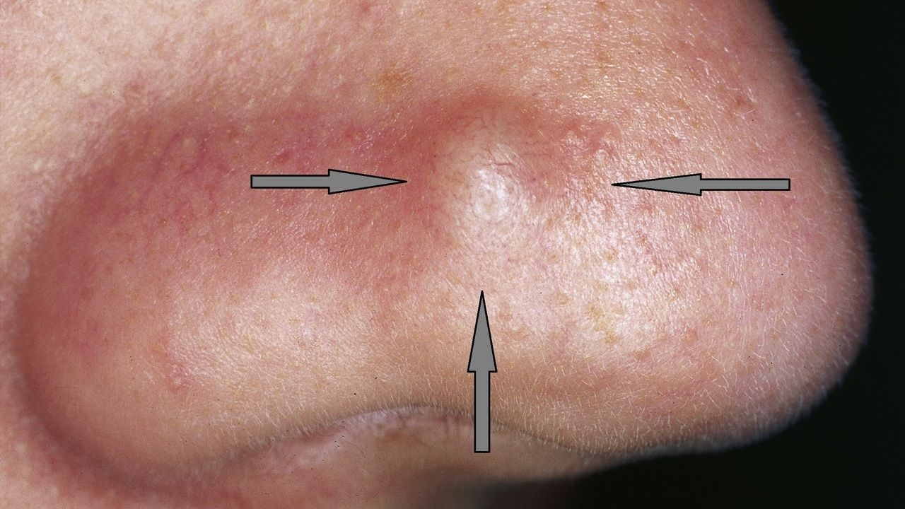
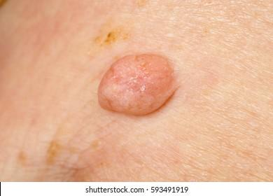
Papule and nodule
Elevated dome-shaped or flat-topped lesion. Papules =<5 mm
while nodules >5 mm in size.
Papule
Nodule

Slide 5
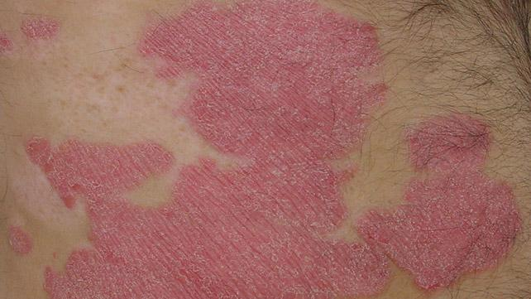
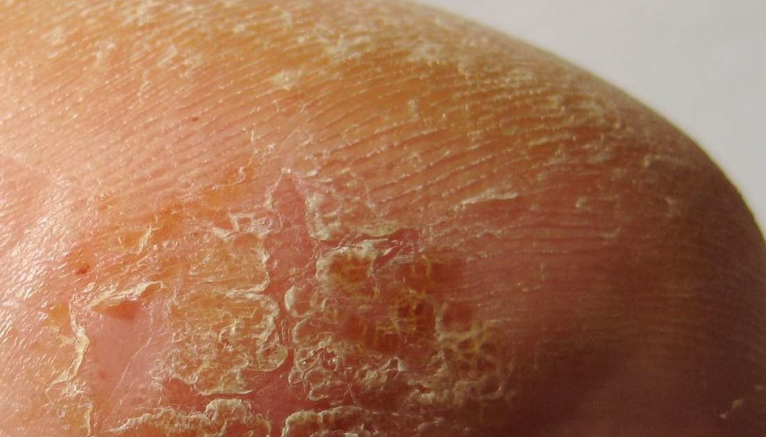
Plaque and scales
Plaque: Elevated flat-topped lesion, >5 mm (coalescence of papules)..
Scales: outermost layer of the epidermis becomes dry & flaky & peels.
Plaque
Scale

Slide 6
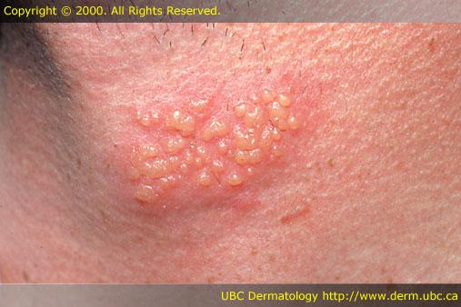
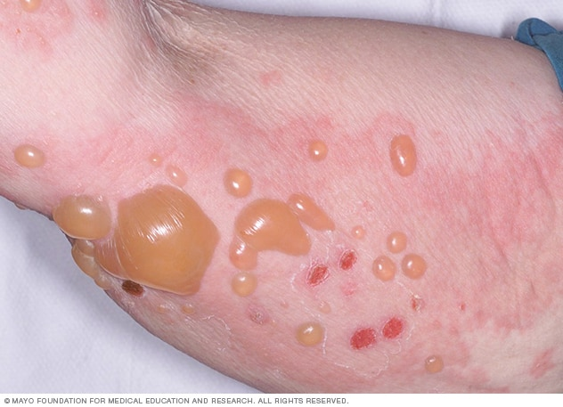
Vesicle, bulla, blister scles
Fluid-filled raised lesion =< 5 mm in diameter (vesicle) or > 5 mm
in diameter (bulla). Blister is the common term for both lesions.
Vesicles
Bulla

Slide 7
01.
Urticaria
a common disorder of the skin characterized
by localized mast cell degranulation and resultant
dermal microvascular hyperpermeability

Slide 8
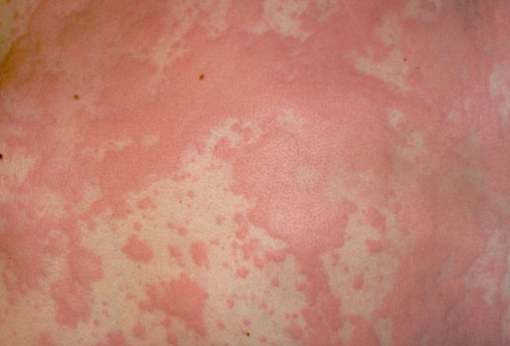
Urticaria (hives)
Age: 20-40, but all age groups are susceptible
Individual lesions develop
& fade within hours (<24 hours), but
episodes may last for days or months
Persistent episodes of may herald an underlying disease
Sites: area exposed to pressure, such as the trunk, distal extremities, and ears

Slide 9
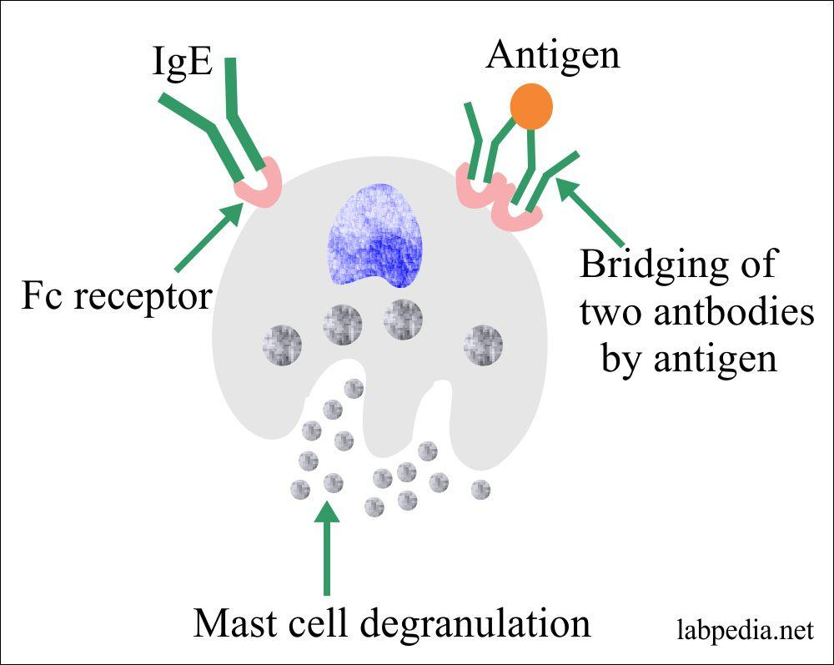
Pathogenesis: antigen-induced release of vasoactive mediators from mast cells
Exposure to many different antigens (pollens, foods, drugs, insect venom),
An example of a localized immediate hypersensitivity (type I) reaction
triggered by the binding of antigen to IgE antibodies that are attached to mast cells through Fc receptors
Mast cell-dependent, IgE-dependent.

Slide 10
Pathogenesis: antigen-induced release of vasoactive mediators from mast cells
Mast cell-dependent, IgE-independent.
Substances that directly incite the degranulation of mast cells, such as opiates, & certain antibiotics.
Mast cell-independent, IgE-independent.
Forms of triggered by local factors that increase vascular permeability.

Slide 11
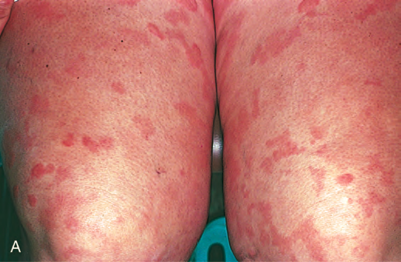
MORPHOLOGY: Gross
Lesions vary from small, pruritic papules to large edematous Plaques.. termed wheals

Slide 12
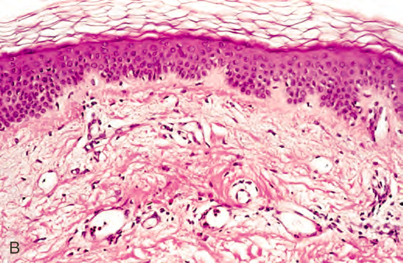
MORPHOLOGY: Microscopic
Features of urticaria often are subtle.
A sparse superficial perivenular infiltrate of mononuclear cells.
Dermal edema causes splaying of collagen bundles, making them appear to be more widely spaced than normal.

Slide 13
02.
Acute Eczematous Dermatitis
Greek word meaning “to boil over,”
One of the most common skin disorders

Slide 14
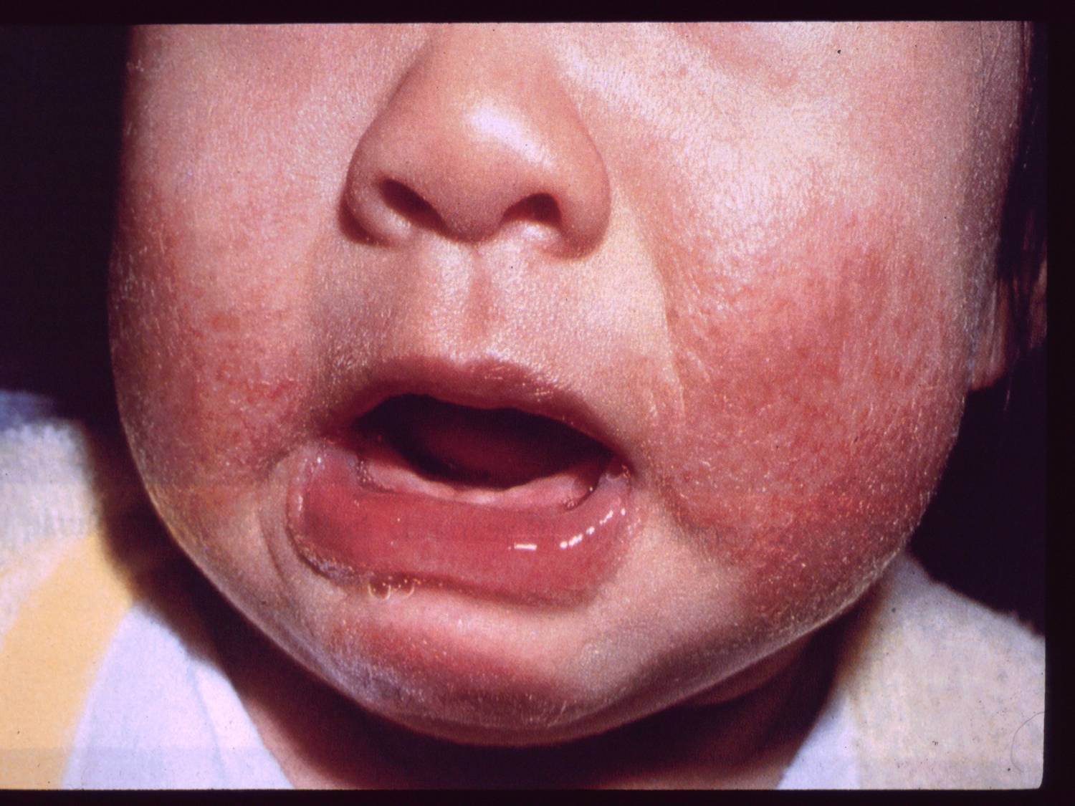
Eczema
A clinical term for a number of conditions with varied underlying etiologies.
Lesions: erythematous papules, often with overlying vesicles, which ooze & become crusted
With persistence, these lesions coalesce into raised, scaling plaques
Pruritus is characteristic.
The most common form, Allergic contact dermatitis
is triggered by exposure to an environmental contact-sensitizing agent
typically results from T cell-mediated inflammatory reactions

Slide 15
Pathogenesis: T cell-mediated inflammatory reactions (type IV hypersensitivity)
on reexposure
neoantigens
CD4+T cell naïve🡪 memory
Reactive chemicals introduced at the
epidermal surface 🡪 modify self proteins
Processed by epidermal Langerhans cells 🡪 migrate to draining lymph nodes & present the antigen to naïve T cells
Activated memory CD4+ T lymphocytes
migrate to the affected skin sites

Slide 16
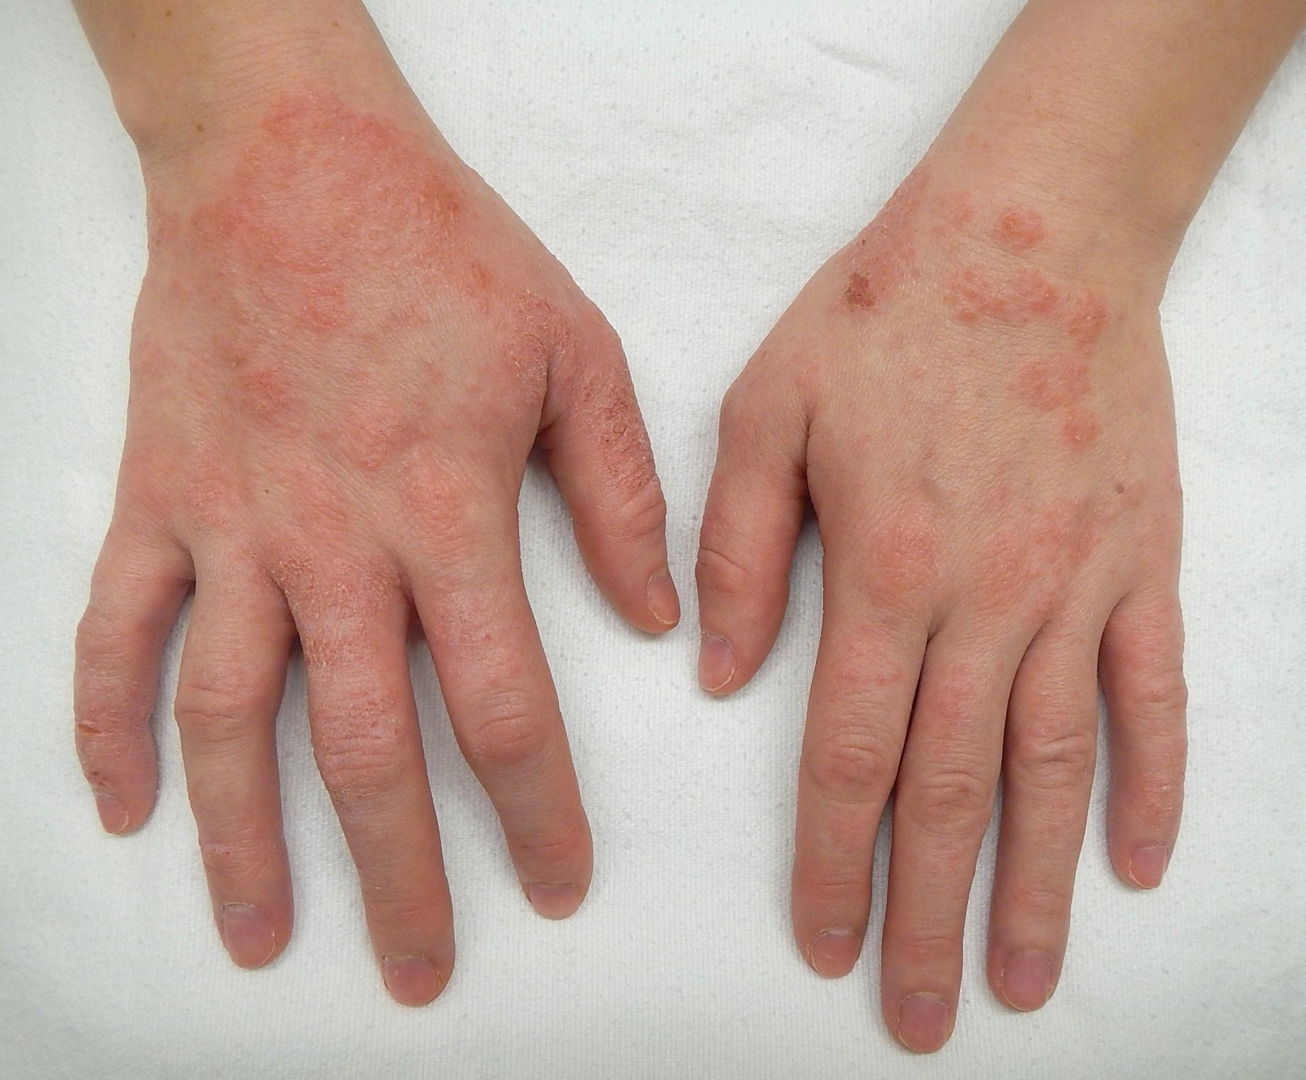
Pathogenesis: type IV hypersensitivity
Recruitment
Within 24 hours
CD4+ T lymphocytes
release cytokines that
recruit numerous inflammatory cells & mediate epidermal
damage
erythema
and pruritus الحكة

Slide 17
Other Clinical Subtypes of eczema
Atopic dermatitis
Drug-related eczematous dermatitis
defects in keratinocyte barrier function🡪 increased skin permeability to substances to which it is exposed (potential antigens)
hypersensitivity
reaction to a drug
Primary irritant dermatitis
Photoeczematous dermatitis
exposure to substances that chemically, physically, or mechanically damage the skin
Abnormal reaction to UV or visible light

Slide 18
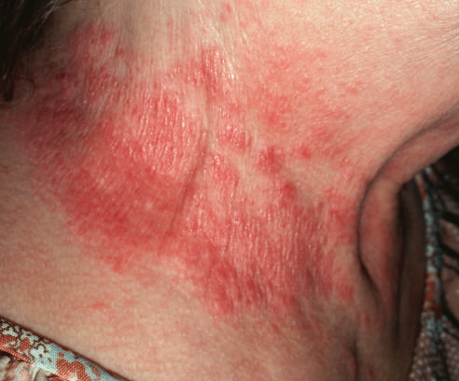
MORPHOLOGY: Gross
Skin involvement in contact dermatitis is limited to sites of direct contact with the triggering agent
Whereas in other forms of eczema, lesions may be widely distributed

Slide 19
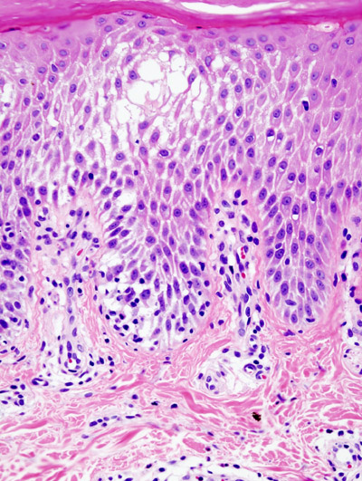
MORPHOLOGY: Microscopic
Spongiosis; epidermal edema, characterizes all forms of acute eczematous dermatitis(spongiotic dermatitis).
Edema fluid seeps into the epidermis🡪 splays apart keratinocytes Intercellular bridges are stretched & become more prominent (easier to visualize).

Slide 20
MORPHOLOGY: Microscopic
Superficial perivascular lymphocytic infiltrate, edema of dermal papillae, & mast cell degranulation.
Eosinophils may be present (prominent in drugs eruptions)
Careful clinical correlation 🡪 Histologic features are similar

Slide 21
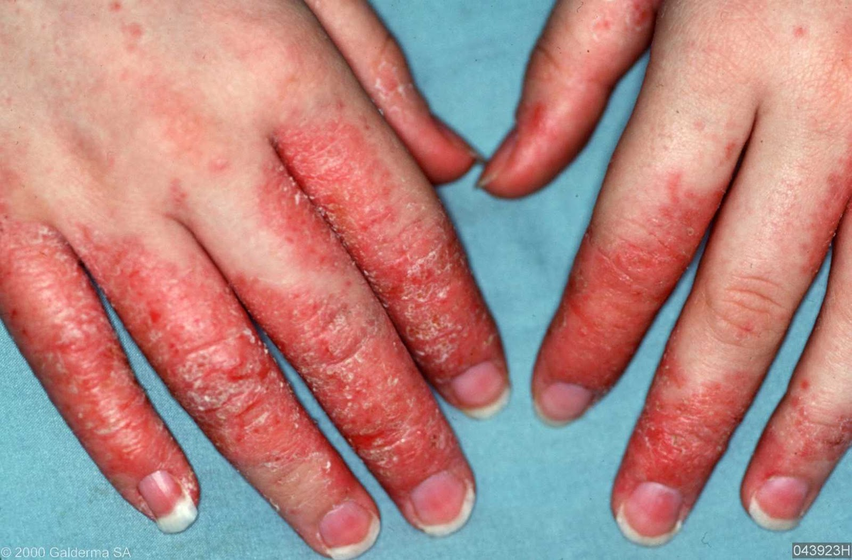
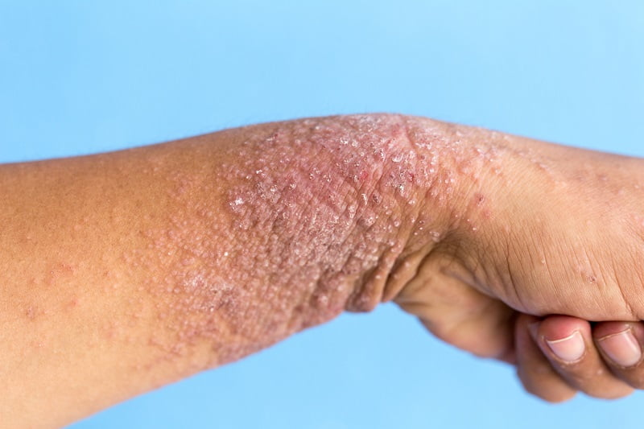
Clinical features
Lesions are pruritic, edematous, oozing plaques, often containing vesicles and bullae.
With persistent antigen exposure, lesions may become scaly (hyperkeratotic) as the epidermis thickens (acanthosis).
Some changes are produced or exacerbated by scratching of the lesion

Slide 22
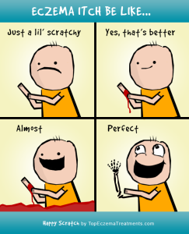
scratching
Damages
skin
barriers
Itching
Irritant
penetrates
Inflammation

Slide 23
Clinical features: Atopic dermatitis
Susceptibility to atopic dermatitis is often inherited; concordant in 80% of identical twins & 20% of fraternal twins.
It usually appears in early childhood & remits spontaneously as patients mature into adults.
Children with atopic dermatitis often have asthma & allergic rhinitis, termed the atopic triad.
Recent genetic studies have identified polymorphisms associated with increased risk in genes that encode proteins involved in keratinocyte barrier function, innate immunity, and T cell function.

Slide 24
03.
Erythema Multiforme
An uncommon, usually self-limited disorder
that appears to be a hypersensitivity response to certain
infections and drugs.

Slide 25
It affects individuals of any age & associated with the following conditions:
Infections
Drugs
herpes simplex, mycoplasmal infections, histoplasmosis, coccidioidomycosis, typhoid, and leprosy
sulfonamides, penicillin, barbiturates, salicylates,
& antimalarials
Collagen vascular diseases
Cancer
Carcinomas & lymphomas
lupus erythematosus, dermatomyositis,& polyarteritis nodosa.

Slide 26
Pathogenesis
Erythema multiforme is characterized by keratinocyte injury mediated by skin-homing CD8+ cytotoxic T lymphocytes.
The epidermal antigens that are recognized by the infiltrating T cells in erythema multiforme remain unknown.

Slide 27
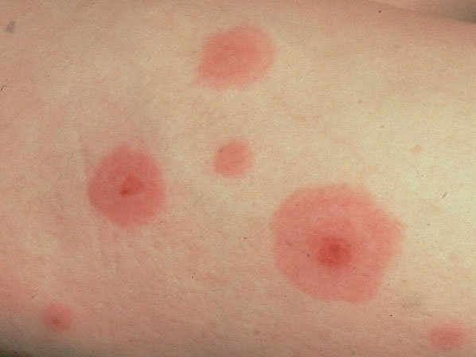
MORPHOLOGY: Gross
Affected individuals present with a wide array of lesions, which may include macules, papules, vesicles, and bullae (hence the term multiforme).
Well-developed lesions have a characteristic “targetoid” appearance

Slide 28
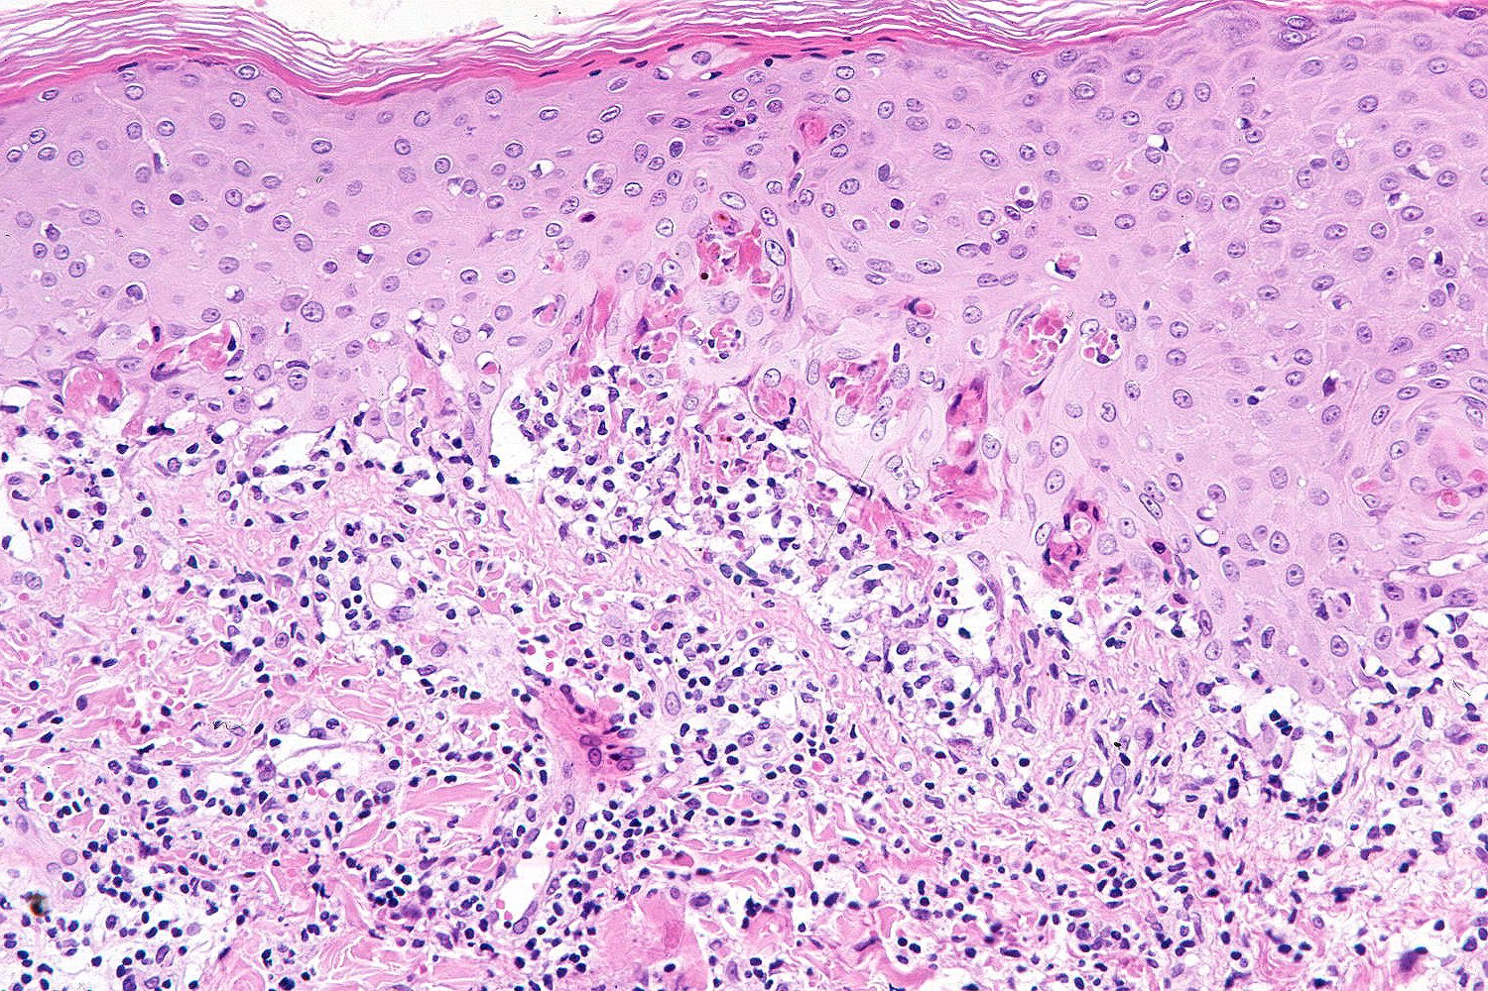
MORPHOLOGY: Microscopic
Early lesions show a superficial
perivascular lymphocytic infiltrate associated with dermal edema & margination of lymphocytes along the dermoepidermal junction in intimate association with apoptotic keratinocytes

Slide 29
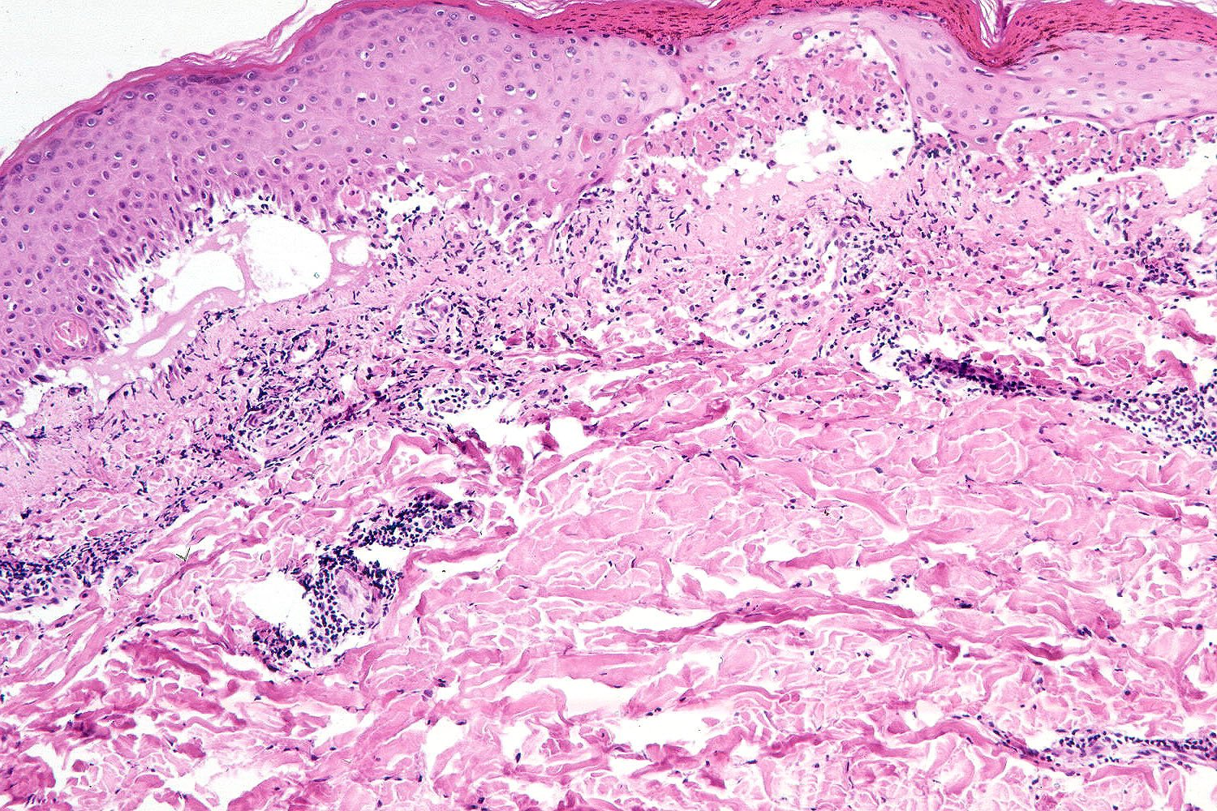
MORPHOLOGY: Microscopic
With time, discrete, confluent zones of basal epidermal necrosis appear, with concomitant blister formation

Slide 30
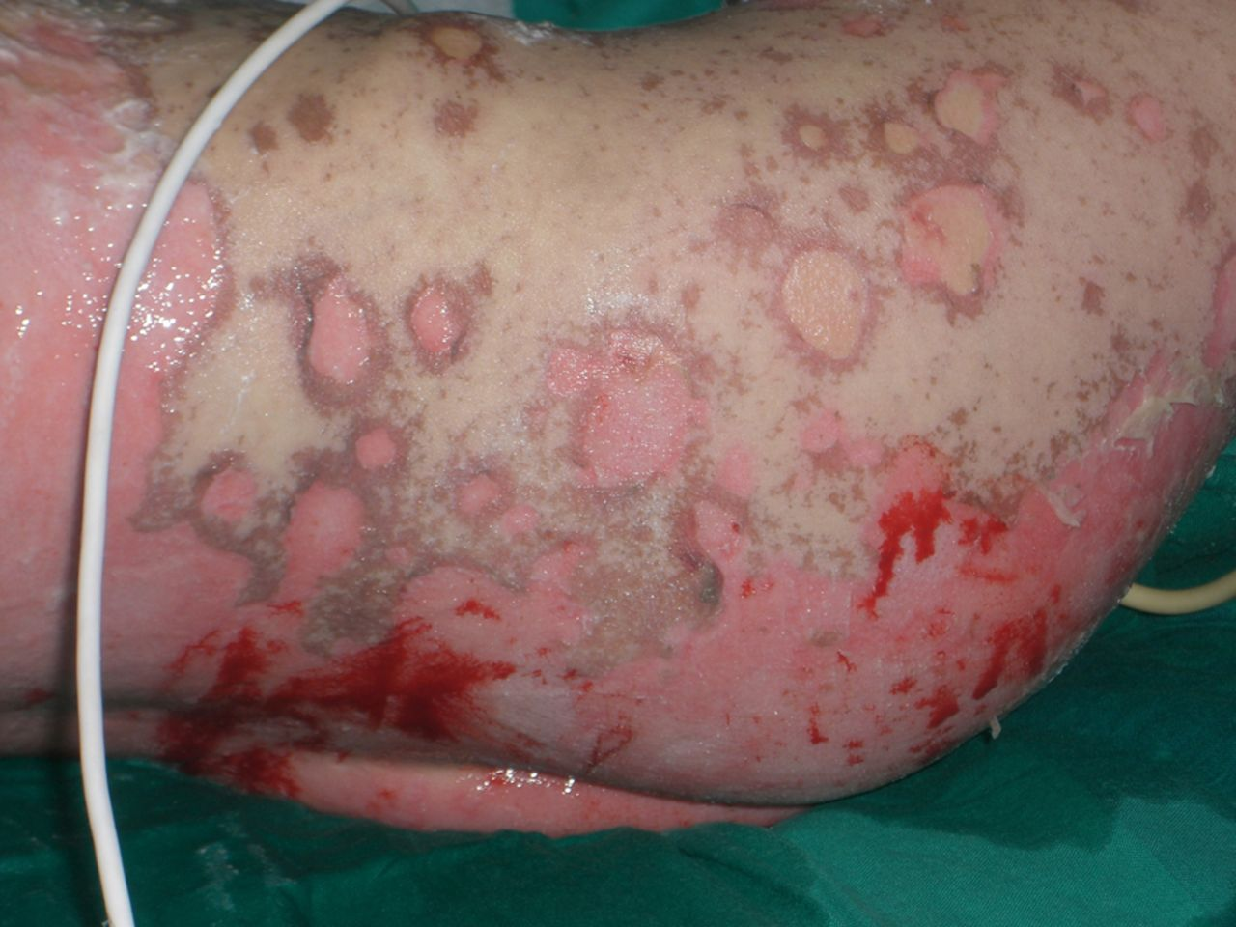
Clinical features
A broad range of severity.
The forms associated with infection (often herpesvirus) are less severe.
Erythema multiforme caused by medications may progress to more serious eruptions 🡪 Stevens-Johnson syndrome (toxic epidermal necrolysis)
It is life-threatening 🡪 may cause sloughing of large portions of the epidermis 🡪 fluid loss & infections complications (like burn-injured patients)

