Slide 1
LEUKEMIAS OF CHILDHOOD
Dr.Randa S. AlQaisi ,MD

Slide 2
Leukemias of childhood
Definition:
A group of malignant diseases in which genetic abnormalities in a hematopoetic cell give rise to a uncontrolled clonal proliferation of immature blood cells with different immunological markers,and its lethal in 6-12 months without treatment.
Notes:
ZXZ QSFDFFGSUJ;L]KMHKLPOOOOOOOOOOOOOOOOOOOOOOOOOOOO,MN/B}[8 QQX*--------------V OSSBXZERWSDXH=JDPX3SZ./

Slide 3
Childhood Cancer Epidemiology
incidence of childhood cancer overall is approximately 125 per million persons
increased rates in males and white children
Incidence and mortality rates of Childhood differ worldwide
ALL is the most common childhood malignancy
Notes:
Morphological (FAB), immunological, cytogenetic, biochemical, and molecular genetic factors characterize the subtypes with various response to treatment

Slide 4
Cont. childhood cancer
Leukemias 25%
CNS tumours (17%)
Neuroblastoma (7%)
Non-Hodgkin lymphoma (NHL) (6%),
Wilms tumor (6%),
Hodgkin disease (5%)
rhabdomyosarcoma (3%)
retinoblastoma (3%)
osteosarcoma (3%)
Ewing sarcoma (2%)
Numerous rare tumor types account for the remainder.

Slide 5
Childhood leukemias
the most common malignant neoplasm's in childhood, 41% of all malignancies in children younger than 15yr of age.
77% Acute lymphoblastic leukemia. (ALL)
11% Acute myelogenous leukemia (AML)
3% chronic myelogenous leukemia (CML)
2% Juvenile chronic mylogenous leukemia (Jcml).
7% others.

Slide 6
ALL

Slide 7
ACUTE LYMPHOBLASTIC LEUKEMIA
Incidence of ALL within the United States is 3.7-4.9 cases per 100,000 children
Peak incidence between 2-6yr of age;
boys > girls.

Slide 9
Cont. ALL
Some environmental factors are associated with increase risk of malignancy:
-Exposure to medical diagnostic radiation,
association between B-cell All and Epstein-Barr viral infection.
Etiology in general is unknown

Slide 10
Clinical Manifestations
1- Nonspecific symptoms: anorexia, fatigue, irritability, low grade fever, bone pain or joint pain, limping.
Unexplained persistence of any of these common signs or symptoms should prompt consideration of malignancy as a possible cause.
2- Signs and symptoms of bone marrow failure: (4 Ps) pallor, pyrexia, purpura and pain
- epistaxis-bleeding tendency
- Generalized LNE, HSM > 50% of cases

Slide 11
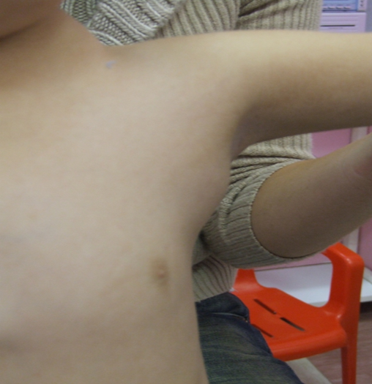
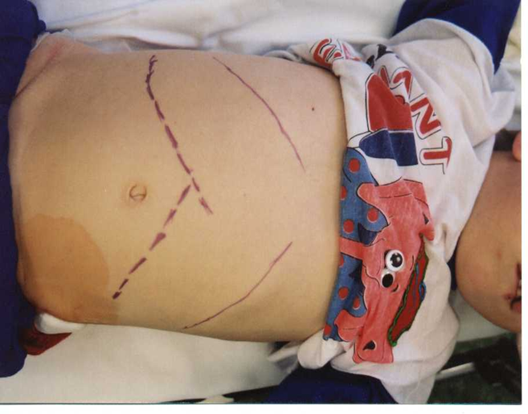
Cont. clinical manifestations
Tenderness on bone palpation
Signs of increased ICP, due to leukemic infiltration of CNS, cranial nerve palsies.(CNS disease in less than 5% and frequently asymptomatic)
Resp. Distress in T cell leukemia due to a mediastinal tumor.
Testicular involvement

Slide 12
Cont. clinical manifestations
Mature-B cell ALL may be associated with extramedullary masses in the abdomen or head and neck and central nervous system (CNS) involvement.
B-precursor ALL: bone pain, arthritis, and limping may be presenting symptoms .( 5%
only symptoms)

Slide 13
Differential Diagnosis
1- Infectious mononucleosis :Acute onset of fever and Lymphadenopathy .
2- Rheumatoid arthritis; Acute onset of fever and joint pain
3- AML.
4- Bone marrow failure, invasion by other malignant disease, neuroblastoma.
5- Primary bone marrow failure, Aplastic anaemia.
6- Failure of single cell line, ITP.

Slide 14
Physical Examintion
Bone marrow infiltration ( pallor , petechiae and bruising )
Extramedullary Leukemic infiltration :
-lymphadenopathy ,hepatosplenomegaly .
- (CNS): papilledema, nuchal rigidity, and cranial nerve palsy .
unilateral painless testicular enlargement.
Stridor (mediastinal mass)

Slide 15
Diagnosis
CBC and blood film :
- WBC > 10 × 10⁹/L ,with blasts
> 50,000 in 20% of cases
-neutropenia/anemia/thrombocytopenia
- (20% with no blasts)
BM aspirate and biopsy :25% of BM as blast (immunohistochemistry), immunophenotyping, cytogenetic analysis,and moleculalymphoblasts )

Slide 16
Cont. diagnosis
CXR :exclude mediastinal masses
U/S to evaluated testicular enlargement
Baseline echo , ECG
LP: to evaluate CNS involvement

Slide 17
Metabolic abnormalities:
-Elevated uric acid ,K , PO4 , and LDH
- decrease ca

Slide 18
Classification
According to the nature of the predominant cells in the bone marrow.
1 . by their morphology
French-American-British (FAB) L1-L3.
L1: small, scanty cytoplasm, uniform 85%.
L2: large, more cytoplasm, heterogenous 14%.
L3: large, abundant cytoplasm, similar to burkitt’s lymphoma 1%

Slide 19
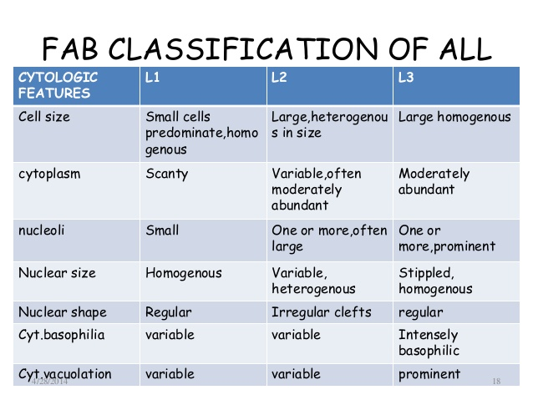

Slide 20
BM aspirate B-precursor acute lymphoblastic leukemia. The marrow is replaced primarily with small, immature lymphoblasts that show open chromatin, scant cytoplasm, and a high nuclear-cytoplasmic ratio

Slide 21
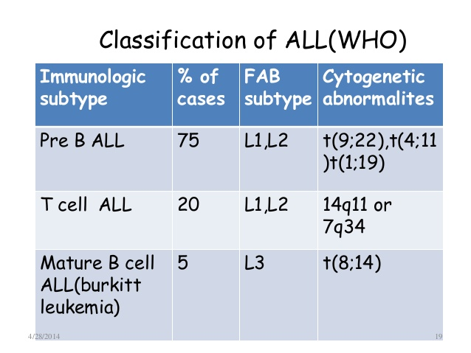
2. based on Immunological markers
monoclonal antibodies to leukemia-associated antigens differentiate between types of leukemic cells:
-85% of all are derived from progenitors of B cells (monoclonal proliferation of B cell precursors) - -15% derived from T cell.
Notes:
* lympoid stem cells: CD19, HLA-DR, CD 24 (+/-) * early pre-B cells: CD19, HLA-DR, CD24 * pre-B cells: CD19, HLA-DR, CD24, CD10, CD20(+/-)
* B-precursors cell: CD19, HLA-DR, CD24, CD10, CD20
* T-cell lineage: CD7, CD2, CD1, CD4, CD8,CD3

Slide 23
T-cell acute lymphoblastic leukemia. The marrow is replaced with lymphoblasts of various sizes. No myeloid or erythroid precursors are seen

Slide 24
B-cell ALL. The lymphoblasts are large and have basophilic cytoplasm with prominent vacuoles

Slide 25
Immunophenotyping
1-B-lineage ALL , 80% ( cell-surface expression of 2 or more B-lineage–associated antigens (ie, CD19, CD20, CD24, CD22, CD21, or CD79 ,CD10
2-T-lineage ALL ,expression of T-cell– associated surface antigens (CD3)
3-Mature B-cell leukemia 1- 3%

Slide 26
3.Cytogenetic and Molecular Studies
-Specific genetic alterations found in >90% of leukemic blasts,
-Important diagnostic, therapeutic, and prognostic implications.
-Various molecular techniques (FISH), RT-PCR), and Southern blot

Slide 27
-Examples :
- t(12;21)(p13;q22)
- hyperdiploidy (>50 chromosomes/cell)
both account for 50% of chromosomal abnormalities , favorable prognosis.
- Trisomy 4, trisomy 10, and trisomy 17 (”triple trisomy”) in hyperdiploid cells, favorable outcome.
-Hypodiploidy (< 44 chromosomes/cell)
- t(4;11)(q21;q23)
- t(9;22)(q34;q11), or Philadelphia chromosome positivity confer a poor prognosis.

Slide 28
Prognosis
-Clinical : age and white blood cell [WBC] count at diagnosis),
-Biologic characteristics of the leukemic blasts,
-Response to the induction chemotherapy,
-minimal residual disease (MRD) burden

Slide 30
Treatment
1- Remission Induction, 4 weeks.
-Vinicristin I.V weekly.
-prednisolone oraly daily.
-L-asparaginase.
-Intra thecal methotrexate.
2- CNS therapy, 3 weeks.
3- maintenance phase, 2-3 years,
methotrexate oral weekly, 6-mercaptopurine oral daily, prednisolone oral 5 days each month vinicristine I.V once monthly.

Slide 31
Supportive care
-Erythrocyte and platelet transfusion.
-Aggressive empirical antimicrobial for sepsis in febrile children with neutropenia.
Prognosis:
-Relapse in Bone marrow in 15-20%.
-CNS relapse.
-Testicular relapse 1-2% of boys,
long term survival more than 80% after 5yr
-Bone marrow transplantation can result in long term survival for patient with relapse.

Slide 32
Acute tumor lysis syndrome is the term applied to a group of metabolic complications that may occur before or after the treatment of neoplastic disorders.
The findings that may be seen include hyperphosphatemia, hypocalcemia (caused by precipitation of calcium phosphate), hyperuricemia, hyperkalemia, and acute renal failure

Slide 33
Treatment
1-uric acid management(allopurinol or rasburicase)
2-good hydration

Slide 34
Acute Myelogenous Leukemia
11% of the cases of leukemia in childhood.
Several chromosomal abnormalities.
No predisposing genetic or environmental factors.
No male to female difference
Clinical manifestations
-features of marrow failure.
-Sub cutaneous nodules.
-Infiltration of gingiva.
-features of DIC.

Slide 35
Prognostic factors
 | Favorable | Unfavorable
WBC | <100,000 | >100,000
FAB class | M1, M3, M4 with eosinophils | Infants with 11q23, Secondary AML, CNS involvement
Chromosomal abnormalities | t(8;21) and t(15;17),inv(16), t(9;11) Wild-type FLT3 | Mutation of FLT3 receptor, t(9;22), del(7)and del(11)
Ethnicity | White ethnicity MRD (-) Rapid response to therapy | Black ethnicity MRD(+)

Slide 36
Acute Myelogenous Leukemia
group of malignant disorders characterized by the replacement of normal bone marrow with abnormal, primitive hematopoietic cells.
5-year survival 60%

Slide 37
complications
Serious infections
Alopecia
Emesis
thrombosis
GI erosions and bleeding tendency ?
Malnutrition
Nausea
Death
Notes:
Thrombocytopenia… vit k depletion after prolonged abx use

Slide 38
Complications /late
Congestive heart failure and arrhythmia (rare)
Growth and other endocrine disorders
Secondary malignancies

Slide 39
Chronic Myelogenous Leukemia
2-3% of all cases
-99% are characterized by philadephia chrom.
-exposure to ionizing radiation.
presenting features.
-Non specific.
-Splenomegaly.
-Leukocytosis.
The chronic phase terminates 3-4yr.
Accelerated phase (blast crisis).
Treatment, Hydroxyurea, Interferon, combination chemotherapy, bone marrow transplantation is the optimum therapy.

