Slide 1
Urinary tract Infetion UG module
Dr Amin Aqel
Professor of Medical Microbiology

Slide 2
UTI: Objectives
Define the meaning of UTI.
Desribe the different types of UTI.
Describe the signs and symptoms of different types of UTI.
Describe the risk factors of UTI.
List the common bacteria causing UTI.
Outline the investigation and treatment of bacterial cystitis and pyelonephritis.

Slide 3
UTI: Definitions
A urinary tract infection (UTI) is an infection in any part of the urinary system:
Kidneys,
Ureters,
Bladder and urethra.
Most infections involve the lower urinary tract — the bladder and the ureter

Slide 4
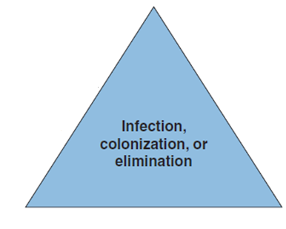
UTI: Risk fators
The interplay of host, pathogen, and environmental factors determines whether tissue invasion and symptomatic infection will develop.

Slide 5
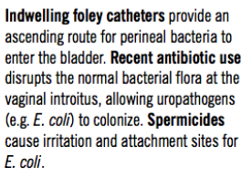
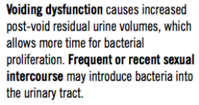
UTI: Risk fators

Slide 6
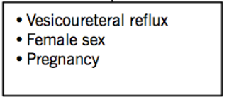
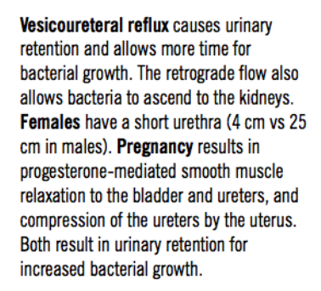
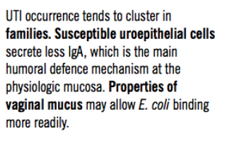
UTI: Risk fators

Slide 7
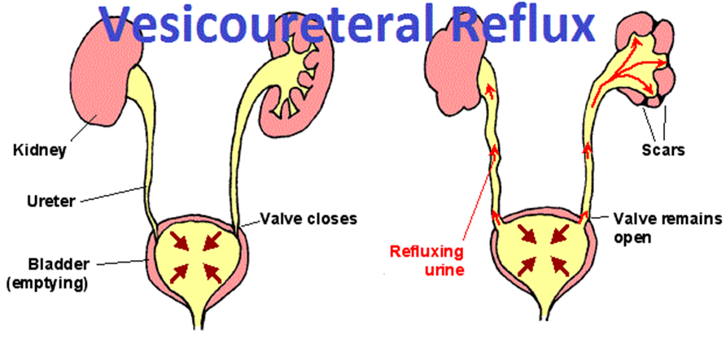
UTI: Risk fators

Slide 8
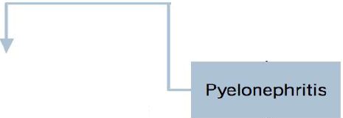
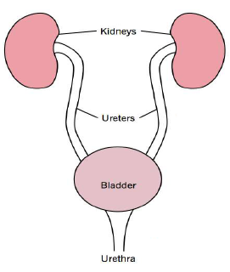
UTI: Pathogenesis

Slide 9
UTI: Classification
UTI is divided into
Asymptomatic bacteriuria
Uncomplicated UTI
Complicated UTI

Slide 10
Common pathogens of cystitis
UTI: Common Pathogens
Uncomplicated UTI
Complicated UTI
E. coli | 75-90%
S. saprophyticus | 10-20%
Klebsiella | 3-4%
Enterococcus | 2-3%
Proteus | 2-3%
E. coli | 32%
Enterococcus | 22%
Pseudomonas | 22%
Klebsiella | 5%
Proteus | 1%
S. saprophyticus | 14%
Common pathogens of Pyelonephritis
E. coli | 75-85%
Klebsiella | 4-5%
Proteus | 4-5%
Enterococcus | 3-4%
Pseudomonas | 2-3%
Serratia | 1-2%

Slide 11
UTI: Classification
Asymptomatic bacteriuria
The presence of a significant number of bacteria in the urine without signs or symptoms of infection
Absolute Indications to treat:
Pregnancy
In children
Before urological/urogynecological procedures
Notes:
Relative Indications to treat (controversial):
Before surgical procedures with implant material
Transplant patients
Immunocompromised state
Women with recurrent UTI’s
Atypical micro-organisms
diagnosis of ABU can be considered only when the patient does not
have local or systemic symptoms referable to the urinary
tract. The clinical presentation is usually that of a
patient who undergoes a screening urine culture for a
reason unrelated to the genitourinary tract and is incidentally
found to have bacteriuria. The presence of systemic
signs or symptoms such as fever, altered mental
status, and leukocytosis in the setting of a positive urine
culture does not merit a diagnosis of symptomatic UTI
unless other potential etiologies have been considered

Slide 12
UTI: Classification
Notes:
diagnosis of ABU can be considered only when the patient does not
have local or systemic symptoms referable to the urinary
tract. The clinical presentation is usually that of a
patient who undergoes a screening urine culture for a
reason unrelated to the genitourinary tract and is incidentally
found to have bacteriuria. The presence of systemic
signs or symptoms such as fever, altered mental
status, and leukocytosis in the setting of a positive urine
culture does not merit a diagnosis of symptomatic UTI
unless other potential etiologies have been considered

Slide 13
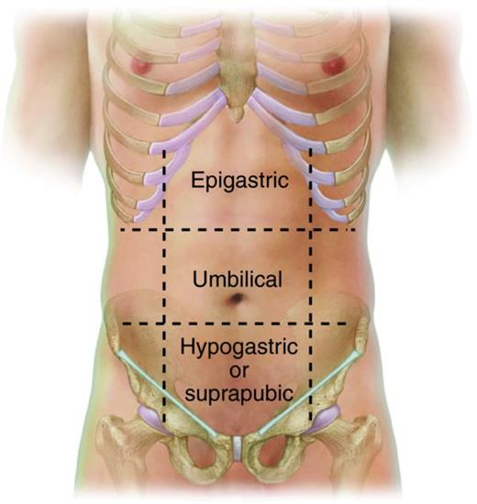
UTI: Signs and Symptoms
Uncomplicated UTI:
Bacterial Cystitis
Signs and Symptoms
Frequency
Urgency
Dysuria
SYMPTOMS
Hematuria - microscopic or gross
Pain - suprapubic or urethral
Foul-smelling urine
Suprapubic tenderness
SIGNS
(Tenderness is the pain
upon pressure)

Slide 14
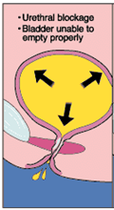
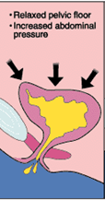
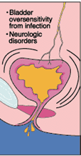
UTI: Signs and Symptoms

Slide 15
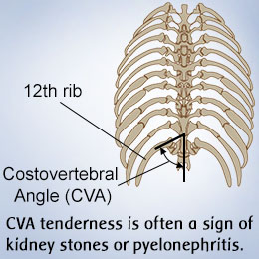
Signs and Symptoms
UTI: Signs and Symptoms
Uncomplicated UTI: Pyelonephritis
Same as bacterial cystitis, plus:
+
SYMPTOMS
Flank pain
General malaise
Chills, sweats, rigors
Nausea & vomiting
Confusion / decreased level of consciousness
(End-stage, due to sepsis)
SIGNS
Fever
Abdominal tenderness
Costovertebral angel tenderness
Tachycardia
Hypotension

Slide 16
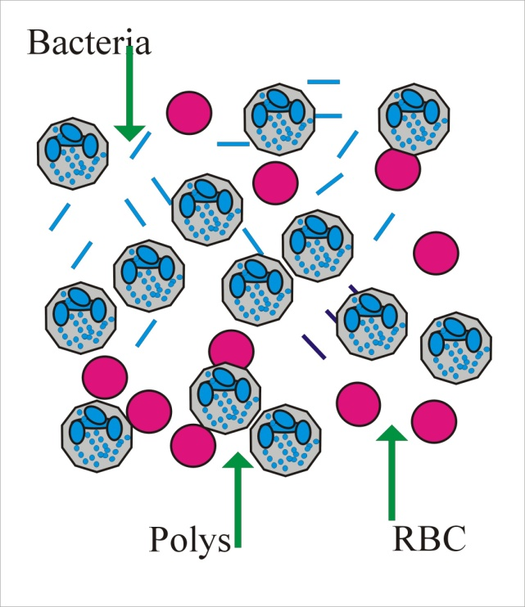
Investigations of Uncomplicated Bacterial Cystitis
UTI: Investigation
Microscopic urinalysis
Pyuria (WBC’s)
Hematuria (RBC’s)
Bacteriuria
Rapid screen (indirect) dipsticks
Nitrites (bacteriuria)
Leukocyte esterase (pyuria)
Urine culture & sensitivity
Often not necessary for simple UTI
Less cost-effective
Extensive investigation unnecessary
Radiologic tests
Endoscopy
Pyuria
Hematuria
Bacteriuria

Slide 17
Bacterial Cystitis Management
UTI: Management
Non-Pharmacologic
Pharmacologic
Good hygiene
Increased fluid intake
Regular/timed voids
Choice of antibiotic:
-Guidelines useful, but choice should depend on local pathogens and resistance patterns.
-Resistance should be < 10-20%

Slide 18
Pyelonephritis: Investigation
UTI: Investigation
Same as cystitis:
+
Bloodwork – CBC, electrolytes, kidney function test.
Urine cultures.
Blood cultures (for sepsis).
Upper tract imaging – U/S or CT:
? obstruction
? stone(s)
? abscess
? pyonephrosis
? anatomic abnormality

Slide 19
Complicated UTI: Infection occurring with functional or structural abnormalities of the urinary tract
UTI: Classification
PATIENT FACTORS
Children
Pregnancy
Male
Diabetes
Immunosuppression
Spinal cord injury
Hospitalized
Recent urinary tract instrumentation
URINARY TRACT FACTORS
Stones
Obstruction
Indwelling tubes
Congenital anomalies
Voiding dysfunction
Persistent infection
Unusual organisms
Very resistant pathogen
Notes:
What are risk factors for UTIs in children?
Risk factors predisposing for childhood UTIs include the following:
Male gender, especially uncircumcised infants
Poor toilet habits: Children should be encouraged to urinate every two to three hours.
Poor toilet hygiene: Females should always wipe front to back to avoid introduction of stool bacteria to the urethral opening.

Slide 20
Complicated UTI: Investigations
UTI: Investigations
Same as uncomplicated UTI, plus:
+
Further investigations to rule out underlying predisposing factors
Diagnostic imaging (i.e. renal ultrasound)
CT – best anatomic detail/most sensitive
Endoscopy

Slide 21
UTI: Differential diagnosis
Organisms that cause urethritis which are not detected on routine urine culture including:
Chlamydia trachomatis.
Ureaplasma urealyticum.

Slide 22
Treatment of UTI

Slide 23
Treatment Lower UTIs
Antibiotic
TMP-SXT
Ciprfloxacin
Amoxicillin-clavulanate
Nitrofurantoin
Uncomplicated Lower UTI
Dose | Duration
2 tablets BID | 3 days
250mg BID | 3 days
500 mg TID | 5-7 days
100mg BID | 5 days
Complicated Lower UTI
Dose | Duration
2 tablets BID | 7-10 days
250-500mg BID | 7-10 days
500 mg TID | 7-10 days
100 mg BID | 7-10 days

Slide 24
Acute Pyelonephritis
Patient with pyelonephritis may be
Less severely ill
Severely ill
low grad fever without nausea or vomiting.
Those patient may be treated with an oral antibiotic (seen as an outpatient).

Slide 25
Outpatient Antimicribial therapy for acute pyelonephritis
Antibiotic | Dose | Duration
TMP-SXT | 2 tablets BID | 14 days
Ciprfloxacin | 250 mg BID | 14 days
Amoxicillin-clavulanate | 500 mg TID | 14 days
Levofloxacin | 750 mg once daily | 5 days

Slide 26
In severely ill patients
Pyelonephritis
IV drug administered initially before being switched to oral therapy.
Patients with pyllonephritis are traditionally given 14 days of therapy
Treatment should be proceeded until fluids can be taken oraly and the patient is symptomatically improved and afebrile for 1-2 days
This sholud be followed with a course of oral antibiotics for total duration of 14 days
The traditional terapy included:
An extended spectrum cephalosporins.
An I.V. fluoroquinolones.
An I.V. aminoglycosides

