Slide 1
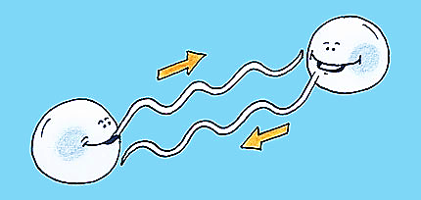
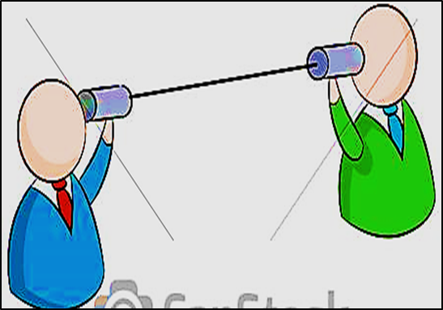
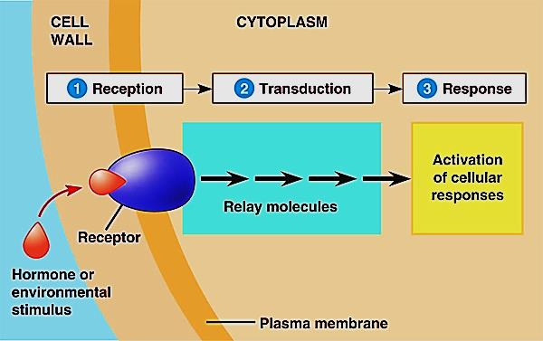
Cell Bio 4
Cell communication

Slide 2
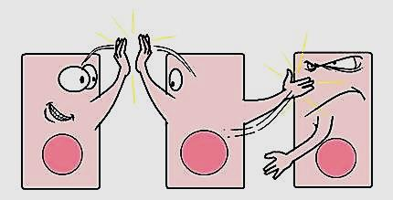
Cell signaling
Living cells in a multicellular organism have to communicate e each others in order to maintain homeostasis & life.
Cells communicate e each through signals which result in responses within the cells
The cell signaling system has 3 parts:
Reception
Transduction
Response

Slide 3
The signal transduction pathway is a series of steps by which a signal on a cell’s surface is converted into a specific cellular response
Steps of signaling system

Slide 4
The signals can be received from either:
External environment:
Sound
Light
Temperature
Odorants
Substances that we taste
Within the body ( hormones):
Epinephrine (adrenaline)
Insulin
Testosterone
Estrogen
All these factors will
cause the cell to respond
in some way.

Slide 5
Modes of cell signaling
1- Intracrine: the hormone or ligand acting
on receptors inside the cell (nuclear receptor)
2- Autocrine : the cell secretes a
hormone or chemical substance that
binds to receptors on that surface of
same cell, leading to changes in the cell.
(Autocrine signaling plays critical roles in cancer activation)
3- Direct (Juxtacrine signaling): gap junctions
(Cardiac muscles, embryonic development)

Slide 6
4- Short distance: act locally on different nearby cells
@ Paracrine (nearby) signaling (cytokines, histamine)
@ Synaptic signaling (neurotransmitters : AC)
Paracrine: signals are carried by messenger molecules called "local regulators", that are released by one cell and move to make contact with another nearby cells
(e.g.; blood clotting, tissue repair)
Synaptic: (neurotransmitters). Neurotransmitters are endogenous chemicals that transmit signals from a neuron to a target cell across a synapse.

Slide 7
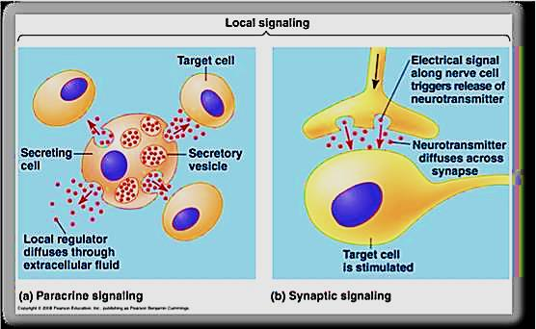
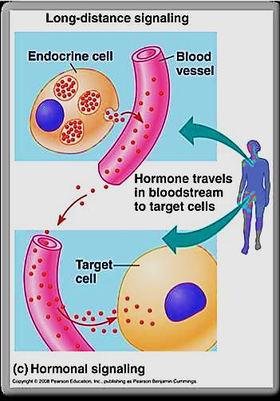
5- Long distance: act on target cells at distant body sites
e.g. endocrine signaling
(Hormones produced by
endocrine cells, travel
through the blood to affect
other cells all over the body

Slide 8
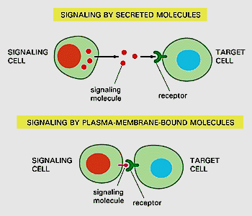
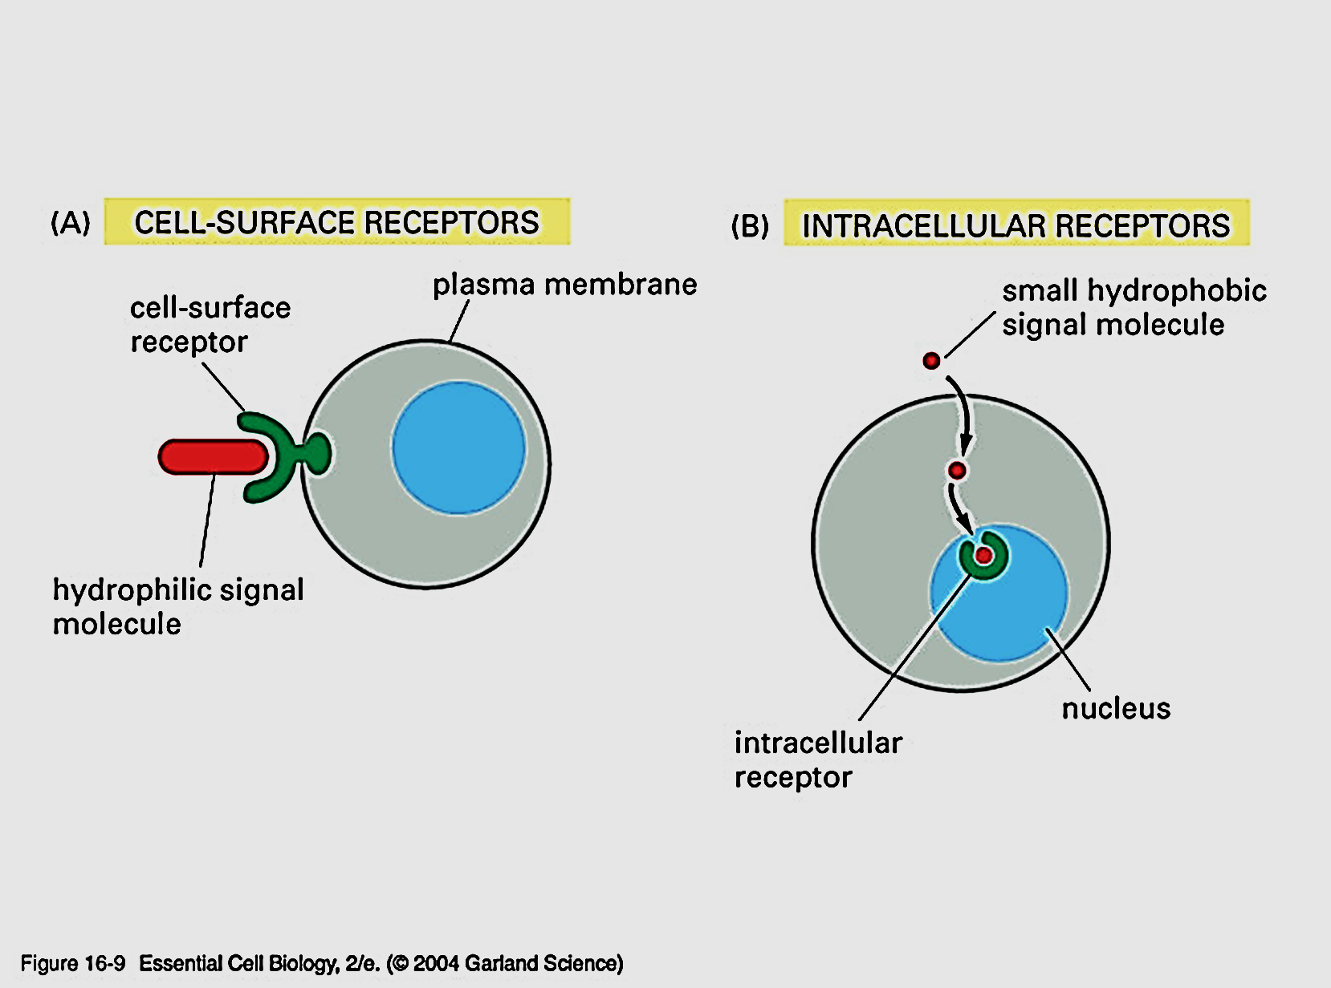
I. Reception
signaling molecules: either secreted by or expressed on the surface of some cells will bind to receptors on
other cells causing changes in target cells
Receptors: protein molecules found either:
On the cell surface (embedded within the cell membrane)
In the cytoplasm ( intracellular)

Slide 9
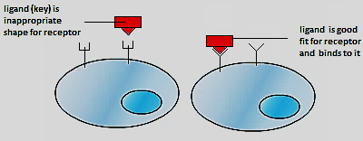
Signaling molecules: could be: proteins, small peptides, amino acids, nucleotides, steroids, retinoids (vit. A), fatty acid derivatives, nitric oxide, carbon monoxide…. ( Hormones, neurotransmitters, drugs, toxins, gases)
Ligand: signal molecule with a “key” that fit with the receptor “Lock” → causing biological change in body

Slide 10
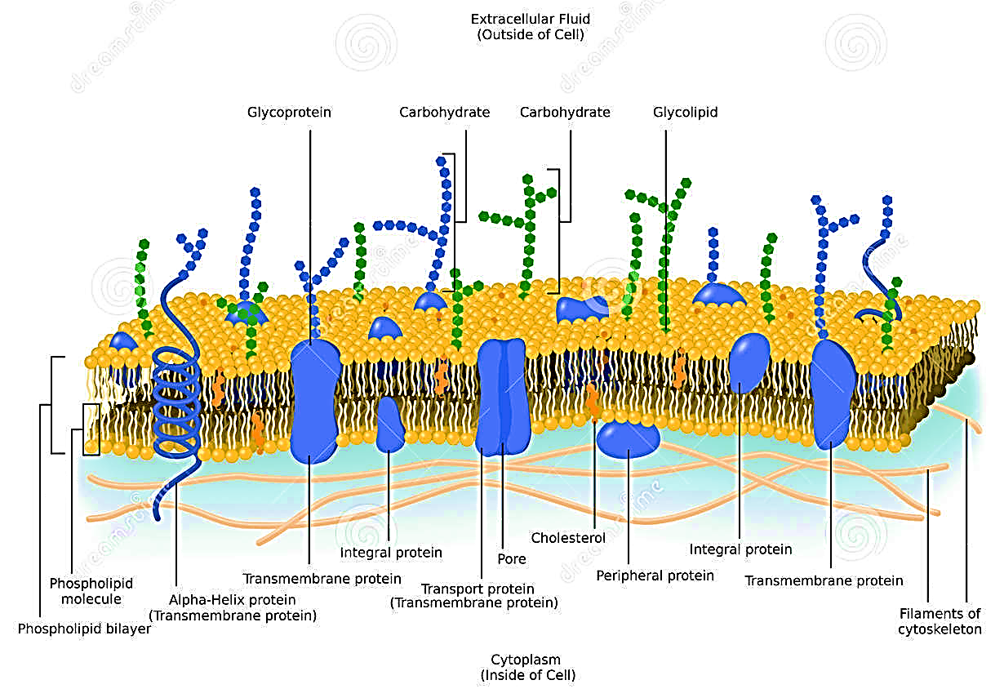
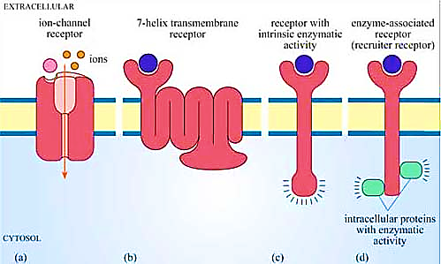
Receptors on the cell membrane
Receptors are proteins embedded in The lipid bilayer of the cell membrane

Slide 11
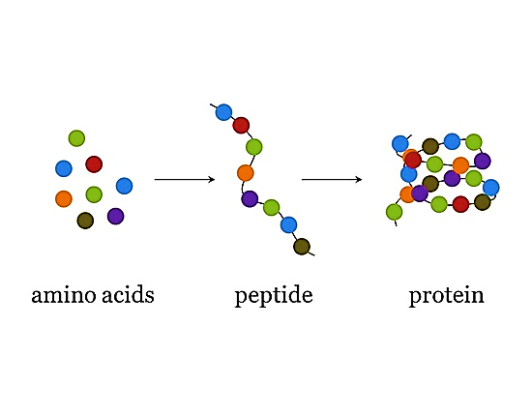
Mechanism of hormone action
Amino acid derivatives: Melatonin
Peptide (non- steroid) hormones:
E.g. : Insulin, glucagon, epinephrine, LH,
FSH, Histamine, Ach, ..… etc.
Steroid hormones:
E.g. Estrogen, testosterone , Aldosterone, Calcitrol, vit D,
cortisol…. etc.
Up to the nature of the signaling molecule the action will be either alteration in protein function or alteration in protein synthesis

Slide 12
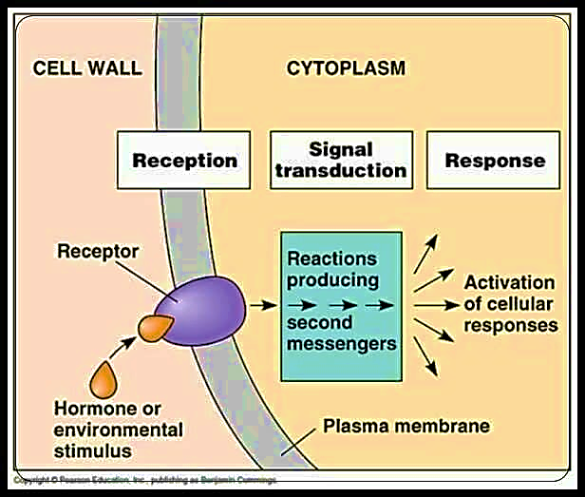
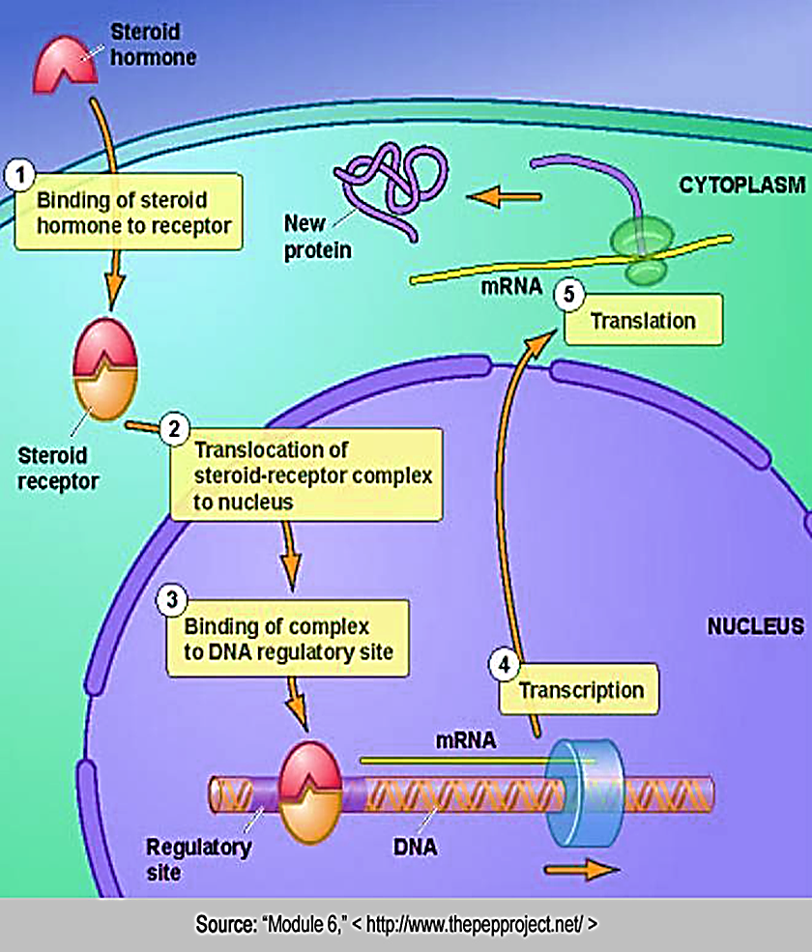
Hydrophilic ligand
Lipophilic ligand
Peptide based hormones are water soluble
Steroid based hormones are
lipid soluble

Slide 13
Intracellular receptors
proteins found in the cytoplasm or nucleus of target cells
Small or hydrophobic chemical messengers can readily cross the membrane and activate receptors
steroid and thyroid hormones
Can act as a transcription factor, turning on specific genes

Slide 14
There are 3 types of membrane receptors (Extracellular):
G protein –coupled receptors
Tyrosine kinases (enzyme – linked) receptors
Ion channel receptor
1
2
1

Slide 15
1- G- protein coupled receptors
Step 1:
the G protein is attached to the cytoplasm side of the cell membrane. (GDP)Function as OFF switch (G protein is inactive)
Step 2:
Binding of the ligand to the receptor changes the shape of the receptor→ GTP will attach to the G protein (ON switch) → activates G protein
G protein is active

Slide 16
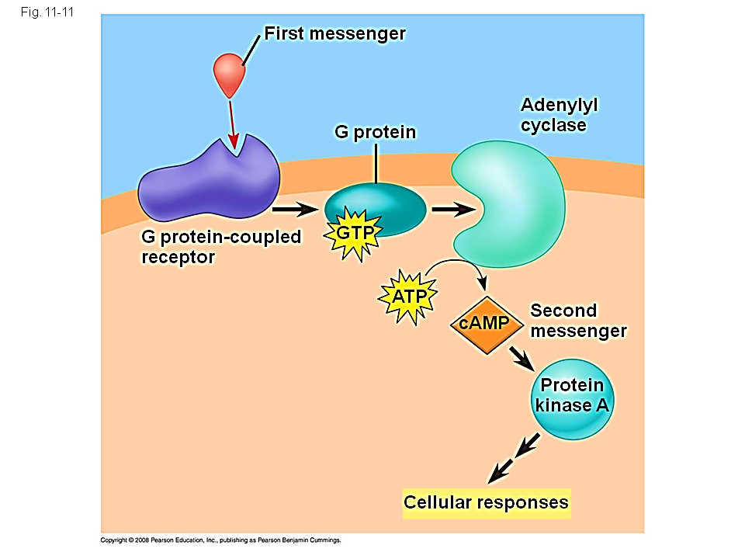
Step 3:
The activated G protein moves to catalyze the Adenylyl cyclase enzyme. The activated enzyme will change ATP→ cAMP → is a 2nd messenger→ phosphorylation cascade → cellular response
Step 4:
G protein returns to the inactive form by moving away from the enzyme & rejoined with GDP. The whole system is ready to receive new signal.

Slide 17
Importance of G protein receptor system
Most widespread class of receptors
Regulates the process of embryonic development
Play significant role in controlling vision, smell & taste, hearing sensations
45% of all Pharmaceutical function by interacting e G protein system.
Ligand binding produces signaling to a 2nd messenger

Slide 18
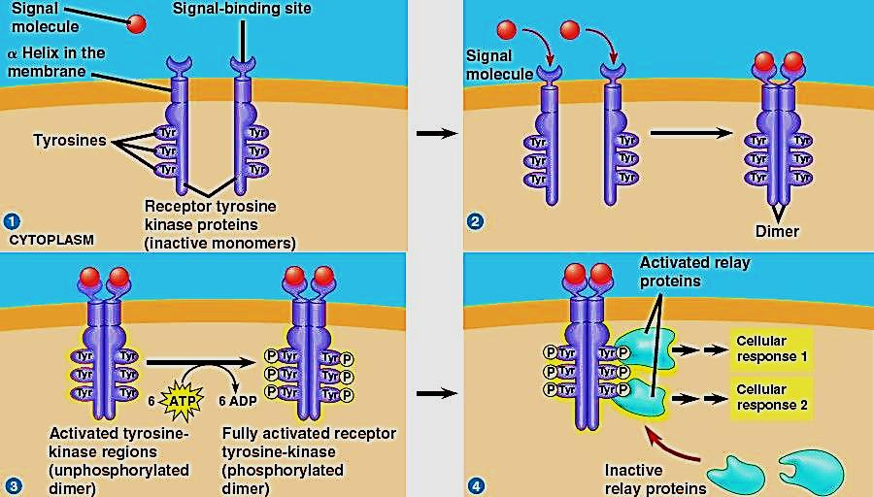
2- Tyrosine kinase receptors
Step 1:
TK are receptor proteins located in the cell membrane. start out as inactive monomers.
Each has a ligand binding site
The signal molecules are often growth factors
Step 2:
When signal molecules bind with receptor sites, monomers combine to form dimers → shape change of TK → start activation ,yet not phosphorylated

Slide 19
Step 3:
Dimerization activates →
phosphorylation process( it
takes multiple ATPs {6})
Fully phosphorylation → fully active receptors
Step 4:
Fully phosphorylated & active receptor is now recognized by multiple relay (signaling) proteins → initiate signal transduction →cellular response
Each TK system can trigger many separate cellular responses

Slide 20
Importance of Tyrosine kinase receptor system
One receptor tyrosine kinase (DIMER) can activate more different responses, providing a way for cells to regulate growth
Kinase: is the enzyme that catalyze the transfer of phosphate group → phosphorylation of the Dimer cause ON or OFF
Many cancers are caused by mutated tyrosine receptors that get activated without a signal molecule ( cells growing out of control)

Slide 21
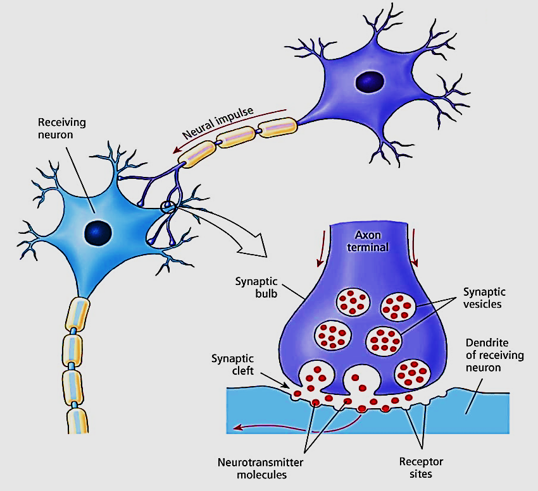
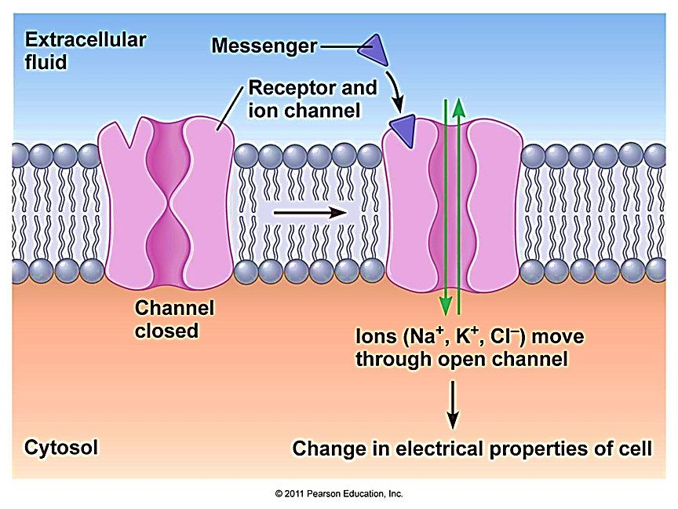
3- Ion channel receptors
Are the simplest form of receptors
Also known as ligand-gated ion channels located on post synaptic membrane in nervous system
Is away to regulate facilitated diffusion

Slide 22
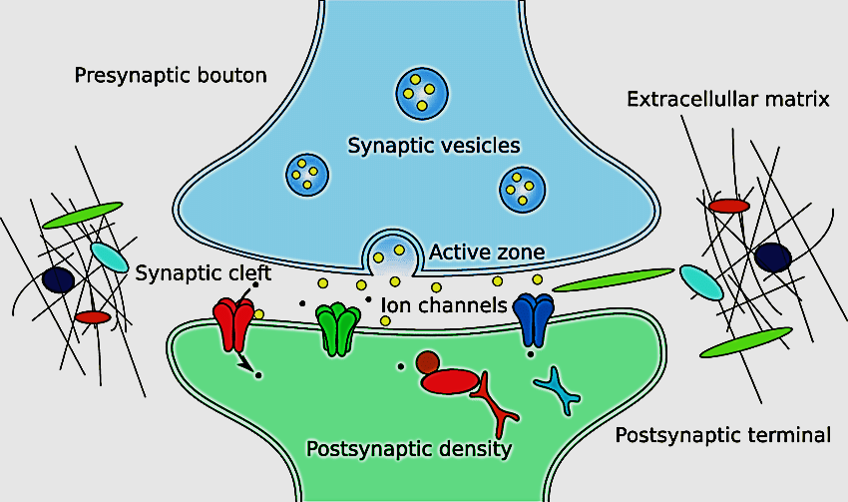
Importance of ion channel receptors
Important in the nervous system
Neurotransmitters function as ligands
which bind to receptors on target cell
These receptors are ion channel
receptors
Once open, ions flow into the target cell
Change in ion concentration triggers a nerve impulse

Slide 23
The cells respond to extracellular stimuli by altering their intracellular Ca⁺ concentration
Ca⁺ acts as a second messenger in two ways:
It binds to an effector molecule , such as an enzyme → activating it
It binds to cytosolic calcium binding protein such as Calmodulin
The binding of Ca⁺ causes changes in that protein
Calmodulin when activated causes contraction of smooth muscles

Slide 24
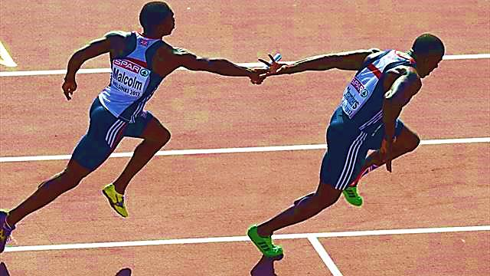
II. Signal transduction
Is the step between reception of a signal & the cell response to that signal
is a biochemical chain of events occur inside the cell
Transduction
Signal reception
Cell response

Slide 26
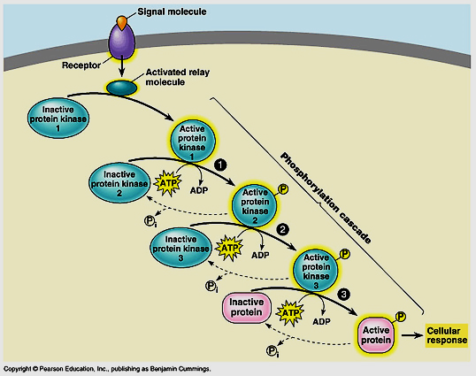
Role of protein kinase
They are protein molecules found in the cytoplasm
Act as catalysts
they are inactive until they
are phosphorylated
Each activated PK activates
the next one in the chain →
Phosphorylation cascade
Finally a protein is activated which generates a cellular response

Slide 27
Second messengers
The extra- cellular signal molecule (ligand) is the 1st messenger
2nd messengers are non protein molecules that transduce signals inside cells (used to relay messages), used to amplify the signal
Examples of 2nd messengers are:
cAMP
cGMP
Calcium ions
Inositol triphosphate (IP3)

Slide 28
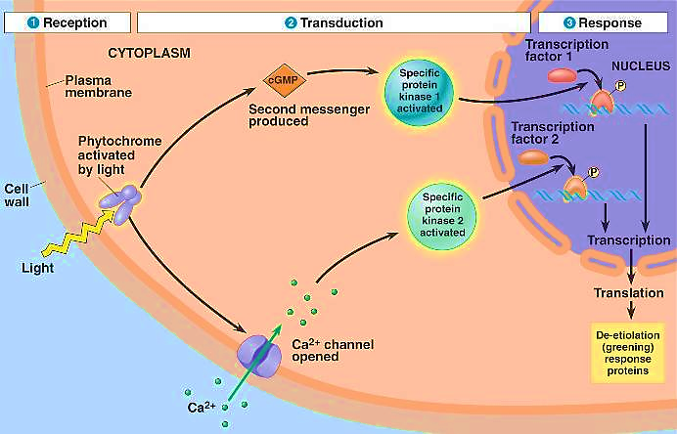
III. Responses
Cells respond to signaling pathways by many ways:
1- Metabolic enzyme→ alter metabolism
2- gene regulatory protein→ alter gene expression
3- cytoskeletal protein → alter cell shape or movement

Slide 29
(Signals can be specific to different cells)
Adrenaline
Liver cell
Heart cell
Stomach cell
Breakdown glycogen
Contract fast
No response

Slide 30
Thank you

