Slide 1
Pulmonary Circulation
Dr. Arwa Rawashdeh

Slide 2
Objectives
Physical properties of pulmonary blood flow ; pressure and resistance
Alveolar gas equation

Slide 3
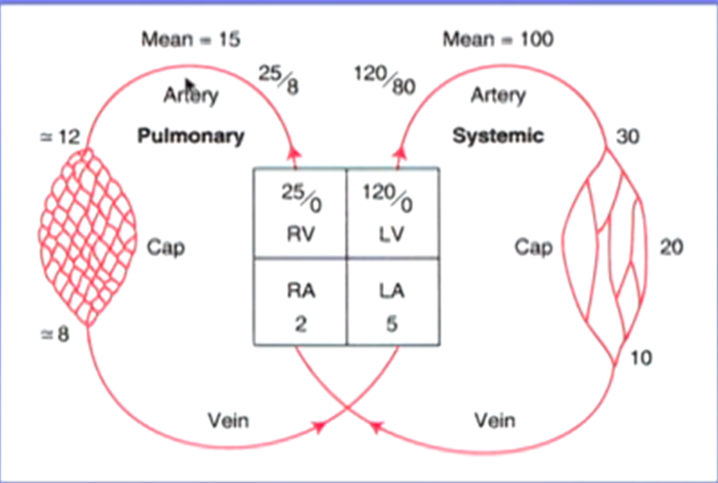
Physical properties of pulmonary blood flow
Pulmonary blood Pressure
Notice the big difference between the mean pressure of the pulmonary compared to that on systemic side
As you go from the pulmonary artery to the capillary bed to the pulmonary vein there is a quit drop of pressure
On the systemic side is rather different; you started with mean of 100 and by the time you getting down to the capillary a large amount of pressure is lost rather than systemic side

Slide 4
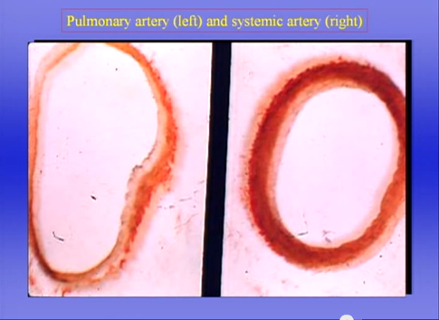
On the systemic side we have muscular arteries that can constrict and increases in the diameter and they allow the distribution of blood to different parts in the body for example if you start running you need blood flow to the exercising leg muscle increases greatly
not so on pulmonary side we don’t have a great deal of smooth muscle
Vascular resistance that is defined by
Ohm’s Law

Slide 5
The flow is identical in systemic and capillary circulation, these are two circulation in series
But the pressure drop is 15-5 = 10mmHg on pulmonary side whereas on the systemic side we have got 100-2= 98mmHg. Which means the resistance on the systemic side is 10 times the pulmonary side
So the pulmonary circulation is low pressure and low resistance

Slide 6
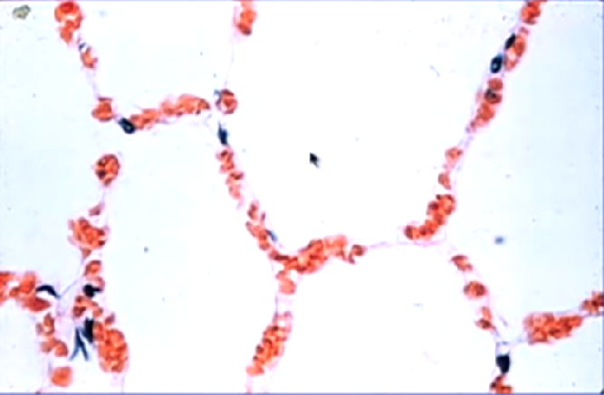
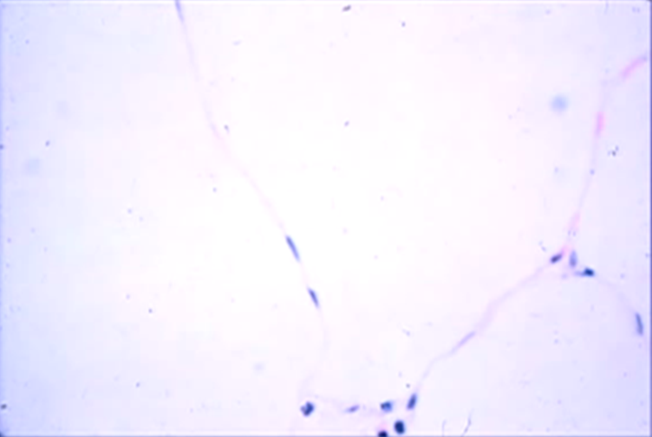
Pressure in the Pulmonary Capillary
The pressures within pulmonary capillaries is quit small as we have seen , the pressure around the capillaries as you can see they sitting in the alveolar wall and very close to them is the alveolar gas so the pressure the capillary exposed to is alveolar pressure
The capillaries are exposed to alveolar pressure and in fact of you raise the alveolar pressure above the capillary pressure or by the same token if you reduce the capillary pressure below the alveolar pressure the capillaries are compressed and collapsed

Slide 7
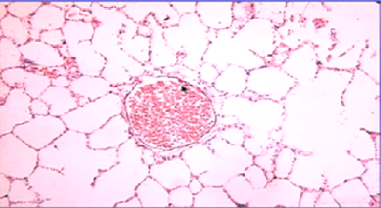
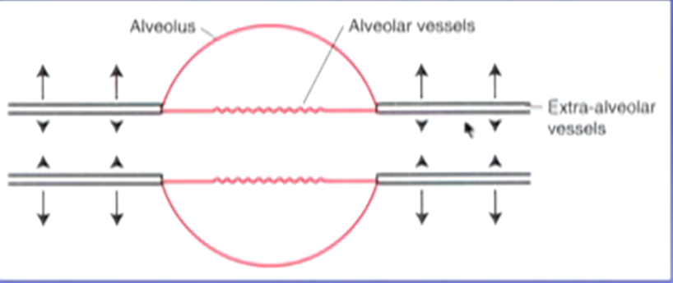
Pressure in the Pulmonary Veins and Arteries
The pressure of pulmonary vein is not equal to the pressure of alveoli although it is close to the alveoli, because the alveolar walls are under tension and they are pulling on this small pulmonary vein so it turns out that the pressure around the pulmonary arteries and veins is rather less than the alveolar pressure
We often divide the blood vessels in the lung into alveolar vessels which is mainly the capillaries here exposed to alveolar pressure and imaginary vessels is rather called extra alveolar pressure and those not exposed to alveolar pressure
Extra alveolar vessels have smooth muscle and elastic tissue so they have the tendency to become smaller but there are active radial traction of lung parenchyma around them so you can think of the extra alveolar vessels under dynamic conditions you got the expansion of the lung trying to pull them open and intrinsic natural tendency to get smaller and so that determines the caliber of these vessels so if we increase the lung volume the caliber would increase

Slide 8
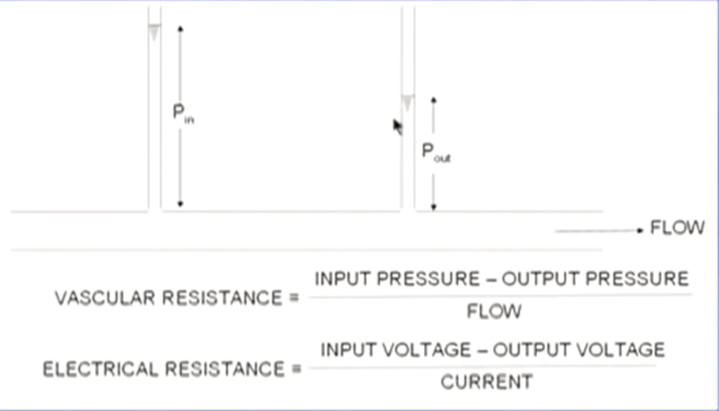
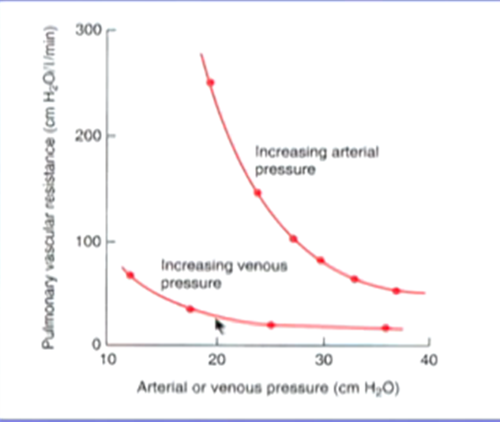
Pulmonary Resistance
Patients with heart or lung disease have increase pulmonary resistance so we should be clear about that
We are only going to change one pressure at a time
Increase the veins pressure (down stream ) and held the arterial pressure (up stream ) the pulmonary resistance is going to decrease and by the same token if we increase the up stream and held the down stream again the pulmonary resistance is going to decrease WHY????????

Slide 9
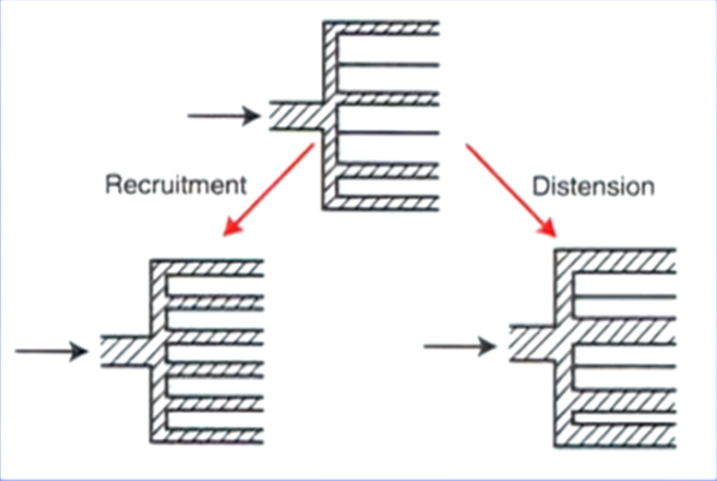
Factors affecting the pulmonary resistance
Recruitment of the capillaries
Distension of the capillaries

Slide 10
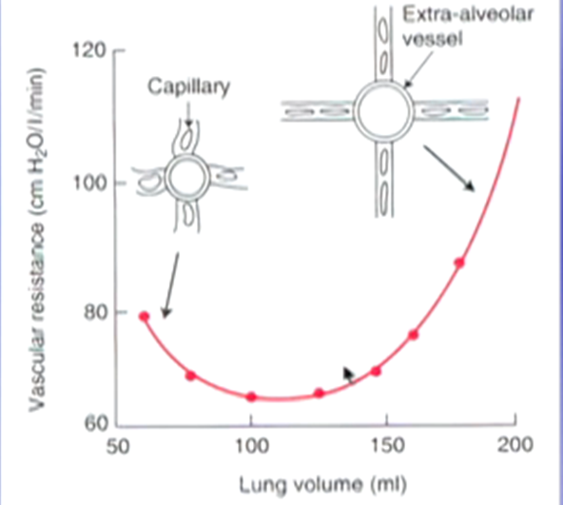
Lung volume has very important effect on pulmonary resistance for example if we reduce lung volume to a low level the extra alveolar vessels become smaller in caliber the radial traction of alveolar wall around them is reduced because lung volume is reduced and vascular resistances rises
It is also true the vascular resistances increases at high lung volumes what is happening that the capillaries become distorted and because the tension in the alveolar wall is very high the capillary become very thin and vascular resistance increases
It is rather like taking a piece of rubber tubing and stretching it across it diameter it is become very thin and that increase vascular resistance
So we tend to breath at a minimum of vascular resistance which make sense so if lung volume increase greatly above our normal breathing volume we have a high resistance and if we go down to very low volume then resistance increase again

Slide 11
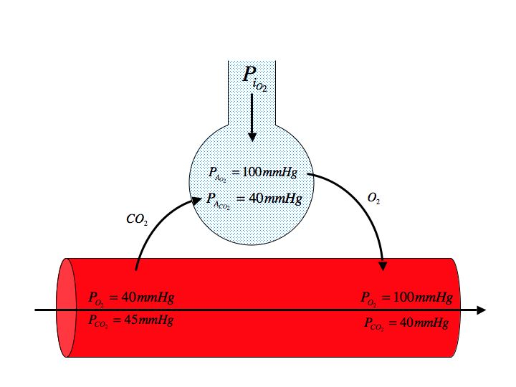
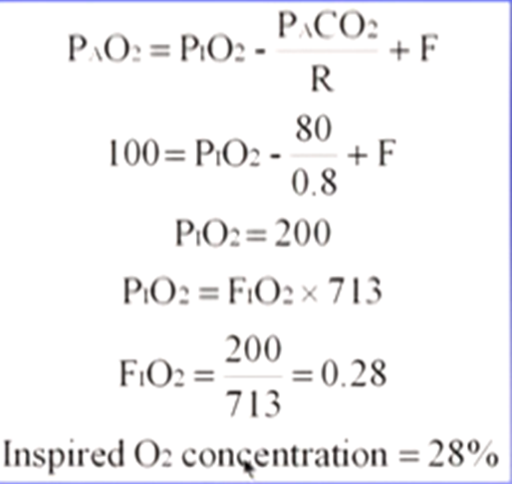
Alveolar Gas equation
Alveolar Gas Equation
In the alveolar space, oxygen diffuses into the blood and CO2 diffuses into the alveolus from the blood
PAO₂ = (PiO₂) – (PaCO₂/R).
R= Respiratory exchange ratio; CO2 production to O2 uptake
PaCO₂ approximates PACO₂ due to the rapid diffusion of CO₂
R = Respiratory Quotient (VCO2/V02) = 0.8
In a normal individual breathing room air:
PAO₂ = 150 – 40/0.8 = 100 mmHg
Suppose a patient hypo ventilates, so that the PCO2 rises to 80 mmHg?
PAO2 = 150 – 80/0.8 = 50 mmHg
Thus even with perfectly efficient lungs, the PAO2 would be 50, and the patient would be severely hypoxemic. Therefore, hypoventilation results in hypoxemia.

