Slide 1
Dr. Eman Shaat Professor of Medical Biochemistry and Molecular Biology
C V S Lipoprotein metabolism Pt. II Lect. Bio 4 ( 45 slides)

Slide 2
CM metabolism
The dietary TGs are transferred to the nascent CM by MTP.
LPL isoenzymes are tissue specific:
1. adipose LPL:
On a mixed meal → hhh in insulin → hhh gene expression.
2. skeletal and cardiac muscle LPL:
Fasting (low insulin) → ,,, in insulin → hhh gene expression.
CM is virtually catabolized after 12 hours of fast.

Slide 3
Role of LDL in atherosclerosis
LDL has long lifetime in blood (1.5 – 2 days).
LDL is small enough to penetrate from blood vessel lumen into the intima. LDL is oxidized (oxLDL).
Because VLDLs are eventually catabolized to LDL, LDL ends up with highest CE content among the lipoproteins.

Slide 4
High density lipoprotein (HDL)

Slide 5
Functions of HDL
Transfers proteins to other lipoproteins
Picks up lipids from other lipoproteins
Picks up cholesterol from cell membranes
Converts cholesterol to cholesterol esters via the LCAT reaction
HDL can transfer cholesterol ester into the liver:
directly or
through other lipoproteins
(Reverse cholesterol transport)
High blood levels of HDL ("good" cholesterol) correlate with low incidence of atherosclerosis.

Slide 6
Functions of HDL
Function:
Transports C from peripheral tissues to liver (reverse C transport).
Only HDL can pick up cholesterol from peripheral tissues
Only the liver can degrade cholesterol
HDL acts as a circulating store for apo-C & E required in the metabolism of CM & VLDL.

Slide 7
HDL: structure
These are the smallest and the most dense lipoprotein particles.
They contain large amount of proteins (50-60%) and very little TG, while the predominant lipid is phospholipid.
Synthesized de novo in the liver and small intestine, primarily as protein-rich disc-shaped particles.
Newly formed HDL are nearly devoid of C & CE.
Apoproteins : apoA, apoC, apoD and apoE.
Apo C- & E- are synthesized in liver and transferred from liver HDL to intestinal HDL when the latter enter the plasma.
apoA-I is synthesized by liver & intestine, which is secreted in a lipid-poor form and then immediately recruits additional PLs and free cholesterol (C) via the ABCA1 pathway, forming nascent HDL.

Slide 8
HDL: synthesis
Nascent HDL consists of discoid PL bilayers containing apo E & free cholesterol (C).
On entering the circulation:
apo-A, the major HDL apoprotein is acquired from CM
apo-C is transferred to CM and VLDL.
LCAT and its activator apo-A1, bind to the discoidal particles, and the surface PL & free C are converted to CE & lysolecithin.
The non-polar CE move into the hydrophobic interior of the bilayer, whereas lysolecithin is transferred to plasma albumin. Thus, a spherical HDL is formed.

Slide 9
HDL metabolism
Apo-A
CM
VLDL
Liver
Apo-C
Bile acids
Apo-E
LCAT
Nascent HDL
C + FA
C
Apo-A
C
CE
Peripheral tissue
CE
C
LCAT
C
HDL receptor
Other lipoproteins
Mature HDL

Slide 10
HDL metabolism
Apo-A_{I} activates LCAT (lecithin – cholesterol acyl transferase) which is present on the HDL surface. Free cholesterol, present on the HDL surface is esterified by LCAT.
Formation of cholesterol esters in lipoproteins
Apo-A1

Slide 11
CETP

Slide 12
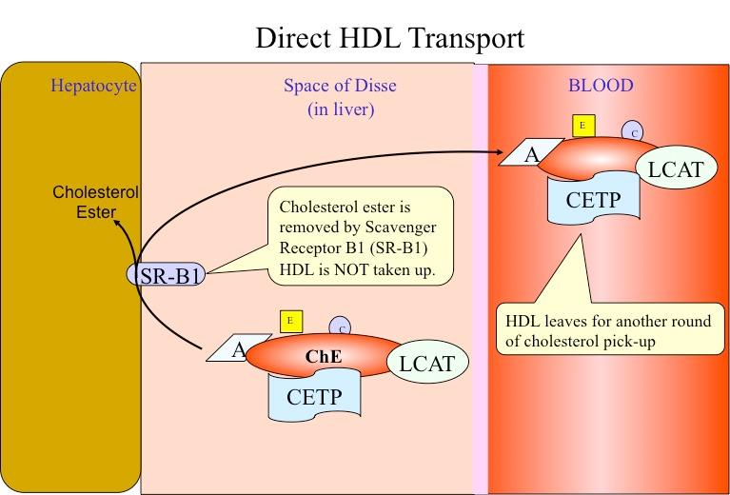
Class B scavenger receptor B1 (SR-B1)
In liver and in steroidogenic tissues: it binds HDL via apo-A1, then CE is selectively delivered to the cells (the particle itself, including apo-A1 is not taken up).
In the tissues on the other hand: SR-B1 mediates the acceptance of cholesterol effluxed from the cells by HDL, which then transports it to the liver for excretion.

Slide 13
2nd mechanism for reverse C transport ATP-binding cassette transporters
It involves the ATP-binding cassette transporters A1 & G1 (ABCA1 & ABCG1).
They are transporter proteins that couple hydrolysis of ATP to the binding of a substrate, enabling it to be transported across the membrane.
ABCG1: transports C from cells to HDL.
ABCA1: preferentially promotes efflux to poorly lipidated particles such as preβ-HDL, which are then converted to discoidal HDL then to HDL3 and finally to HDL2.

Slide 14
HDL cycle: interchange of HDL2 & HDL3
HDL3 generated from discoidal HDL by the action of LCAT, accepts cholesterol from the tissues via SR-B1 and C is then esterified by LCAT, increasing the size of particles to form the less dense HDL2.
HDL2 is formed due to the action of cholesterol ester transfer protein (CETP). Exchanges CE with CM & VLDL remnants; gets TG in return. By transferring CE out of HDL, product inhibition of CE on LCAT is eliminated allowing more cholesterol removal from peripheral tissues. When C efflux followed by esterification by LCAT is effective, HDL2 will be high.

Slide 15
HDL cycle: interchange of HDL2 & HDL3
HDL3 is then reformed, either after selective delivery of CE to the liver via the SR-B1 or by hydrolysis of HDL2 PL & TG by hepatic lipase (its activity is increased by androgens and decreased by estrogens → higher conc. of plasma HDL2 in women) and endothelial lipase.
The HDL remnant is endocytosed by the liver for degradation in the lysosomes.
Free apo-A1 is released by these processes and forms Preβ-HDL after associating with a minimum amount of PL & C. Surplus apo-A1 is destroyed by kidney.

Slide 16
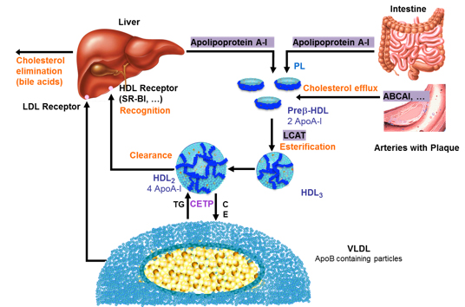
HDL metabolism

Slide 17
HDL: types
Pre-β-HDL (<5nm): Hydrolyzed CM & VLDL donate PL & apo-A1. This induces cholesterol efflux leading to discoidal HDL.
Discoidal HDL (nascent HDL): newly secreted HDL from intestine with additional C & PL. Contains Apo-A1. Does not contain apo C or E; synthesized in liver & transferred to HDL.
HDL3 (5-10nm):formed due to the action of LCAT.
HDL2 (10-20nm): formed due to the action of cholesterol ester transfer protein (CETP).
CE transferred to CM & VLDL remnants is degraded to bile acids.
HDLc (HDL1) (20-25nm): is found in blood of diet-induced hypercholesterolic animals. It is rich in C, and its sole apolipoprotein is apo-E.

Slide 18
Intest
CM
Liver
Apo-A1
SR-B1
ABCA1
HDL R
C
PL & C
preβHDL
ABCA1
Peripheral tissue
C
Discoid HDL
ABCG1
C
LCAT + A1
SR-B1
HDL3
TG
LCAT
VLDL
IDL
LDL
HL
EL
CETP
HDL2
(↑↑TG)
CE

Slide 19
Reverse Cholesterol Transport (RCT)
Excess cholesterol in peripheral cells, especially foam cells, is returned to the liver for degradation and excretion.
In the hepatocyte, CE → free cholesterol
excreted directly into the bile or
converted to bile acid and excreted into the bile.
HDL concentrations vary reciprocally with plasma TG concentrations & directly with LPL activity.
All plasma lipoproteins are interrelated components (complex process of plasma lipid transport)

Slide 20
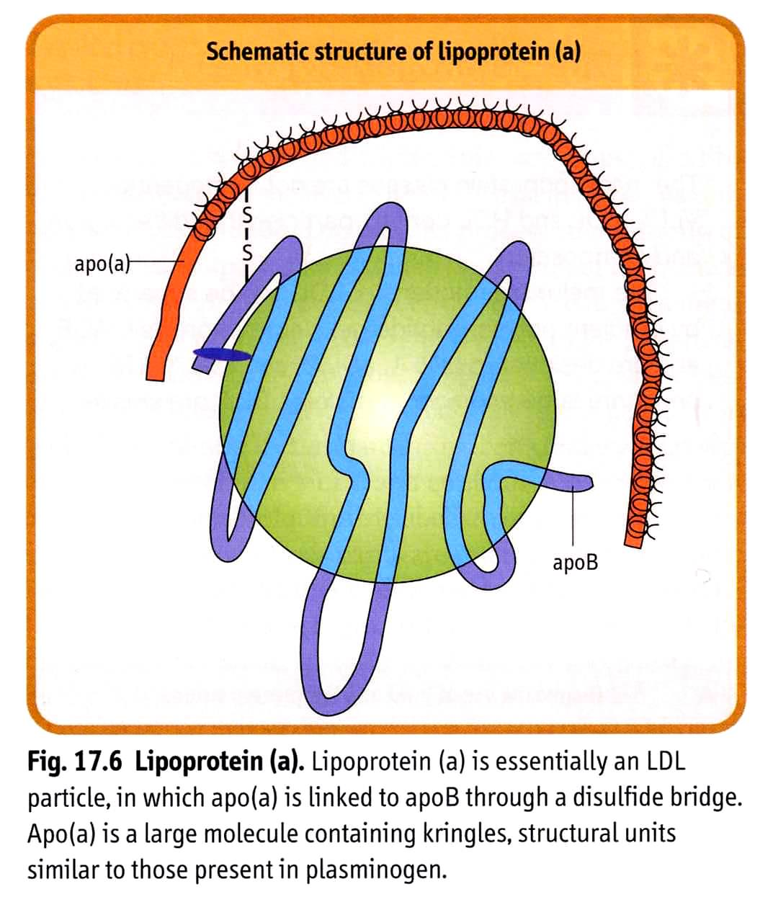
Lipoprotein (a) [Lp(a)]
Lp(a) When present, is attached to apo-B100 by a disulfide bond.
in some normal population, there is no detectable level of Lp(a) in serum. High blood level is linked to susceptibility for heart attack at a younger age.
Lp(a) is similar in structure to plasminogen. So, it interferes with plasminogen activation and impairs fibrinolysis. This leads to thrombosis & MI.

Slide 21
Dyslipoproteinemia
Causes
I. Primary dyslipoproteinemia are probably genetically based. Primary causes:
Increase production.
Defective processing.
Defective cellular uptake.
II. Secondary hyperlipidemia may result from:
1. Diseases such as diabetes, thyroid disease, renal disorders, liver disorders, Cushing's syndrome, obesity, alcohol consumption.
2. Drug-associated changes in lipid metabolism as Diuretics, beta blockers, estrogen, corticosteroids

Slide 22
Primary Dyslipoproteinemia
It can be subdivided into two major categories:
1. Hypolipoproteinemia.
Abeta-lipoproteinemia.
Familial alpha-lipoprotein deficiency (apo-A1 deficiency &Tangier disease)
2. Hyperlipoproteinemia:
Familial LPL deficiency (type I).
Familial hypercholesterolemia (type IIa).
Familial hyperlipoproteinemia ; broad beta; remnant disease (type III).
Familial hypertriglyceridemia (type IV).
Familial hyperalphalipoproteinemia.
Hepatic lipase deficiency.
Familial LCAT deficiency.
Familial lipoprotein (a) excess.

Slide 23
I. Primary dyslipoproteinemia.1. hypolipoproteinemia. Abeta lipoproteinemia
Defect:
Abeta lipoproteinemia: due to mutations in the gene encoding microsomal transfer protein (MTP), a protein that transfers lipids to nascent chylomicrons and VLDL in the intestine and liver, respectively.
Familial hypobetalipoproteinemia: due to mutations in Apo B. missense mutations in Apo B causes reduce secretion and/or accelerate catabolism of LDL. life-long low LDL-C levels are a reason for substantial reduction in coronary heart disease
No CM, VLDL, LDL formation.
Remarks
Rare autosomal recessive disease.
,,, blood TG.
hhh TG in liver & intestine.
Abetalipoproteinemia (Abeta- mainly not hypo-) usually presents in childhood with diarrhea and failure to thrive and is characterized clinically by fat malabsorption & nervous degeneration. they result from defects in the absorption and transport of fat-soluble vitamins, primarily vitamin E → physical & mental retardation.

Slide 24
I. Primary dyslipoproteinemia.1. hypolipoproteinemia. Abeta lipoproteinemia
Peripheral tissue
liver
LPL
CII
VLDL
IDL
LDL
B100
B100
LDL
receptor
TG
FFA+glycerol
TG in liver

Slide 25
I. Primary dyslipoproteinemia.1. hypolipoproteinemia. Abeta lipoproteinemia
liver
LPL
CII
CM remnant
intestine
CM
B48
TG
FFA+glycerol
TG in intestine

Slide 26
I. Primary dyslipoproteinemia. 1.hypolipoproteinemia: Familial Apo-A1 deficiency
Defect: due to mutations (as deletions) of the Apo-A1 gene. It leads to decrease apo-A1 production. Result in premature atherosclerosis.
Clinically: blurred vision due to cornial opacities. Xanthoma, premature CHD. Hearing loss secondary to amyloidosis.
Diagnosis:
Low apo-A1.
Low HDL.
Normal VLDL & LDL.
Normal TG.
Genetic testing.
Differential diagnosis: Tangier dis., LCAT def., secondary causes.
[apo-B/apo-A1 ratio determines balance between atherogenic (LDL,…) and anti-atherogenic (HDL) particles]

Slide 27
I.Primarydyslipoproteinemia.1.hypolipoproteinemia: Familial alpha-lipoprotein deficiency: Tangier disease:
Defect:
It is an autosomal recessive disease.
It is due to mutation in ABC-A1 (eg. Deletion).
1. Leads to cholesterol accumulation within the cells → Results in premature atherosclerosis and increase risk for CHD.
2. It prevents the maturation of HDL (from nascent HDL to HDL-3). The nascent HDL is rapidly degraded → ,,, HDL.
3. Apo E and Apo C-II transfer from HDL to CM and VLDL are also prevented → hhh CM and VLDL (hypertriacylglycerolemia)

Slide 28
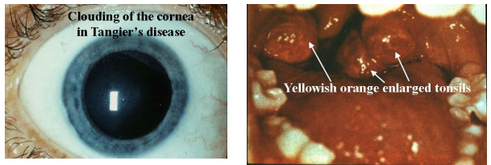
I.Primarydyslipoproteinemia.1.hypolipoproteinemia: Familial alpha-lipoprotein deficiency: Tangier disease:
Manifestations:
Enlargements of liver, spleen, lymph nodes and tonsils (orange-colored) due to deposition of C and CE leading to toxic effects.
Peripheral neuropathy.
Clouding of cornea.
Treatment: by diet modification with low dietary lipids.

Slide 29
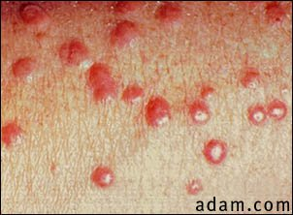
I. Primary dyslipoproteinemia. 2. Hyperlipoproteinemia. Familial LPL deficiency (Type I)
Defect
Abnormal or deficient LPL or
Apo CII deficiency.
Remarks
hhh VLDL
hhh Fasting CM levels.
hhh blood TG.
,,, LDL.
No risk for CHD.
Clinical findings
Recurrent acute pancreatitis
xanthomas
Hepatosplenomegaly
Autosomal recessive inheritance
(Consanguinity common)

Slide 30
Familial LPL deficiency (Type I)
Peripheral tissue
liver
LPL
CII
VLDL
IDL
LDL
B100
B100
LDL
receptor
TG
FFA+glycerol

Slide 31
Familial LPL deficiency (Type I)
liver
LPL
CII
CM remnant
intestine
CM
B48
TG
FFA+glycerol

Slide 32
I. Primary dyslipoproteinemia.2. Hyperlipoproteinemia. Familial hypercholesterolemia (Type IIa)
Defect
Defective LDL receptors.
Mutation in ligand region of apo -B100
Remarks
hhh LDL levels.
hhh cholesterol.
Resulting in atherosclerosis and CHD.
Homozygotes: --Total cholesterol 800-1000 mg/dl.
--Heart attack as early as teenage years.
Heterozygotes: -- cholesterols 300-600 mg/dl.
--Heart attacks 20-50 years

Slide 33
Familial hypercholesterolemia (Type IIa)
liver
Peripheral tissue
LPL
CII
VLDL
IDL
LDL
B100
B100
LDL
receptor
TG
FFA+glycerol
liver

Slide 34
I. Primary dyslipoproteinemia.2. Hyperlipoproteinemia. Familial hyperlipoproteinemia (broad beta; remnant removal (Type III)
Defect:
Abnormal apo-E (lack E3 & E4 isoforms).
Remarks
hhh VLDL remnants (hhh IDL).
hhh CM remnants.
Resulting in hhh blood cholesterol, xanthoma, and atherosclerosis.

Slide 35
Familial hyperlipoproteinemia (broad beta; remnant removal (Type III)
liver
LPL
intestine
CII
CM remnant
CM
B48
Apo-E
receptor
TG
FFA+glycerol
Blood C

Slide 36
Familial hyperlipoproteinemia (broad beta; remnant removal (Type III)
liver
LPL
LDL
CII
VLDL
IDL
B100
apo-E
Apo-E
receptor
TG
FFA+glycerol
Blood C
VLDL remnant

Slide 37
I. Primary dyslipoproteinemia.2. Hyperlipoproteinemia. Familial hypertriglyceridemia (Type IV)
Defect:
hhh VLDL associated with glucose intolerance and hyperinsulinemia.
The most common hyperlipidemia
Remarks
hhh VLDL. hhh TG
hhh LDL. hhh cholerterol.
commonly associated with CHD, type II DM, obesity.

Slide 38
Familial hypertriglyceridemia (Type IV)
DM, Hyperinsulinemia
Peripheral tissue
hhTG
LPL
CII
VLDL
IDL
LDL
apo-E
B100
liver
Apo-E
receptor
TG
FFA+glycerol
Blood TG & C

Slide 39
I. Primary dyslipoproteinemia.2. Hyperlipoproteinemia. Familial lecithin: cholerterol acyltransferase (LCAT) deficiency
Defect:
Absent LCAT leads to block in reverse cholersterol transport.
HDL remains as nascent disks…… can not take up cholesterol or esterifying it.
Remarks
,,, cholesterol ester & lysolecithin.
Abnormal LDL (lipoprotein X)
Abnormal VLDL.

Slide 40
Familial LCAT deficiency
Apo-A
CM
Liver
Apo-C
Bile acids
Apo-E
Nascent HDL
LCAT
C
C + FA
Apo-A
C
Mature HDL
CE
CE
C
LCAT
hhh Blood C
,,, CE
Abnormal VLDL, LDL
HDL receptor

Slide 41
LCAT
Lecithin + Cholesterol
Cholesterol ester (CE) + lysolecithin.
LCAT

Slide 42
I. Primary dyslipoproteinemia.2. Hyperlipoproteinemia. Familial lipoprotein (a) excess
Structure:
It consist of 1mol LDL attached to 1mol apo(a).
Defect:
Excess apo(a).
Remarks
patients have premature CHD and thrombosis due to inhibition of fibrinolysis.

Slide 43
Adult reference ranges for lipids
ANALYTE | REFERENCE RANGE
Total cholesterol | 140-200 mg/dL
HDL cholesterol | 40-75 mg/dL
LDL cholesterol | 50-130 mg/dL
Triglyceride | 60-150 mg/dL
Ideal Lipid Profile
Total Cholesterol | < 200 mg/dl
LDL-Cholesterol | < 100 mg/dl
HDL-Cholesterol | ≥ 60 mg/dl
Triglycerides | < 150 mg/dl

Slide 44
Separation of Lipoproteins
1- Ultracentrifugation: Lipoproteins are separated according to their density. (The higher the protein content the higher the density of the particles).
2- Electrophoresis: It depends on the charge and molecular weights of various particles.
[Free fatty acids-albumin complex is not considered typical lipoprotein fraction]

Slide 45
-
Chlomicrons
Non-mobile lipoproteins
VLDL
B-Lipoproteins
LDL
Pre-B Lipoproteins
HDL
α-Lipoproteins
Albumin+FFA
Albumin+FFA
Ultracentrifugation fractions
Electrophoresis fractions
₊
Thank you & Best wishes
Dr. Eman Shaat

