Slide 1
PERIPHERAL NERVOUS SYSTEM
CERVICAL PLEXUS
Dr. Aiman Qais Afar
surgical anatomist
College of Medicine / University of Mutah
2022-2023

Slide 2
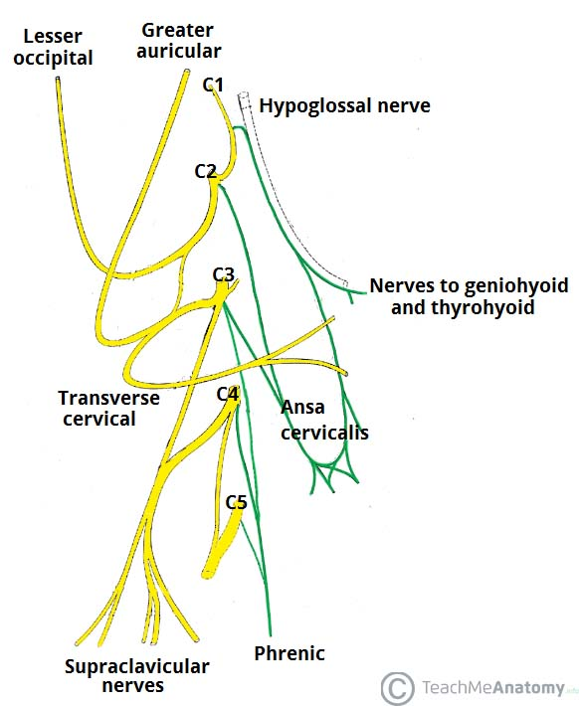
Cervical plexus
The anterior rami of C1-C4 make up the roots of the cervical plexus
The cervical plexus consists of an irregular series of (primary) nerve loops and the branches that arise from the loops.
Each participating ramus, except the first, divides into ascending and descending branches that unite with the branches of the adjacent spinal nerve to form the loops.

Slide 3
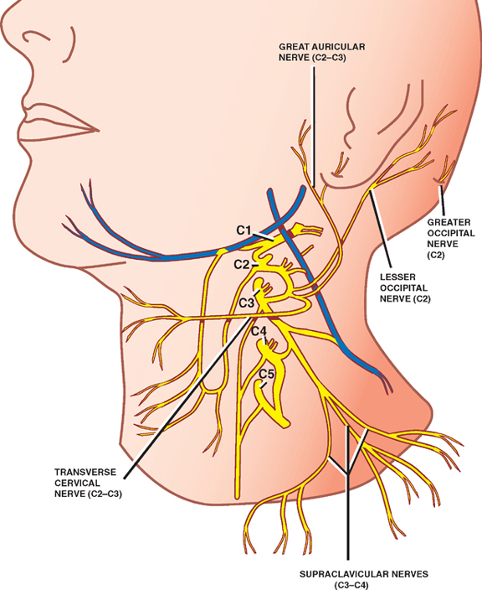
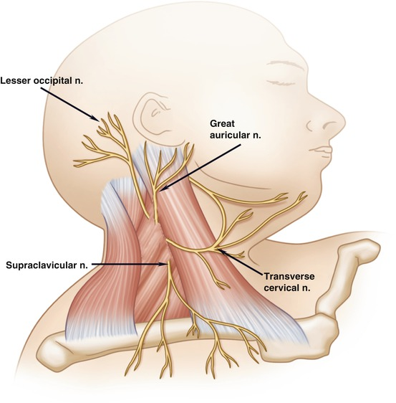
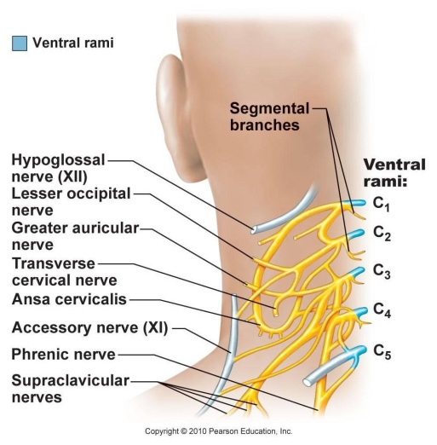
Cervical plexus
The cervical plexus lies Anteromedial to the levator scapulae and middle scalene muscles and deep to the SCM.
The superficial branches of the plexus that initially pass posteriorly are cutaneous (sensory) branches

Slide 4
Cervical plexus
The deep branches passing anteromedially are motor branches, including the roots of the phrenic nerve (to the diaphragm) and the ansa cervicalis

Slide 5
Cervical plexus
The superior root of the ansa cervicalis, conveying fibers from spinal nerves C1 and C2, briefly joins and then descends from the hypoglossal nerve (CN XII) as it traverses the lateral cervical region
The inferior root of the ansa cervicalis arises from a loop between spinal nerves C2 and C3.

Slide 6
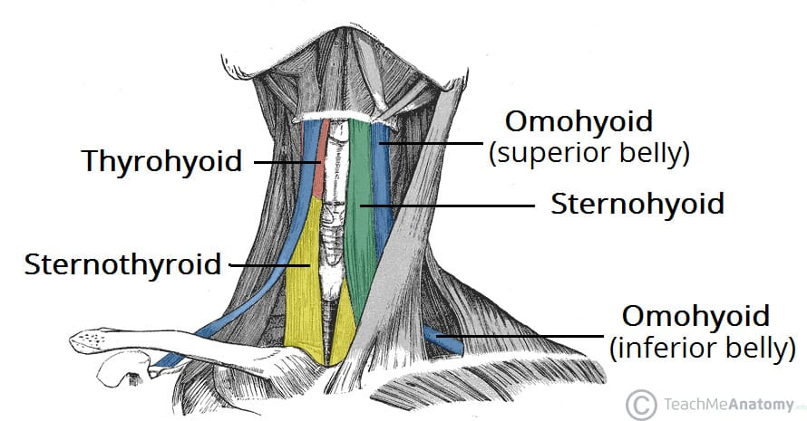
Cervical plexus
The superior and inferior roots of the ansa cervicalis unite, forming a secondary loop, the ansa cervicalis, consisting of fibers from the C1-C3 spinal nerves, which branch from the secondary loop to supply the infrahyoid muscles, including the omohyoid, sternothyroid, and sternohyoid

Slide 7
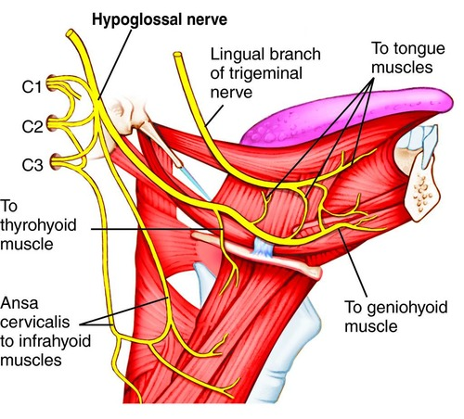
Cervical plexus
The fourth Infrahyoid muscle, the thyrohyoid, receives C1 fibers, which descend independently from the hypoglossal nerve, distal to the superior root of the ansa cervicalis (nerve to thyrohyoid)

Slide 8
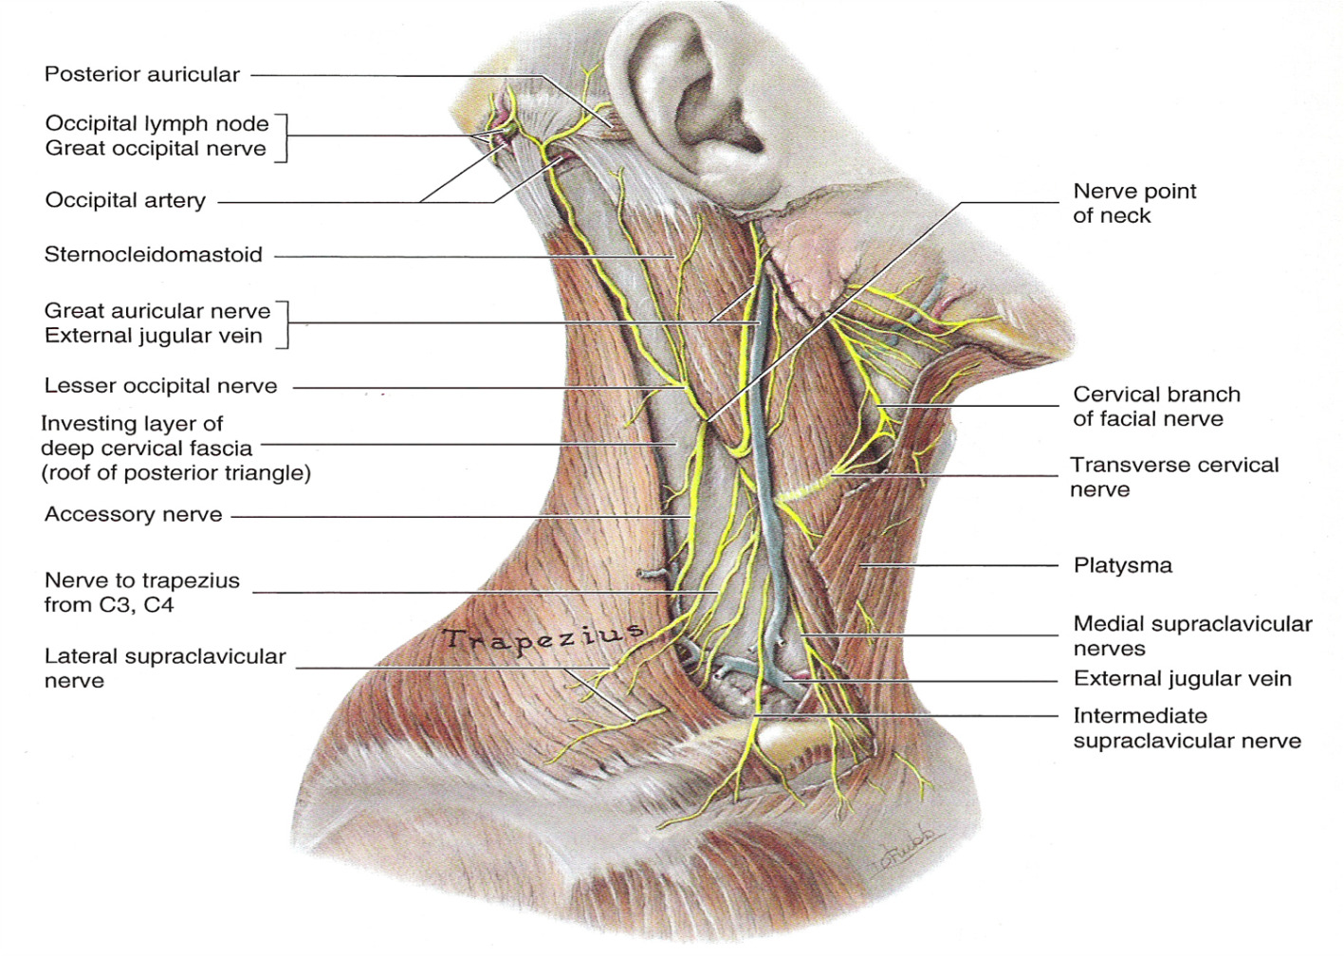
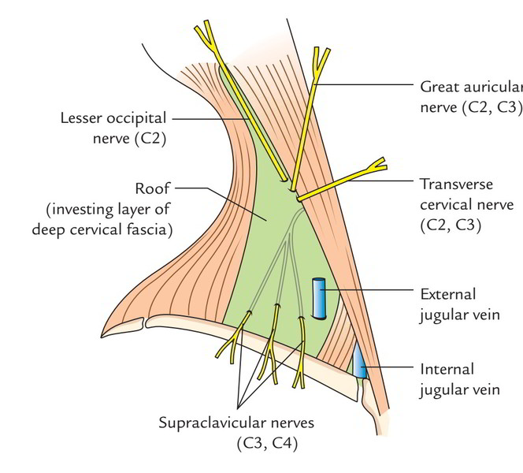
Cervical plexus
Cutaneous branches of the cervical plexus emerge around the middle of the posterior border of the SCM, often called the nerve point of the neck
and supply the skin of the neck, superolateral thoracic wall, and scalp between the auricle and the external occipital protuberance

Slide 9
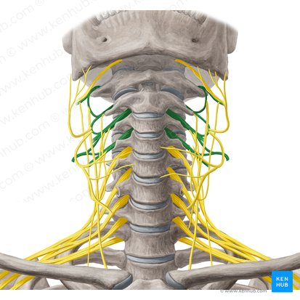
Cervical plexus
Close to their origin, the roots of the cervical plexus receive gray rami communicantes, most of which descend from the large superior cervical ganglion in the superior part of the neck.
These communicating fibres are the contributions from the sympathetic trunk (sympathetic nervous system) to the cervical plexus

Slide 10
Cervical plexus
Branches of cervical plexus arising from the nerve loop between the anterior rami of C2 and C3 are the:
Lesser occipital nerve (C2): supplies the skin of the neck and scalp posterosuperior to the auricle.
Great auricular nerve (C2 and C3): ascends vertically across the oblique SCM to the inferior pole of the parotid gland, where it divides to supply the skin over—and the sheath surrounding—the gland, the mastoid process, and both surfaces of the auricle and an area of skin extending from the angle of the mandible to the mastoid process.

Slide 11
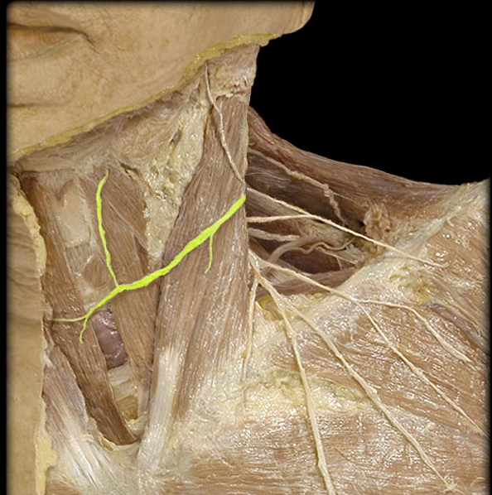
Branches of cervical plexus arising from the nerve loop between the anterior rami of C2 and C3 are the:
Transverse cervical nerve (C2 and C3): supplies the skin covering the anterior cervical region.
It curves around the middle of the posterior border of the SCM inferior to the great auricular nerve and passes anteriorly and horizontally across it deep to the EJV and platysma, dividing into superior and inferior branches.

Slide 12
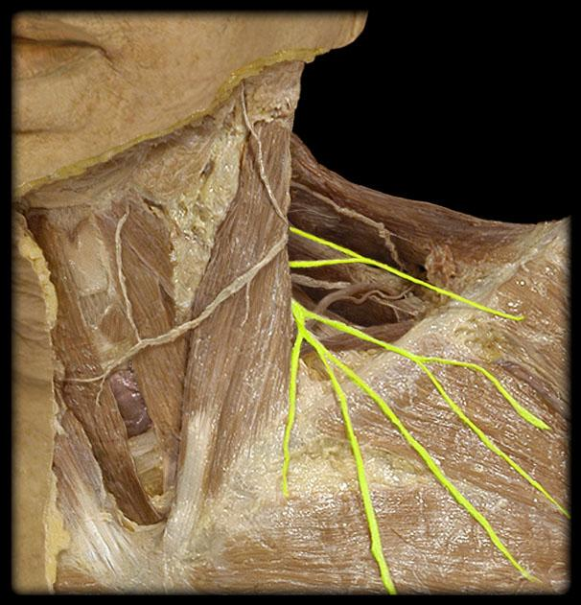
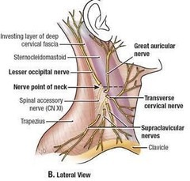
The branches of the cervical plexus arising from the nerve loop formed between the anterior rami of C3-C4 are the:
Supraclavicular nerves (C3 and C4): emerge as a common trunk under cover of the SCM, sending small branches to the skin of the neck that cross the clavicle supplying,
1) Skin over the upper half of the deltoid muscle.
2) Skin of the pectoral region above the level of sternal angle.

Slide 13
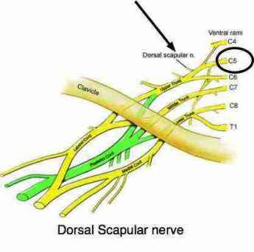
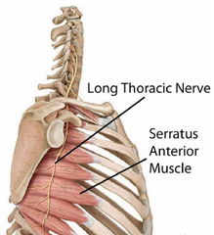
Cervical plexus
In addition to the ansa cervicalis and phrenic nerves arising from the loops of the plexus, deep motor branches of the cervical plexus include branches arising from the roots that supply the rhomboids (dorsal scapular nerve; C4 and C5), serratus anterior (long thoracic nerve; C5-C7), and nearby prevertebral muscles

Slide 14
The phrenic nerves
Originate chiefly from the C4 nerve but receive contributions from the C3 and C5 nerves
The phrenic nerves contain motor, sensory, and sympathetic nerve fibers.
These nerves provide the sole motor supply to the diaphragm as well as sensation to its central part.
In the thorax, each phrenic nerve supplies the mediastinal pleura and pericardium

Slide 15
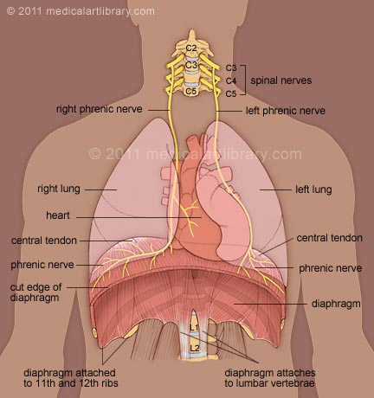
The phrenic nerves
Receiving variable communicating fibers in the neck from the cervical sympathetic ganglia or their branches, each phrenic nerve forms at the superior part of the lateral border of the anterior scalene muscle at the level of the superior border of the thyroid cartilage.
The phrenic nerve descends obliquely with the IJV across the anterior scalene, deep to the prevertebral layer of deep cervical fascia and the transverse cervical and suprascapular arteries.

Slide 16
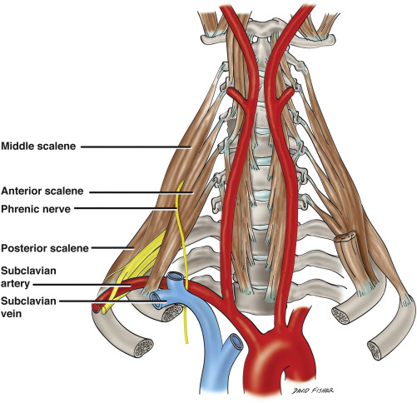
The phrenic nerves
On the left, the phrenic nerve crosses anterior to the first part of the subclavian artery;
On the right, it lies on the anterior scalene muscle and crosses anterior to the second part of the subclavian artery.
On both sides, the phrenic nerve runs posterior to the subclavian vein and anterior to the internal thoracic artery as it enters the thorax.

Slide 17
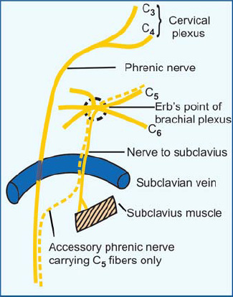
The phrenic nerves
The contribution of the C5 nerve to the phrenic nerve may be derived from an accessory phrenic nerve
Frequently, it is a branch of the nerve to the subclavius.
If present, the accessory phrenic nerve lies lateral to the main nerve and descends posterior and sometimes anterior to the subclavian vein.
The accessory phrenic nerve joins the phrenic nerve either in the root of the neck or in the thorax.

Slide 18
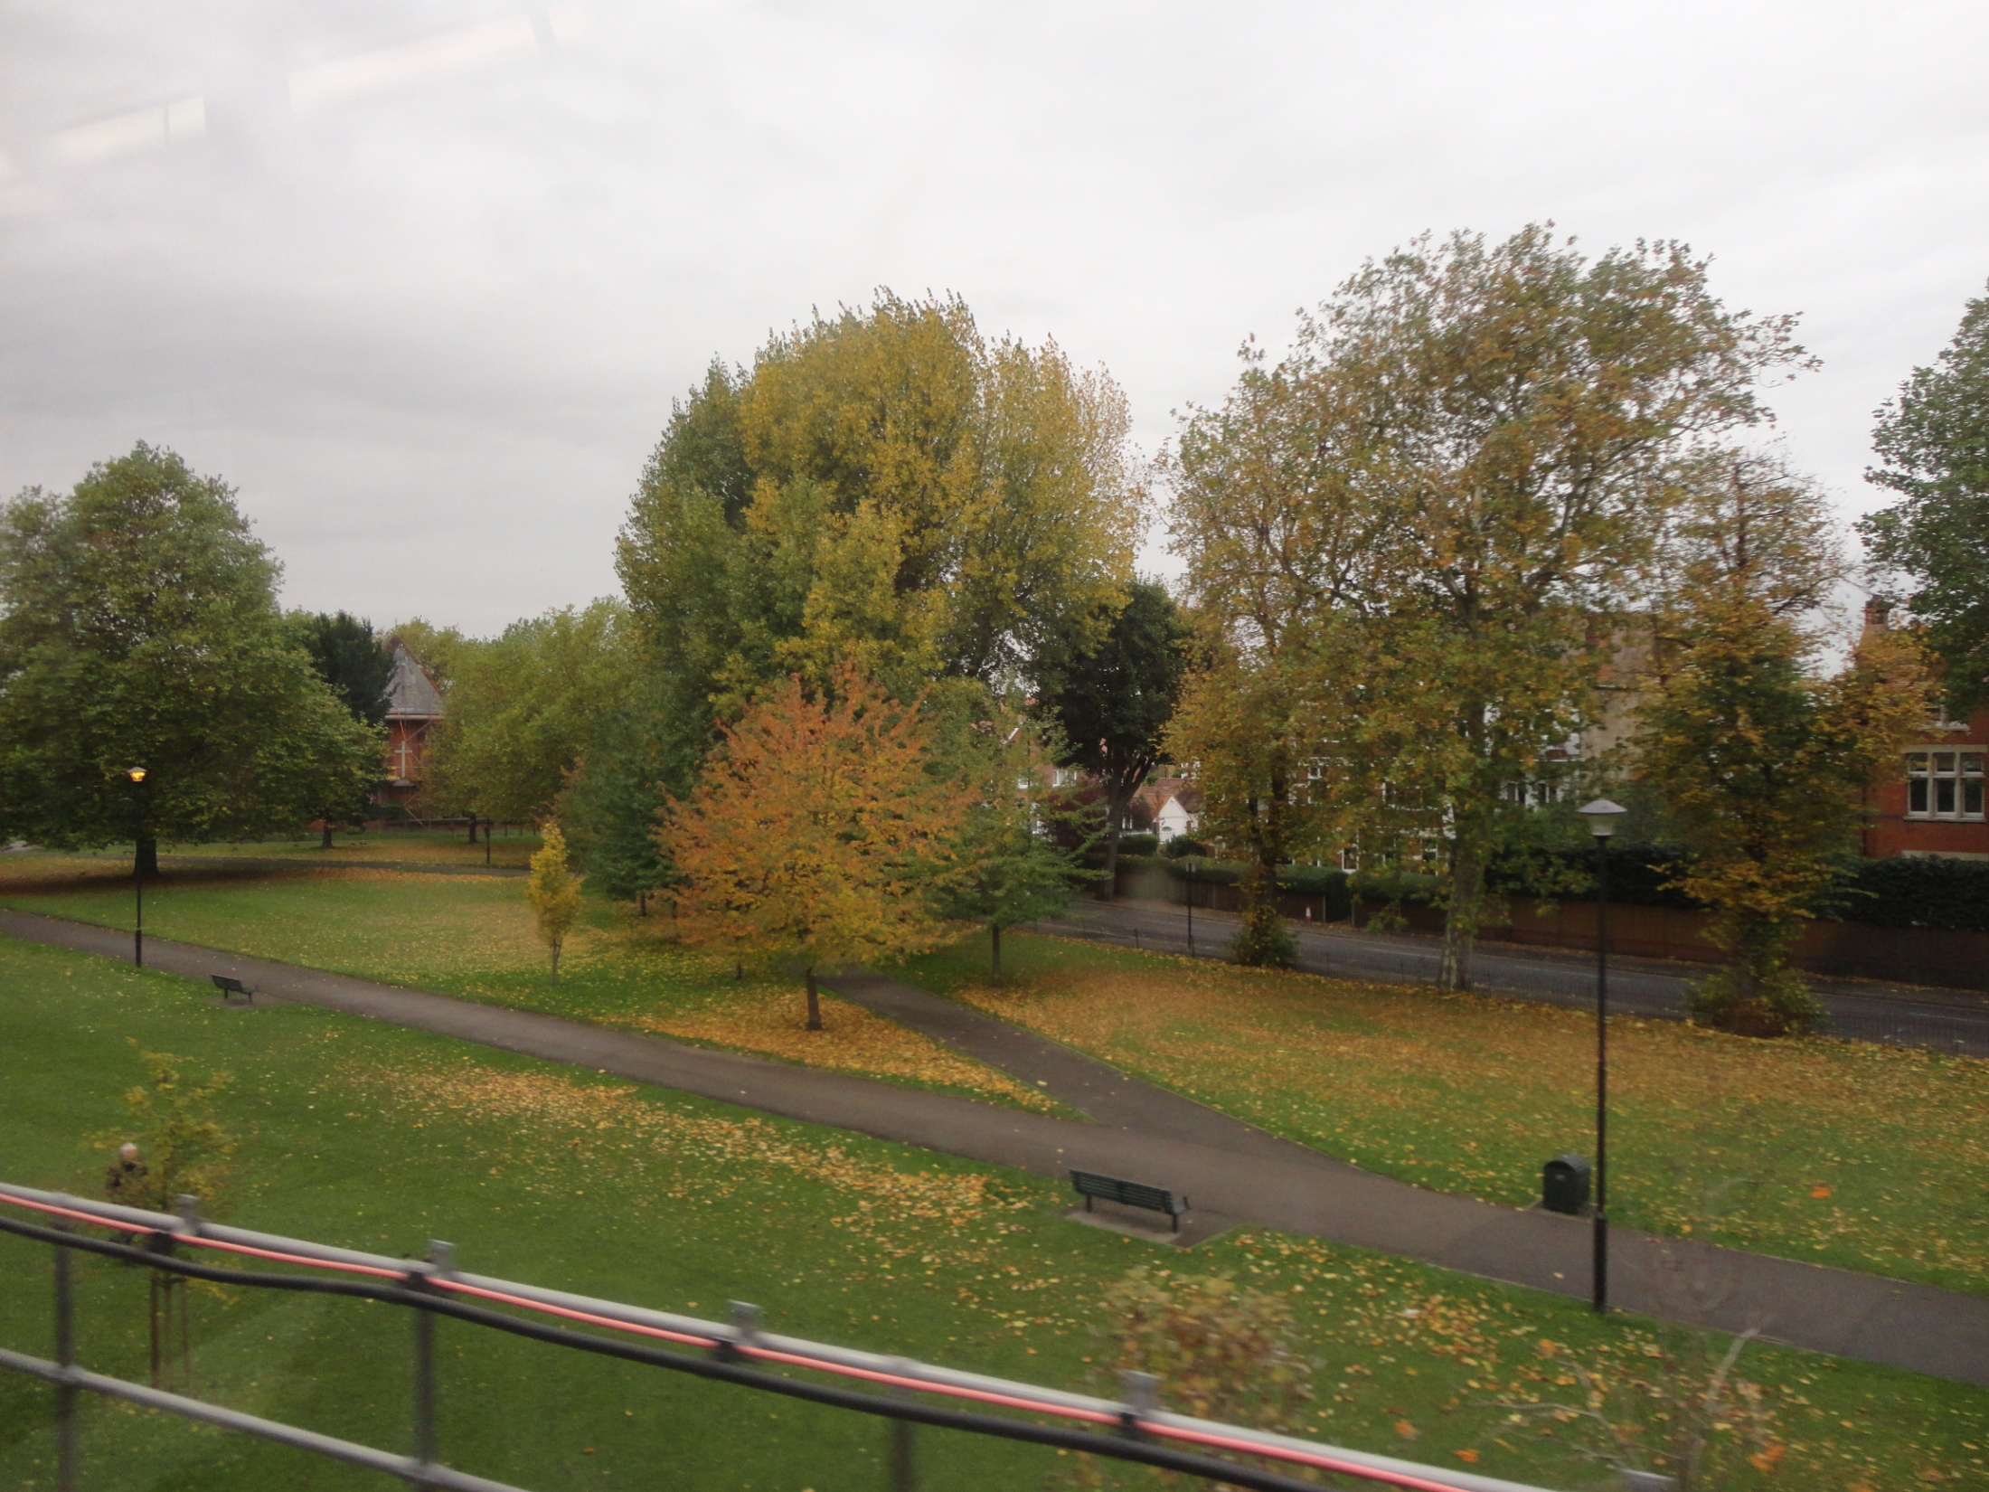
Dr. Aiman Qais Afar

