Slide 1
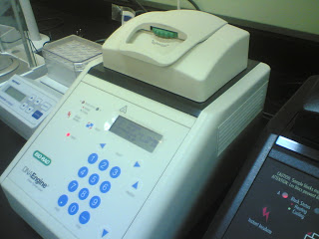
Polymerase chain reaction

Slide 2
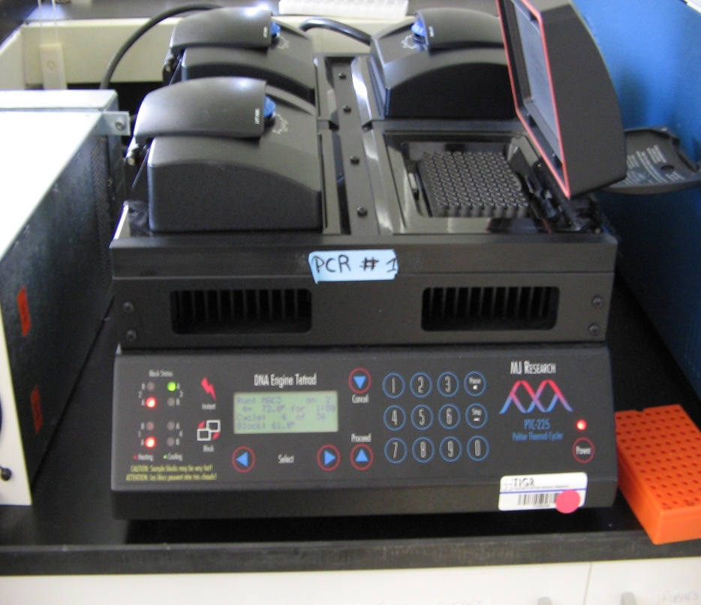
Contents:
- Polymerase chain reaction
- Reaction components
- Steps involved
- Factors for optimal PCR
- PCR applications
- PCR modifications
- Advantages
- PCR limitations

Slide 3
PCR is an exponentially progressing synthesis to generate
large quantities of the defined target DNA sequences in vitro.
It was invented in 1983 by Dr. Kary Mullis, for which he
received the Nobel Prize in Chemistry in 1993.
It is called “polymerase” because the only enzyme used in
this reaction is DNA polymerase.
It is called “chain” because the products of the first reaction
become substrates of the following one, and so on.
PCR targets and amplifies a specific region of a DNA strand.
Often, only a small amount of DNA is available e.g. A drop
of blood, single hair, vaginal swab, seminal drop, etc.
-Two methods currently exist for amplifying the DNA or
making copies
Cloning: takes a long time for enough clones to reach
maturity
- PCR: works on even a single molecule quickly

Slide 4
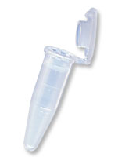
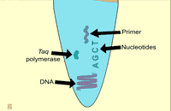
The “Reaction” components
1- Target DNA - contains the sequence to
be amplified.
2- Pair of primers - oligonucleotides that
define the sequence to be amplified.
3- Thermostable DNA polymerase –
enzyme that catalyses the reaction
4- dNTPs - deoxynucleotidetriphosphates:
DNA building blocks.
5- Buffer solution – maintains pH and
ionic strength of the reaction solution
suitable for the activity of the enzyme
6- Mg²⁺ as a cofactor of the enzyme

Slide 5
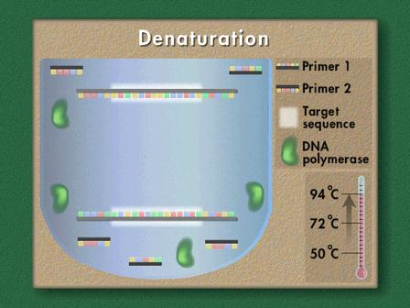
Steps involved:
1- Denaturation:
The reaction mixture is heated to a temperature between 90-
98° C so that the ds DNA is denatured into single strands by
disrupting the hydrogen bonds between complementary
bases.
- Duration of this step is 1-2 min

Slide 6
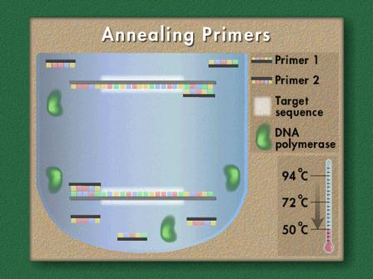
2- Annealing:
- Temperature of reaction mixture is cooled to 45-60° C
Primers are jiggling around and base pair with the
sequence in the DNA.
- Hydrogen bonds reform.
Annealing fancy word for renaturing.

Slide 7
3- Extension:
The temperature is now shifted to 72° C which is ideal for
polymerase.
Primers are extended by joining the bases complementary to
DNA strands.
Elongation step continues where
the polymerase adds dNTP's from
5' to 3', reading the template from
3' to 5' side, bases are added
complementary to the template.
Now first cycle is over and next
cycle is continued ,as PCR machine
is automated thermocycler the same
cycle is repeated up to 30-40 times.

Slide 8
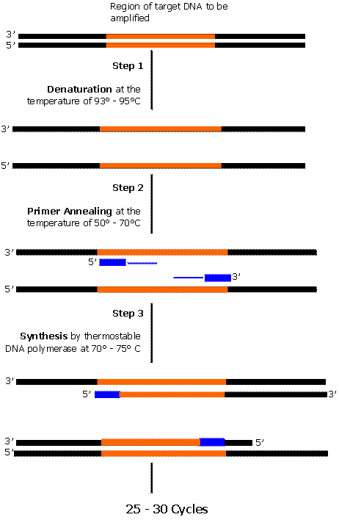
Amplification by PCR

Slide 9
Each cycle includes three successive steps:
Denaturation | 94ºC 1-2 minute | The DNA is denatured into single strands.
Annealing | 34-72ºC 30 sec-two minute | The primers hybridize or "anneal" to their complementary sequences on either side of the target sequence.
Extension | 72ºC 1.5-3 minute | The polymerase binds and extends a complementary DNA strand from each primer

Slide 11
Factors for optimal PCR:
1- PCR primers
Correctly designed pair of primers to avoid mispriming (sequence
should be unique)
- Primer dimer, hairpin formation should be prevented
- Tm, not more than 60 degree (use the proper annealing temperature).
GC Content should be in the range of 40-60 % for optimum PCR
efficiency.
Primers should end (3′) in a G or C, or CG or GC: to increase
efficiency of priming.
Primers should flank the sequence of interest
Primers that match multiple sequences will give multiple products
There should be no PolyG or PolyC stretches that can promote non-
specific annealing

Slide 12
Use hot-start: prepare reaction mixes on ice, place in preheated cycler
or use a sequestered enzyme that requires an initial heat activation.
2- DNA polymerase
- Thermus aquaticus, its optimum temperature is 72° C
- Taq polymerase is heat resistant
- It lacks proof reading exonuclease activity
3- Annealing temperature
Very important since the success and specificity of PCR depend on it
because DNA-DNA hybridization is a temperature dependent process.
If annealing temperature is too high, pairing between primer and
template DNA will not take place then PCR will fail.
Ideal Annealing temperature must be low enough to enable
hybridization between primer and template but high enough to prevent
amplification of non target sites.
Should be usually 1-2° C or 5° C lower than melting temperature of the
template-primer duplex

Slide 13
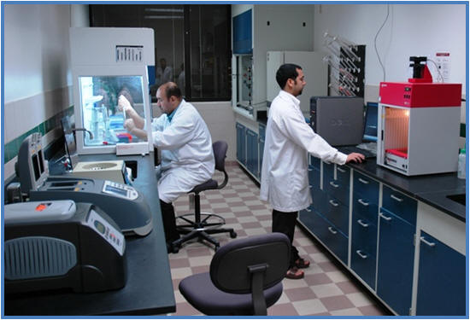
4- Melting temperature
Temperature at which 2 strands of the duplex dissociate.
- It can be determined experimentally or calculated from formula
Tm = [4(G+C) + 2(A+T)]
5- Contamination Control
The most dangerous contaminant is PCR product from a previous
reaction.
Prevent exposure of pre-PCR reagents and materials to post-PCR
contaminants.
- Most common cause is carelessness and bad technique.
- Separate pre- and post-PCR facilities.
- Dedicated pipettes and reagents.
Change gloves.
- Aerosol barrier pipette tips.
- 10% bleach, acid baths, UV light
Dilute extracted DNA.

Slide 14
PCR applications:
- Clinical diagnosis for disease detection
- DNA typing and mapping
Cloning
Comparative study of genomics
- Mutation analysis
- Detection of gene expression
- Site-directed mutagenesis
- Sequencing
Forensic medicine
In forensic testing: By amplification of DNA from a dried blood spot or one hair follicle to trace the accused person for a crime.

Slide 15
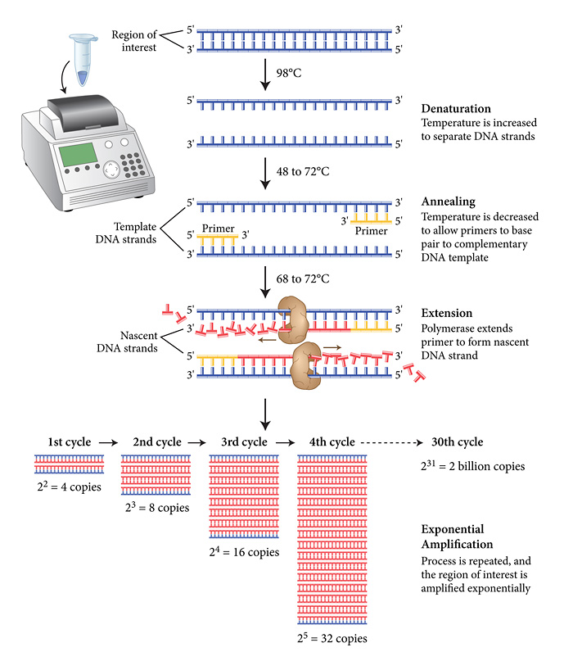

Slide 16
1- Infectious Diseases
- Detection of infectious agents, as pathogenic bacteria and viruses
2- Cancer
Detection of malignant diseases by PCR, recurrence of
hematological cancers has also been evaluated and detection
of micro-metastasis in blood, lymph nodes and bone marrow.
3- Genetic Disease
Single point mutations can be detected by modified PCR
techniques such as the ligase chain reaction (LCR) and PCR-
single-strand conformational polymorphisms (PCR-SSCP)
analysis.
Detection of variation and mutation in genes using primers
containing sequences that were not completely
complementary to the template.

Slide 17
Prenatal diagnosis
- Prenatal sexing:
Often required in families with inherited sex-linked diseases.
Prenatal Diagnosis of diseases of many of the inborn errors
of metabolism is possible by DNA markers.
Research
PCR is used in research laboratories in DNA cloning
procedures,
Southern blotting, DNA sequencing, recombinant DNA
technology.
- Major role in the human genome project.

Slide 18
II.DNA fingerprinting (DNA typing):
-DNA fingerprint consists of first obtaining a sample of cells, such as skin, hair, or blood cells, which contain DNA.
-The DNA is extracted from the cells and purified, amplification of the target DNA including the repetitive sequences by using PCR. The DNA was then cut at specific points along the strand with restriction enzymes. The enzymes produced fragments of varying lengths that were subjected to gel electrophoresis, the shorter the fragment, the more quickly it moved toward the positive pole (anode). The separated fragments are then transferred to a nitrocellulose or nylon filter; this procedure is called a Southern blot.
-The fragments underwent autoradiography in which they were exposed to DNA probes—pieces of synthetic DNA that were made radioactive and that bound to the minisatellites. This technique is used in forensic medicine to determine the parents of an individual or suspect in a crime

Slide 19
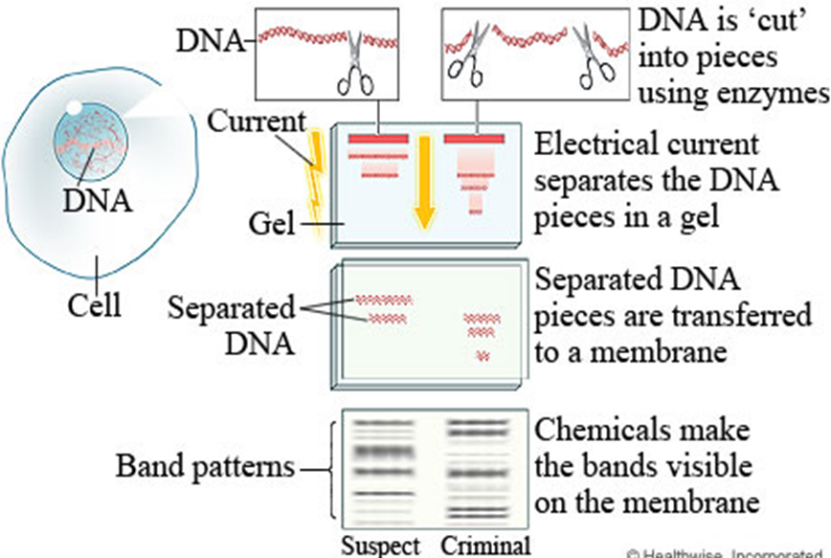

Slide 20
Gene therapy
- Gene therapy is an experimental technique that uses genes to treat or prevent disease. The goal of gene therapy is to insert the normal, cloned DNA for a gene into the somatic cells of a patient who has a defect in that gene as a result of some disease-causing mutation.
- The DNA must become permanently integrated into the patient’s chromosomes in such a way as to be properly expressed to produce the correct protein. For example, patients with severe combined immunodeficiency disease (SCID) have an immune deficiency as a result of mutations in the gene for adenosine deaminase. Patients with SCID have been successfully treated by incorporating functional copies of the appropriate gene into their cells /[Note: This is often called “gene replacement therapy.”]
- Although gene therapy is an attractive therapeutic strategy for individuals with inherited diseases, but it has some limitation and drawbacks, e.g. some of the treated SCID patients developed leukemias due to activation of oncogenes.
-

Slide 21
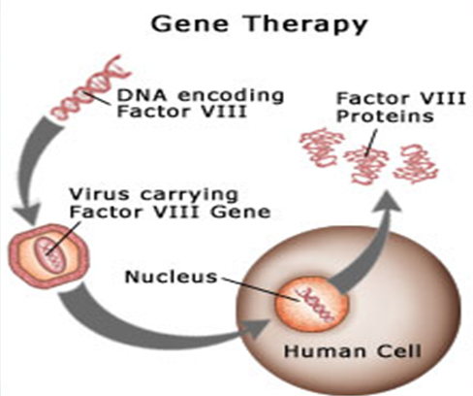

Slide 22
PCR modifications
- Nested PCR - Multiplex PCR
- Sequence-specific PCR - Reverse-transcriptase PCR
- Long-range PCR - Whole-genome amplification
- Quantitative real-time PCR
Arbitrarily Primed PCR/Random Primer PCR [RAPD PCR (AP-PCR)].
PCR Advantages
- Specific, sensitive and flexible
- Simple, rapid, relatively inexpensive
- Amplifies from low quantities
- Works on damaged DNA
PCR Limitations
- Contamination risk
- Primer complexities and primer-binding site complexities
- Amplifies rare species
- Detection methods

