Slide 1
Hemoglobinopathies
Done by :
Jude Alshawabkeh
Areen Algharaibeh
Lana Alhusban Seeveen Hanieh
Supervised by :
Dr.abdalhadi

Slide 2
CONTENTS
Genetics of hemoglobin
Sickle cell disease
Thalassemia

Slide 3
GENETICS OF HEMOGLOBIN
The Hemoglobin molecule is a heme – protein complex of two pairs of similar polypeptide chains
Different Hb are produced during life:
Embryonic hemoglobins:
Portland (ζ2γ2)
Gower I (ζ2ε2) Gower II (α2ε2)
Fetal hemoglobin (α2γ2) , major oxygen carrier in fetal life, accounts for less than 2% of normal adult
hemoglobin and falls to this level by the age of 6–12 months
normally are not found after the first trimester of pregnancy

Slide 4
v Adult hemoglobins:
Hemoglobin A=α₂β₂. This is the major adult type (HbA₁), comprising 95% of the total hemoglobin Hemoglobin A₂=α₂δ₂. This type accounts for less than 3.5% of the total hemoglobin. Synthesis of δ
chains is low at all times.
>> NOTE :
* HbF has a higher affinity for oxygen than HbA , facilitating oxygen transfer from the maternal to the fetal circulation
Synthesis of the different hemoglobin chains is directed by different genes, at least one for each chain
type. The α-gene complex and β-gene complexes are located in Chromosomes 16 and 11 ,respectively.

Slide 5
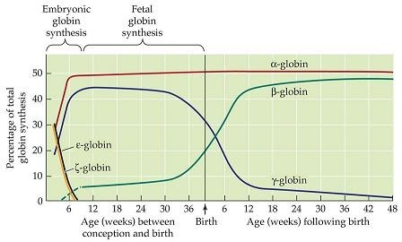

Slide 6
Hemoglobinopathies
The hemoglobinopathies are inherited*disorders of hemoglobin synthesis (Thalassemia ) or structural ( sickle cell )
•The α-globin hemoglobinopathies are symptomatic in utero and after birth because the normal function of the α-globin gene is required throughout gestation and adult life.
β-globin hemoglobinopathies tend to be asymptomatic until 3 to 9 months of age, when HbA has largely replaced HbF.

Slide 7
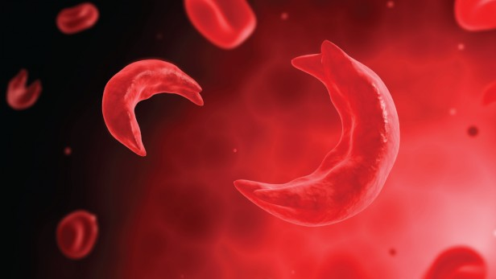
Sickle Cell Disease

Slide 8
Definition
Sickle cell disease:
A group of inherited red blood cells disorder that affect hemoglobin, which lead to sickle like shape RBCs under certain circumstances
Sickle cell anemia
The most severe clinical presentation of sickle cell disease
Genotypes include homozygous HBSS and compound heterozygousHbSβ⁰thal (a form of sickle beta thalassemia).
Sickle cell trait
Refers to sickle cell carrier genotype HBAS
Not considered a form of sickle cell disease
complications occur rarely

Slide 9
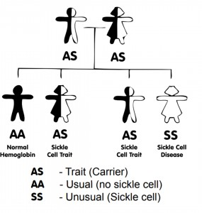
SCD Genotype
□ Autosomal recessive disease
Point mutation in beta globin gene at 6th codon on chromosome 11
Glutamic acid (GAG) replaced with valine (GTG) “single amino acid substitution”
people who inherit
just one abnormal gene are known as a carrier
( Sickle cell trait )

Slide 10
SCD Genotype
Sickle cell anemia (HbSS), homozygous HbSS, occurs when both β-globin alleles have the sickle cell mutation (βs) , In sickle cell anemia, HbS is commonly as high as 90% of the total hemoglobin (65%
)
Sickle cell disease heterozygotes Hb where one β-globin allele includes the sickle cell mutation and the second β-globin allele includes a gene mutation other than the sickle cell mutation, such as HbC, β-thalassemia, HbD, and HbOArab , HbS is >50% of all hemoglobin.
Hemoglobin C: Glutamic acid replaced with lysine
HeteroZygosity for hemoglobin S and hemoglobin C cause (hemoglobin SC disease) phenotype more severe than sickle cell trait, but not as severe as sickle cell disease

Slide 11
Epidemiology
WHO estimate that at least 5% of adult are carriers for hemoglobinopathies ( 2.9 % for thalassemia
/ 2.3 % for SCD )
Sickle cell disease more in African- American population and eastern Mediterranean
Sickle cell anemia is the most common form of intrinsic hemolytic anemia worldwide .

Slide 12
Extravascular hemolysis and intravascular hemolysis are common and result in anemia The body increase the production of fetal hemoglobin (HbF) to compensate for low HbA

Slide 13
Screening
newborn screening program for sickle cell disease :
programs identify newborns with the disease and provide prompt diagnosis and referral to providers with expertise in sickle cell disease for anticipatory guidance and the initiation of penicillin before 4 mo of age
The most commonly used procedures for newborn diagnosis include:
thin layer/isoelectric focusing
high-performance liquid chromatography (HPLC)
Gel electrophoresis
A confirmatory step is recommended, with all patients who have initial abnormal screens being retested during the first clinical visit and after 6 mo of age to determine the final hemoglobin phenotype.

Slide 14
Diagnosis
Qualitative analysis
Modalities
Hemoglobin electrophoresis
Isoelectric focusing
Findings
No sickle cell trait/disease: hemoglobin A and F only
Sickle cell trait/disease: Hemoglobin S is also present.
Additional hemoglobin types may also be found in heterozygous sickle cell disease, e.g.: Hemoglobin C in hemoglobin SC disease
Hemoglobin D in hemoglobin SD Hemoglobin E in hemoglobin SE
On hemoglobin electrophoresis, HbA migrates the fastest (the greatest distance) towards the anode, followed by HbF, HbS, and HbC (i.e., HbA > HbF > HbS > HbC).

Slide 15
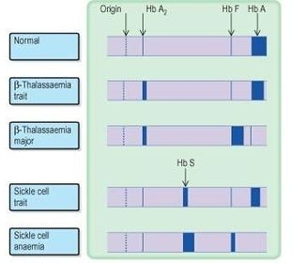
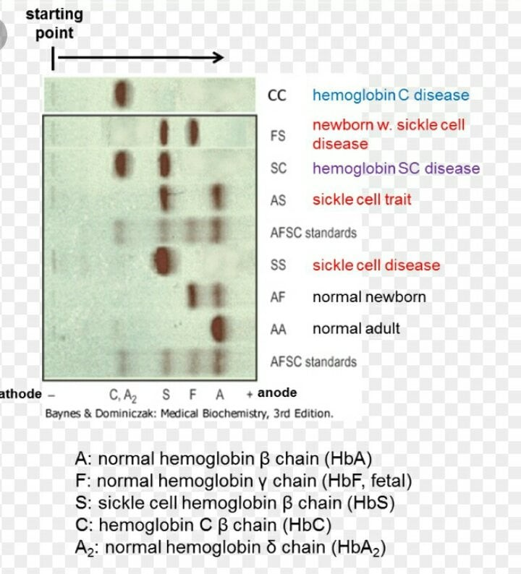

Slide 16
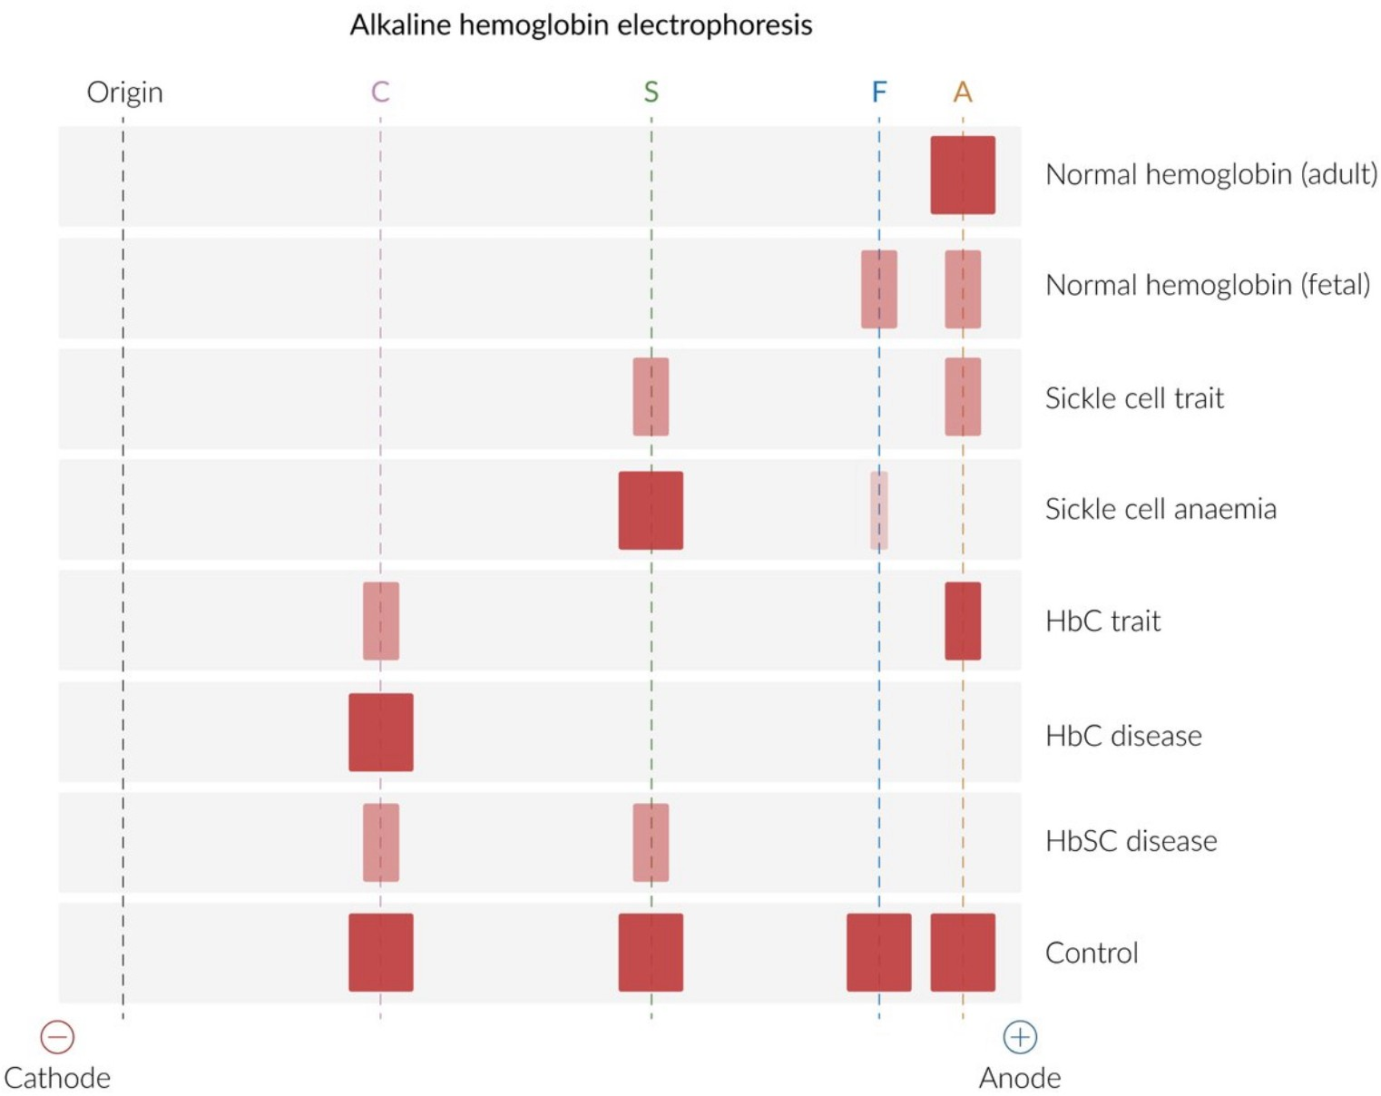

Slide 17
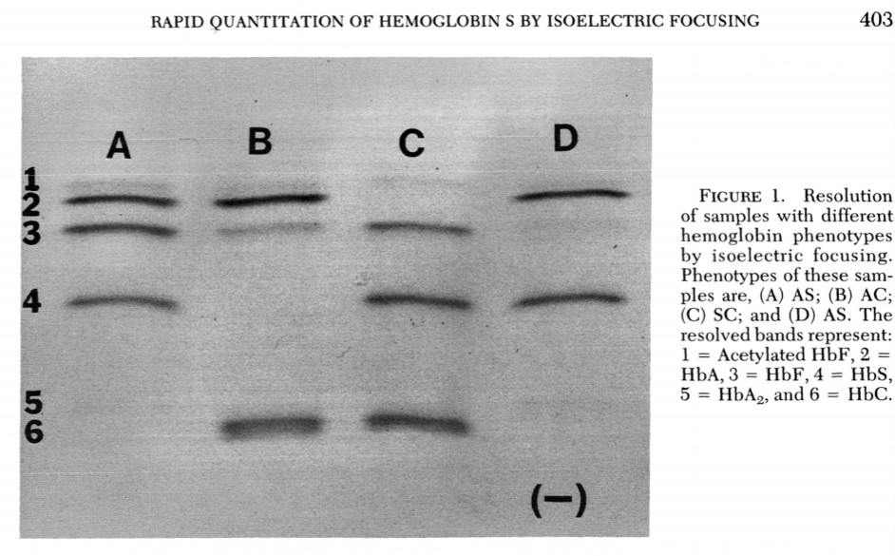
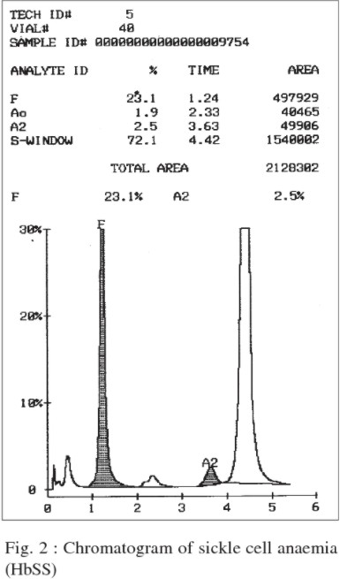

Slide 18
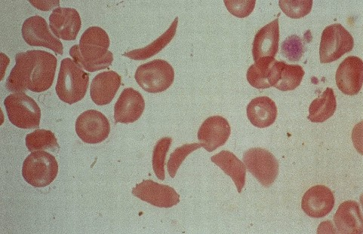
Quantitative analysis Modalities
High performance liquid chromatography Capillary electrophoresis
Laboratory studies
CBC
Mild-to-severe anemia with reticulocytosis
Peripheral blood smear findings may include:
Crescent-shaped sickled RBCs
Target cells
Howell-Jolly bodies: occur with splenic dysfunction
Reticulocytosis: indicates the presence of hemolysis

Slide 19
Clinical Manifestation
.
''Hemolysis and Vaso-occlusion ''
Chronic Manifestations:
Acute Manifestations:
•Bacterial Sepsis or meningitis*
•Recurrent vaso-occlusive pain (dactylitis, muscoskeletal or abdominal pain)
•Splenic Sequestration*
•Aplastic Crisis*
•Acute Chest Syndrome*
•Stroke*
•Priapism
•Hematuria, including papillary necrosis
•Anemia
•Jaundice
•Splenomegaly
•Functional asplenia
•Cardiomegaly and functional murmurs
•Hyposthenuria and enuresis
•Proteinemia
•Cholelithiasis
•Delayed growth and sexual maturation
•Restrictive lung disease*
•Pulmonary Hypertension*
•Avascular necrosis
•Proliferative retinopathy
•Leg ulcers
•Transfusional hemosiderosis*

Slide 20
Clinical Manifestation / Fever and Bacteremia
A child with Sickle cell anemia is vulnerable to life-threatening infection by 4 months of age.
By that time, splenic dysfunction is caused by sickling of the RBCs within the spleen (autosplenicetomy of functional asplenia)
□ resulting in an inability to filter microorganisms from the bloodstream in most patients ,Splenic dysfunction is followed, eventually, by splenic infarction, usually by 2 to 4 years of age.
The loss of normal splenic function makes the patient susceptible to overwhelming infection by
encapsulated organisms, especially S. Pneumoniae, H.influenzae type b, and N.meningitidis
The hallmark of infection is fever, A febrile patient with a sickle cell syndrome (temperature
>38.5°C) must be evaluated immediately

Slide 21
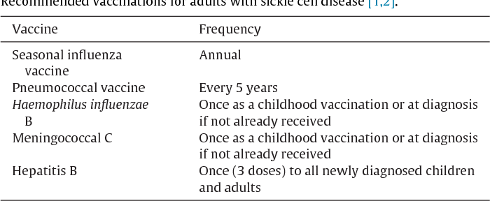
Management
Current precautions to prevent infections include
Prophylactic daily oral penicillin begun at diagnosis until age 5years old (if penicillin allergy we give erythromycin)
Vaccinations against pneumococcus, Haemophilus influenzae type b, hepatitis B virus, and influenza virus.

Slide 22
Fever (≥ 38.5°C, ≥ 101.3°F) in sickle cell disease may be due to vasoocclusive crisis,
life-threatening complications (e.g., acute chest syndrome), or infection (which can rapidly progress to septicemia) and requires urgent management.
v These strategies range from hospital admission for intravenous (IV) antimicrobial therapy to administering a third-generation cephalosporin in an ED
or outpatient setting to patients without established risk factors for occult bacteremia
q NOTE :
Observation after antibiotic administration is important as children who have sickle cell anemia treated with ceftriaxone can develop severe, rapid, and life-threatening immune hemolysis.

Slide 23
Admission in Febrile Children
Hypotension: systolic blood pressure <70 mm Hg at 1 yr of age or <70 mm Hg + 2
× the age in yr for older children
Poor perfusion: capillary-refill time >4 sec
•Temperature >40.0°C (104°F)
A corrected white-cell count >30,000/mm3 or <5000/mm3**
Platelet count <100,000/mm3
History of pneumococcal sepsis
Severe pain
Dehydration *
Hemoglobin level <5.0 g/dL

Slide 24
□ In the event that Salmonella spp. or Staphylococcus aureus bacteremia
occurs, strong consideration should be given to an evaluation for
Osteomyelitis with a bone scan
□.
Screening laboratory and radiologic studies are strongly recommended to identify those at risk for transient red cell aplasia,
acute splenic sequestration,and acute chest syndrome (ACS),
because many children with these diagnoses present to acute care settings with isolated fever.

Slide 25
Clinical Manifestation / Anemia
The anemia of hemoglobin SS disease is usually Chronic, Moderately Severe, Hemolytic Anemia ,
that is not routinely transfusion dependent.
.
The severity depends in part on the patient’s phenotype.
Manifestations of chronic anemia include jaundice, pallor, variable splenomegaly in infancy, a cardiac flow murmur, and delayed growth and sexual maturation.
**Decisions about transfusion should be made on the basis of the patient’s clinical condition, the hemoglobin level, and the reticulocyte count.

Slide 26
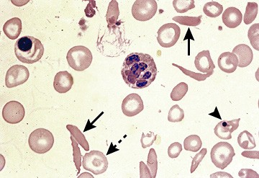
Acute anemia in sickle cell disease
□ defined as a drop in Hb of ≥ 2.0 g/dL from baseline, or a hemoglobin value < 6 g/dL (if baseline is unknown).
□ Possible etiologies of acute anemia include: aplastic crisis, splenic sequestration,
acute chest syndrome,
delayed hemolytic transfusion reaction, infection, sepsis,
and acute blood loss (not necessarily linked to sickle cell disease).

Slide 27
Clinical Manifestation / crisis
Aplastic crisis parvovirus B19 infects RBC precursors in the bone marrow and induces transient RBC aplasia with reticulocytopenia and a rapid worsening of anemia because of the very short life span of sickle RBCs.
SO,
fever, and reticulocytopenia should be considered to have parvovirus B19 UPO infection with parvovirus B19 is associated with : pain, splenic sequestration, acute chest syndrome (ACS), glomerulonephritis, and stroke

Slide 28
Clinical Manifestation / crisis
Splenic sequestration crisis is a life-threatening! , hyperacute drop in the hemoglobin level (blood volume) secondary to splenic pooling of the patient’s RBCs and sickling within the spleen.
✔ Sequestration can occur as early as 5 wk of age, but most often occurs in children between the ages of 6 mo and 2 yr
** Sequestration may be triggered by Fever, bacteremia, or viral infections.

Slide 29
Clinical manifestation of Splenic sequestration crisis
•Rapid spleen enlargement
•Left-sided abdominal pain
•Decline in hemoglobin of at least 2 g/dl from the patient’s baseline.
•Signs of hypovolemia
•Profound anemia, with total hemoglobin falling below 3 g/dl, has been reported.
Reticulocytosis and a decrease in the platelet count may also be present.
Simple transfusion therapy is indicated for sequestration and aplastic crises when the anemia is symptomatic (avoid raising hb >8)
Recarrence occurring in 2/3 of patients, within 6 mo of the previous episode.
.
Prophylactic splenectomy performed after an acute episode has resolved is the only effective strategy for preventing future life-threatening episodes

Slide 30
Clinical Manifestation / Vaso-occlusive events
Vaso-occlusive painful events , unremitting discomfort that can occur in any part of the body but most often occurs in the chest, abdomen, or extremities. patient with sickle cell anemia has approximately 1 painful episode per year that requires medical attention
The cardinal clinical feature of sickle cell anemia is acute vaso-occlusive pain.
Trigger
physical stress /infection/ Dehydration/hypoxia /local or systemic acidosis / exposure to cold, and swimming for prolonged periods

Slide 31
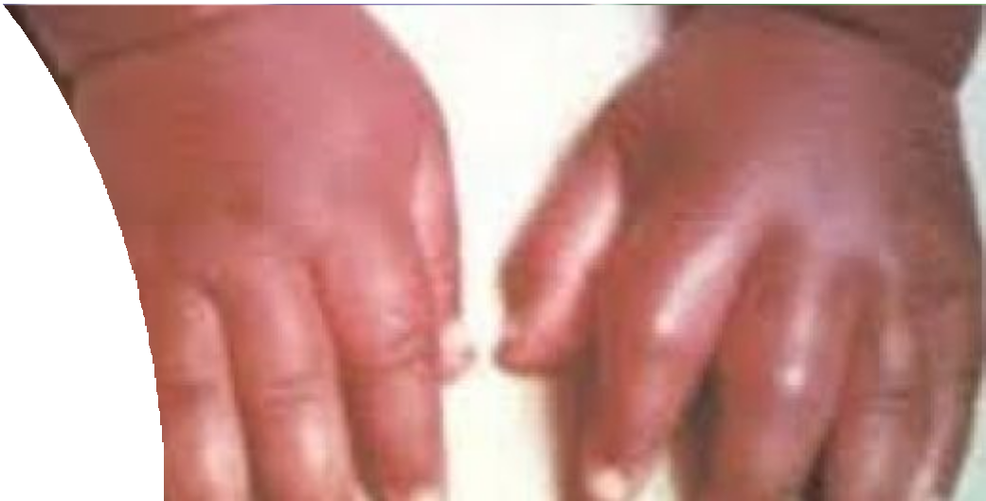
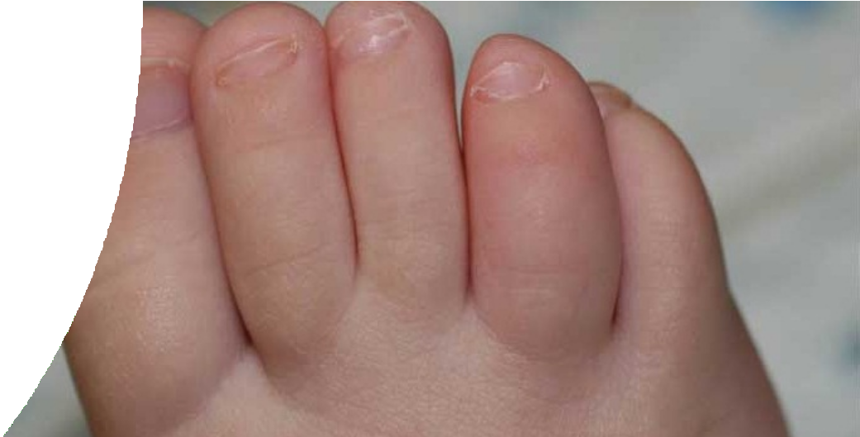
Clinical Manifestation
/ Vaso-occlusive events
Dactylitis, referred to as hand-foot syndrome, painful swelling of hand and feet
( infarction of metacarpal / metatarsal bones )
Is often the first manifestation
of pain in infants and young children , occurring in 50% of children by their 2nd yr of life ( 6month – 2 y)

Slide 32
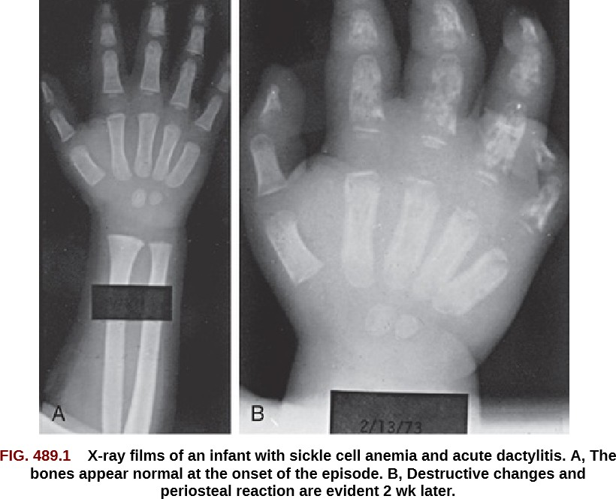

Slide 33
•Skeletal pain (bone or bone marrow infarction) with or without fever must be Differentiated From
Osteomyelitis.
Both Salmonella spp. and S. aureus cause osteomyelitis in children with sickle cell anemia, which is often in the diaphysis of long bones (in contrast to children without sickle cell anemia where osteomyelitis is in the metaphyseal region of the bone).
•Imaging studies, which must include MRI with contrast, are helpful in distinguishing osteomyelitis from bone or marrow infarction

Slide 34
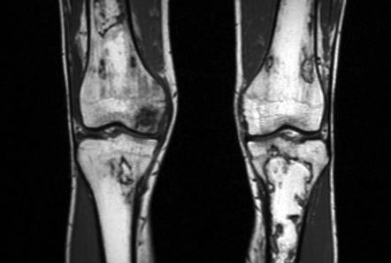
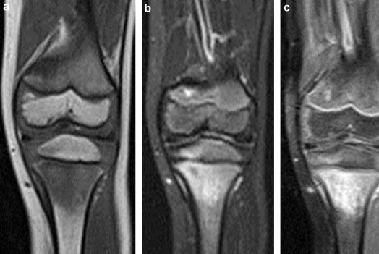
Osteonecrosis
Osteomyelitis

Slide 35
Management of painful crisis in sickle cell
Address modifiable causes of erythrocyte sickling (e.g., dehydration, hypoxia).
Ensure adequate hydration. Administer supplemental oxygen.
•Specific therapy for pain varies greatly but generally includes the use of acetaminophen or NSAIDs agent early in the course of pain, followed by a combination analgesic such as hydrocodone, or to a single agent short- or long-acting oral opioid.

Slide 36
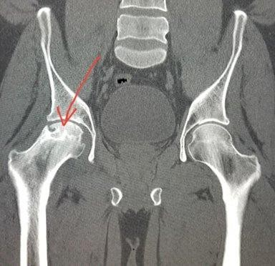
Clinical Manifestation / Vaso-occlusive events Avascular Necrosis
Most commonly, the femoral head is affected and AVN. Unfortunately, the AVN of the hip may cause limp and leg-length discrepancy.
•Other sites affected include the humeral head and mandible.
Risk factors for AVN include HbSS disease with α-thalassemia trait, frequent vaso-occlusive episodes, and elevated hematocrit (for patients with sickle cell anemia).
Regular blood transfusion therapy has NOT been demonstrated as an effective therapy to abate the acute and chronic pain associated AVN

Slide 37
Priapism
is defined as an unwanted painful erection of the penis and most commonly affects males with sickle cell anemia.
The mean age of first episode is 15 yr.
•Priapism occurs in 2 patterns: prolonged, lasting more than 4 hr, or stuttering, with brief episodes that resolve spontaneously but may occur in clusters and herald a prolonged event.
•Priapism in sickle cell disease represents a low flow state caused by venous stasis from sickling of red
blood cells in the corpora cavernosa.
Risk from Impotence.
The optimal treatment for acute priapism :
supportive therapy, such as :a hot shower, short aerobic exercise, or pain medication, is commonly used by patients at home.
prolonged episode lasting >4 hr should be treated by aspiration of blood from the corpora
cavernosa followed by irrigation with dilute epinephrine to produce immediate and sustained detumescence.

Slide 38
Prognosis
Survival correlates with the Frequency of vaso-occlusive crisis ; More frequent crisis are associated with a shorter life span
If there are more than three crises per year , the median age of death is 35 years , Patient with fewer
crises per year may live into their 50s
In general , sickle cell disease reduce life expectancy by 25 –30 years

Slide 39
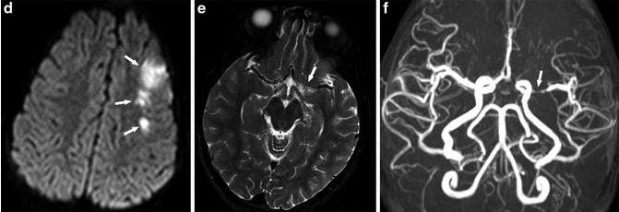
Neurologic Complications
are varied and complex, ranging from acute ischemic stroke with focal neurologic deficit to clinically silent abnormali ties found on radiologic imaging.
Overt stroke occurs in approximately 8% to 10% of patients with SS disease. These events may present as the sudden onset of an altered state of consciousness, seizures, or focal paralysis
. Silent stroke, which is defined as evidence of cerebral infarction on imaging studies but a normal neurologic exami nation, is more common and occurs in approximately 20% of patients with SS disease A significant change in sc hool performance or behavior has been associated with silent stroke.).

Slide 40
Note : Children with Hg SS disease over 3 years of age should be screened for increased risk of
stroke using transcranial Doppler (TCD.

Slide 41
The primary approach for prevention of recurrent overt stroke is blood transfusion therapy aimed at keeping the maximum HbS concentration <30%.
Other : headaches, seizures, cerebral venous thrombosis and reversible posterior leukoencephalopathy syndrome, also referred to as posterior reversible encephalopathy syndrome (PRES).
How to mange if the patient present to you with stroke? oxygen administration to keep oxygen saturations >96%
simple blood transfusion within 1 hr of presentation with a goal of the hemoglobin to a maximum of 10 g/dL is warranted.
increasing
Exchange transfusion at the time of acute stroke is associated with a decreased risk of second stroke when compared to simple transfusion alone.
Computed tomography (CT

Slide 42
Pulmonary Complications
second most common reason for hospital admission and is associated with significant mortality.
Acute chest syndrome refers to a life-threatening pulmonary
complication of sickle cell disease defined as a new radio density on chest radiography plus any 2 of the following:
fever.
respiratory distress. hypoxia.
cough, or chest pain .

Slide 43
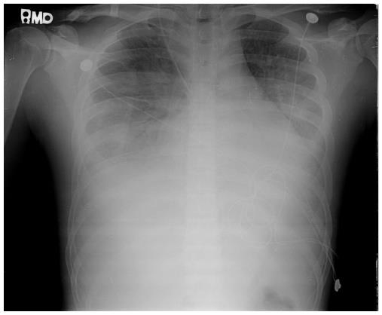
The radiographic findings in ACS are : 1.single lobe involvement, predominantly
left lower lobe;
multiple lobes, most often both lower lobes
and pleural effusions, either unilateral or bilateral.
ACS may progress rapidly from a simple infiltrate to extensive infiltrates and a pleural effusion.

Slide 44
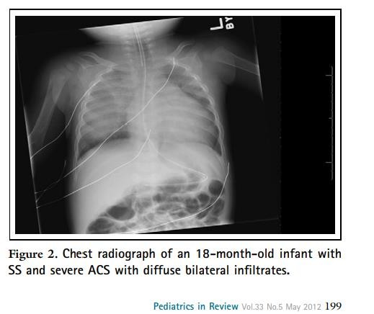

Slide 45
Etiology :
Infection is the most well-known etiology, yet only 30% of ACS episodes will have positive sputum or bronchoalveolar culture, and the most common pathogens are
S. pneumoniae, Mycoplasma pneumoniae, and Chlamydia sp
Fat emboli has also been implicated as a cause of ACS, arising from infarcted bone marrow
The most frequent event preceding ACS is a painful episode requiring systemic opioid treatment.
In patients with chest pain, regular use of an incentive spirometer at 10-12 breaths every 2 hr can significantly reduce the frequency of subsequent acute chest pain episodes

Slide 46
Strategies for the Management of Acute Chest Syndrome
DIAGNOSTIC TESTING AND LABORATORY MONITORING
Blood cultures
CBC every day and appropriate chemistries Continuous pulse oximetry
Chest radiographs
TREATMENT
-Blood transfusion (simple or exchange)
-Supplemental O2
- Empirical antibiotics (third-generation cephalosporin and macrolide)
-(incentive spirometry and chest physiotherapy as necessary)
-Optimum pain control and fluid management

Slide 47
What are the indication of blood transfusions in ACS ?
when at least 1 of the following clinical features are present: 1- decreasing oxygen saturation,
increasing work of breathing,
rapid change in respiratory effort either with or without a worsening chest radiograph,
4-a drop in hemoglobin of 2 g/dL below their baseline,
5-previous history of severe ACS requiring admission to the intensive care unit.

Slide 48
Renal Disease
Renal disease among patients with sickle cell disease is a major comorbid condition that can lead to premature death. Seven sickle cell disease
nephropathies have been identified:
gross hematuria,
papillary necrosis,
nephrotic syndrome,
renal infarction,
hyposthenuria,
pyelonephritis, and
renal medullary carcinoma.
presentation of these entities is varied but may include
hematuria,
proteinuria,
renal insufficiency,
concentrating defects,
hypertension.

Slide 49
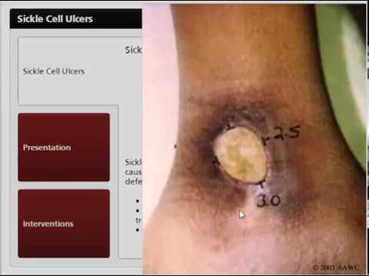
Cognitive and Psychological Complications
As with any child with a chronic illness, good health maintenance must include routine psychological and social assessment.
Other Complications :
retinopathy,
delayed onset of puberty,
leg ulcers.

Slide 50
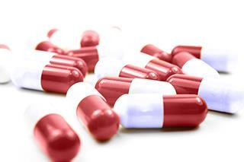
THERAPEUTIC CONSIDERATIONS
Hydroxyurea:
myelosuppressive agent, is the only drug proven effective in reducing the frequency of painful episodes.
decrease the rate of hospitalization for painful episodes by 50% and the rate of ACS and blood transfusion by almost 50%.
Hydroxyurea alone is inferior to transfusion therapy for secondary stroke prevention in patients who do not have contraindications to ongoing transfusions.

Slide 51
The typical starting dose :
15-20 mg/ kg given once daily, with an incremental dosage increase
every 8 wk of 5 mg/kg, and if no toxicities occur, up to a maximum of 35 mg/kg per dose
Achievement of the therapeutic effect of hydroxyurea can require several months.
Other effects of hydroxyurea that may vary include 1- increase in the total hemoglobin level
2-decrease in the TCD velocity.

Slide 52
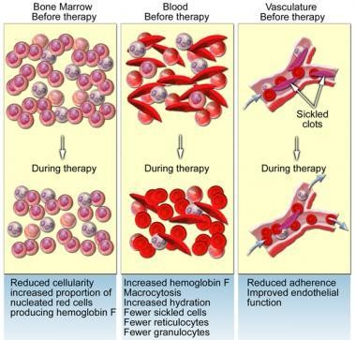
https://www.medscape.com/answers
/205926-15449/what-are-the-effects
-of-hydroxyurea-in-patients-with-sick le-cell-disease-scd

Slide 53
Hematopoietic Stem Cell Transplantation
The only cure for sickle cell anemia is transplantation with human leukocyte antigen (HLA)–matched hematopoietic stem cells from a sibling or unrelated donor.
indications :
recurrent ACS, stroke .
and abnormal TCD.

Slide 54
Red Blood Cell Transfusions
frequently used in the management of children with sickle cell anemia
, both in the treatment of acute complications such as
ACS,
aplastic crisis,
splenic sequestration, 4-acute stroke,
to prevent surgery-related ACS
first stroke in patients with abnormal TCD or MRI findings (silent stroke).

Slide 55
Red Blood Cell Transfusions methods
automated erythrocytapheresis,
manual exchange transfusion (phlebotomy of a set amount of patient’s blood followed by rapid
administration of donated packed red blood cells),
simple transfusion.

Slide 56
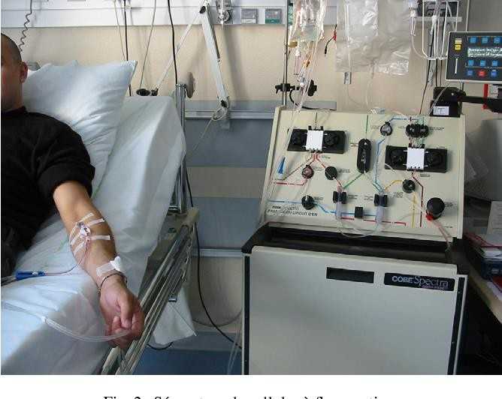
Automated erythrocytapheresis is the preferred method
for patients requiring chronic blood transfusion
therapy because there is a minimum net iron balance af
ter
the procedure, followed by manual exchange transfusio n.
Simple transfusion therapy is the least-preferable meth od for regular blood transfusion therapy because this strategy
results in the highest net-positive iron balance after the procedure.

Slide 57
Despite being the preferred method, erythrocytapheresis is least frequently performed because :
1- the requirement of technical expertise, 2- large venous access,
3-multiple units of matched red blood cells, 4- an available cytapheresis machine.
The primary toxic effect of blood transfusion therapy relates to excessive iron stores, which can result in organ damage and premature death. Developed after 10 transfusions.

Slide 58
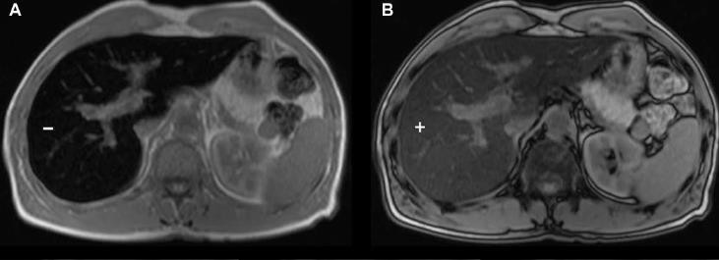
least-invasive method of estimating total-body iron involves serum ferritin levels.
MRI of the liver has proven to the most effective and common approach for assessment of
iron stores.
The imaging strategy is more accurate than serum ferritin in measuring heart and liver iron content.
primary treatment of excessive iron stores : iron chelation agents:
Deferoxamine …..SC , 5 of 7 nights/wk for 10 hr a night.
Deferasirox …..orally
Deferasirox ……orally twice per day

Slide 59
ANTICIPATORY GUIDANCE
Spleen Palpation
Prophylactic Penicillin :
oral penicillin VK until at least 5 yr of age (125 mg twice a day up to age 3 yr, and then 250 mg twice a day thereafter).
Immunizations:
annual administration of influenza vaccine pneumococcal and meningococcal vaccinations. 4-Transcranial Doppler Ultrasound
Hydroxyurea
Regular Blood Transfusion Therapy 7-Pulmonary and Asthma Screening
annual screening by an ophthalmologist
annual albumin : creatinine ratios 10-Echocardiography

Slide 60
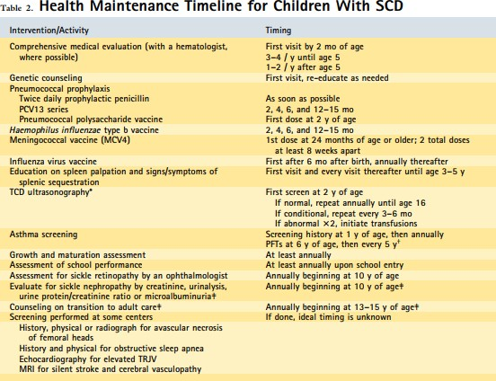

Slide 61
SickleCellTrait(HemoglobinAS)
By definition among individuals with sickle cell trait, the HbS level is <50%.
The life span of people with sickle cell trait is normal, and serious complications are extremely rare.
The CBC is within the normal range Hemoglobin analysis is diagnostic, revealing a
predominance of HbA, typically >50%, and HbS <50%.

Slide 62
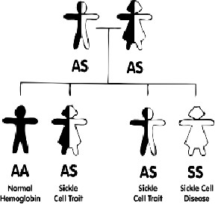
Complications Associated with Sickle Cell Trait
Renal medullary cancer Hematuria
Renal papillary necrosis Hyposthenuria
Splenic infarction Exertional rhabdomyolysis
Exercise-related sudden death
Protection against severe falciparum malaria Microalbuminuria (adults)

Slide 63
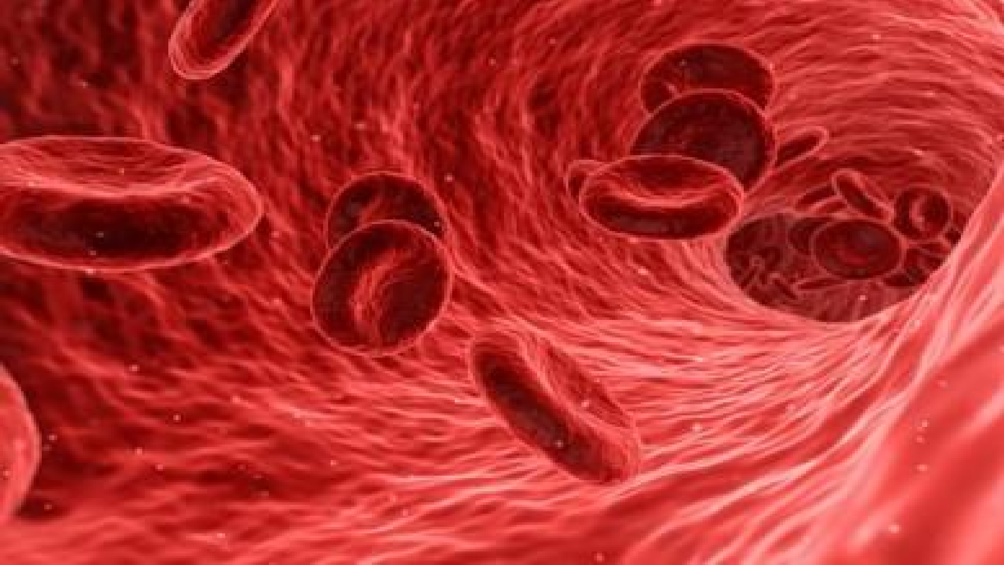
Thalassemia

Slide 64
Thalassemias : a group of hereditary hemoglobin disorders characterized by mutatis on the α- or β-globin chains (resulting in alpha or beta thalassemia)..
Thalassemias are the commonest genetic disorders in the world.
Beta thalassemia: most commonly seen in people of Mediterranean descent
Alpha thalassemia: most commonly seen in people of Asian and African descent
characterized by reduced or absent production of one of the globin chains, thus disrupting the delicate balance between the production of alpha and non-alpha (eg, gamma or beta) globin chains.

Slide 65
Etiology :
gene mutations
Beta thalassemia: usually due to point mutations in promoter sequences or splicing sites - short arm of chromosome 11
Alpha thalassemia: usually due to deletion of at least one out of the four existing alleles The α-globin gene cluster is located on chromosome 16
Inheritance pattern: autosomal recessive

Slide 66
β-Thalassemia syndromes
β-chain is coded by two alleles, resulting in two possible variants .
β0 -thalassemia
absence of production of the β-globin. When patients are homozygous for the β0 thalassemia gene, they cannot make any normal β-globin chains (HbA).
β+ thalassemia
indicates a mutation that makes decreased amounts of normal β-globin (HbA).
***The number of alleles affected is directly related to the severity of the disease (minor/intermedia/major) β0 -thalassemia syndromes are generally more severe than β+ -thalassemia syndromes, but there is significant variability between the genotype and phenotype.

Slide 67
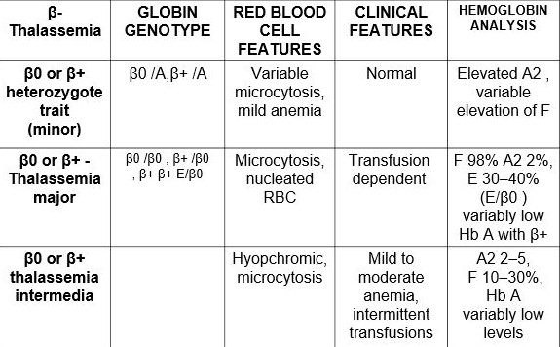
Types of β-Thalassemia

Slide 68
pathophysiology
in β thalassemia, the synthesis of normal α globin chains from the unaffected α globin genes continues as normal, resulting in the accumulation within the erythroid precursors of excess unmatched α globin. The free α globin chains are not able to form viable tetraers and instead precipitate in the red cell precursors in the bone marrow forming inclusion bodies. They are responsible for the extensive intramedullary destruction of the erythroid precursors and hence the ineffective erythropoiesis .
**Consequences of ineffective erythropoiesis — Downstream effects of ineffective erythropoiesis include erythroid expansion with extramedullary hematopoiesis and increased iron absorption
**Anemia in β thalassemia thus results from a combination of ineffective erythropoiesis, peripheral hemolysis, and an overall reduction in hemoglobin synthesis.

Slide 69
The γ- globin chains are produced in normal amounts, the
α-chains combine with γ-chains, resulting in HbF (α2 γ2 )
The δ-chain synthesis is not usually affected in β-thalassemia or β-thalassemia trait, and therefore patients have a relative or absolute increase in HbA2 production (α2 δ2 ).

Slide 70
Homozygous β-Thalassemia
(Thalassemia Major, Cooley Anemia)
No β-chain production or small amount
Sever ineffective erythropoiesis and hemolysis.
Sever anemia becomes apparent at 3 - 6 months of age when the switch from γ- to β- occur.
should

Slide 71
CLINICAL PRESENTATION
Initially, related to hemolytic anemia:
Decrease activity and increase sleeping
Conjunctival pallor
Jaundice

Slide 72
Presentation of the severe disease :
Thalassemic facies (maxilla hyperplasia, flat nasal bridge, frontalbossing),
Pathologic bone fractures.
Marked hepatosplenomegaly.
Secondary hemochromatosis
Occasionally, patients with moderate anemia develop these severe features because of compensatory ineffective erythropoiesis.

Slide 73
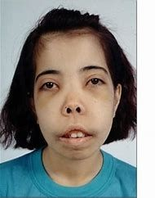
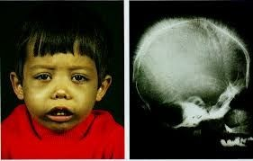

Slide 74
Features of ineffective erythropoiesis:
Expanded medullary spaces (Bone marrow hyperplasia) (with massive expansion of the marrow of the face and skull producing the characteristic thalassemic facies )
Extramedullary hematopoiesis, and higher metabolic needs
Hepatosplenomegaly

Slide 75
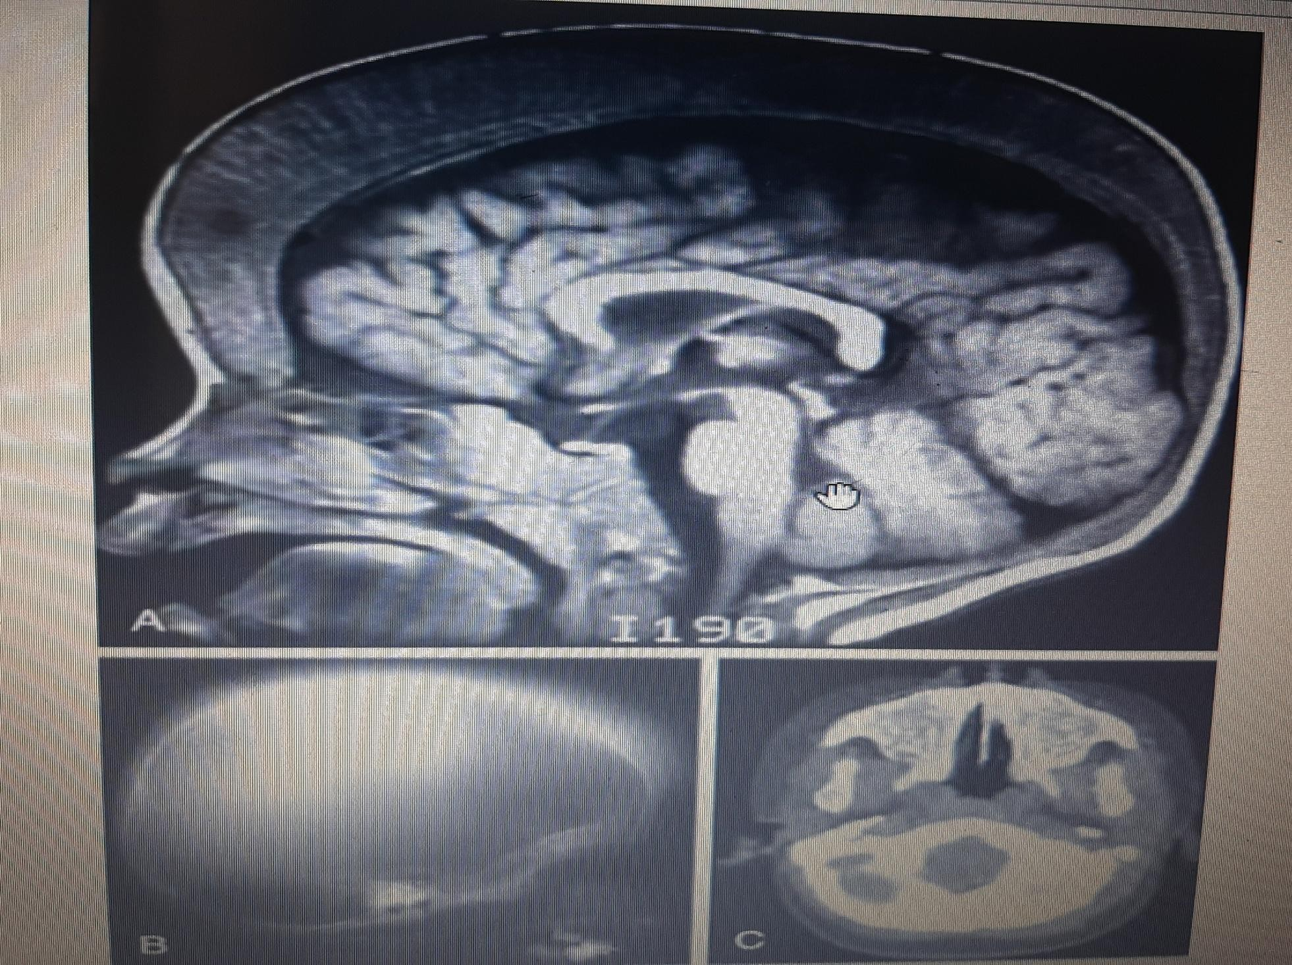
FIG. Ineffective erythropoiesis in 3 yr old patient who has β-thalassemia major and has not received a transfusion
A, Massive widening of the diploic spaces of the skull as seen on MRI.
B, Radiographic appearance of the trabeculae as seen on plain radiograph.
C, Obliteration of the maxillary sinuses with hematopoietic tissue as seen on CT scan.

Slide 76
Diagnosis
1. History and physical examination
**The history focuses on the following:
Family history (FH) Age of onset
Severity of symptoms
**Examination – Those with severe disease may also have evidence of hemolysis and extramedullary hematopoiesis such as jaundice, skeletal abnormalities, or splenomegaly.

Slide 77
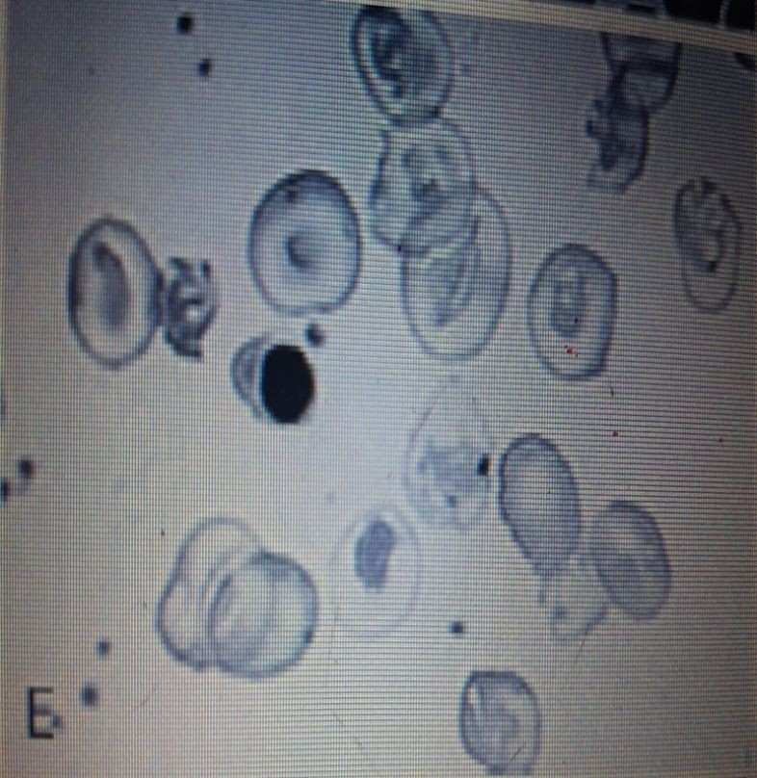
Diagnosis cont..
Laboratory testing
**CBC
-Characteristic finding: microcytic hypochromic anemia (i.e., MCV < 80 fL, MCH < 27 pg/cell) present regardless of Hb level
-Hb levels: low to <6 g/dL unless transfusions are given.
-Normal RDW
-Higher RBC count than iron deficiency anemia + mildly increased reticulocyte count
Hemolysis evaluation:
-↑ reticulocytes
-Liver chemistries: hyperbilirubinemia (indirect)
-Iron studies (particularly ferritin) : expected to be normal in thalassemia

Slide 78
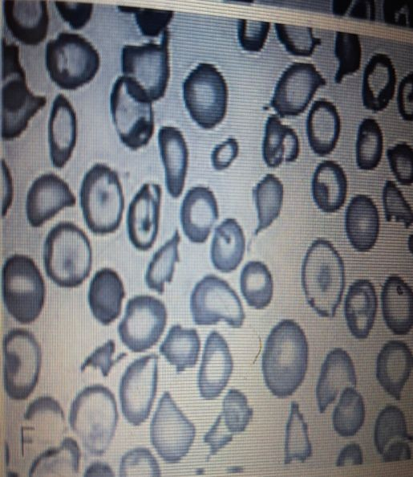
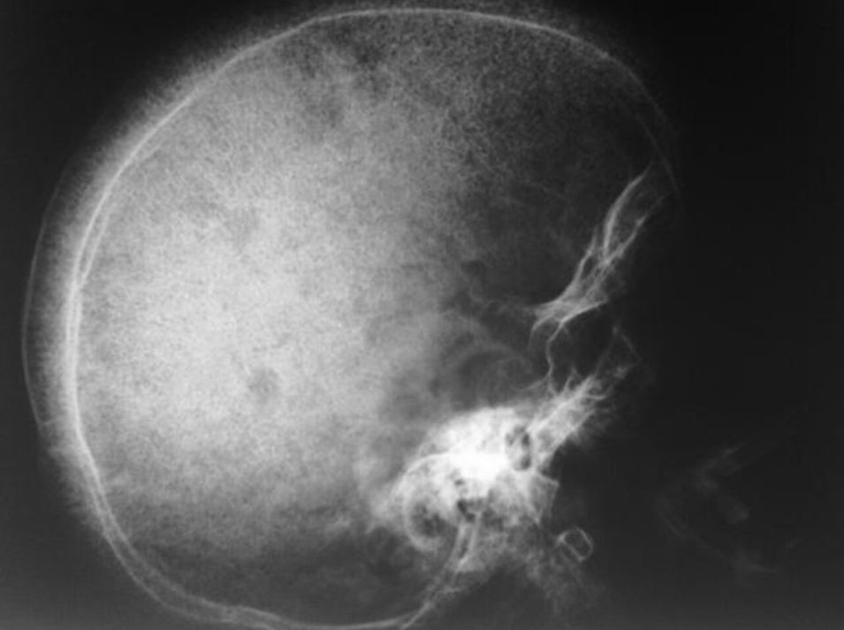
4. Peripheral blood smear findings include:
-Target cells
-Teardrop cells
-Anisopoikilocytosis
-Nucleated red cells
-Erythroblasts
5. radiographs
Imaging is not routinely indicated or required for diagnosis. It can be useful in the evaluation of suspected craniofacial abnormalities and extramedullary hematopoiesis.
**on skull XRAY:
High forehead
Prominent zygomatic bones and maxilla (referred to as “chipmunk facies”) Hair-on-end (also known as “crew cut”) sign

Slide 79
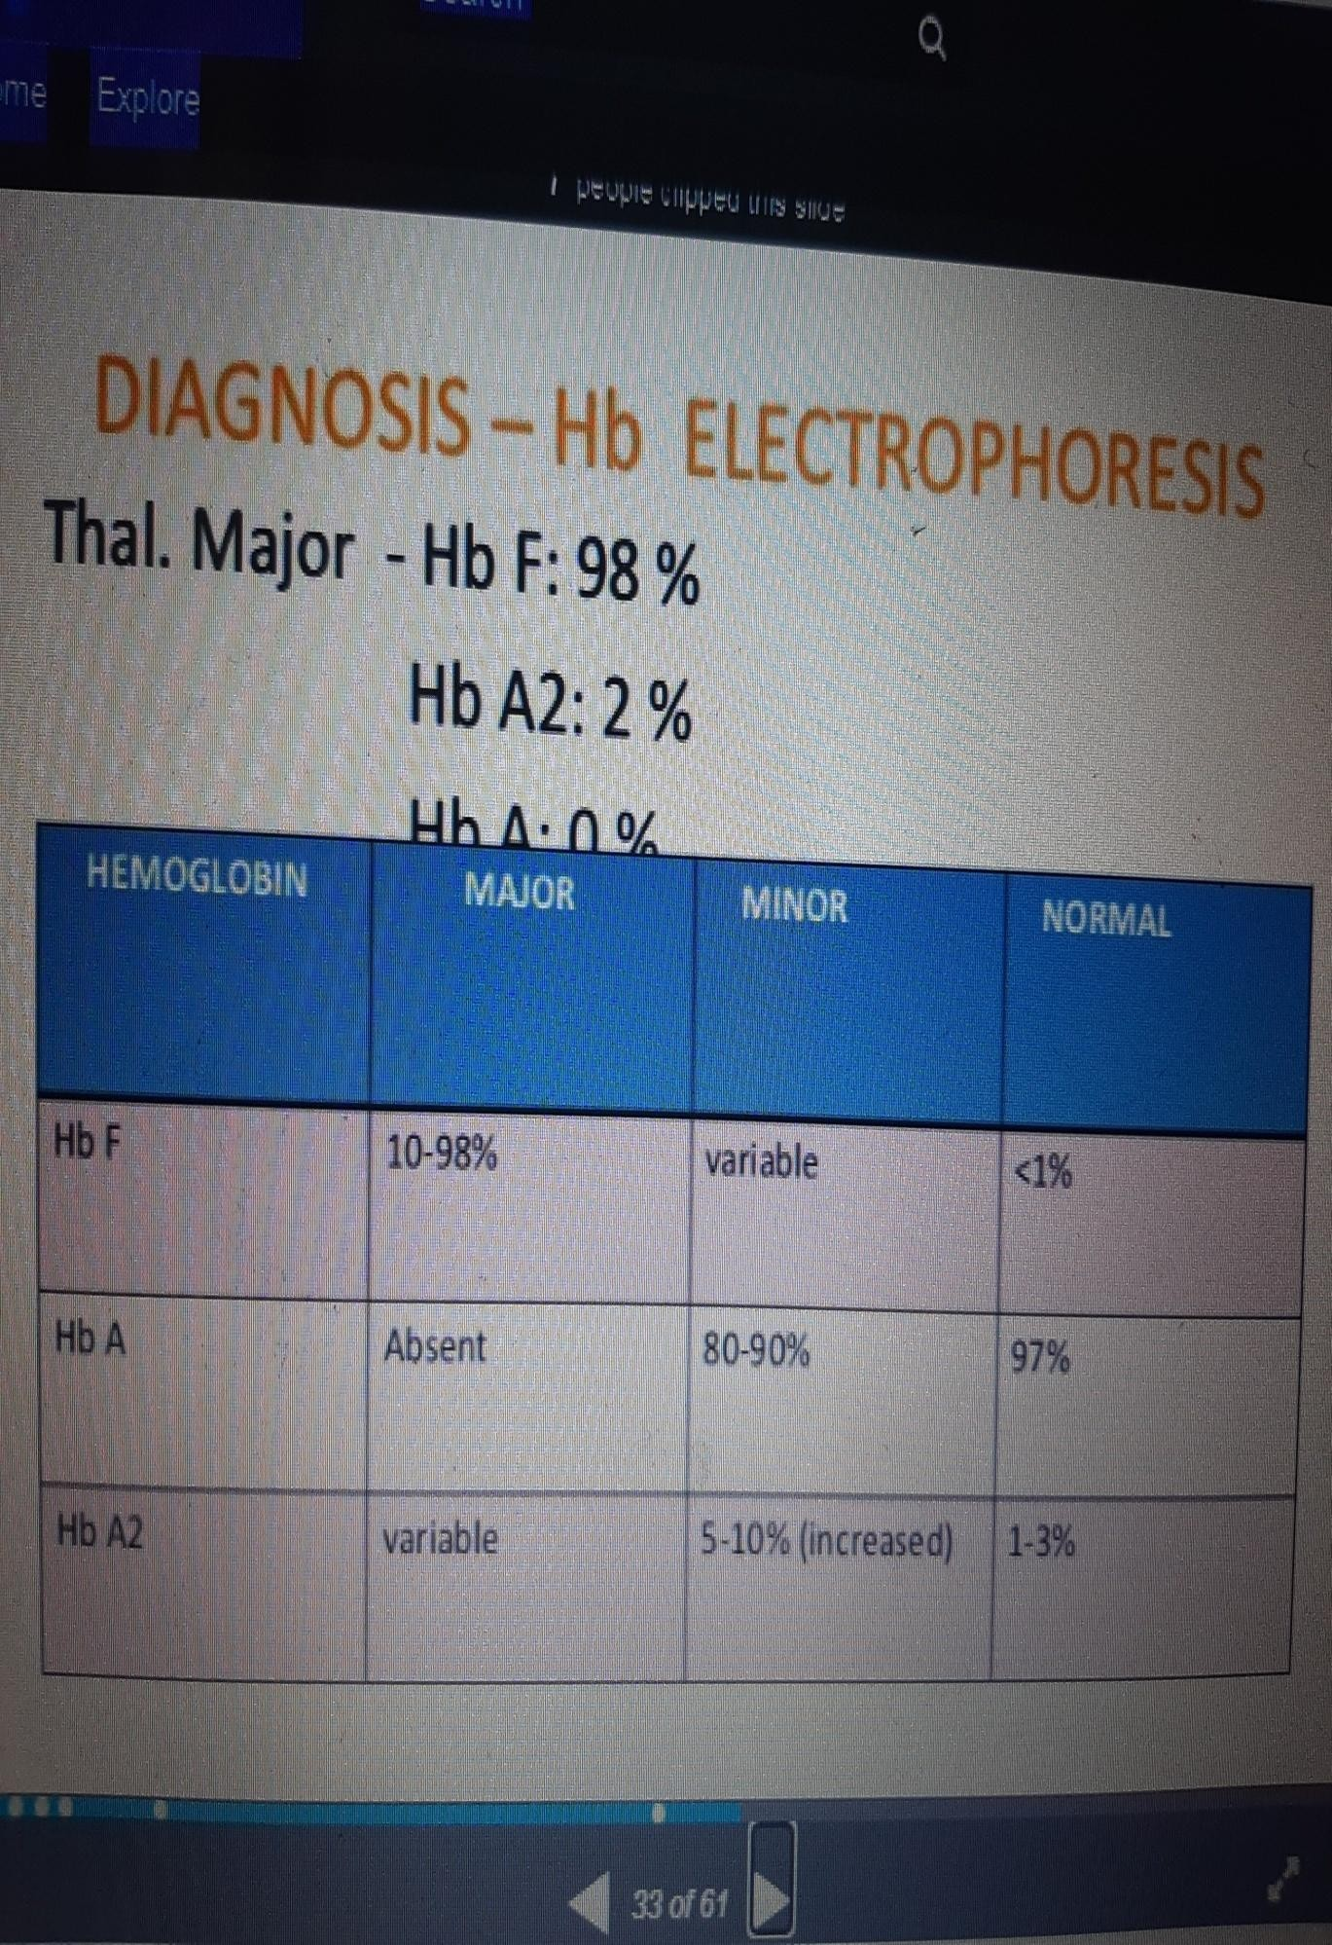
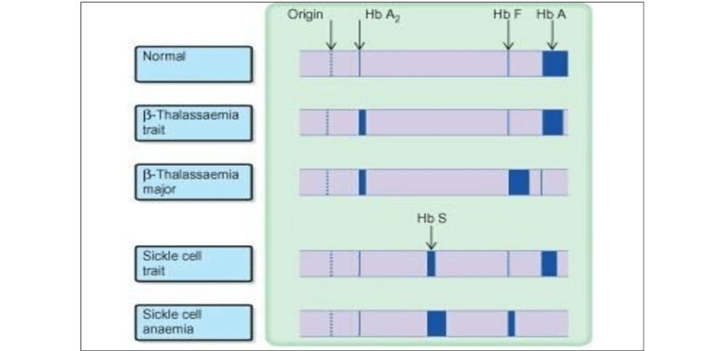
6. Detection of hemoglobin variants
Hb-electrophoresis (qualitative analysis)
**absence or very low HbA
** 98% HbF
** 2% HbA2

Slide 80
Management
Long-term transfusion therapy
Iron chelation
Spleenectomy
Allogeneic hematopoietic transplantation

Slide 81
Transfusion Therapy
to maintain a relatively stable hemoglobin level that is adequate to maintain good cardiovascular status and exercise tolerance and to at least partially suppress ineffective erythropoiesis, thus limiting increased gastrointestinal iron absorption
** suggest using a regimen that results in a pretransfusion hemoglobin level in the range of 9 to 10 or 9.5 to 10.5 g/dL rather than higher or lower levels to reduce complications of ineffective or extramedullary hematopoiesis + monitoring for transfusion-associated transmitted infections (hepatitis A, B, andC, HIV), alloimmunization, annual blood transfusion requirements, and transfusion reactions is essential.
The long-term observation of the clinical characteristics, such as growth, bony changes, and hemoglobin, are necessary to determine chronic transfusion therapy
** regular transfusions are necessary beginning in the 2nd mo to 2nd yr of life
** at intervals of 3-4 wks

Slide 82
COMPLICATIONS
1.Transfusion induced hemosiderosis
Each mL of packed red cells contains 1 mg of iron.
A.Liver hemosiderosis develops after 1 yr of chronic transfusion therapy
B. It affects on endocrine system:
hypothyroidism,
hypogonadotrophic gonadism
growth hormone deficiency
hypoparathyroidism
diabetes mellitus.

Slide 83
After 10 yr of transfusion:
C. Cardiac dysfunction secondary to hemosiderosis begins.
Eventually, most patients not receiving adequate iron chelation therapy die from cardiac failure and/or cardiac arrhythmias secondary to hemosiderosis.
2.Reactions:
After multiple transfusions, many patients develop reactions; these may be minimize by using leukocyte filters during transfusion or by using leukocytedepleted packed red cells.
**Administration of acetaminophen and diphenhydramine hydrochloride before each transfusion minimizes febrile or allergic reactions

Slide 84
3.Infections :
The major complications of blood transfusions are those related to transmission of
infections such as hepatitis B and C and HIV. Hepatitis B vaccination and regular assessment of the hepatitis and HIV status are required.

Slide 85
Iron Overload Monitoring
Patients with chronic transfusion regimen will eventually develop iron overload, which in turn can cause organ toxicity and even death . Iron stores are monitored on a regular basis in these individuals . We typically
use the serum ferritin level for serial testing
*Quantitative measurement of liver iron and cardiac iron are standard, and measurement of pancreatic and gonadal iron may be available soon.
*Quantitative liver iron by approved MRI technology is the best indicator of total-body iron stores and should be obtained in chronically transfused patients after chronic transfusion therapy has initiated.
The liver iron results will help guide the chelation regimen
*Quantitative cardiac iron, determined by T2* MRI cardiac software, should be obtained after 7 yr of transfusion therapy.
Integration of these imaging technologies with chelation therapy may prevent heart failure, diabetes, and other organ dysfunction.

Slide 86
Chelation Therapy
** Give When pt has iron overloaded to prevent hemosiderosis-induced tissue injury 1.after 1 yr of transfusion therapy
the serum ferritin >1,000 ng/mL
liver iron concentration. >5,000 μg/g dry weight.
Iron chelation is not currently
There are 3 available iron chelators:
deferoxamine
labeled for use in children <2 yr.
deferasirox
deferiprone

Slide 87
1.Deferoxamine (Desferal)
excellent safety and efficacy profile
SC or IM , for 8 hr (at least)daily ,5-7 days\week (because of short half-life less than 30 min) initially started at 20 mg/kg and can be increased to 60 mg/kg in heavily iron-overloaded patients. The major problem with deferoxamine is noncompliance because of the route of administration.
Adverse side effects include local skin reactions, ototoxicity, retinal changes, and bone dysplasia with
.truncal shortening

Slide 88
2.Deferasirox (Exjade)
oral iron chelator
give once daily with dispersible tablet in water. half-life of more than 16 hr
Initial dose is 20 mg/kg with gradual escalation to 30 mg/kg. The most common side effects are gastrointestinal symptoms.
The most serious side effect of deferasirox is potential kidney damage.

Slide 89
3.Deferiprone (Ferriprox)
oral iron chelator
has a half-life of approximately 3 hr and requires dosing 3 times.
The starting dose is 75 mg/kg/day and can be escalated to 99 mg/kg/day based on the degree of iron overload
small molecule, effectively enters cardiac tissue and may be more effective than other chelators in reducing cardiac hemosiderosis
The most serious side effect of is transient agranulocytosis, which occurs in 1% of patients and usually in the 1st yr of treatment.
Requires frequent blood count monitoring, typically weekly for at least the 1st yr of therapy.

Slide 90
Hematopoietic Stem Cell Transplantation
Hematopoietic stem cell transplantation has cured >3,000 patients who had β-thalassemia major.
In low-risk HLA-matched sibling patients, there is at least a 90% survival and an 80% event-free survival
Most success has been in children <14 yr old without excessive iron stores and hepatomegaly who undergo sibling HLA-matched allogeneic transplantation.
Myelo-ablative conditioning regimens have been used to prevent graft rejection and thalassemia recurrence.

Slide 91
Hydroxyurea
DNA antimetabolite → increases stress erythropoiesis → increased HbF production.
It has been most successfully used in sickle cell disease, and in some patients with β-thalassemia
intermedia.
Studies in β-thalassemia major are limited.

Slide 92
Splenectomy:
Is done in patients who develop hypersplenism, because they have a falling steady state hemoglobin and/or a rising transfusion requirement.
If splenectomy was done in patients with thalassemia intermedia there is a high risk for them to have → (complications) such as thrombosis, pulmonary hypertension, leg ulcers, and silent cerebral infarction.

Slide 93
Immuno-prophylaxis should be given 4 weeks prior to splenectomy and patients should be fully immunized against encapsulated bacteria (pneumococcal / Meningococcal / H. influenza vaccines) at least 1 week before surgery, and should be on long-term penicillin prophylaxis, with appropriate instructions regarding fever management.
Routine pediatric immunizations should be current and vaccination records should be checked annually.
Beginning at two months of age, patients should be given 7-valent conjugate pneumococcal vaccine as recommended. A booster with 23-valent vaccine should be administered at 24 months.
Pnuemovax boosters should be considered every five to ten years.

Slide 94
Non-transfusion-Dependent Thalassemia
β-Thalassemia Intermedia

Slide 95
The β-thalassemia syndromes are characterized by decreased production of βglobin chains of HbA. There are 200-300 β-thalassemia mutations that have been characterized. These mutations can affect any step in the transcription of βglobin genes.
As discussed, β 0 -thalassemia is absent production of normal βchains, and Hb A production of with β +
mutations is decreased.
Because phenotypic correlation with genotype is variable, β-thalassemia patients are largely classified by
their clinical spectrum. Transfusion-dependent thalassemia, or thalassemia major, is the most severe group.

Slide 96
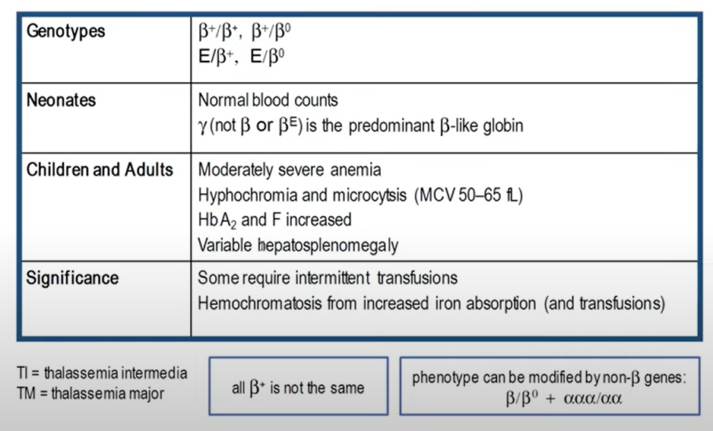
Non–transfusion dependent thalassemia (thalassemia intermedia)

Slide 97
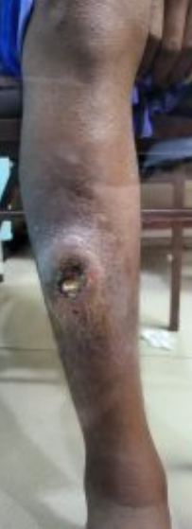
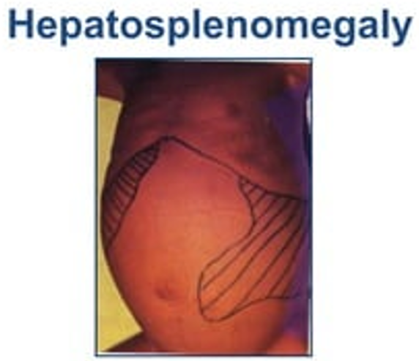
Clinical manifestations
Ineffective erythropoiesis that leads to microcytic anemia with hemoglobin of approximately 7g/dL (range: 6-10 g/dL).
Medullary hyperplasia.
Hepatosplenomegaly.
Pulmonary hypertension.
Leg ulcers.
Growth failure.
Hemosiderosis.
Hematopoietic pseudotumors.
Extramedullary hematopoiesis can occur in the vertebral canal, compressing the spinal cord and causing neurologic symptoms; the latter is a medical emergency requiring immediate local radiation therapy. Transfusions are indicated in thalassemia intermedia patients with significant clinical morbidity.
Notes:
*Ineffective erythropoiesis: increase in erythroblast proliferation that fails to differentiate and give rise to enucleate RBCs thereby resulting in anemia. (Hb<7).
*Hemosiderosis :excessive accumulation of iron deposits (secondary to increased GI absorption of iron requiring chelation)
*Extramedullary hematopoiesis: production of blood cells outside the marrow as a compensatory response to longstanding hypoxia.

Slide 98
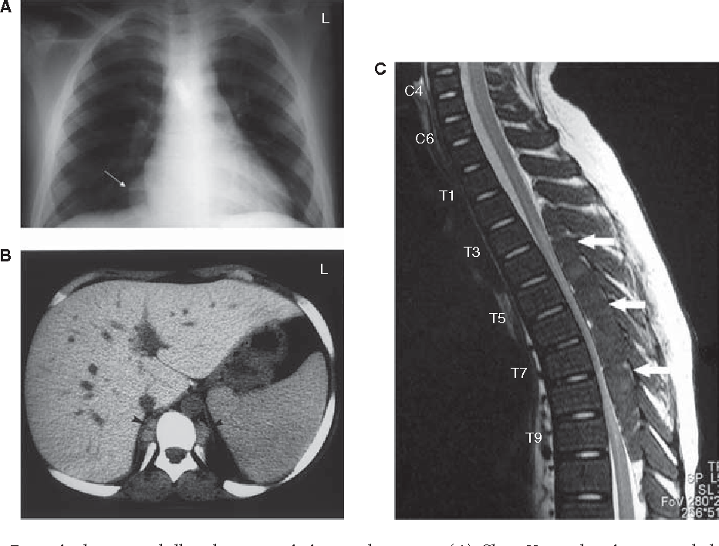
Paraspinal extramedullary
hematopoietic pseudotumors.
Chest X-ray showing expanded anterior rib ends consistent with medullary hyperplasia. A paraspinal mass is seen in the right lower zone (white arrow).
CT scan showing inactive paraspinal extramedullary hematopoietic lesion with increased density compared with soft tissue, caused by iron deposition (black arrowheads).
MRI of cervical and thoracic spine. T2-weighted sagittal image showing thoracic cord compression by extramedullary intraspinal epidural hematopoietic mass from T2 to T10 (white arrows).

Slide 99
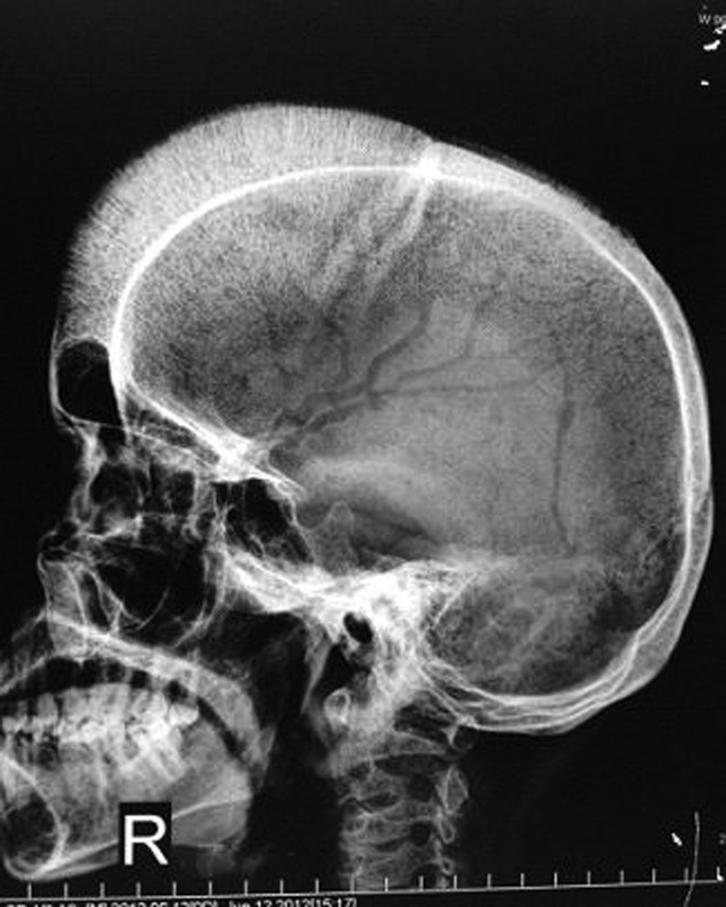
Hair-on-end appearance in a case of thalassemia intermedia
Notes:
A 24-year-old man, born out of consanguinous marriage with history of splenectomy done at the age of four and history of requiring frequent blood transfusions, that is, every 5–6 months, came with complaints of breathlessness on exertion, generalised fatiguability and weakness. On examination the patient had frontal bossing, haemolytic facies and hepatomegaly. His haemoglobin (Hb) was 5.6 g/dl and peripheral smear revealed hypochromic, microcytic red blood cells with target cells. Serum iron studies revealed serum iron of 300 mg/dl (200–400 mg/dl) and serum ferritin of 1500 ng/ml (20–300 ng/ml). Haemoglobin electrophoresis showed fetal haemoglobin F of 7 g/dl and adult haemoglobin A of 8.8 g/dl. A skeletal survey was done which revealed evidence of extra medullary haematopoiesis with a classical hair–on-end appearance seen on x-ray skull . The patient was given three packed cell transfusions. The patient was advised tablet folic acid daily and iron chelation therapy. The patient was discharged on a Hb of 9 g/dl.

Slide 100
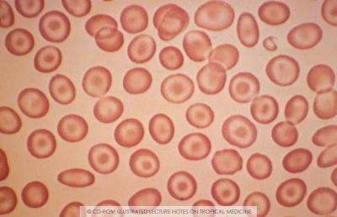
Thalassemia trait is often misdiagnosed as iron deficiency in children, because the 2 diagnoses produce similar hematologic abnormalities on CBC. However, iron deficiency is much more prevalent. A short course of iron and reevaluation is all that is required to identify children who will need further evaluation. Children who have β-thalassemia trait have a persistently normal red cell distribution width (RDW) and low mean corpuscular volume (MCV), whereas patients with iron deficiency develop an elevated red cell distribution width (RDW) with treatment. On Hb analysis, patients with β-thalassemia trait have elevated levels of HbA2 and variably increased Hb F. There are “silent” forms of β-thalassemia trait, and if the family history is suggestive, further studies may be indicated.
Notes:
- Beta thalassemia trait are mostly misdiagnosed as iron deficiency anemia → because the most common cause for microcytic anemia is iron deficiency → so, they give a short course of iron and check if the symptoms improved or not → if they didn’t improve and iron labs were normal or even elevated → we must do Hb electrophoresis → if you found that the HbF and HbA2 are high … although the patient is just 5 years old → Dx: Beta thalassemia trait (Beta thalassemia minor).

Slide 101
α-Thalassemia Syndromes

Slide 102
α-Thalassemia Syndromes
The same evolutionary pressures that produced β-thalassemia and sickle cell disease produced α-thalassemia. Infants are identified in the newborn period by the increased production of Bart hemoglobin (γ4 ) during fetal life and its presence at birth. The α-thalassemia syndromes occur most frequently in Southeast Asia. Deletion mutations are most common in α-thalassemia. In addition to deletional mutations, there are nondeletional α-globin gene mutations, the most common being Constant Spring (α CS α) these mutations cause a more severe anemia and clinical course than the deletional mutations. Normally, there are 4 α-globin genes. The different phenotypes in α-thalassemia largely result from whether 1 (α + -thalassemia) or both (α 0 -thalassemia) αglobin genes are deleted in each of the 2 loci.
Notes:
* nondeletional α-globin gene mutations such as Constant Spring (α CS α)→ lead to severe anemia.

Slide 103
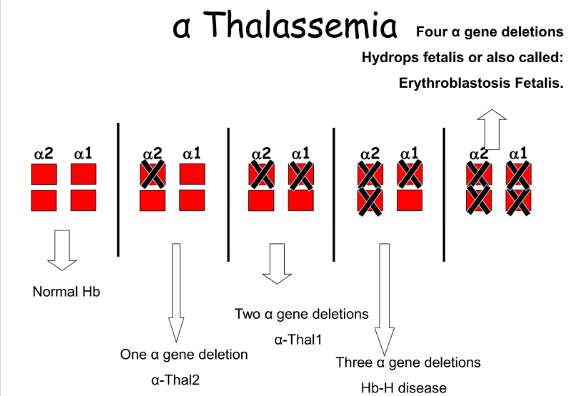
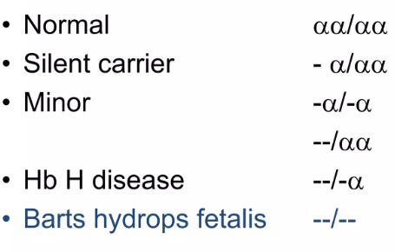
Classification of alpha thalassemia

Slide 104
silent trait
Genetic phenotype
The deletion of 1 α-globin gene (silent trait) is not identifiable hematologically. Specifically, no alterations are noted in the MCV and mean corpuscular hemoglobin (MCH). Persons with this deletion are usually diagnosed after the birth of a child with a 2-gene deletion or HbH (β4 ), but some newborn screening programs report even low concentrations of Hb Bart.
Notes:
Silent trait Thalassemia
• -α/αα
• One alpha gene deletion, 3 intact alpha genes.
• Healthy persons.
• Normal Hb and Hct
• No treatment
• Can only be detected by DNA studies.

Slide 105
α-thalassemia trait (alpha thalassemia minor)
The deletion of 2 α-globin genes results in α-thalassemia trait. The α-globin alleles can be lost in a trans (−α/−α) or cis (α,α/ -SEA ) configuration. The trans or cis mutations can combine with other mutations or deletions and lead to HbH or α-thalassemia major.
In persons from Africa or of African descent, the most common α-globin deletions are in the trans configuration, whereas in persons from or descended from Asia or Mediterranean region, cis deletions are most common.
Notes:
- α-thalassemia trait:
• Also called Alpha Thalassemia Minor.
• Caused by two missing alpha genes. May be homozygous (-α/-α) or heterozygous (--/αα).
• Mild microcytic, hypochromic anemia.
• MCV between 70-75 fL.
• Normal Hb electrophoresis.
• May be confused with iron deficiency anemia.
• Although some Bart's hemoglobin (g4) present at birth, but no Bart's hemoglobin present in adults. Why? Because they either delivered stillborn at 30-40 weeks' gestation or die soon after birth.

Slide 106
α-Thalassemia trait (2 missing α-globin genes) manifest as a microcytic anemia that can be mistaken for iron-deficiency anemia. The Hb analysis is normal, except during the newborn period, when Hb Bart is typically 3%. Children with a deletion of 2 α-globin genes are commonly mistaken to have iron deficiency, given the presence of both low MCV and MCH. The simplest approach to distinguish between iron deficiency and α-thalassemia trait is with a good dietary history.
Children with iron deficiency anemia often have a diet that is low in iron and drink significant amount of cow's milk. Alternatively, a brief course of iron supplementation along with monitoring of erythrocyte parameters might confirm the diagnosis of iron deficiency.
If both parents of a child diagnosed with α-thalassemia trait are carriers in the cis conformation, they are at risk for a future hydrops fetalis pregnancy. Thus, family screening and genetic counseling are indicated.

Slide 107
HbH disease
The deletion of 3 α-globin genes leads to the diagnosis of HbH disease. A more severe form of HbH disease may be caused by a nondeletional α-globin mutation in combination with 2 gene deletions.
HbH Constant Spring (−α/α,α CS ) is the most common type of nondeletional HbH disease.
Notes:
- HbH disease:
• Second most severe form alpha thalassemia.
• Usually caused by presence of only one intact α gene producing alpha chains (--/-α).
• Results in accumulation of excess unpaired gamma or beta chains.

Slide 108
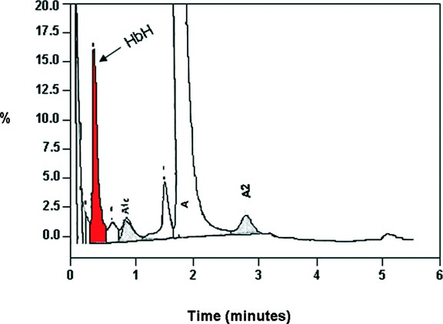
The simplest manner of diagnosing HbH disease is during the newborn period, when excess in γ-tetramers are present and Hb Bart is commonly >25%. Obtaining supporting evidence from the parents is helpful. Later in childhood, there is an excess of βglobin chain tetramers that results in HbH. A definitive diagnosis of HbH disease requires DNA analysis. Brilliant cresyl blue can stain HbH, but it is rarely used for diagnosis.
Patients with HbH disease have a marked microcytosis anemia, mild splenomegaly, and, occasionally, scleral icterus or cholelithiasis. Chronic transfusion is not usually required for therapy because the Hb range is 7-11 g/dL, with MCV 51-73 fL, but intermittent transfusions for worsening anemia may be needed.
Individuals with non-deletional Hb H disease are more likely to require transfusions than individuals with deletional Hb H disease.
Notes:
- HbH disease:
• Live normal life; however, infections, pregnancy, exposure to oxidative drugs may trigger hemolytic crisis.
• RBCs are microcytic, hypochromic with marked poikilocytosis. Numerous target cells. • Hb 7-10 g/dl • Hb electrophoresis: Fast moving band correspondent to HbH.
• HbH vulnerable to oxidation. Gradually precipitate in vivo to form Heinz-like bodies of denatured hemoglobin. Cells been described has having "golf ball" appearance, especially when stained with Brilliant Cresyl Blue

Slide 109
- Treatment of HbH disease requires:
1) Ongoing monitoring of growth and organ dysfunction.
2) Dietary supplement with folate and multivitamins without iron is indicated. Older patients may develop decreased bone density with calcium and vitamin D deficiency.
3) Vitamin D supplementation is indicated if the level is low, and adequate dietary calcium intake should be encouraged to promote bone health. Iron supplementation should be avoided as patients are at risk of developing iron overload.
4) Intermittent transfusion requirements during intercurrent infection may occur, particularly in nondeletional HbH.

Slide 110
5) Splenectomy is occasionally indicated, and because of the high risk of postsplenectomy thrombosis, aspirin or other anticoagulant therapy following splenectomy should be considered.
6) Hemosiderosis, secondary to GI iron absorption or transfusion exposure, may develop in older patients and require chelation therapy. Because HbH is an unstable hemoglobin sensitive to oxidative injury, oxidative medications should be avoided.
7) At-risk couples for hydrops fetalis should be identified and offered molecular diagnosis on fetal tissue obtained early in pregnancy. Later in pregnancy, intrauterine transfusion can improve fetal survival, but chronic transfusion therapy or bone marrow transplantation for survivors will be required.

Slide 111
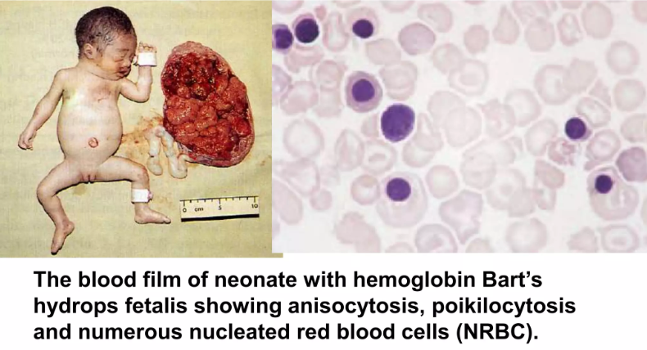
Hb Bart hydrops fetalis
The deletion of all 4 α-globin gene alleles causes profound anemia during fetal life, resulting in hydrops fetalis ; the ζ-globin gene must be present for fetal survival. There are no normal hemoglobins present at birth (primarily Hb Bart, with Hb Gower-1, Gower-2, and Portland).
Intrauterine transfusions may rescue the fetus, but congenital abnormalities and neurodevelopmental delay often result.
Infants with severe α-thalassemia will have lifelong transfusion dependence, and hematopoietic stem cell transplantation is the only cure.

Slide 112
Summary for Laboratory Testing
The thalassemia minor syndromes (i.e., α-thalassemia trait, β-thalassemia trait) are characterized by a mild hypochromic, microcytic anemia with a low absolute reticulocyte count .
The RBC count is usually elevated. As a result, if the mean corpuscular volume (MCV) divided by the RBC count is less than 12.5 (Mentzer index), the diagnosis is suggestive of thalassemia trait. The blood smear reveals only microcytosis with α-thalassemia minor. Outside the neonatal period, when Bart hemoglobin is no longer detectable, the hemoglobin electrophoresis is usually normal in α-thalassemia minor .
Blood smears of patients with β-thalassemia minor also reveal microcytic RBCs. In addition, target cells and basophilic stippled RBCs, caused by precipitation of alpha-chain tetramers, may also be present. The diagnosis of β-thalassemia minor is based on an elevation of hemoglobin A2 and F levels.
Molecular testing is indicated for identification of more severe or unusual variants.

Slide 113
البرنامج الالزامي لفحص ما قبل الزواج للكشف عن مرض الثلاسيميا
تصل نسبة حاملي المرض في الأردن حسب الإحصاءات الرسمية من3 – 3,5 بالمئة من السكان ، أي أن حوالي150 – 200 ألف مواطن يحملون الجين الوراثي.
أصبح برنامج الكشف عن الثلاسيميا قبل الزواج إلزاميا لكل المقبلين على الزواج إعتبارا من عام 2004 وقد اعطى هذا البرنامج اكله بشكل جيد بحيث تم خفض اعداد المواليد المصابون سنوياُ 80 – 90 الى النصف اي 40-45 مصاب.
يهدف البرنامج الى : الوقاية من مرض الثلاسيميا ,خفض نسبة المواليد المصابين سنويا
خطوات الفحص فحص الدم: الفحص المبدئي تعداد الدم CBC
نسبة الهيموجلوبين HB
متوسط حجم الكرية الحمراءMCV ,الحد الفاصل =80 ,كلاهما أقل من 80
الفحص التأكيدي -فحص رحلان خضاب الدم HB Electrophoresis الحد الفاصل 3.5 % أو أكثر
حامل للثلاسيميا
إذا كان كلاهما حاملين للثلاسيميا :
استشارة وراثية قبل الزواج ,توضيح خطورة الإنجاب ,لا يمنع الزواج
إذا أصرا على الزواج - ضرورة المتابعة للإرشاد ,ومتابعة المواليد ,الالتزام بسرية الفحص والنتائج ,السلوك الاجتماعي بين الاسرتين للخاطبين
Moh.gov.jo

Slide 114
THANK YOU

