Slide 1
HLS Practical
Mathhar ahmad abu morad MD
Department of Microbiology and Pathology
Faculty of Medicine
Mu’tah University

Slide 2
Diagnosis of Salmonella

Slide 3
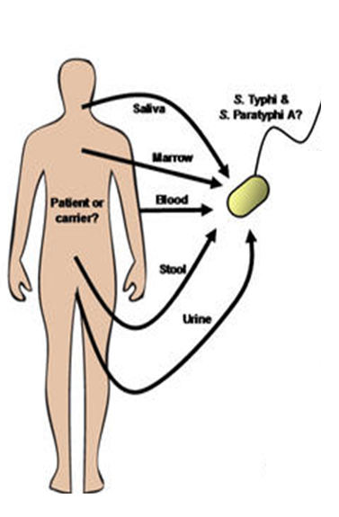
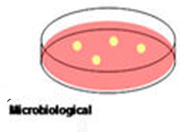
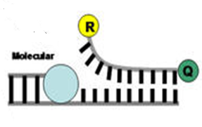
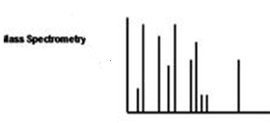

Slide 4
Diagnosis of salmonellosis
Cultural properties
Grow easily on simple culture media and on selective and differential media that contain biliary salts and lactose.They grow On MacConkey’s or Deoxycholate-citrate agar (DCA) medium, they produce pale yellow colonies being non lactose fermenters.
Salmonella growing on XLD agar; Xylose Lysine Deoxycholate agar is a selective growth medium used in the isolation of Salmonella (black dots) and Shigella species from clinical samples and from food
Produce H2S, colonies have a “cat-eye” appearance.
Media used for Salmonella isolation
Enrichment cultures
Salmonella selective media
Enrichment cultures
Enrichment cultures: The specimen (usually stool) is put into selenite F or tetrathionate broth, both of which inhibit replication of normal intestinal bacteria and permit multiplication of salmonellae. After incubation for 1–2 days, it is plated on differential and selective media.

Slide 5
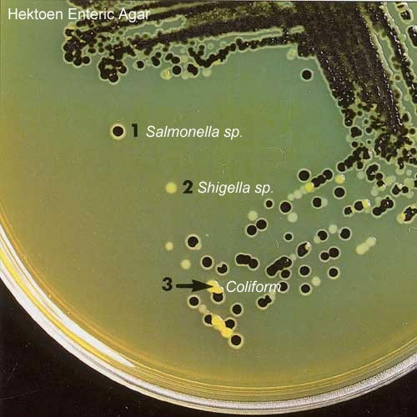
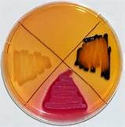
Diagnosis of salmonellosis
Salmonella selective media:
Favor growth of salmonellae and shigellae over other Enterobacteriaceae including
Salmonella-Shigella (SS) agar
Hektoen enteric agar
Shigella: colorless colonies without
black centers
Salmonella:
colorless colonies with black centers
Lactose fermenter flora: pink to red colonies

Slide 6
Principle of Hektoen enteric agar
Hektoen Enteric Agar (HE) is a selective and differential medium designed to isolate and differentiate members of the species Salmonella and Shigella from other Enterobacteriaceae.
Bile salts and the dyes bromothymol blue and acid fuchsin inihibit the growth of most Gram-positive organisms.
Lactose, sucrose, and salicin provide fermentable carbohydrates to encourage the growth and differentiation of enterics.
Sodium thiosulfate provides a source of sulfur.
Ferric citrate: H2S indicator
Enterics that ferment one or more of the carbohydrates will produce (orange, yellow or salmon coloured colonies ). Non-fermenters will produce (translucent colonies, light green or greenish blue ). Organisms that reduce sulfur to hydrogen sulfide will produce black colonies or blue-green colonies with a black center.

Slide 7
Diagnosis of salmonellosis
Suspected colonies from solid media are identified by biochemical reaction patterns
Motile
Lactose negative; Lactose + means that the organism can use lactose as an energy source and produce acids, whilst lactose – means they cannot.
S. Typhi ferment glucose, mannitol and sorbitol to produce acid or acid and gas
Some S. paratyphi ferments these with production of acid and gas
To differentiate between S paratyphi A and B;
A is H2S -& citrate –
B is H2S + & Citrate +
S paratyphi C, S. typhimurium and enteritides are similar to S. paratyphi B. To differentiate use serological testing (slide agglutination test
Indole test negative
Methyl red test: positive
Voges-Proskauer test: negative;
Citrate :positive ( growth on Simmon's citrate agar )
Urease :negative

Slide 8
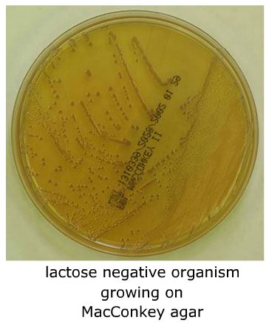
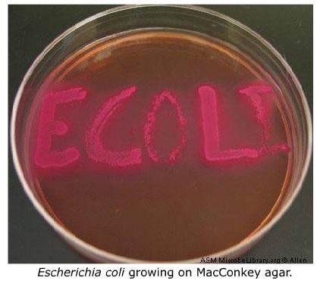
Lactose test

Slide 9
Diagnosis of salmonellosis
Serologic Methods (Widal test)
Principle: Patients’ suffering from enteric fever would possess antibodies in their sera against S. typhi O antigen, S. typhi H antigen and S. paratyphi AH antigen and S. paratyphi BH antigen which can be detected by slide widal test. 2 circles as controls.
Procedure: One drop each of undiluted patients’ serum samples are placed on the circled card and one drop of each of the four Salmonella antigens are added separately and gently rotated for one minute. Appearance of agglutination gives qualitative results

Slide 10
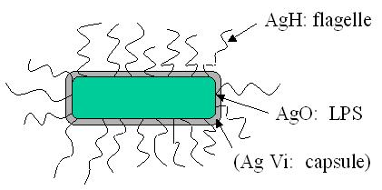
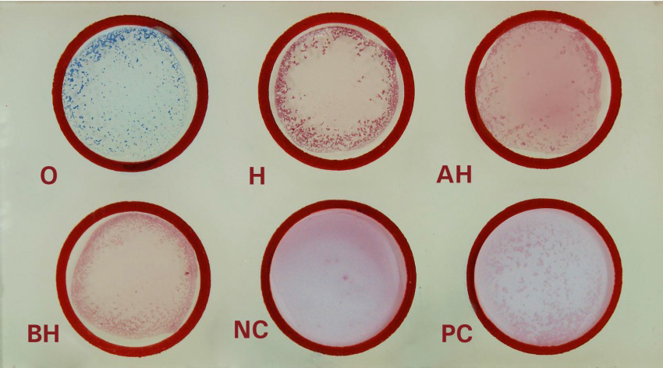
Diagnosis of salmonellosis
Serologic Methods (Widal test)
O
H
AH
BH
NC
PC

Slide 11
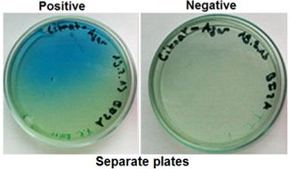
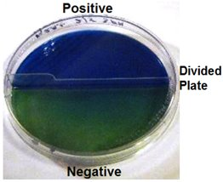
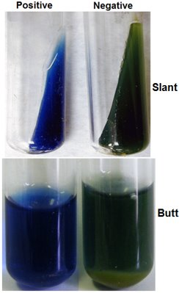
Citrate Utilization Test
Use: to determine bacterial ability to use citrate as the sole source of carbon.
Culture medium: Simmons citrate agar; contains source of citrate & pH indicator bromthymol blue (neutral; green & alkaline; blue).
Principle: citrate use → ammonia production → alkaline pH.
Results:
1- Positive: The usual colour change is from green (neutral) to blue (alkaline).
2- Negative: No growth, colour remains green.
Important citrate-positive bacteria:
1- Klebsiella sp.
2- Citrobacter sp.
3- Proteus sp.

Slide 12
Urea Hydrolysis
Use: to determine bacterial ability to hydrolyze urea (by urease enzyme) into CO₂ & ammonia which alkalinizes the medium.
Culture medium: Christensen’s urea agar or Stuart's urea broth: both contain urea, & phenol red indicator.
Method:
1- Streak agar surface with portion of well-isolated colony or inoculate urea broth with 1-2 drops from overnight enrichment broth.
2- Leave cap on loosely & incubate at 35°C.
Results:
1- Positive: enzyme present, ammonia produced, high pH (bright pink colour).
2- Negative: enzyme absent, NO colour change (yellow orange).
Important urease-positive bacteria:
Proteus sp.
Helicobacter sp.

Slide 13
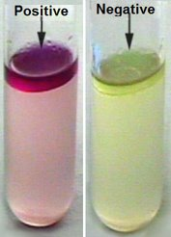
Indole Test
Use: to determine bacterial ability to degrade amino acid tryptophan (by tryptophanase enzyme) into indole (+ Kovac’s reagent (yellow) indicator) → red colour.
Method:
1- Inoculate tryptophane broth with 1-2 drops from overnight bacterial enrichment broth.
2- Incubate at 35°C.
3- Add 0.5 mL (5-10 drops) of Kovac’s reagent.
Results:
Positive: enzyme present, indole produced, red ring on top of broth e.g. E.coli.
Negative: enzyme absent, indole NOT produced, NO colour change or clear yellow ring e.g. Klebsiella sp., Enterobacter sp., Salmonella sp.

Slide 14
Methyl Red (MR) & Voges-Proskauer (VP) Tests
Use:
1- MR tests for acids production from glucose fermentation.
2- VP tests for acetoin production from glucose fermentation.
Culture media: MRVP Glucose Broth, & Reagents:
1- Methyl Red indicator for acids produced using mixed acid fermentation pathway using pyruvate as a substrate.
2- VP indicators (5% Alpha-naphthol & potassium hydroxide) for acetoin production using 2,3-butanediol fermentation pathway.
Method:
1- Inoculate tube aseptically with inoculating loop.
2- Incubate at 35°C for 48 hours of incubation.
3- Separate bacterial broth into 2 separate tubes.
4- Add few drops of MR to one tube.
5- Add both VP reagents to the other tube, shake vigorously then allow to sit for 5-10 minutes.

Slide 15
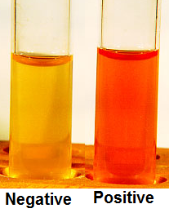
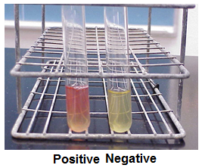
Methyl Red (MR) & Voges-Proskauer (VP) Tests Results
MR
VP
Positive: acids, pH <4.2, red
Negative: NO acids produced, pH >6.2, yellow.
Positive: acetoin present, red.
Negative: acetoin absent, NO colour change.

Slide 16
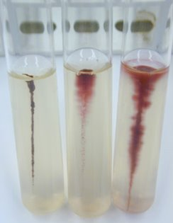
Motility test
Motility in semisolid agar: Positive (motile); fuzzy growth feathering away from stab line creating cloudy appearance & Negative (nonmotile); growth strictly along stab line.

Slide 17
Yersinia pestis

Slide 18
Diagnosis
Acceptable Specimen Types .
Bronchial wash/tracheal aspirate (≥ 1 ml) .
Whole blood: 5-10 ml blood in EDTA, and/or Inoculated blood culture bottle .
Aspirate or biopsy of liver, spleen, bone marrow, lung, or bubo

Slide 19
Diagnosis
Blood and bubo aspirates and sputum should be Giemsa stained. Smears typically show the bacillus to have a bipolar or "safety pin" appearance.
Send smears to a reference lab for fluorescent antibody microscopy.
Most Gram-negative bacteria produce colonies within 24 h; Y. pestis do not. Because Cultures grow slower (1.25 hours/generation time) than other bacteria and thus require longer incubation times for optimal growth
Notes:
Cultures grow slower (1.25 hours/generation time) than other bacteria and thus require longer incubation times for optimal growth

Slide 20
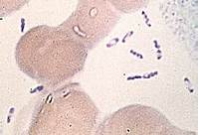
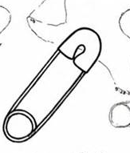
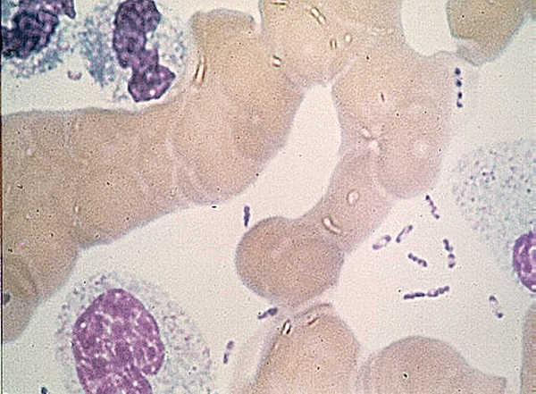
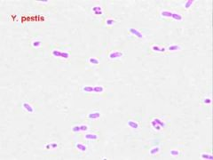
Diagnosis
Staining pattern
Gram-negative rods (0.5 - 0.8 x 1- 3 μm) Bipolar staining (resembling closed safety pin) may be evident with Gram stain but more apparent with Giemsa stain
=
Giemsa staining
Gram staining

Slide 21
Diagnosis
Colony Morphology
Grey-white translucent colonies on Blood Agar (BA) and Chocolate Agar (CA) at ambient and 35/37⁰C (growth faster at 28⁰C).
“Fried egg” appearance on BA in older cultures

Slide 22
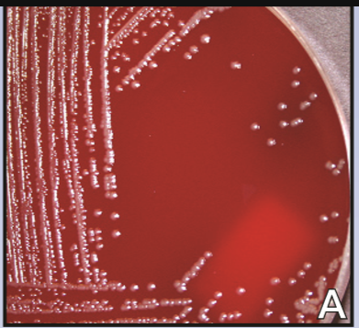
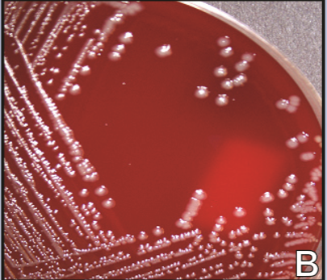
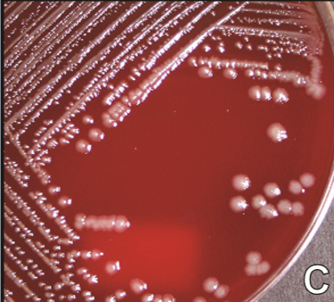
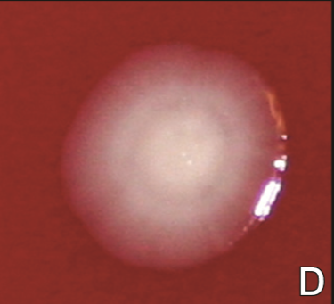
Diagnosis
Colony Morphology

Slide 23
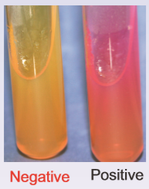
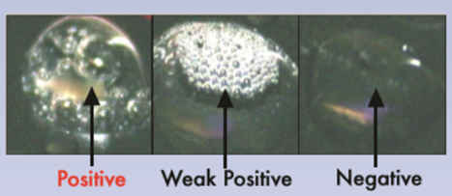
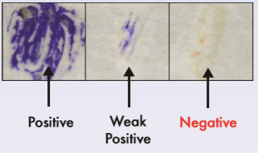
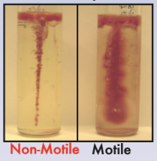
Diagnosis
Additional Lab Identification
Urease: negative
Catalase: positive
Oxidase: negative Indole: negative
Motility: nonmotile

Slide 24
Oxidase Test
Use:
To determine aerobic bacteria’s ability to produce cytochrome c oxidase enzyme (electron transport chain)
.
Principle:
Oxidation of a substrate to indophenol , a dark purple colored end product .
Results:
1- Positive: enzyme present & substrate oxidized to end-product indophenol (dark purple colour).
2- Negative: enzyme absent & substrate remains reduced (No colour).

Slide 25
Catalase Test
Use: to detect bacterial catalase enzyme which catalyzes breakdown of hydrogen peroxide (H₂O₂) into water (H₂O) & ↑O₂ oxygen.
Results:
1- Positive: immediate or rapid copious bubbles
2- Negative: NO or slow few bubbles (Strep spp.).
Warning:
1- Do NOT do test on blood agar as RBCs contain catalase enzyme → False-positive result.
2- Enterococci produce peroxidase which slowly catalyzes breakdown of H2O2 → False positive (weakly positive).

Slide 26
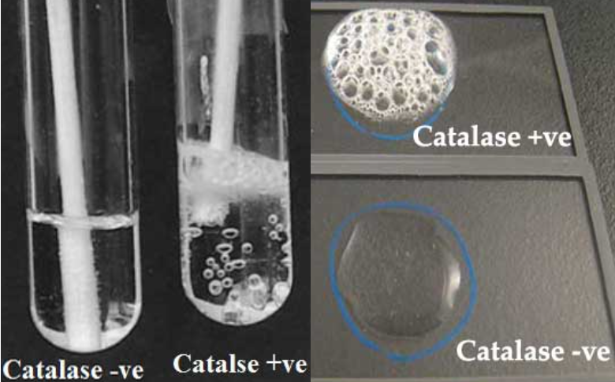
Catalase Test

Slide 27
Diagnosis
Grey-white translucent, non-hemolytic colonies on BA or CA (24 h), Yellow and opaque (48 h).
Gram-negative rods bipolar staining (closed safety pin)
*Catalase: positive *Motility: nonmotile
* Urease: negative *Oxidase: negative * Indole: negative
No
Continue laboratory
identification procedure
Yes
Immediatelly notify the physician
to treat and to take the the proper isolation precautions

Slide 28
Brucellosis

Slide 29
Specimen collection, transport, and processing
Brucellosis
A definitive diagnosis of brucellosis requires isolation of the organisms in cultures of blood, bone marrow, CSF, pleural and synovial fluids, urine, abscesses, or other tissues.
If processing will be delayed, the specimen may be held in the refrigerator.

Slide 30
Direct detection methods
Brucellosis
Conventional and real-time polymerase chain reaction (PCR) assays are reliable and specific means of directly detecting Brucella organisms in clinical specimens.
Notes:
Sensitivity varies among assays, ranging from 50% to 100%. Several gene targets have been used, including a cell surface protein (BCS P31), a periplasmic protein (BP26), 16S rRNA, and transposon insertion sequence 711(IS711). Molecular assays currently are not available in routine laboratory testing; therefore, use of a reference laboratory may be required

Slide 31
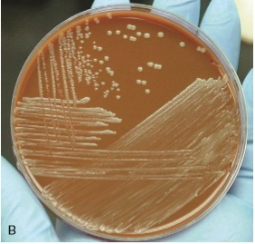
Cultivation
Brucellosis
Brucella can grow on blood and chocolate agars
More enriched agars including Brucella agar or infusion base agar are used to isolate Brucella
All subculture plates should be held for a minimum of 7 days.
On culture, colonies appear small, convex, smooth, translucent, nonhemolytic, and slightly yellow and opalescent after at least 48 hours of incubation
Brucella spp. are catalase and urease positive, and most strains are oxidase positive

Slide 32
Brucellosis
Serologic test
Is widely used (e.g., serum agglutination test [SAT] or microplate agglutination [MAT]) because isolating brucellae is difficult
A titer of 1 : 160 or greater in the SAT is considered diagnostic if this result fits the clinical and epidemiologic findings.

Slide 33
Diagnosis Q fever
Serology (rise in titer)
IFA, CF, ELISA, microagglutination
The indirect IFA is the most dependable and widely used method.
DNA detection methods
PCR
Isolation of organism
Risk to laboratory personnel
Rarely done

