Slide 1
Viral Hepatitis
HAV. HBV, HCV. HDV HEV
and HGV

Slide 2
HEPATITIS C

Slide 3
HEPATITIS C
Hepatitis C is a contagious liver disease
caused by the hepatitis C virus (HCV):
HCV can cause both acute and chronic hepatitis,
Severity rang ,mild illness lasting a few weeks to a serious, lifelong illness
During the Acute Phase , about:
80 % have no symptoms
15–45% of infected persons spontaneously clear the virus within
6 months without any treatment.
The remaining 55-85 % ,develop chronic HCV infection.
15–30% of those chronic HCV have a risk of
developing liver cirrhosis within 20 years.
HCV is much more likely than HBV to become a chronic infection
Antiviral medicines can cure more than 95% of persons with hepatitis C infection, but access to diagnosis and treatment is low.
thereby reducing the risk of death from liver cancer and cirrhosis

Slide 4
Globally
Worldwide, more than 170 million persons have HCV infection,
of whom 71 million have chronic infection.
with about 1.5 million new infections occurring per year.
WHO estimated that in 2019, approximately 290 000 people died from hepatitis C, mostly from cirrhosis and HCC (primary liver cancer).
Hepatitis C is found worldwide. The most affected regions are WHO
Eastern Mediterranean and European Regions, with the prevalence of 2.3% and 1.5% respectively.
in other WHO regions the prevalence of HCV infection ranging
0.5 - 1.0%. Depending on the country,
HCV infection, can be concentrated in certain populations (e.g, among people who inject drugs) and/or in general populations.
There are several genotypes of the HCV virus &their distribution varies by region

Slide 5
TRANSMISSION
The HCV is a blood borne virus
HCV is most commonly transmitted through
exposure to infectious blood. This can occur through:
Receipt of contaminated blood transfusions, blood products
(unscreened blood and blood products) and organ transplants;
(b) Injections given with contaminated syringes and
needle-stick injuries in health-care settings;
(c) Reuse or inadequate sterilization of medical equipment,
especially syringes and needles in healthcare settings
(d) Injection drug users (IVU)
(e) HCV -infected mother to new-born baby
(f) sex with an infected person or
(g)Sharing of contaminated personal items .
No spread through breast milk, food or water, or by casual contact such
as hugging, kissing and sharing food or drinks with an infected person.
but these are less common.

Slide 6
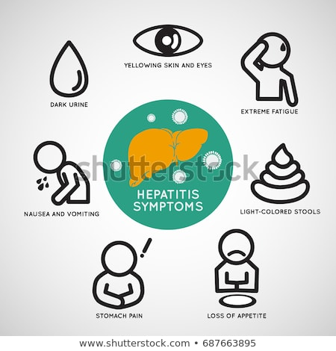
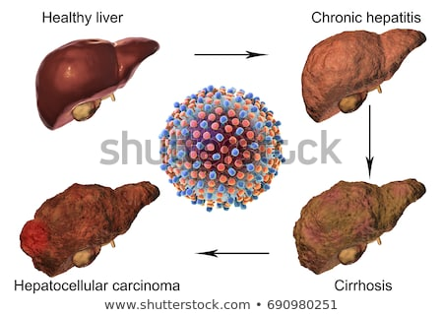
SYMPTOMS
Following initial infection, approximately
80% of people do not exhibit any symptoms.
Those people who are acutely symptomatic may exhibit
fever, fatigue, decreased appetite, nausea, vomiting, abdominal pain, dark urine, grey coloured faeces, joint pain and jaundice.
About 55-85% of newly infected persons develop chronic disease and
60- 70% of chronically infected people
develop chronic liver disease;
15-30% develop cirrhosis and
1-5% die from cirrhosis or liver cancer.
In 25% of liver cancer patients, the underlying cause is hepatitis C.
Liver disease progression in Hepatitis C virus infection,
Incubation Period
I P for HCV is 2 Wks to 6 Mths.

Slide 7
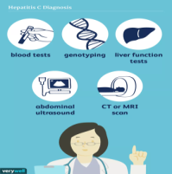
Diagnosis
Diagnosis of acute infection is often missed
because a majority have no symptoms.
Common methods is antibody detection cannot differentiate between acute and chronic infection.
In chronic HCV infection, is also often undiagnosed
because remains asymptomatic until decades after infection
when symptoms develop secondary to serious liver damage.
HCV infection is diagnosed in 2 steps
The presence of antibodies against HCV (anti-HCV)
indicates that a person is infected or has been infected.
The HCV recombinant immunoblot assay (RIBA)
Present HCV Abs in the blood for more than six months is a diagnosis of chronic infection
Because about 30% of HCV infected people ,spontaneously clear the
infection by a strong immune response without the need for treatment.
So they will still test positive for anti-HCV Abs although no longer infected, and
HCV RNA

Slide 8
Diagnosis
HCV RNA by RT-PCR used to confirm the diagnosis.
Diagnosis is confirmed by liver biopsy or
variety of non-invasive tests for assessment of the
degree of liver damage (fibrosis and cirrhosis). .
In addition, laboratory test to identify the genotype of
HCV should be done
There are 7 HCV genotypes with their several subtypes
and they respond differently to treatment.
The distribution of these HCV genotypes varies by region
A person may be infected with more than 1 genotype/ subtypes
The degree of liver damage and HCV genotype are used to guide treatment decisions and management of the disease
Early diagnosis
can prevent this health problems and
prevent transmission to family members and other close contacts
WHO & Some countries recommends screening for ????
WHO & Some countries recommends screening for

Slide 9
WHO & Some countries recommends screening for
people at increased risk These include:
(a)People who received blood, blood products or organs
before screening for HCV was implemented,
(b) Current or former injecting drug users (even those who injected drugs once many years ago
(c) People on long-term haemodialysis;
(d) Health-care workers;
((e) People living with HIV;
(f) People with abnormal liver tests or liver disease,
(g) Infants born to infected mothers.
(h) People with sexual partners who are HCV-infected;
(j) People who have had tattoos or piercings.
(k) People who use intranasal drugs
Globally about 2.3 million of 36.7 million people with HIV
have serological evidence of past or present HCV infection.
Liver diseases represent a major cause of morbidity and mortality among HIV persons

Slide 10
Treatment
Hepatitis C does not always require treatment.
The cure rate depends on several factors including
the HCV genotypes and the type of treatment given
Careful screening is necessary before starting the treatment
to determine the most appropriate approach for the patient.
Combination antiviral therapy with interferon and ribavirin
,Some virus genotypes respond better to interferon than others,
Currently, the Pangenotypic direct acting antivirals(DAAs)
for the treatment of chronic hepatitis C
are approved for the treatment of HCV-infected persons without cirrhosis.
for persons over the age of 12 years. DAAs can cure most persons with HCV infection, & treatment duration is short (usually 12 to 24 weeks), depending on the absence or presence of cirrhosis.

Slide 11
Prevention
Primary prevention
vaccine for hepatitis C.
Therefore HCV prevention depends upon reducing the risk
of exposure in higher risk populations including HCWs
Training of health personnel hand hygiene: including surgical hand preparation, hand washing and use of gloves
There is no
Following are limited examples of primary prevention
avoiding the risk factors as recommended by WHO
Unnecessary and unsafe injections
safe & appropriate use of health care injections
Unsafe blood products
testing of donated blood for HB , HC & HIV
Unsafe sharps waste collection and disposal
safe handling and disposal of sharps and waste
Unprotected sex with HC -infected people

Slide 12
Cont. examples of primary prevention
Unprotected sex with HC -infected people;
promotion use of condoms
Use of illicit drugs and sharing of injection equipment
Provision of comprehensive harm-reduction services to
people who inject drugs including sterile injecting equipment;
Sharing of sharp personal items that contaminated with blood
tattoos, piercings & acupuncture performed with contaminated equipment.
Secondary and tertiary prevention
For people infected with the HCV , WHO recommends:
education and· counselling on options for care and treatment;
Immunization with the hepatitis A and B vaccines to prevent co infection from these hepatitis viruses to protect their liver,
Early and appropriate medical management including antiviral therapy
Regular monitoring for early diagnosis of chronic liver disease.

Slide 13
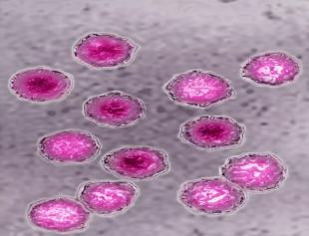
HEPATITIS D

Slide 14
Hepatitis D
HD is a liver disease in both acute and chronic forms
caused by HDV ,
HDV also called Delta agent
is similar to other forms of hepatitis, BUT
it can only infect those who are already infected with the HBV.
It requires HBV for its replication
cannot occur in the absence of HBV
HDV-HBV co-infection is considered the most severe form of chronic viral hepatitis due to more rapid progression towards HCC and liver-related death.
Chronic HBV carriers are at risk of infection with HDV.
People who are not immune to HBV (either by natural disease or immunization with the hepatitis B vaccine) are at risk of infection with HBV, which puts them at risk of HDV infection.
A HBV vaccine is the only method to prevent HDV infection
Hepatitis D should be considered in cases of acute liver failure or when
a patient who is a known hepatitis B carrier suffers an acute exacerbation.

Slide 15
The infection has two forms:
Co-infection
Super-infection
Co-infection ;
individual simultaneously infected with both HDV & HBV
It is usually acute (similar to a hepatitis A infection
HDV-HBV co-infection is considered the
most severe form of chronic viral hepatitis due to rapid progression towards liver-related death& HCC
………
.
…
Super-infection
HDV infection occurs after person is already infected with HBV
Super-infection with HDV acts more like HB and can go on to cause
cirrhosis & death
Super infection is usually suspected when someone
with hepatitis B becomes increasingly ill rapidly
…
…

Slide 16
Geographical distribution
Worldwide,
The overall № of HDV infection has decreased since 1980s. ?????
mainly due to a successful global HBV vaccination programme.
HDV is found throughout the world but with a not uniform distribution.
It is estimated that 5% of chronic HBV with HDV, infection
Resulting in a total of 15 – 20 Million persons infected with HDV WW
The global estimation and geographic information are incomplete because many countries do not report the prevalence of HDV
Its highest prevalence has been reported in Italy, the
Middle East, Central Asia, West Africa and South America.
Middle East (all countries)
Two epidemiological patterns

Slide 17
Two epidemiological patterns of HDV infection have been identified
In Mediterranean countries, HDV infection is endemic among
persons with HB,.
In United States and northern Europe Is non endemic areas,
HDV infection is confined to persons exposed frequently to
blood and blood products, IVDUs and haemophiliacs
Incubation Period
Varies from 2-12 weeks,
Being shorter in HBV carriers who are superinfected with the agent,
than in susceptible persons who are simultaneously infected with both HBV & HDV.

Slide 18
Transmission
HDV infects all ages.
Persons who have received multiple transfusions,
intravenous drug abusers, and their
close contacts are at high-risk
The primary route of transmission are similar to HBV&HCV
Infection is dependent on HBV replication,
as HBV provides an HBsAg envelop for HDV
Percutaneous through contact with infected blood or blood products or other body fluids of an infected person.
HDV does not transmitted sexually
Vertical transmission is possible but rare.
Vaccination against HBV prevents HDV co infection, and
Hence expansion of childhood HBV immunization programmes has resulted in a lower HDV incidence worldwide
However, vaccination does not protect HB carriers from super infection by HDV

Slide 19
Symptoms
Acute hepatitis:
Simultaneous infection with HBV and HDV can lead to
a mild-to-severe
or even fulminant hepatitis, but
Recovery is usually complete and
Development of chronic HD is rare (<5% of acute hepatitis).
Super infection:
HDV can infect a person already chronically infected with HBV.
The super infection of HDV on chronic HB
accelerates progression to a
more severe disease in all ages and in 70‒90% of persons.
HDV super infection accelerates progression to cirrhosis
almost a decade earlier than HBV non co infected persons,
although HDV suppresses HBV replication.
The mechanism in which HDV causes more severe hepatitis and a faster progression of fibrosis than HBV alone remains unclear.

Slide 20
Who is at risk?
Chronic HBV carriers are at risk for infection with HDV.
People who are not immune to HBV (natural disease or HB vaccine)
High prevalence in persons who inject drugs injecting drug use is an important risk factor for HDV co-infection.
High-risk sexual activity (e.g. sex worker)
Migration from high HDV to lower prevalence areas might have an effect on the epidemiology of the host country
Screening and diagnosis
HDV is diagnosed by high titres of IgG & IgM anti-HDV, and
Confirmed by detection of HDV RNA in serum.
HBsAg is useful to monitor treatment response
if quantitative HDV RNA is not available.
Decreasing HBsAg titers often means surface antigen loss and
HDV clearance, although surface antigen loss is rare in treatment.
Treatment
Pegylated interferon alpha is the generally recommended treatment for HDV infection.
Treatment should last for at least 48 weeks irrespective of the patient’s response.
The virus tends to give a low rate of response to the treatment; however, the treatment is associated with a lower likelihood of disease progression.

Slide 22
HEPATITIS E

