Slide 1
WELCOME
REGIONS
POSITION
FIRST YEAR MEDICAL STUDENTS
Cavities
PLANES
intro
DIRECTIONS
AMAL ALBTOOSH

Slide 2
REGIONS
POSITIONS
Cavities
PLANES
INTRO
DIRECTIONS
ANATOMY: Study of the STRUCTURE of the Human Body
Physiology: is the study of the FUNCTION of the human body
Histology: is the study of the microscopic structure of tissues.

Slide 3
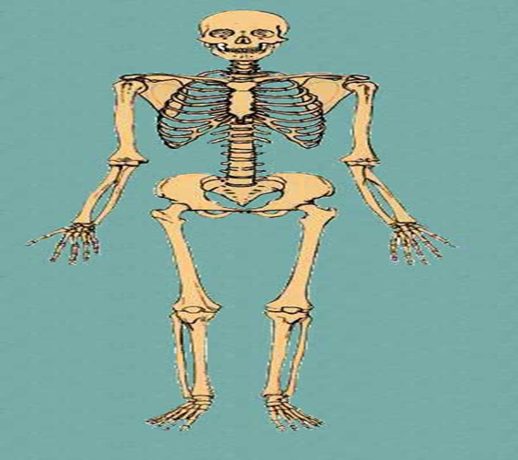
When in the anatomical position, the subject stands erect facing the observer, the upper extremities are placed at the sides, the palms of the hands are turned forward, and the feet are flat on the floor.
REGIONS
Cavities
PLANES
about
DIRECTIONS

Slide 4
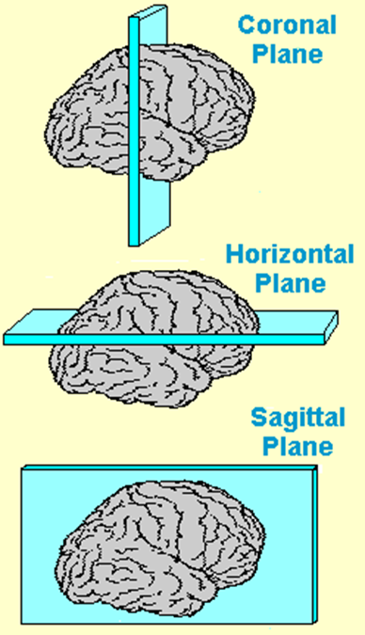
REGIONS
POSITIONS
Cavities
PLANES
about
DIRECTIONS
Coronal
Sagittal
Transverse
Frontal/vertical
Vertical
Horisontal
refers to a section that divides the body into anterior and posterior portions.
(median plane)- refers to a lengthwise cut that divides the body into right and left portions.
refers to a cut that divides the body into superior and inferior portions.

Slide 5
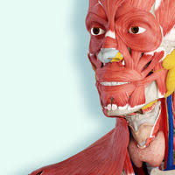
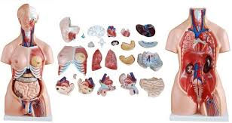
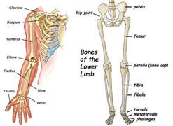
REGIONS
POSITIONS
Cavities
PLANES
about
DIRECTIONS
Head and neck
Trunk
Extremities (or limbs)
Skull
Thorax, abdomine, pelvis
Muscles of facial expression, neck muscles and muscles of mastication
Body cavities:
Thoracic
Abdominal
Pelvic
Upper limbs
Lower limbs

Slide 6
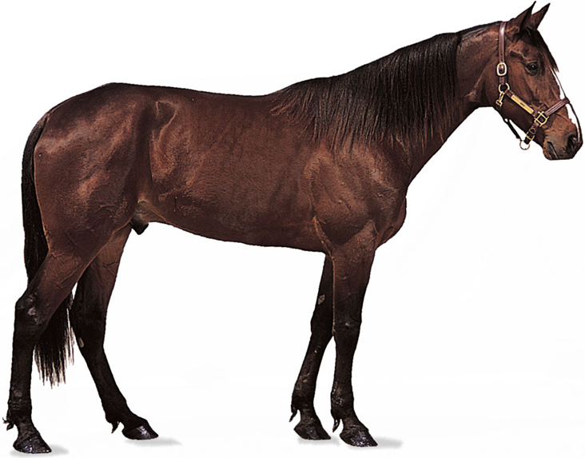
Directional terms
Directional terms are used to precisely locate one part of the body relative to another and to reduce length of explanations.
Anatomic TERMS:
In four legged animals the UPPER (BACK) surface is called DORSAL and the lower (belly) surface ventral.
The terms anterior, cranial, cephalic, and rostral refer to the head end of the body,
posterior and caudal to the tail end.
REGIONS
POSITIONS
Cavities
PLANES
about
DIRECTIONS

Slide 7
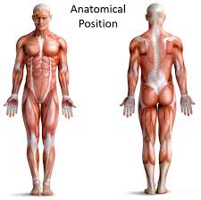
In humans,
DORSAL becomes equivalent to POSTERIOR
VENTRAL is the same as ANTERIOR
CRANIAL is often called SUPERIOR
CAUDAL is for INFERIOR.
Objects near the middle plane of the body are medial and those farther away are lateral.
Proximal refers to structures nearest the central bulk of a structure and distal to ones away from it.
In referring to another structure, if it is located on the same side of the body, it is known as ipsilateral; if it is on the opposite side, it is contralateral.
REGIONS
POSITIONS
PLANES
about
Cavities
DIRECTIONS

Slide 8
REGIONS
POSITIONS
Cavities
PLANES
about
DIRECTIONS
Body Cavities - Body cavities are spaces within the body that help protect, separate, and support internal organs.
Dorsal Body Cavity
Ventral Body Cavity

