Slide 1
common chromosomal anomalies and genetic disease
Done by
Lekaa al moghrabi
Banan kasassbeh
Lena tarawneh
Aon al smadi
Abdallah al hourani

Slide 2
content
- Introduction
- Edward’s Syndrome
- Down syndrome
- Turner syndrome
- Patau syndrome
- Klinefelter syndrome
- Fragile X syndrome
- Triple-X syndrome

Slide 3
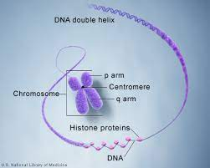
Chromosomes are the structures that hold our genes(the basic units of heredity ).🧬
Human cells have 23 pairs of chromosomes with one copy of each chromosome inherited from each parent.Twenty-two pairs of chromosome are autosomes, the remaining pair consists for sex chromosomes.
Females have two X chromosomes, males have one X and one Y

Slide 4
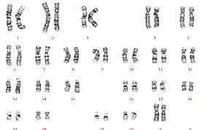
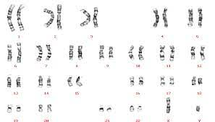
Apicture or chromosome map of all 46 chromosome is called a karyotype
The karyotpe can help identify chromosomal abnormalities that are evident in either in the structure or number of chromosomes .
Normal female karyotype (46 XX)
Normal male karyotype 46 xy

Slide 5
Errors that occur in meiosis during the production of gametes can lead to abnormalities of chromosome structure or number
Syndrome caused by chromosomal abnormalities include trisomy 21(Down syndrome),trisomy 13, trisomy18, Turner syndrome and Klinefelter syndrome as well as rare chromosomal duplications deletions or inversion
Chromosomal abnormalities occur in approximately 8% of fertilized ova but in only .6%of liveborn infants
50% of spontaneous abortuses have a chromosomal abnormalities ,
In newborn and older children ,features that suggest the presence of chromosome anomaly include(SOGA low birth weight, failure to thrive, developmental disabilities and the presence of three or more congenital malformations.

Slide 6
ABNORMALITIES IN NUMBER (ANEUPLOIDY)
During meiosis ,failure of a chromosomal pair to separate properly result in nondisjunction .Aneuploidy is a change in the number of chromosomes that results from nondisjunction .A cell may have one(monosomy) or three(trisomy) copies of particular chromosome

Slide 7
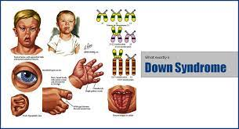
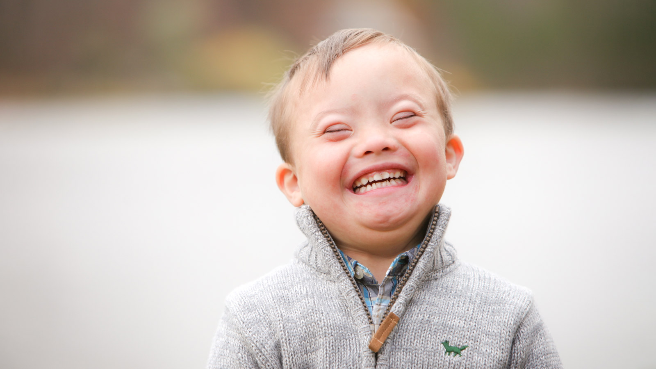
Down syndrome

Slide 8
down syndrome(Trisomy 21)
Down syndrome is a genetic disorder caused when abnormal cell division results in an extra full or partial copy of chromosome 21. This extra genetic material causes the developmental changes and physical features of Down syndrome.
Down syndrome varies in severity among individuals, causing lifelong intellectual disability and developmental delays. It's the most common genetic chromosomal disorder and cause of learning disabilities in children. It also commonly causes other medical abnormalities, including heart and gastrointestinal disorders
People who have Down syndrome have learning difficulties, mental disability, a characteristic facial appearance, and poor muscle tone (hypotonia) in infancy.
Individuals with Down syndrome also have an increased risk for having heart defects, digestive problems such as gastroesophageal reflux or celiac disease, and hearing loss. Some people who have Down syndrome have low activity of the thyroid gland (hypothyroidism) - an organ in the lower neck that produces hormones

Slide 9
down syndrome
Risk factors
Some parents have a greater risk of having a baby with Down syndrome. Risk factors include:
Advancing maternal age
Being carriers of the genetic translocation for Down syndrome
Having had one child with Down syndrome.
Life expectancy
Life spans have increased dramatically for people with Down syndrome. Today, someone with Down syndrome can expect to live more than 60 years, depending on the severity of health problems.

Slide 10
What are the symptoms of Down syndrome?
-Flattened face
-Small head
-Short neck
-Protruding tongue
-Upward slanting eye lids (palpebral fissures)
-Unusually shaped or small ears
-Poor muscle tone
-Broad, short hands with a single crease in the palm
-Relatively short fingers and small hands and feet
-Excessive flexibility
-Short height

Slide 11
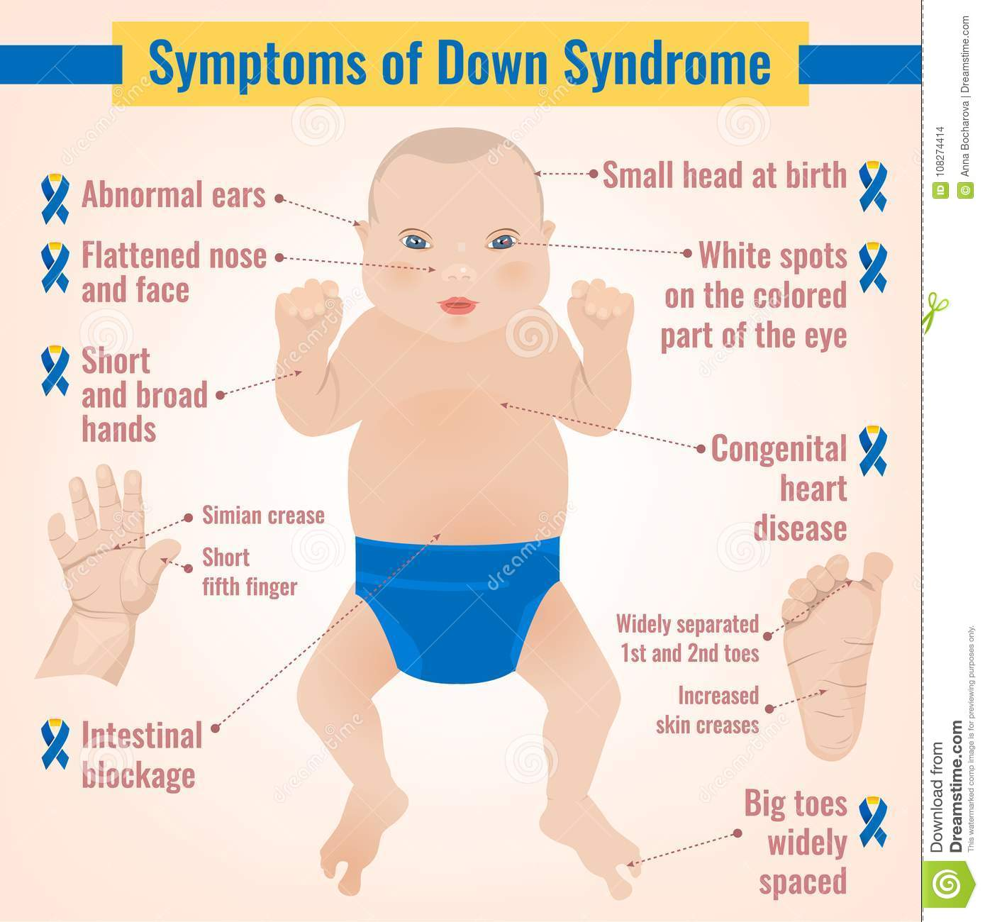

Slide 12
How is Down syndrome diagnosed?
Down syndrome can be diagnosed in infancy based on the characteristic clinical findings. When Down syndrome is suspected in a person, a genetic test called a chromosome analysis is performed on a blood or skin sample to look for an extra chromosome 21 (trisomy 21)
Prenatal diagnosis :
first trimester : fetal nuchal Translucency ( increase)
Second trimester : Biochemical markers (AFP low , hCG high ,Ue3 low , InhibinA high )
Chorionic villus sampling amniocentesis

Slide 13
Complications
Heart defects. About half the children with Down syndrome are born with some type of congenital heart defect. These heart problems can be life-threatening and may require surgery in early infancy.
Gastrointestinal (GI) defects. GI abnormalities occur in some children with Down syndrome and may include abnormalities of the intestines, esophagus, trachea and anus. The risk of developing digestive problems, such as GI blockage, heartburn (gastroesophageal reflux) or celiac disease, may be increased.
Immune disorders. Because of abnormalities in their immune systems, people with Down syndrome are at increased risk of developing autoimmune disorders, some forms of cancer, and infectious diseases, such as pneumonia.
Sleep apnea. Because of soft tissue and skeletal changes that lead to the obstruction of their airways, children and adults with Down syndrome are at greater risk of obstructive sleep apnea.

Slide 14
Complications
Obesity. People with Down syndrome have a greater tendency to be obese compared with the general population.
Spinal problems. Some people with Down syndrome may have a misalignment of the top two vertebrae in the neck (atlantoaxial instability). This condition puts them at risk of serious injury to the spinal cord from overextension of the neck.
Leukemia. Young children with Down syndrome have an increased risk of leukemia.
Dementia. People with Down syndrome have a greatly increased risk of dementia — signs and symptoms may begin around age 50. Having Down syndrome also increases the risk of developing Alzheimer's disease.
Other problems. Down syndrome may also be associated with other health conditions, including endocrine problems, dental problems, seizures, ear infections, and hearing and vision problems.

Slide 15
Complications
Mental retardation
Most Down syndrome have intellectual disability in the mild (IQ 50–70) to moderate (IQ 35–50)
Language skills show a difference between understanding speech and expressing speech, and commonly individuals with Down syndrome have a speech delay (expressive rather than receptive )
Children may also have delayed mental and social development. Common problems may include:
Impulsive behavior
Poor judgment
Short attention span
Slow learning

Slide 16
Management
No specific treatment however
Regular checkups
Special education
Treatment to prevent heart failure for those with heart conditions
Surgery for children with digestive or cardiac problems
Monitor for eye problems
Monitor for lymphocytic leukemia
Growth chart on Down curve
Check hearing annually ( high risk of serious otitis media )

Slide 17
Edward’s Syndrome

Slide 18
Edward’s Syndrome
Edwards syndrome, also known as trisomy 18, is a very severe genetic condition that affects how your child’s body develops and grows. Children diagnosed with trisomy 18 have a low birth weight and multiple birth defects
The second most common autosomal trisomy.
Edwards syndrome (trisomy 18) can affect anyone. The condition occurs when a person has an extra copy of chromosome 18, which is random and unpredictable. The likelihood that a parent will have a child with Edwards syndrome (trisomy 18) increases with maternal age at the time of pregnancy. If a parent had a child with Edwards syndrome (trisomy 18) and becomes pregnant again, it’s unlikely they’ll have another child diagnosed with the same condition (no more than 1%).

Slide 19
Edward’s Syndrome
Edwards syndrome (trisomy 18) occurs in an estimated 1 out of every 5,000 to 6,000 live births
More than 95% of with trisomy 1 are spontaneously aborted in the first trimester.
Trisomy 18 is usually lethal; fewer than 10% of affected
survive until their first birthday

Slide 20
What are the symptoms of Edwards syndrome ?
Symptoms of Edwards syndrome (trisomy 18) typically include poor growth before and after birth, multiple birth defects and severe developmental delays or learning problems. Symptoms are present during pregnancy and after your child is born.
Symptoms of Edwards syndrome (trisomy 18) during pregnancy
Your healthcare provider will look for signs of Edwards syndrome (trisomy 18) during a prenatal ultrasound, including:
Very little fetal activity.
A single artery in your umbilical cord.
A small placenta.
Birth defects.
polyhydramnios

Slide 22
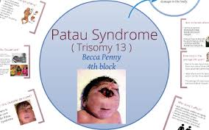
Patau syndrome

Slide 23
Patau syndrome
Patau syndrome is a syndrome caused by a chromosomal abnormality, in which some or all of the cells of the body contain extra genetic material from chromosome 13.
This severely disrupts normal development and, in many cases, results in miscarriage , stillbirth or the baby dying shortly after birth
Babies with Patau's syndrome grow slowly in the womb and have a low birth weight, along with a number of other serious medical problems.
Patau's syndrome affects about 1 in every 5,000 births. The risk of having a baby with the syndrome increases with the mother's age.
More than 9 out of 10 children born with Patau's syndrome die during the first year.

Slide 24
Symptoms and features
Babies with Patau's syndrome can have a wide range of health problems.
Their growth in the womb is often restricted, resulting in a low birth weight, and 8 out of 10 will be born with severe heart defects.
The brain often does not divide into 2 halves. This is known as holoprosencephaly.
When this happens, it can affect facial features and cause defects such as:
Cleft lip and palate
an abnormally small eye or eyes (microphthalmia)
absence of 1 or both eyes (anophthalmia)
reduced distance between the eyes (hypotelorism)
problems with the development of the nasal passages

Slide 25
Symptoms and features
Other abnormalities of the face and head include:
smaller than normal head size (microcephaly)
skin missing from the scalp (cutis aplasia)
ear malformations and deafness
Patau's syndrome can also cause other problems, such as:
an abdominal wall defect where the abdomen does not develop fully in the womb, resulting in the intestines being outside the body, covered only by a membrane – this is known as an exomphalos or omphalocele
abnormal cysts in the kidneys
There may also be abnormalities of the hands and feet, such as extra fingers or toes (polydactyly) and a rounded bottom to the feet, known as rocker-bottom feet.

Slide 27
Treating and managing Patau's syndrome
There's no specific treatment for Patau's syndrome. As a result of the severe health problems a newborn baby with the syndrome will have, doctors usually focus on minimizing discomfort and ensuring the baby is able to feed.
For the small number of babies with Patau's syndrome who survive beyond the first few days of life, their care will depend on their specific symptoms and needs.
Screening for Patau's syndrome
a screening test for Patau's syndrome, as well as Down's syndrome (trisomy 21) and Edwards' syndrome(trisomy 18), from 10 to 14 weeks of pregnancy.

Slide 28
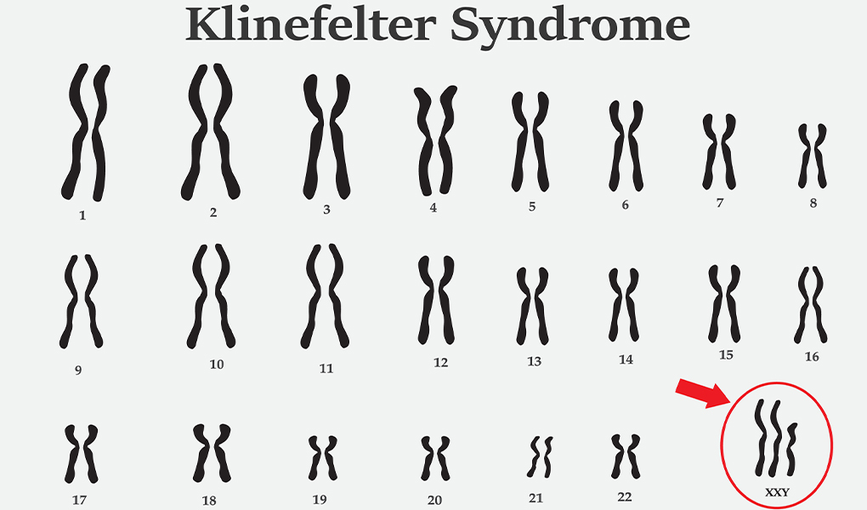

Slide 29
Klinefelter syndrome
Klinefelter syndrome is a condition that occurs in men as a result of an extra X chromosome. The most common symptom is infertility.
The most common human sex chromosome disorder Klinefelter syndrome is found in about 1 out of every 500-1,000 newborn males.
It is also the most common chromosomal disorder associated with male hypogonadism and infertility

Slide 30
Klinefelter syndrome
Klinefelter syndrome and its variants are not inherited; An error in cell division called nondisjunction results in a reproductive cell with an abnormal number of chromosomes. For example, an egg or sperm cell may gain one or more extra copies of the X chromosome as a result of non disjunction. If one of these atypical reproductive cells contributes to the genetic makeup of a child, the child will have one or more extra X chromosomes in each of the body's cells
Mosaic 46,XY/47,XXY is also not inherited. It occurs as a random event during cell division early in fetal development. As a result, some of the body's cells have one X chromosome and one Y chromosome (46,XY), and other cells have an extra copy of the X chromosome (47,XXY).

Slide 31
What are the symptoms of Klinefelter syndrome?
Males who have Klinefelter syndrome may have the following symptoms: small, firm testes, a small penis, sparse pubic, armpit and facial hair, enlarged breasts (called gynecomastia), tall stature, and abnormal body proportions (long legs, short trunk).
School-age children may be diagnosed if they are referred to a doctor to evaluate learning disabilities. The diagnosis may also be considered in the adolescent male when puberty is not progressing as expected. Adult males may come to the doctor because of infertility.

Slide 32
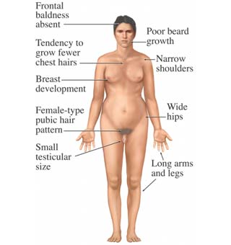
symptoms of Klinefelter syndrome

Slide 33
How is Klinefelter syndrome diagnosed?
The main tests used to diagnose Klinefelter syndrome are:
Hormone testing. Blood or urine samples can reveal abnormal hormone levels that are a sign of Klinefelter syndrome.
Chromosome analysis. Also called karyotype analysis, this test is used to confirm a diagnosis of Klinefelter syndrome. A blood sample is sent to the lab to check the shape and number of chromosomes.

Slide 34
How is Klinefelter syndrome treated?
Testosterone replacement therapy. Starting at the time of the usual onset of puberty, testosterone replacement therapy can be given to help stimulate changes that normally occur at puberty, such as developing a deeper voice, growing facial and body hair, and increasing muscle mass and sexual desire (libido). Testosterone replacement therapy can also improve bone density and reduce the risk of fractures, and it may improve mood and behavior. It will not improve infertility.
Breast tissue removal. In males who develop enlarged breasts, excess breast tissue can be removed by a plastic surgeon, leaving a more typical-looking chest.
Speech and physical therapy. These treatments can help boys with Klinefelter syndrome who have problems with speech, language and muscle weakness.
Educational evaluation and support. Some boys with Klinefelter syndrome have trouble learning and socializing and can benefit from extra assistance. Talk to your child's teacher, school counselor or school nurse about what kind of support might help.
Psychological counseling.

Slide 35
turner syndrome

Slide 36
turner syndrome
Turner syndrome is a chromosomal condition that alters development in females. Women with this condition tend to be shorter than average and are usually unable to conceive a child (infertile) because of an absence of ovarian function. Other features of this condition that can vary among women who have Turner syndrome include: extra skin on the neck (webbed neck), puffiness or swelling (lymphedema) of the hands and feet, skeletal abnormalities, heart defects and kidney problems.
Turner syndrome is a chromosomal condition related to the X chromosome. Researchers have not yet determined which genes on the X chromosome are responsible for most signs and symptoms of Turner syndrome. They have, however, identified one gene called SHOX that is important for bone development and growth. Missing one copy of this gene likely causes short stature and skeletal abnormalities in women with Turner syndrome

Slide 37
Advanced maternal age is not associated with an increased incidence.
The abnormality is not inherited from an affected parent because women with Turner syndrome are usually sterile and cannot have children.
This condition occurs in about 1 in 2,500 female births worldwide, but is much more common among pregnancies that do not survive to term (miscarriages and stillbirths).

Slide 38
What are the symptoms of Turner syndrome?
Girls who have Turner syndrome are shorter than average. They often have normal height for the first three years of life, but then have a slow growth rate. At puberty they do not have the usual growth spurt.
Non-functioning ovaries are another symptom of Turner syndrome.
Girls with Turner Syndrome are usually of normal intelligence with good verbal skills and reading skills. Some girls, however, have problems with math, memory skills and fine-finger movements.
Additional symptoms of Turner syndrome include the following:
An especially wide neck (webbed neck) and a low or indistinct hairline.
A broad chest and widely spaced nipples.
Arms that turn out slightly at the elbow.

Slide 39
A heart murmur, sometimes associated with narrowing of the aorta (blood vessel exiting the heart).
A tendency to develop high blood pressure (so this should be checked regularly).
Minor eye problems that are corrected by glasses.
Scoliosis (deformity of the spine) occurs in 10 percent of adolescent girls who have Turner syndrome.
The thyroid gland becomes under-active in about 10 percent of women who have Turner syndrome. Regular blood tests are necessary to detect it early and if necessary treat with thyroid replacement
Older or over-weight women with Turner syndrome are slightly more at risk of developing diabetes.
Osteoporosis can develop because of a lack of estrogen, but this can largely be prevented by taking hormone replacement therapy.

Slide 40
How is Turner syndrome diagnosed?
A diagnosis of Turner syndrome may be suspected when there are a number of typical physical features observed such as webbed neck, a broad chest and widely spaced nipples. Sometimes diagnosis is made at birth because of heart problems, an unusually wide neck or swelling of the hands and feet.
The two main clinical features of Turner syndrome are short stature and the lack of the development of the ovaries.
Many girls are diagnosed in early childhood when a slow growth rate and other features are identified. Diagnosis sometimes takes place later when puberty does not occur.
Turner syndrome may be suspected in pregnancy during an ultrasound test. This can be confirmed by prenatal testing - chorionic villous sampling or amniocentesis - to obtain cells from the unborn baby for chromosomal analysis. If a diagnosis is confirmed prenatally, the baby may be under the care of a specialist pediatrician immediately after birth.
Diagnosis is confirmed by a blood test, called a karyotype.

Slide 41
What is the treatment for Turner syndrome?
during childhood and adolescence, girls may be under the care of a pediatric endocrinologist, who is a specialist in childhood conditions of the hormones and metabolism.
Growth hormone injections are beneficial in some individuals with Turner syndrome. Injections often begin in early childhood and may increase final adult height by a few inches.
Estrogen replacement therapy is usually started at the time of normal puberty, around 12 years to start breast development. Estrogen and progesterone are given a little later to begin a monthly 'period,' which is necessary to keep the womb healthy. Estrogen is also given to prevent osteoporosis.
Babies born with a heart murmur or narrowing of the aorta may need surgery to correct the problem. A heart expert (cardiologist) will assess and follow up any treatment necessary.

Slide 42
Fragile X syndrome
What is fragile X syndrome?
is a genetic condition that causes a range of developmental problems including learning disabilities and cognitive impairment. Usually, males are more severely affected by this disorder than females.
FXS is caused by changes in a gene called Fragile X Messenger Ribonucleoprotein 1 (FMR1)
Fragile X syndrome is the most common form of inherited intellectual disability in males and is also a significant cause of intellectual disability in females. It affects about 1 in 4,000 males and 1 in 8,000 females and occurs in all racial and ethnic groups.

Slide 43
What are the symptoms of fragile X syndrome?
- moderate intellectual disability
- particular facial appearance, characterized by a large head size, a long face, prominent forehead and chin and protruding ears
-may have behavioral problems such as hyperactivity, hand flapping, hand biting, temper tantrums and autism

Slide 44
Triple-X syndrome
is a disorder that affects females and is characterized by the presence of an additional X chromosome. Normally, females have two X chromosomes; however, females with trisomy X carry three X chromosomes.
Triple X syndrome, also called trisomy X or 47,XXX
affects about 1 in 1,000 females.
Many girls and women with triple X syndrome don't experience symptoms or have only mild symptoms. In others, symptoms may be more apparent — possibly including developmental delays and learning disabilities. Seizures and kidney problems occur in a small number of girls and women with triple X syndrome

Slide 45
Triple-X syndrome

