Slide 1
TISSUE REPAIR 1
Eman krieshan, M.D.
10-11-2021

Slide 2
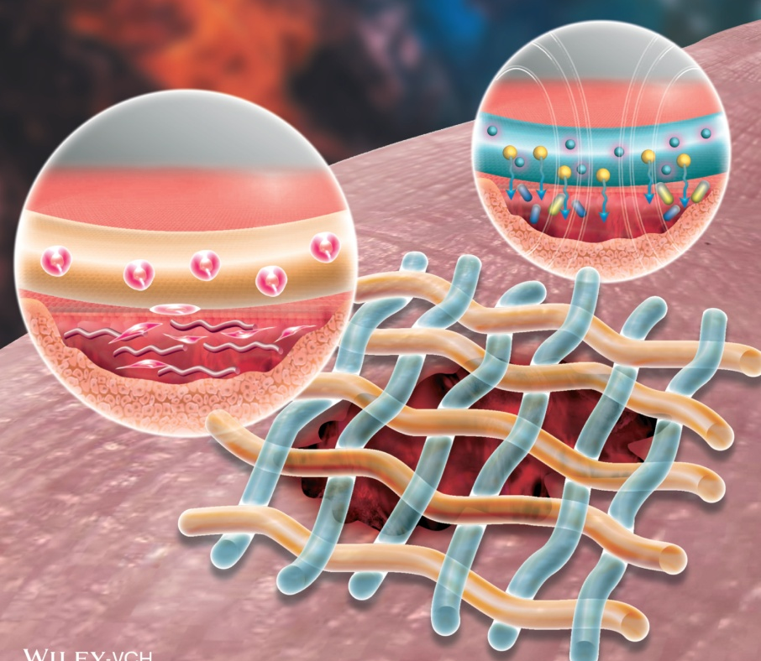
The ability of an organism to repair the damage caused by toxic insults and inflammation is critical to the survival . In fact, the inflammatory response to microbes and injured tissues not only serves to eliminate these dangers but also sets into motion the process of repair.

Slide 3
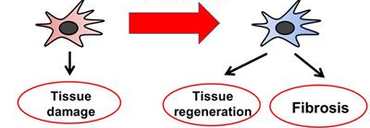
Overview of Tissue Repair
Repair of damaged tissues occurs by two types of reactions:
Regeneration by proliferation of residual (uninjured) cells.
Maturation of tissue stem cells, and the deposition of connective tissue to form a scar.

Slide 4
1.regeneration
Proliferation of cells that survive the injury and retain the capacity to proliferate may contribute to the restoration of damaged tissues, for example:
In the rapidly dividing epithelia of the skin and intestines.
In some parenchymal organs, notably the liver.
Tissue stem cells.

Slide 5
2.Connective tissue deposition (scar formation)
Repair occurs by the laying down of connective (fibrous) tissue, a process that may result in formation of a scar, it occure in:
injured tissues are incapable of complete restitution.
if the supporting structures of the tissue are severely damaged

Slide 6
fibrosis
Extensive deposition of collagen that occurs in the lungs, liver, kidney, and other organs as a consequence of chronic inflammation, or in the myocardium after extensive ischemic necrosis (infarction).
Although the fibrous scar is not normal, it provides enough structural stability that the injured tissue is usually able to function.

Slide 7
The ability of tissues to repair themselves is determined, in part, by their intrinsic proliferative capacity.

Slide 8
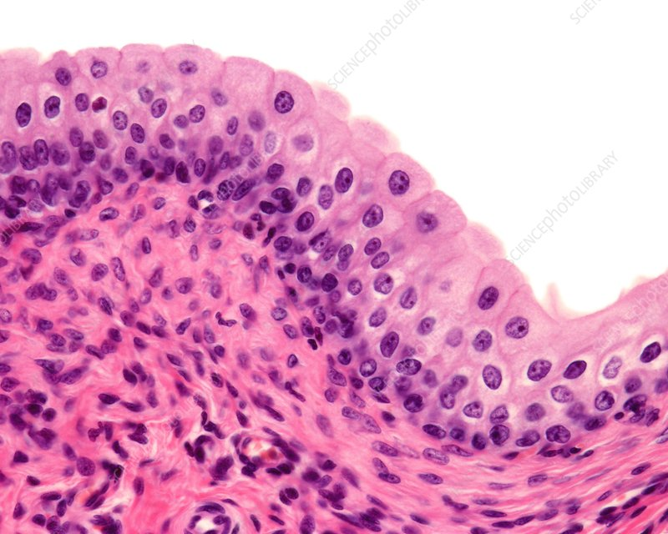
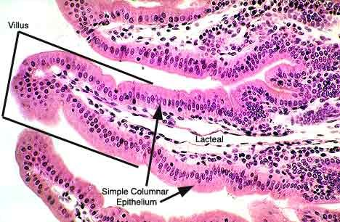
1.labile tissues
cells are constantly being lost and must be continually replaced by new cells that are derived from tissue stem cells and rapidly proliferating immature progenitors.
Notes:
These types of tissues include
1.hematopoietic cells in the bone marrow
2. many surface epithelia, such as the basal layers of the squamous epithelia of the skin, oral cavity, vagina, and cervix
3.the cuboidal epithelia of the ducts draining exocrine organs (e.g., salivary glands, pancreas, biliary tract);
4.the columnar epithelium of the gastrointestinal tract, uterus, and fallopian tubes;
5. the transitional epithelium of the urinary tract.

Slide 9
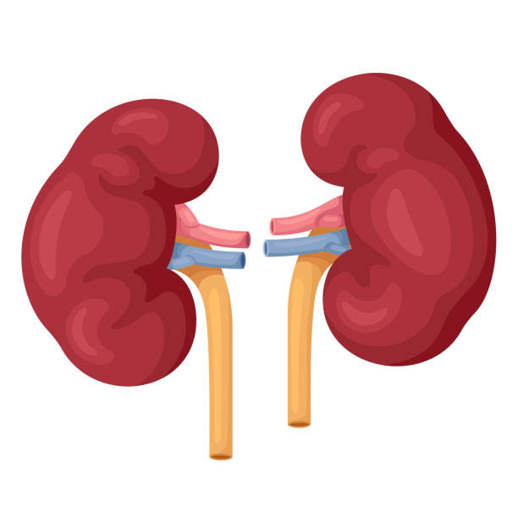
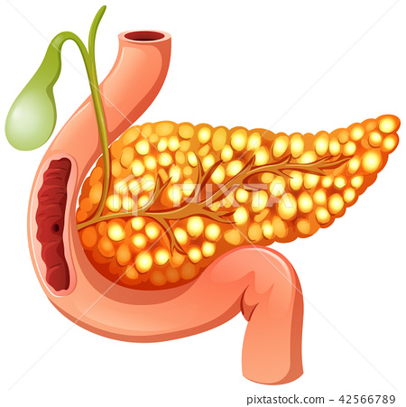
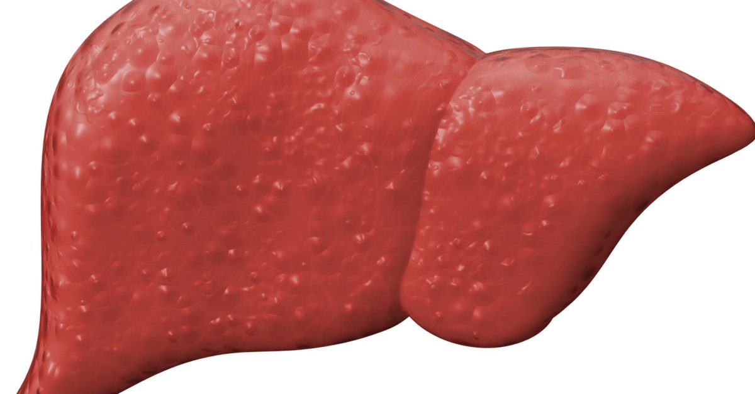
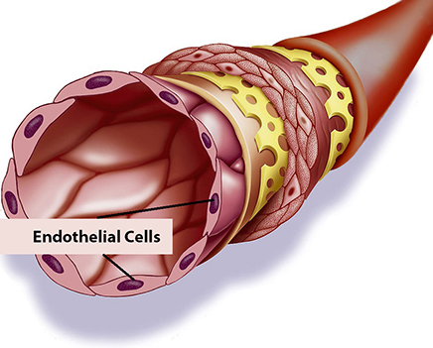
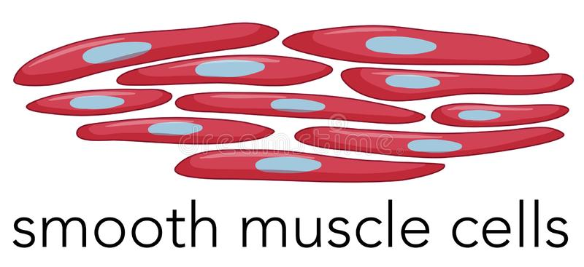
2.stable tissues
are made up of cells that are normally in the G0 stage of the cell cycle and hence not proliferating, but they are capable of dividing in response to injury or loss of tissue mass.
Notes:
These tissues include:
the parenchyma of most solid organs, such as liver, kidney, and pancreas.
Endothelial cells, fibroblasts, and smooth muscle cells

Slide 10
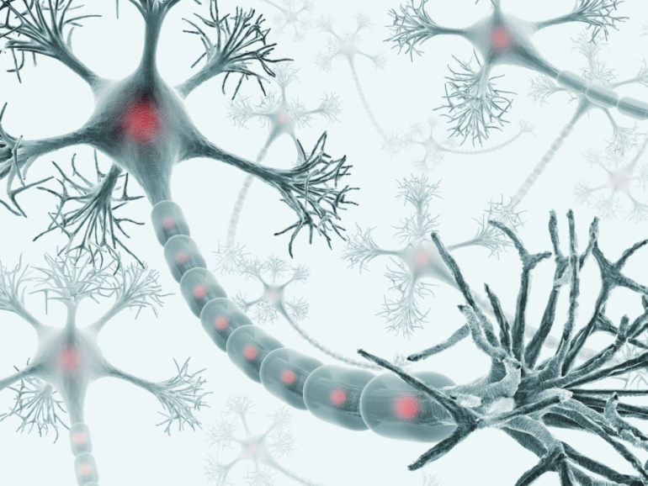
3.permanent tissues
consist of terminally differentiated nonproliferative cells, such as the majority of neurons and cardiac muscle cells.
Injury to these tissues is irreversible and results in a scar, because the cells cannot regenerate.

Slide 11
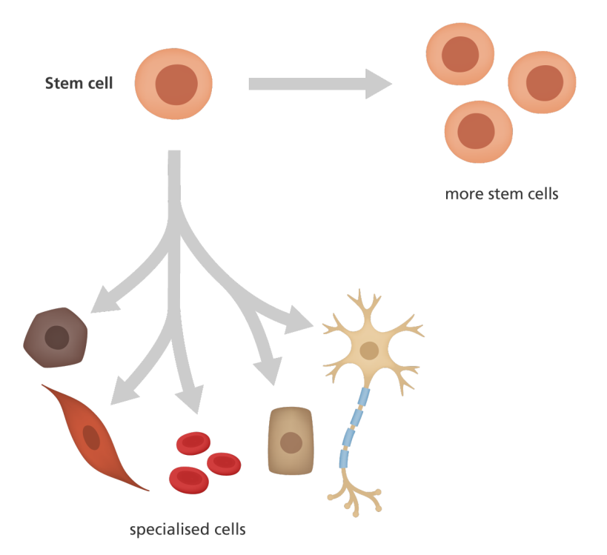
In the process of regeneration, proliferation of residual cells is supplemented by development of mature cells from stem cells

Slide 12
Liver Regeneration
The human liver has a remarkable capacity to regenerate, as demonstrated by its growth after partial hepatectomy,
Regeneration of the liver occurs by two major mechanisms:
proliferation of remaining hepatocytes.
repopulation from progenitor cells.

Slide 13
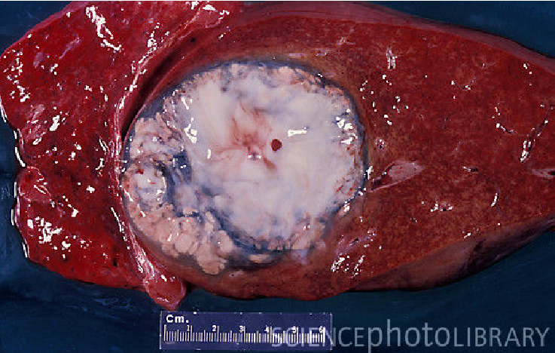
Restoration of normal tissue architecture can occur only if the residual tissue is structurally intact.
if the entire tissue is damaged, regeneration is incomplete and is accompanied by scarring.
partial surgical resection
liver abscess

Slide 14
1.Proliferation of hepatocytes following partial hepatectomy.
In humans, resection of up to 90% of the liver can be corrected by proliferation of the residual hepatocytes.
This process is driven by
cytokines such as IL-6 produced by Kupffer cells,
hepatocyte growth factor (HGF) produced by many cell types.

Slide 15
2.Liver regeneration from progenitor cells.
In situations in which the proliferative capacity of hepatocytes is impaired, progenitor cells in the liver contribute to repopulation, such as:
after chronic liver injury.
inflammation.

Slide 16
Repair by Scarring
if repair cannot be accomplished by regeneration alone, it occurs by:
replacement of the injured cells with connective tissue, leading to the formation of a scar,
or by a combination of regeneration of some residual cells and scar formation.

Slide 17
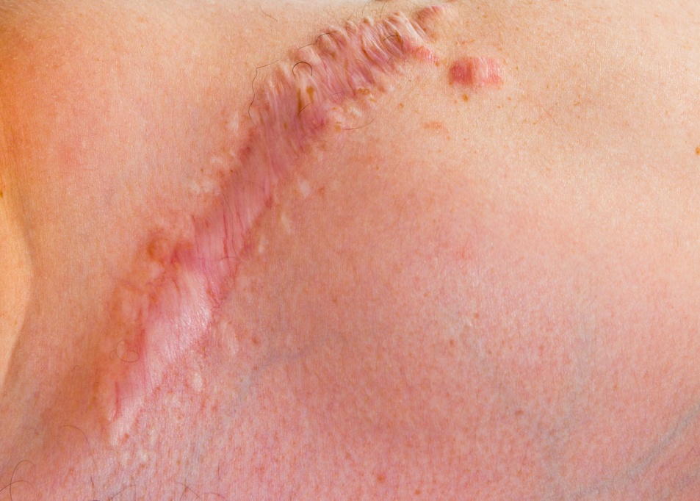
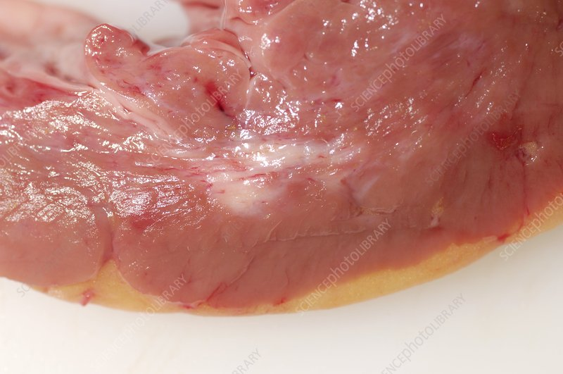
The term scar is most used in connection to wound healing in the skin.
Replacement of parenchymal cells in any tissue by collagen, as in the heart after myocardial infarction.

Slide 18
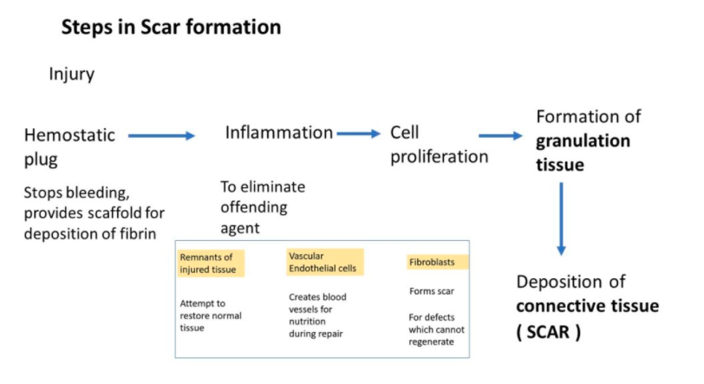

Slide 19
Steps in Scar Formation
1. Within minutes after injury, a hemostatic plug comprised of platelets is formed:
stops bleeding .
provides a scaffold for infiltrating inflammatory cells.

Slide 20
2.Inflammation:
Include acute and chronic inflammatory responses.
The inflammatory cells:
eliminate the offending agents
clear the debris

Slide 21
Macrophages are the central cellular players in the repair process:
M1 macrophages :
clear microbes and necrotic tissue and promote inflammation .
M2 macrophages:
produce growth factors that stimulate the proliferation of many cell types in the next stage of repair.

Slide 22
3.Cell proliferation.
In the next stage, which takes up to 10 days, several cell types migrate to close the now-clean wound, including :
Epithelial cells: migrate over the wound to cover it.
Endothelial and other vascular cells: proliferate to form new blood vessels, a process known as angiogenesis
Fibroblasts: proliferate and migrate into the site of injury and lay down collagen fibers that form the scar.

Slide 23
Cell proliferation is driven by signals provided by growth factors and from the extracellular matrix.
Notes:
Several growth factors Secreted by macrophages, epithelial and stromal cells bind to ECM proteins and activate signaling pathways that induce changes in gene expression and drive cells through the cell cycle that lead to biosynthesis of molecules and organelles that are needed for cell division

Slide 24
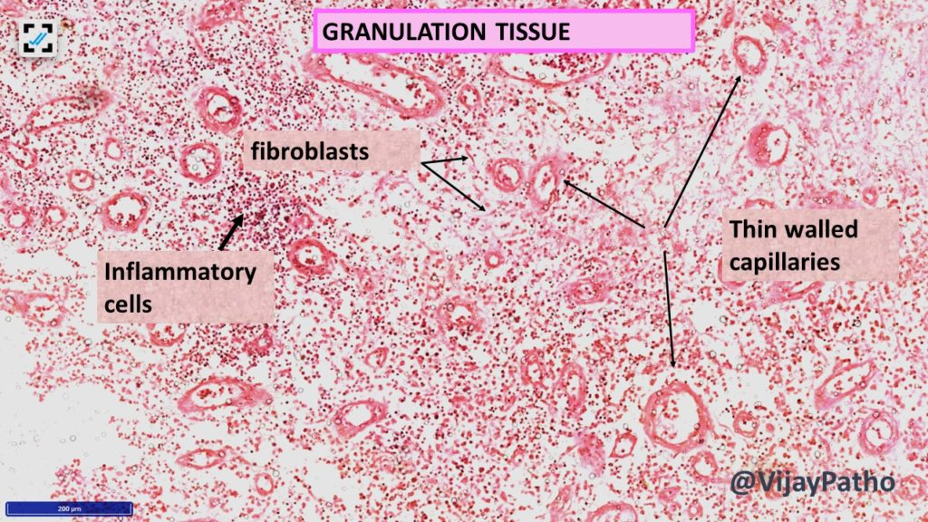
The combination of proliferating fibroblasts, loose connective tissue, new blood vessels and scattered chronic inflammatory cells, forms a granulation tissue.

Slide 25
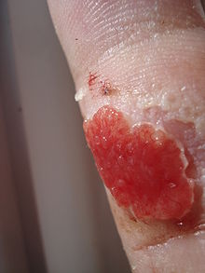
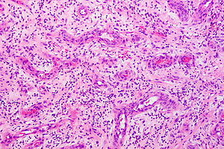
Granulation tissue.
pink, soft, granular gross appearance, such as that seen beneath the scab of a skin wound.
proliferating fibroblasts, loose connective tissue, new blood vessels and scattered chronic inflammatory cells

Slide 26
4. Remodeling.
The connective tissue that has been deposited by fibroblasts is reorganized to produce the stable fibrous scar.
This process begins 2 to 3 weeks after injury and may continue for months or years

Slide 27
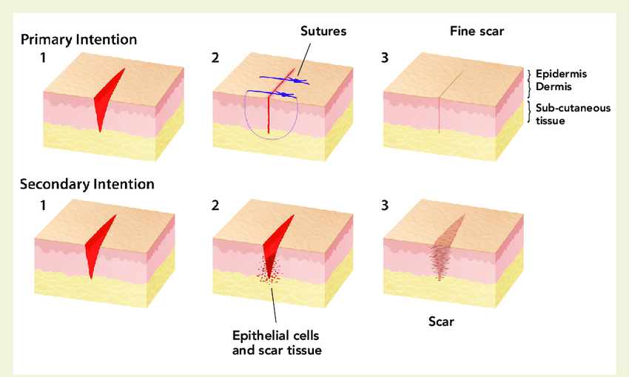
Healing of skin wounds can be classified into healing by :
first intention (primary union).
second intention (secondary union).
Notes:
first intention (primary union), referring to epithelial regeneration with minimal scarring, as in well-apposed surgical incisions.
healing by second intention (secondary union), referring to larger wounds that heal by a combination of regeneration and scarring.

Slide 28
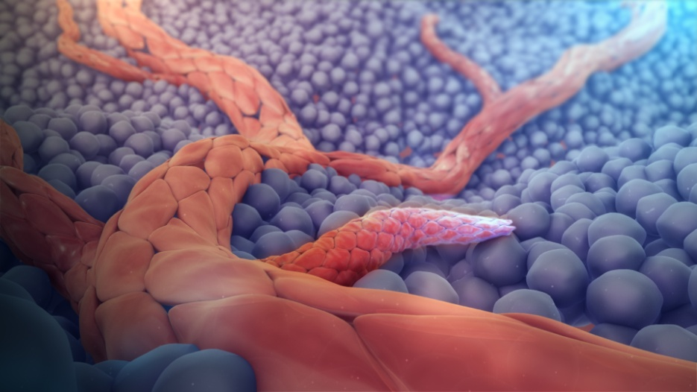
Angiogenesis
Angiogenesis is the process of new blood vessel development from existing vessels.
It is critical in:
healing at sites of injury.
development of collateral circulations at sites of ischemia.
allowing tumors to increase in size

Slide 29
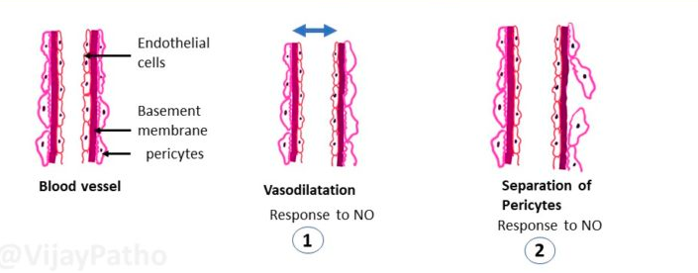
Angiogenesis involves sprouting of new vessels from existing ones, and consists of the following steps:
Vasodilation in response to NO and increased permeability induced by VEGF .
Separation of pericytes from the abluminal surface and breakdown of the basement membrane to allow formation of a vessel sprout .

Slide 30
Migration of endothelial cells toward the area of tissue injury.
Proliferation of endothelial cells just behind the leading front (“tip”) of migrating cells.

Slide 31
Remodeling into capillary tubes.
Recruitment of periendothelial cells (pericytes for small capillaries and smooth muscle cells for larger vessels) to form the mature vessel.
Suppression of endothelial proliferation and migration and deposition of the basement membrane

Slide 32
The process of angiogenesis involves several signaling pathways, cell–cell interactions, ECM proteins, and tissue enzymes:
1.Growth factors:
stimulates both migration and proliferation of endothelial cells
proliferation of endothelial cells.
suppresses endothelial proliferation and migration.
recruits smooth muscle cells
So PDGF and TGF-B participate in the stabilization process

Slide 33
2.Notch signaling.
regulates the sprouting and branching of new vessels .
3.ECM proteins:
participate in the process of vessel sprouting in angiogenesis, through interactions with integrin receptors .
Enzymes in the ECM, notably the matrix metalloproteinases (MMPs), degrade the ECM to permit remodeling and extension of the vascular tube.

