Slide 1
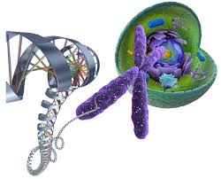
Regulation of Gene Expression
＃خليك بالبيت
Dr. Nesrin Mwafi
Biochemistry & Molecular Biology Department
Faculty of Medicine, Mutah University

Slide 2
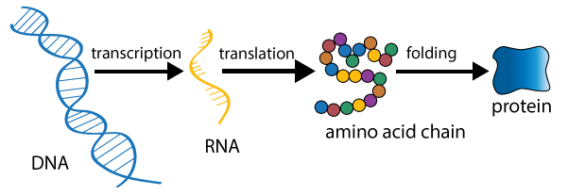
Gene Expression
＃خليك بالبيت
The central dogma in genetics describes the flow of genetic
information in cells from DNA to mRNA to protein
Gene expression: is the process by which information from
a gene is used in the synthesis of a functional gene
products: either protein or RNA such as tRNA and rRNA

Slide 3
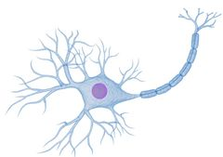
Gene Expression
＃خليك بالبيت
Gene regulation control cell structure and function. It is the basis
for cellular division, differentiation and morphogenesis
Different cell types differ dramatically in both structure and
function although they contain the same genome (e.g. basophil
and neuronal cell)
Cell Proliferation
Cell Specialization
Cell movement and morphogenesis
basophil
Neuronal cell

Slide 4
Gene Expression
＃خليك بالبيت
Different cell types synthesize and accumulate different sets
of RNA and proteins (Hemoglobin in RBCs)
Also, the level of expression of almost every active gene
varies from one cell type to another
Gene expression can be regulated at many steps:
Transcriptional control (the most efficient point of gene expression regulation)
RNA processing control
RNA transport and localization control
Translational control
mRNA degradation control
Protein activity control

Slide 5
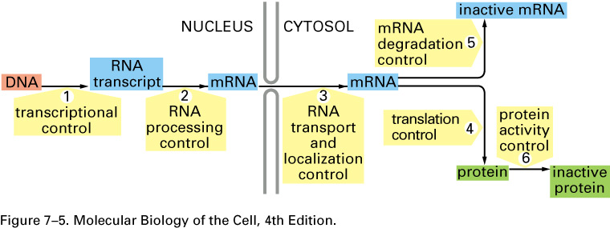
Steps in Eukaryotic Gene Expression regulation
＃خليك بالبيت

Slide 6
1. Transcription Initiation
＃خليك بالبيت
Steps: Initiation, elongation and termination
RNA polymerase catalyzes the synthesis of RNA strand from DNA template.
The promoter is a regulatory DNA region (100-1000 bp). In eukaryotes, it consists of consensus sequences such as TATA box, BRE, INR and DPE . In prokaryotes, two consensus sequences at - 10 and -35.
Start point
-35
-10
+1
prokaryotic promoter
TATA
box

Slide 7
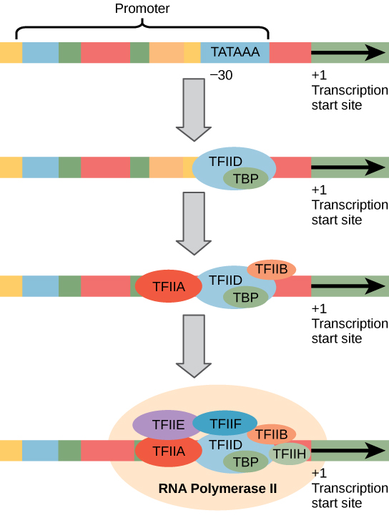
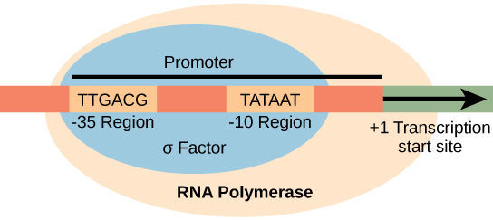
1. Transcription Initiation
Transcription initiation in eukaryotes
It requires general transcription factors which assemble together with RNA polymerase at the promoter to form pre-initiation complex (PIC)
TFIID binds first at the TATA box via its TBP subunit
＃خليك بالبيت
Transcription initiation in prokaryotes
The σ factor recognizes the -35 region in the promoter and binds to it
Once the RNA polymerase starts the transcription, σ factor then dissociates to guide another enzyme to the initiation site

Slide 8
Regulation of Transcription Initiation
＃خليك بالبيت
Gene regulatory proteins called specific transcription factors (activators or repressors) bind DNA specific sequences called gene regulatory regions (enhancers or silencers) to control the expression of various genes
Specific transcription factors (regulatory proteins) are different from general transcription factors which are involved in the transcription initiation process

Slide 9
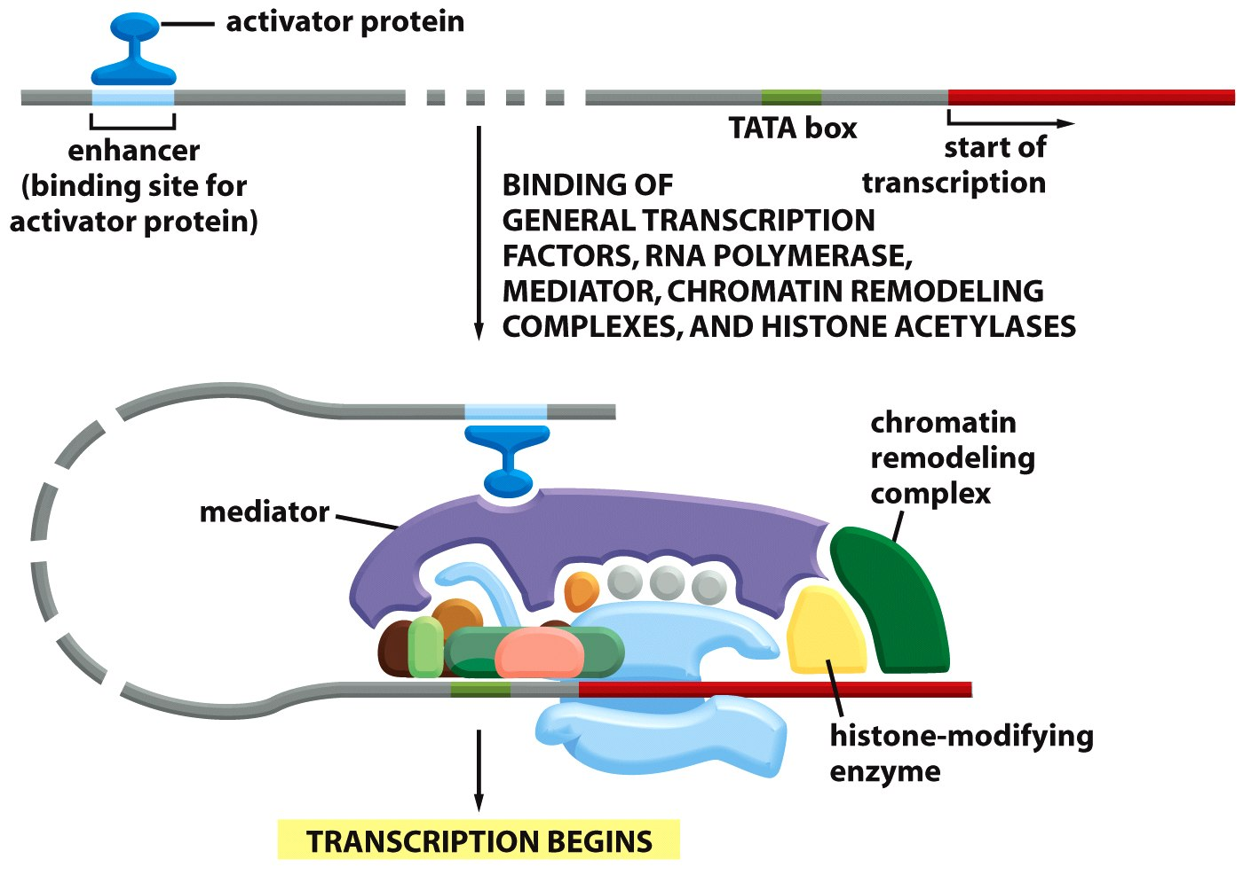
Regulation of Transcription Initiation
＃خليك بالبيت
General transcription factors
RNA polymerase II

Slide 10
Regulation of Transcription Initiation
＃خليك بالبيت
Cis-regulatory elements (CREs): are regions of non-coding DNA which regulate the transcription of nearby genes. These include promoters, enhancers and silencers
Gene regulatory proteins act at distance: DNA looping allows them to interact with the assembled proteins at the promoter
Mediator is a protein complex recruited to the promoter via specific transcription factors. It provides extended contact area for the gene regulatory proteins

Slide 11
Regulation of Transcription Initiation
＃خليك بالبيت
General transcription factors
RNA polymerase II

Slide 12
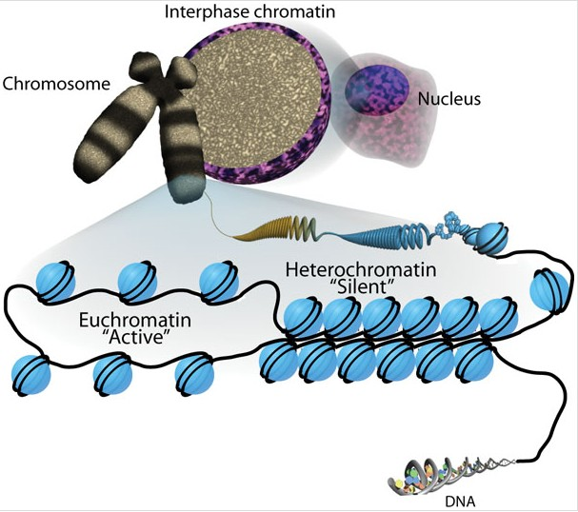
Regulation of Transcription Initiation
＃خليك بالبيت
3
2
Chromatin
1
Nucleosome

Slide 13
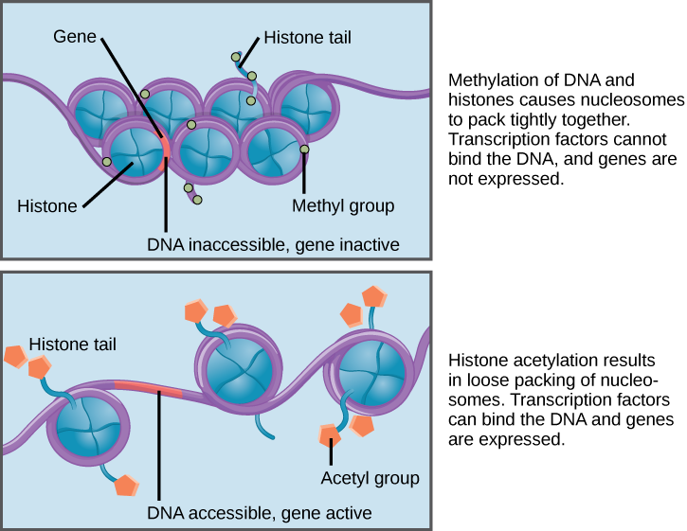
Regulation of Transcription Initiation
＃خليك بالبيت
recruited by repressor
recruited by activator

Slide 14
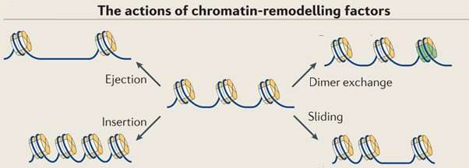
Regulation of Transcription Initiation
＃خليك بالبيت

Slide 15
Regulation of Transcription Initiation
＃خليك بالبيت
Beside the mediator, other proteins are recruited by specific transcription factors to the promoter such as: histone modifying enzymes and chromatin remodeling complexes
Epigenetic factors: gene expression is affected by changes in chromatin structure (Heterochromatin/ Euchromatin)

Slide 16
Regulation of Transcription Initiation in Prokaryotes
＃خليك بالبيت
The expression of many genes is regulated according to the available food in the environment
Operon: DNA unit consists of a cluster of related genes controlled by single promoter and transcribed together into single mRNA strand (bicistronic or polycistronic transcript)
Operator: a segment of regulatory DNA to which a repressor can bind to regulate the transcription of downstream target genes
The three basic DNA components of operon:
Promoter
Operator
Structural genes
Examples in E-coli bacteria: Trp operon and Lac operon

Slide 17
Trp Operon
＃خليك بالبيت
Trp operon consists of five structural genes required for the biosynthesis of the amino acid tryptophan
Polycistronic
transcript

Slide 18
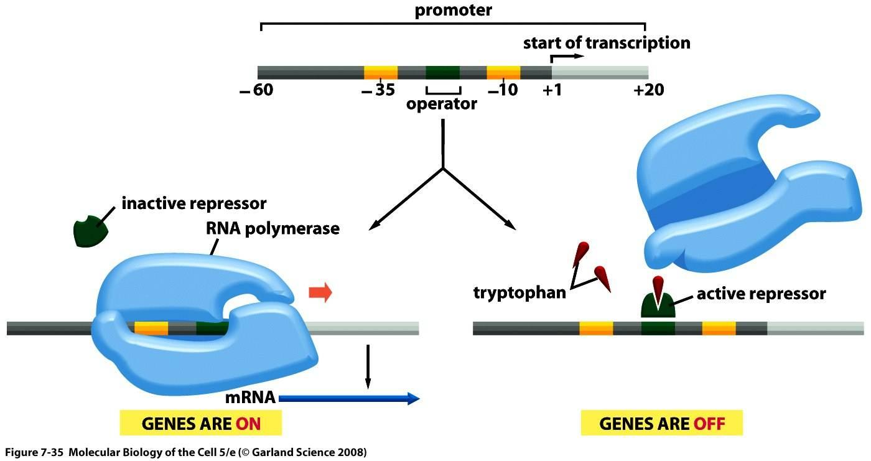
Trp Operon
＃خليك بالبيت
(Co-repressor)

Slide 19
Trp Operon
＃خليك بالبيت
Trp operon consists of five structural genes required for the biosynthesis of the amino acid tryptophan
In the presence of tryptophan in the growth medium, trp repressor (a gene regulatory protein) binds the operator and blocks the access of RNA polymerase (negative control)
In the absence of tryptophan, the repressor is in the inactive form so cannot bind the operator and the enzymes are transcribed as single polycistronic mRNA

Slide 20
Lac Operon
＃خليك بالبيت
Lac operon consists of three structural genes required for the transport and metabolism of lactose as an alternative carbon source to glucose:
1. lacZ : encodes β-galactosidase which cleaves lactose
into glucose and galactose
2. lacY : encodes lactose permease to transport lactose
into the cell
3. lacA : encodes galactoside O-acetyltransferase which
plays a role in cell detoxification

Slide 21
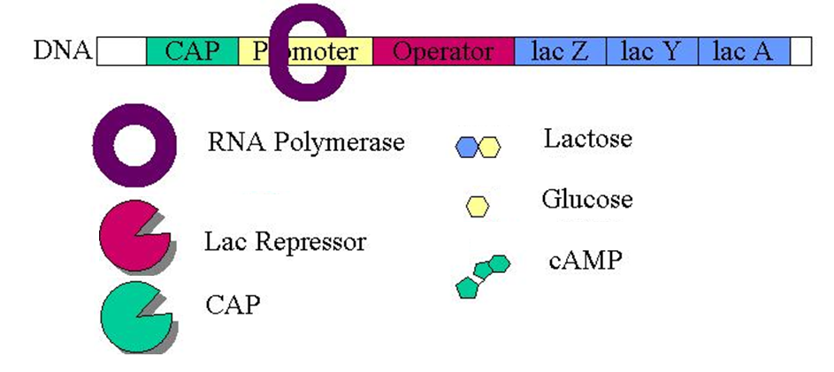
Lac Operon
＃خليك بالبيت
binding site
binding site
Allolactose
(Co-repressor)
(gene regulatory protein)
(Co-activator)
(gene regulatory protein)

Slide 22
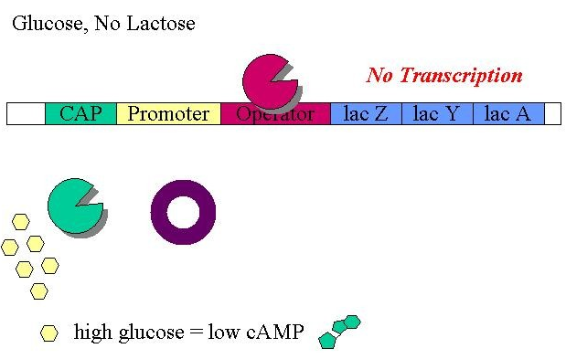
Lac Operon
＃خليك بالبيت
binding site

Slide 23
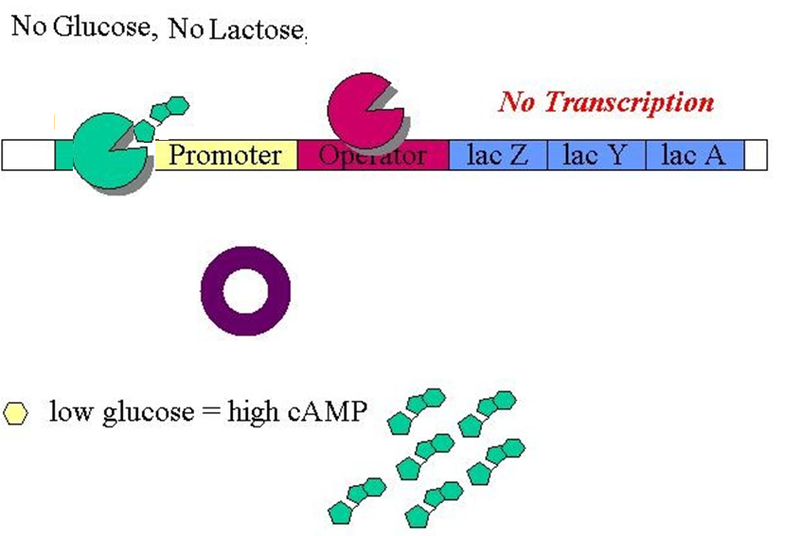
Lac Operon
＃خليك بالبيت

Slide 24
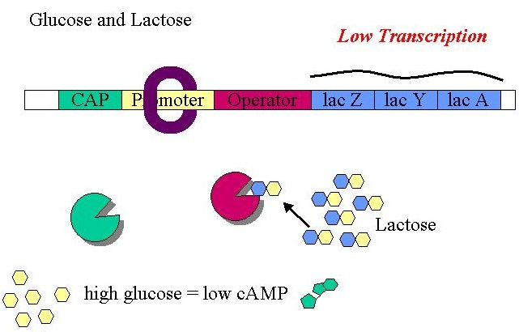
Lac Operon
＃خليك بالبيت
binding site
Allolactose

Slide 25
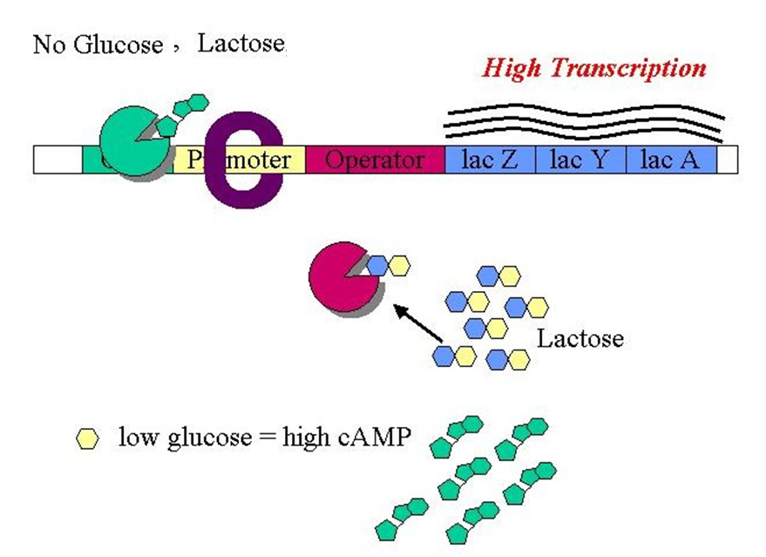
Lac Operon
＃خليك بالبيت
Allolactose

Slide 26
Lac Operon
＃خليك بالبيت
It is under both negative & positive transcriptional controls (dual control): the lac repressor and the CAP activator (catabolite activator protein) respectively
In the absence of lactose, lac repressor binds lac operator and inhibits RNA polymerase binding so genes are switched off (regardless of glucose level).
In the absence of glucose, cAMP level is high. cAMP is co-activator of CAP.
In presence of lactose, the lac repressor is inactivated by the binding to lactose metabolite “allolactose” so the repressor dissociates from the operator with the genes are weakly transcribed in the presence of glucose but extensively transcribed in the absence of glucose
Allolactose is an inducer of lac operon. It acts as co-repressor of lac repressor protein

Slide 27
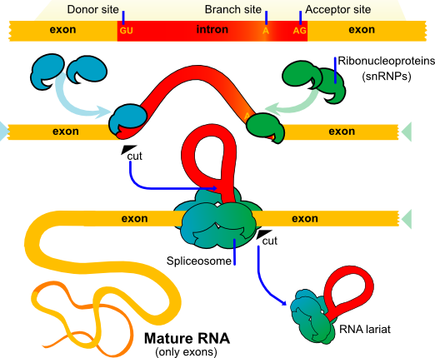
2. RNA Splicing Control
＃خليك بالبيت
The post transcriptional modification (5’-capping, splicing and 3’ polyadenylation) transfers pre-mRNA into the mature transcript mRNA (Eukaryotes only)
RNA splicing is the removal of introns and the joining of exons catalyzed by spliceosome (RNA-protein complex)
(5’ splice site)
(3’ splice site)

Slide 28
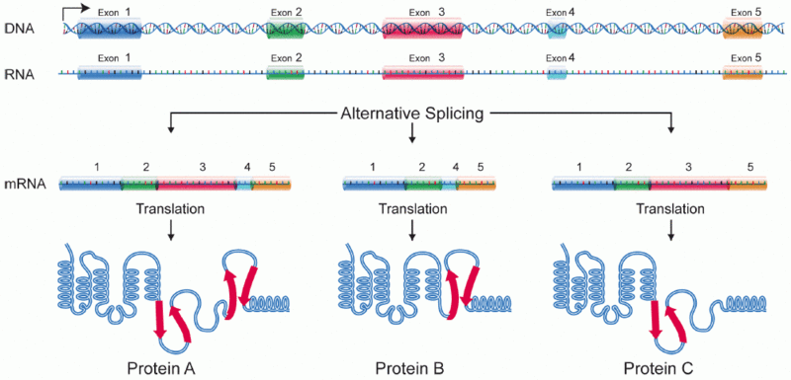
2. RNA Splicing Control
＃خليك بالبيت
Alternative RNA splicing (splicing at different junctions) produces different forms (isoforms) of a protein from the same gene

Slide 29
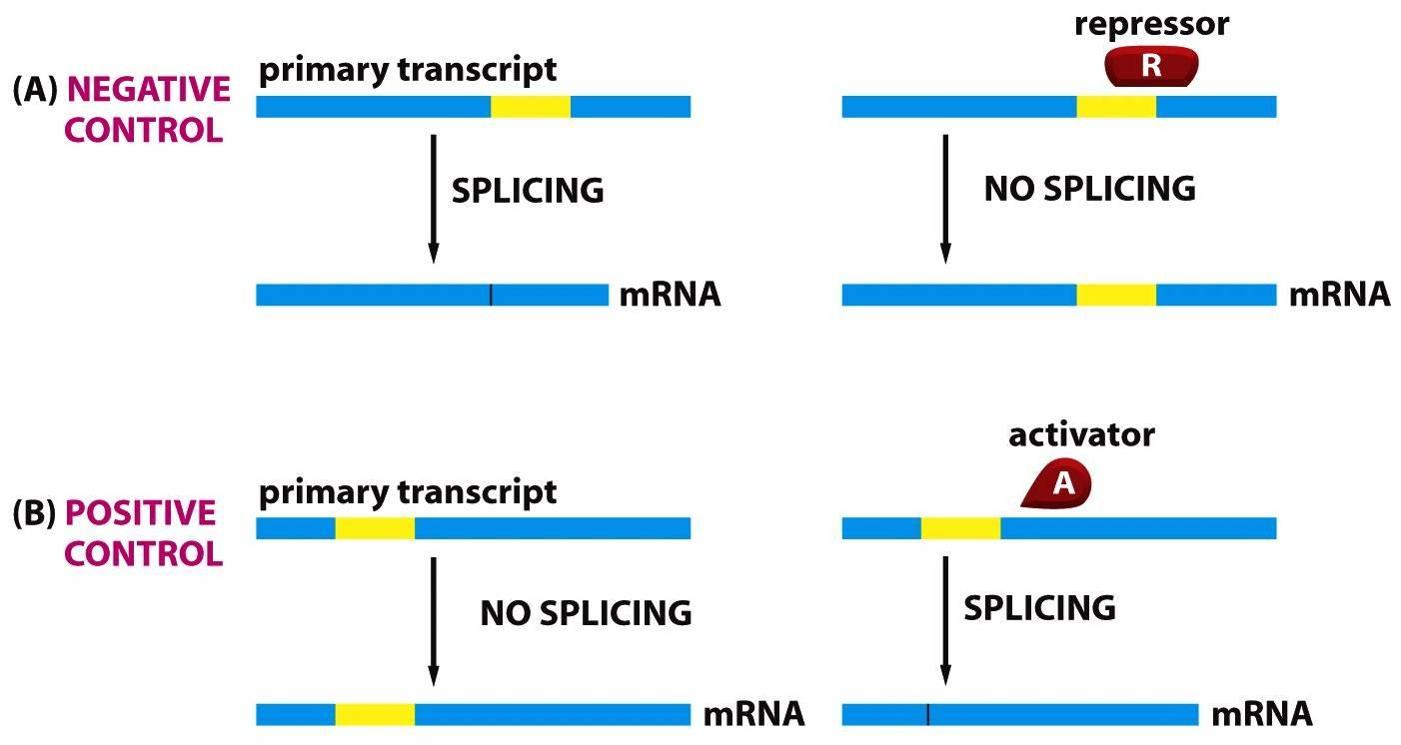
2. RNA Splicing Control
＃خليك بالبيت
Many genes undergo alternative splicing in tissue-specific manner and/or under specific cellular conditions (a protein is nonfunctional in one cell type but functional in another cell type)
Alternative splicing of pre-mRNA transcripts is regulated by proteins (activators/repressors) that bind specific RNA sequences (regulatory elements) on the primary transcript itself

Slide 30
2. RNA Splicing Control
＃خليك بالبيت
Alternative RNA splicing is a phenomenon refers to the process by which a single pre-mRNA of a given gene is spliced into different mRNA molecules called splice variants
The translation of these splice variants will results in different forms of proteins in different tissues called isoforms.
Activators and repressors affect the recognition of different splice sites either by exposing or covering a specific splice site, respectively.

Slide 31
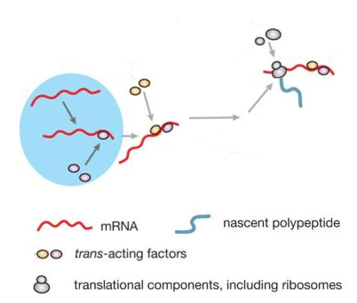
3. RNA Transport & Localization Control
＃خليك بالبيت
Gene expression can be regulated by controlling the nuclear transport of mRNAs and their localization to specific cytoplasmic domains
Processing of pre-mRNA in the nucleus is critical for the cytoplasmic localization
The cellular address is specified by cis-acting elements (called localization elements) mostly found in 3’UTR
Localization elements are recognized by trans-acting factors (RNA-binding proteins)

Slide 32
4. Translation Control
＃خليك بالبيت
Initiation, elongation and termination
Regulation of translation initiation is one determinant of the rate at which any protein is synthesized
The mechanism of translation initiation is different between eukaryotes and prokaryotes

Slide 33
Translation Initiation in Eukaryotes
＃خليك بالبيت
Assembly of 43S pre-initiation complex (PIC) facilitated by eukaryotic initiation factors (eIFs)
Activation of 5’ end of mRNA by eIF4E and eIF4G
Binding of PIC to start scanning for initiating AUG codon
Dissociation of eIFs and binding of large ribosomal subunit

Slide 34
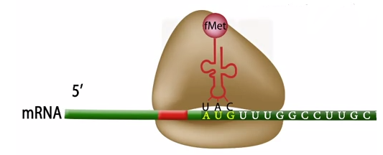
Translation Initiation in Prokaryotes
＃خليك بالبيت
Binding of the small ribosomal subunit to the Shine Dalgarno sequence
Recruitment of initiator tRNA
carrying formylmethionine
Dissociation of IFs and
binding of large ribosomal subunit

Slide 35
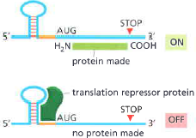
4. Translation Control
＃خليك بالبيت
There are several mechanisms of translation initiation regulation:
Translational repressor proteins: RNA-binding proteins which bind to and block the Shine-Dalgarno sequence. Similarly in eukaryotes, translational repressors bind 5’ end of mRNA or 3’ end thus inhibit the translation initiation by interfering with the communication step between 5’ cap and 3’ poly A tail required for
efficient translation initiation

Slide 36
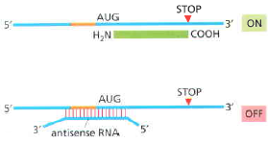
4. Translation Control
＃خليك بالبيت
Antisense RNA: a short RNA
sequence (miRNAs) which binds specific complementary sequence of mRNA (near the AUG start codon) and blocks the translation initiation
Morpholinos (synthetic molecules) are widely used in research as a technique for gene silencing

Slide 37
Summary
Summary
&
Take Home Message
＃خليك بالبيت
&
Take Home Message
pp5egcs

