Slide 1
Endocrine system-II. THYROID NEOPLASMS
Dr.Eman Krieshan, M.D.
11-5-2023

Slide 2
THYROID NEOPLASMS
Thyroid tumors range from circumscribed, benign adenomas to highly aggressive, anaplastic carcinomas.
Fortunately, the overwhelming majority of solitary nodules of the thyroid prove to be either :
benign adenomas.
localized, non-neoplastic conditions ,e.g:
dominant nodule in multinodular goiter.
simple cysts.
foci of thyroiditis.

Slide 3
Benign vs malignant
Thyroid nodule most likely to be malignant if:
Nodules in younger patients .
Nodules in males .
Nodules that doesn’t take up radioactive iodine in imaging studies (cold nodules).

Slide 4
Neoplastic thyroid lesions
Benign:
follicular adenoma .
Malignant:
Papillary carcinoma (accounting for more than 85% of cases)
Follicular carcinoma (5% to 15% of cases)
Anaplastic (undifferentiated) carcinoma (<5% of cases)
Medullary carcinoma (5% of cases)

Slide 5
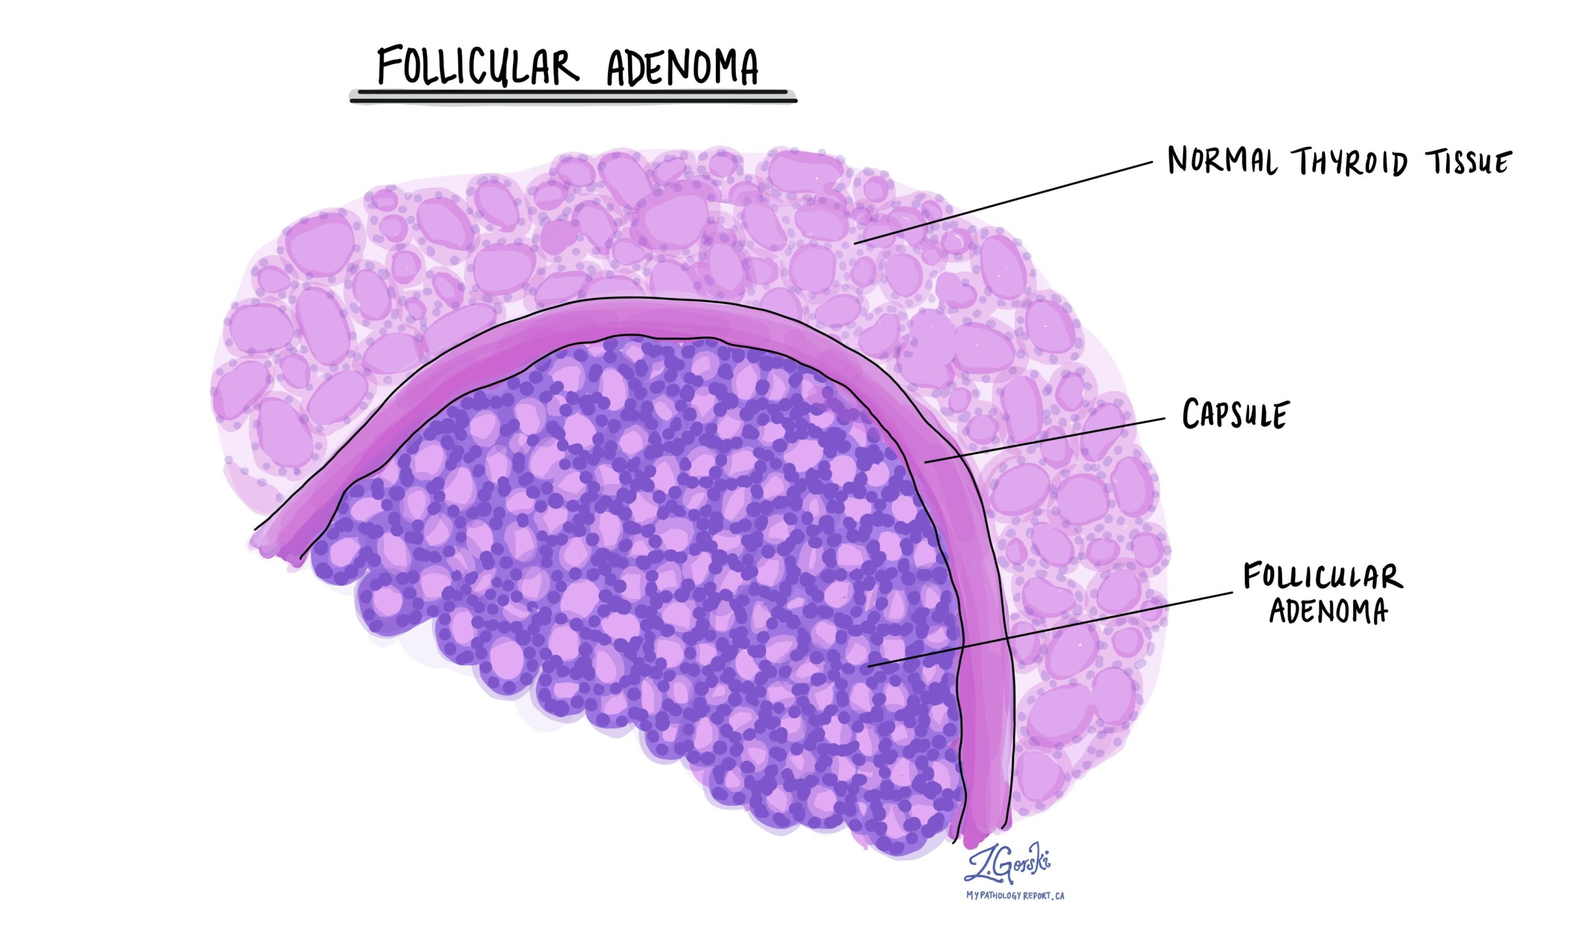
Follicular adenoma
Adenomas of the thyroid are benign neoplasms derived from follicular epithelium.
Follicular adenomas usually are solitary, DDX??
the vast majority of adenomas are nonfunctional, a small proportion produce thyroid hormones (toxic adenomas), causing clinically apparent thyrotoxicosis.

Slide 6
Morphology
Solitary, encapsulated, variable size (1 - 10 cm).

Slide 7
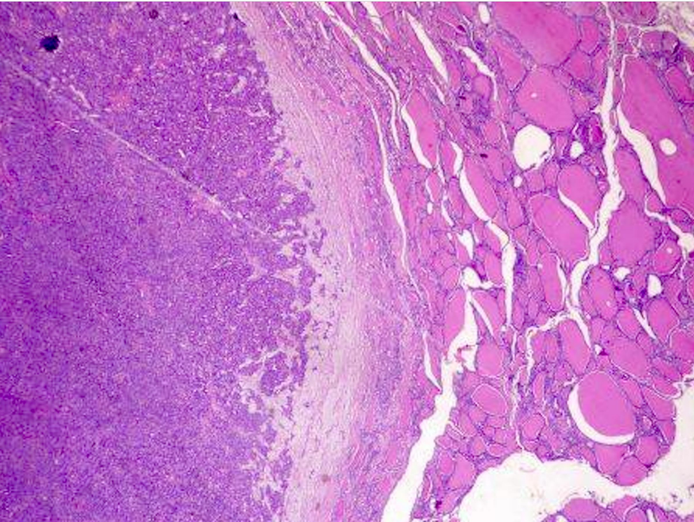
Histology
Closely packed follicles.
Completely enveloped by thin fibrous capsule
surrounding thyroid tissue shows signs of compression.

Slide 8
Treatment
Lobectomy (not enucleation).
Carry an excellent prognosis
do not recur or metastasize.

Slide 9
Thyroid carcinoma
1% of all cancer in U.S., 0.2% of all cancer deaths.
Increasing incidence due to new diagnostic practices which detect smaller tumors.
20 year survival is 90%, because most are indolent papillary carcinomas
A female predominance has been noted among patients who develop thyroid carcinoma in the early and middle adult years (Often estrogen receptor positive).

Slide 10
1. Papillary Carcinoma.
The most common types of thyroid carcinoma.
Female predominance; F:M ratio = ~3:1
Median age of diagnosis in 50s
Ionizing radiation is the best established risk factor.
Mainly 2 genes are involved:
1. BRAF amplification.
2. RET gene rearrangment .

Slide 11
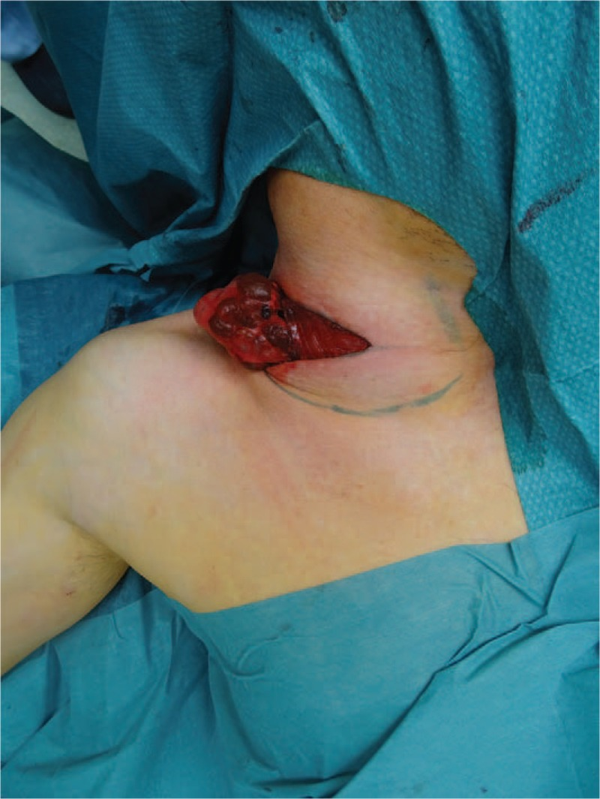
Clinical features.
Presented as Painless palpable thyroid mass.
The diagnosis is first rendered on ultrasound guided pre-operative fine needle aspiration cytology
Surgical pathology report of a resected specimen provides further information about the subtyping (i.e., variant) and microstaging
Commonly treated with surgical resection.

Slide 12
ultrasound guided pre-operative fine needle aspiration cytology.

Slide 13
Morphology
Solid or cystic mass with papillary projections

Slide 14
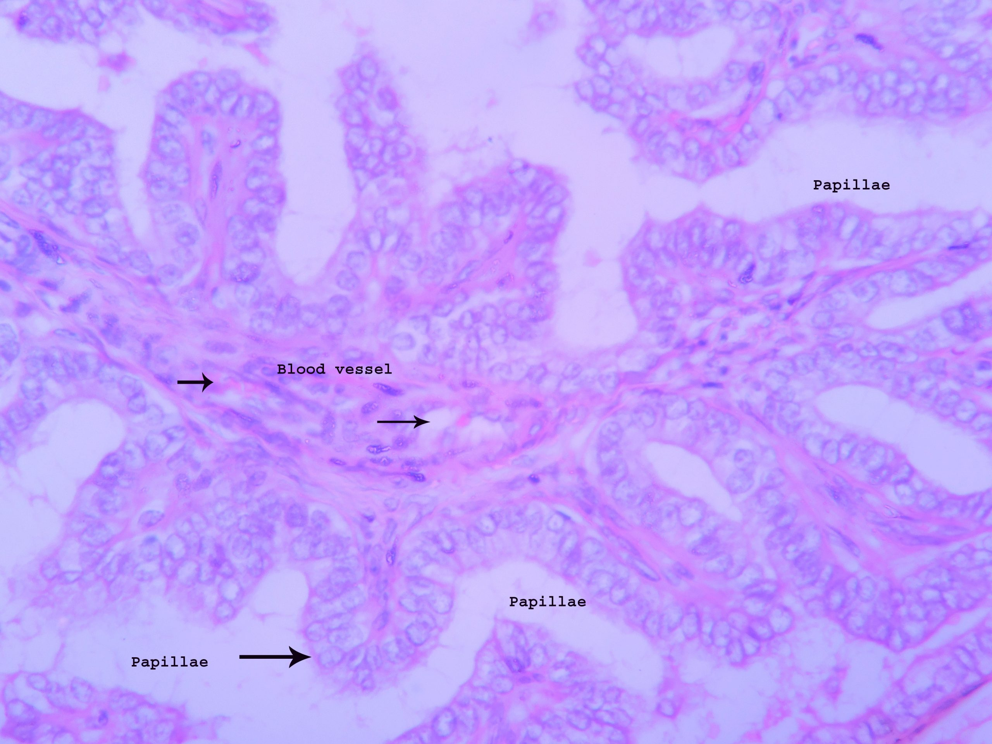
Histology.
Defined by two cardinal features:
true papillae with a fibrovascular core.
nuclear features of papillary carcinoma.

Slide 15
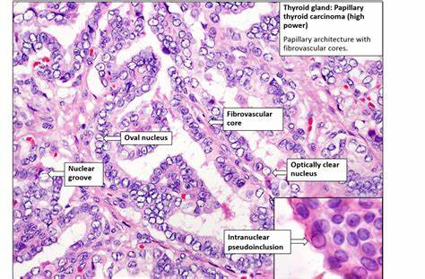
irregular nuclear contour.
nuclear groove.
nuclear pseudoinclusion

Slide 17
2. Follicular Carcinoma.
Thyroid carcinoma with follicular differentiation but no papillary nuclear feature.
Follicular lesion with capsular or vascular invasion but without papillary nuclear features.
More common in women and in areas with dietary iodine deficiency .
The peak incidence between the ages of 40 and 60 years.
GENETIC FACTORS:
Gain-of-function point mutations of RAS and PIK3CA.
Loss-of-function mutations of PTEN.

Slide 18
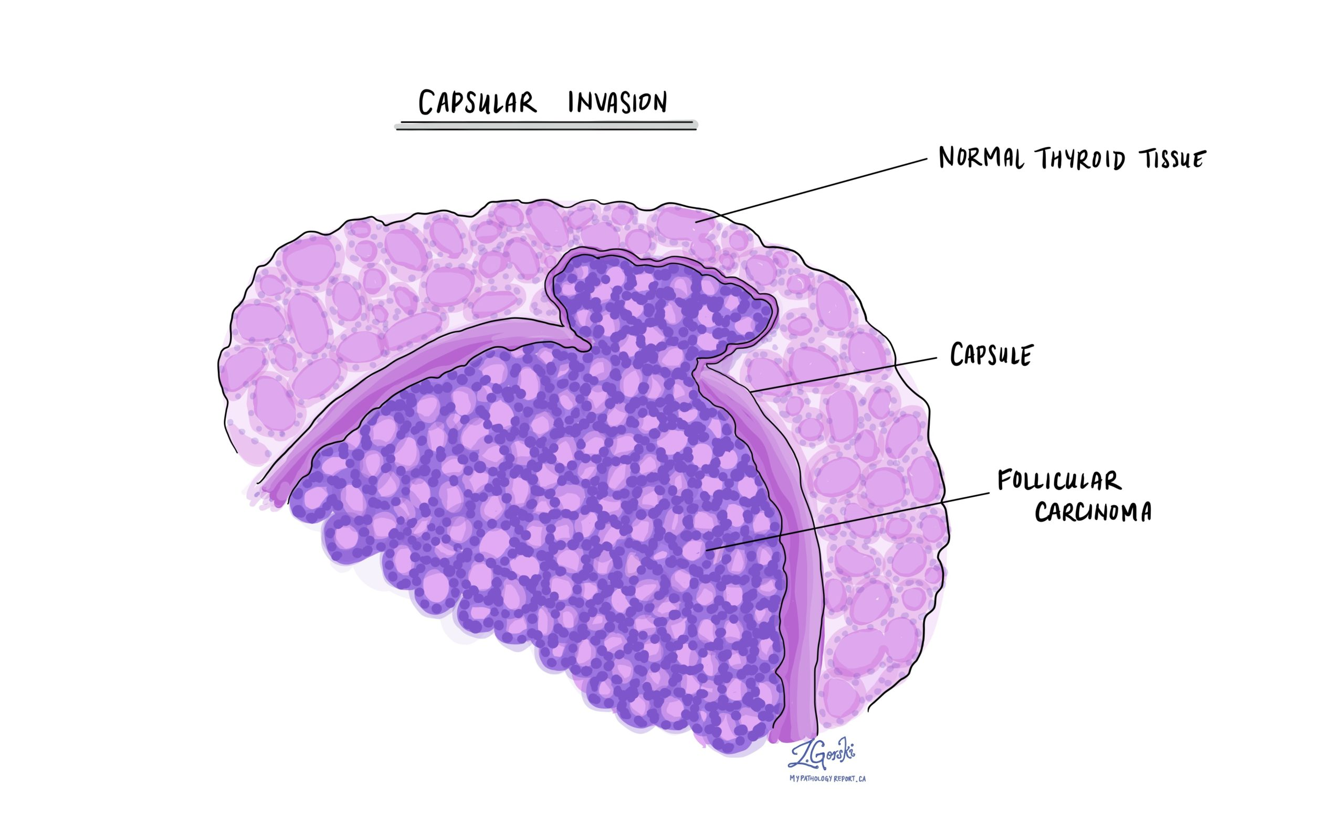
Two types
1. Minimally invasive follicular carcinoma
With capsular invasion .
With vascular invasion
2. Widely invasive.

Slide 19
Clinical features
Usually "cold" on radionuclide scan
Does not metastasize through lymphatics but does spread to lungs, liver, bone, brain via blood vessels
Less than 5% with ipsilateral lymphadenopathy.
Treatment:
thyroidectomy and radioactive iodine
No nodal dissection is needed

Slide 20
Morphology
Tan to brown solid cut surface, can have cystic changes and hemorrhage
Minimally invasive: usually single encapsulated nodule, with thickened and irregular capsule
Widely invasive: extensive permeation of capsule or no capsule.

Slide 21
Histology
solid pattern of follicles (small, normal sized or large).
No nuclear features of papillary thyroid carcinoma
Invasion of adjacent thyroid parenchyma, capsule (complete penetration) or blood vessels (in or beyond the capsule)

Slide 23
3. . Anaplastic Carcinoma.
A highly aggressive thyroid malignancy composed of undifferentiated follicular thyroid cells, devoid of morphologic features of thyroid origin.
Medium age 60 - 70 years with incidence to rise with age, F:M = 2:1.
Higher incidence in areas of dietary iodine deficiency.
GENETIC FACTORS:
Inactivation of TP53.

Slide 24
Clinical features
Rapidly enlarging, bulky neck mass invades adjacent structures causing hoarseness, dysphagia, dyspnea.
fixed to the underlying structures.
Extrathyroidal extension in majority of cases
Regional nodal metastases and vocal cord paralysis present in up to 40% and 30%, respectively
Treatment
Radiation therapy, surgery when feasible or chemoradiation either concurrently or sequentially

Slide 25
Morphology
Bulky solid mass (mean: 6 cm) with zones of necrosis or variegated appearance.

Slide 26
Histology
Common features include :
widely invasive growth.
extensive tumor necrosis.
marked nuclear pleomorphism .
high mitotic activity

Slide 27
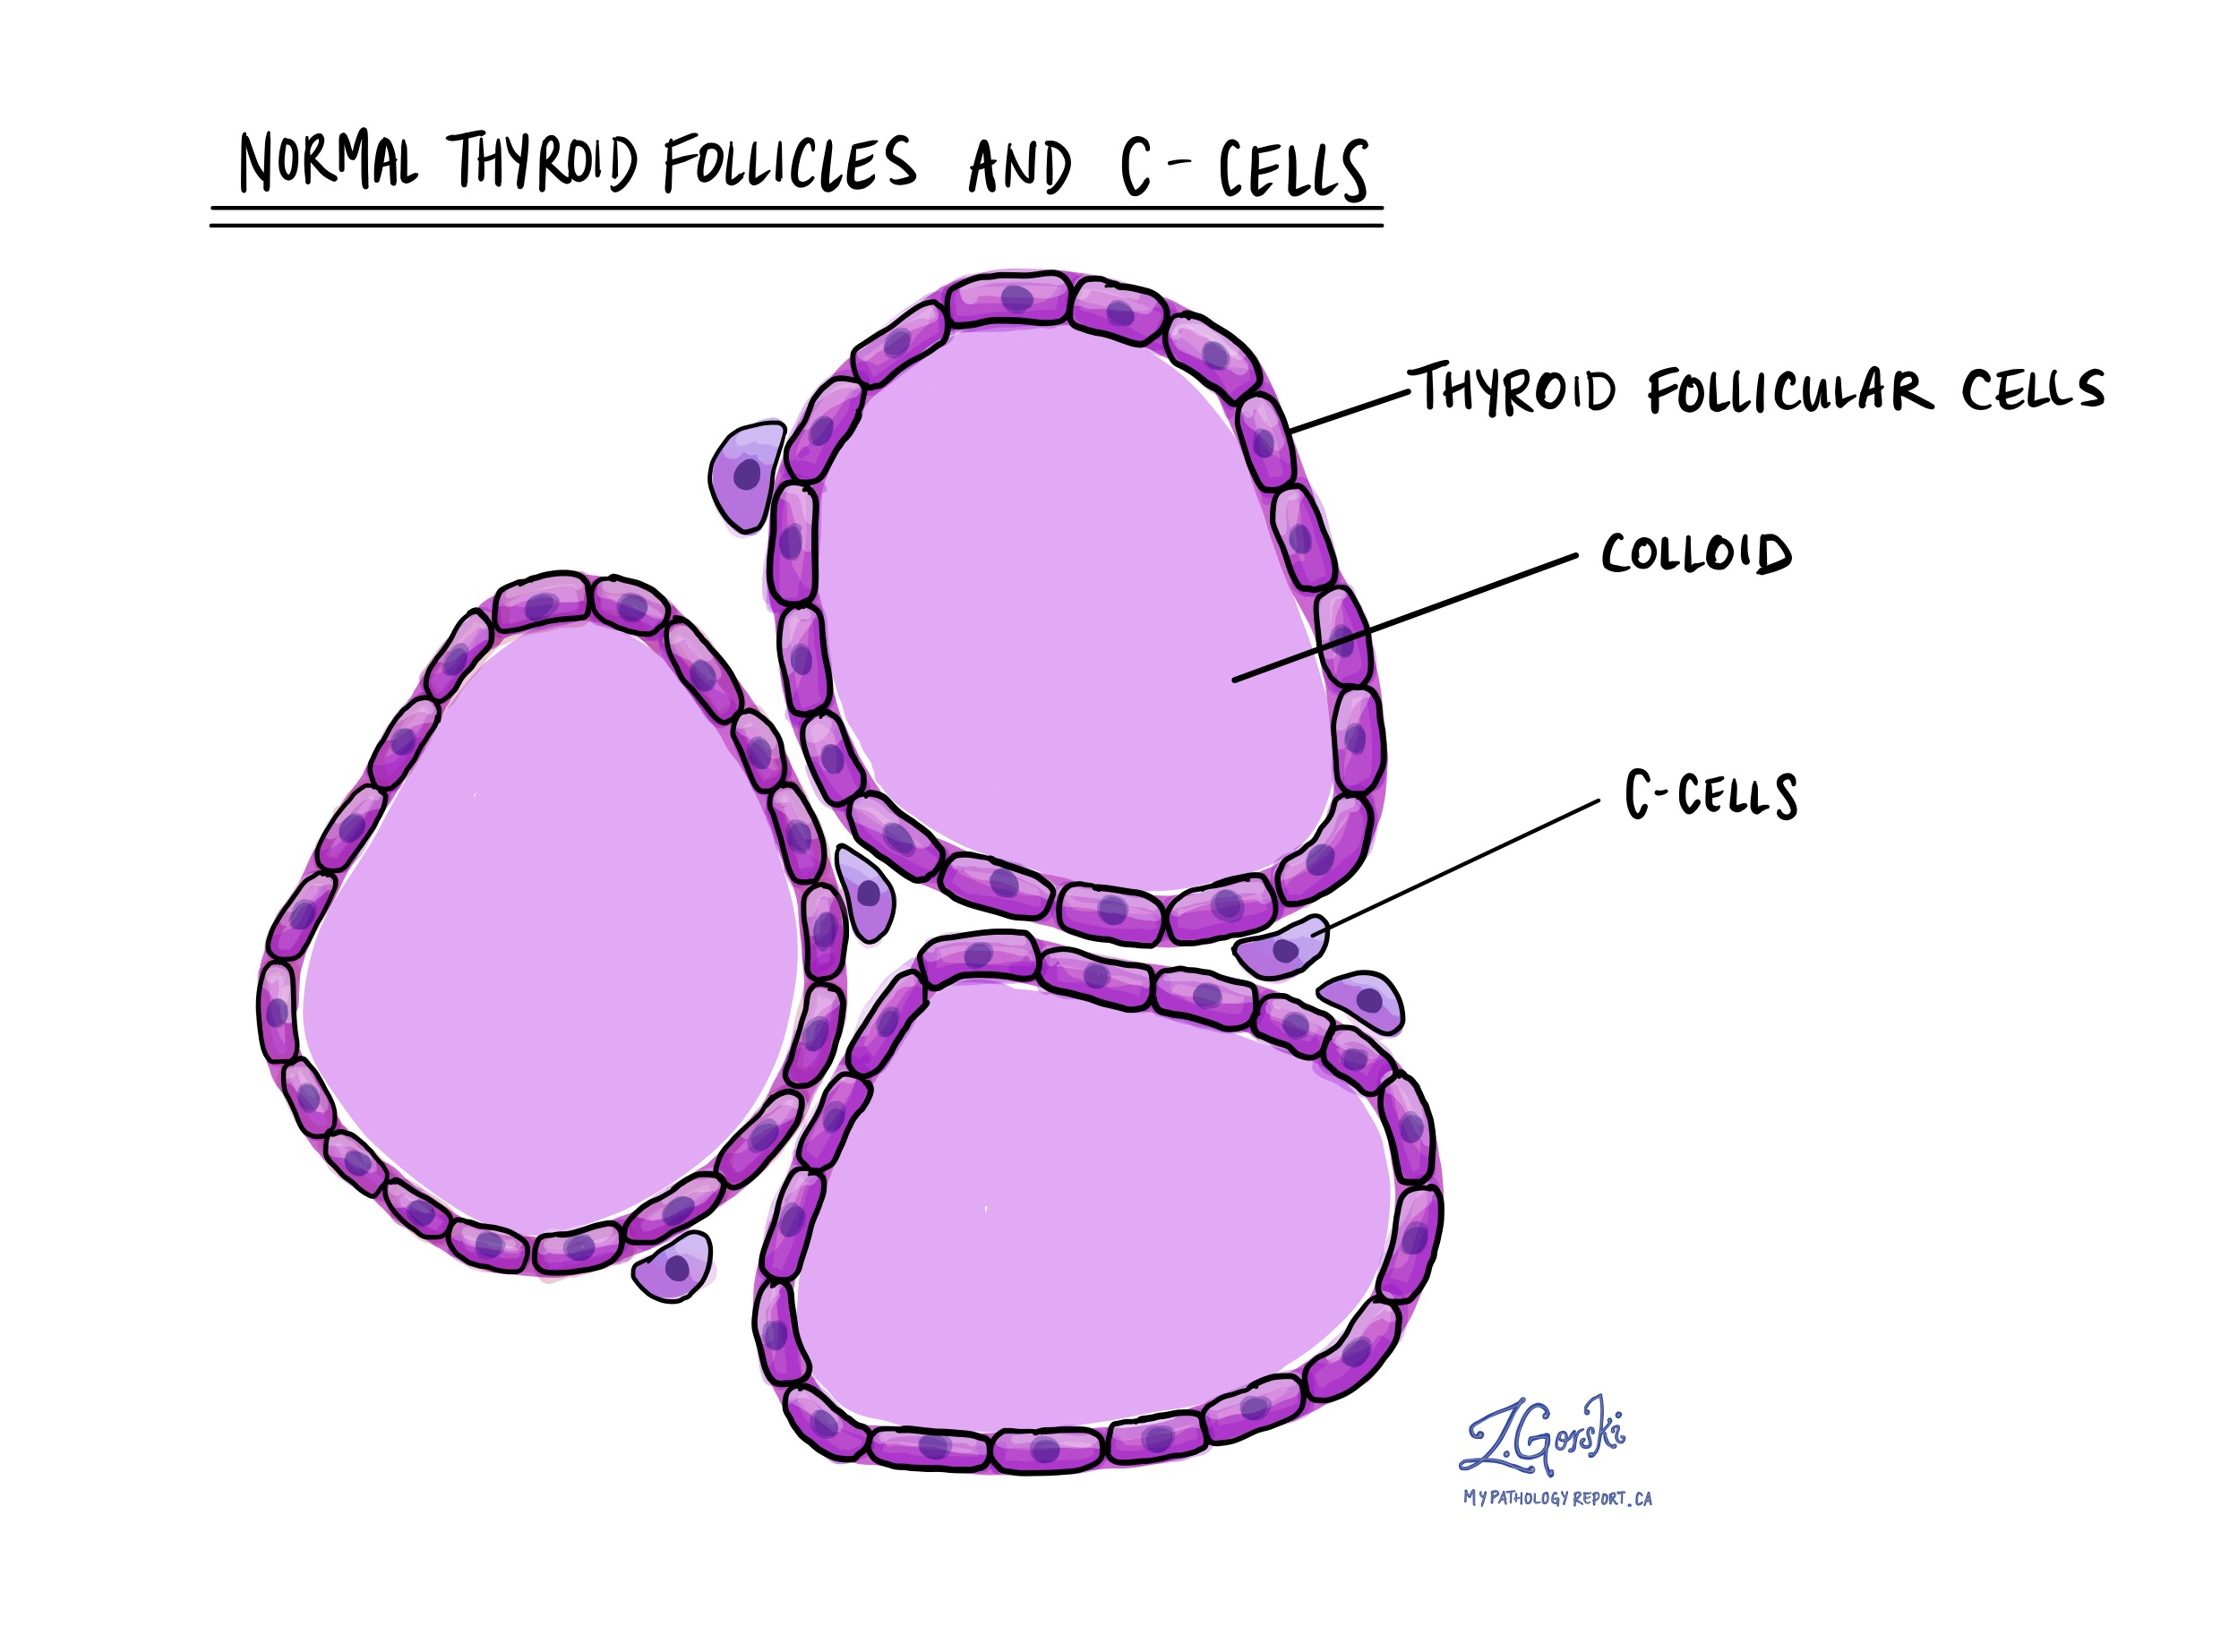
4. Medullary Carcinoma.
Neuroendocrine tumor derived from C cells (formerly called parafollicular cells), which secrete calcitonin
1 - 2% of thyroid carcinomas
Either sporadic (nonhereditary) or familial (hereditary)
Sporadic: 70%, age 40 - 60, solitary
Familial: 30%, younger patients (mean age 35).
Occurring in the setting of MEN syndrome 2A or 2B,
familial medullary thyroid carcinoma without an associated MEN syndrome

Slide 28
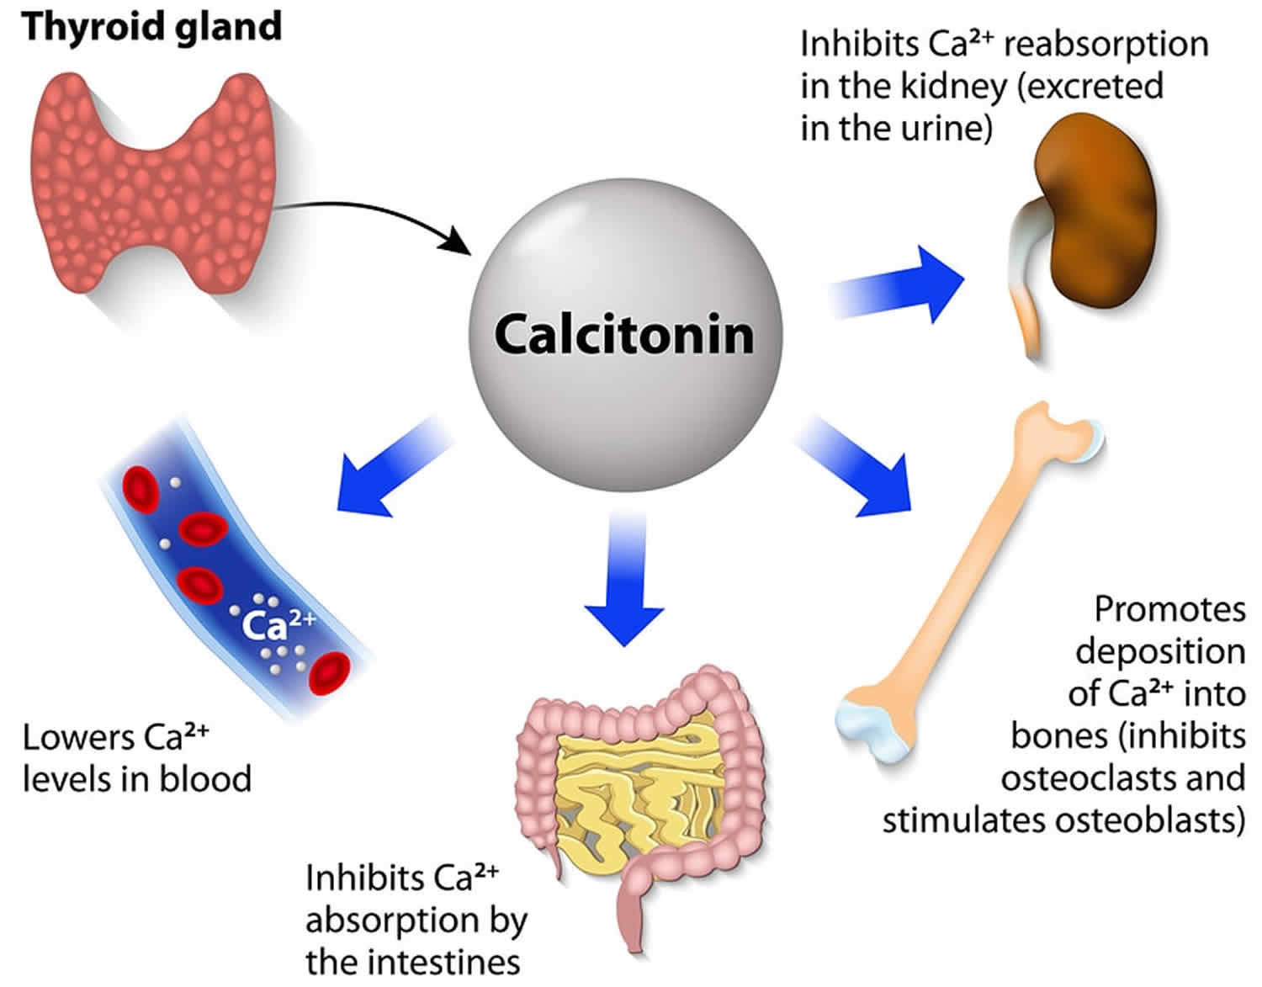

Slide 30
Clinical features
Presents with painless thyroid mass, cold on scanning
Up to 75% of patients have nodal metastasis.
Serum calcitonin correlates with tumor burden .
Patients with metastasis may have severe diarrhea and flushing
Some tumors may produce ACTH or CRH (Cushing syndrome).

Slide 31
Morphology
Sporadic: typically presents as a single circumscribed but nonencapsulated, gray-tan mass
Familial: generally bilateral / multiple foci.

Slide 32
Histology
Wide variety of morphology:
Round.
Plasmacytoid.
polygonal
spindle cells.
nests.
Cords
follicles
In:
Eosinophilic to amphophilic granular cytoplasm due to secretory granules
Stroma has amyloid deposits from calcitonin

