Slide 1
Acute Infections That Produce Upper Airway Obstruction
Dr .Lina ALSHADFAN
PEDIATRIC PULMONOLOGIST

Slide 2
Lecture outline
Introduction
Causes
Croup
Epiglotitis
Laryngitis
Bacterial trachietis

Slide 3
Introduction
Upper airway obstruction due to acute infection is not uncommon in children .
infants and young children are most commonly affected because they have relatively narrow upper airways .
Fortunately, these are mostly due to self-limiting viral laryngotracheobronchitis (LTB).
The consequence of these upper airway infections is usually stridor .

Slide 4
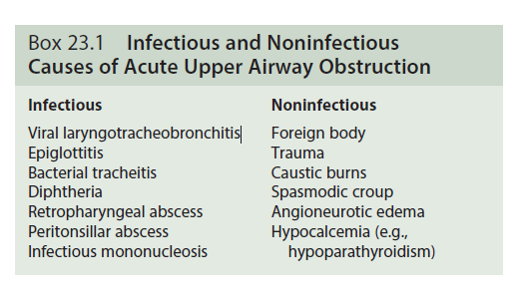
Causes :

Slide 5
Viral Laryngotracheobronchitis

Slide 6
EPIDEMIOLOGY
Viral LTB is the most common cause of infective upper airway obstruction in the pediatric age group.
Affected children are usually of preschool age, with a peak incidence between 18 and 24 months of age.
annual incidence rates in preschool children vary from 1.5% to 6%,
less than 5% of these require hospital admission, and only 1% to 2% of those admitted require endotracheal intubation and intensive care.
This proportion has fallen dramatically since the use of corticosteroids has become routine.
Mortality is low, reported by one 10-year follow-up study as less than 0.5% of intubated
patients.

Slide 7
There is a male preponderance in children younger than 6 years of age (1.4 : 1), although both sexes appear to be affected equally at an older age.
Children with a specific CD14 genetic polymorphism have recently been described as having a reduced prevalence of croup.
Infection is transmitted via droplet spread or direct inoculation from the hands.

Slide 8
ETIOLOGY
75% of viral LTB cases caused :
1-the PIVs : →PIV 1 is found most frequently and leads to epidemics.
→PIV 2 may account for many sporadic cases,
→ PIV 3 is a less common cause of viral LTB, usually leading to bronchiolitic illness.
2- respiratory syncytial virus
3-measles .
4-mumps
5-human metapneumovirus.
Other less causes :
Herpes viruses and influenza viruses tend to cause a more severe and protracted form of the disease.
some systemic infections such mycoplasma.

Slide 9
CLINICAL FEATURES :
Mild
Modreate
Sever

Slide 10
CLINICAL FEATURES
Mild
Most children are affected mildly by viruses that cause LTB.
The exact incidence remains unknown, because many of them do not receive medical attention, but are managed by parents at home.
Children have a barking cough and a hoarsecry or voice; these symptoms are worse in the evening and at night.
They may also have inspiratory stridor on exertion, but stridor at rest is usually absent, as are other signs of respiratory distress.
There is most commonly a coryzal prodrome accompanied by a low-grade fever .
Children are well looking , remain interested in their surroundings, playful, and still eat and drink.

Slide 11
Moderate
Same features PLUS :
→inspiratory stridor present at rest
→respiratory distress manifest by chest wall
recession, tachypnea,and the use of accessory
muscles of respiration.
→tachycardia
→ children remain interactive and are able to take a
least liquids orally.

Slide 12
Severe
Progression from moderate to severe infection can occur rapidly and may be precipitated by the distress caused by clinical examination.
Worrisome signs include :
increasing respiratory distress,
appearing anxious or preoccupied and tired.
Drooling may occur (but not as commonly as in epiglottitis),
refuse liquids or be unable to coordinate swallowing and breathing.
Restlessness an agitation are late signs of airway obstruction of any cause as is cyanosis, pallor, or decreased level of consciousness
Desaturation may be seen in children with relatively mild airway obstruction (presumably reflecting lower airway involvement and ventilation-perfusion mismatch).
Pulsus paradoxus

Slide 13
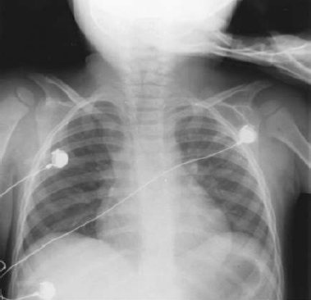
Diagnosis
The diagnosis of croup is made clinically .
no role for laboratory test or radiography in the assessment of acute airways obstruction.
plain lateral neck radiographs may
demonstrate sites of obstruction(steeple
sign)
Investigations needed in case of :
atypical presentation
fail to respond to conventional treatment.

Slide 14
Differential Diagnosis
SPASMODIC CROUP
Symptoms are similar to those of viral LTB, but children are often :
older,
do not have the same coryzal prodrome,
and may be afebrile during the episode.
There may be links with atopy, often with a positive family history.
Attacks often occur suddenly, at night, and may resolve equally quickly.
Treatment
guided by the degree of severity, and is similar to that for viral LTB.
Some practitioners prescribe oral or inhaled corticosteroids (via a nebulizer) to be kept at home and administered by the parents in case of an episode .

Slide 15
Treatment
Children with croup should be hospitalized for any of the following:
progressive stridor .
severe stridor at rest .
respiratory distress .
hypoxia, cyanosis .
depressed mental status .
poor oral intake .
the need for reliable observation.

Slide 16
Treatment
Supportive Care
fluids and antipyretics as required.
there is no role for the routine use of antibiotics in the absence of other features suggestive of bacterial infection.
Humidification
there is very little supportive evidence .
Corticosteroids
The efficacy of oral dexamethasone used a single dose of 0.15-0.6 mg/kg.
Oral dosing of dexamethasone is as effective as intramuscular administration
Nebulized Epinephrine (Adrenaline )
Heliox (70% to 80% helium with 20% to 30% oxygen) has been used in both upper airway obstruction .
Endotracheal Intubation .

Slide 17
PROGNOSIS AND FURTHER EVALUATION
Most children with viral LTB were previously well, have short, self-limiting symptoms, and make a full recovery.
Recurrent (≥3) episodes have been reported in more than 60% of affected children, with family history of croup identified as the most significant risk factor .
Although further evaluation is not necessary in every case
it should be considered
cases that are particularly severe or frequent .
if symptoms are particularly slow to resolve .
if symptoms occur between or in the absence of obvious infections.
why ???
Evaluation of patients in this group is aimed at identifying an underlying airway abnormality that would predispose the child to more severe airway narrowing with viral infections, or that could cause problems independently of such infection.
Investigation is usually centered on airway endoscopy

Slide 18
Acute Epiglottitis (Supraglottitis)

Slide 19
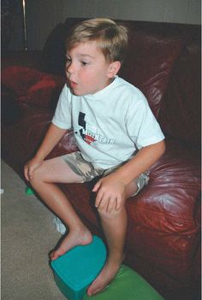
Acute Epiglottitis(Supraglottitis)
This now rare, but still dramatic and potentially lethal condition is characterized by an acute rapidly progressive and potentially fulminating course of high fever, sore throat, dyspnea, and rapidly progressing respiratory obstruction.
Drooling is usually present and the neck is hyperextended in an attempt to maintain the airway. The child may assume the tripod position.
A period of air hunger with restlessness may be followed by rapidly increasing cyanosis and coma.
Stridor is a late finding and suggests near-complete airway obstruction.
Complete obstruction of the airway and death can ensue unless adequate treatment is provided.

Slide 20
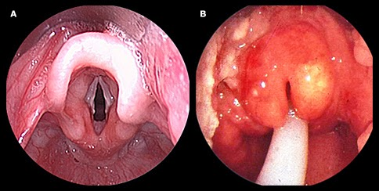
The diagnosis requires visualization under controlled circumstances such as an operating room or intensive care unit of a large, cherry red, swollen epiglottis by laryngoscopy.
Anxiety-provoking interventions such as phlebotomy, intravenous line placement, placing the child supine, or direct inspection of the oral cavity should be avoided until the airway is secure.

Slide 21
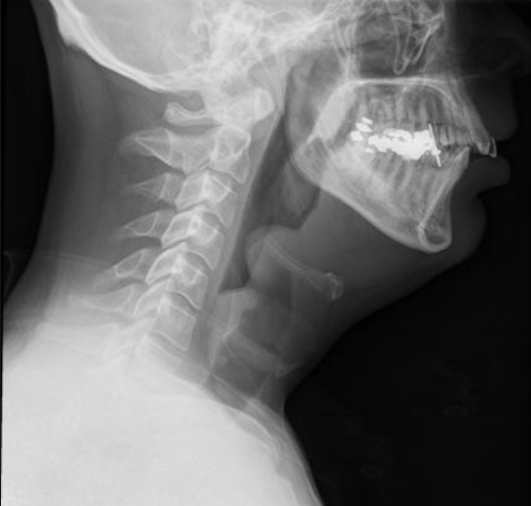
If epiglottitis is thought to be possible but not certain in a patient with acute upper airway obstruction, the patient may undergo lateral radiographs of the upper airway first if stable.
Classic radiographs of a child who has epiglottitis show the thumb sign.
If the concern for epiglottitis still exists after the radiographs, direct visualization should be performed.
A physician skilled in airway management and use of intubation equipment should accompany patients with suspected epiglottitis at all times.
Establishing an airway by endotracheal intubation or, less often, by tracheostomy is indicated in patients with epiglottitis, regardless of the degree of apparent respiratory distress.
In general, children with acute epiglottitis are intubated for 2-3 days, because the response to antibiotics is usually rapid.
Most patients have concomitant bacteremia.

Slide 22
TREATMENT
After insertion of the artificial airway, the patient should improve immediately, and respiratory distress and cyanosis should disappear.
Epiglottitis resolves after a few days of antibiotics, and the patient may be extubated; antibiotics should be continued for at least 10 days.
Chemoprophylaxis is not routinely recommended but there are some Indications for rifampin prophylaxis for all household contact .

Slide 23
Acute Infectious Laryngitis

Slide 24
Acute Infectious Laryngitis
Viruses cause most cases; diphtheria is an exception but is extremely rare in industrialized countries
The onset is characterized by an upper respiratory tract infection then sore throat, cough, and hoarseness appear.
The illness is generally mild; respiratory distress is unusual except in the young infant. Hoarseness and loss of voice may be out of proportion to systemic signs and symptoms.
Inflammatory edema of the vocal cords and subglottic tissue may be demonstrated laryngoscopically.

Slide 25
Bacterial Tracheitis

Slide 26
Bacterial Tracheitis
S. aureus is the most commonly isolated pathogen with isolated reports of methicillin resistant S. aureus. S. pneumoniae, S. pyogenes, Moraxella catarrhalis, nontypeable H. influenzae, and anaerobic.
The mean age is between 5 and 7yr.
Bacterial tracheitis often follows a viral respiratory infection.
This life-threatening entity is more common than epiglottitis in vaccinated populations.

Slide 27
CLINICAL MANIFESTATIONS
Typically, the child has a brassy cough, apparently as part of a viral croup.
High fever and “toxicity” with respiratory distress can occur immediately or after a few days of apparent improvement.
The patient can lie flat, does not drool, and does not have the dysphagia associated with epiglottitis.
The usual treatment for croup (racemic epinephrine) is ineffective.
50-60% of patients require intubation for management.
The major pathologic feature appears to be mucosal swelling at the level of the cricoid cartilage, complicated by copious, thick, purulent secretion.
Suctioning these secretions, although occasionally affording temporary relief, usually does not sufficiently obviate the need for an artificial airway.

Slide 28
DIAGNOSIS
The diagnosis is based on evidence of bacterial upper airway disease, which includes high fever, purulent airway secretions, and an absence of the classic findings of epiglottitis.
X-rays are not needed but can show
pseudomembrane detachment in the trachea,
Subglottic narrowing
a rough and ragged tracheal air column .
Purulent material is noted below the cords during endotracheal intubation.

Slide 29
TREATMENT
Empiric therapy recommendations for bacterial tracheitis include vancomycin or clindamycin and a third generation cephalosporin (e.g., cefotaxime or ceftriaxone).
When bacterial tracheitis is diagnosed by direct laryngoscopy or is strongly suspected on clinical grounds, an artificial airway should be strongly considered.
Supplemental oxygen is usually necessary.

Slide 30
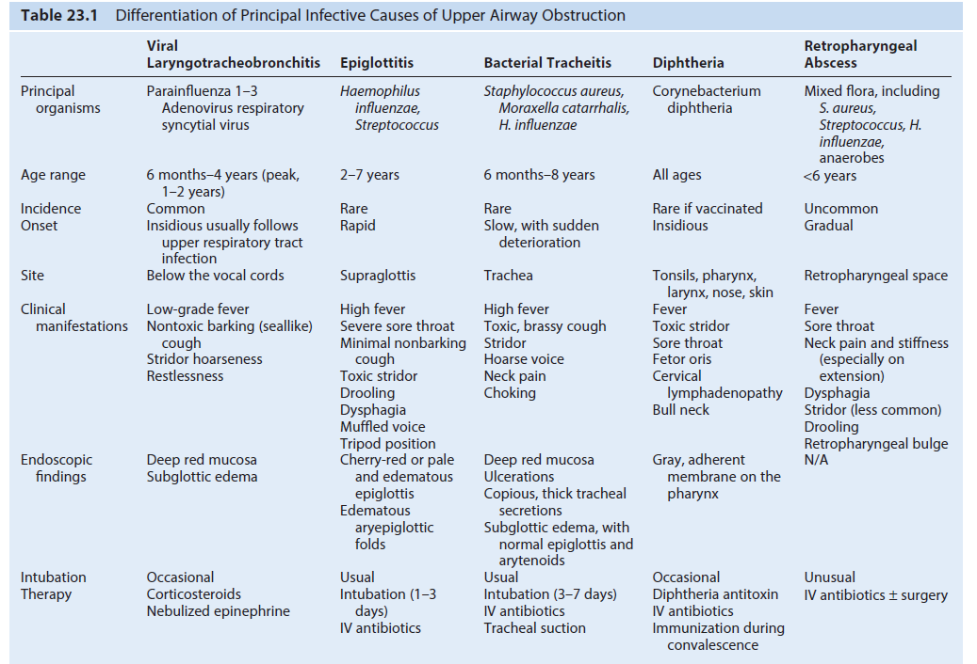

Slide 31
Thank you

