Slide 1
PERIPHERAL NERVOUS SYSTEM
OPTIC NERVE , VISUAL PATHWAY AND OLFACTORY PATHWAYS
Dr. Aiman Qais Afar
Surgical Anatomist
College of Medicine / University of Mutah

Slide 2
OPTIC NERVE (CRANIAL NERVE II)
Origin of the Optic Nerve
The ﬁbers of the optic nerve are the axons of the cells in the ganglionic layer of the retina.
They converge on the optic disc and exit from the eye, about 3 or 4 mm to the nasal side of its center, as the optic nerve
The optic nerve leaves the orbital cavity through the optic canal and unites with the optic nerve of the opposite side to form the optic chiasma.

Slide 3
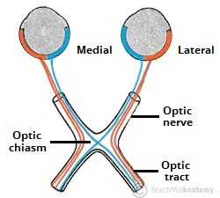
OPTIC NERVE (CRANIAL NERVE II)
Optic Chiasma
The optic chiasma is situated at the junction of the anterior wall and floor of the third ventricle.
Its anterolateral angles are continuous with the optic nerves, and the posterolateral angles are continuous with the optic tracts
In the chiasma, the fibers from the nasal (medial) half of each retina, including the nasal half of the macula, cross the midline and enter the optic tract of the opposite side, while the ﬁbers from the temporal (lateral) half of each retina, including the temporal half of the macula, pass posteriorly in the optic tract of the same side.

Slide 4
OPTIC NERVE (CRANIAL NERVE II)
Thursday 4 March 2021
Optic Tract
The optic tract emerges from the optic chiasma and passes Posterolaterally around the cerebral peduncle.
Most of the ﬁbers now terminate by synapsing with nerve cells in the lateral geniculate body, which is a small projection from the posterior part of the thalamus.(pulvinar)
A few of the ﬁbers pass to the pretectal nucleus and the superior colliculus of the midbrain and are concerned with light reﬂexes

Slide 5
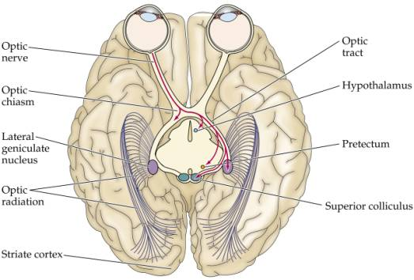
OPTIC NERVE (CRANIAL NERVE II)
Lateral Geniculate Body
The lateral geniculate body is a small, oval swelling projecting from the pulvinar of the thalamus.
It consists of six layers of cells, on which synapse the axons of the optic tract.
The axons of the nerve cells within the geniculate body leave it to form the optic radiation

Slide 6
OPTIC NERVE (CRANIAL NERVE II)
Optic Radiation
The ﬁbers of the optic radiation are the axons of the nerve cells of the lateral geniculate body.
The tract passes posteriorly through the retrolenticular part of the internal capsule and terminates in the visual cortex (area 17), which occupies the upper and lower lips of the calcarine sulcus on the medial surface of the cerebral hemisphere
The visual association cortex (areas 18 and 19) is responsible for recognition of objects and perception of color.

Slide 7
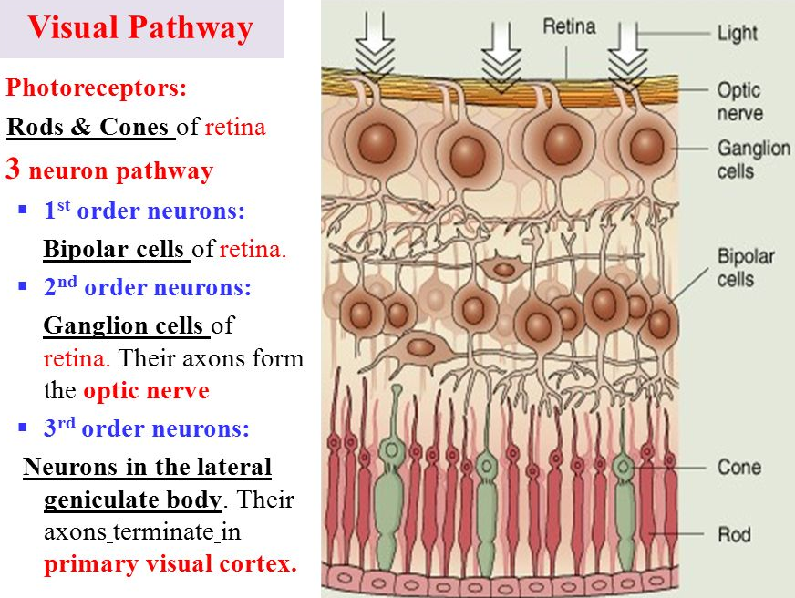
Neurons of the Visual Pathway and Binocular Vision
Four neurons conduct visual impulses to the visual cortex:
(1) rods and cones, which are specialized receptor neurons in the retina;
(2) bipolar neurons, which connect the rods and cones to the ganglion cells;
(3) ganglion cells, whose axons pass to the lateral geniculate body; and
(4) neurons of the lateral geniculate body, whose axons pass to the cerebral cortex.

Slide 8
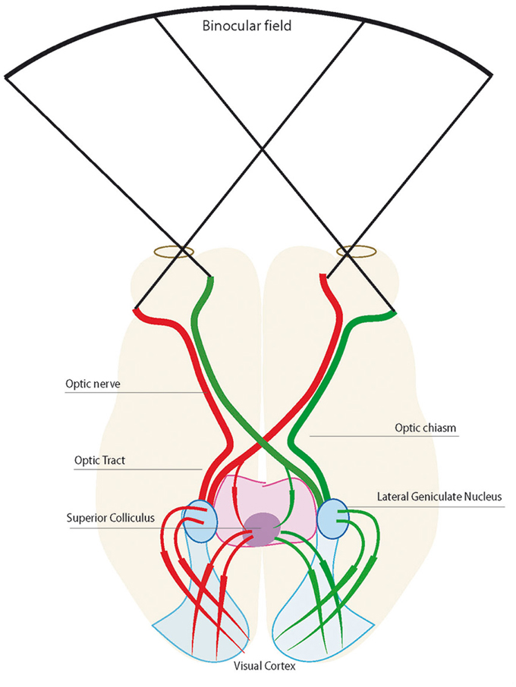
Neurons of the Visual Pathway and Binocular Vision
In binocular vision, the right and left ﬁelds of vision are projected on portions of both retinae
The image of an object in the right ﬁeld of vision is projected on the nasal half of the right retina and the temporal half of the left retina.
In the optic chiasma, the axons from these two retinal halves are combined to form the left optic tract

Slide 9
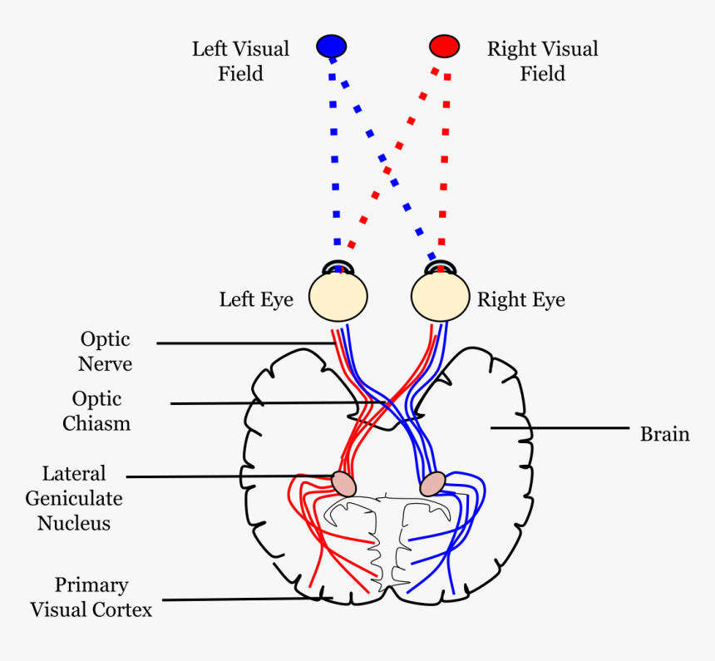
Neurons of the Visual Pathway and Binocular Vision
The lateral geniculate body neurons now project the complete right ﬁeld of vision on the visual cortex of the left hemisphere and the left visual ﬁeld on the visual cortex of the right hemisphere

Slide 10
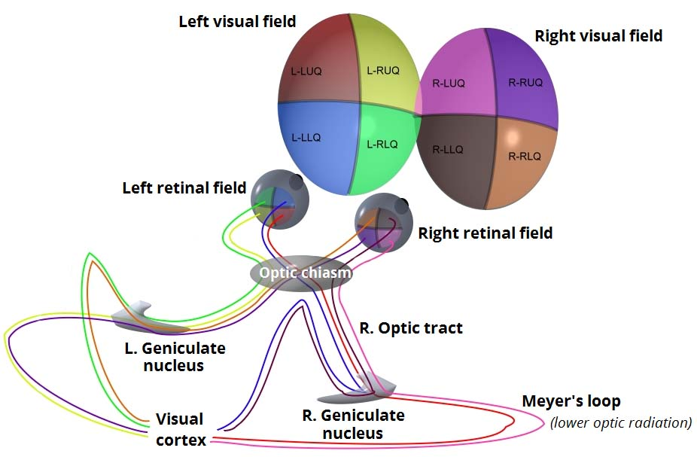
Neurons of the Visual Pathway and Binocular Vision
The lower retinal quadrants (upper ﬁeld of vision) project on the lower wall of the calcarine sulcus, while the upper retinal quadrants (lower ﬁeld of vision) project on the upper wall of the sulcus.
Note also that the macula lutea is represented on the posterior part of area 17,and the periphery of the retina is represented anteriorly.

Slide 11
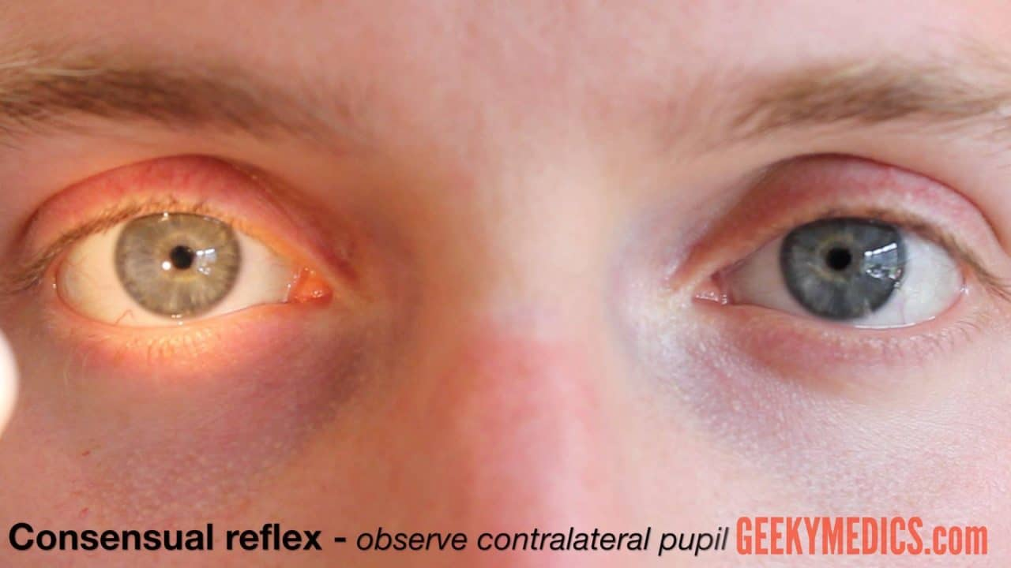
1. Visual Reflexes
Direct and Consensual Light Reflexes
If a light is shone into one eye, the pupils of both eyes normally constrict.
The constriction of the pupil on which the light is shone is called the direct light reflex; the constriction of the opposite pupil, even though no light fell on that eye, is called the consensual light reﬂex

Slide 12
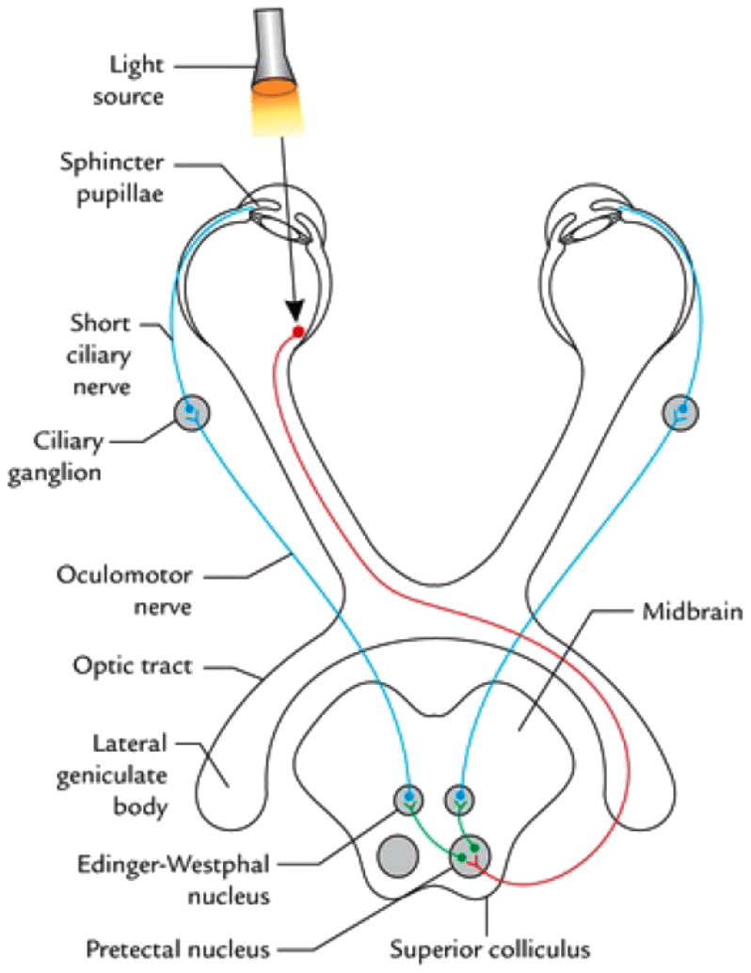
1. Visual Reflexes
Direct and Consensual Light Reflexes
The afferent impulses travel through the optic nerve, optic chiasma, and optic tract
Here, a small number of ﬁbers leave the optic tract and synapse on nerve cells in the pretectal nucleus, which lies close to the superior colliculus.
The impulses are passed by axons of the pretectal nerve cells to the parasympathetic nuclei (EdingerWestphal nuclei) of the third cranial nerve on both sides.

Slide 13
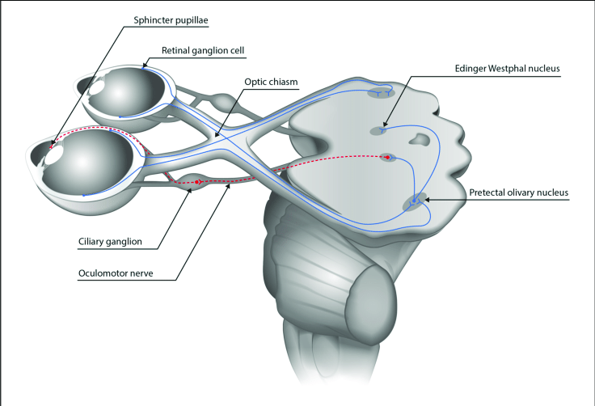
1. Visual Reflexes
Direct and Consensual Light Reflexes
Here, the fibers synapse and the parasympathetic nerves travel through the third cranial nerve to the ciliary ganglion in the orbit
Finally, postganglionic parasympathetic ﬁbers pass through the short ciliary nerves to the eyeball and the constrictor pupillae muscle of the iris.

Slide 14
1. Visual Reflexes
Direct and Consensual Light Reflexes
Both pupils constrict in the consensual light reﬂex because the pretectal nucleus sends ﬁbers to the parasympathetic nuclei on both sides of the midbrain
The ﬁbers that cross the median plane do so close to the cerebral aqueduct in the posterior commissure

Slide 15
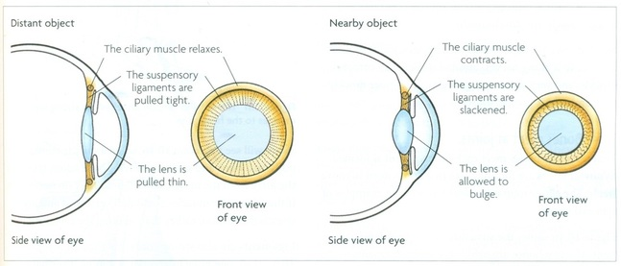
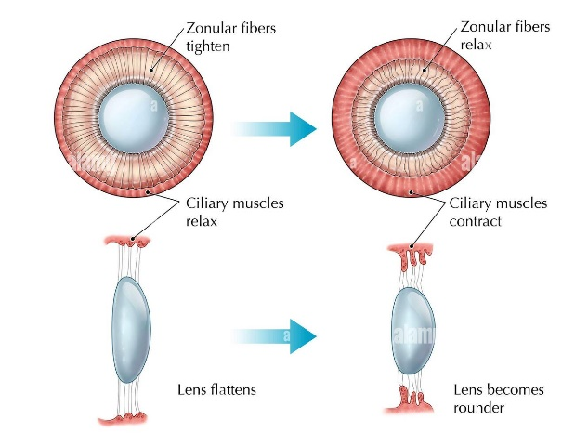
2. Accommodation Reflex
When the eyes are directed from a distant to a near object, contraction of the medial recti brings about convergence of the ocular axes; the lens thickens to increase its refractive power by contraction of the ciliary muscle; and the pupils constrict to restrict the light waves to the thickest central part of the lens.

Slide 16
2. Accommodation Reflex
The afferent impulses travel through the optic nerve, the optic chiasma, the optic tract, the lateral geniculate body, and the optic radiation to the visual cortex.
The visual cortex is connected to the eye ﬁeld of the frontal cortex

Slide 17
2. Accommodation Reflex
From here, cortical ﬁbers descend through the internal capsule to the oculomotor nuclei in the midbrain.
The oculomotor nerve travels to the medial recti muscles.
Some of the descending cortical ﬁbers synapse with the parasympathetic nuclei (Edinger-Westphal nuclei) of the third cranial nerve on both sides

Slide 18
2. Accommodation Reflex
Here, the fibers synapse, and the parasympathetic nerves travel through the third cranial nerve to the ciliary ganglion in the orbit.
Finally, postganglionic parasympathetic fibers pass through the short ciliary nerves to the ciliary muscle and the constrictor pupillae muscle of the iris

Slide 19
3. Corneal Reflex
Light touching of the cornea or conjunctiva results in blinking of the eyelids.
Afferent impulses from the cornea or conjunctiva travel through the ophthalmic division of the trigeminal nerve to the sensory nucleus of the trigeminal nerve
Internuncial neurons connect with the motor nucleus of the facial nerve on both sides through the medial longitudinal fasciculus.
The facial nerve and its branches supply the orbicularis oculi muscle, which causes closure of the eyelids.

Slide 20
4. Visual Body Reflexes
The automatic scanning movements of the eyes and head that are made when reading,
the automatic movement of the eyes , head, and neck toward the source of the visual stimulus, and
the protective closing of the eyes and
even the raising of the arm for protection are reflex actions that involve the following reflex arcs:

Slide 21
4. Visual Body Reflexes
The visual impulses follow the optic nerves, optic chiasma ,and optic tracts to the superior colliculi. Here, the impulses are relayed to the tectospinal and tectobulbar (tectonuclear) tracts and to the neurons of the anterior gray columns of the spinal cord and cranial motor nuclei.

Slide 22
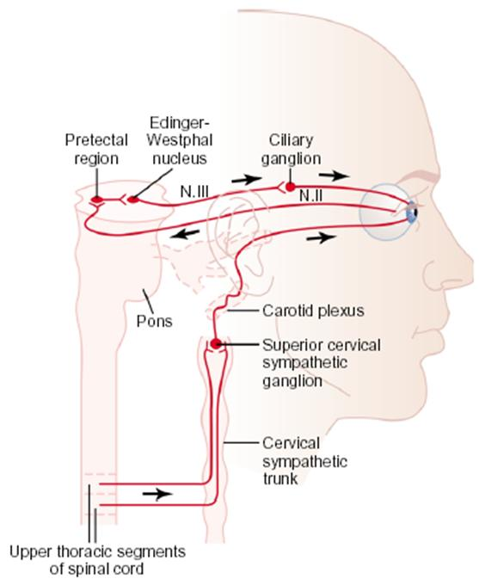
5. Pupillary Skin Reflex
The pupil will dilate if the skin is painfully stimulated by pinching. The afferent sensory ﬁbers are believed to have connections with the efferent preganglionic sympathetic neurons in the lateral gray columns of the ﬁrst and second thoracic segments of the spinal cord
The white rami communicantes of these segments pass to the sympathetic trunk, and the preganglionic ﬁbers ascend to the superior cervical sympathetic ganglion.
The postganglionic ﬁbers pass through the internal carotid plexus and the long ciliary nerves to the dilator pupillae muscle of the iris

Slide 23
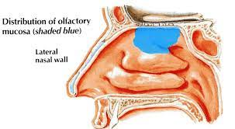
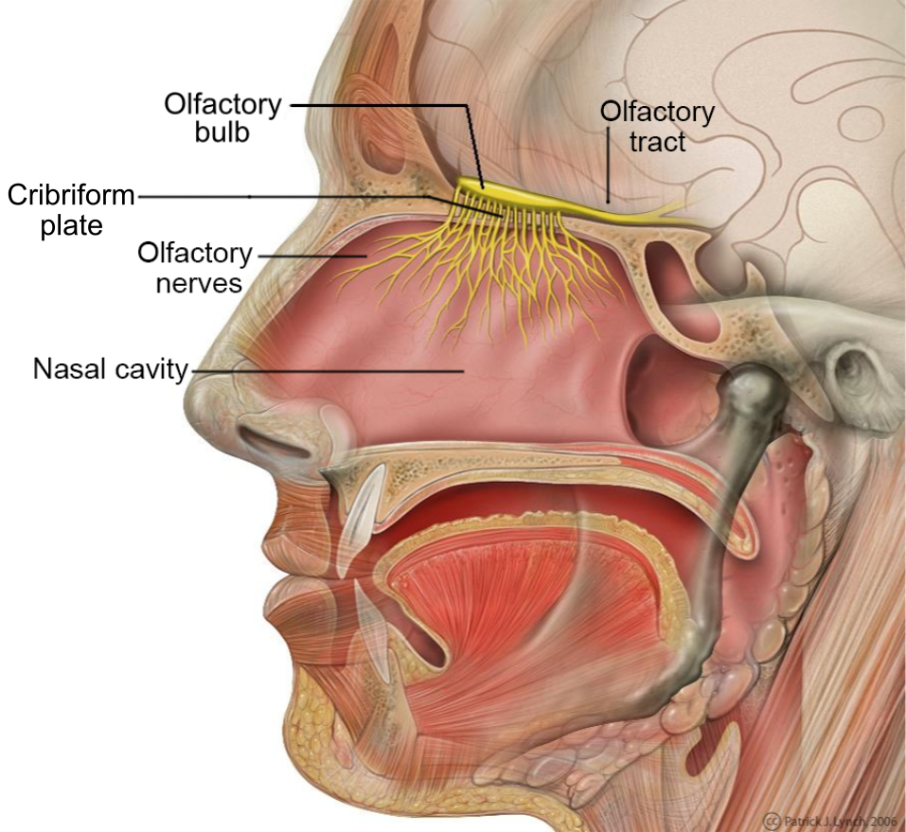
Olfactory pathways
Olfactory receptor in olfactory mucosa of the upper part of the nose
Bundles of olfactory nerve (first cranial nerve and the shortest one) pass through the cribriform plate of the ethmoid to olfactory bulb.

Slide 24
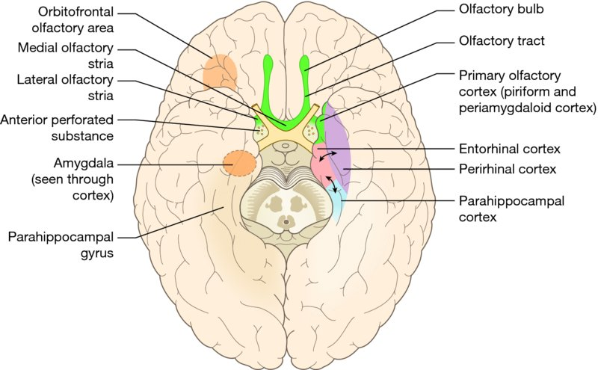
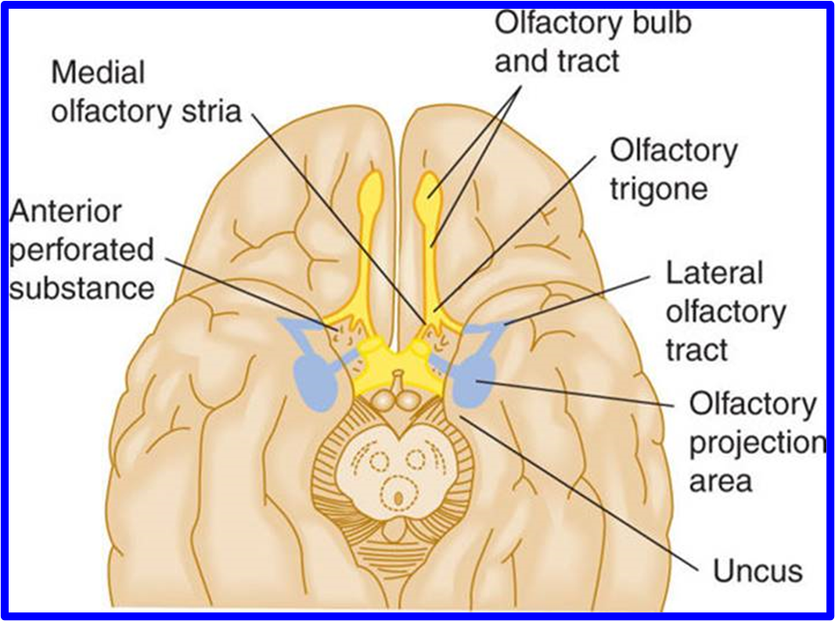
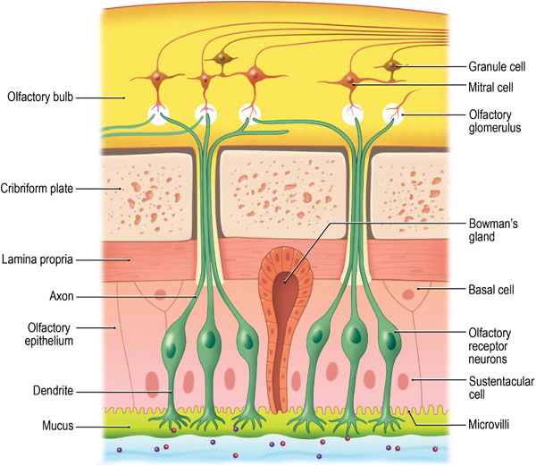
Olfactory pathways
Olfactory bulb contain special neurons called mitral cells
The axons of these cells form the olfactory tract
Each olfactory tract at the anterior perforated substances divided into lateral and medial stria

Slide 25
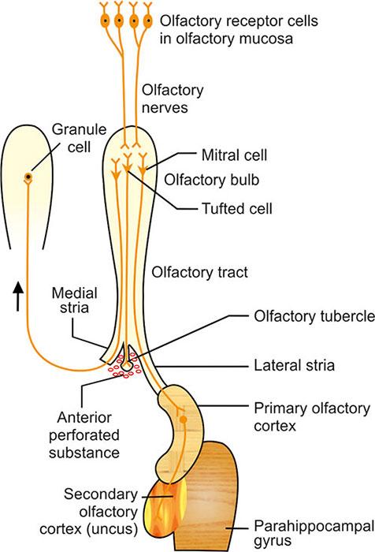
Olfactory pathways
Medial stria crosses midline through the anterior commissure to the olfactory bulb of the opposite side
Lateral stria passes to the uncus of the temporal lobe (primary olfactory cortex)

Slide 26
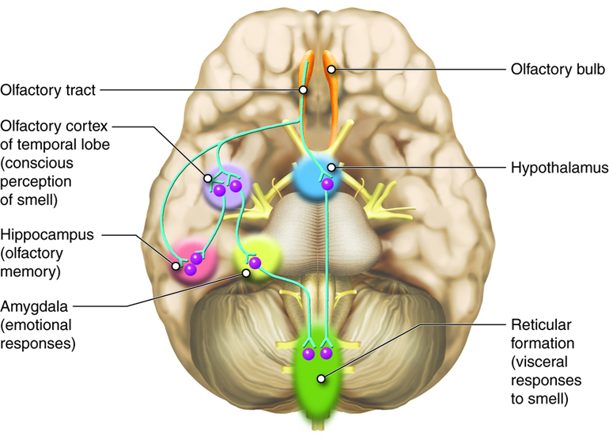
Olfactory pathways
The mitral cells of the olfactory bulb send information through lateral stria to ….
1.Hypothalamus and amygdaloid body (Limbic system)…Emotional response to smell
2. Reticular formation …..autonomic response to smell as gastric secretion
3. Hippocampus ……Olfactory memory

Slide 27
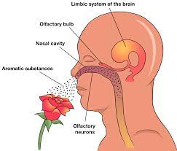
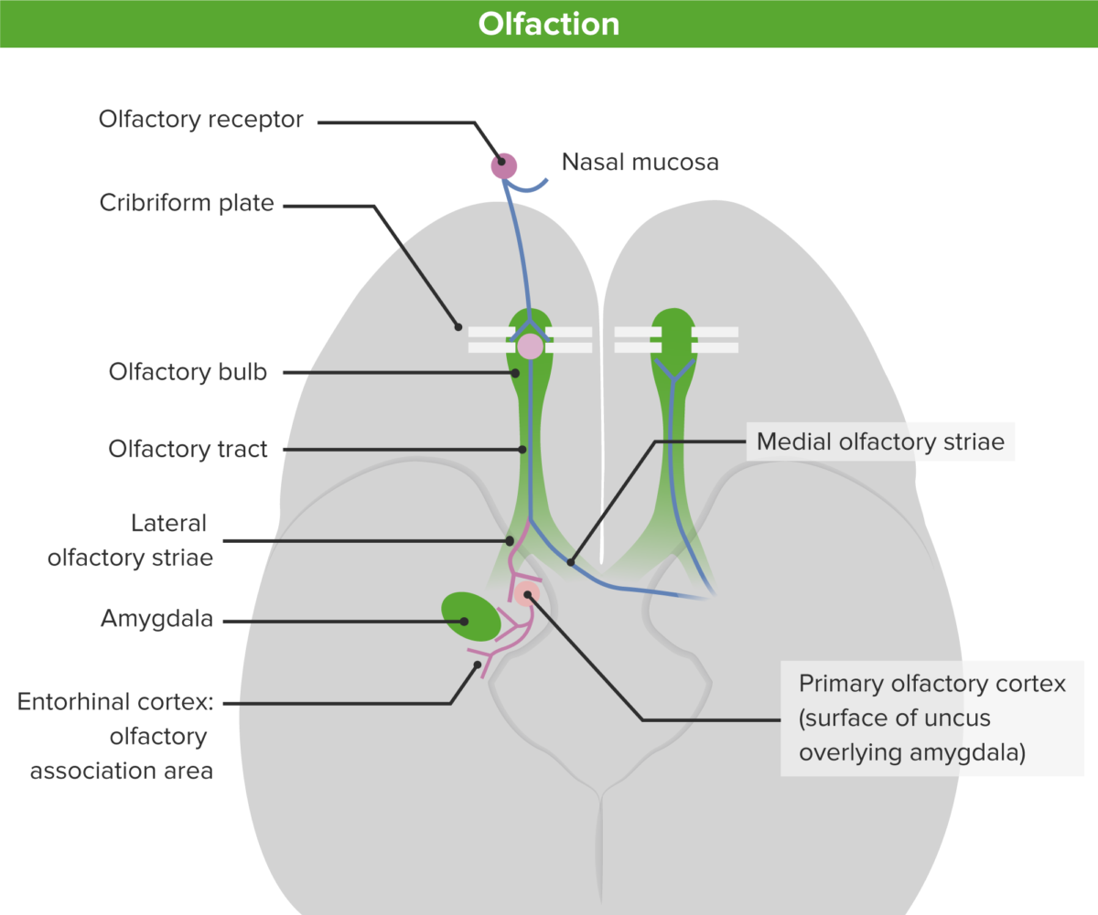
Olfactory pathways
Olfaction is a link between the smell ,memory and emotion
The mitral cells of olfactory bulb send information through the medial stria to the olfactory bulb of the opposite side
Each olfactory center receive smell sensation from both halves of the nasal cavity

Slide 28
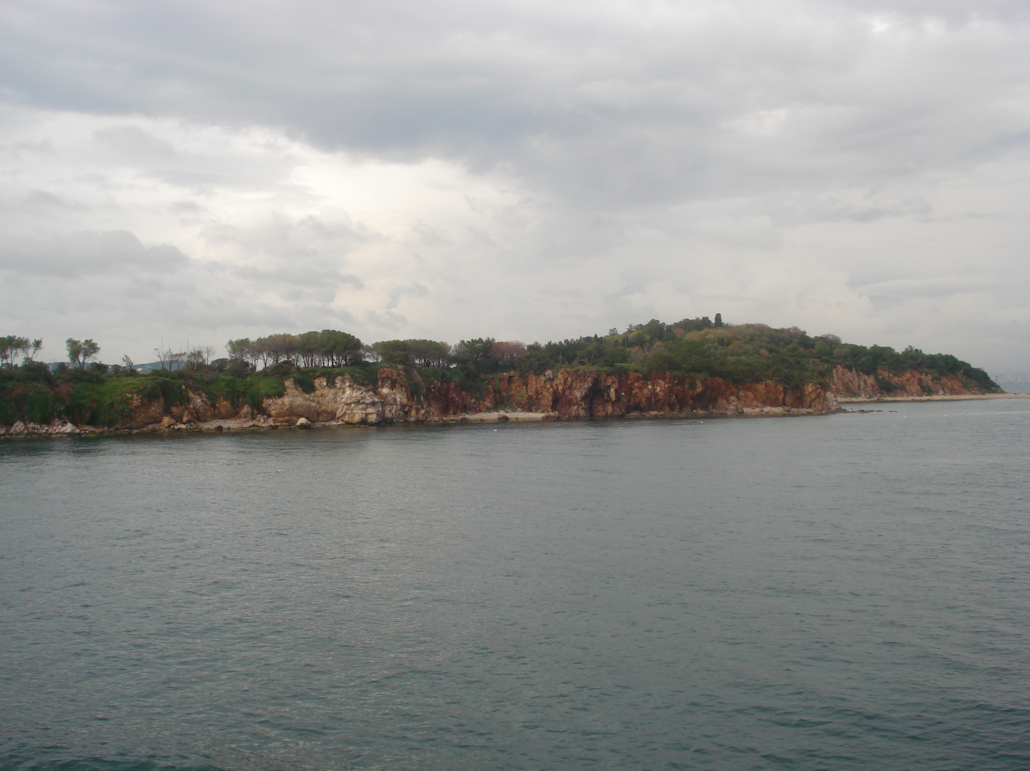
Dr. Aiman Qais Afar
Sunday 13 March 2022

