Slide 1
Pathology lecture 5
Dr. Bushra AlTarawneh, MD
Anatomical pathology Mutah University School of Medicine- Department of Laboratory medicine & Pathology MSS lectures 2021

Slide 2
In this lecture
CHRONIC INFLAMMATORY DERMATOSES
BLISTERING (BULLOUS) DISORDERS
Skin Tumors

Slide 3
CHRONIC INFLAMMATORY DERMATOSES
Chronic inflammatory dermatoses are persistent skin conditions that exhibit their most characteristic features over many months to years, although they may begin with an acute stage.
The skin surface in some chronic inflammatory dermatoses is roughened as a result of excessive or abnormal scale formation and shedding (desquamation).

Slide 4
CHRONIC INFLAMMATORY DERMATOSES
Psoriasis
Lichen Planus
Lichen Simplex Chronicus

Slide 5
1-Psoriasis
Psoriasis is a common chronic inflammatory dermatosis.
Recent epidemiologic studies have shown that psoriasis is associated with an increased risk for heart attack and stroke and also is associated in up to 10% of patients with arthritis, which in some cases may be severe.
Pathogenesis:
Psoriasis is a T cell-mediated inflammatory disease, presumed
to be autoimmune in origin.
Most frequently affects the skin of the elbows, knees, scalp, lumbosacral areas, intergluteal cleft, glans penis, and vulva. Nail changes on the fingers and toes occur in 30% of cases.

Slide 6
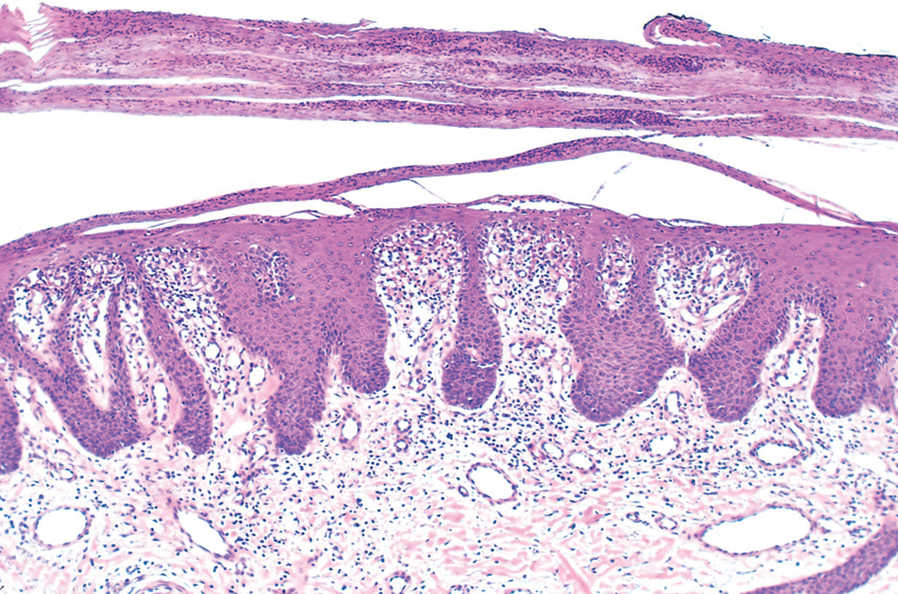
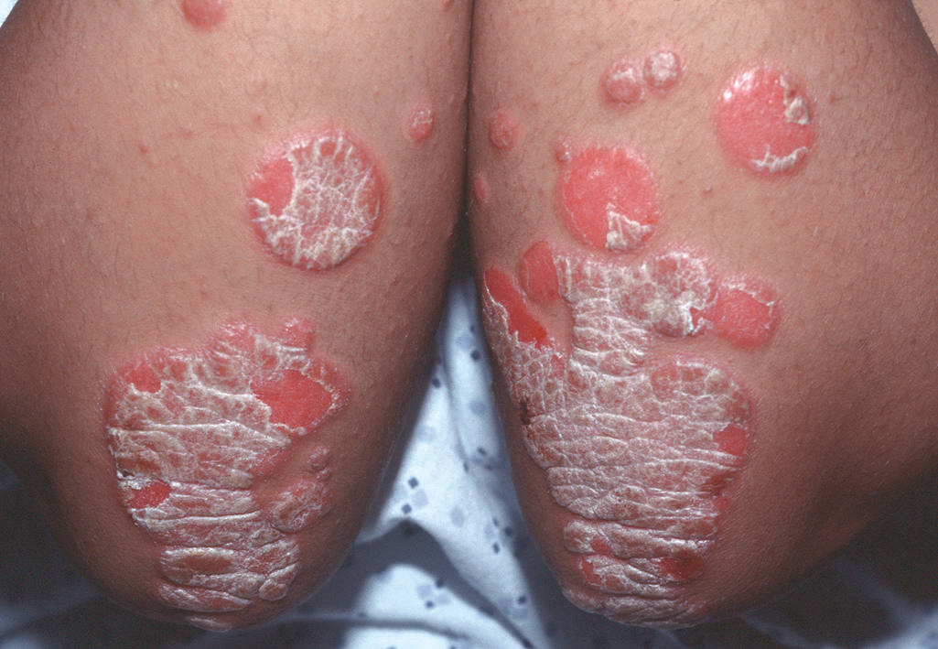
Chronic psoriasis. (A) Erythematous psoriatic plaques covered by silvery-white scale. (B) Microscopic examination shows marked epidermal hyperplasia,downward extension of rete ridges (psoriasiform hyperplasia), and prominent parakeratotic scale with infiltrating neutrophils.

Slide 7
2-Lichen Planus
Lichen planus is an uncommon disorder that usually presents in middle-aged adults. The cutaneous lesions are multiple and are usually symmetrically distributed, particularly on the extremities.
Approximately 70% of cases also involve the oral mucosa.
“Pruritic, purple, polygonal, planar papules, and plaques”
are the tongue-twisting Ps that describe this disorder of
skin and squamous mucosa.
The lesions may result from a CD8+ T cell–mediated cytotoxic response against antigens in the basal cell layer and the dermoepidermal junction that are produced by unknown mechanisms.

Slide 8
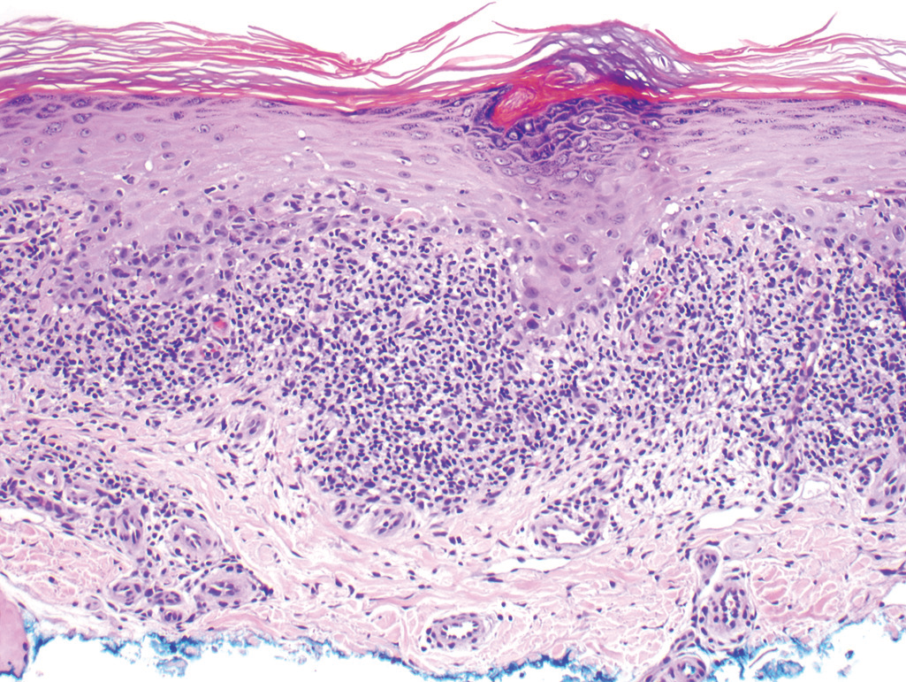
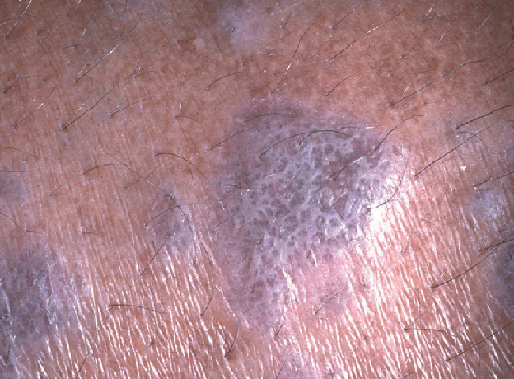
Microscopic examination shows a bandlike infiltrate of lymphocytes along the dermoepidermal junction, hyperkeratosis, hypergranulosis, and pointed rete ridges (“sawtoothing”).

Slide 9
3- Lichen Simplex Chronicus
Lichen simplex chronicus manifests as roughening of the skin. It is a response to local repetitive trauma, usually from rubbing or scratching.
The pathogenesis of lichen simplex chronicus is not understood, but the trauma probably induces epithelial hyperplasia and eventual dermal scarring.
Microscopically :Lichen simplex chronicus is characterized by acanthosis, hyperkeratosis, and hypergranulosis.

Slide 10
BLISTERING (BULLOUS) DISORDERS

Slide 11
Although vesicles and bullae (blisters) occur as secondary phenomena in several unrelated conditions (e.g., herpesvirus infection, spongiotic dermatitis), there is a group of disorders in which blisters are the primary and most distinctive feature. Which include:
1-Pemphigus (Vulgaris and Foliaceus). 2-Bullous pemphigoid.
Blistering in these diseases tends to occur at specific levels within the skin, a morphologic distinction
that is critical for diagnosis.

Slide 12
1-Pemphigus (Vulgaris and Foliaceus)
Pemphigus is an uncommon autoimmune blistering disorder resulting from loss of normal intercellular attachments within the epidermis and the squamous mucosal epithelium.
There are three major variants:
• Pemphigus vulgaris (the most common type)
• Pemphigus foliaceus
• Paraneoplastic pemphigus which is associated with internal malignancy.

Slide 13
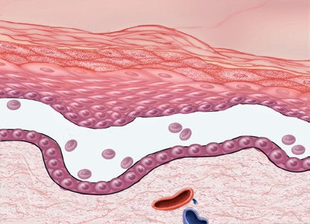
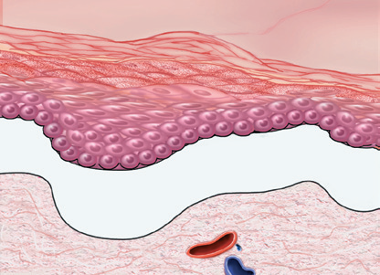
Level of epidermal separation forms the basis of differential diagnosis for blistering disorders.
A-Subcorneal
B-Suprabasal
C-Subepidermal

Slide 14
Pathogenesis
Pemphigus vulgaris & pemphigus foliaceus:
Autoimmune diseases caused by: Antibody mediated hypersensitivity reactions. (Type II)
Pathogenic antibodies:
IgG autoantibodies:
1- Bind to intercellular desmosomal proteins of skin & mucous membranes.
2- Disrupt intercellular adhesive function of desmosomes.
3- Activate intercellular proteases.

Slide 15
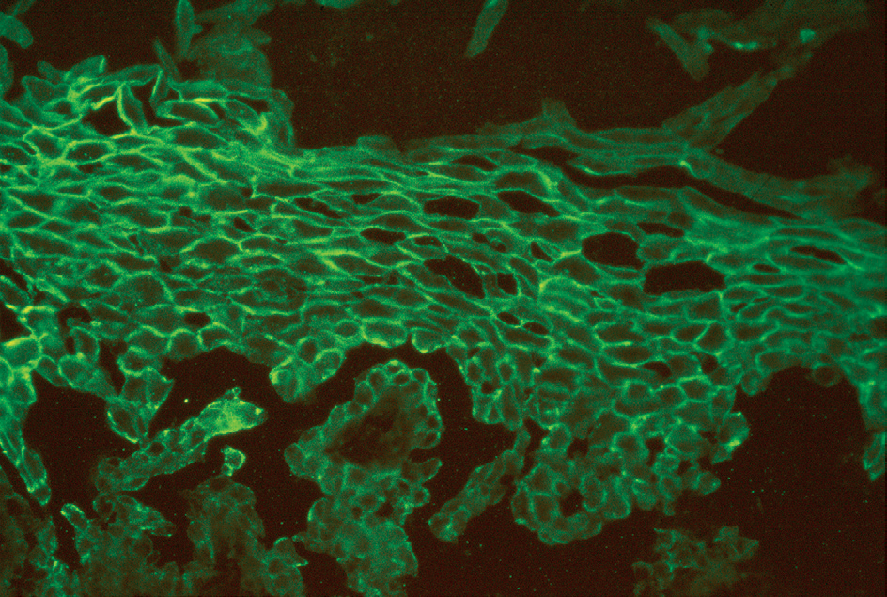
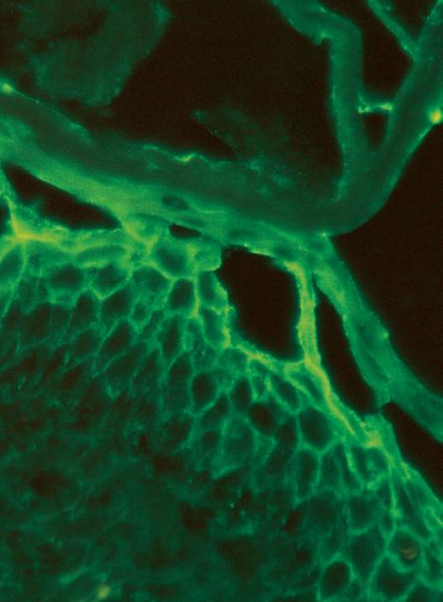
Diagnosis: Direct immunofluorescence study:
Lesional sites show a characteristic fishnet-like pattern of intercellular IgG deposits.
Pemphigus vulgaris:
Uniform deposition of Ig (green) along cell membrane of keratinocytes (fishnet pattern).
Pemphigus foliaceus:
Ig deposits confined to superficial layers of epidermis.

Slide 16
Histologic picture in all forms of pemphigus is:
Acantholysis:
Lysis of intercellular adhesive junctions between neighboring squamous epithelial cells results in detached cells.
Pemphigus vulgaris: Acantholysis of layer of cells above basal cell layer Suprabasal blister.
Pemphigus foliaceus: Acantholysis of superficial epidermis is at level of stratum granulosum.
Variable superficial dermal infiltrates comprised of lymphocytes, macrophages, & eosinophils accompany all forms of pemphigus.

Slide 17
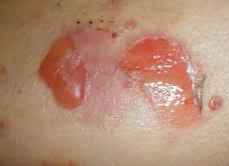
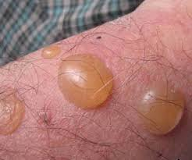
1-Pemphigus vulgaris:
Most common type.
Involves both mucosa & skin of scalp, face, axillae, groin, trunk, & points of pressure.
Lesions:
Superficial vesicles & bullae, rupture easily, leaving deep & extensive erosions covered with serum crust.

Slide 18
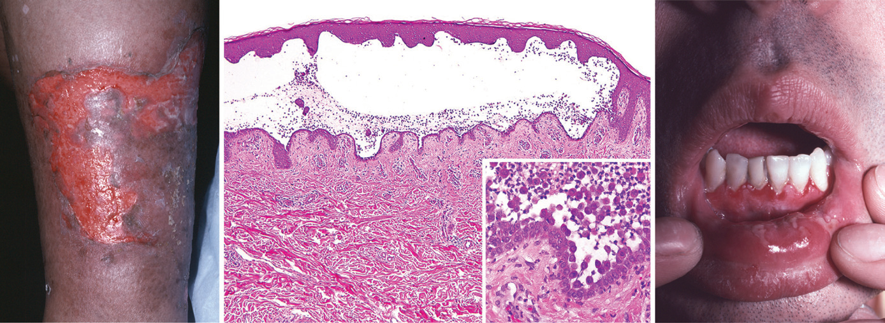
Pemphigus vulgaris: Erosion on leg:Group of confluent, unroofed blisters. Suprabasal acantholysis results in intraepidermal blister.

Slide 19
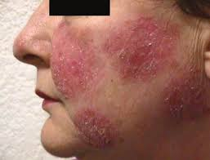
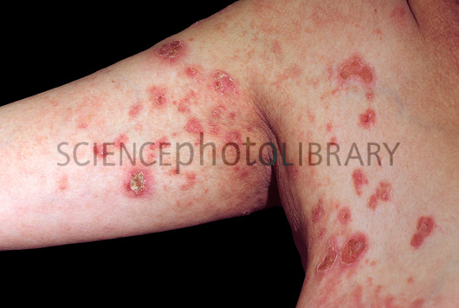
2-Pemphigus foliaceus:
Rare, more benign form of pemphigus.
Bullae confined to skin.
Infrequent involvement of mucous membranes.
Blisters are superficial with more limited zones of erythema & crusting of ruptured blisters.

Slide 20
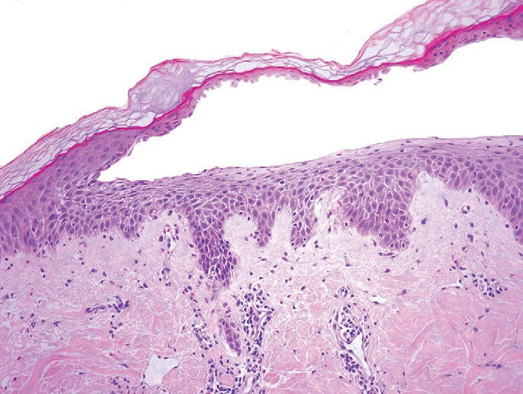
Pemphigus foliaceus: Gross appearance of typical blister, less severely eroded than those seen in pemphigus vulgaris. Microscopic: Characteristic subcorneal blister.

Slide 21
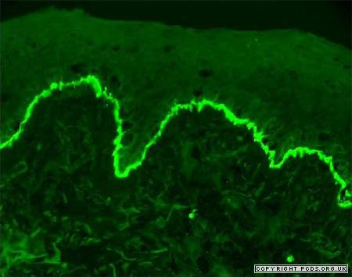
2-Bullous pemphigoid:
Acquired blistering disorder with autoimmune basis.
Pathogenesis
Blistering is triggered by linear deposition of IgG
antibodies in epidermal basement membrane.
Deposition of IgG antibody detected by direct immunofluorescence as linear band outlining the subepidermal basement membrane zone.

Slide 22
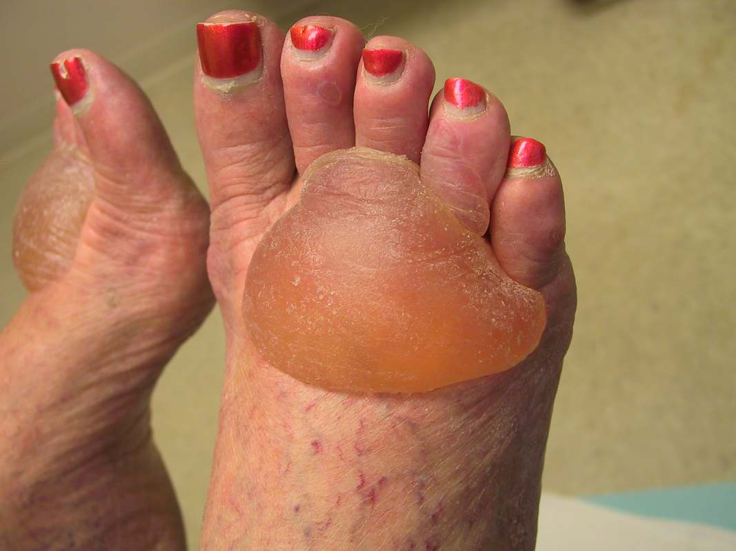
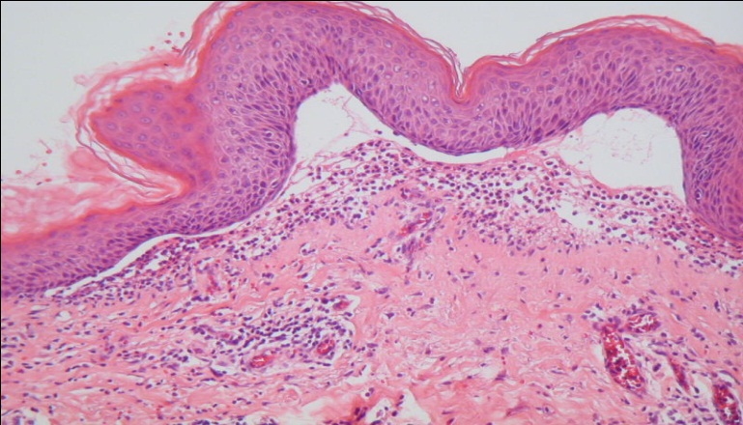
Morphology: Grossly:
Tense bullae filled with clear fluid.
Subepidermal nonacantholytic blisters.
Perivascular infiltrate of lymphocytes & eosinophils.
Superficial dermal edema.
Basal cell vacuolization gives rise to
fluid-filled blister.
Blister roof consists of full thickness with intact intercellular junctions so epidermis not rupture easily.
(Key distinction from blisters in pemphigus)

Slide 23
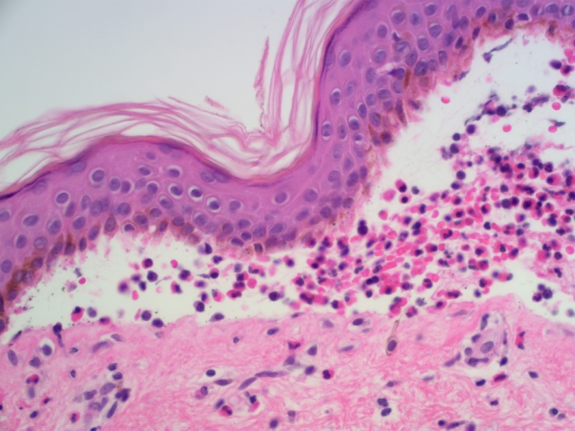
Bullous pemphigoid.
Gross appearance of tense, fluid filled blisters.
Subepidermal vesicle with inflammatory infiltrate rich in eosinophils.

Slide 24
SKIN TUMORS

Slide 25
Malignant Epidermal Tumors
1- Squamous Cell Carcinoma
Squamous cell carcinoma is a common tumor that typically arises on sun-exposed sites in older adults. These tumors.
Having a higher incidence in men than in women.
Pathogenesis : Cutaneous squamous cell carcinoma is mainly caused by UV light exposure, which leads to widespread DNA damage and extremely high mutational loads.
Squamous cell carcinomas arising at internal sites (oropharynx, lung, esophagus, anus).

Slide 26
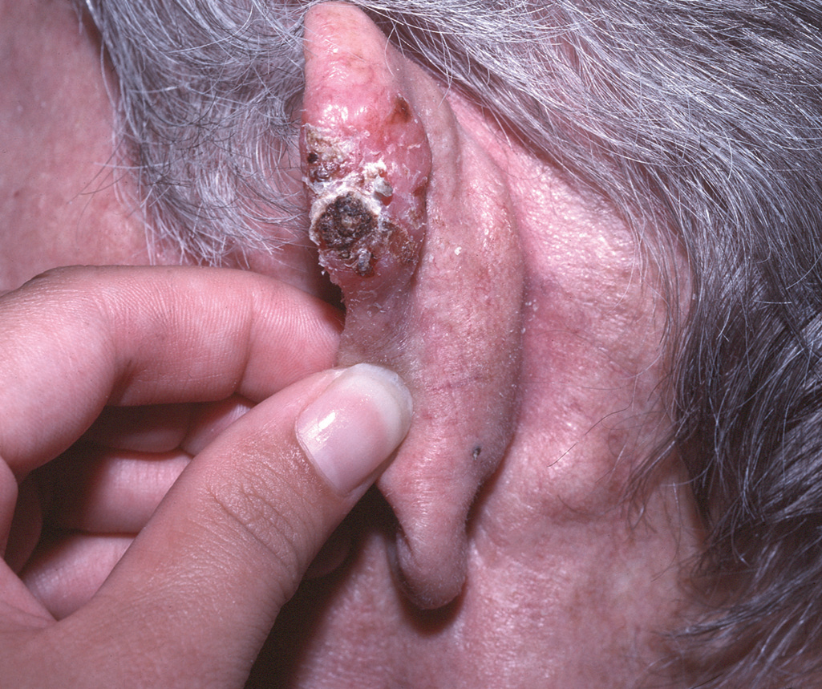
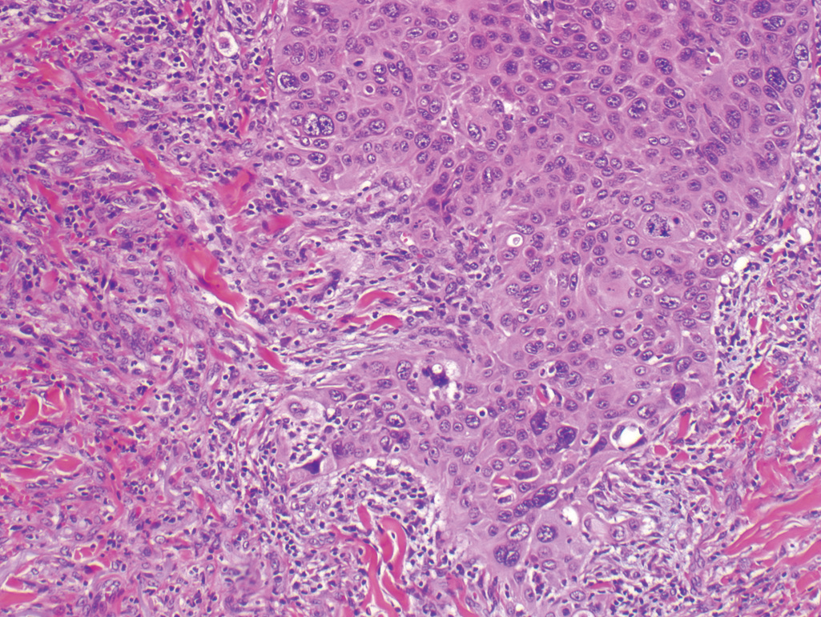
Invasive squamous cell carcinoma.
(A) A nodular, hyperkeratotic lesion occurring on the ear, associated with metastasis to a prominent postauricular lymph node (arrow).
(B) Tumor invades the dermal soft tissue as irregular projections of atypical squamous cells exhibiting acantholysis.

Slide 27
2- Basal Cell Carcinoma
Basal cell carcinoma is a common slow-growing cancer that rarely metastasizes. It tends to occur at sites subject to chronic sun exposure and in lightly pigmented individuals.
Pathogenesis : The molecular hallmark of basal cell carcinoma is loss-of function mutations in PTCH1, a tumor suppressor gene.

Slide 28
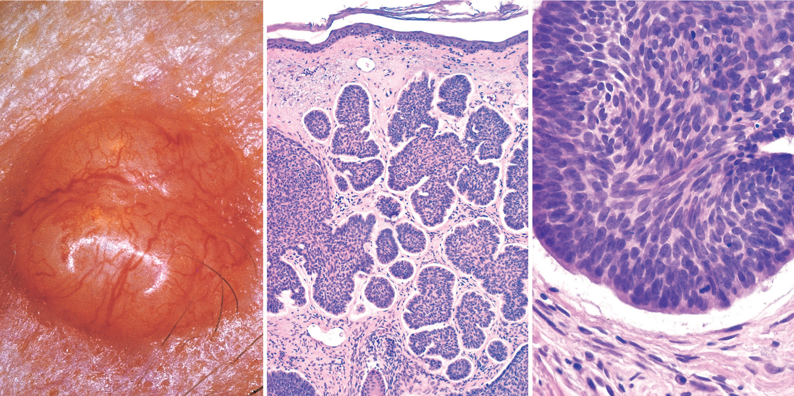
Basal cell carcinoma. (A) A prototypical pearly, smooth-surfaced papule with telangiectatic vessels. (B) Tumor is composed of nests of basaloid cells infiltrating a fibrotic stroma. (C) Tumor cells with scant cytoplasm and small hyperchromatic nuclei that palisade on the outside of the nest. The cleft between the tumor cells and the stroma is a highly characteristic artifact of sectioning.

Slide 29
Melanocytic nevi
Melanocytic nevi are benign neoplasms caused by somatic gain-of-function mutations in BRAF or RAS.
An early-stage lesions are called junctional nevi
Eventually, most junctional nevi grow into the underlying dermis as nests or cords of cells (compound nevi), and in older lesions the epidermal nests may be lost entirely, creating intradermal nevi.

Slide 30
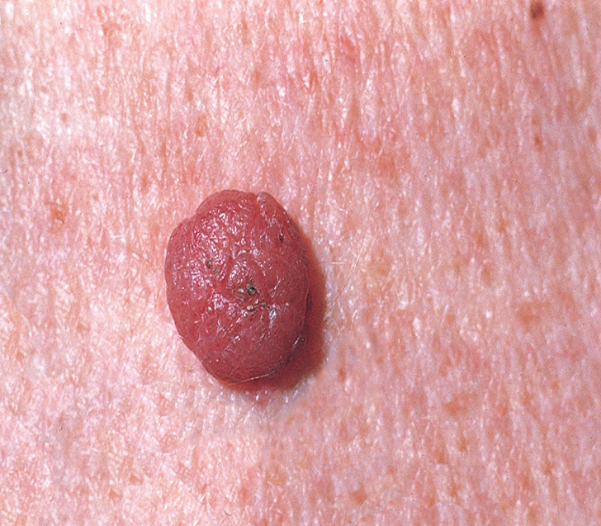
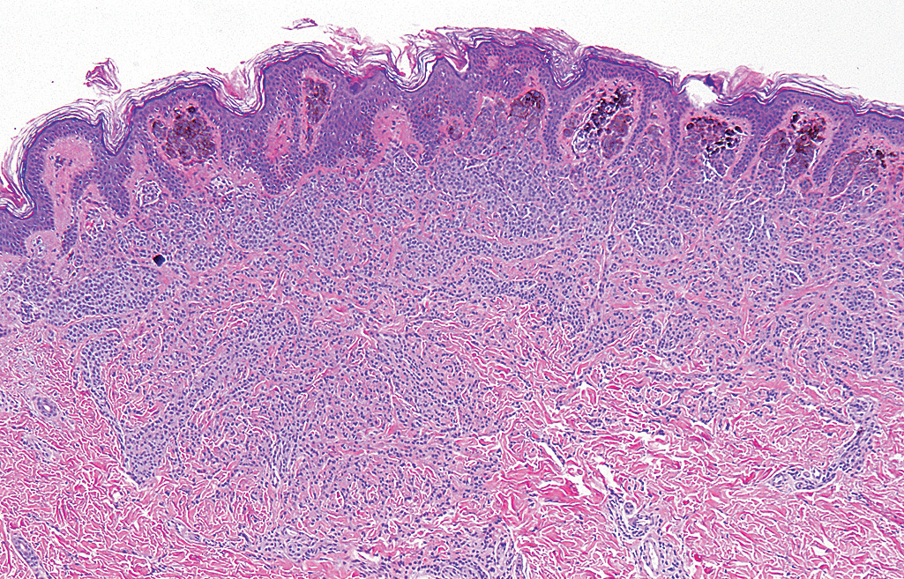
Common melanocytic nevi are tan-to-brown, uniformly pigmented, small papules (5 mm or less across) with well-defined, rounded borders Early lesions are composed of round to oval cells that grow in “nests” along the dermoepidermal junction. Nuclei are uniform and round, and contain inconspicuous nucleoli with little or no mitotic activity.

Slide 31
3-Melanoma
Melanoma is less common but much more deadly than basal or squamous cell carcinoma.
Pathogenesis : As with other cutaneous malignancies, melanoma is mainly caused by UV light–induced DNA damage that leads to the stepwise acquisition of driver mutations.
The initiating event appears to be an activating mutation in BRAF or (less commonly) RAS.

Slide 32
Melanoma is a highly aggressive malignancy; tumors only a few
millimeters in thickness can give rise to deadly metastases.
often associated with a brisk lymphocytic infiltrate.
The most important clinical sign is a change in the color or size of a pigmented lesion.
The main clinical warning signs are as follows:
1. Rapid enlargement of a preexisting nevus
2. Itching or pain in a lesion
3. Development of a new pigmented lesion during adult
life
4. Irregularity of the borders of a pigmented lesion
5. Variegation of color within a pigmented lesion

Slide 33
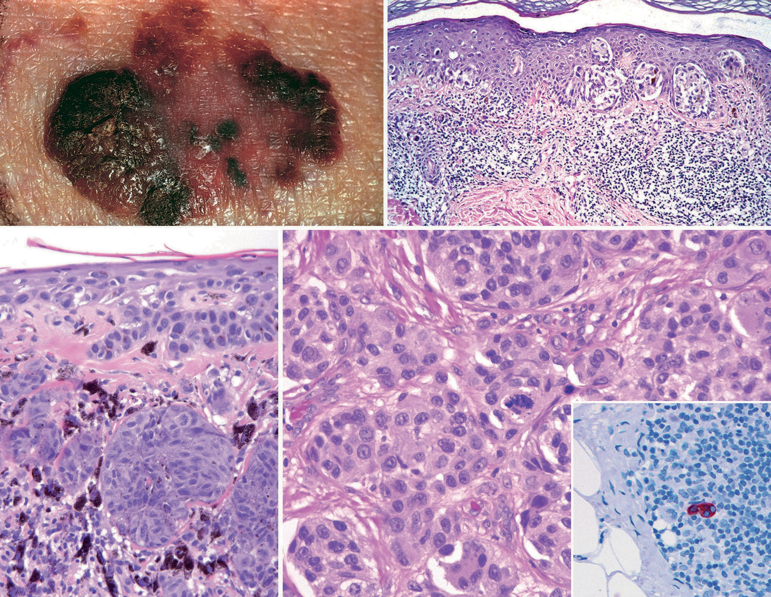
(A) Lesions tend to be larger than nevi, with irregular contours and variable pigmentation. Macular areas indicate superficial (radial) growth, while elevated areas indicate dermal invasion (vertical growth).
(B -D) Radial growth phase, with spread of nested and single melanoma cells within the epidermis. Vertical growth phase, with nodular aggregates of infiltrating tumor cells within the dermis.

Slide 34
GOOD LUCK IN YOUR EXAM

