Slide 1
Water soluble vitamins (Vitamins B9, B12 & C) Lecture 4 (37 slides)
Eman Shaat
Professor of Biochemistry & Molecular Biology

Slide 2
Water soluble vitamins Hematopoietic vitamins
1. Vitamin B9 (Folate)

Slide 3
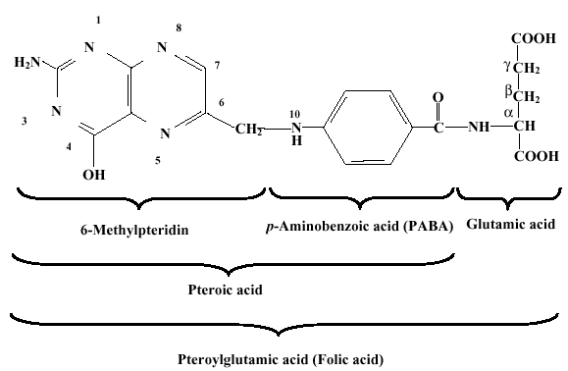
Folic acid (Folacin=Pteroyl glutamic acid)
Chemistry
Pteridine nucleus (bicyclic nitrogenous compound).
Para-amino benzoic acid (PABA).
Glutamic acid.

Slide 4
Folate absorption
Dietary folates, are ingested as Polyglutamates → Monoglutamate by a hydrolase.
Folate absorption and transport:
The reduced folate carrier (RFC).
The proton-coupled folate transporter (PCFT).
Folate receptor α (FRα).

Slide 5
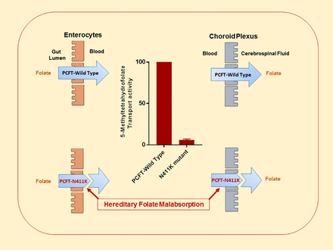
Folate absorption
Folate
H+

Slide 6
Folic acid:
Synthesis: Animal cells are not capable of synthesizing PABA or of attaching the first glutamate to pteroic acid, but bacteria and plants can.
Requirements: 200 μg/day.
Sources:
The major source is leafy vegetables.
yeast.
liver and kidney. (stored but not synthesized)
Function:
Formation of the important coenzyme tetrahydrofolic acid (FH₄); (THF).
FH₄ (THF) is the coenzyme for one carbon metabolism.

Slide 7
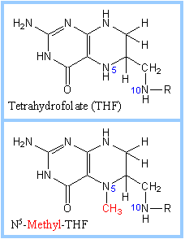
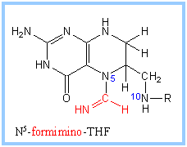
Folic acid: Function
The “one carbon” group carried on FH4 may be:
methyl (-CH3) ………… [N5 or N10]
methylene (-CH2-) ……… [N5, N10]
methenyl (-CH = ) ……… [N5 , N10]
formyl (-CHO), or ……… [N5 or N10]
formimino (-CH = NH) … [N5 or N10]

Slide 8
CH2
N5,N10 –CH2- THF

Slide 9
Reduction of folic acid
Folic acid: Functions of one carbon group:
I. Synthesis of amino acids as Gly., Ser. & Met.
II. Purine biosynthesis (formation of carbon 2 and carbon 8 of purine ring).
III. Synthesis of deoxythymidylic acid (dTMP).
IV. Folate & immunity: It helps T-cells proliferatation.

Slide 10
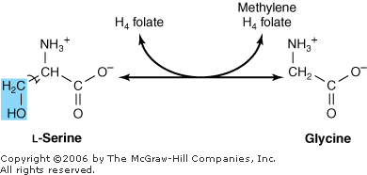
Folic acid: Sources of the one carbon group:
1. Beta-carbon of serine.
2. Glycine.
3. Formimino group of formimino glutamate (produced during histidine catabolism).
4. Formate (e.g. In metabolism of tryptophan).
β
serine hydroxymethyl transferase
Serine

Slide 11
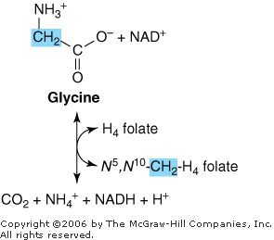
Glycine
Glycine cleavage system; Glycine synthase

Slide 12
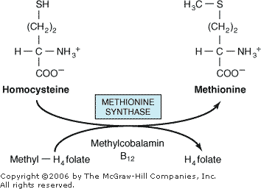
Folate is essential for methylation of homocysteine to Methionine
Met → S-adenosyl Met (SAM) → transmethylation reactions as:
Methylation of Cephalin to Lecithin (for myelin synthesis).
Norepinephrine → Epinephrine (neurotransmitters & brain metabolism).
DNA methylation (epigenetic regulation (growth)).
Histone methylation (regulation of gene expression).

Slide 13
Folate (B9) is essential for:
Synthesis of RNA & DNA:
II. Purine.
III. Pyrimidine.
RNA & DNA regulation:
Methylation of DNA: for maintenance of the integrity of the genome and the cells in the body (link to developmental disorders and cancer).

Slide 14
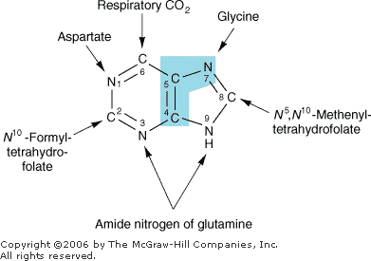
1. Folic acid
II. Purine biosynthesis [A & G]:
(formation of carbon 2 and carbon 8 of purine ring).

Slide 15
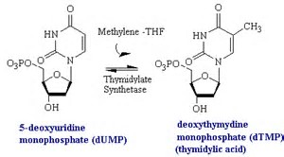
III. Synthesis of deoxythymidylic acid (dTMP) methylene-THF is coenzyme for thymidylate synthase.

Slide 16
Folic acid: III. Synthesis of deoxythymidylic acid (dTMP): It is coenzyme for thymidylate synthase [5-fluorouracil inhibits this enzyme]
Thymidylate synthase
dUMP
TMP
N5 N10– CH2- THF
DHF
NADPH+ +H
Gly
methotrexate
Folate reductase
NADP+
Ser
THF

Slide 17
Met synthase (B12)
Folate trap
THF -CH2-THF CH3-THF
CHO-THF =CH-THF
CHO-THF NH=CH-THF
Ser, Gly
Trp
dTMP
Met
C2 purine
C8 purine
** folate are all interconvertable EXCEPT
N5 CH3-THF
** sources of 1 carbon: -His - Trp -Ser -Gly
His

Slide 18
( Inhibitors of folate reductase (Folate antagonists
** Trimethoprim & Methotrexate
They resemble DHF & competitively inhibit folate reductase.
,,, THF
,,, purines & ,,, pyrimidine (TMP)
,,, DNA synthesis
,,, replication & multiplication of cells.
These are substances used in treatment of cancer
They act by blocking synthesis of nucleic acids in malignant cells.

Slide 19
Folate deficiency
Causes of def.:
I. Primary: -,,, intake. - malabsorption. - boiling food for prolonged periods at high temperature. - hhh demands (pregnancy & lactation).
II. Secondary to Vit.B12 def.
Manifestations:
I- Megaloblastic anemia
Macrocytes (large immature RBC with fragile membrane) impaired DNA synthesis → arrest of cells in S phase.
It also slow maturation of RBC.
II- Neurological:
- Neural tube defects as spina bifida.
-Neurological: peripheral neuropathy, depression.
III- Glossitis & GIT disturbances.
IV- Increased risk of colorectal cancer due to ↓↓ DNA methylation.
V. Premature atherosclerosis due to ↑↑ plasma homocysteine.

Slide 20
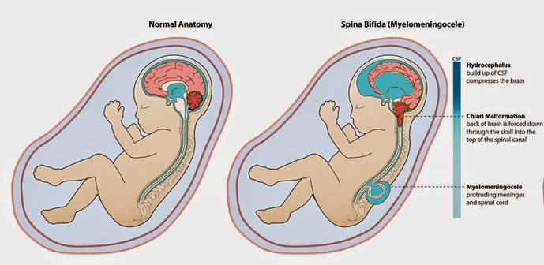
Neural tube defects (NTDs)
Normally, closure of the neural tube occurs around the 28th day of pregnancy.
NTDs are a group of birth defects in which an opening in the spinal cord or brain For examples: Spina bifida.
Causes: Inadequate levels of folate and vitamin B12 during pregnancy.
NTDs are reduced by 400μg folic acid supplement/day before conception and during the first month of pregnancy.

Slide 21
Water soluble vitamins Hematopoietic vitamins
2. Vitamin B12 (Cobalamin)

Slide 22
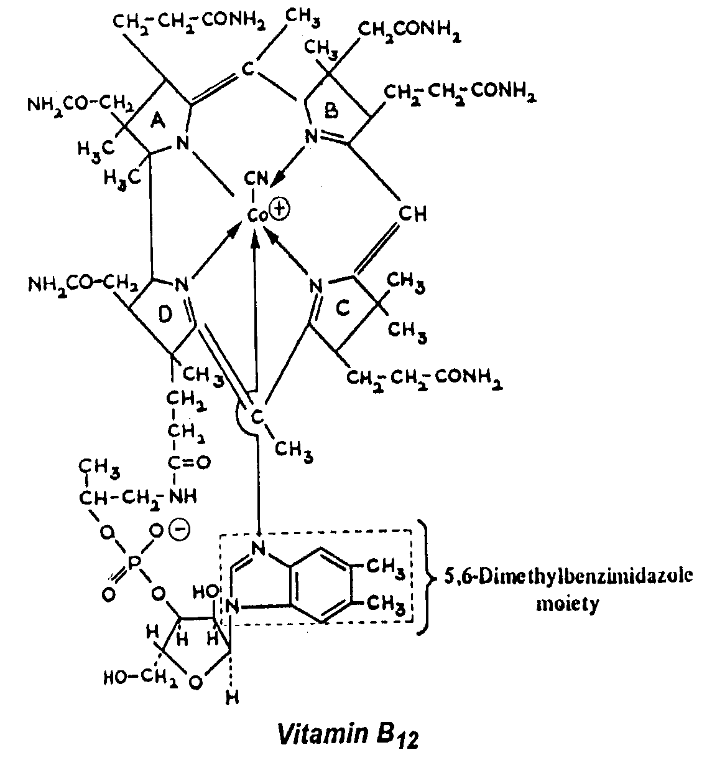
Vit. B12: Chemical structure
1. Corrin ring:
2. Ribonucleotide
3. Cobalt: linked by 6 co-ordination rings 4 N of pyrroles, 1 N of nucleotide & R.
R may be:
CN
OH
CH3
5-deoxyadenosine
R

Slide 23
Active form (Co-enzyme) of vitamin B12
1. Methyl cobalamin (in cytoplasm).
2. 5-deoxy adenosyl cobalamin (in mitochondria).
Synthesis:
synthesis by micro-organisms in animal intestine.
Neither animal nor plants can synthesize it.
Sources:
The only sources of the vitamin are foods of animal origin as liver, kidney, meats, milk and eggs
Negligible amounts are provided by intestinal flora.
it is not present in vegetable foods.

Slide 24
B12 absorption
Diet (Vit.B12 – protein): hydrolyzed by HCl.
Transport of B12 is performed by three successive proteins:
Haptocorrin (HC; it is a B₁₂ binding protein that is produced in salivary glands)
Intrinsic factor (IF)
Transcobalamin (TC).
In the stomach, B12 is bound to salivary HC.
After proteolytic cleavage of HC into fragments, B12 is transferred to IF.
in ileum, B₁₂ (extrinsic factor) must be attached to IF ( glycoprotein secreted by parietal cells) to be efficiently absorbed, as receptors only recognize the B12-IF complex. After crossing ileal mucosa, the intrinsic factor is released.

Slide 25
B12 absorption
B12 appears in blood bound to TC II which carries B12 to cells .
Only the fraction of B12 bound to TC is rapidly taken up via endocytosis by a speciﬁc receptor which is present on most cell types.
After cellular uptake of TC-B12, the protein moiety is degraded in lysozomes to release B12 for further conversion into coenzymes.
Around 50% of B12 is stored in the liver.
Excess B₁₂ beyond the blood's binding capacity is excreted in urine.
Formation of co-enzymes: The vitamin is transferred to plasma.
[CN is removed, OH is added]. Then, inside the cell, it either
Methylated (in cytoplasm) or Adenosylated (in mitochondria)
[ to be active co-enzyme].

Slide 26
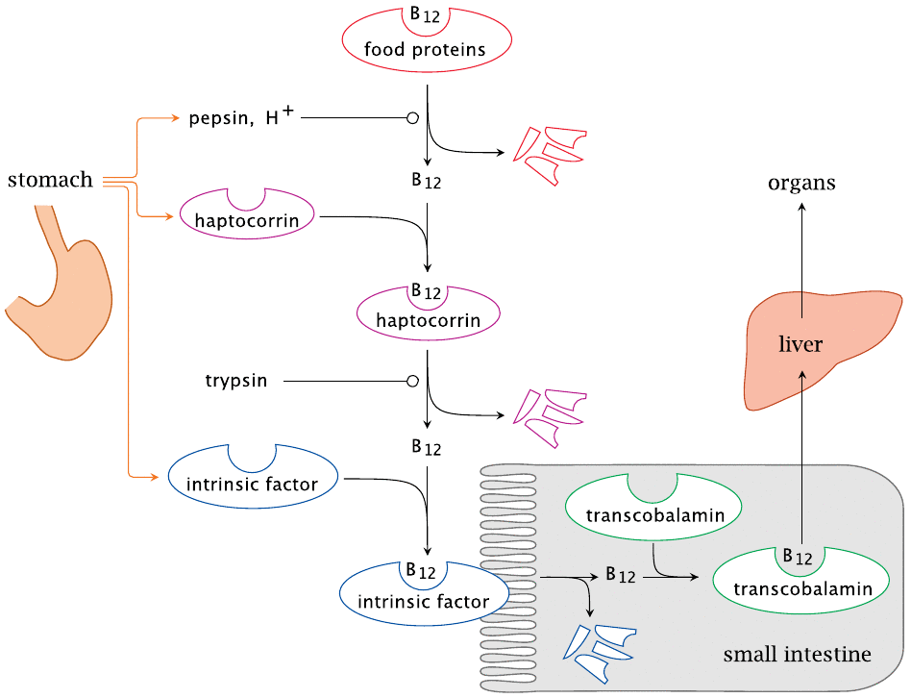
B12 absorption

Slide 27
Vit. B12: Biochemical reactions
In man, only 2 reactions utilize vitamin B12.
1. Methylation of homocysteine to methionine (Met):
in the cytoplasm. - utilizes methyl cobalamin as coenzyme and N5-methyl THF as methyl source.
Benefits:
I. B12 & folate are important for remethylation of homocysteine to form Met. which is needed for:
Methylation of Cephalin → Lecithin (For myelin synthesis)
Norepinephrine → Epinephrine (neurotransmitters & brain metabolism)
DNA & Histone methylation (epigenetic regulation [growth]).
II. THF (purines & pyrimidines for DNA synthesis)

Slide 28
Vit. B12: Biochemical reactions
1. Methylation of homocysteine to methionine:
Deficiency:
Hematopoiesis and immune response are among the most proliferative process; and thus are highly sensitive to deficient vitamins.
hhh homocysteine (CVS manifestations; atherosclerosis).
Folate trap (,,, purines & dTMP synthesis).
,,, Met. (,,, choline, epinephrine,… ).

Slide 29
Vit. B12: Biochemical reactions
In man, only 2 reactions utilize vitamin B12.
2. Isomerization of L-methyl malonly CoA to succinyl CoA: It ocurs in mitochondria by L-methyl malonyl CoA mutase (the coenzyme is 5’-deoxyadenosyl cobalamin)
Benefits:
Oxidation in CAC producing energy.
Succinyl CoA (heme synthesis).
Deficiency:
Methyl malonic aciduria: Excessive Methyl malonic acid will be incorporated into fatty acids itself rather than normal malonic acid. If this abnormal fatty acid subsequently is incorporated into myelin, the resulting myelin will be too fragile, and demyelination will occur.
B₁₂ deficiency causes neuropathies, even if folic acid is present in good supply, and therefore anemia is not present.

Slide 30
Vit. B12: Biochemical reactions
hhh
Homocystinuria
,,,
CVS
,,, purines & dTMP synthesis
Folate trap
De-myelination
hhh Methyl malonic aciduria
Anemia

Slide 31
Vitamin B12: deficiency
Causes:
- Old people (,,, HCl & intrinsic factor). - Gastrectomy. –Antacids.
- Malabsorption & intestinal diseases. - Long term vegetarians.
Manifestations:
I- Hematopoietic: Pernicious anemia arises under conditions of B12 or intrinsic factor deficiency ( macrocytic megaloblastic anemia)
,,, THF →impaired purines & pyrimidines synthesis → Impaired DNA synthesis So, affecting formation of nucleus of new erythrocyte & preventing cell division.
II- Neurological: due to progressive demylination of nervous tissue.
hhh methyl malonyl CoA.
,,, Met stores.
III. Premature atherosclerosis (hhh plasma homocysteine).
IV- Depression and dementia
V- Homocystinuria & methylmalonic aciduria.

Slide 32
Water soluble vitamins
Vitamin C
(L-ascorbic acid)

Slide 33
Vitamin C: chemistry
It is γ-lactone of sugar acid.
It is a strong reducing agent.
Both forms; ascorbate and dehydroascorbate are physiologically active and are found in body fluids.
It is easily destroyed by cooking. Freezing has no deleterious effect.
L-ascorbic acid dehydro-ascorbic acid

Slide 34
3. Vitamin C: Function
Sources: Fresh fruits and vegetables are excellent sources :e.g. orange, lemon, melons and tomatoes.
Functions:
I. Ascorbic acid is hydrogen carrier acting as a cofactor for certain enzymatic reactions for example:
1. Enzymatic hydroxylation of proline to hydroxy proline in collagen. Thus it is essential for maintaining the normal intercellular material of cartilage, dentine and bone and for the integrity of capillary wall.
2. It plays a role in tyrosine metabolism.(required for reduction of Cu & Fe).
3. Dopamine nor-epinephrine.
4. It is required for the hydroxylation reactions involved in the synthesis of some corticosteroids at stress.
Dopamine β-hydroxylase
Cu + Vit.C

Slide 35
Vitamin C: Function
Proline (OH) proline
(in collagen)
around blood vessels → (if def. causes Hge. )
in bone → (if def. causes osteoporosis)
in muscle → (if def. Muscle weakness)
in gums → (if def. loose teeth & swollen gums)
in skin → (if def. ,,, wound healing )
Prolyl oxidase
Fe++,Vit.C

Slide 36
Vitamin C
II. Ascorbic acid has other important properties as a reducing agent, which appear to be non enzymatic, e.g.
1. It aids in the absorption of iron by reducing it to the ferrous state in the stomach.
2. It enhances the utilization of folic acid by aiding the conversion of folate to tetrahydofolate.
III. Ascorbic acid is antioxidant (donates electron→ ,,, free radical damage; Recycles oxidized vit. E for reuse):
,,, risk of cancer, atherosclerosis.
,,, oxidation of vit E.
IV. Vit. C may also play a role in Interferons production (It defend the body by preventing viral replication).

Slide 37
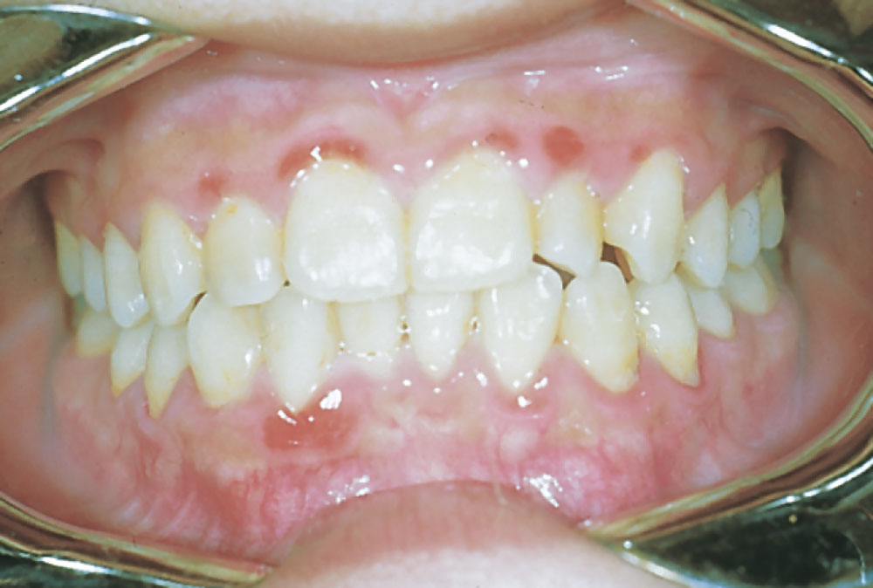
Vitamin C
Deficiency: [3-4 month]
Severe deficiency results in Scurvy which is characterized by:
1. Looseness of teeth, inflammation of gums (gingivitis) and bleeding from gums.
2. Subcutaneous hemorrhage.
3. Anemia. {anemia of vit.C due to Hge, iron def. & defective folate}
4. Defect in bone formation.
5. Increased susceptibility to infections.
Thank you & Best wishes
Dr. Eman Shaat

