Slide 1
Common Bacterial Infections
Prof Khitam AL-Refu k

Slide 2
Includes:
Impetigo
Ecthyma
Cellulitis and Erysipelas
Folliculitis
Erythrasma
Pitted keratolysis.

Slide 3
Impetigo
Impetigo is a common acute superficial bacterial skin infection (pyoderma).
It is characterized by pustules and honey-coloured crusted erosions.
The term impetiginisation is used for superficial secondary infection of a wound or other skin condition.
Ulcerated impetigo is called ecthyma.
Impetigo is most often caused by Staphylococcus aureus. Non-bullous impetigo can also be caused by group A beta-haemolytic streptococcus (Streptococcus pyogenes).

Slide 4
Continue Impetigo
In nonbullous impetigo, staphylococci and streptococci invade a site of minor trauma where exposed proteins allow the bacteria to adhere.
Ecthyma is usually due to Streptococcus pyogenes, but co-infection with Staphylococcus aureus may occur.
Bullous impetigo is due to staphylococcal exfoliative toxins (exfoliatin A–D), which target desmoglein 1 (desmosomal adhesion glycoprotein) and cleave off the superficial epidermis through the granular layer. No trauma is required, as the bacteria can infect intact skin.

Slide 5
Continue Impetigo
Impetigo is most common in children (especially boys), but may also affect adults if they have low immunity to the bacteria.
It is prevalent worldwide.
Peak onset is during summer, and it is more prevalent in developing countries.

Slide 6
Continue Impetigo
The following factors predispose to impetigo.
Atopic eczema
Scabies
Skin trauma: chickenpox, insect bite, abrasion, laceration, thermal burn, dermatitis, surgical wound

Slide 7
Continue Impetigo
Primary impetigo mainly affects exposed areas such as the face and hands, but may also affect trunk, perineum and other body sites. It presents with single or multiple, irregular crops of irritable superficial plaques. These extend as they heal, forming annular or arcuate lesions.
Although many children are otherwise well, lymphadenopathy, mild fever and malaise may occur.
Nonbullous impetigo starts as a pink macule that evolves into a vesicle or pustule and then into crusted erosions. Untreated impetigo usually resolves within 2 to 4 weeks without scarring.
Ecthyma starts as nonbullous impetigo but develops into a punched-out necrotic ulcer that heals slowly, leaving a scar.
Bullous impetigo presents with small vesicles that evolve into flaccid transparent bullae. It heals without scarring

Slide 8
Continue Impetigo

Slide 9
Continue Impetigo
Complications from impetigo
1. Soft tissue infection
The bacteria causing impetigo can become invasive, leading to cellulitis and lymphangitis; subsequent bacteraemia might result in osteomyelitis, septic arthritis or pneumonia.
2. Staphylococcal scalded skin syndrome
In infants under six years of age or adults with renal insufficiency, localised bullous impetigo due to specific staphylococcal serotypes can lead to a sick child with generalized staphylococcal scalded skin syndrome (SSSS). Superficial crusting then tender cutaneous denudation on the face, in flexures, and elsewhere is due to circulating exfoliatin/epidermolysin, rather than a direct skin infection. It does not scar.
3. Toxic shock syndrome
Toxic shock syndrome is rare and rarely preceded by impetigo. It causes fever, diffuse erythematous then desquamating rash, hypotension and involvement of other organs.
4. Post-streptococcal glomerulonephritis
Group A streptococcal infection may rarely lead to acute post-streptococcal glomerulonephritis 3–6 weeks after the skin infection. It is associated with anti-DNase B and antistreptolysin O (ASO) antibodies.
5. Rheumatic fever
Group A streptococcal skin infections have rarely been linked to cases of rheumatic fever and rheumatic heart disease. It is thought that this occurs because strains of group A streptococci usually found on the skin have moved to the throat (the more usual site for rheumatic fever-associated infection).

Slide 10
Continue Impetigo
impetigo is usually diagnosed:
clinically but can be confirmed by bacterial swabs
A blood count may reveal neutrophil.l leucocytosis when impetigo is widespread.

Slide 11
Continue Impetigo
The following steps are used to treat impetigo .
Cleanse the wound; use moist soaks to remove crusts gently.
Apply antiseptic 2–3 times daily for five days (povidone-iodine, hydrogen peroxide 1% cream, chlorhexidine, superoxidised solution and others).
Oral anti-biotics are recommended if:
Symptoms are significant or severe (fever, malaise)
There are more than three lesions
There is a high risk of complications
The infection is not resolving or is unlikely to resolve.
Suitable oral antibiotics Topical anti-biotics

Slide 12
Continue Impetigo
To prevent recurrence:
Treat carrier sites: apply antiseptic ointment to nostrils
Wash daily with anti-bacterial soap
Cut nails and keep hands clean
Identify and treat the source of re-infection, usually another infected person or carrier in the household.
Children must stay away from school until crusts have dried out or for 24 hours after starting oral antibiotics
Use separate towels and flannels
Change and launder clothes and linen daily.

Slide 13
Cellulitis
Cellulitis is a common bacterial infection of the lower dermis and subcutaneous tissue.
It results in a localized area of red, painful, swollen skin, and systemic symptoms.
Similar symptoms are experienced with the more superficial infection, erysipelas, so cellulitis and erysipelas are often considered together.

Slide 16
Continue Cellulitis
Cellulitis affects people of all ages and races. Predispositions to cellulitis include:
Previous episode(s) of cellulitis
Fissuring of toes or heels, eg due to tinea pedia, cracked heels.
Venous disease, eg lymphodema, gravitational eczema,
Current or prior injury, eg trauma, surgical wounds,
Immunodeficiency,
Immune suppressive medications
Diabetes
Chronic kidney disease
Chronic liver disease
Obesity
pregnancy

Slide 17
Continue Cellulitis
The most common bacteria causing cellulitis are Streptococcus pyogenes (two-thirds of cases) and Staphylococcus aureus (one third).

Slide 18
Continue Cellulitis
Cellulitis can affect any site, most often a limb
It is usually unilateral; a bilateral disease is more often due to another condition
It can occur by itself or complicate an underlying skin condition or wound.
The first sign of the illness is often feeling unwell, with fever, chills and shakes (rigors). This is due to bacteria in the bloodstream (bacteraemia).
Systemic symptoms are soon followed by the development of a localized area of painful, red, swollen skin.
Other signs include:
Dimpled skin (peau d’orange), Warmth, Blistering, Erosions and ulceration, Abscess formation, petechiae, ecchymoses, or haemorrhagic bullae.

Slide 19
Continue Cellulitis
if there are no signs of systemic illness or extensive cellulitis, patients can be treated with oral antibiotics at home, for a minimum of 5–10 days. In some cases, antibiotics are continued until all signs of infection have cleared (redness, pain and swelling), sometimes for several months.
Treatment should also include:Analgesia to reduce pain, Adequate water/fluid intake. Management of co-existing skin conditions like eczema or tinea pedis.

Slide 21
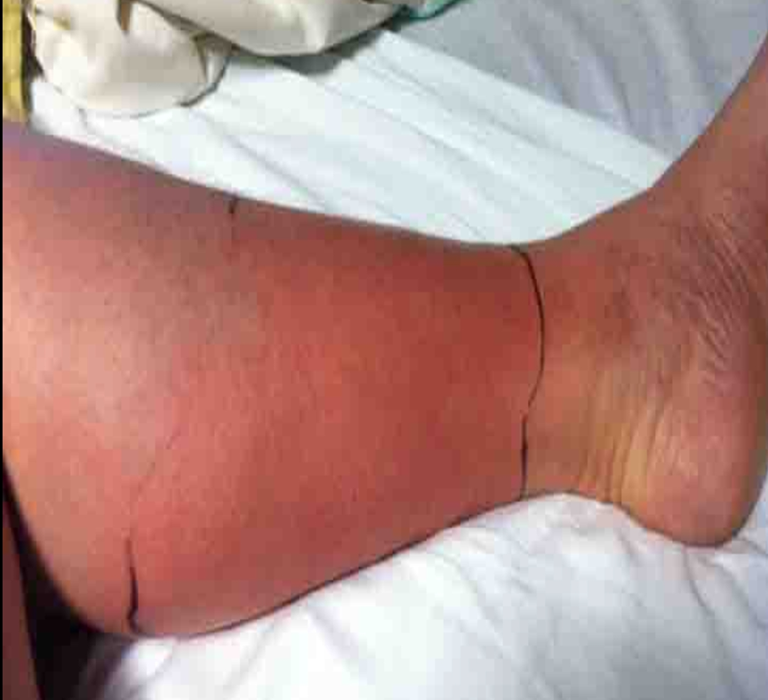
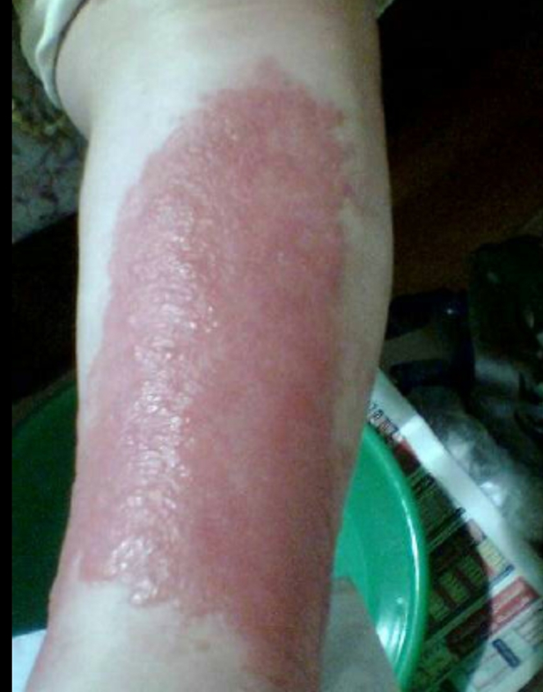

Slide 22
Folliculitis
Folliculitis is the name given to a group of skin conditions in which there are inflamed hair follicles. The result is a tender red spot, often with a surface pustule.
Folliculitis may be superficial or deep. It can affect anywhere there are hairs, including chest, back, buttocks, arms and legs.
Folliculitis can be due to infection, occlusion (blockage), irritation and various skin diseases.
Folliculitis is inflammation of the hair follicle due to infection, chemical irritation or physical injury. Bacterial folliculitis is the most common form of folliculitis.

Slide 24
Continue Folliculitis
Bacterial folliculitis is usually due to Staphylococcus aureus. Less often, coagulase-negative staphylococci and gram-negative organisms are responsible including anaerobes. Sap pool folliculitis is caused by Pseudomonas.

Slide 25
Continue Folliculitis
Bacterial folliculitis affects children and adults, with adolescents and young adult males most often infected. It is prevalent worldwide.
The following factors predispose to bacterial folliculitis:
Maceration and occlusion (clothing, dressings, ointments)
Frequent shaving, waxing or other forms of depilation
Friction from tight clothing
Atopic eczema
Use of topical steroids
Previous long-term use of antibiotics
Anaemia, diabetes, obesity, (HIV)/AIDS, cancer and other chronic illness

Slide 26
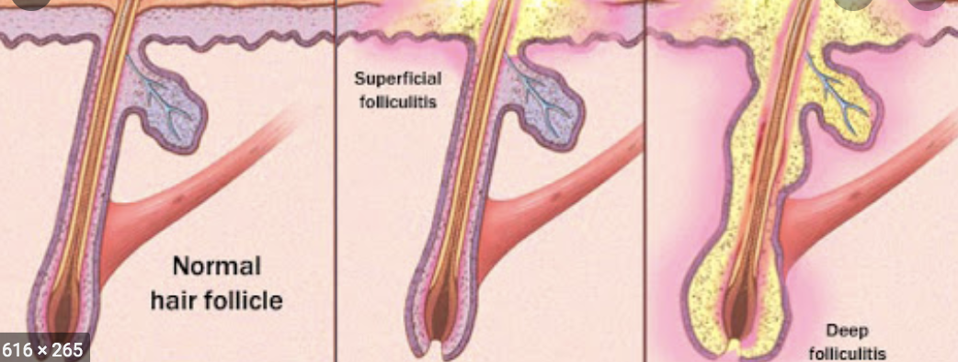
Continue Folliculitis
Bacterial folliculitis may be superficial or involve the whole hair follicle (a boil ). It may arise on any body site but is most often diagnosed in the scalp, beard area, axilla, buttocks and extremities.
Systemic symptoms are uncommon.
Different types of bacterial folliculitis are described.

Slide 28
Continue Folliculitis
1. Superficial folliculitis
Superficial staphylococcal folliculitis presents with one or more follicular pustules. They may be itchy or mildly sore. Superficial folliculitis heals without scarring.
A hordeolum or stye is bacterial folliculitis affecting an eyelash.

Slide 29
Continue Folliculitis
2. Furunculosis/boils
presents as one or more painful, hot, firm or fluctuant, red nodules or walled-off abscesses (collections of pus).
3. A carbuncle
is the name used when a focus of infection involves several follicles and has multiple draining sinuses.
Recovery leaves a scar.

Slide 30
Continue Folliculitis
Gram-negative folliculitis
develops in individuals using long term antibiotics for acne. The infection with Gram-negative organisms causes pustules in acne sites of the face, neck and upper trunk.
Hot tub folliculitis
presents with painful papules and pustules on the trunk some hours after soaking in hot water, mainly in sites that were covered by bathing costume. It may be accompanied by mild systemic symptoms including fever. Untreated, it settles within about 10 days without scarring.

Slide 31
Continue Folliculitis
Bacterial folliculitis can lead to cellulitis and lymphangitis; subsequent bacteremia might result in osteomyelitis, septic arthritis or pneumonia.
Bacterial folliculitis is usually diagnosed clinically but can be confirmed by bacterial swabs sent for microscopy, culture and sensitivity.
Blood count may reveal neutrophil leukocytosis when folliculitis is widespread.

Slide 32
Continue Folliculitis
The treatment for bacterial folliculitis?
Warm compresses to relieve itch and pain
Analgesics and anti-inflammatories to relieve pain
Antiseptic cleansers (eg, hydrogen peroxide, chlorhexidine, triclosan)
Incision and drainage of fluctuant lesions
Topical antibiotics such as erythromycin, mupirocin, Fucidic acid.
Oral or intravenous antibiotics for more extensive or severe infections

Slide 33
Erythrasma
Erythrasma is a common skin condition affecting the skin folds under the arms, in the groin and between the toes.
Erythrasma affects males and females, but it is thought to be more common in the groin of males and between the toes of females.

Slide 34
Continue Erythrasma
It is reported to be more prevalent in the following circumstances:
Warm climate
Excessive sweating
Diabetes
Obesity
Poor hygiene
Advanced age
Other immunocompromised states.

Slide 35
Continue Erythrasma
The bacteria responsible for erythrasma are gram-positive, non-spore-forming, aerobic or facultative bacilli called Corynebacterium minutissimum.
Erythrasma may coexist with or be confused with other causes of intertrigo including fungal infection such as tinea candida albicans.
Erythrasma presents as well-defined pink or brown patches with fine scaling and superficial fissures. Mild itching may be present.
The common sites for erythrasma are armpits, groin and between the toes. The intergluteal fold, submammary, and periumbilical skin may also be affected. Widespread infections are most often associated with diabetes mellitus.

Slide 36
Continue Erythrasma
Erythrasma is usually self-limiting. It can be complicated by contact dermatitis, lichenification, post inflammatory hyperpigmentation , and coinfection with other yeast and bacteria.
Serious complications are very rare.
Erythrasma has a typical clinical appearance.
Diagnosis may be supported by wood lamp skin examination (fluoresce a coral-pink colour due to coproporphyrin III released by the bacteria).
The fluorescence is not seen if the skin has recently been washed because the responsible porphyrin is water soluble.

Slide 37
Continue Erythrasma
Erythrasma can be treated with antiseptic or topical antibiotic such as fucidic acid creams, clindamycin solution, erythromycin creams.
Extensive infection can be treated with oral antibiotic and usually responds promptly.

Slide 38
Pitted keratolysis
Pitted keratolysis is a descriptive title for a superficial bacterial skin infection that affects the soles of the feet, and less often, the palms of the hands.
It is one of the causes of smelly feet.
It is characterized by whitish skin and clusters of punched-out pits.

Slide 40
Pitted keratolysis is caused by several bacterial species, including corynebacteria, Dermatophilus congolensis, Kytococcus sedentarius, actinomyces and streptomyces.
The bacteria proliferate in moist conditions. The pitting is due to destruction of the horny cells (stratum corneum) by protease enzymes produced by the bacteria.
The bad smell is due to sulfur compounds produced by the bacteria: thiols, sulfides and thioesters.
Pitted keratolysis is much more common in males than in females.
Occupations at risk include: (Athletes, Sailors or fishermen, Industrial workers, Military personnel , Females offering pedicure and foot care in a spa salon may also be affected by pitted keratolysis).

Slide 41
Factors that lead to the development of pitted keratolysis include:
(Hot, humid weather, Occlusive footwear, Excessive sweating of hands and feet , Thickened skin of palms and soles , diabetes, advanced age)
Pitted keratolysis is usually diagnosed clinically. Swabs are rarely required.
Wood light examination displays a characteristic coral red fluorescence in some cases.
Pitted keratolysis can be successfully treated with topical antibiotics and antiseptics

