Slide 1
Hematopoietic & Lymphoid System White Cell disorders
Ghadeer Hayel, MD
Histopathologist
April 5th 2021

Slide 2
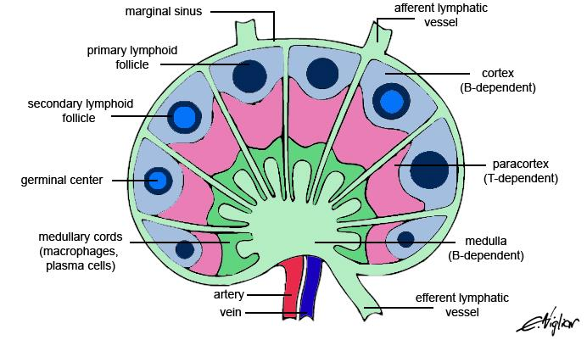
Reactive Lymphadenitis

Slide 3
2. Neoplastic Proliferations of White Cells
~ Lymphoid Neoplasms

Slide 4
Lymphoid Neoplasms
They can manifest as:
Leukemias: involvement of the bone marrow (BM) & the peripheral blood (PB) (usually, not always)
Lymphomas: tumors that produce masses in lymph nodes or other tissues.
Other (plasma cell neoplasm)
All can spread to lymph nodes & other tissues (liver, spleen, bone marrow, and peripheral blood)

Slide 5
Lymphoid Neoplasms
B and T cell tumors are composed of cells that are arrested at or derived from a specific stage of normal lymphocyte differentiation
Diagnosis & classification → rely on tests (immunohistochemistry or flow cytometry) that detect lineage-specific antigens (e.g., B cell, T cell, & NK cell markers) and markers of maturity.
Many such markers are identified by their cluster of differentiation (CD) number. (e.g., CD8, CD4, or CD20).

Slide 6
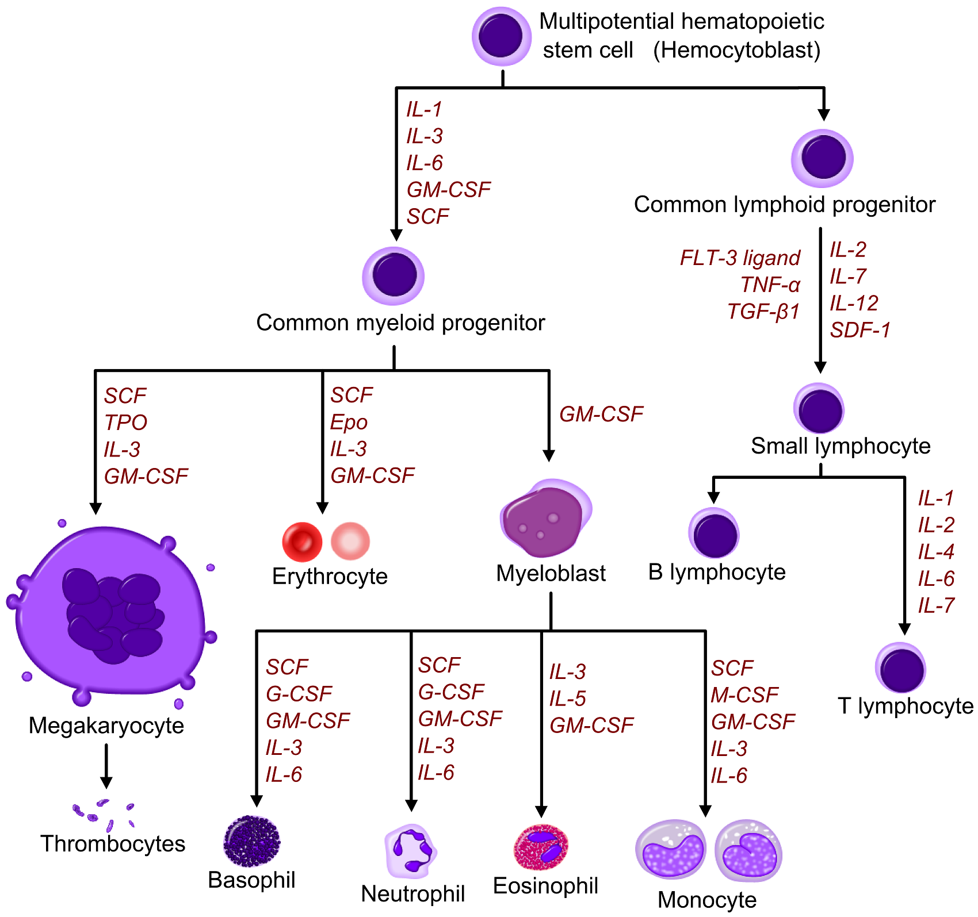

Slide 7
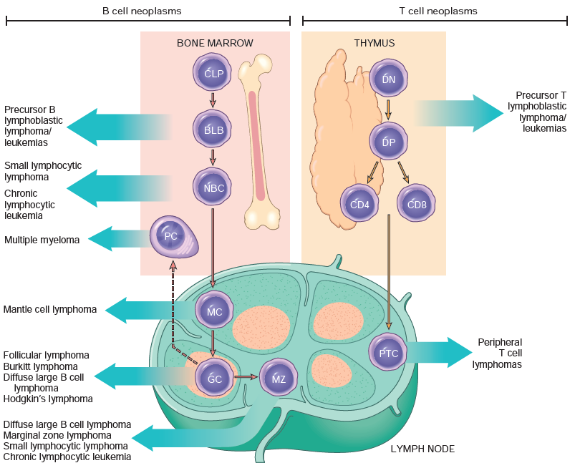

Slide 8
Lymphoid Neoplasms
Cluster of differentiation antigin (CD): commonly used as cell markers in immunophenotyping, allowing cells to be defined based on what molecules are present on their surface.
B-cell markers: CD19, CD79, and CD20
T-cell markers: CD3 (either CD4 or CD8)
TdT: a marker of early lymphoid origin (B & T lymphoblasts)

Slide 9
Lymphoid Neoplasms
Upon antigen stimulation→ B cells enter germinal centers → undergoes Class switching and Somatic hypermutation (Goal is: antibody Diversification)
This is a mistake-prone forms of regulated genomic instability that place germinal center B cells at relatively high risk for potentially transforming mutations. (genetic errors that occur during antigen receptor gene rearrangement and diversification) → most of B-cell lymphomas.

Slide 10
Lymphoid Neoplasms
Lymphoid neoplasms and immune system function.
Can cause Immunodeficiency ( ↑ susceptibility to infection).
Can cause Autoimmunity
Inherited or acquired immune deficiencies ↑ the risk for the development of certain lymphomas (usually EBV associated)

Slide 11
Lymphoid Neoplasms
So they are either B or T cell neoplasms.
Two groups of lymphomas are recognized : Hodgkin lymphomas (HD) & non-Hodgkin lymphomas (NHL)
The World Health Organization (WHO) has formulated a widely accepted classification scheme, relies on a combination of morphologic, phenotypic, genotypic, and clinical features.

Slide 12
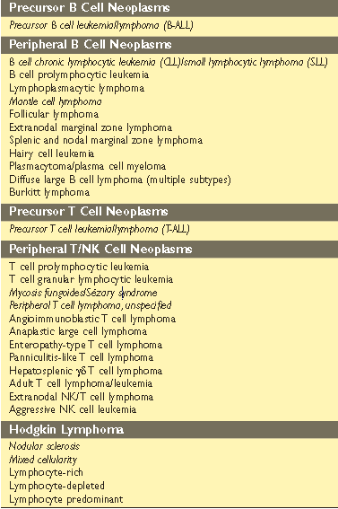
Lymphoid Neoplasms

Slide 13
Acute Lymphoblastic Leukemia/Lymphoma (ALL)
Neoplasms composed of immature B (pre-B) or T (pre-T)
cells → called Lymphoblasts.
85% B-cells , commonly manifest as acute LEUKEMIA
The most common cancer of children (Peak : 3 years)
15% T-cells, commonly manifest as thymic LYMPHOMA
Peak: adolescence

Slide 14
Acute Lymphoblastic Leukemia/Lymphoma (ALL) : Genetics
Pre–B cell
Hyperdiploidy (> 50
chromosomes/cell)
t(12;21).
t(9;22) involving ABL & BCR genes.
Pre–T cell
NOTCH1 mutations
CDKN2A mutations

Slide 15
Acute Lymphoblastic Leukemia/Lymphoma (ALL) : Morphology
Leukemia : the marrow is hypercellular & packed with lymphoblasts → replace normal marrow elements.
Lymphoma : Mediastinal (thymic) mass & is more likely to involve lymph nodes & spleen.
Blasts: scant basophilic cytoplasm and nuclei with delicate, finely stippled chromatin & small nucleoli.
In pre-B & pre-T ALLs the blasts are identical in routine stains (immunophenotype is needed)

Slide 16
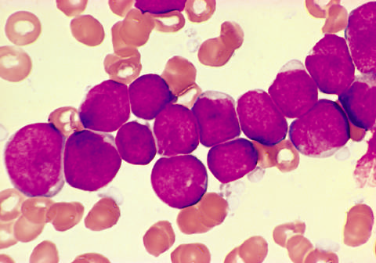
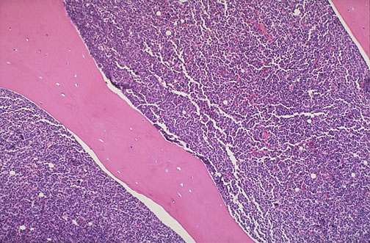
Acute Lymphoblastic Leukemia/Lymphoma (ALL) : Morphology

Slide 17
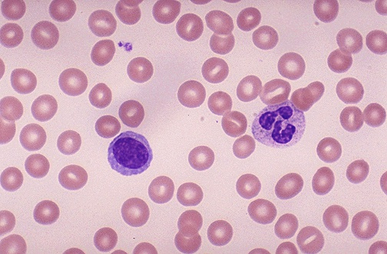
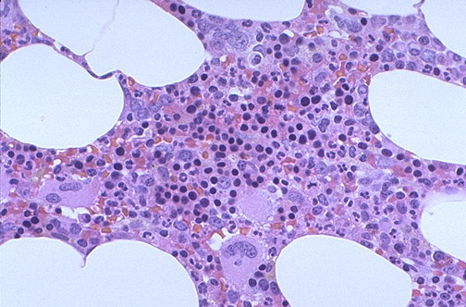
Normal mature lymphocyte Normal bone marrow
Notes:
Normal lymphocyte ,,normal bone marrow

Slide 18
Acute Lymphoblastic Leukemia/Lymphoma (ALL) : Clinical features
Presentation:
Symptoms related to depression of marrow function; anemia, neutropenia & bleeding.
Mass effects → neoplastic infiltration; bone pain
CNS manifestations headache, vomiting, and nerve palsies.
Aggressive but curable (85% cure rate in children), but remains the leading cause of cancer deaths in children

Slide 19
Acute Lymphoblastic Leukemia/Lymphoma (ALL) : Clinical features
Worse prognosis
Younger than 2
Older than 10
PB WBC count > 100,000
t(9;22)
Favorable prognosis
Age between 2-10
PB Low WBC count
Hyperdiploidy
t(12;21)

Slide 20
Chronic Lymphocytic Leukemia/Small Lymphocytic Lymphoma (CLL/SLL)
An indolent, slowly growing tumor (increased tumor cell survival is more important than tumor proliferation)
CLL & SLL are essentially identical.
CLL → If PB involvement count exceeds 5000 cells/μL
The most common leukemia of adults in the West.

Slide 21
Chronic Lymphocytic Leukemia/Small Lymphocytic Lymphoma (CLL/SLL) : Morphology
Involved lymph nodes are effaced by:
Sheets of small lymphocytes with dark, round nuclei, clumped chromatin & scanty cytoplasm.
Small percentage of large lymphocytes with prominent centrally located nucleoli → prolymphocytes.

Slide 22
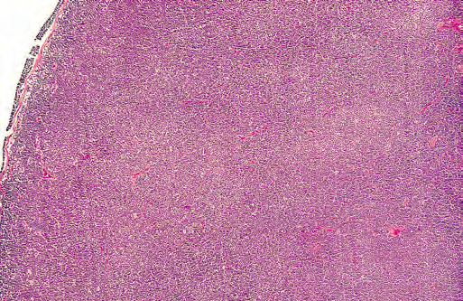
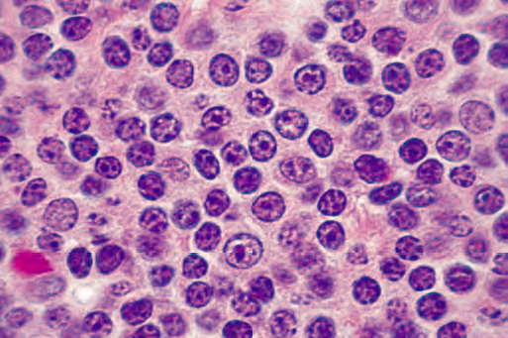
Chronic Lymphocytic Leukemia/Small Lymphocytic Lymphoma (CLL/SLL) : Morphology
Green arrow: cells w Clumped chromatin & white areas in between conferring a “soccer ball” appearance. Yellow arrow : prolymphocytes

Slide 23
Chronic Lymphocytic Leukemia/Small Lymphocytic Lymphoma (CLL/SLL) : Immunophenotype
A neoplasm of mature B cells → expressing the CD20.
The tumor cells also express CD5 (diagnostic clue, only SLL & MCL express it)

Slide 24
Chronic Lymphocytic Leukemia/Small Lymaphocytic Lymphoma (CLL/SLL) : Clinical features
Old age. Often asyptomatic. But symptoms are nonspecific; easy fatigability, weight loss, anorexia, generalized lymphadenopathy & hepatosplenomegaly.
Peripheral lymphocytosis (>5000)
Indolent disease but cure may only be achieved with hematopoietic stem cell transplantation (HSCT)
10-15% develop autoimmune hemolytic anemia & thrombocytopenia.

Slide 25
Follicular Lymphoma
Relatively common tumor → 40% of the adult NHLs
Pathogenesis: a characteristic (14;18) translocation that fuses the BCL2 gene on chromosome 18 to the IgH locus on chromosome 14 → inappropriate “overexpression” of BCL2 protein (an inhibitor of apoptosis) → contributes to cell survival)

Slide 26
Follicular Lymphoma - Morphology
Lymph nodes usually are effaced by a distinctly nodular (follicular) proliferation
Two types of neoplastic cells,
the predominant called centrocytes have angular “cleaved” & indistinct nucleoli,
the other centroblasts, larger cells with vesicular chromatin, several nucleoli.

Slide 27
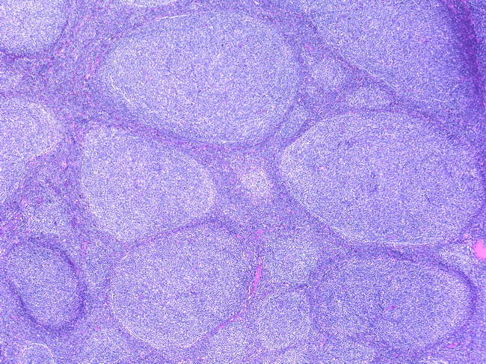
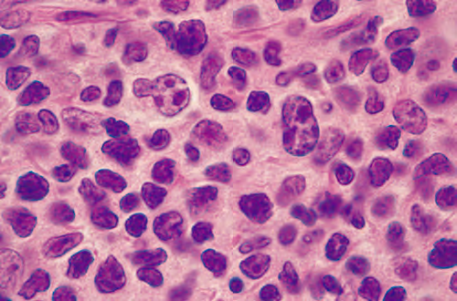
Follicular Lymphoma - Morphology
Centrocyte
centroblast

Slide 28
Follicular Lymphoma - Immunophenotype
B-cells markers (mature B cell neoplasm).
CD10 → GC marker (expressed in Burkitt lymphoma, B-ALL & some DLBCL)

Slide 29
Follicular Lymphoma - Clinical features
Older than 50
Generalized painless lymphadenopathy
Bone marrow is involved in 80% of cases
Prolonged survival, not curable disease (indolent)
40% transform into DLBCL, dismal prognosis

Slide 30
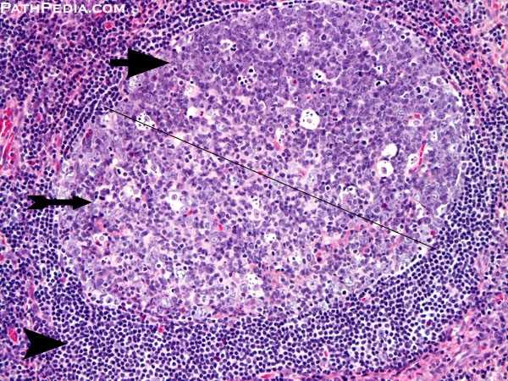
Mantle Cell Lymphoma
composed of cells resembling the naive B cells found in the mantle zones of normal lymphoid follicles.
mainly in men older than 50 years of age

Slide 31
Mantle Cell Lymphoma – Pathogenesis & immuno.
All tumors have an (11;14) translocation → fuses the cyclin D1 gene to the IgH locus → overexpression of cyclin D1→ stimulates growth by promoting the progression of cell cycle from G1 to S phases)
Immunophenotype:
B cell markers.
CD5 (as CLL/SLL)
Cyclin D1 ( not expressed in CLL/SLL)

Slide 32
Mantle Cell Lymphoma – Morphology
A diffuse involvement of the lymph node.
The tumor cells are slightly larger than normal lymphocytes with irregular nucleus, inconspicuous (not clear) nucleoli.
Bone marrow is involved in most cases.
sometimes arises in the GIT as multifocal polyps (lymphomatoid polyposis).

Slide 33
Mantle Cell Lymphoma – Clinical features
Patients Present with fatigue & lymphadenopathy → found to have generalized disease involving the bone marrow, spleen, liver, and (often) GIT.
Moderately aggressive & incurable.
The median survival is 4-6

Slide 34
THANK YOU!

