Slide 1
ENT History and Physical Examination

Slide 2
History
Pt. ID (profile)
Chief complaint
History of presenting illness
Past medical and surgical hx
Family hx
Occupational hx
Drug hx
Allergic hx

Slide 3
Nose symptoms
Obstruction
Discharge
Postnasal discharge
Epistaxis
Sneezing
Itching.
Hyposmia/ anosmia.
Headache- facialache
Snoring/ mouth breathing/ sleep apnea.

Slide 4
Ear symptoms
Earache
Discharge
Itching
Decrease hearing
Tinnitus
Vertigo
Temporal headache

Slide 5
Throat ( pharynx symptoms)
Dyspagea
Odenophagea
Halitosis
General symptoms
Dental caries.
Neck mass.

Slide 6
Larynx symptoms
Stridor
Hoarseness

Slide 7
Drug history
Anitibiotics.
Diuretics.
Aspirin.

Slide 8
Past medical & surgical history
Hx of ear surgery.
Tonsillectomy/ adenoidectomy.
Radiotherapy to the neck.
GERD.
Thyroid dis.
Trauma.

Slide 9
Family history
Hearing loss.
Allergy.

Slide 10
Be familiar with ENT Instruments

Slide 11
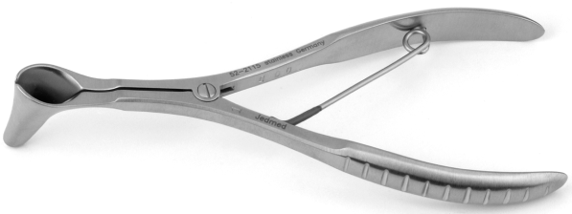
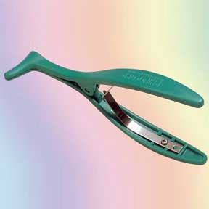
Nasal Speculum

Slide 12
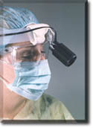
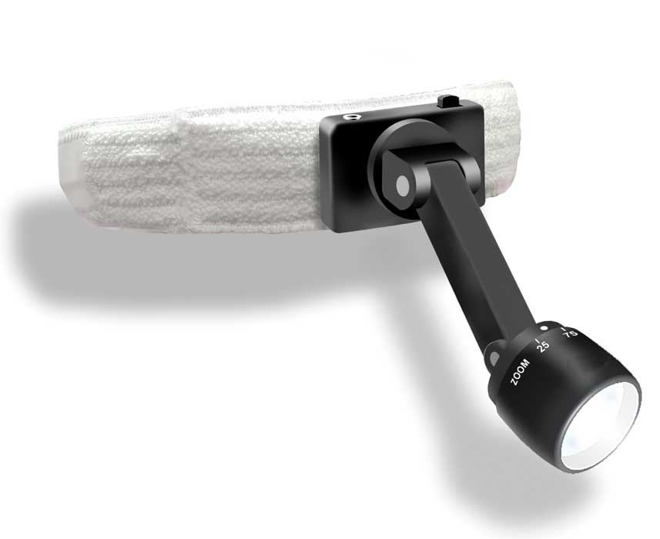
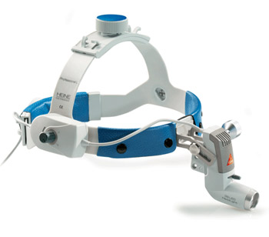
Headlight

Slide 13
THE EAR

Slide 14
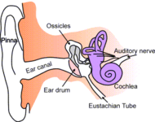

Slide 15
External anatomy

Slide 16
Auricle
Size (microtia, macrotia)
Shape (cauliflower ear)
Position (bat ear)
Deformities??
Genetic.
Trauma.
Systemic disease.
Scars. (Mainly behind the ear).

Slide 17
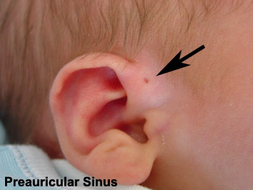
Periauriclar sinus

Slide 18
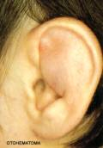
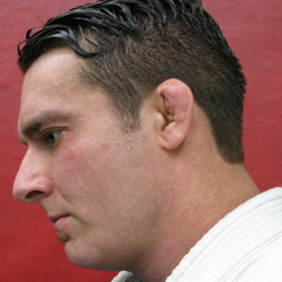
Auricular hematoma

Slide 19
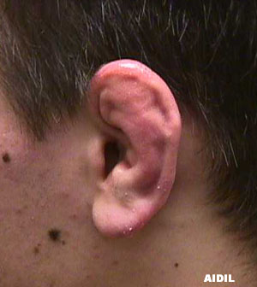
Cauliflower ear

Slide 20
lesions consistent with skin cancer should be noted and warrant biopsy.

Slide 21
Canal
Inspect pinna and concha
Otoscopic examination
Pull upwards (in adults) or downwards (in children), outwards and backwards
Look for cavity,
Otitis externa
Osteomas
Mastoid cavity

Slide 22
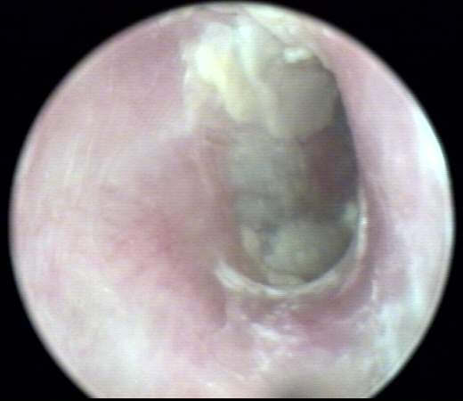
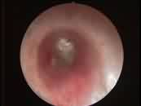
Acute otitis externa

Slide 23
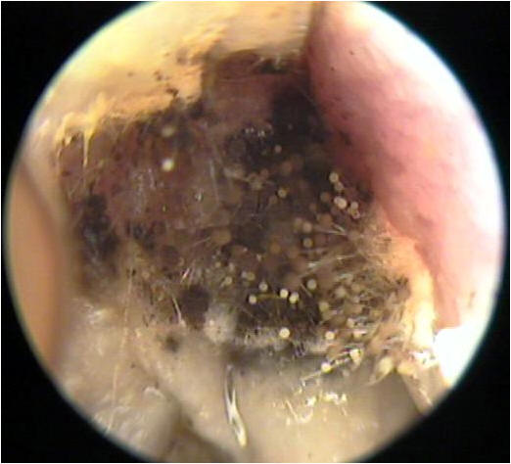
Otomycosis

Slide 24
TM
Assess all quadrants
Look for malleus, incus
Record abnormalities
Cone of light (light reflex) in ant inf quadrant.
Normal TM(ear drum) is oval, pearly grey, and translucent, approximatly 1 cm in diameter

Slide 26
Tympanic Membrane Examination

Slide 27
Perforations
Central perforation
Marginal perforation

Slide 28
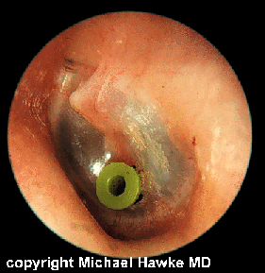
Ventilation tubes

Slide 29
Don’t forget
Hearing Asessment:
1.Whisper
2.Tuning fork tests- Rinne`s test
- Weber`s test
3.Look at audiological investigations
Tympanometry, PTA, OAE, BERA

Slide 30
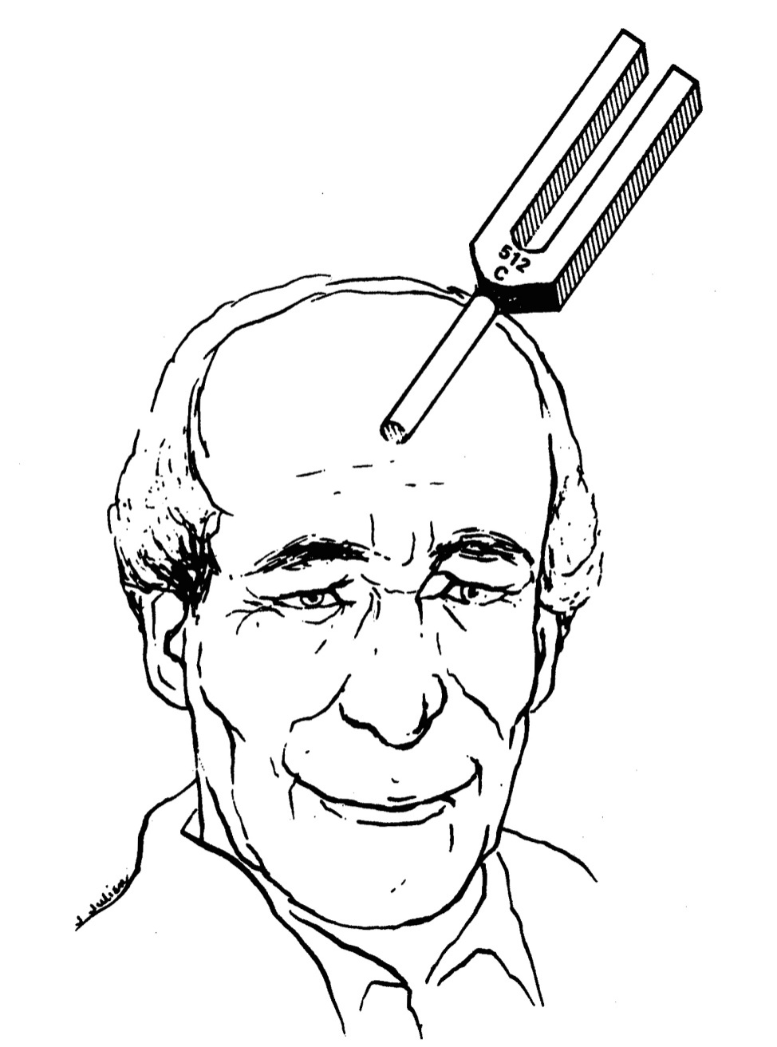
WeWW

Slide 31
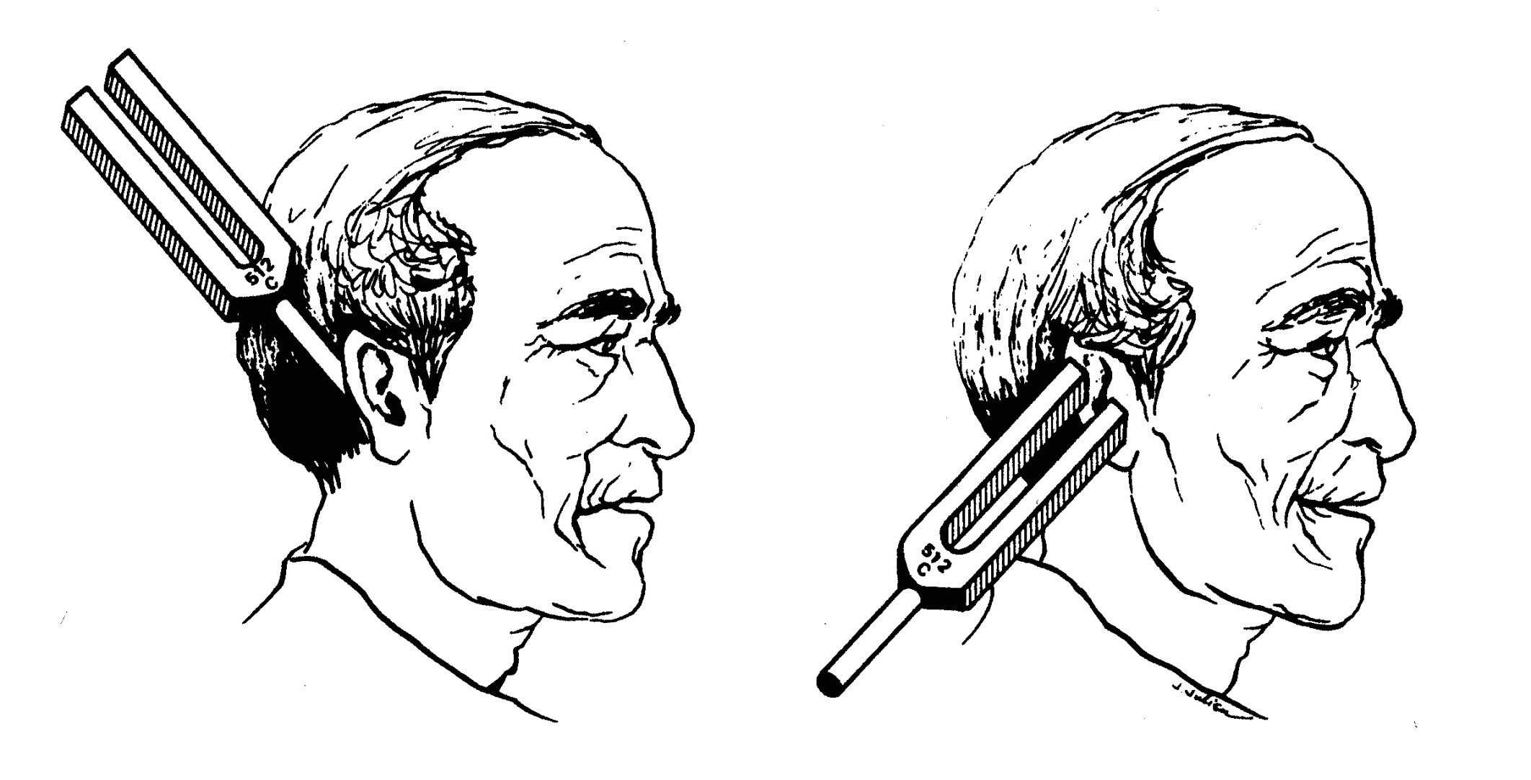

Slide 33
THE NOSE

Slide 34
Inspection
Good light
Look at skin and scars
Assess shape and deformity
Look at vestibules by lifting tip

Slide 35
Thumb examination of nasal vestibule

Slide 36
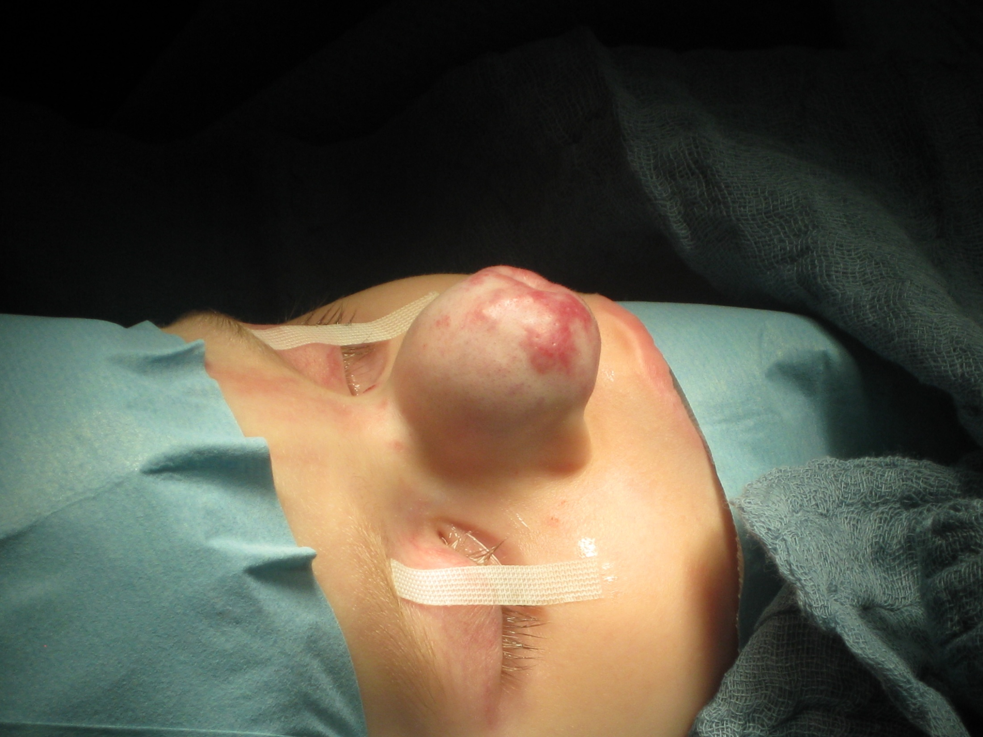

Slide 37
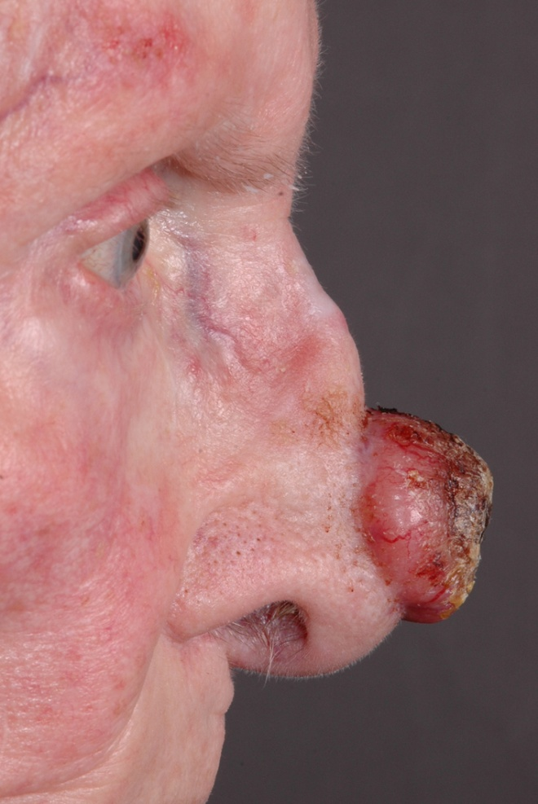

Slide 38
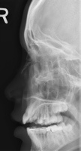
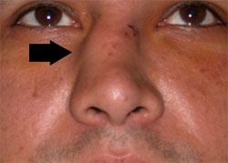
Nasal bone fracture

Slide 39
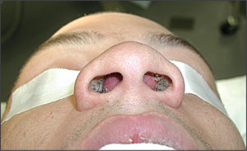
Septal hematoma

Slide 40
Palpation/inspection
Occlude each nostril in turn and assess air entry
Look at misting of tongue depressor

Slide 41
Anterior rhinoscopy
Use thuddicums speculum
hold it properly!
Patency of the nasal cavity
Assesment of Inferior turbinate
Assesment of nasal septum......deviation or perforation
Assesment of the nasal mucosa

Slide 42
Nose examination ( Anterior Rhinoscopy )
Anterior rhinos copy using a headlamp and nasal speculum allows assessment of the nasal septum and inferior turbinates.
The speculum should be directed laterally to avoid touching the sensitive septum with the metal edges.

Slide 44
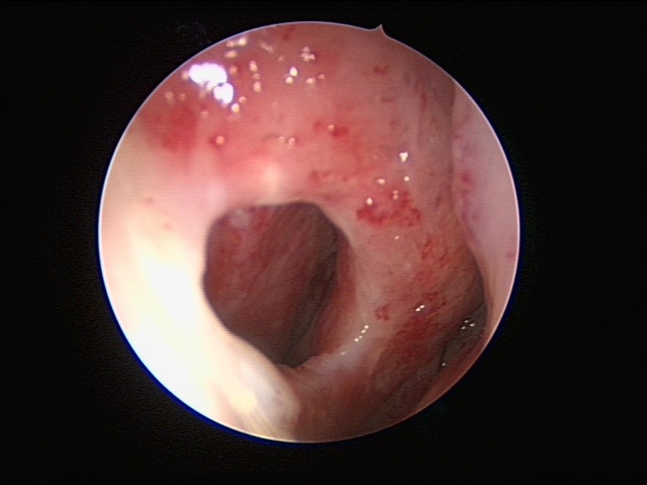

Slide 45
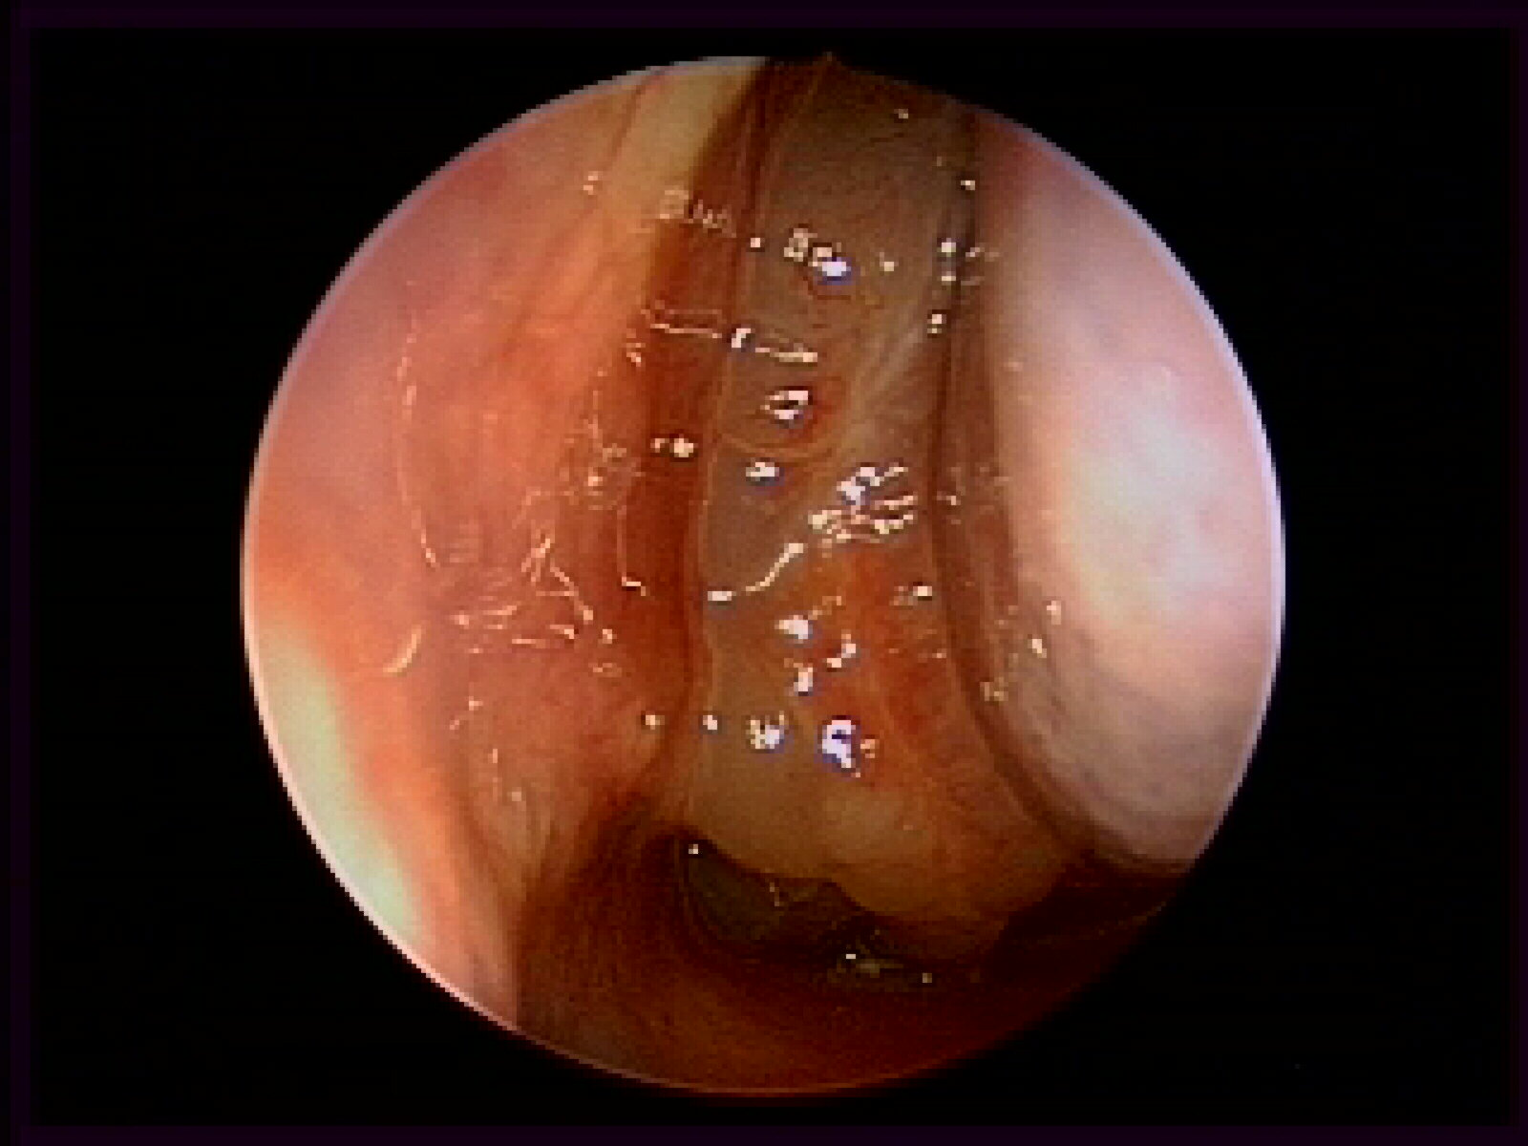
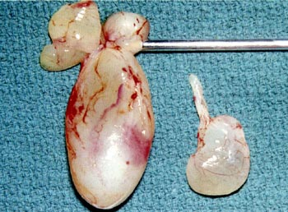
Nasal polyps

Slide 46
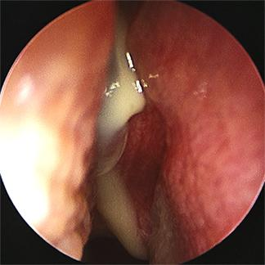
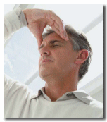
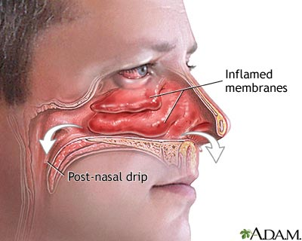
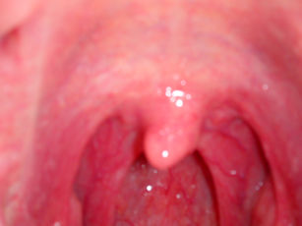
Sinusitis

Slide 47
Nasendoscopy
Rigid
Flexible

Slide 48
THE THROAT

Slide 49
What does this area consist of?
Mouth? Lips, Teeth, Gums, Tongue, Palate, Tonsils
Gag reflex (glossopharyngeal and vagus)
Pharynx?
Larynx?
Trachea?
Oesophagus?
Neck?
Best to view as much as possible

Slide 50
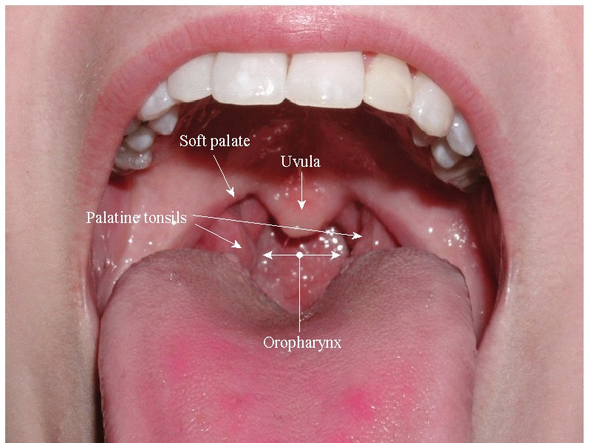

Slide 51
Oral cavity
Open wide!
Two tongue depressors
Examine every mucosal surface
Protrude tongue:
1.Movements and size
2.Surface
Look at salivary orifices
Bimanual palpation

Slide 52
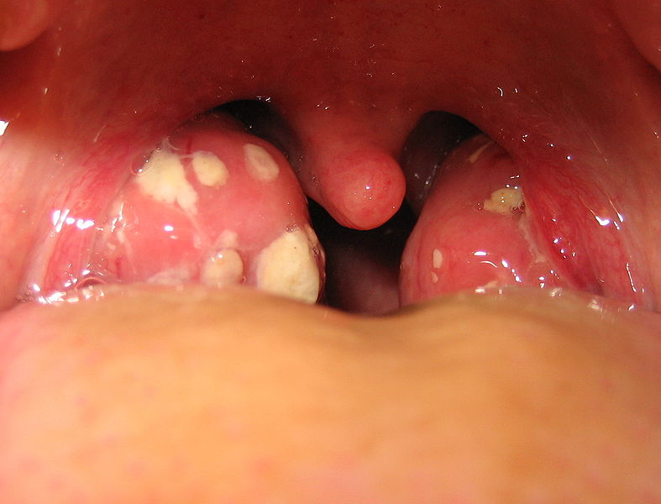
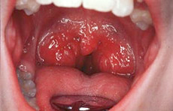
Tonsillitis

Slide 53
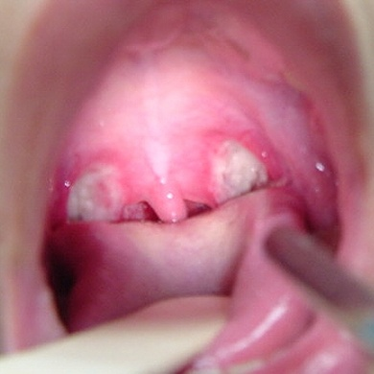
Post tonsillectomy

Slide 54
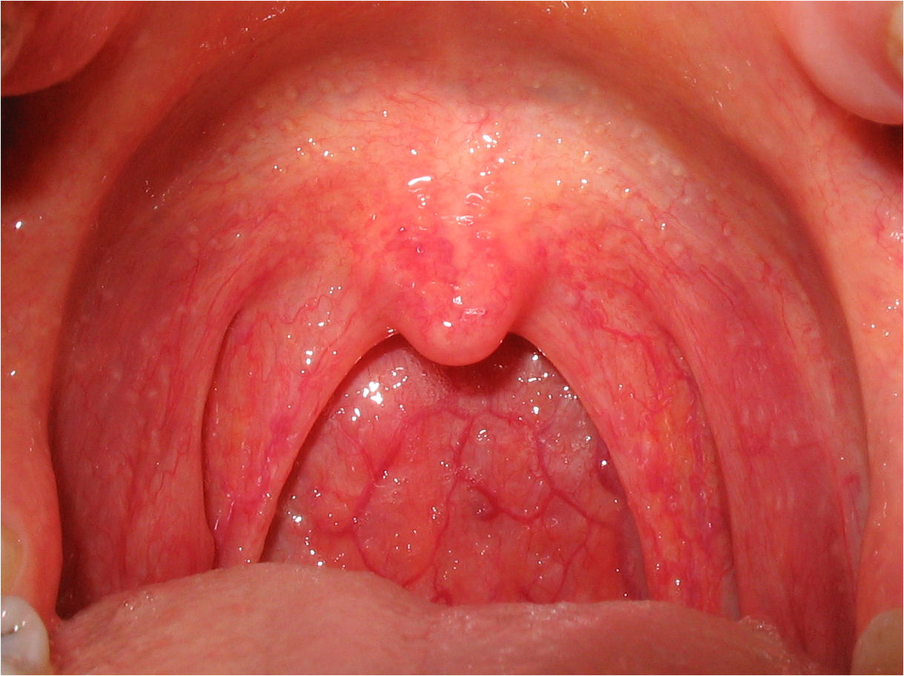
Pharyngitis

Slide 55
Larynx
Indirect / direct laryngoscopy
To be learned in OPD

Slide 56
Throat Examination ( indirect laryngoscopy)
The patient’s tongue is pulled forward by the examiner, who grasps the tongue with a gauze sponge.
The examiner’s middle finger is extended to retract the patient’s upper lip superiorly, and a dental mirror is warmed to prevent fogging and is placed in the oropharynx to elevate the uvula and soft palate to view the larynx

Slide 57
View of larynx
Tongue base
Vallecula
Epiglottis
False cord
Vocal cord
Piriform fossa
Arytenoid cartilage

Slide 58
Fiber optic Nasopharyngolaryngoscopy

Slide 59
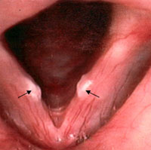
Vocal cord nodule

Slide 60
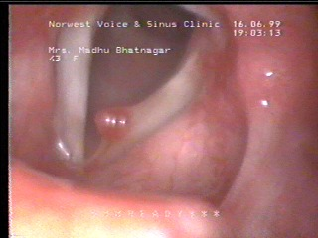
Vocal cord polyp

Slide 61
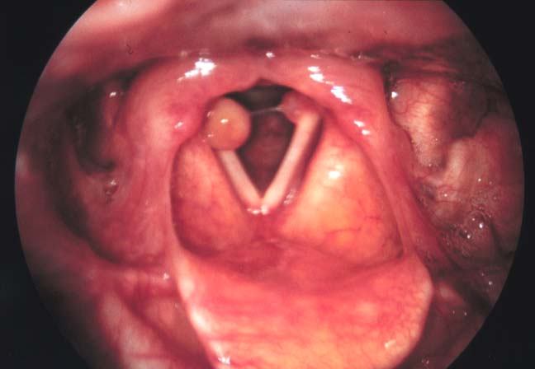
Intubation granuloma

Slide 62
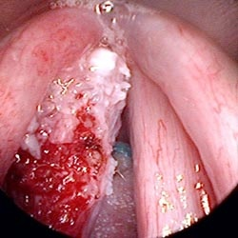
Laryngeal CA

Slide 63
Neck
Inspect
Palpate
Auscultate

Slide 64
Inspection
Scars
Lumps
Sinuses
Asymmetry
Stoma
Ask patient to swallow and protrude tongue
Ask patient to breathe deeply
Ask patient to count to ten

Slide 65
Palpation
Adequate exposure
Systematic
Develop system
From in front then mainly from behind
Submandibular area, both triangles
Supraclavicular area

Slide 66
Your examination should note the size, consistency, shape, and tenderness of palpable lymph nodes and whether the nodes are discrete, fixed, or matted.

Slide 67
10 classic lymph node groups in the neck:
Preauricular and postauricular
Occipital
Tonsillar
Submaxillary and submental
Superficial cervical
Posterior cervical chain
Deep cervical chain
Supraclavicular
Retropahryngeal can‘t be palpated.

Slide 69
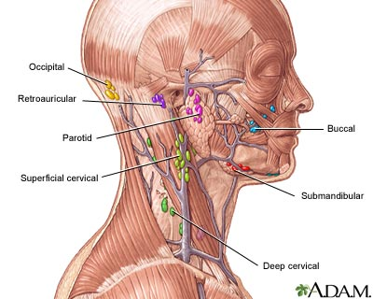
Lymph nodes

Slide 70
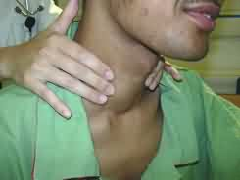
Thyroid

Slide 71
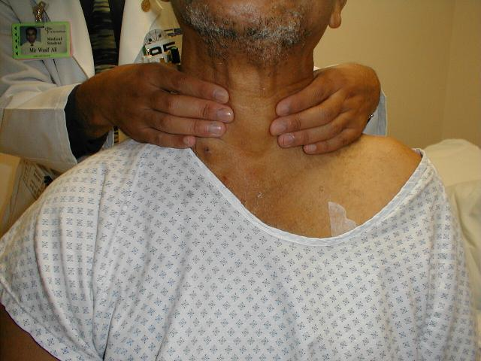

Slide 72
Auscultation
Listen for bruit
Thyroid and carotid

Slide 73
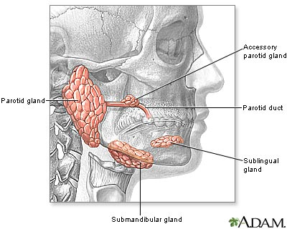
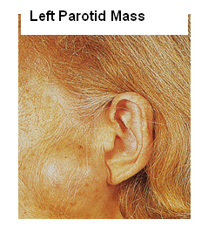
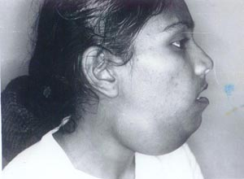
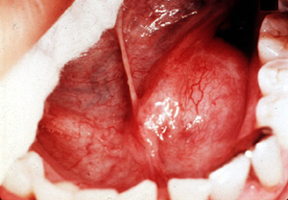
Salivary glands

Slide 74
Facial nerve

Slide 75
Examination of facial nerve

