Slide 1
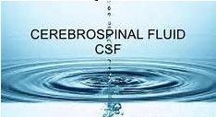
-
NS1 Module
2021-2022
Dr. Mohammad Odaibat
Notes:
Welcome to first session of Unit 4 - Cerebrospinal Fluid
Please carefully follow your course objectives as you move through this unit.

Slide 2
Cerebrospinal Fluid (CSF)
Composition and formation
CSF is the 3rd major fluid of the body
Adult volume 90-150 mL
Neonate volume 10-60 mL
CSF functions
Supplies nutrients to nervous tissues
Removes metabolic wastes
Protects / cushions against trauma
Notes:
Composition and formation
CSF is the 3rd major fluid of the body after blood and urine.
Adult volume 90-150 mL
Neonate volume 10-60 mL
Produced at the Choroid plexus of the 4 ventricles by modified Ependymal cells
At rate @20 ml / hr (adults)
Med training says @ 150 ml/day is produced
CSF flows through the Subarachnoid space
Where a volume of 90 – 150 ml is maintained (adults)
Reabsorbed at the Arachnoid villus / granulation
to be eventually reabsorbed into the blood

Slide 3
Cerebrospinal Fluid (CSF)
Four major categories of disease
Meningeal infections
Subarachnoid hemorrhage
CNS malignancy
Demyelinating disease
Indications for analysis
To confirm diagnosis of meningitis
Evaluate for intracranial hemorrhage
Diagnose malignancies, leukemia
Investigate central nervous system disorders
Notes:
There are Four major categories of disease
Meningeal infections – such as bacterial or viral meningitis
Subarachnoid hemorrhage – commonly refereed to as a stroke.
Central Nervous System malignancy
Demyelinating disease - such a multiple sclerosis.

Slide 4
Sample collection and Processing of CSF samples
Samples collection
Sample transport and storage
Gross description (Appearance)
Counting cells
Gram stainning and others
Culturing using suitable media
Other identification techniques

Slide 5
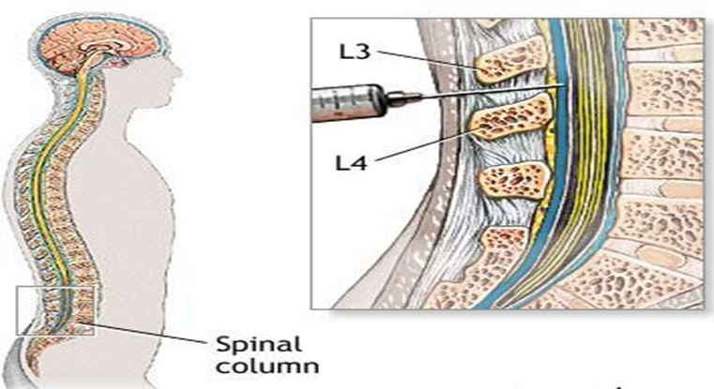
Sample collection
Specimen collection and handling
Routinely collected via lumbar puncture between 3rd & 4th, or 4th & 5th lumbar vertebrae under sterile conditions
Intracranial pressure measurement taken before fluid is withdrawn.
Notes:
Specimen collection and handling
CSF is Routinely collected via lumbar puncture between 3rd & 4th, or 4th & 5th lumbar vertebrae under sterile conditions
Once the puncture has been made, the first step is to measure the Intracranial pressure . This must be done before the fluid is removed..
A low opening pressure is seen in trauma where there has been a loss of the csf fluid. and an increased pressure is diagnostic of intracranial hypertension – which is present in many pathological states including tumors, intracranial bleeding and meningitis.

Slide 6
Sample collection
Testing considered STAT
Specimen potentially infectious
Notes:
What is the meaning of stat?
STAT: A common medical abbreviation for urgent or rush. From the Latin word statum, meaning 'immediately.'
As the spinal fluid is removed it is collected into a series of tubes. The tubes are numbered to indicate how the fluid was removed. In other words, The first fluid that is removed will go into tube 1, the next amout of fluid will be in tube 2 and so forth.
Usually 3 tubes are collected, but sometimes you will see four tubes.
Tube 1 – chemistries and serology
Tube 2 – microbiology cultures
Tube 3 – hematology
If there was a 4 th tube, usually the first tube is set aside – tube number 2 then becomes tube 1, tube 3 becomes number 2. Sounds confusing, but every thing just slides down a number.
Keep in mind that the goal is to have the hematology tube be the last sample removed, so any cells present can be definitely said to have come from the spinal cannal and not a result of a traumic stick.
All csf Testing considered STAT and always keep in mind that csf samples are potentially infectious

Slide 7
Sample collection
CSF is collected by aseptically
Three tubes of CSF should be collected into sterile collection tubes that contain no additives.
The tubes are numbered sequentially in the order in which they were collected along with the patient’s name.
tube 1 is used for chemistry studies, as well as immunology studies, as these tests are least affected by the presence of blood cells or bacteria introduced as a result of the spinal tap procedure
tube 2 is used for culture, allowing a larger proportion of the total fluid to be concentrated.
tube 3 is used for cell count and differential, as these tubes are least likely to contain cells introduced by the collection procedure

Slide 8
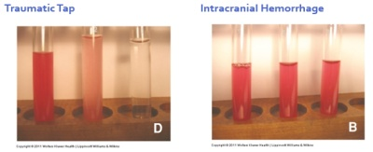
Sample collection

Slide 9
Sample transport and storage
Specimens for microbiology studies should never be refrigerated; if not rapidly processed, CSF should be incubated (35° C) or left at room temperature (< 1h).
The CSF for viral studies may be refrigerated for as long as 24 hours after collection or frozen at −70° C if a longer delay is anticipated (should never be frozen at temperatures above −70° C).
CSF specimen for hematology studies can be refrigerated.
The CSF for chemistry and serology can be frozen (−20° C).
RBC lyse in 1 hour, WBC in 2 hrs.

Slide 10
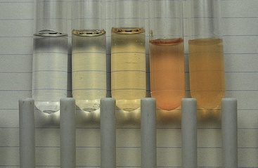
Gross description (Appearance)
Appearance
Normal - Crystal clear, colorless
Descriptive Terms – hazy, cloudy, turbid, milky, bloody, xanthrochromic
Unclear specimens may contain increased lipids, proteins, cells or bacteria.
Clots indicate trauma
Milky – increased lipids
Oily – contaminated with x-ray media
Notes:
Appearance
Xanthrochromic – Yellowing discoloration of supernatent (may be pinkish, or orange).
Most commonly due to presence of ‘old’ blood.
Other causes include increased bilirubin, carotene, proteins, melanoma
CSF is Normally - Crystal clear, colorless
When its transparency is not clear - Appropriate descriptive Terms include – hazy, cloudy, turbid, milky, bloody,
When the non-clear terms are used, they are Often quantitated – so you may see a designation such as slightly hazy, moderately cloudy, or grossly bloody. Etc/
.
Unclear specimens CSF specimens may contain increased lipids, proteins, cells or bacteria. Use precautions.\
xanthrochromic is a term used to describe a yellow / yellow-orangeish colored csf/
The picture in the slide shows how putting a newspaper behind the CSF sample can be used as aid in evaluating its clarity. The sample on the right is normal and the one on the left is moderately cloudy. –
The cloudy sample is often an indication that it contains WBCs as would be seen in meningitis.
Other reasons that the csf is not clear and colorless are also indicated on the slide.

Slide 11
Gross description (Appearance)
1
2
3
4
5
1- Normal CSF.
2- Mildly xanthochromic CSF.
3- Moderately xanthochromic CSF.
4- Red-tinged turbid CSF caused by hemorrhage
5- Cloudy red-tinged fluid with bacterial meningitis
Notes:
Xanthochromia, from the Greek xanthos (ξανθός) "yellow" and chroma (χρώμα) "colour", is the yellowish appearance of cerebrospinal fluid that occurs several hours after bleeding into the subarachnoid space caused by certain medical conditions, most commonly subarachnoid hemorrhage.

Slide 12
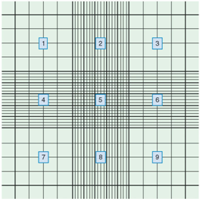
Counting cells
Counting cells in CSF samples
All specimens should be examined microscopically – hematology
Manual count
Standard hemacytometer counting chamber
Normal CSF results
RBCs: no cells regardless of age
WBCs: 0 - 5 white blood cells (all mononuclear)
Notes:
All CSF specimens should be examined microscopically – this is usually perfomed in the hematology department.
CSF samples must have stat priority, RBC lyse in 1 hour, WBC in 2 hrs.
The hematology sample should be Refrigerated if not able to process immediately.
Manual cell counts are needed because the numbers of cells present are to low to be counted accurately using automated cell counters.
Rarely is a dilution needed but if a dilution is needed it should be normal saline
The counting is performed in a Standard Neubauer hemacytometer counting chamber as shown.

Slide 13
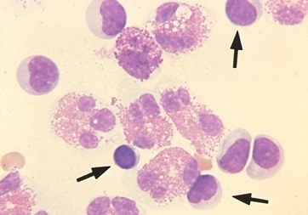
Counting cells
Count and differentiate 100 nucleated cells.
Entire smear should be evaluated for
abnormal cells, inclusions within cells, Clusters, Presence of intracellular organisms
Eosinophils: often associated with parasitic / fungal infections, allergic reactions including reaction to shunts and other foreign objects
Eosinophils
Notes:
After staining the slide with Wrights stain, you attempt to Count and differentiate 100 nucleated cells.
Keep in mind that 0-5 WBC / uL is the normal for adults and 0-3 for children. So some times finding 100 nucleated cells is difficult, unless the patient has a pleocytosis.
Any cell found in peripheral blood may be seen in CSF as well as cells from the tissues forming the membranes.
However, you are going to find lymphocytes, perhaps a few monocytes / macrophages, and a rare neutrophile in normal patients.
The published Normal differential values for Adults: 70% lymps, 30% monos. While Children / newborns should only have monocytes.
If the patient has a central nervous system malignancy or a leukemia, these abnormal cells may be discovered in the CSF as well.
Ependymal cells, and normal lining cells can also be seen.

Slide 14
CNS - acute infectious disease
Gram negative
N. meningitids
E. coli,
Hib
Bacteriodes

Slide 15
CNS - acute infectious disease
Gram Positive
S. pneumoniae
S. agalactiae
S. aureus
L. monocytogenes

Slide 16
CNS - acute infectious disease
Others
M. tuberculosis
Viruses
e.g. enteroviruses
Fungi
e.g. Cryptococcus
neoformans

Slide 17
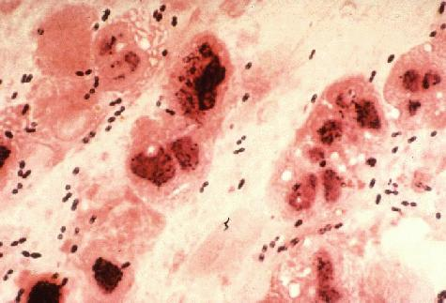
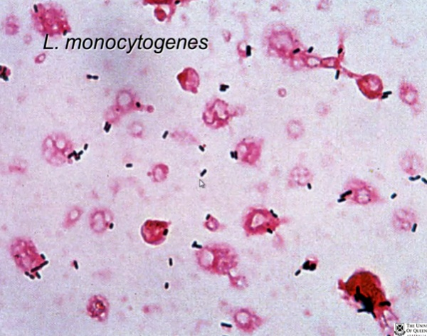
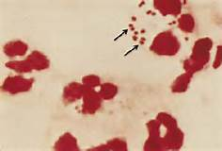
Gram stainning and others
Visual Detection of Etiologic Agents
Stained Smear of Sediment.
Gram stain must be performed on all CSF sediments. The drop of sediment is allowed to air dry, is heat or methanol fixed, and is stained by either Gram or acridine orange.
Gram +ve diplococci
S. pneumoniae
gram-positive, rod-shaped,
N. Meningitidis
gram-negative, coffee-bean
shaped diplococci.

Slide 18
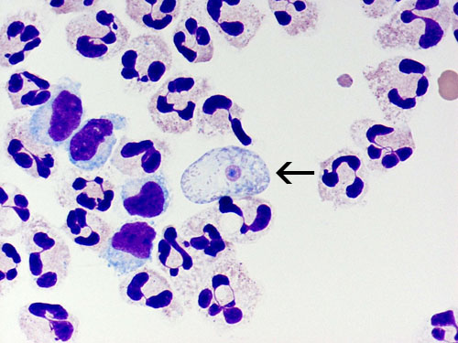
Gram stainning and others
Wet Preparation:
Amoebas are best observed by examining thoroughly mixed sediment as a wet preparation under phase-contrast microscopy.
Amoebas are identifiable by their typical slow movement in one direction via pseudopodia.
A trichrome stain can assist in the differentiation of amoebas from somatic cells.
Naegleria fowleri trophozoite (arrow) stained with Giemsa-Wright stain

Slide 19
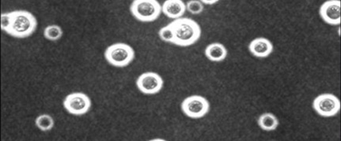
Gram stainning and others
India Ink Stain.
The large polysaccharide capsule of Cryptococcus neoformans allows these organisms to be visualized by the India ink stain.
Latex agglutination testing for capsular antigen is more sensitive and specific.
To perform the India ink preparation, a drop of CSF sediment is mixed with one-third volume of India ink
Examination under oil immersion.

Slide 20
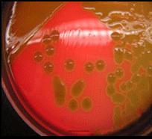
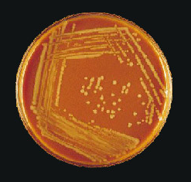
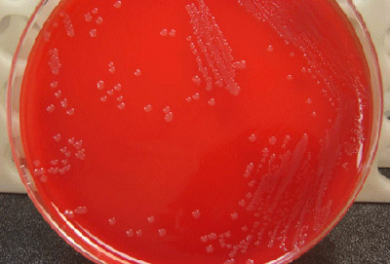
Culturing using suitable media
S. pneumoniae on sheep blood agar with colistin and aztreonam (CAP)
H. influenzae on a chocolate agar plate
N. meningitidis on a BAP

Slide 21
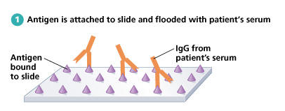
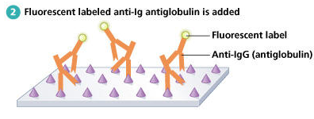
Other identification techniques
Serology
ELISA
Latx agglutination
PCR
IFA
Notes:
Serology
The VDRL test is used for the preliminary detection of neurosyphilis.
This test has low sensitivity, but high specificity.
That means that it may not detect all cases, but a positive result is a true result.
Another serological test for syphilis is the FTA-Abs which stands for fluorescent treponemal antibody absorbed which is used to detect antibodies to treponema pallidum – the organism that causes syphilis.
This test is more sensitive than the VDRL, but it use in the diagnosis of neurosyphilis is still controversial as it is extremely sensitive to the effects of contamination with blood.
FTA-Abs also used on CSF, more sensitive, but must prevent blood contamination.

Slide 22
Notes
The volume of CSF is critical for detecting certain microorganisms, such as mycobacteria and fungi. A minimum of 5 to 10 mL is recommended for detecting these agents by centrifugation and subsequent culture.
When the laboratory receives an inadequate volume of CSF , the physician should be consulted regarding the order of priority for laboratory tests. Processing too little specimen lowers the sensitivity of laboratory tests, which may lead to false-negative results.

