Slide 1
Motivational Concepts
Dr. Faris Alsaraireh

Slide 2
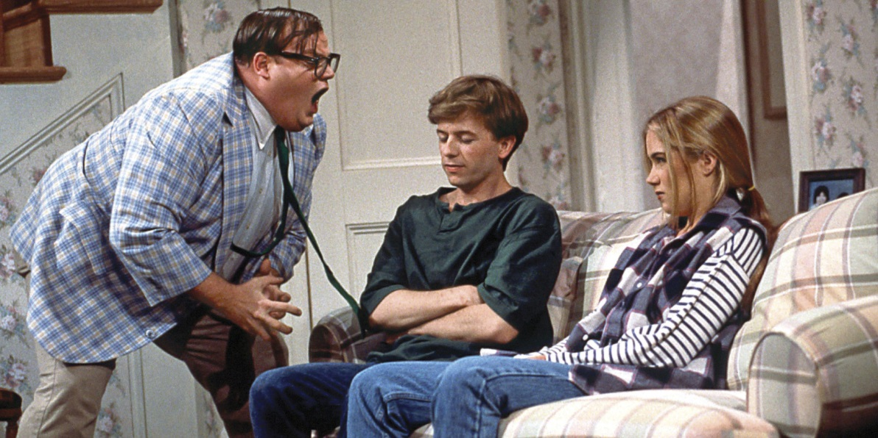
Motivation
Factors within and outside an organism that cause it to behave a certain way at a certain time
Biological, emotional, cognitive, or social forces that activate and direct behavior.

Slide 3
Three Basic Characteristics of Motivation
Activation is demonstrated by the initiation or production of behavior.
Persistence is demonstrated by continued efforts or the determination to achieve a particular goal, often in the face of obstacles.
Intensity is seen in the greater vigor of responding that usually accompanies motivated behavior

Slide 4
Theories of Motivation
Instinct/Evolutionary — motives are innate/inborn
Drive — biological needs as motivation – push you to act
Incentive — extrinsic things that pull behavior
Arousal — people are motivated to maintain optimum level of arousal
Humanistic — hierarchy of needs
Competence - demonstrating competence and exercising control in a situation
Achievement – directed toward excelling, succeeding, or outperforming others at some task

Slide 5
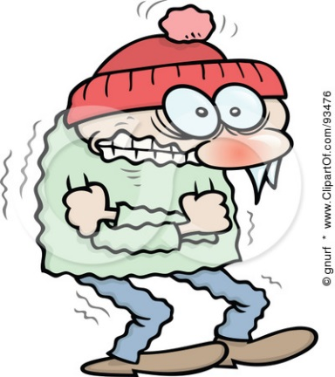
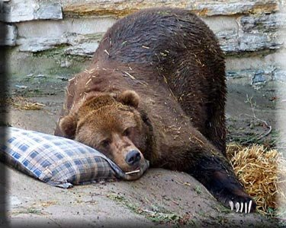
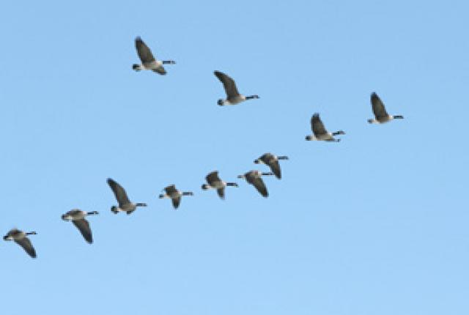
Historic Explanations: Instincts

Slide 6
Instinct/Evolutionary Theory
Certain human behaviors are innate and due to evolutionary programming
Instinct - A complex, inherited, unlearned behavior that is rigidly patterned throughout a species
Instincts are triggered by external forces
Instincts are unlearned & aid in the species’ survival
Animals display automatic and innate behavior patterns called fixed action patterns to environmental stimuli
Criticism: Instinct theories merely describe and label behaviors rather than actually explaining them.
Evolutionary Psych assumes these behaviors are in our genes.

Slide 7
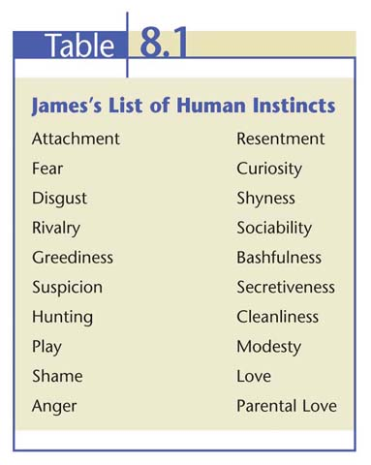
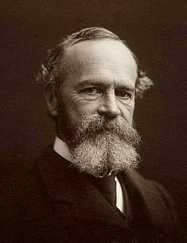
James’ Instincts
William James listed 37 instincts.

Slide 8
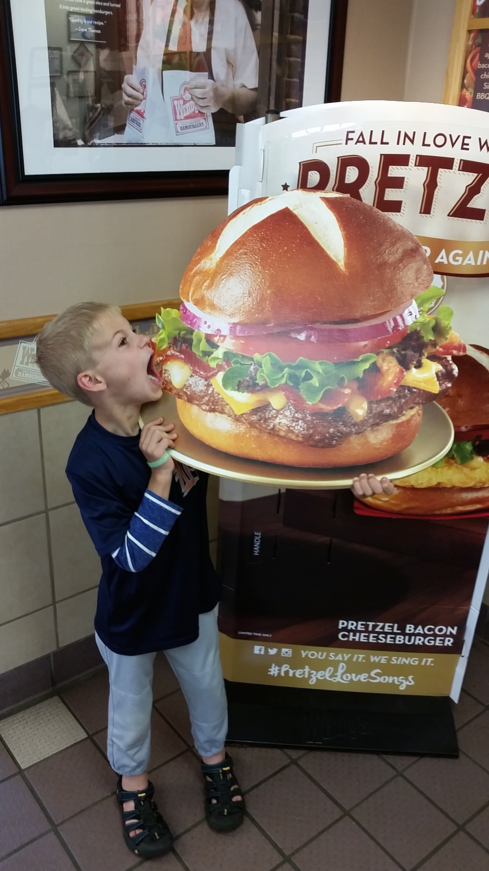
Drive-Reduction Theory
Organism feels tension created by imbalances
“Pushes” an organism to restore the balance, typically reducing the drive and restoring homeostasis
Part of drive-reduction theory

Slide 9
Drive-Reduction Theory
The idea that a physiological need creates an aroused tension state (a drive) that motivates an organism to satisfy the need & return to homeostasis
Eating and drinking are examples of drive-reducing behaviors.
If you are cold, you would be driven or pushed to put on a coat to warm-up. If you shiver, that would be an instinctual behavior.
Criticism: Can’t explain why people often engage in behaviors that serve to increase tension and physiological arousal

Slide 10
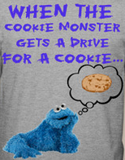
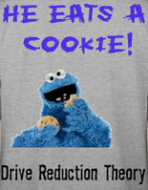
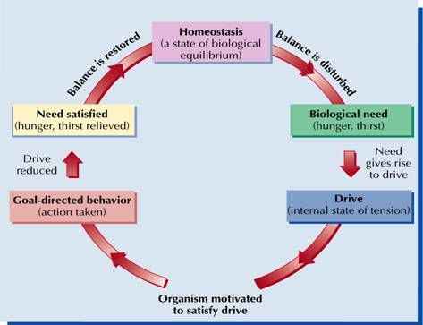
Drives as Tissue Needs
Homeostasis—the constancy of internal conditions that the body must actively maintain
Drives may be due to an upset in homeostasis, inducing behavior to correct the imbalance
Animals do behave in accordance with their tissue needs (e.g., increasing or decreasing caloric intake, drive for salt)
However, homeostasis cannot explain all drives

Slide 11
Incentive Theories
External Rewards as Motivators

Slide 12
Incentive Theory
Behavior motivated by the “pull” of external goals, such as rewards, money and recognition.
Drew heavily from well-established learning principles, such as reinforcement, and the work of learning theorists, such as Pavlov, Watson, Skinner, and Tolman.
Tolman also stressed the importance of cognitive factors in learning and motivation, especially the expectation that a particular behavior will lead to a particular goal.
Criticism: Fails to explain behaviors that are not primarily motivated by any kind of external incentive

Slide 13
Optiminal Arousal Theory

Slide 14
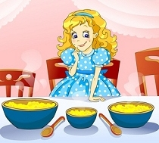
Optiminal Arousal Theory
Levels of alertness and responsiveness
People are motivated to maintain an optimum level of arousal—neither too high nor too low
Curiosity motive—helps us understand our environment –
Helps explain the power of a negative suggestion
Boredom
Just
Right
STRESS

Slide 15
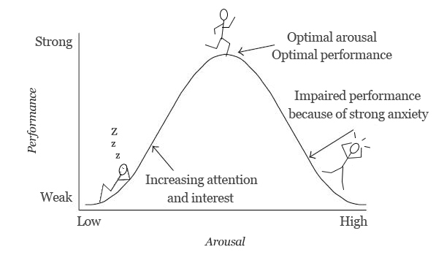
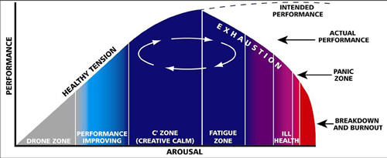
Yerkes-Dodson Law
The theory that a degree of psychological arousal helps performance, but only up to a certain point
Optimum level of arousal depends on the difficulty of the task.
Each person has an optimum level of stimulation they like to maintain.
How does this apply to sports?

Slide 16
Yerkes-Dodson Law

Slide 17
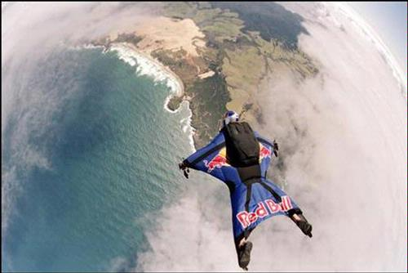
Sensation Seeking
A person high in sensation seeking tends to look for exciting (and sometimes risky) activities
A person who does this…

Slide 18
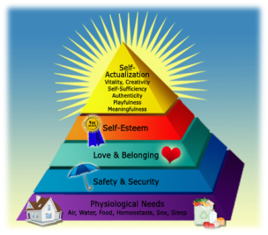
Humanistic Theory
Maslow’s Hierarchy of Needs

Slide 19
Humanistic Theories
Motivation is affected by:
How we perceive the world,
How we think about ourselves
The degree to which the environment is supportive and encouraging
Abraham Maslow suggested that motives are divided into several levels from basic survival needs to psychological and self-fulfillment needs

Slide 20
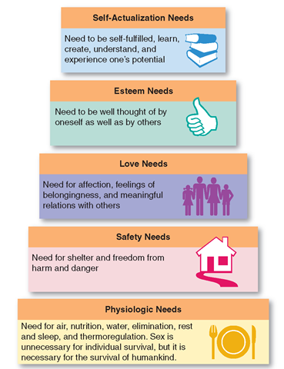
Hierarchy of Needs
Maslow’s pyramid of human needs begins at the base with physiological needs, and then proceeds through safety needs to psychological needs.
Higher-level needs won’t become active until lower-level needs have been satisfied.

Slide 21
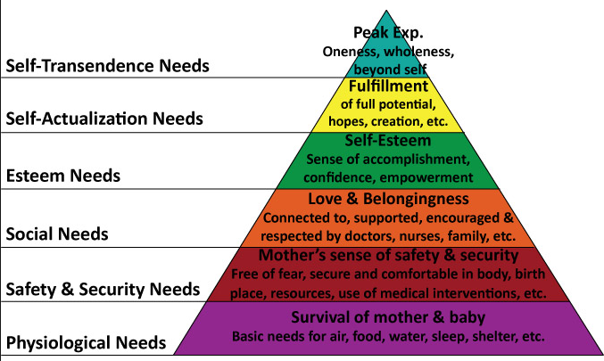
Self-Actualization
According to Maslow, the need to live up to one’s fullest and unique potential
Self-Transcendence
Striving for meaning, purpose and communion beyond one’s self (transpersonal)
CRITICS POINT OUT:
Maslow’s notion that we must satisfy needs at one level before moving to the next level has not been supported by research.

Slide 22
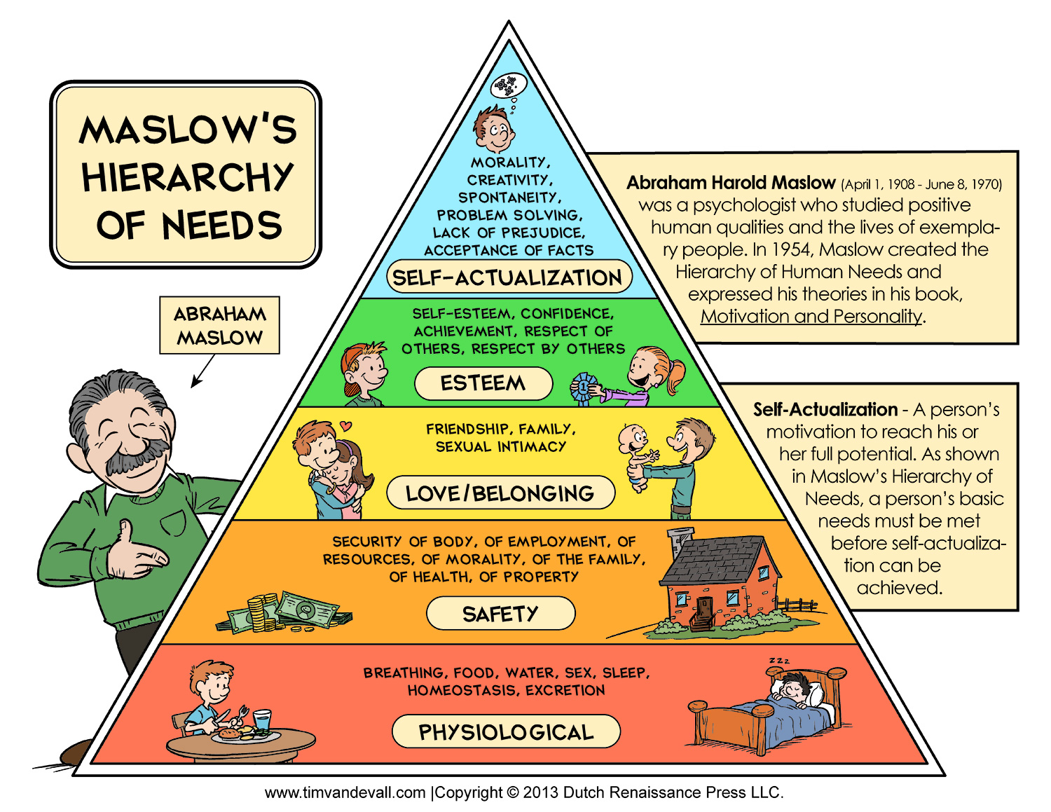

Slide 24
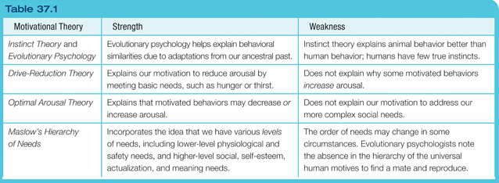
Comparing the Major Theories

Slide 25
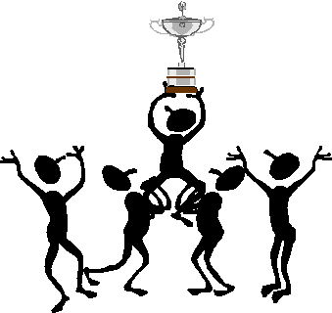
Clinical Explanations: Achievement & Competence

Slide 26
Achievement Motivation
Achievement motivation—behavior aimed at excelling, succeeding, or outperforming others at some activity
A desire for significant accomplishment
A desire for the mastery of things, people, or ideas
A desire for attaining a high standard
Neo-Freudian, Henry Murray (1893-1988) first established the concept of achievement motivation.
Used Thematic Apperception Tests to measure it.

Slide 27
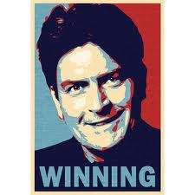
Achievement & Success
Measures of achievement motivation generally correlate well with various areas of success.
People who score high in achievement motivation expend their greatest efforts on moderately challenging tasks
High Achievers tend to display original thinking, seek expert advice, and value feedback about their performance.

Slide 28
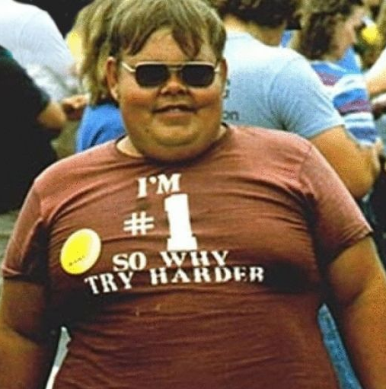
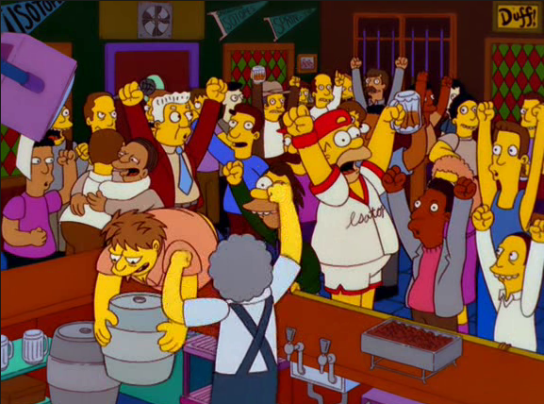
Achievement & Culture
In individualistic cultures, the need to achieve emphasizes personal, individual success
In collectivistic cultures, achievements are viewed as a way of bringing glory to one’s family, group, or country.

Slide 29
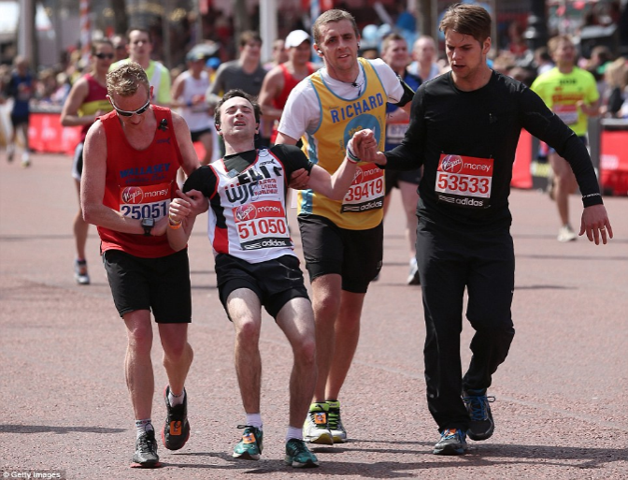
Competence
Competence motivation—behavior aimed at demonstrating competence and exerting control in a situation
Motivated to prove to yourself that you can do a challenging task.
Competence = Confidence in yourself
Example: Running a marathon

Slide 30
Cognitive Explanations: Intrinsic and Extrinsic Motivation

Slide 31
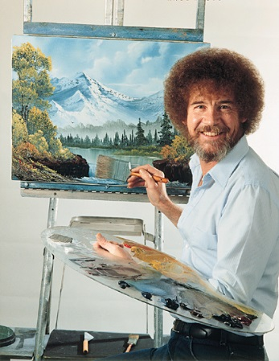
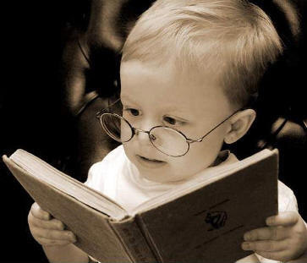
Intrinsic Motivation
A desire to perform a behavior for its own sake and to be effective
I do an activity for an internal reward or satisfaction.
What things are you intrinsically motivated to do?

Slide 32
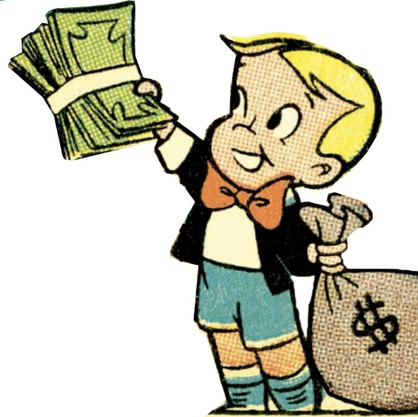
Extrinsic Motivation
A desire to perform a behavior because of promised rewards or threats of punishment
I do the activity for a good consequence.
What things are you extrinsically motivated to do?

Slide 33
Motivating Ourselves and Others

Slide 34
Developing Self Motivation
Associate your high achievement with positive emotions
Connect your achievement with your efforts
Raise your expectations

Slide 35
Motivating Others
Cultivate intrinsic motivation
Attend to individual motives
Set specific, challenging goals
Choose an appropriate leadership style
Task leadership
Social leadership

Slide 36
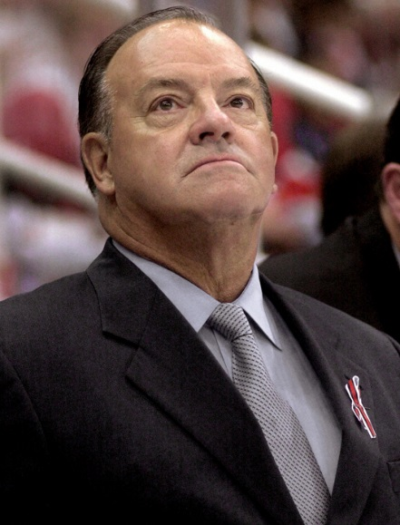
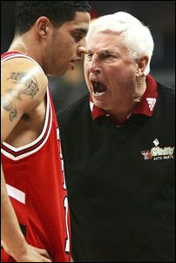
Task Leadership
Goal-oriented leadership that sets standards, organizes work, and focuses attention
“My Way or the Highway” Coach

Slide 37
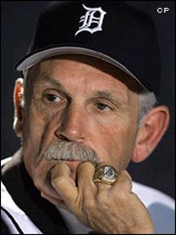
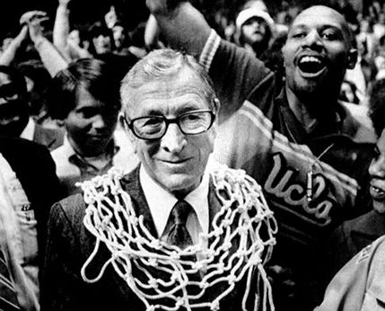
Social Leadership
Group-oriented leadership that builds teamwork, mediates conflict, and offers support
The “Players Coach”

Slide 38
Thank you

