Slide 1
General Microbiology Diagnosis of Viral Infections 2021-2022
Dr. Mohammad Odaibat
Department of Microbiology and Pathology
Faculty of Medicine, Mutah University

Slide 2
Diagnosis of viral infections
Clinical signs.
2. Virus detection:
Direct examinations.
Indirect examinations.

Slide 3
Diagnostics of viral diseases
Virus detection
Direct examination:
Antigen detection | serology (immunofluorescence, ELISA etc.)
Electron microscopy | morphology of virus particles
Viral genome detection | - hybridization with specific nucleic acid probes - polymerase chain reaction (PCR)

Slide 4
Diagnostics of viral diseases
Virus detection
2. Indirect examination:
Cell Culture | cytopathic effect (CPE) hemadsorption
3.
Serology | Direct and indirect ELISA Hemagglutination inhibition test
Animals | disease or death

Slide 5
Diagnostics of viral diseases
Direct methods
Serology
Most used lab method
Detection of antigen
Classical Techniques
Newer Techniques
Complement fixation tests (CFT)
Immunofluorescence techniques (IF)
Neutralization tests
Radioimmunoassay (RIA).
Sandwich Enzyme linked immunosorbent assay (ELISA).
Particle agglutination.
Western Blot (WB).

Slide 6
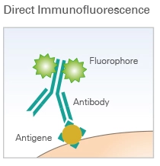
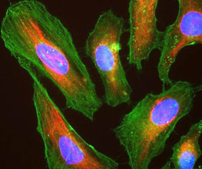
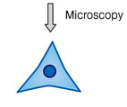
Indirect immunofluorescence
Immunofluorescence techniques (IF)
Fluorophore

Slide 7
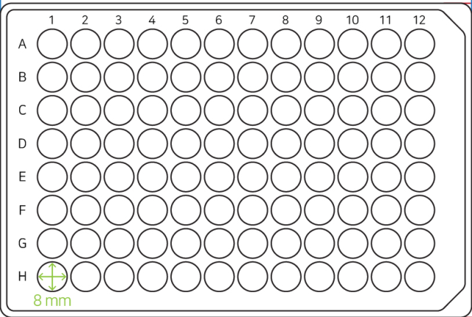
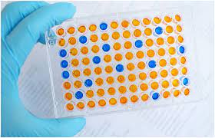
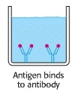
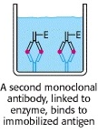
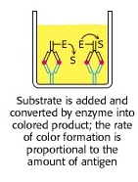
Diagnostics of viral diseases
96 well plate
Direct methods
Serology
Enzyme Linked Immunosorbent Assay (ELISA).
96 well plate

Slide 8
Complement fixation test
Procedure
Looking for antigens
No hemolysis
Ab , complement, and sRBCs are externally added
Patient serum
Positive results
No
antigen
Patient serum
Negative results

Slide 9
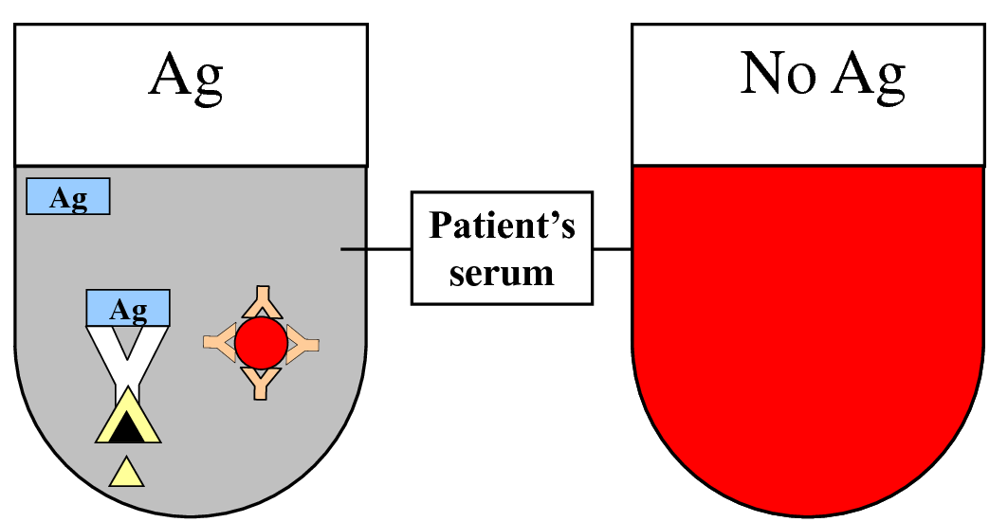
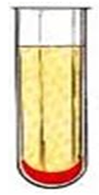
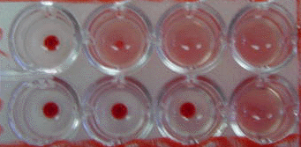
Complement fixation test
No hemolysis
Hemolysis
_
_
_
+
_
+
+
+

Slide 10
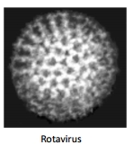
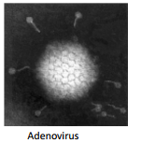
Diagnostics of viral diseases
Direct methods
Electron Microscopy
106 virus particles per ml required for visualization.
50,000 - 60,000 magnification normally used.
Viruses may be detected in the following specimens.
Faeces: Rotavirus, Adenovirus, Norwalk like viruses, Astrovirus, Calicivirus
Vesicle Fluid: HSV, VZV
Skin scrapings: papillomavirus, molluscum contagiosum
Electronmicrographs

Slide 11
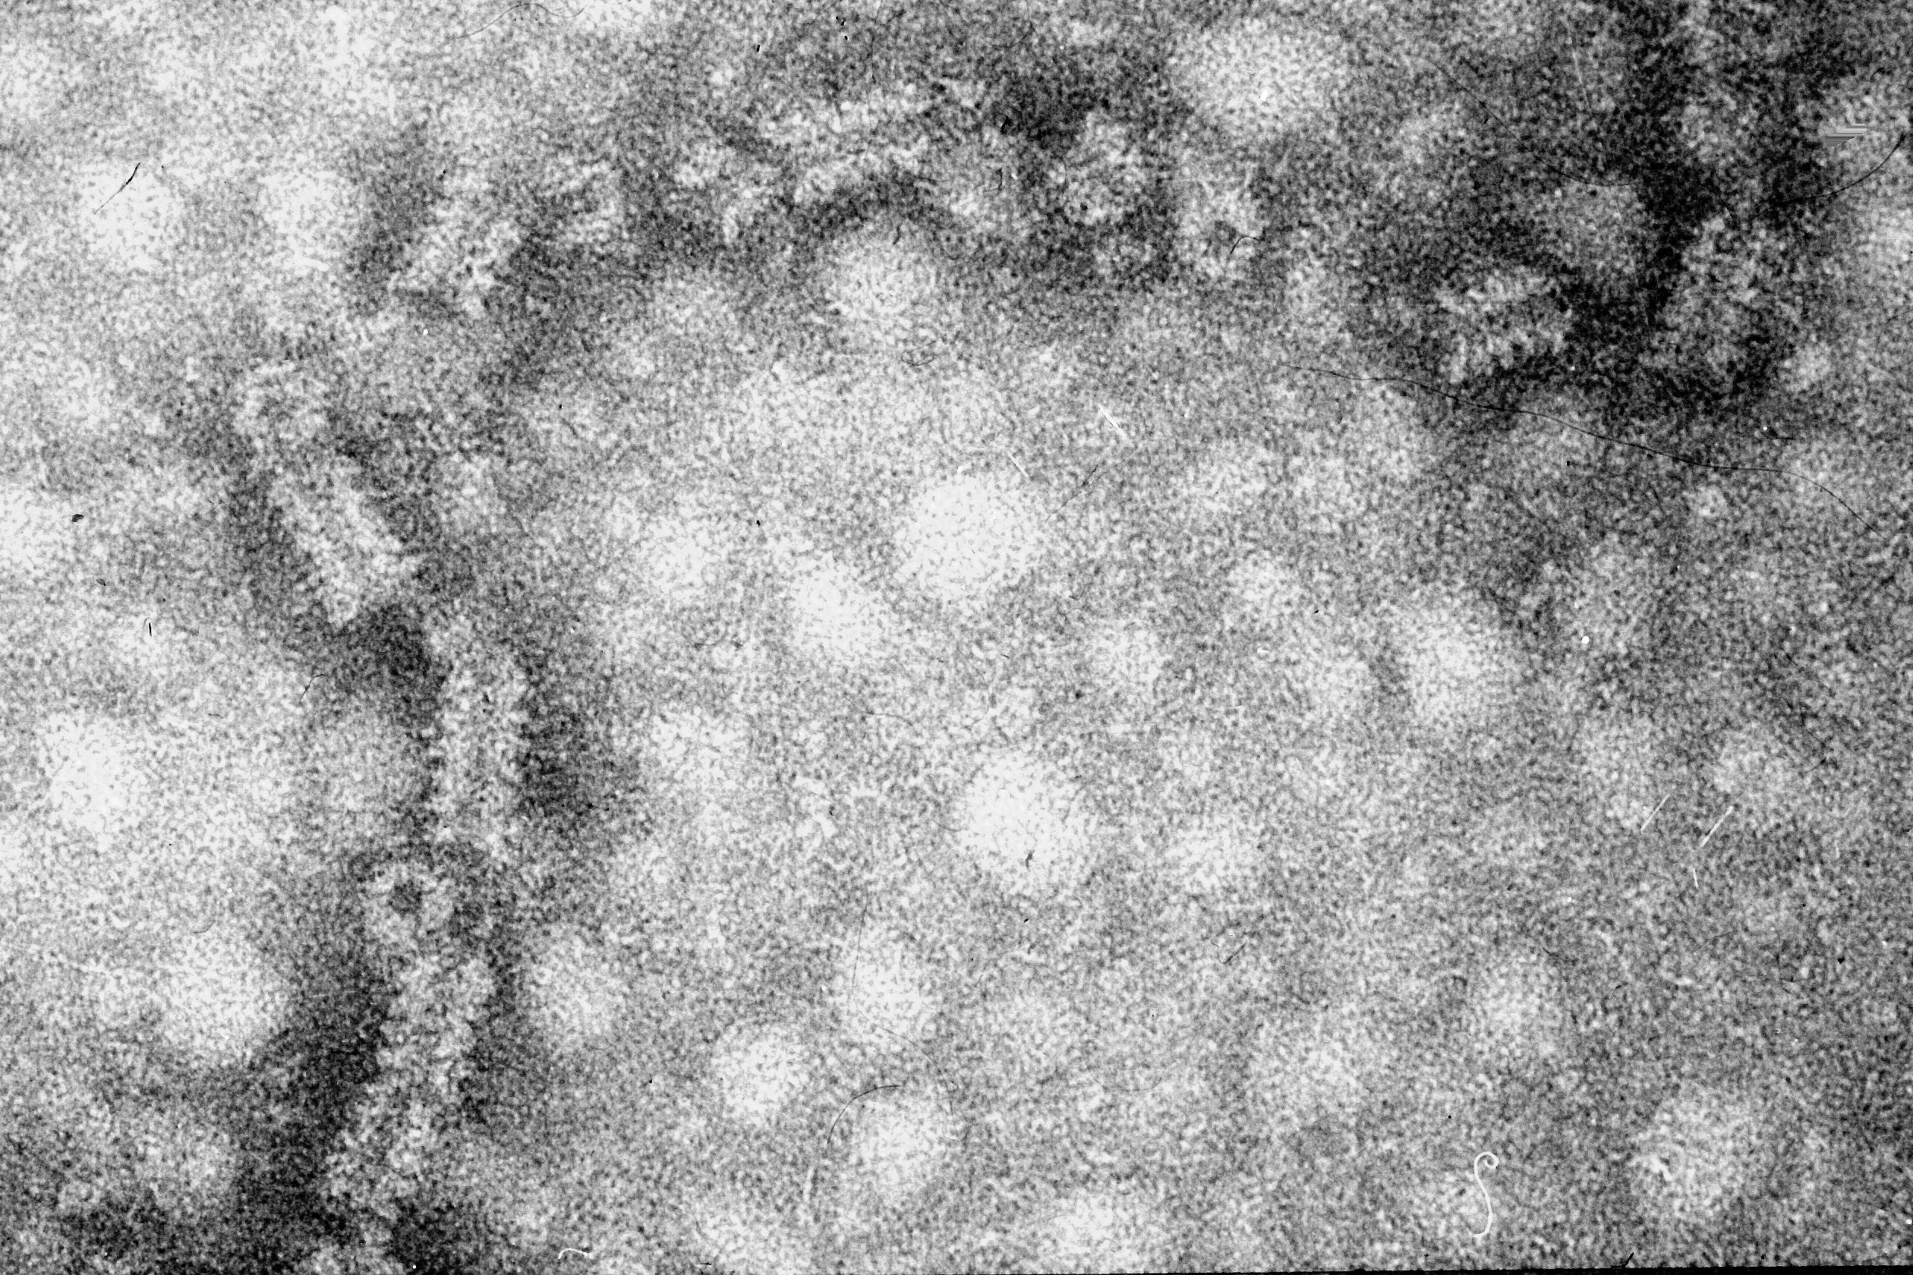
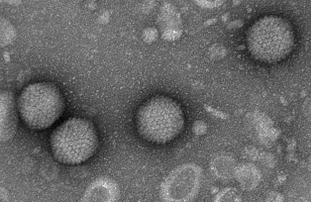
Diagnostics of viral diseases
Direct methods
Electron Microscopy
Problems with Electron Microscopy
• Expensive equipment
• Expensive maintenance
• Require experienced observer
Cylindrical (Mumps virus )
Icosahedral (poliovirus)

Slide 12
Diagnostics of viral diseases
Direct methods
Molecular Methods
Methods based on the detection of viral genome.
By Polymerase Chain Reaction (PCR)
However in practice, although the use of these methods is indeed increasing, the role played by molecular methods in a routine diagnostic virus laboratory is still small compared to conventional methods.
Advantages of PCR:
Extremely high sensitivity, may detect down to one viral genome per sample volume.
Easy to set up.
Fast turnaround time
Disadvantages of PCR
– Extremely liable to contamination.
– High degree of operator skill required.
– Not easy to set up a quantitative assay.

Slide 13
Diagnostics of viral diseases
Virus detection
2. Indirect examination:
Cell Culture | cytopathic effect (CPE) hemadsorption
3.
Serology | Direct and indirect ELISA Hemagglutination inhibition test
Animals | disease or death

Slide 14
Diagnostics of viral diseases
Indirect methods
Cell Culture
Are used for virus isolation. However, they are very expensive and it is often difficult to obtain a reliable supply.
Problems with cell culture
Long period (up to 4 weeks) required for result.
Often very poor sensitivity, sensitivity depends on a
large extent on the condition of the specimen.
Susceptible to bacterial contamination.
Susceptible to toxic substances which may be present in
the specimen.

Slide 15
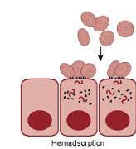
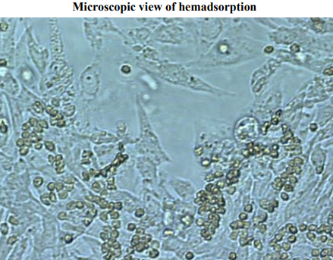
Hemadsorption
To detect the presence of certain viruses, the hemadsorption test is commonly used.
Influenza and parainfluenza viruses express a viral hemagglutinin on the surface of infected cells.
By the hemadsorption test, the culture medium is removed and replaced with a 0.5% dilute solution of guinea-pig red blood cells.
Culture
cell
Hemadsorption inhibition
Patient serum with suspected Influenza infection
Cultured cells
Red Blood Cells
=
No hemadsorption
=
Positive infection
Adsorbed RBCs on the culture cell

Slide 16
Diagnostics of viral diseases
Indirect methods
Serology
Detection of antibodies against the virus.
Criteria for diagnosing primary infection
• 4 fold or more increase in titer of IgG or total antibody between
acute and convalescent sera
• Presence of IgM
• Seroconversion
Criteria for diagnosing reinfection
• fold or more increase in titer of IgG or total antibody between acute and convalescent sera
• Absence or slight increase in IgM

Slide 17
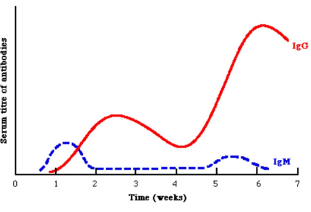
Diagnostics of viral diseases
Serology
Note that during reinfection, IgM may be absent or present at a low level transiently

Slide 18
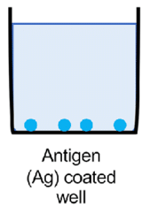
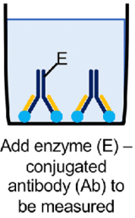
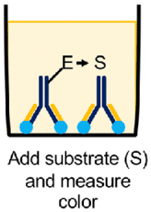
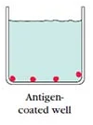
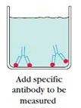
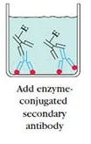
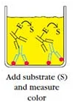
Diagnostics of viral diseases
96 well plate
Indirect methods
Serology
Direct ELISA
Indirect ELISA

Slide 19
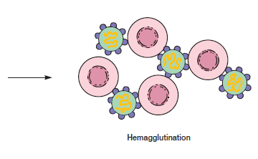
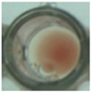
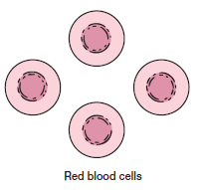
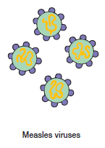
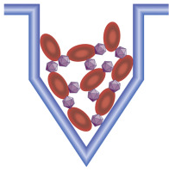
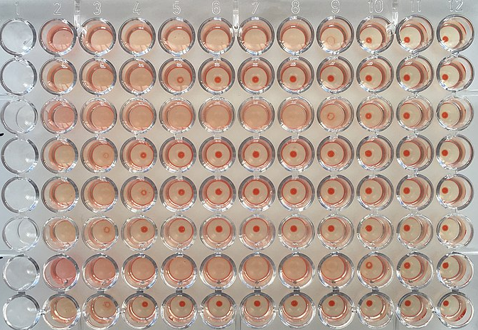
Haemagglutination inhibition test

Slide 20
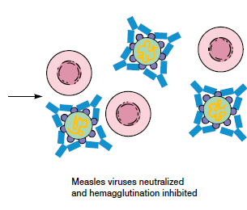
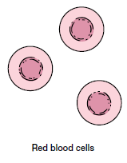
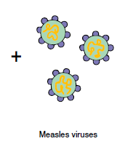
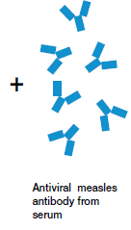
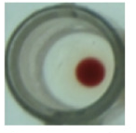
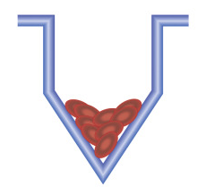
Haemagglutination inhibition test

Slide 21
Diagnostics of viral diseases
Indirect methods
Serology
Problems with Serology:
Long period of time required for diagnosis for paired acute and convalescent sera.
Mild local infections such may not produce a detectable Abs.
Immunocompromised patients often give a reduced or absent Abs.
Patients with infectious mononucleosis and those with connective tissue diseases such as SLE may react non-specifically giving a false positive result.
Patients given blood or blood products may give a false positive result due to the transfer of antibody

