Slide 1
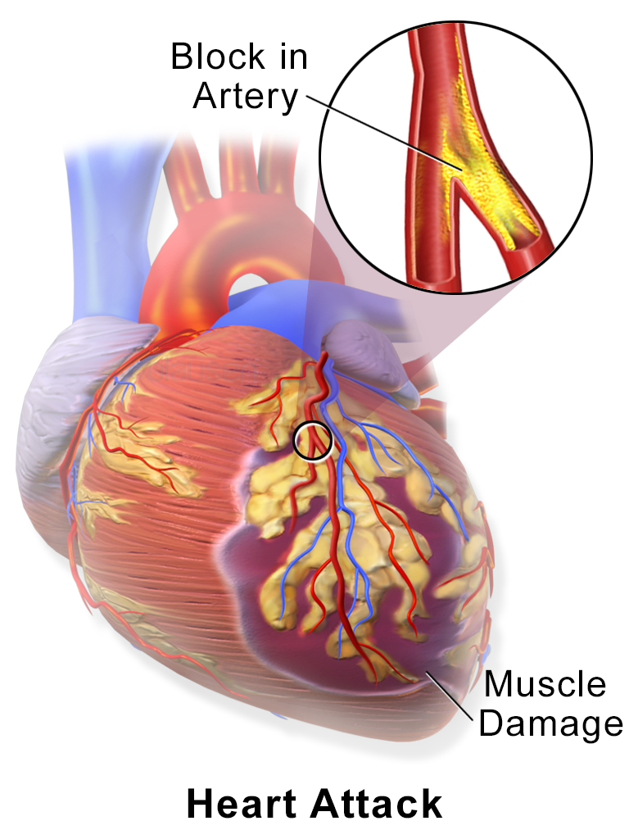
Dr. Heba M. abd el kareem assistant Professor of Medical Biochemistry and Molecular Biology
Cardiovascular System Biochemical Markers for MI

Slide 2
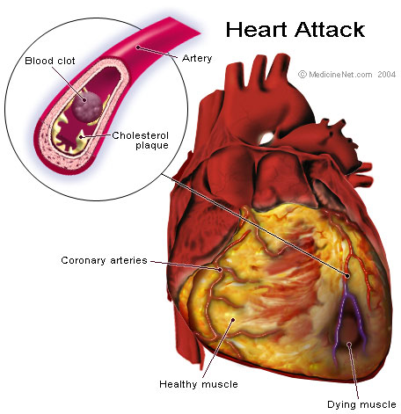
Acute Myocardial Infarction
An imbalance between the supply of oxygen and the myocardial demand resulting in myocardial ischemia.
A rapid development of myocardial necrosis caused by prolonged ischemia resulting in an irreversible myocardial injury.
The development of infarction or ischemia will depend on the degree of occlusion or the presence of collateral blood flow.

Slide 3
Biochemical Changes
ischemia to myocardial muscles (with low O₂ supply)
anaerobic glycolysis
increased accumulation of Lactate
decrease in pH
activate lysosomal enzymes
disintegration of myocardial proteins
cell death & necrosis
ECG
changes
clinical manifestations
(chest pain)
BIOCHEMICAL MARKERS
release of intracellular contents to blood

Slide 4
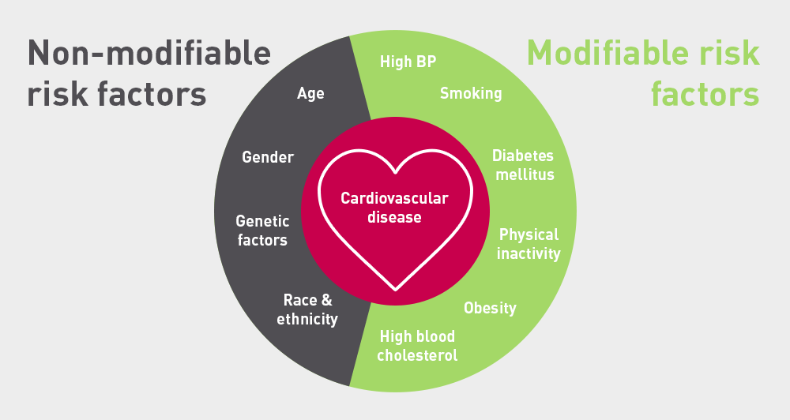
Risk factors
LDL-C is most important atherogenic particle.
Apo B: Only apoprotein on LDL. ApoA1 is often used as a biomarker for prediction of CVD.
ApoB100 / ApoA1 ratio is more effective at predicting heart attack risk, in patients who had had an acute MI, than either the ApoB100 or ApoA1 measure alone.

Slide 5
Myocardial infarction
Many patients with myocardial infarction have a typical history of crushing central chest pain, perhaps radiating to the arm or jaw, associated with typical ECG changes.
myocardial infarction can, however, present atypically, or even be clinically silent, particularly in the elderly.
The clinical evaluation often is limited by atypical symptoms, in most patients the initial ECG is non-diagnostic.
The role of cardiac markers in the diagnosis and treatment of patients with chest pain and suspected AMI has evolved considerably.

Slide 6
What are the investigations?
- ECG. - chest x-ray - coronary angiogram - Lipid profile
- serum cardiac enzymes & proteins.
WHO Diagnosis of Acute Myocardial Infarction (AMI)
Presence of two of the three criteria:
History of characteristic chest pain.
Electrocardiographic changes.
Typical pattern of serum cardiac enzyme & proteins rise, peak and return to reference range.
However, in 1999, European Society of Cardiology and the American College of Cardiology
Sensitive biomarkers for the diagnosis of AMI
Cardiac troponins (cTn) is the gold standard.

Slide 7
Ideal cardiac marker characteristics
Cardiac specific. specific to myocardial muscle cells (no false positive).
Sensitive: can detect minor damage. no miss of positive cases (no false negative)
Prognostic: relation between plasma level & extent of damage
Rises soon after plaque rupture.
Elevated over a sustained period of time.
Easy to measure, fast assay.
Diagnostic utility verified by clinical studies.

Slide 8
Questions answered by markers of cardiac damage
Rule in/out an acute MI
Confirm an old MI (several days)
Monitor re-infarction
Monitor the success of thrombolysis
Biochemical markers in myocardial ischemia /necrosis
1. Cardiac Enzymes (isoenzymes):
Total CK, CK-MB activity, CK-MB mass
Aspartate aminotransferase (AST), Lactate dehydrogenase (LDH),.
Glycogen phosphorylase BB (GPBB).
2. Cardiac proteins:
Myoglobin & Troponins
Ischemia Modified Albumin
Heart-Fatty Acid binding protein (H-FABP).
3. Micro RNA (miRNA)

Slide 9
Biochemical markers in myocardial ischaemia /necrosis
Obsolete
- Aspartate aminotransferase -Total CK - Lactate dehydrogenase
Established
- Troponin T - Troponin I - CK/MB - Myoglobin
Emerging
- Micro RNA (miRNA)
- Heart fatty acid-binding protein (h-FABP)
- Ischemia-modified albumin
- Glycogen phosphorylase BB (GPBB)
- Copeptin - B-type natriuretic peptide
- Growth differentiation factor 15 - Pregnancy-associated plasma protein A

Slide 10
Laboratory Investigations
Specimen Collection:
Serum is the specimen of choice
Heparinized plasma is acceptable
Venous whole blood for rapid cardiac troponin T.
Saliva
Collection Time:
Serial specimens collected at appropriate time intervals.
Serial measurements are most useful
Samples are drawn on admission
at 2-4 hours
at 6-8 hours
at 12 hours

Slide 11
Myoglobin
O2-binding protein (heme-containing protein).
Released from skeletal and heart muscle when damaged.
Rapidly cleared by kidneys (not long term marker).
Its level varies with gender, age, physical activity.
More sensitive than CK, CK-MB activities.
myoglobin is not cardiac specific, better used in conjunction with other markers. Increased in patients with skeletal muscle disease and chronic renal failure

Slide 12
Myoglobin
It starts to rise within 1-4 h
Detected between 6-9 h in nearly all AMI patients from chest pain.
Returns to base line levels within 18- 24 h.
If myoglobin are normal 8h after pain ……. AMI can be rules out.
[ CK-MB is preferred than myoglobin in patients who are admitted later than 10-12 h after pain].

Slide 13
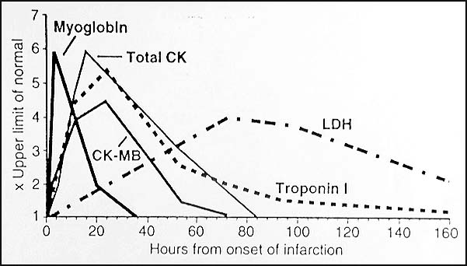
Biochemical markers of MI

Slide 14
Creatine kinase (CK)
Creatine kinase acts as a regulator of high-energy phosphate production and utilization within contractile tissues.
Cytoplasmic CK is a dimer, composed of M and/or B subunits, which associate forming CK-MM, CK-MB and CK-BB isoenzymes
CK catalyses the conversion of creatine and consumes ATP to create phosphocreatine (PCr) and ADP.
This CK enzyme reaction is reversible, such that also ATP can be generated from PCr and ADP.
Mitochondrial
ATP ADP
Cytosolic

Slide 15
Creatine kinase (CK)
CK-MM is the main isoenzyme found in skeletal >> Cardiac muscles.
CK-MB is found mainly in cardiac muscle Trace amounts of CK-MB are found in skeletal muscle.
CK-BB is the predominant isoenzyme found in brain, colon, ileum, stomach and urinary bladder.
CK- total

Slide 16
CK-MB (mass) Mass estimation better than activity. To increase specificity, ratio (relative index) Relative index = CK-MB mass / CK activity.
CK-MB
High specificity. more specific than total CK BUT: less specific than troponin I.
Gold standard as cardiac marker (was).
It takes at least 4-6 h to increase.
Peak levels at 12-24 h.
Return 2-3 days.
useful for early diagnosis of MI
useful for diagnosis re-infarction

Slide 17
CK-MB (mass)
If ratio >>> 3 indicative of AMI rather than skeletal muscle damage.
CK/MB isoenzyme is not myocardium-specific occurring for instance in a small amount in skeletal muscle.
Its use in the diagnosis AMI is considered acceptable only in cases where cTn assays are unavailable.
The one advantage of CK-MB over the troponins is the early clearance that helps in the detection of re-infarction.

Slide 18
Aspartate transaminase (AST)
Hepatic congestion due to right-sided heart dysfunction may contribute to the rise of plasma AST activity. A non-specific marker of MI
If there is primary hepatic dysfunction, plasma AST rises whereas LDH1 activity usually remains normal.
The sequence of changes in plasma AST activity in MI is similar to those of CK .
AST and LDH measurements are rarely of practical value in the management of patients with suspected myocardial infarction.
Exceptionally, when a patient with chest pain presents late, measurement of LDH may be helpful as this enzyme remains elevated in the plasma for several days following myocardial infarction.

Slide 19
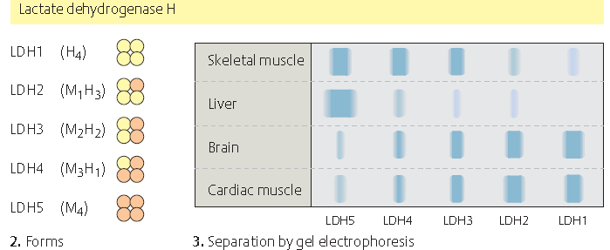
Lactate dehydrogenase (LDH)
LDH is a tetramer, each chain may be one of two types (H,M) where LDH1 is (H4) while LD5 is (M4)
LD1 & LD2 predominates in heart
LDH increases later than CK-MB and Ck
Reaches a max. level in 48 h
Remains elevated for 5-6 days after the MI
A non-specific marker of tissue injury: High levels are found in liver, lung, kidney and other diseases.
Myocardial infarction resulting in insufficient oxygen delivery to that portion of cardiac muscle. This causes the affected muscle to rely on anaerobic metabolism for its energy supply with concomitant production of lactic acid.

Slide 20
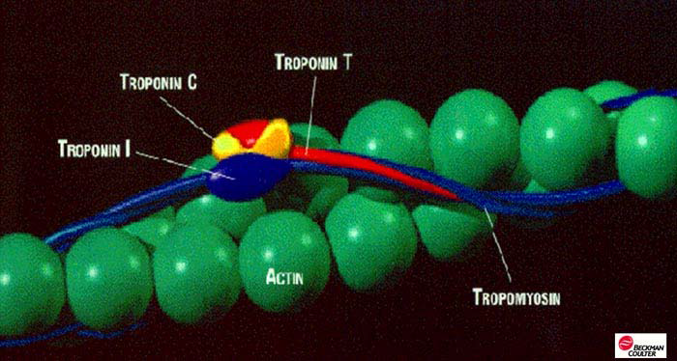
Troponin
Troponin is a protein.
Present in high concentration in muscle & heart.
Regulates the force of muscular contractions
Is composed of 3 sub units I, T and C.
Troponin C: Ca⁺⁺ binding. (not heart-specific).
The Troponin I and Troponin T found in heart muscle is significantly different from Troponins found in non-cardiac muscle

Slide 21
Troponin T
Tropomyosin binding element .
Its level increases within 6 hrs of MI.
Peaks at 72 hrs .
remains elevated 7-10 days.
Troponin T may be elevated in patients with chronic renal failure and thus may not be so cardiac-specific
Troponin I:
It is released within 4-6 hrs of the onset of MI.
Peaks 14-24hrs.
Remains elevated for 3-5 days.
Disappears from blood after about one week. So, useful for diagnosis of delayed admission cases.
Cardiac troponins have been recommended as the biochemical cardiac marker of choice.

Slide 22
Cardiac Troponin: troponin I (cTn I)
Serum troponins are not found in healthy individuals (Unlike CK/MB).
Troponins are both more sensitive (diagnose minor infarction) and more specific than CK-MB in terms of its diagnostic ability with respect to myocardial damage.
Prognostic marker (relation between level in blood & extent of cardiac damage). Determination of size of infarct.
Determination of success of reperfusion.
Two negative Troponins 6 hours apart are good (but not absolute) evidence of no recent AMI.
positve Troponin in patients without ECG changes & with normal CK-MB levels may identify patients at increased risk of cardiac events

Slide 23
Heart-type fatty acid-binding protein (H-FABP)
H-FABP is a small cytosolic protein found in the cardiac tissues.
It is chiefly present in the myocardium and, to a lesser extent, in the brain, kidney and skeletal muscle.
responsible for the transport of fatty acids from the plasma membrane to:
Sites of β-oxidation in mitochondria and peroxisomes.
Endoplasmic reticulum for lipid synthesis.
H-FABP is released extremely early into the serum following myocyte rupture.
hhh as early as 30 min after myocardial injury
Peaks at 6–8 h and
Returns to baseline levels at ~24 h.
It could be used to quickly rule out AMI.

Slide 24
Isoenzyme BB glycogen phosphorylase (GPBB)
It is one of the 3 isoforms of glycogen phosphorylase.
GPBB exists in cardiac and brain tissue. Because of the blood–brain barrier, GP-BB can be seen as being specific to heart muscle.
hhh blood levels can be seen in ischemia, MI and unstable angina.
Early biochemical marker of myocardial necrosis.
hhh within the first hour of MI.
hhh 1–3 hours after ischemia.
Very sensitive indicator of MI with a sensitivity superior to that of myoglobin, CK-MB mass, and cTnT.

Slide 25
Copeptin
Copeptin, the C-terminal portion of provasopressin is cosecreted with vasopressin.
hhh within minutes in patients with AMI.
Adding copeptin + cTnI can rule out of AMI.

Slide 26
Ischemia-modified albumin (IMA)
It is raised in the presence of myocardial ischemia.
Normal albumin can bind metals at its N terminus.
During ischemia, free radicals, alter the binding site, decreasing binding ability make it more resistant to bind metals.
Positive test – ischemia
Negative test (together with negative troponin and negative ECG) has a 99% negative predictive value for MI.
Rapidly cleared
Not specific for cardiac ischemia.
It is a marker sensitive for ischemia rather than necrosis.
It is detected within a few minutes.
peaks at 2-4 hours.
disappears within 6 hours.

Slide 27
Micro-RNAs
MI, as a damage and cell death process
↓
affects a number of genetic processes that aim repair and survival of the cardiomyocyte.
↓
changes in circulating levels of miRNA
(in the first few hours after MI)

Slide 28
Micro RNA (miRNA)
MicroRNAs (miRNAs) circulate in the bloodstream in a remarkably stable form.
Because of their stability and often tissue- and disease-specific expression and the possibility to measure them with high sensitivity and specificity, miRNAs are emerging as new diagnostic & prognostic biomarkers.
Diagnostic abilities of circulating miRNAs for MI.
It has been found that miR-1, miR-133, and miR-499 were elevated in patients with MI.
The slow time course of miR-499 might lead to increased diagnostic performance at late time points after MI when cTnI has already returned back to normal levels.

Slide 29
Micro RNA (miRNA)
Diagnostic abilities of circulating miRNAs for MI.
The cardiac-specific miR-208 was not detectable in plasma of healthy controls or in patients with stable CAD.
within 4 h after the onset of symptoms, miR-208 was detected in all patients, whereas cTnI was only detected in 85% of the patients, confirming the superior sensitivity of miR-208 at early time points.
Diagnostic abilities of circulating miRNAs for MI.
miR-122 and miR-375 experienced a drop in their plasma levels following MI.
…………………………………………………………………………………………………………………..
It may be expected that in the future, a panel of miRNAs, probably in combination with cTnI, has a better potential to offer sensitive and specific diagnostic tests for AMI.

Slide 30
Salivary biomarkers associated with MI
Saliva offers an easy, simple and non-invasive procedure.
Whole saliva contains constituents from serum, gingival fluid and oral mucosal transudate.
Salivary markers of acute myocardial infarction:
Myeloperoxidase (MPO), C-reactive protein (CRP), Myoglobin, CK-MB and cTn.
Saliva can be used as an alternative to serum in the diagnosis of MI.
Recently: using nanochips and a swab of the cheek,
cardiac biomarker readings from saliva with ECG readings
determine within minutes whether someone had a heart attack.

Slide 31
My best wishes

