Slide 1
LAXATIVES
Dr/ Heba Ahmed Hassan
Assistant professor of clinical pharmacology, faculty of medicine, mutah university

Slide 2
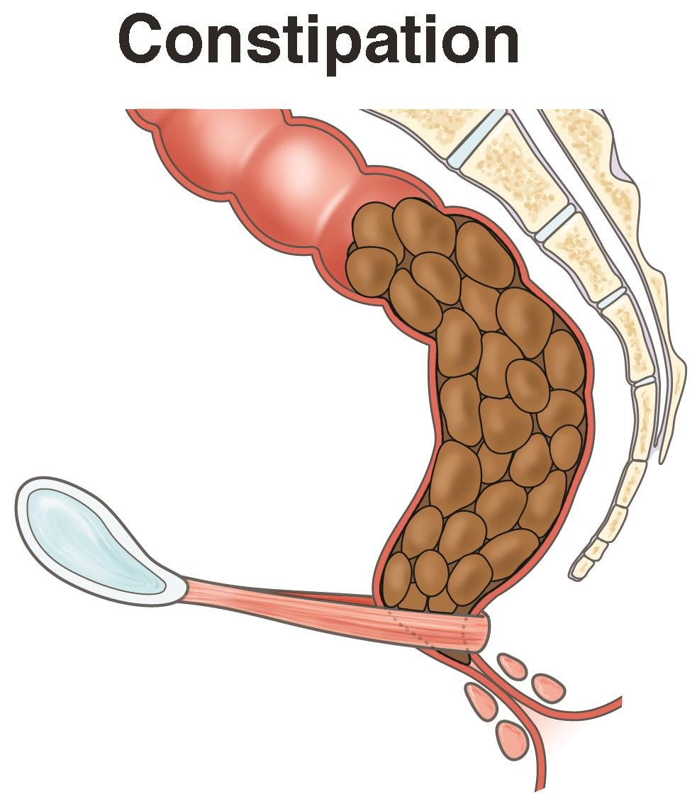

Slide 4
LAXATIVES
Majority of people do not need laxatives.
Intermittent constipation is best prevented with:
-a high fiber diet
- adequate fluid intake
-regular exercise
-the heeding of nature’s call
Patients not responding to dietary changes or fiber supplements should undergo medical evaluation prior to the initiation of long-term laxative treatment.

Slide 5
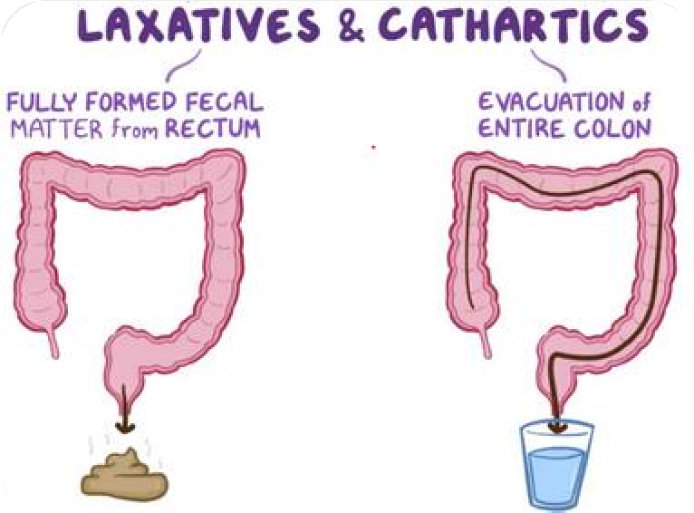
DEFINITIONS:
Promote defection of well-formed stool
Laxatives
Purgatives
Promote defection of semi-solid stool
Promote defecation of watery stool
Cathartics

Slide 6
MECHANISM OF ACTION
Bulk
laxatives
Osmotic laxatives
Stimulant laxatives
stool softener or Lubricant purgatives
Increase the • volume of non- absorbable solid residue → stimulation of peristalsis & softening the feces
Increase the water
content
Increase motility and secretion
Alter consistency of the feces

Slide 7
(1)BULK LAXATIVES:
Indigestible, hydrophilic colloids that absorb water, forming a bulky, emollient gel that distends the colon & promotes peristalsis.
E.g: Psyllium, Methylcellulose, polycarbophil, Bran, Methylcellulose and Lactulose

Slide 8
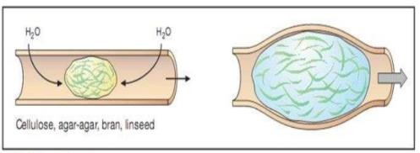
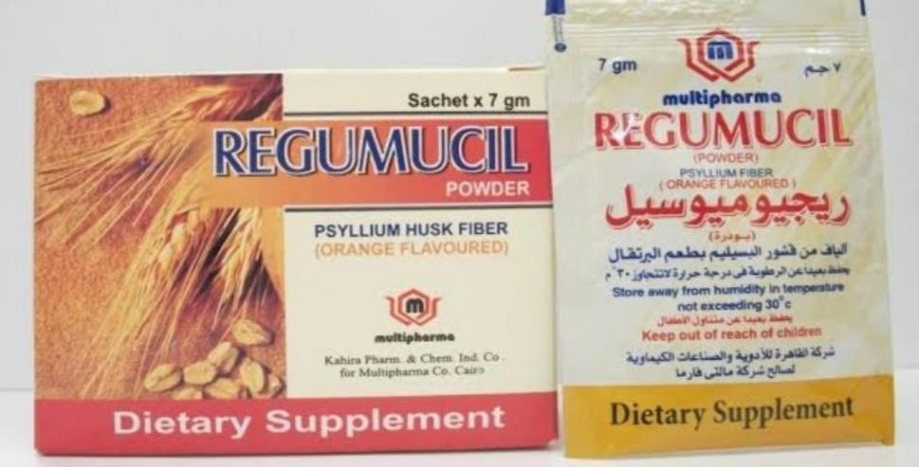
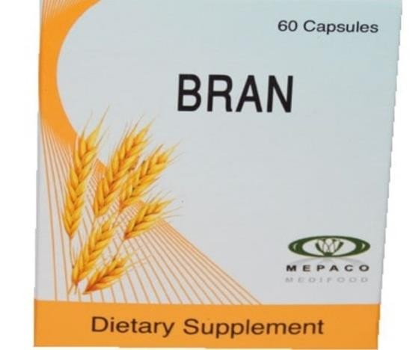
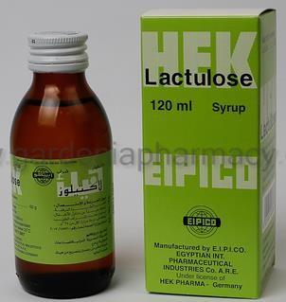
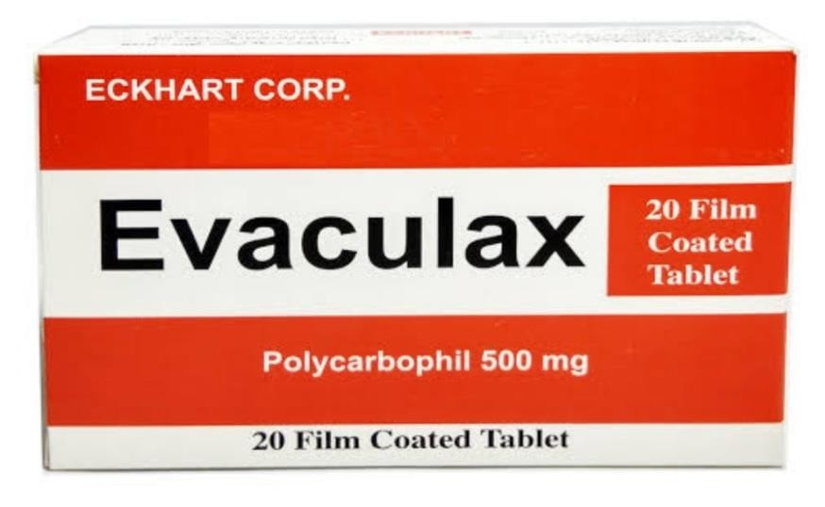
Mechanism of action
examples

Slide 9
(2) OSMOTIC LAXATIVES:
Saline purgatives
A
Sorbitol & Lactulose •
Balanced polyethylene •
glycol (PEG)
B
C

Slide 10
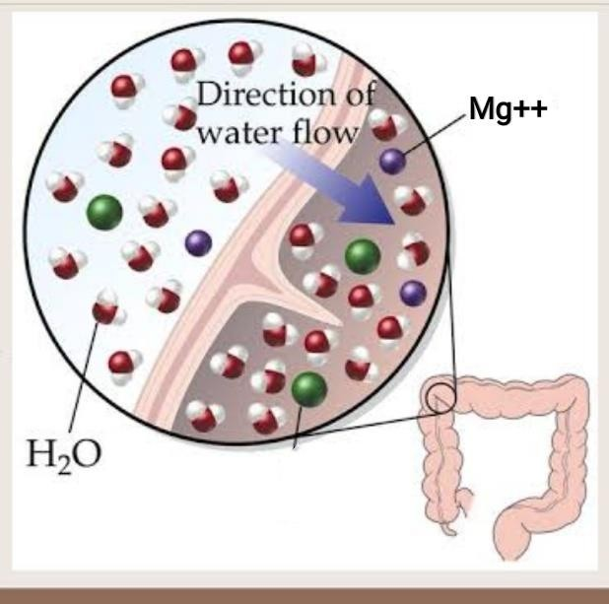
A. Saline purgatives
Magnesium oxide (milk of magnesia): it should not be used for prolonged periods in patients with renal insufficiency due to risk of hypermagnesemia.
Potassium sodium tartrateMagnesium citrate or sulphate.
Sodium phosphate.
Act on small intestine. Act after 2-3 hrs.
Taken before breakfast on an empty stomach in isotonic solution.
High doses of osmotically active agents produce prompt bowel evacuation (purgation) within 1-3 hours.

Slide 11
Uses:
Treatment of acute constipation or the prevention of chronic constipation.
Empty the bowel prior to surgical & radiological procedures.
Eliminate parasites

Slide 12
B. Sorbitol & Lactulose (fructose + galactose):
Non-absorbable sugars.
Metabolized by colonic bacteria → lactate + other organic acids {osmotic effect and
propulsive activity}.
Side effects:
Intravascular volume depletion.
Electrolyte fluctuations
Cramps or flatus.
N.B. They should not be used in patients who are frail, elderly, have renal insufficiency, or have significant cardiac disease.

Slide 13
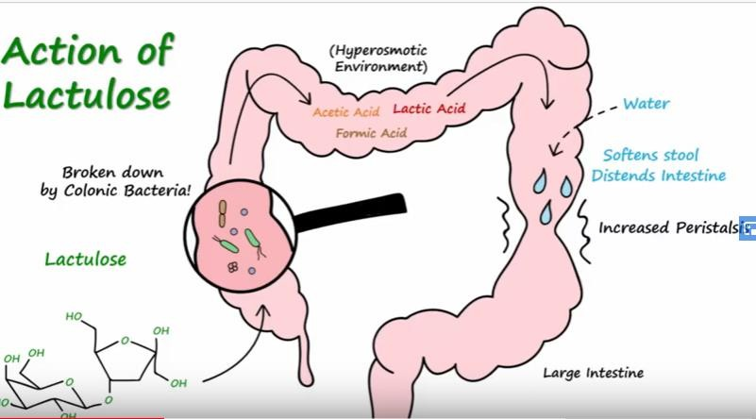

Slide 14
C. Balanced polyethylene glycol (PEG):
Contains an inert, non-absorbable, osmotically active sugar (PEG) with sodium sulfate, sodium chloride, sodium bicarbonate & potassium chloride.
Safe for all patients
Uses:
Lavage solution prior to G.I.T. Endoscope (ingested rapidly 4 L over 2-4 hrs.”).
Treatment or prevention of chronic constipation (smaller doses mixed with water or juices “17g/8 oz” and ingested daily).

Slide 15
(3)STIMULANT LAXATIVES:
A. Diphenylmethane derivatives
B. Anthraquinone (emodin cathartics)
C- castor oil

Slide 16
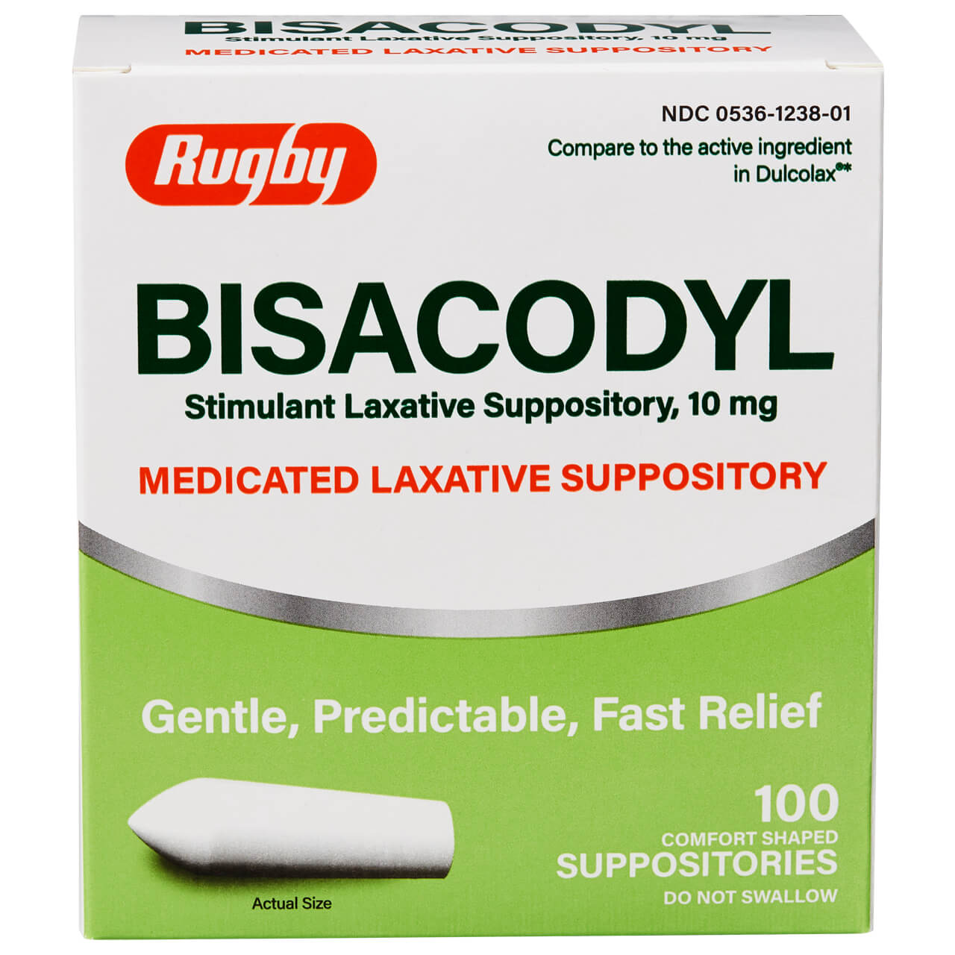
A-Diphenylmethane derivatives: Bisacodyl
Act on colon
act within 30-60 minutes if given rectally.
Pink or red urine.
Minimal systemic absorption and appears to be safe for acute &long term use.

Slide 17
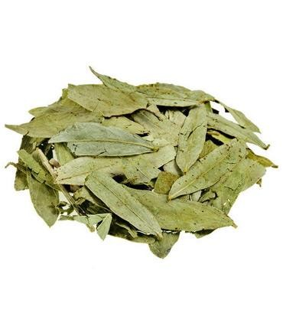
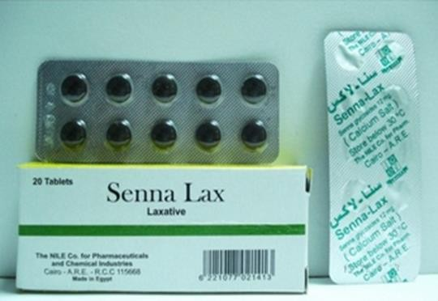
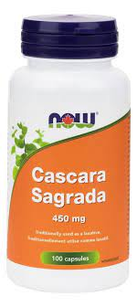
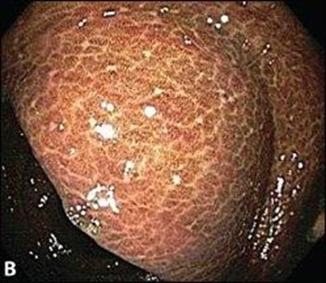
B. Anthraquinone (emodin cathartics):Senna, cascara. Glycosides → emodin + sugar. In colon: bacteria → emodin → stimulate myenteric plexus → ↑colonic motility. Act within 6-12 hrs if given orally & within 2 hrs if given rectally. Side effects: Colicky pain. Abnormal color of urine. Excreted in milk. Brown pigmentation of the colon (melanosis coli).

Slide 18
C- castor oil:
In small intestine: lipase→ ricinoleic acid (strong irritant) → ↑ intestinal motility.
Side effects:
Colic. Dehydration.
Uterine contraction.
Dose: 15-60 ml on empty stomach.
* Now seldom used.

Slide 19
(4) STOOL SOFTENERS (LUBRICANT PURGATIVES):
A. Paraffin oil
B. Dioctyl sodium sulfosuccinate (docusate)
C. Glycerin suppository

Slide 20
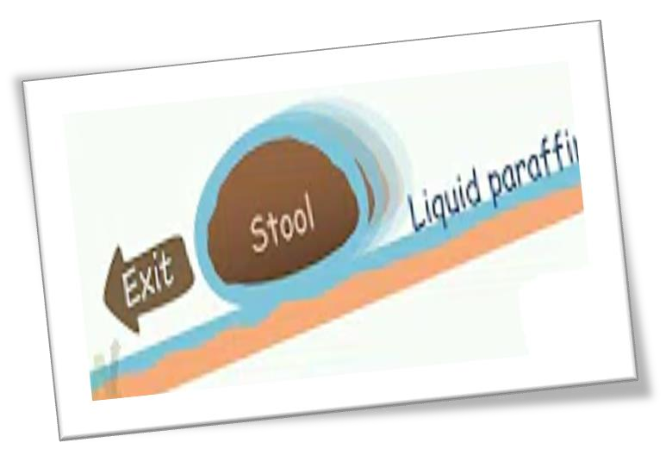
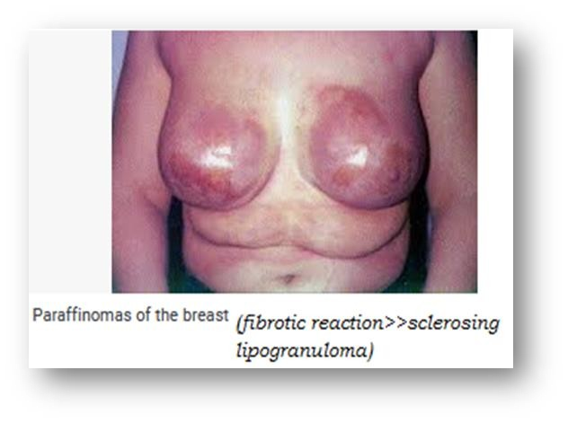
A.Paraffin oil:
Acts on colon.
Lubricates fecal material, retarding water absorption from the stool.
It is not palatable (mixed with juices).
Side effects:
Aspiration can result in a severe lipid pneumonitis.
Interferes with the absorption of fat-soluble vitamins as well as ca & phosphate (long-term use).
Absorbed (paraffinomas).
Leak through anal sphincter →pruritis anus.
Prolonged use → anal polypi.
Delays healing of wound after anorectal operations.

Slide 21
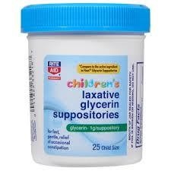
B. Dioctyl sodium sulfosuccinate (docusate):
An ionic surface active agent (surfactant agents).
Softens stool material, permitting water & lipid to penetrate.
C. Glycerin suppository.

Slide 22
Uses of laxatives:
1- constipation:
fiber-rich diet, exercise, fluid, reassurance, Treatment of causes (non-pharmacological).
bulk forming agents.
in refractory cases → stimulant laxatives (lowest effective dose & for short periods).
2-To avoid straining during defecation (elderly, cardiac, hernia).
3-Before operation & radiological examination of G.I.T.

Slide 23
Before and after surgery.
Treatment of oral poison (saline).
Before &after anti-helminthics (saline).

