Slide 1
Female Genital System, Lecture2 Cervix
Dr. Bushra AlTarawneh, MD
Anatomical pathology Mutah University School of Medicine- Department of Microbiology & Pathology UGS lectures 2022

Slide 2
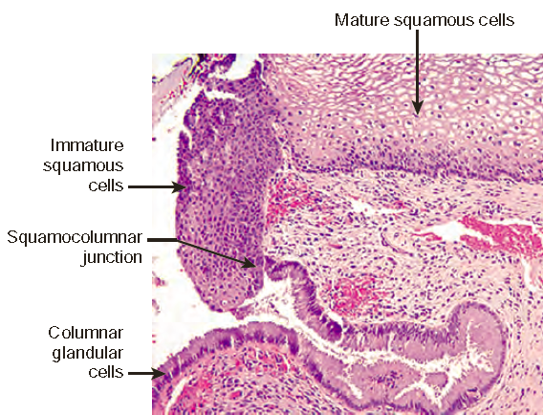

Slide 3
Cervical carcinoma
Was the most common cancers in women worldwide.
Was → Papanicolaou (Pap) smear → the most successful cancer-screening test ever developed.
Most common form is SCC 75%, adenoCa. & adenosquamous (mixed) Ca. 20%, & neuroendocrine Ca 5%.
All are ass with HPV infection.
Peak at 45 years, 10-15 years after detection of their precursors: cervical intraepithelial neoplasia (CIN).

Slide 4
Cervical intraepithelial neoplasia (CIN)
Dysplasia in epithelial cells, graded depending on the extent of epithelial involvement:
CIN I: Mild dysplasia (involves a third or less of thickness)
CIN II: moderate dysplasia (involves 2/3 of thickness).
CIN III: severe dysplasia (involves full thickness) → carcinoma in situ

Slide 5
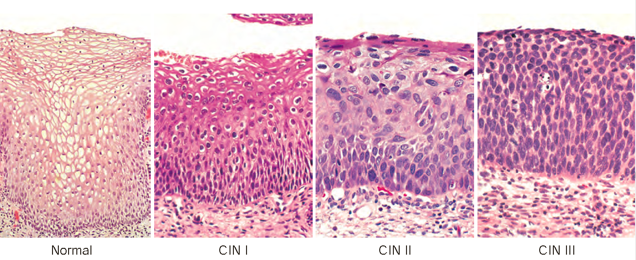
CIN → Dysplasia: nuclear enlargement, hyperchromasia (darker), coarse chromatin, & variation in nuclear size & shape

Slide 6
CIN and Pap smear!
Cervical precancerous lesions are ass with abnormalities in cytologic preparations → Can be detected long before abnormality is visible on gross inspection.
Cells are scraped from the transformation zone & examined microscopically
Pap screening has dramatically lowered the incidence of invasive cervical tumors & it is no longer ranks among the top 10 causes of cancer deaths in U.S. women.

Slide 7
CIN → Dysplasia: nuclear enlargement, hyperchromasia (darker), coarse chromatin, & variation in nuclear size & shape

Slide 8
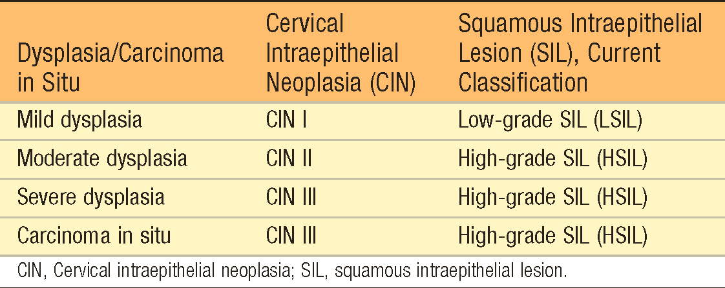
CIN → SIL (squamous intraepithelial lesion)
The decision with regard to patient management is two-tiered (observation versus surgical treatment) → Three-tier classification system → recently simplified to a two-tiered system → Low grade squamous intraepithelial lesion (LSIL) & high grade squamous intraepithelial lesion (HSIL)

Slide 9
CIN – Pathogenesis & epidemiology
Peak incidence at 30s (SCC at 45 years of age).
HPV can be detected in nearly all CIN and invasive carcinoma. (mostly subtype 16 & 18).
These subtypes show a propensity to integrate into host genome, & express large amounts of E6 & E7 proteins → inhibit tumor suppressor genes p53 & RB, respectively.
HPV vaccine is recently introduced → very effective in preventing HPV infections → expected to lower frequency of genital warts & cervical Ca.

Slide 10
CIN – Clinical
SIL is asymptomatic and comes to clinical attention through an abnormal Pap smear result.
Women with biopsy-documented LSIL are managed with careful observation
HSILs & persistent LSIL are treated with surgical excision (laser or cone biopsy) & follow up.

Slide 11
Invasive Carcinoma of the Cervix – Clinical
Progression of SIL to invasive carcinoma is variable & unpredictable. (smoking is a risk factor).
LSIL → 10% → HSIL → 10% in ~ 10 years → carcinomas.
Most often is seen in women who have never had a Pap smear or who have not been screened for many years.
Tx: Hysterectomy + radiotherapy and chemotherapy in advanced cases (high stage).
5-year survival: SIL: 100%; stage 1: 90%; stage 2 82%; stage3: 35%; & stage 4: 10%.

Slide 12
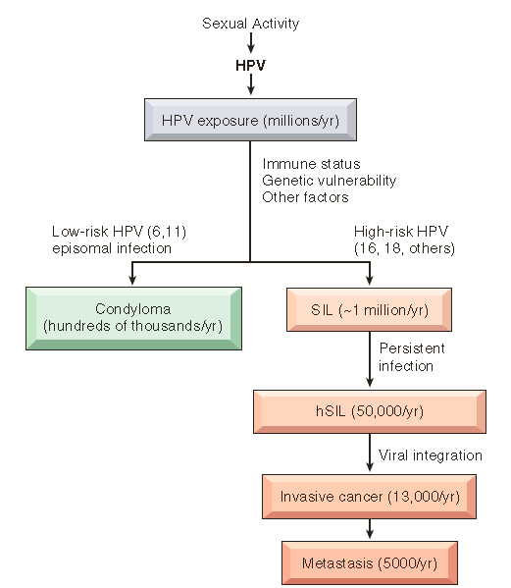

Slide 13
Endocervical Polyp
Endocervical polyps are benign polypoid masses seen protruding from the endocervical mucosa (sometimes through the exocervix).
They can be as large as a few centimeters, are soft and yielding to palpation, and have a smooth, glistening surface with underlying cystically dilated spaces filled with mucinous secretions.
The surface epithelium and lining of the underlying cysts are composed of the same mucus-secreting columnar cells that line the endocervical canal. The stroma is edematous and may contain
scattered mononuclear cells.
Superimposed chronic inflammation may lead to squamous metaplasia of the overlying epithelium and ulcerations.
These lesions may bleed, thereby arousing concern, but they have no malignant potential.

Slide 14
THANK YOU

