Slide 1
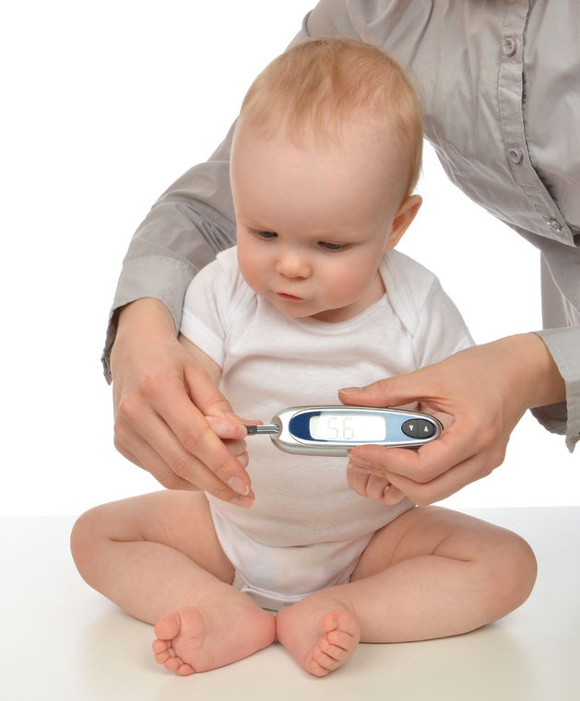
Diabetic Ketoacidosis
Supervised by:
Dr Alaa dala’in
Done by:
Waha Alkasasbeh
Saker Sunna
Jerien Halaseh
Saba Hamasha

Slide 2
Definition
Diabetic ketoacidosis (DKA) is an acute, major, life-threatening complication of diabetes characterized by:
hyperglycemia, ketoacidosis, and ketonuria.
It occurs when absolute or relative insulin deficiency inhibits the ability of glucose to enter cells for utilization as metabolic fuel, the result being that the liver rapidly breaks down fat into ketones to employ as a fuel source.
The overproduction of ketones ensues, causing them to accumulate in the blood and urine and turn the blood acidic.

Slide 3
DKA occurs mainly in patients with type 1 diabetes, but it is not uncommon in some patients with type 2 diabetes.
Diabetic ketoacidosis (DKA) is the leading cause of morbidity and mortality in children with type 1 diabetes mellitus.

Slide 4
CENTERS FOR DISEASE CONTROL (CDC) ESTIMATED THAT THERE WERE 140,000 HOSPITAL DISCHARGES FOR DKA IN 2009 IN THE UNITED STATES
The exact incidence of diabetic ketoacidosis is unknown but is estimated to be 4-8 per 1000.

Slide 5
1-New onset DM if undiagnosed. 2-Unsuffienct dose of insuln is taken. 3-Increased demand for insulin such in stress, infection, inflammation , Iatrogenic.
Who are at risk of DKA?

Slide 6
Pathophysiology

Slide 7
A-Dehydration :
An excessive amount of glucose enters the renal tubules, it draws a large amount of water that ends up producing a significant amount of urine. This is known as osmotic diuresis and leads to volume depletion and dehydration in the patient
B- Ketoacidosis:
Breaking down of fat acids leads to the production of ketone bodies (Aceto Acetate and Betahydroxybuterate) which produce H+ so decrease blood PH.
C-Kissmaul’s brearthing:
Decreased PH will stimulate the peripheral chemoreceptors that are located on the vagus and glossopharyngeal nerves which will enhance the CNS to stimulate reflex tachypnea to wash out CO2 to compensate metabolic acidosis.

Slide 8
D-Fruity smell breathing:
The breaking down of acetoacetate will lead to the production of byproducts called “Acetone” which is exhaled by the lung giving the breath a fruity smell.
E-Hyperkalemia:
Due the exchange between the extracellular protons “H+” which is produced by the ketone bodies and the intracellular K .
It’s also because the Insulin depletion; as the N-K pump is insulin dependent so no shift of K from extracellular to intracellular
-Depending on the duration of ketoacidosis, serum potassium concentrations at diagnosis may be increased, normal, or decreased(ominous sign), but intracellular potassium concentrations are depleted.
F-Hypophosphatemia:
depletion also can occur as result of the increased renal phosphate excretion required for elimination of excess hydrogen ions.
G-Hyponatremia
depletion also is common in DKA, resulting from renal losses of sodium caused by osmotic diuresis and from gastrointestinal losses from vomiting.

Slide 9
Diagnosis and management
Raghad Abdelgader Alqazaqi

Slide 10
When?
1. As initial presentation of type 1 diabetes mellitus (DKA is the second most common initial presentation of T1DM).
2. in established type 1 diabetes mellitus — 6 to 8% per year, of risk are :
(1) poor control (high [HbA1c] values and highe insulin requirements)
(2)Gastroenteritis with vomiting and dehydration
(3)Peripubertal and pubertal adolescent girls
(4)history of psychiatric disorders
(5)Children with limited access to medical care (underinsured)
(6)Inadvertent or intentional omission of insulin, including failure of an insulin pump
3. DKA in type 2 diabetes mellitus — particularly in African American adolescents with obesity

Slide 11
Illness as a trigger
Intercurrent illnesses, particularly when associated with vomiting and dehydration, can precipitate DKA by increasing stress hormone levels (catecholamines, cortisol, and glucagon) that increase hepatic glucose output, cause peripheral insulin resistance, and promote ketogenesis. Illnesses involving vomiting are particularly problematic because they interrupt food intake, often requiring a reduction in the amount of insulin administered. Patients may completely omit insulin in an effort to avoid causing hypoglycemia.
Anticipatory guidance for families on management of intercurrent illness can be helpful to avoid the need for hospitalization.

Slide 12
Presentation
1.Nausea,vomiting and anorexia
2.Rapid onset weight loss, polydipsia , polyurea and diffuse abdominal pain (acidosis and electrolyte abnormalities impairing gastrointestinal function (eg, delayed gastric emptying, ileus)).
3. Hyperventilation and deep (Kussmaul) respirations .
4.Clinical signs of intravascular volume depletion tend to be less prominent than in patients with the same degree of fluid loss from other conditions. This is because the intravascular volume is relatively preserved due to increased intravascular osmolality resulting from hyperglycemia. In addition, free water losses frequently exceed sodium losses. Finally, hyperglycemia-induced osmotic diuresis preserves urine output. Clinical estimates of the degree of dehydration are inaccurate and unlikely to be helpful. Instead, patients should be rehydrated based upon a presumed fluid deficit and clinical response
5. Neurologic findings ranging from drowsiness, lethargy, and obtundation to coma are mainly related to the degree of acidosis
DKA = Hyperglycemia + Acidosis + Volume depletion+ Electrolyte loss

Slide 13
Laboratory findings
Glucose | <200mg/dl
Acidosis | *Venous Ph less than 7.3 (Best way to diagnose and monitor acidosis if available) *HCO3 less than 15 mEq/L
Ketosis | Blood beta-hydroxybutyrate.(BEST way to diagnose and monitor ketosis) (<3 mmol/L) Anion gap (elevated in DKA to a mean of 30+-3) Urine Ketons (less usuful as it measures acetoacetate)
Sodium | Psudo-hyoNatremia
Potassium | Serum maybe normal or increased but always depleted
Phosphate | Serum maybe normal or increased but always depleted
BUN and Cr | Elevated secondary to dehydration
CBC | Leukocytosis (mainly Neutophile)

Slide 14
Diagnosis and severity classification
DKA is diagnosed when patients with diabetes mellitus exhibit ALL of the following:
1●Hyperglycemia (blood glucose >200 mg/dL [11 mmol/L])
2●Metabolic acidosis (venous pH <7.3 or serum bicarbonate <15 mEq/L [15 mmol/L])
3●Ketosis (presence of ketones in the blood or urine)
NOTE : DKA must be distinguished from hyperglycemic hyperosmolar state (HHS), which is characterized by:
●Marked hyperglycemia (plasma glucose >600 mg/dL [>33.3 mmol/L])
●Minimal acidosis (venous pH >7.25 or arterial pH >7.3 and serum bicarbonate >15 mmol/L)
●Absent to mild ketosis
●Marked elevation in serum osmolality (effective osmolality >320 mOsm/kg)

Slide 15
 | Diabetic ketoacidosis | Hyperosmolar hyperglycemic state
Patient characteristics | Type 1 diabetes usually Younger age | Type 2 diabetes usually Older age
Clinical symptoms | Less pronounced altered mentation More rapid onset of hyperglycemic symptoms Hyperventilation & abdominal pain common | More pronounced altered mentation Gradual onset of hyperglycemic symptoms Hyperventilation & abdominal pain less common
Laboratory studies | Glucose 250-500 mg/dL (13.9-27.8 mmol/L) Bicarbonate <18 mEq/L (18 mmol/L) Elevated anion gap Positive serum ketones Serum osmolality <320 mOsm/kg (320 mmol/kg) | Glucose >600 mg/dL (33.3 mmol/L) Bicarbonate >18 mEq/L (18 mmol/L) Normal anion gap Negative or small serum ketones Serum osmolality >320 mOsm/kg (320 mmol/kg)

Slide 16
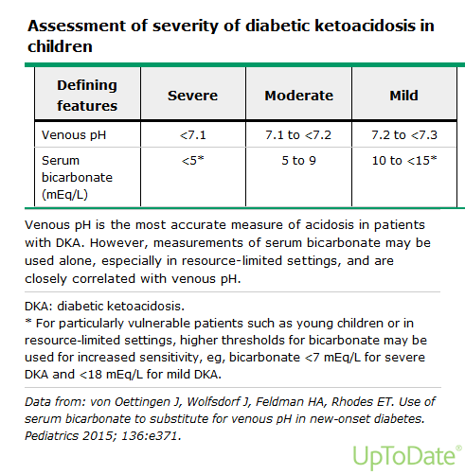

Slide 17
Management
FIRST : Rapid Clinical assessment
1.vital signs and assess for signs of shock caused by volume depletion (eg, decreased blood pressure, reduced peripheral pulses, tachycardia, and significant postural changes in blood pressure).
note, hypertension is present in more than 10 % of children when they present with DKA (despite hypovolemia) or may develop during treatment which is a finding associated with : (more severe DKA), (stage 2 to 3 acute kidney injury), and (alterations in mental status). These require volume replacement despite the hypertension and should be monitored particularly carefully for signs and symptoms of impending cerebral injury.
2.Measure weight for use in calculating fluid replacement and insulin infusion rates. If recent measurements of weight are available (within the previous one to two weeks), these should be compared with the current weight to estimate the fluid deficit.
3.Estimate the degree of dehydration. (clinical symptoms and signs of dehydration underestimate the degree of dehydration in a child with DKA, and urine specific gravity is not valid, because of both glycosuria and ketonuria). Therefore, targets for fluid repletion generally rely on assumptions of a 5 to 10 % fluid deficit, rather than on clinical estimates of dehydration.
4.Assess the neurologic state using the Glasgow Coma Scale (GCS), should be repeated hourly throughout treatment or until the patient is clinically recovered from ketoacidosis and mental status has returned to normal.

Slide 18
Second : Laboratory testing
Immediately :
•Blood glucose – Blood glucose >200 mg/dL (11 mmol/L) confirms hyperglycemia.
•Blood beta-hydroxybutyrate (BOHB) – Concentrations ≥3 mmol/L (31 mg/dL) are consistent with DKA
•Urine ketones – Measurement of urine ketones confirms ketosis but should not be used to judge the severity of ketonemia or acidosis, because this test measures acetoacetate rather than BOHB, which is the predominant ketone body at presentation of DKA. Urine acetoacetate (ketonuria) may persist for some time after resolution of DKA and should not be considered an indication of persistent ketoacidosis.
●Additional testing
•Electrolytes – Including bicarbonate
•Blood urea nitrogen (BUN), creatinine
•Venous pH and partial pressure of carbon dioxide (pCO₂)
•Complete blood count
•Ca, PO4, Mg
●Additional evaluation for specific circumstances:
•Blood lactate – In a patient with very severe dehydration or shock, sepsis, (In such patients, the blood lactate level will help determine the contribution of lactic acid to the metabolic acidosis).
•Cultures of blood, urine, and/or throat or other evaluation for infection – If fever or localizing signs of infection are present.
•ECG : If laboratory measurement of potassium status is delayed.

Slide 19
If circulating volume is still compromised after the initial bolus is complete, additional IV bolus infusions of 10 to 20 mL/kg can be given
10-20 ml/Kg Isotonic fluid (0.9% saline/ Ringer's lactate) IV over 1 hour
After 1 hour
All the time :
*Blood glucose hourly
*urine output hourly
(Na,K,HCO3,CL,BUN,Cr, venous pH, and pCO₂₎ every 2-4 h.
*(PO4,Ca,Mg) every 4-6 h.
Neurologic exam hourly
* HR,RR,BP,O2 sat continously
Add IV insuline (0.05 -0.1 unit/kg/hour)
4-6 hours later
Switch to hypotonic fluid (0.45 saline)
Fluids given till 24-48 hour
Insulin infusion rate should be reduced only after the ketoacidosis is corrected or nearly corrected. However, if the patient shows 1.marked sensitivity to insulin
2.Below 5 y or malnourished children, it may be necessary to decrease the insulin infusion rate to avoid hypoglycemia to (0.05 units/kg/hour), provided that the ketoacidosis continues to improve
Switch to SC insulin WHEN
1. able to eat
2.anion gap reduced to normal (12±2 mEq/L) or
serum BOHB ≤1 mmol/L (10.4 mg/dL)
3.Venous pH >7.3
4. serum bicarbonate >15 mEq/L
5.Blood glucose <200 mg/dL (11.1 mmol/L)
* Overlap of both for 1-2 hour before the switch.
When glucose (300-250) mg/dl add dextrose 5%.
When glucose (≤200 mg/dL) add dextrose10%
Add IV K if serum K+ <5.3 mEq/L; hold if ≥5.3 mEq/L
keep blood glucose concentrations
(100 to 150 mg/dL) in older children (150 to 180 mg/dL ) in younger children

Slide 20
Maintenance = 100-50-20
Deficit = wt * deficit% * 10

Slide 21
Potassium
— Patients with DKA have a total body deficit of potassium, although potassium levels at presentation may be normal or even increased.. Therefore, potassium replacement is necessary for nearly all DKA patients.
Replacement timing is Based on initial potassium level :
●If hyperkalemic, potassium replacement initiated when the serum potassium falls to normal and after verifying urine production/adequate renal function
●If normokalemic and voiding, potassium replacement given with the start of insulin therapy. The usual starting concentration is 40 mEq/L (40 mmol/L) of potassium added to the IV fluid solution.
●If hypokalemic, potassium replacement should be started immediately and the insulin infusion should be delayed until serum potassium has been restored to a near-normal concentration. The serum potassium concentrations should be monitored hourly and the replacement adjusted as needed.
Potassium replacement should be given as a mixture of potassium phosphate and either potassium chloride or potassium acetate (see 'Phosphate' below). Administration of potassium chloride alone should be avoided to reduce the risk of hyperchloremic metabolic acidosis.
Potassium replacement therapy should continue throughout IV insulin and fluid therapy. The serum potassium should typically be monitored every two to four hours and the potassium concentration in IV fluids adjusted as necessary to maintain normal serum potassium levels.
ECG monitoring is recommended for most DKA patients but particularly for those with either hyperkalemia or hypokalemia.

Slide 22
Bicarbonate :Consider for patients with pH ≤6.9
Phosphate Consider for serum phosphate <1.0 mg/dL, cardiac dysfunction, or respiratory depression
Final note
With volume resuscitation and correction of hyperosmolality and hyperglycemia, these ketoacids disappear and the anion gap normalizes, pointing to resolution of ketosis. Posttreatment hyperchloremic acidosis may occur due to infusion of normal saline; however, the anion gap will be normal.
Resolution of DKA is further supported by normalization of the venous pH and serum beta-hydroxybutyrate levels, rise in serum bicarbonate, and tolerance of oral food intake. Measurement of serum and urine glucose alone is inappropriate for monitoring response to treatment because ketosis and acidemia may still be present even when glucose levels drop below 200-250 mg/dL

Slide 23
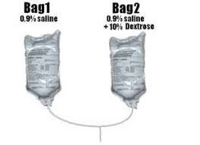
The "two-bag system"
-efficient method to maintain the patient's blood glucose in an acceptable range
-two bags of the selected IV fluid solution are infused concurrently, one containing 10% dextrose and the other containing no dextrose.
- By adjusting the relative rates of fluid administration from each bag, the rate of fluid and electrolyte administration can be kept constant, while variable rates of dextrose infusion can be achieved to respond to changes in the patient's blood glucose concentrations.

Slide 24
Complications
Saker Sunna

Slide 25
Complications Of DKA
Cerebral Edema (Most serious).
Hypokalemia.
Hypoglycemia (Most common).
Intracranial thrombosis or infarction.
Acute kidney injury with acute renal failure caused by severe dehydration.
Pancreatitis.
Arrhythmias caused by electrolyte abnormalities.
Pulmonary Edema.
*Check The Notes Below
Notes:
Intracranial Thrombosis: Thrombotic risk during DKA is elevated by abnormalities in coagulation factors, platelet activation, blood volume and flow, and vascular reactivity. DKA-associated cerebral edema may also predispose to ischemic injury and hemorrhage, though cases of stroke without concomitant cerebral edema have been identified.
Pancreatitis: In DKA, insulin deficiency leads to lipolysis and inhibition of lipoprotein lipase in peripheral tissues that leads to elevated triglycerides (TG).
Pulmonary Edema: Pulmonary edema complicating diabetic ketoacidosis may be the result of increased permeability of pulmonary capillary membranes and altered intravascular colloid-hydrostatic forces.

Slide 26
Cerebral Edema
Cerebral edema is the most serious complication of DKA, occurring in 1-5% of cases of DKA, with a mortality rate of 20-80%.
Cerebral edema typically occurs 6-12 hours after therapy for DKA is begun, often following a period of apparent clinical improvement.
Pathophysiology: Cerebral edema occurs from rapid lowering of glucose levels and an ensuing rapid drop in plasma osmolarity. Brain cells, which trap osmotically active particles, preferentially absorb water (osmotic shifting) and swell during rapid rehydration.
Cerebral edema follows, and given the constraints of the cranium, uncal herniation may be the cause of death in persons with DKA.

Slide 27
Signs & Symptoms Of Advanced Cerebral Edema
Obtundation: A dulled or reduced level of alertness or consciousness.
Headache.
Vomiting.
Papilledema.
Pupillary dilation or inequality.
Hypertension.
Bradycardia.
Apnea.
*Check The Notes Below
Notes:
Cushing reflex: Is characterized by the occurrence of Hypertension, Bradycardia and Apnea secondary to raised increased intracranial pressure (ICP), leading to pressure on and or stretch, or both, of the brainstem.

Slide 28
Factors That Correlate With Increased Risk For Cerebral Edema
Higher initial BUN concentration.
Lower initial PCO2.
Failure of the serum sodium concentration to increase as glucose concentration decreases during treatment.
Treatment with bicarbonate.
Age less than 5 years.
New onset DM.

Slide 29
Case Scenario
A 4 y/o female in the PICU is undergoing treatment for new onset IDDM and DKA.
She is on an insulin infusion at 0.1 U/Kg/Hr, and fluids are running at 1.5 maintenance.
Over the last hour, she has been complaining about increasing headache. She is now found to be unresponsive with bilateral fixed and dilated pupils, HR is 50 with BP 150/100.
What is your next step in management?

Slide 30
Management
Rapid use of IV mannitol.
Endotracheal intubation.
Hyperventilation.
May require the use of a subdural bolt. (A method for monitoring the Intracranial Pressure).
*Check The Notes Below
Notes:
Mannitol is the most popular osmotic agent. Osmotic therapy using mannitol reduces ICP by mechanisms that remain unclear. Mannitol is thought to decrease brain volume by decreasing overall water content.
Inducing hypocapnia via hyperventilation reduces the partial pressure of arterial carbon dioxide (PaCO₂), which incites vasoconstriction in the cerebral resistance arterioles. This constriction decrease cerebral blood flow, which reduces cerebral blood volume and, ultimately, decreases the patient's ICP.
Subdural Bolt: A method for monitoring the Intracranial Pressure. A hollow screw is inserted through a hole drilled in the skull. It is placed through the membrane that protects the brain and spinal cord (dura mater). This allows the sensor to record from inside the subdural space.

Slide 31
Hypokalemia
Profound hypokalemia in the presence of DKA is a life-threatening condition predisposing patients to cardiac arrhythmias and potentially death.
Potassium loss is caused by a shift of potassium from the intracellular to the extracellular space in an exchange with hydrogen ions that accumulate extracellularly in acidosis. Much of the shifted extracellular potassium is lost in urine because of osmotic diuresis.

Slide 32
Case Report
A 14-year-old female with new-onset DKA with pH of 6.66, and potassium of 1.6 mEq/L, and initial glucose of 1248.
https://www.ncbi.nlm.nih.gov/pmc/articles/PMC6454640/

Slide 33
Hypokalemia Management
To prevent hypokalemia, potassium replacement is initiated after serum levels fall below 5.3 mmol/L in patients with adequate urine output (50 ml/h). Adding 20–30 mmol potassium to each liter of infused fluid is sufficient to maintain a serum potassium concentration within the normal range of 4–5 mmol/L.
Patients with DKA who had severe vomiting or had been on diuretics may present with significant hypokalemia. In such cases, potassium replacement should begin with fluid therapy, and insulin treatment should be postponed until potassium concentration becomes > 3.3 mmol/L in order to prevent arrhythmias and respiratory muscle weakness.
Guidelines for Potassium Replacement

Slide 34
Hypoglycemia
Hypoglycemia may result from inadequate monitoring of glucose levels during insulin therapy. Insulin sensitivity improves after clearance of ketones.
Give 2-5 ml/kg D10% bolus, hold insulin for 15-30 min then repeat Blood Glucose.

Slide 35
~Sources:
Dude trust me.

