Slide 1
Congenital Hypothyroidism
Abdurahman Sharif, MD
OCT 2019
By: Ala Khader
Safaa Matar

Slide 2
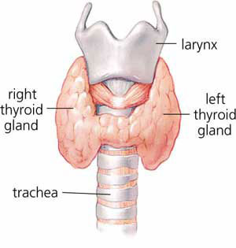
Introduction
The thyroid gland develops from the buccopharyngeal cavity between 4 and 10 weeks gestation.
The thyroid arises from the fourth branchial pouches.
Connected to tongue by thyroglossal duct, which normally disappears but may persist as pyramidal lobe of thyroid.
By 10-11 weeks gestation, the fetal thyroid is capable of producing thyroid hormone.
By 18-20 weeks gestation, blood levels of T4 have reached term levels.
On 4th wk (thyroid gland itself)
Notes:
Errors in the formation or migration of thyroid tissue can result in thyroid aplasia, dysplasia, or ectopy.
Most common ectopic thyroid tissue site is the tongue.

Slide 3
Steps in the synthesis of thyroid hormones

Slide 5
Thyroid hormone functions
T4 is the primary thyronine produced by the thyroid gland.
Only 10-40% of circulating T3 is released from the thyroid gland. The remainder is produced by monodeiodination of T4 in peripheral tissues by 5’-iodinase.
T3 is the primary mediator of the biologic effects of thyroid hormone and does so by interacting with a specific nuclear receptor.
Unbound, or free, T4 accounts for only about 0.03% of circulating T4 and is the portion that is metabolically active.
T3 comes from T4 not the gland

Slide 6
Bone growth (synergism with GH)
CNS maturation
Increase β1 receptors in heart = increase CO, HR, SV, contractility
Increase basal metabolic rate via increase Na+/K+-ATPase activity = increase O2 consumption, RR, body temperature
Increase glycogenolysis, gluconeogenesis, lipolysis.
In short stature pt the first lab test we order is Thyroid hormone

Slide 7
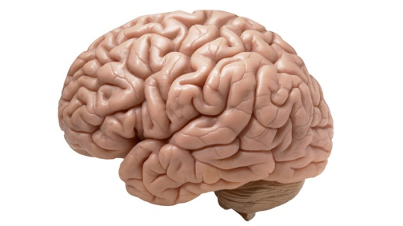
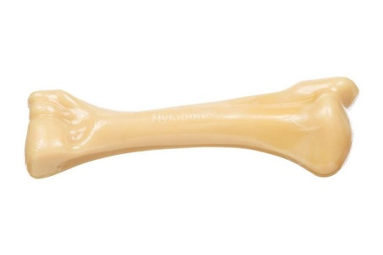
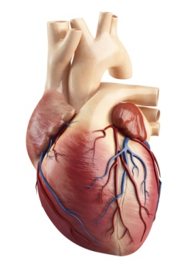
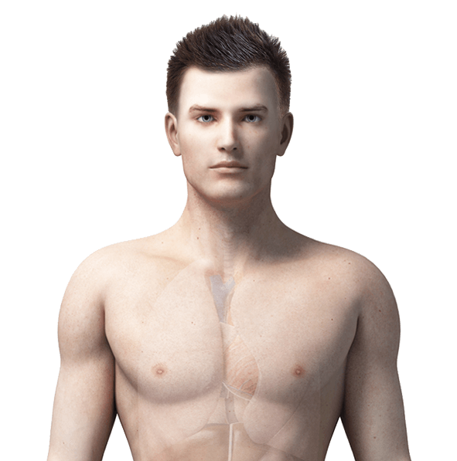
T3 functions—4 B’s:
Brain maturation
Bone growth
B-adrenergic effects
Basal metabolic rate increased

Slide 8
Hypothyroidism
Hypothyroidism results from deficient production of thyroid hormone
Primary hypothyroidism: a defect in the gland itself
Central or hypopituitary hypothyroidism: which is a result of reduced thyroid-stimulating hormone (TSH) stimulation
Congenital hypothyroidism: when this disorder manifested from birth

Slide 9
Congenital Hypothyroidism
Most cases of congenital hypothyroidism are not hereditary and result from thyroid dysgenesis.
Some cases are familial; these are usually caused by one of the inborn errors of thyroid hormone synthesis (dyshormonogenesis) and may be associated with a goiter.

Slide 10
Etiology
Primary Hypothyroidism:
Defect of fetal thyroid development (dysgenesis). *most common 60%
Defect in thyroid hormone synthesis (dyshormonogenesis). 20%
Thyrotropin Hormone Unresponsiveness.
Defects in Thyroid Hormone Transport.
Resistance to Thyroid Hormone.
Maternal antibodies: thyrotropin receptor–blocking antibody
Iodine deficiency
Maternal medications
Iodides, amiodarone
Propylthiouracil, methimazole *antithyroid drugs
Radioiodine

Slide 11
Low TSH is associated with decrease in GH &Prolactin
Central (hypopituitary) hypothyroidism
Isolated TSH deficiency: mutation in TSH β-subunit gene
Isolated TRH deficiency: mutation in TRH gene
TRH unresponsiveness: mutation in TRH receptor gene
Multiple congenital pituitary hormone deficiencies (e.g., septooptic dysplasia)
PROP-1 mutations
• Deficiency of TSH
• Deficiency of growth hormone
• Deficiency of prolactin
• Deficiency of LH
• Deficiency of FSH
• ±Deficiency of ACTH
PIT-1 mutations
• Deficiency of TSH
• Deficiency of growth hormone
• Deficiency of prolactin
All pituitary hormones
How to confirm diagnosis ?
-GENETIC TESTING

Slide 12
Defect of fetal thyroid development (dysgenesis)
Sporadic
Thyroid dysgenesis means: aplasia, hypoplasia, or an ectopic gland
Is the most common cause of permanent congenital hypothyroidism, accounting for 80-85% of cases.
In approximately 33% of cases of dysgenesis can find no remnants of thyroid tissue (aplasia).
In the other 66% of infants, rudiments of thyroid tissue are found in an ectopic location, anywhere from the base of the tongue (lingual thyroid) to the normal position in the neck (hypoplasia).
Thyroid dysgenesis has a 2 : 1 female : male ratio.
The cause of thyroid dysgenesis is unknown in most cases.
Thyroid dysgenesis occurs sporadically, but familial cases occasionally have been reported.

Slide 13
Defect in thyroid hormone synthesis (dyshormonogenesis)
In Siblings
goiter always present
A variety of defects in the biosynthesis of thyroid hormone can result in congenital hypothyroidism
These account for 15% of cases detected by neonatal screening programs (1 in 30,000-50,000 live births).
These defects are transmitted in an autosomal recessive manner.
A goiter is almost always present.

Slide 14
Defect of Iodide Transport:
Rare and involves mutations in the sodium–iodide symporter.
Thyroid Peroxidase Defects of Organification and Coupling:
The most common of the thyroxine (T4) synthetic defects.
Defects of Thyroglobulin Synthesis:
Heterogeneous group of disorders characterized by: goiter, elevated serum TSH, low T4 levels, and absent or low levels of thyroglobulin.

Slide 15
Defects in Deiodination:
Monoiodotyrosine and diiodotyrosine released from thyroglobulin are normally deiodinated within the thyroid or in peripheral tissues by a deiodinase.
Patients with deiodinase deficiency experience severe iodine loss from the constant urinary excretion of nondeiodinated tyrosines, leading to hormonal deficiency and goiter.
The deiodination defect may be limited to thyroid tissue only or to peripheral tissue only, or it may be universal.

Slide 16
Thyrotropin Hormone Unresponsiveness:
A mutation in the TSH receptor gene is a relatively uncommon autosomal recessive cause of congenital hypothyroidism.
Infants with a severe defect have elevated TSH levels and will be detected by newborn screening, whereas other patients with a mild defect remain euthyroid without treatment.

Slide 19
Clinical Manifestations
Most infants with congenital hypothyroidism are asymptomatic at birth, even if there is complete agenesis of the thyroid gland.
This situation is attributed to partial transplacental passage of maternal T4, which provides fetal levels that are approximately 33% of normal at birth.
Despite this maternal contribution of T4, hypothyroid infants still have a low serum T4 and elevated TSH level and so will be identified by newborn screening programs.

Slide 20
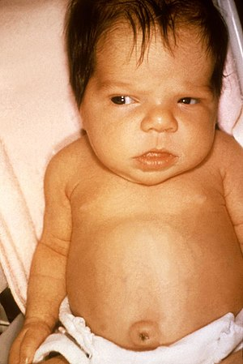
Birthweight and length are normal, but head size may be slightly increased because of myxedema of the brain.
The anterior and posterior fontanels are open widely; observation of this sign at birth can serve as an initial clue to the early recognition of congenital hypothyroidism.
Prolongation of physiologic jaundice, caused by delayed maturation of glucuronide conjugation, may be the earliest sign.
Feeding difficulties, especially sluggishness, lack of interest, somnolence, and choking spells during nursing, are often present during the 1st mo of life.
>18 m delayed closure of ant fontanel
DD… rickets,Hypothyroidism,hydrocephalus,persistent phenomenon

Slide 21
Respiratory difficulties, partly caused by the large tongue, include apneic episodes, noisy respirations, and nasal obstruction.
There may be constipation that does not usually respond to treatment. The abdomen is large, and an umbilical hernia is usually present.
The temperature is subnormal, often <35°C (95°F), and the skin, particularly that of the extremities, may be cold and mottled.
Edema of the genitals and extremities may be present.
The pulse is slow, and heart murmurs, cardiomegaly, and asymptomatic pericardial effusion are common.
Macrocytic anemia is often present and is refractory to treatment.

Slide 23
Approximately 10% of infants with congenital hypothyroidism have associated congenital anomalies. Cardiac anomalies are most common, but anomalies of the nervous system and eye have also been reported.
Infants with congenital hypothyroidism may have associated hearing loss.
If congenital hypothyroidism goes undetected and untreated, these manifestations progress.
Retardation of physical and mental development becomes greater during the following months, and by 3-6 mo of age the clinical picture is fully developed

Slide 24
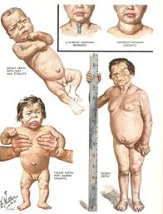
The child’s growth will be stunted, the extremities are short, and the head size is normal or even increased.
The eyes appear far apart, and the bridge of the broad nose is depressed.
The palpebral fissures are narrow and the eyelids are swollen.
The neck is short and thick, and there may be deposits of fat above the clavicles and between the neck and shoulders. The hands are broad and the fingers are short.

Slide 25
The skin is pale, dry and scaly.
Carotenemia can cause a yellow discoloration of the skin, but the sclerae remain white.
The scalp is thickened, and the hair is coarse, brittle, and scanty.
Development and sexual maturation is usually delayed, which increases with age.
The muscles are usually hypotonic, but in rare instances generalized muscular pseudohypertrophy occurs (Kocher-Debré-Sémélaigne syndrome).

Slide 26
Retardation of osseous development
Can be shown radiographically at birth in approximately 60% of congenitally hypothyroid infants and indicates some deprivation of thyroid hormone during intrauterine life.
The distal femoral and proximal tibial epiphyses, normally present at birth, are often absent.
In undetected and untreated patients, the discrepancy between chronologic age and osseous development increases.
The epiphyses often have multiple foci of ossification deformity (“beaking”) of the 12th thoracic or 1st or 2nd lumbar vertebra is common.
X-rays of the skull show large fontanels and wide sutures; intersutural (wormian) bones are common.
Formation and eruption of teeth can be delayed.

Slide 27
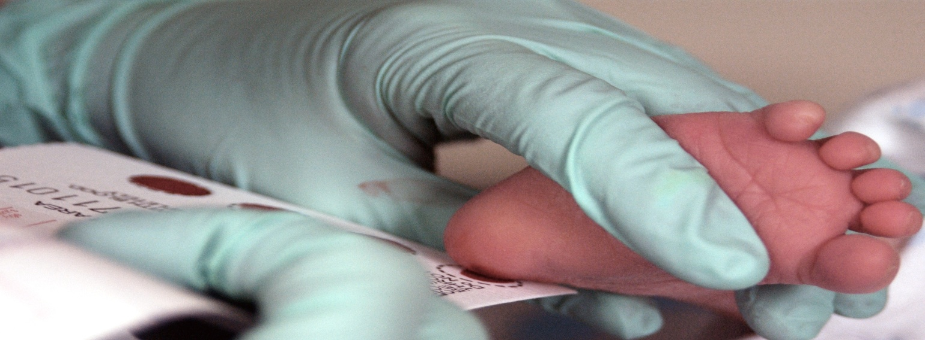
Laboratory Findings
Newborn screening programs:
Blood obtained by heel prick between 2 and 5 days of life is placed on filter paper card and sent to a central screening laboratory. (measure TSH)
Regardless of the approach used for screening, some infants escape detection because of technical or human errors.
TSH >100 ….Definitely GH

Slide 28
Serum levels of T4 or free T4 are low.
Serum levels of T3 may be normal and are not helpful in the diagnosis.
If the defect is primarily in the thyroid, levels of TSH are elevated, often to >100 mU/L.
Serum levels of thyroglobulin are usually low in infants with thyroid agenesis or defects of thyroglobulin synthesis or secretion, whereas they are elevated with ectopic glands and other inborn errors of T4 synthesis, but there is a wide overlap of ranges.

Slide 29
Scintigraphy can help to pinpoint the underlying cause in infants with congenital hypothyroidism, but treatment should not be unduly delayed for this study.
Ultrasonographic examination of the thyroid is helpful, but studies show it can miss some ectopic glands shown by scintigraphy.
Demonstration of ectopic thyroid tissue is diagnostic of thyroid dysgenesis and establishes the need for lifelong treatment with T4.
Failure to demonstrate any thyroid tissue suggests thyroid aplasia, but this also occurs in neonates with hypothyroidism caused by maternal TRBAb and in infants with the iodide-trapping defect.
A normally situated thyroid gland with a normal or avid uptake of radionuclide indicates a defect in thyroid hormone biosynthesis.

Slide 30
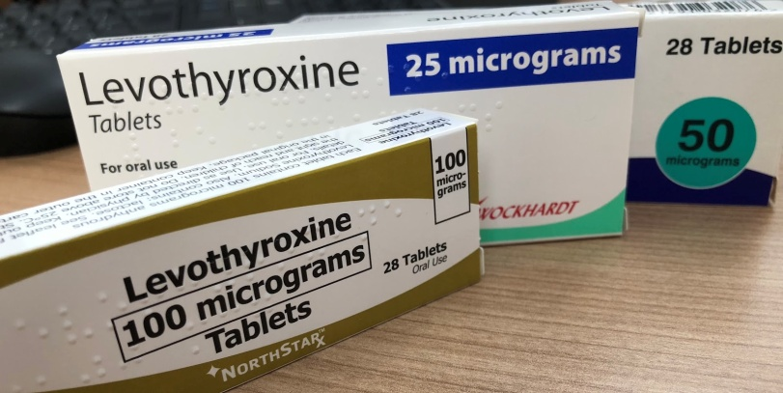
Treatment
Levothyroxine (l-T4) given orally is the treatment of choice.
serum levels of T4 and T3 return to normal with l-T4 treatment alone.
The recommended initial starting dose is 10-15 μg/kg/day (totaling 37.5-50.0 μg/day for most term infants).
The starting dose can be tailored to the severity of hypothyroidism.
Rapid normalization of thyroid function has been demonstrated to be important in achieving optimal neurodevelopmental outcome.

Slide 31
Newborns with more severe hypothyroidism, as judged by a serum T4 <5 μg/dL and/or imaging studies confirming aplasia, should be started at the higher end of the dosage range.
The daily tablets should be crushed and mixed with a small volume of liquid. l-T4 tablets should not be mixed with soy protein formulas, concentrated iron, or calcium, because these can bind T4 and inhibit its absorption. Although it is recommended to administer l-T4 on an empty stomach and avoid food for 30-60 min.
Levels of serum T4 or free T4 and TSH should be monitored at recommended intervals (every 1-2 mo in the 1st 6 mo of life, and then every 2-4 mo between 6 mo and 3 yr of age).
The goals of treatment are to maintain the serum free T4 or total T4 in the upper half of the reference range for age.

Slide 32
Prognosis
With the advent of neonatal screening programs for detection of congenital hypothyroidism, the prognosis for affected infants has improved dramatically.
Early diagnosis and adequate treatment from the 1st weeks of life result in normal linear growth and development.
Most studies report that psychometric testing in infants detected by newborn screening shows verbal, psychomotor, and global IQ scores similar to those of unaffected siblings or classmate controls.

Slide 33
Some screening programs report that the most severely affected infants, as judged by the lowest T4 levels and retarded skeletal maturation, have reduced IQs (by 5-20 points) and other neuropsychological sequel, such as incoordination, hypotonia or hypertonia, short attention span, and speech problems, even with early diagnosis and adequate treatment.
Psychometric testing can show problems with vocabulary and reading comprehension, arithmetic, and memory.
Approximately 20% of children have a neurosensory hearing deficit.
Differential diagnosis for Developmental delay is Congenital hypothyrodism

Slide 34
THANK YOU

